Slide 1

Marketplace Application
Haden Liu

Slide 2
Development Background
Develop an eBay like 2-sided marketplace application
Allow customers to exchange spare items in the marketplace
Allow safe and fast access for users

Slide 3
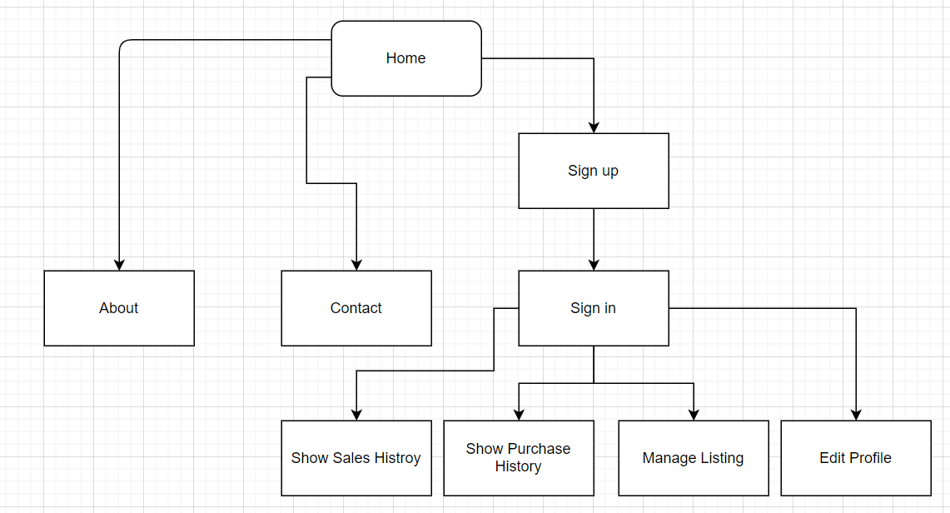
Sitemap

Slide 4
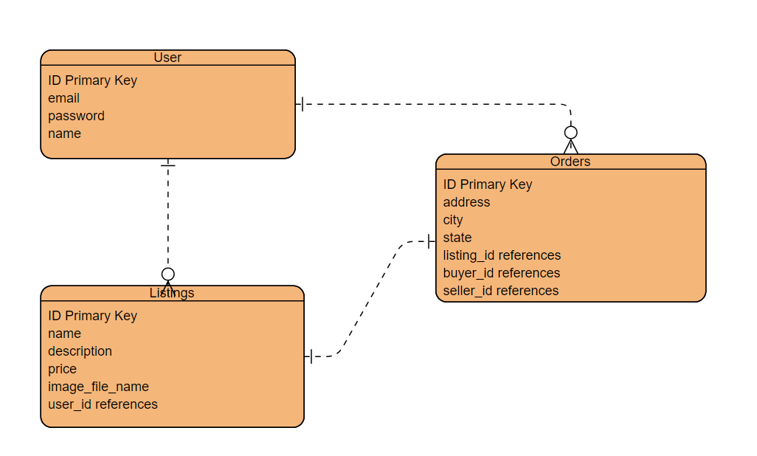
Database Design

Slide 5
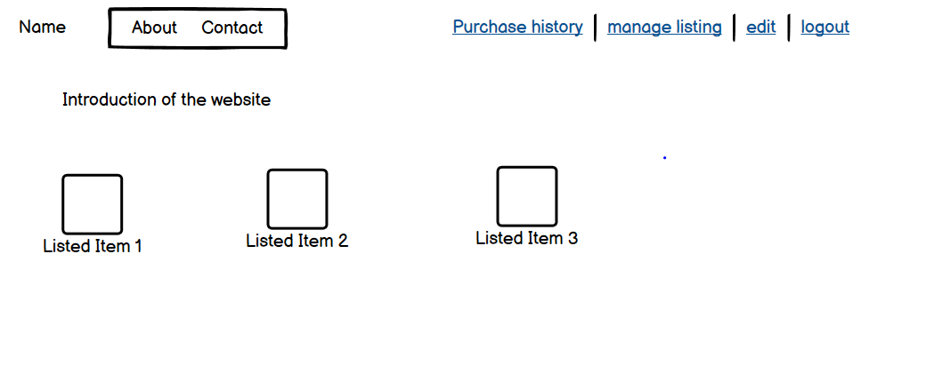
Wireframe Design

Slide 6
Techniques
HTML ( ERB )
CSS & Bootstrap
Ruby on rails
PostgreSQL

Slide 7
External Services (Gem)
Paper Clip - - Upload image
Devise – Authentication control

Slide 8
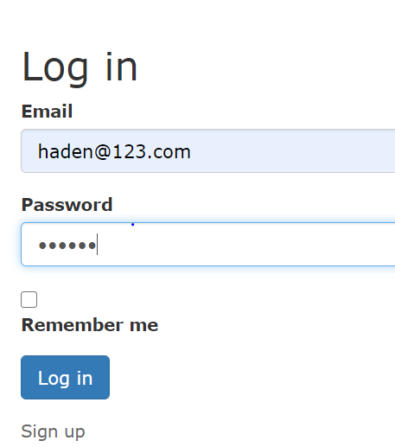
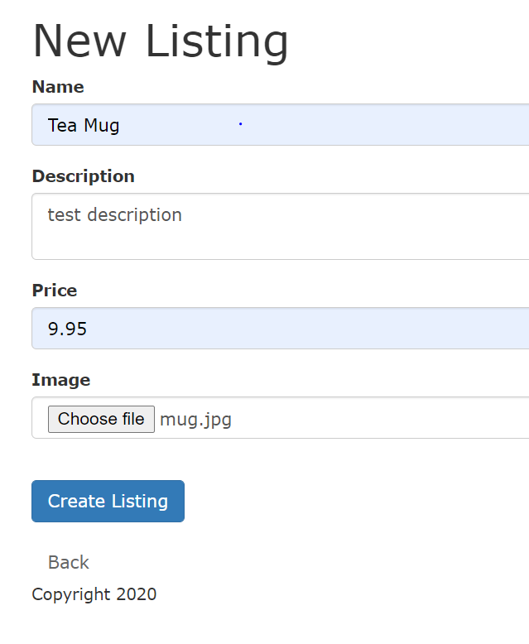
Functions – user sign up

Slide 9
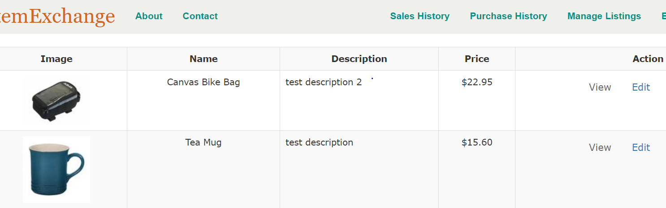
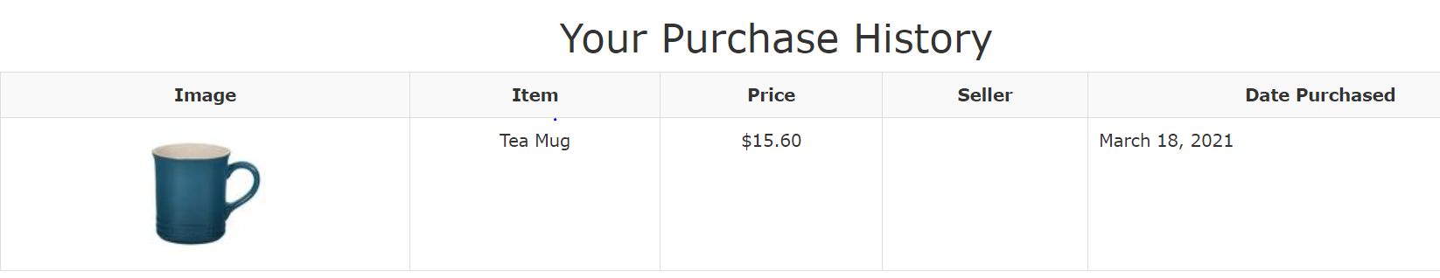
Functions – manage listing

Slide 10
Future Development
Online image storage
Payment management with Stripe
Deployed: https://hadendemo-2021.herokuapp.com/

