Slide 1

Sprocket Central Pty Ltd Data Analytics Approach
The Analytics Team

Slide 2
Contents
1. Introduction
2. Data Exploration
3. RFM Model Development
4. Interpretation

Slide 3
Introduction
1000 potential customers do not have prior transaction history.
Generate useful customer insights
Optimize resource allocation for targeted marketing.

Slide 4
Data Exploration
Data Cleaning and Quality Assessment
•Accuracy: Correct Values
•Completeness: Data Fields with Values
•Consistency: Value Free From Contradiction
•Currency: Values Up to Date
•Relevancy: Items with Value Meta-data
•Validity: Data Containing Allowable Values
•Uniqueness: Duplicated Records

Slide 5
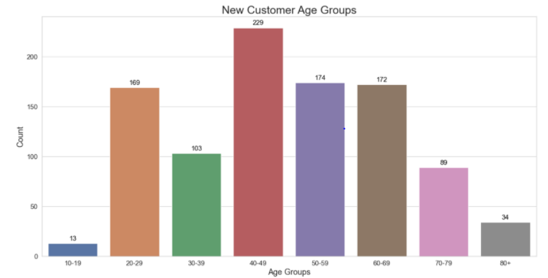
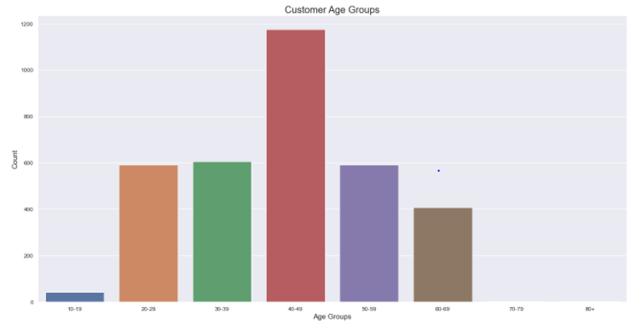
Data Exploration – Customer Age Distribution
Most customers age around 40 to 49 years old
The least popular groups are 10 to 19 and 70 years old and above.
Popular shoppers tend to be between 20
to 69 years old.

Slide 6
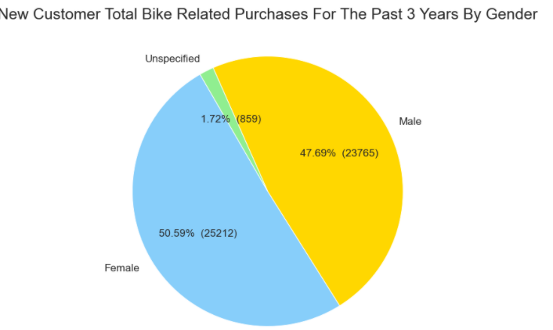
Data Exploration – Purchases in the Past 3 Years By Gender
Customer gender demographic evenly spread between male and females.
Females make up majority of the bike purchases in the past three years

Slide 7
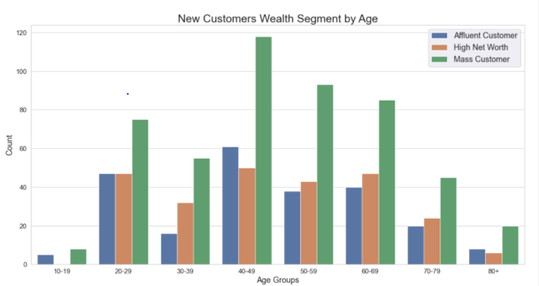
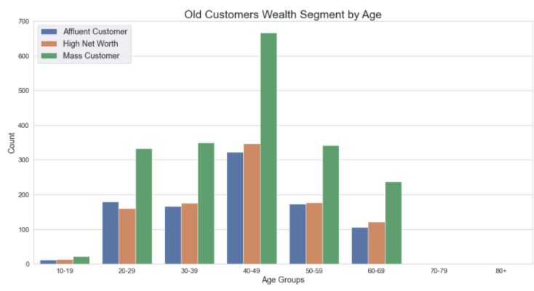
Data Exploration – Wealth Segmentation By Age
Most customers are labelled as Mass Customer.
More customers labelled as High Net Worth than Affluent by a small margin.

Slide 8
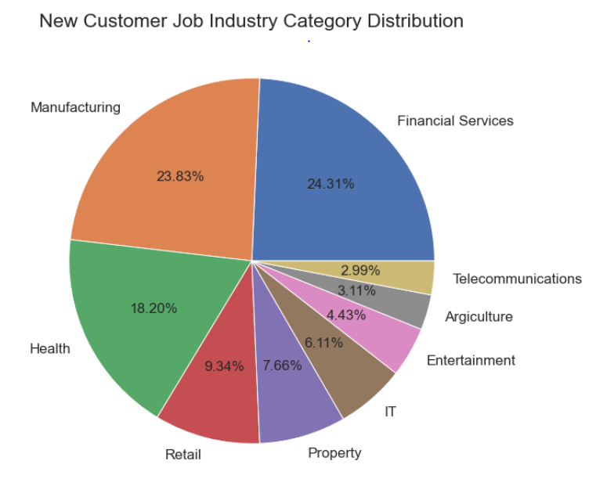
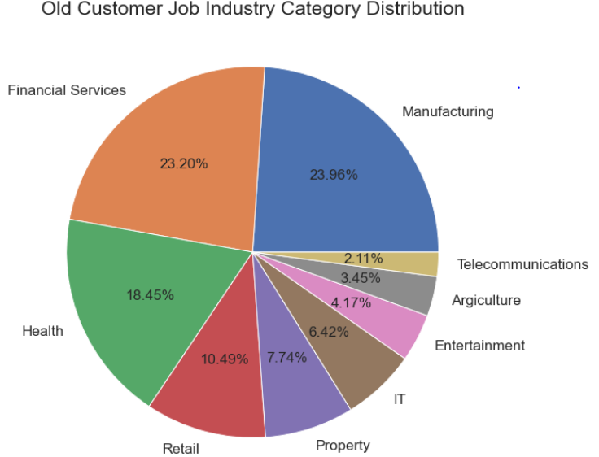
Data Exploration – Job Industry Distribution
Top three job industries that customers work in are financial services, manufacturing, and health
Least popular job industries are telecommunications, agriculture, entertainment, and IT

Slide 9
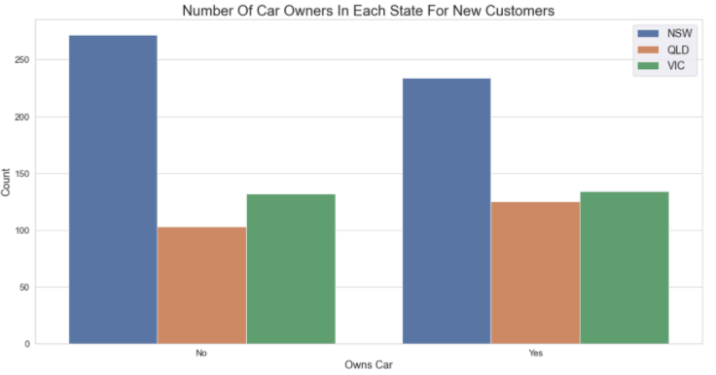
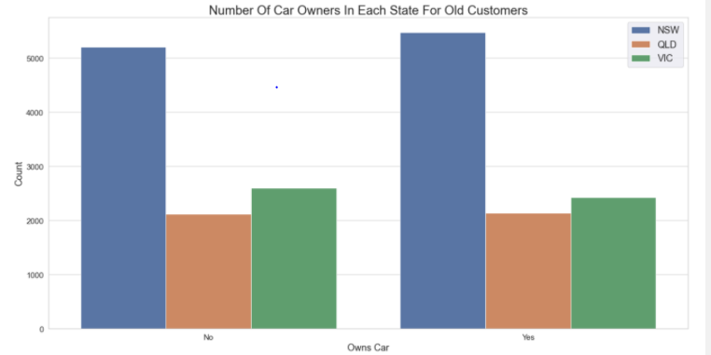
Data Exploration – Car Ownership By State
Most customers from New South Wales don’t own a vehicle
Consider to allocate more stocks and resources on the NSW region.

Slide 10
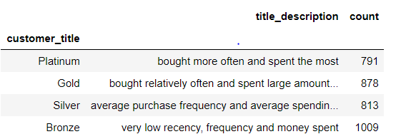
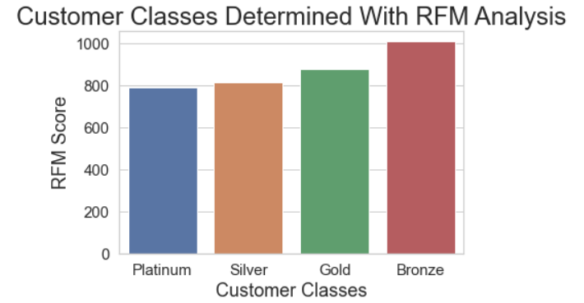
Model Development – RFM Analysis
RFM stands for Recency, Frequency and Monetary.
Frequency and Monetary affects customer lifetime value.
Recency affects customer retention
Classified into four groups by their RFM score from highest to lowest respectively: Platinum, Gold, Silver, and Bronze

Slide 11
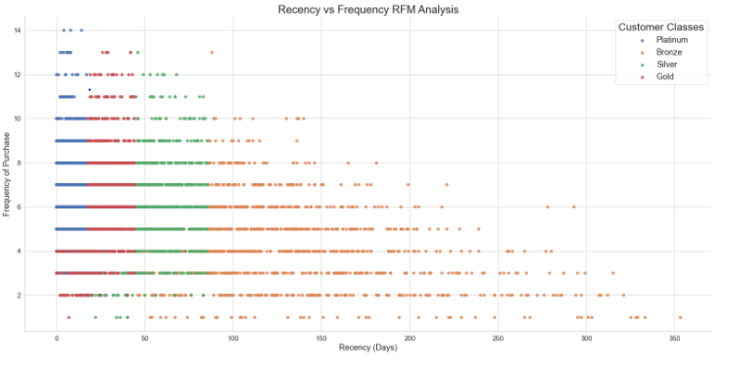
Model Development – Recency vs Frequency
Platinum customers bought more recently and frequently than other groups
Negative correlation between recency and frequency
The less recent the last purchase is, the less frequent the customer buys

Slide 12
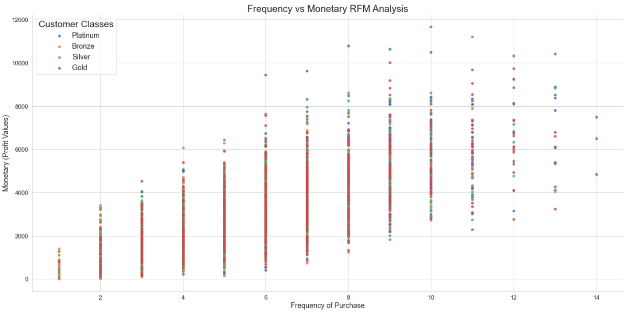
Model Development - Frequency vs Monetary
Positive correlation between recency and monetary
Business should expect higher monetary gains when the more frequently the customer buys

Slide 13
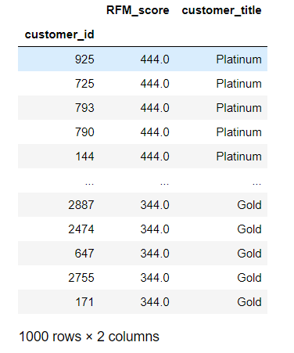
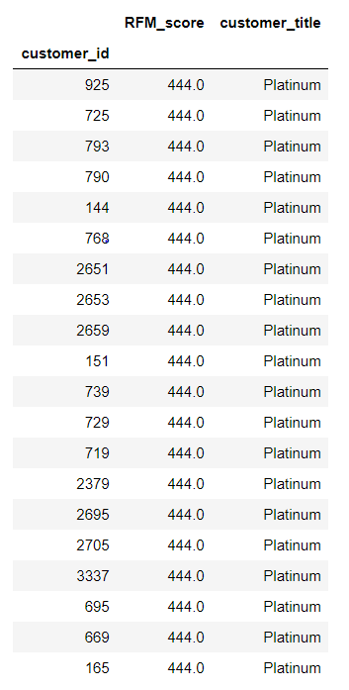
Interpretation – Target Market
Sprocket should focus on the top – 1000 potential customers based on RFM score and tend to retain most valuable customers.
Should focus more on the customers within age group 40-49, the customers working for financial service sector, and customers live in NSW do not own car.

