Slide 1

Terminal Application by Ruby – Business Contact book
Hang (Haden) Liu

Slide 2
Development Background
Business / Sales professionals need a app to upload customer contacts.
Organisations need an app to store the customer contact.
Need further integration with other systems and database.

Slide 3
Target Users
Various business professionals
Organisation / team managements
IT team ( to maintain data / records )

Slide 4
Features
Uploading contact information
Prompt users to enter the contact details
Viewing current contact details ( entered / csv imported )
Allow user to review current contact details
Import contact details
Read CSV file and display in app
Modifying and updating entered contact details
Using Ruby methods to update contact details
Validating user inputs

Slide 5

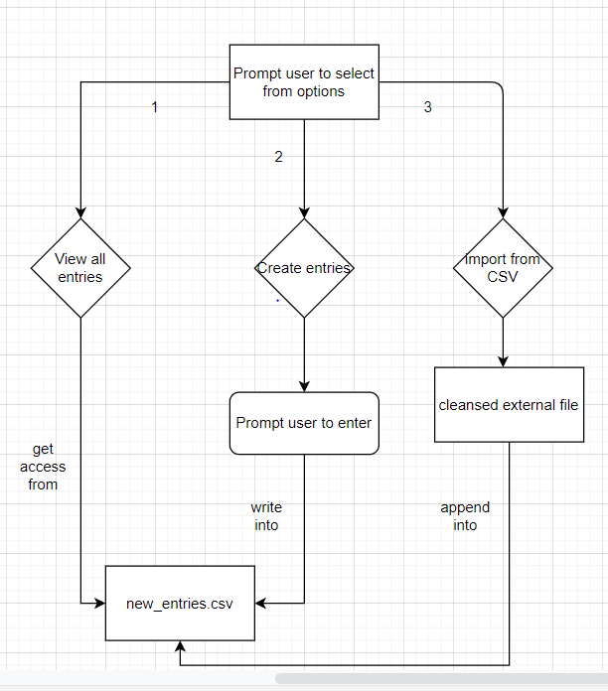
Flow chart

Slide 6
Technologies
Ruby
Gem packages:
CSV
Rspect
New Entries
Existing CSV Files
Write into
Append to
Internal CSV file

Slide 7
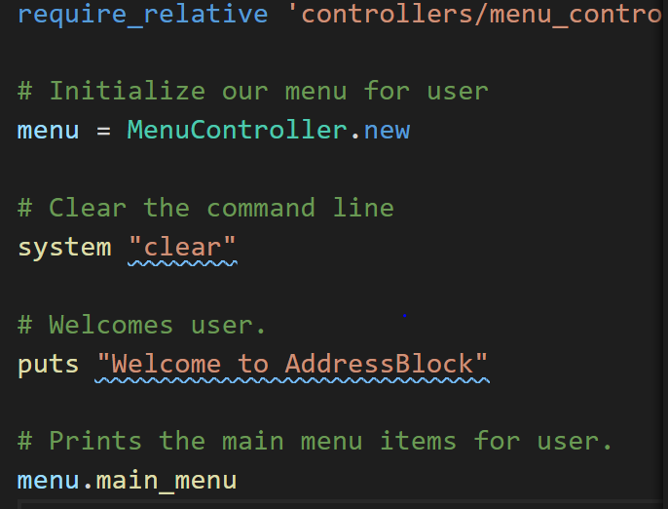
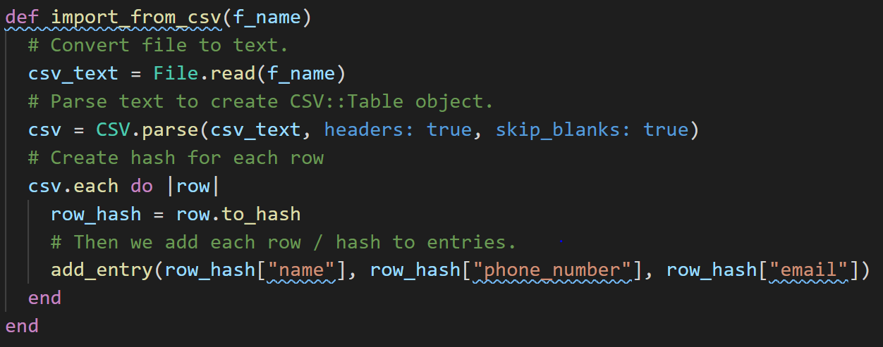
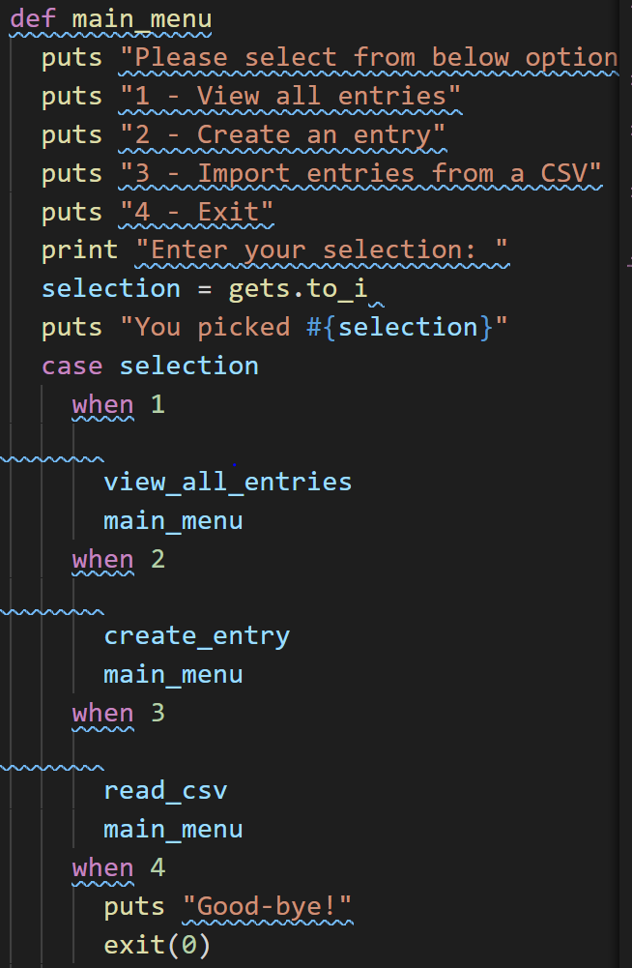
Code & structure
Initialize
App controller
CSV controller
Entries format

Slide 8
Demo

Slide 9
Further Development
Binnary search & editing
Using PG package of gem and SQL, connect app with PostgradSQL.

