Slide 1
CLO 1.1
Demonstrate Knowledge of Statistical Terms and Types of Data
BUS 1023: Applied Mathematics for Business

Slide 2

Statistics involves:
  Collecting data.
  Organizing and analyzing data.
  Drawing conclusions from data.

Slide 3

Example 1:
A company produces a million boxes of cereal per day. It wants to determine the average calories per box of cereal.
Solution:
Problems with this solution
They could test all of the boxes produced.
It would take a lot of time.
It would use all of the cereal produced.
* Instead they could use sample of maybe 50 or 100 boxes.
.

Slide 4
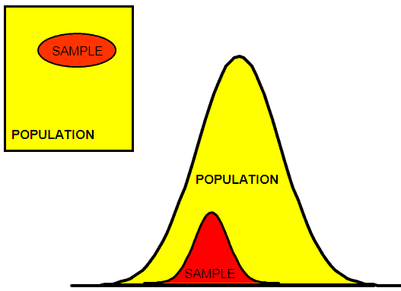
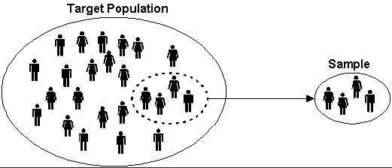
SAMPLE vs POPULATION

Slide 5
Example 2.
Etisalat wants to ask the employees of businesses in Sharjah their opinions of internet services. Etisalat chose 30 companies and asked the employees in a questionnaire, about the levels of services provided by the company.
What is the population?
the employees of all businesses in Sharjah.
What is the sample?
the employees of the 30 companies in Sharjah selected by Etisalat.

Slide 6
Data:
Data
Data can be classified into qualitative or quantitative data.
quantity is the amount of something.
quality is the characteristics of data
Remember:
qualitative
quantitative
Data refers to a set of values, which are usually organized by variables (what is being measured) and observational units (members of the sample/population).
Variable is a characteristic or attribute of a subject that can assume different values (from data collected in survey or experiments).

Slide 7
Qualitative and Quantitative Data:
Quantitative data involve numerical measurements.
  Examples:
    Height, weight, speed, and number of students at the college.
Qualitative data involve measurements of qualities/physical characteristics.
  Examples:
    Gender, occupation, nationality, color.

Slide 8
Examples: Qualitative or Quantitative Data?
1. The weather today is cloudy.
2. The average weight of Diploma students is 60 kg.
3. My student number is H000482190.
4. The average score on a math test is 77%.
5.Most students in the class like
mathematics.
Qualitative
Quantitative
Qualitative
(ID number is not a measurement.)
Quantitative
Qualitative

Slide 9
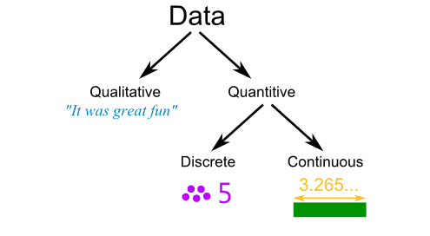
Discrete and Continuous Variables

Slide 10
Discrete Variables
Discrete variable is the result of counting something and is always a whole number value.
Examples:
  number of students in a class.
  number of pens in the supply room.

Slide 11
Continuous Variables
A continuous variable is one that is measured and can change over time.
Examples:
  Height of a student in the class.
  Length of time required to do a test.
  Distance to Abu Dhabi to Dubai.

Slide 12
Examples: Discrete or Continuous Variables
1. The weight of a chicken.
2. The number of pizzas sold last week.
3. The number of teachers at RKW.
4. The capacity of a water glass.
Continuous
Discrete
Discrete
Continuous

Slide 13
Thank You

