Slide 1
CLO 1.2
Organize and Interpret Data Using Frequency Distributions
BUS 1023: Applied Mathematics for Business

Slide 2
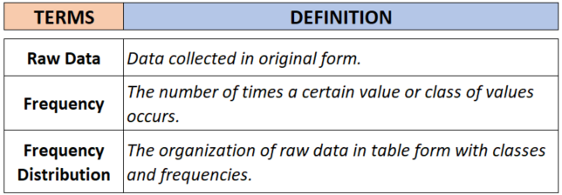

Slide 3
Frequency
Frequency is how something occurs.
Example: Sam played football on…
          Saturday morning
          Saturday afternoon
          Sunday afternoon
How often Sam played football?
The frequency is: 3
By counting frequencies we can make a frequency distribution table
http://www.mathsisfun.com/data/frequency-distribution-grouped.html

Slide 4
FREQUENCY DISTRIBUTION
(a) CATEGORICAL FREQUENCY DISTRIBUTION
(b) GROUPED or (c) UNGROUPED FREQUENCY DISTRIBUTION

Slide 5





A. Categorical Frequency Distribution
The categorical frequency distribution is used for data that can be placed into specific categories.
Steps for Creating a Categorical Frequency Distribution.
Step 1: Make a table with the following columns in order: class, tally, and frequency.
Step 2: Tally the data and place the results in the tally column.
Step 3: Count the tallies and place the results in the frequency column.
Example: If frequency = 5
When the fifth tally is reached for a mark, draw a horizontal line through the first four tally marks

Slide 6
Example 1: Categorical Frequency Distribution
Red
Yellow
Green
Red
Blue
Blue
Red
Red
Green
Red
Green
Yellow
Red
Blue
Green
These are the favorite colors of fifteen 2nd graders. Construct a frequency distribution table for the data.
Class | Tally | Frequency
Red
Blue
Green
Yellow
6
3
4
2
Total = 15

Slide 7

Steps in Creating a Grouped Frequency Distribution
Step 1: Determine the minimum and maximum values, and how many classes you need.
Step 2: Find the class width.
*ALWAYS round up to the next whole number
$$Class Width= \frac{Range}{No. of Classes}$$

Slide 8
Example 2: Categorical Frequency Distribution
A
AB
O
A
B
B
A
A
O
A
O
AB
A
B
O
Fifteen soldiers have given blood test to determine their blood type. Construct a frequency distribution table for the data.
Class | Tally | Frequency
A
B
O
AB
6
3
4
2
Total = 15

Slide 9

What about if the values of the data are numbers?

Slide 10
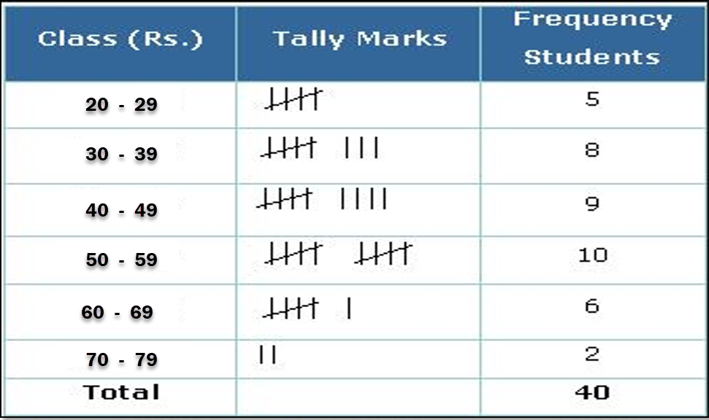
B. Grouped Frequency Distribution
When the range of the data is large, the data must be grouped into classes, that are more than one unit in width
A Grouped Frequency Distribution is an organization of raw data in table form, using classes and frequencies.

Slide 11
Key Components of Grouped Frequency Distribution
Class Limits
The values which determine the upper and lower limits of a class
Lower Class Limit
Smallest data value that can be included in the class
Upper Class Limits
Largest data value that can be included in the class
Class Width
Difference between two consecutive lower class limits or upper
class limits.

Slide 12
Steps in Creating a Grouped Frequency Distribution
Step 3: Write your minimum value as your lowest lower limit.
Example: Class Limit: 2 - 10
Minimum value
2
Step 4: Add the class width to your lower limit to find the next lower limit;
WRITE BELOW NOT BESIDE!
(do all lower limits first)
Example: If class width = 9
Lower Class Limits
2
+9
11
20
+9
Continue until you have the number of classes needed (in this case 4)
29
+9

Slide 13
Steps in Creating a Grouped Frequency Distribution
Class Limits
Step 5: To find each upper limit, subtract one from the next lower limit.
2
- 10
11 - 1
11
- 19
20 - 1
20
- 28
29 - 1
29
Class Limits
Step 6: To find the last upper limit, add class width to the 2nd to last upper limit.
2
- 10
11
- 19
20
- 28
+9
29
- 37

Slide 14
Steps in Creating a Grouped Frequency Distribution
Step 7: To make the class continuous we have to set boundaries.
Class Limits
Class Boundaries
2
- 10
2 - 0.5
1.5
- 10.5
10 + 0.5
11
- 19
11 - 0.5
10.5
- 19.5
19 + 0.5
20
- 28
20 - 0.5
19.5
- 28.5
28 + 0.5
29
- 37
29 - 0.5
28.5
- 37.5
37 + 0.5
Lower Class Boundary= Lower class limit – 0.5
Upper Class Boundary= Upper class limit + 0.5

Slide 15
Example 1: Grouped Frequency Distribution
102 124 108 86 103 82
71 104 112 118 87 95
103 116 85 122 87 100
105 97 107 67 78 125
109 99 105 99 101 92
The given data represents temperatures in 30 states. Construct a grouped frequency table for the data using 5 classes.
67
Minimum value =
Maximum value =
125
Note: This data will be used for several examples. You might want to duplicate it for use with the slides that follow.

Slide 16
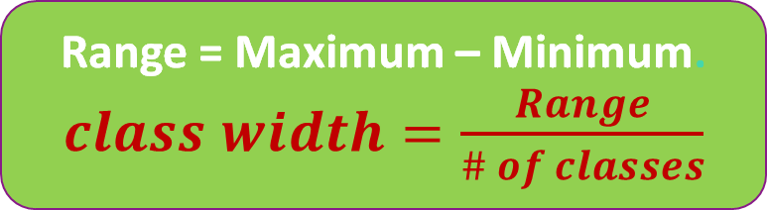

Example 1: Grouped Frequency Distribution
1. Choose the # of classes
For this problem, let’s use 5 for # of classes.
Class Limits | Class Boundaries | Tally | Frequency
Range = Maximum – Minimum.
$class width=\frac{Range}{\# of classes}$
2. Calculate the Class Width
$class width=\frac{125−67}{5}$ =11.6 ≈ 12

Slide 17
Example 1: Grouped Frequency Distribution
3. Determine All Class Limits
The lower class limit is the lowest data value that belongs in a class and the upper class limit is the highest. Use the minimum value as the lower class limit in the first class. (67)
Class Limits | Class Boundaries | Tally | Frequency
67
- 78
79
- 90
91
- 102
103
- 114
115
- 126
67 + 12 = 79
79 + 12 = 91
91 + 12 = 103
103 + 12 = 115

Slide 18
Example 1: Grouped Frequency Distribution
4. Construct the class boundaries
Lower Class Boundary= Lower class limit – 0.5
Upper Class Boundary= Upper class limit + 0.5
Class Limits | Class Boundaries | Tally | Frequency
67 – 78
79 – 90
91 – 102
103 – 114
115 – 126
66.5 – 78.5
78.5 – 90.5
90.5 – 102.5
102.5 – 114.5
114.5 – 126.5

Slide 19
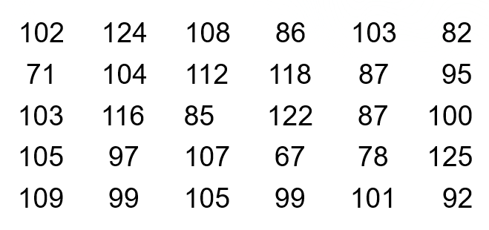
Example 1: Grouped Frequency Distribution
5. Mark a tally I to the appropriate class for each data value.
After all data values are tallied, count the tallies in each class for the class frequencies.
Class Limits | Class Boundaries | Tally | Frequency
67 – 78 | 66.5 – 78.5
79 – 90 | 78.5 – 90.5
91 – 102 | 90.5 – 102.5
103 – 114 | 102.5 – 114.5
115 – 126 | 114.5 – 126.5
III
3
IIII
5
IIII
-III
8
IIII
-IIII
9
IIII
5
Total = 30

Slide 20
Example 1: Grouped Frequency Distribution
From this grouped frequency distribution, answer the following questions:
Class Limits | Class Boundaries | Frequency
67 – 78 | 66.5 – 78.5 | 3
79 – 90 | 78.5 – 90.5 | 5
91 – 102 | 90.5 – 102.5 | 8
103 – 114 | 102.5 – 114.5 | 9
115 – 126 | 114.5 – 126.5 | 5
 | Total = | 30
1. What is the class width of the frequency distribution?
Answer = 12 (79 - 67)
2. How many states have a temperature at most 90 degrees ?
Answer = 8 (3 + 5)
3. How many states have at least 103 degrees?
Answer = 14 (9+5=14)

Slide 21
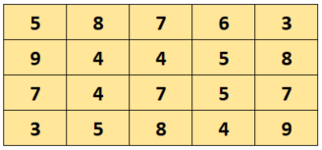
C. Ungrouped Frequency Distribution
When the range of data is relatively small, we can use single data values for each class. This type is called Ungrouped frequency distribution.
The ages of 20 dogs in a pet shelter are shown. Construct the ungrouped frequency table for the data.
Example 2:
Note: This data will be used for several examples. You might want to duplicate it for use with the slides that follow.

Slide 22

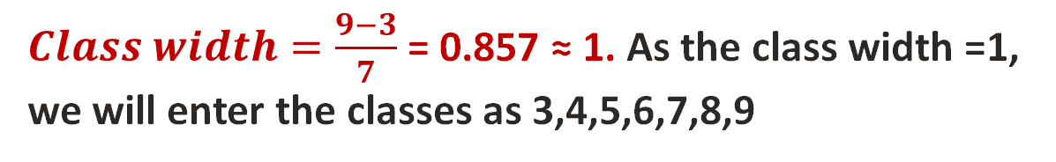
Steps to Construct the Ungrouped Frequency Distribution
C. Ungrouped Frequency Distribution
Because the Range of data is relatively small, we can use the single data value in the frequency distribution.
Minimum value =
Maximum value =
3
9
1. Choose the # of classes
Let choose 7 classes
Range = 9 - 3 = 6
Range = Maximum – Minimum.
$class width=\frac{Range}{\# of classes}$
2. Calculate the Class Width
3. Tally the data
$Class width=\frac{9−3}{7}$ = 0.857 ≈ 1. As the class width =1, we will enter the classes as 3,4,5,6,7,8,9
4. Find the frequency and cumulative frequency

Slide 23
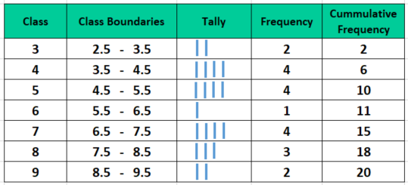
Steps to Construct the Ungrouped Frequency Distribution

Slide 24
Example 2: From this grouped frequency distribution, answer the following questions:
1. What age of dog has the least frequency?
Answer = 6
2. How many dogs in the shelter is 5 years old or less?
Answer = 10
3. How many dogs in the shelter is at least 5 years old
Answer = 14

Slide 25
Thank You

