Slide 1

Tuesday, 14.00 – 15.20
Charles University
Charles University
Econometrics
Econometrics
http://samba.fsv.cuni.cz/~visek/Econometrics_Up_To_2010/
http://samba.fsv.cuni.cz/~visek/Econometrics_Up_To_2010/
Jan Ámos Víšek
Jan Ámos Víšek
FSV UK
Institute of Economic Studies
Faculty of Social Sciences
Institute of Economic Studies
Faculty of Social Sciences
STAKAN III
First Lecture

Slide 2

Schedule of today talk
We are going to learn what is the
and of course, we’ll give notations, various forms
of the model, names for its components, etc.
What we shall start with? Naturally with
REGRESSION MODEL
motivation .
http://samba.fsv.cuni.cz/~visek/

Slide 3
Health Club Data
Time
per ¼-mile total
Name
1 John K. Smith 91 481
2 Richard Z. Crad 66 292
3 Halbert V. Laswar 68 338
4 Peter W. Troca 70 357
30 George I. Wrong 75 338
Naïve estimate
Time total = 4.9 * Time per ¼-mile
An expert
estimate
Time total = -52.3 + 5.8 * Time per ¼-mile
70% explanation of data

Slide 4


Plot of the expert-estimated
underlying model
Time
total
5.8
Time per ¼-mile
-52.3
So we look for a model
“reasonably” explaining data.

Slide 5
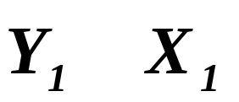
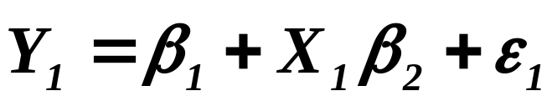
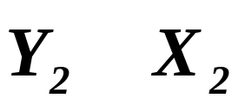
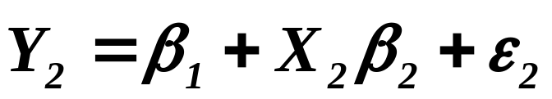
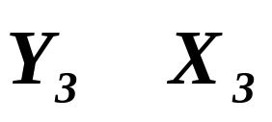
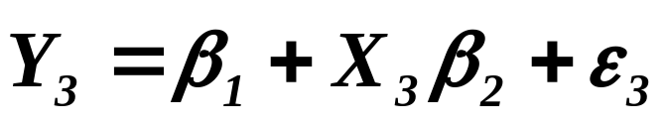

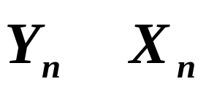
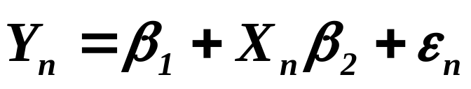
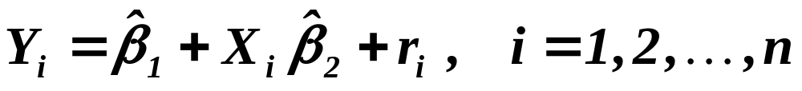
Structure of data
Assumed mechanism
of generating data
Our estimate of the underlying mechanism

Slide 6
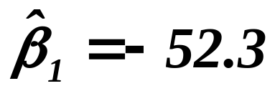
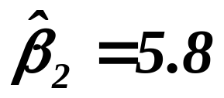

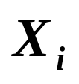
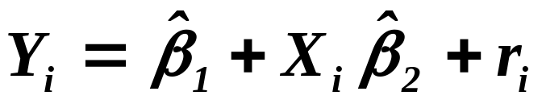
Time total
intercept ( absolutní člen )
slope ( náklonový koeficient )
5.8
Residual
(residuum)
Predicted value
Time
per
¼-mile
-52.3
Simple regression model

Slide 7

Health Club Data
Weight Strength Time
Pulse per total
¼-mile
Name
1 John K. Smith 217 67 260 91 481
2 Richard Z. Crad 141 52 190 66 292
3 Halbert V. Laswar 152 58 203 68 338
4 Peter W. Troca 153 56 183 70 357
30 George I. Wrong 177 53 183 75 338
The best possible estimate
Time total = -3.62 + 1.27 * Weight - 0.53 * Puls
- 0.51 * Strength + 3.90 * Time per ¼-mile
85% explanation of data

Slide 8
Health Club Data
Weight Strength Time
Pulse per total
¼-mile
Name
1 John K. Smith 217 67 260 91 481
2 Richard Z. Crad 141 52 190 66 292
3 Halbert V. Laswar 152 58 203 68 338
4 Peter W. Troca 153 56 183 70 357
30 George I. Wrong 177 53 183 75 338
Nearly equivalent estimate
Time total = -25.4 + 1.21 * Weight
- 0.45 * Strength + 3.74* Time per ¼-mile
85% explanation of data

Slide 9
Health Club Data
Weight Strength Time
Pulse per total
¼-mile
Name
1 John K. Smith 217 67 260 91 481
2 Richard Z. Crad 141 52 190 66 292
3 Halbert V. Laswar 152 58 203 68 338
4 Peter W. Troca 153 56 183 70 357
Strength and Pulse appeared to be
statistically insignificant for explanation.
30 George I. Wrong 177 53 183 75 338
Still very good estimate
Time total = -63.2 + 0.84 * Weight + 3.93* Time per ¼-mile
83% explanation of data

Slide 10
Health Club Data
Weight Strength Time
Pulse per total
¼-mile
Name
1 John K. Smith 217 67 260 91 481
2 Richard Z. Crad 141 52 190 66 292
3 Halbert V. Laswar 152 58 203 68 338
4 Peter W. Troca 153 56 183 70 357
Should we use all data -
- even when some of them
are (evidently) damaged or atypical ?
29 Daniel E. Nawurat 141 63 193 60 252
Better than the best possible estimate
Time total = 31.72 + 1.38 * Weight – 1.32 * Puls
- 0.64 * Strength + 4.23* Time per ¼-mile
88% explanation of data

Slide 11
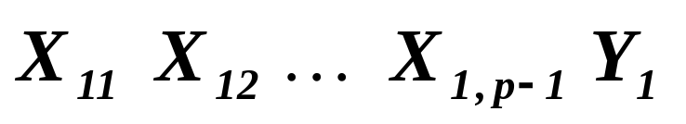
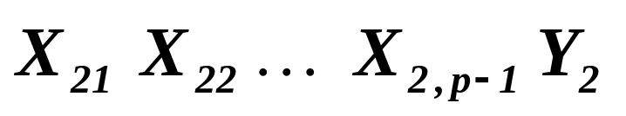
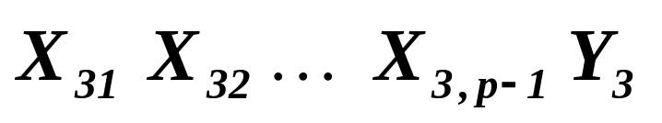
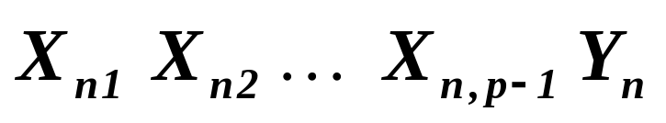
Structure of data
In previous example
n = 30, p - 1 = 4
Assumed mechanism
of generating data

Slide 12
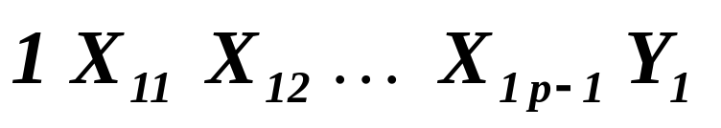
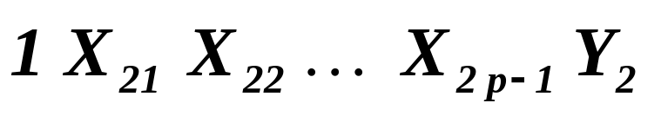
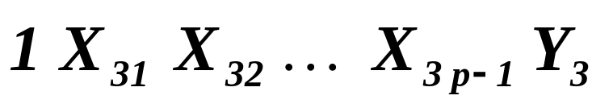
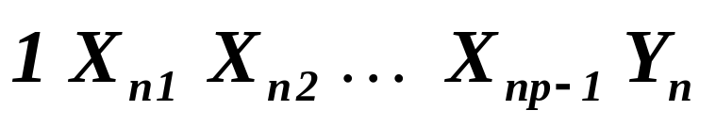
Structure of data
Assumed mechanism
of generating data

Slide 13
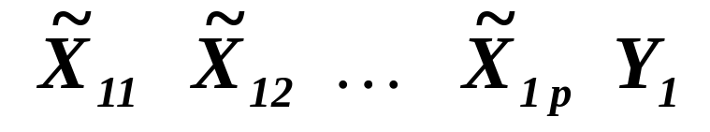
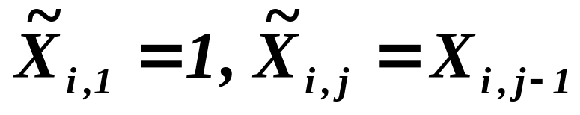
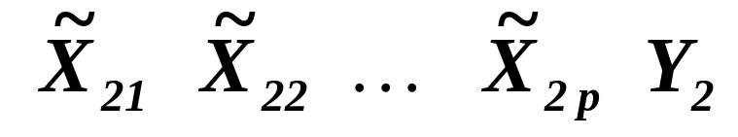
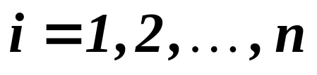
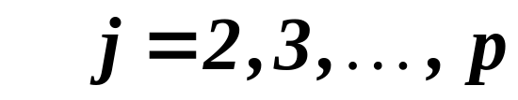
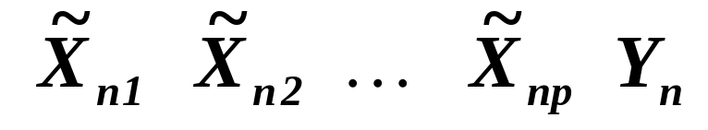
Structure of data
Assumed mechanism
of generating data

Slide 14
Assumed mechanism of generating data
Disturbances, error term, fluctuations, etc.
Disturbance, náhodné chyby, atd.
(2., etc.) explanatory variable (regressor, factor, carrier, etc.)
1. (2., atd.) vysvětlující (nezávisle) proměnná, atd.
Response variable
Vysvětlovaná (závisle) proměnná
They will be assumed
to be deterministic.

Slide 15
Assumed mechanism of generating data -
- REGRESSION MODEL
Slopes ( náklonové koeficienty)
Intercept
Regression coefficients -
- unknown, hence to be ESTIMATED!

Slide 16
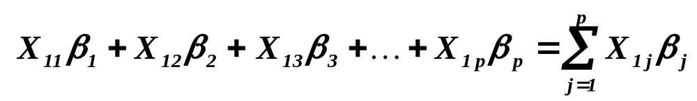
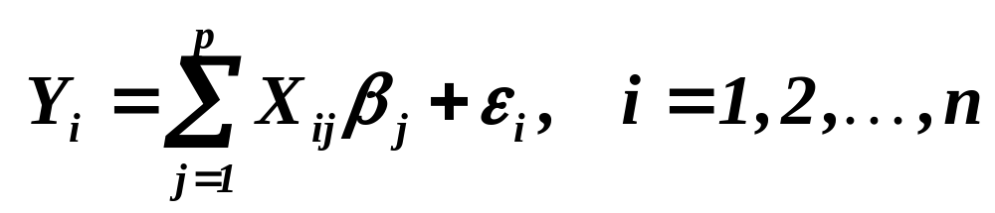
Assumed mechanism of generating data -
- REGRESSION MODEL

Slide 17

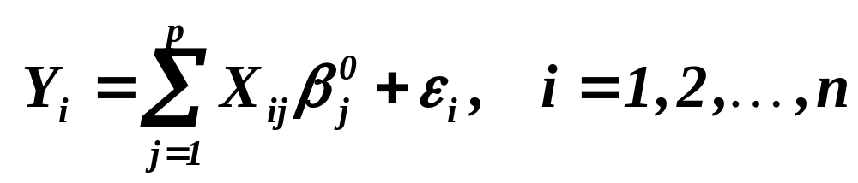
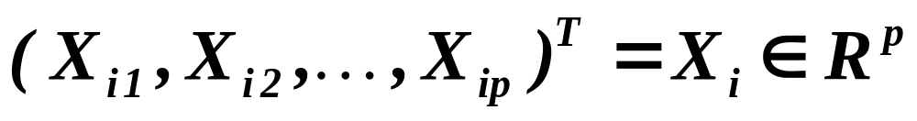
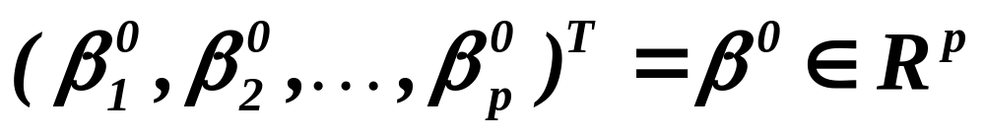
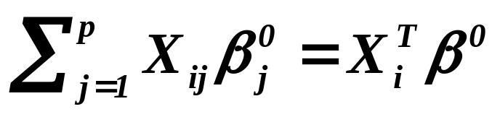
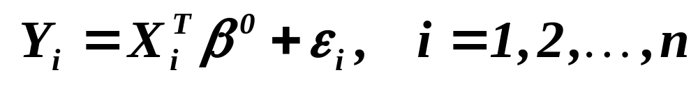
REGRESSION MODEL
This „zero“ will indicate that is
the „true“ value of regression coefficients
All vectors will be considered as column vectors
„Vector“ form

Slide 18
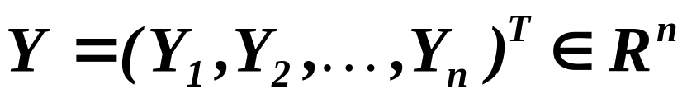
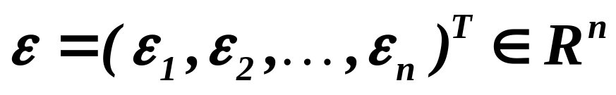
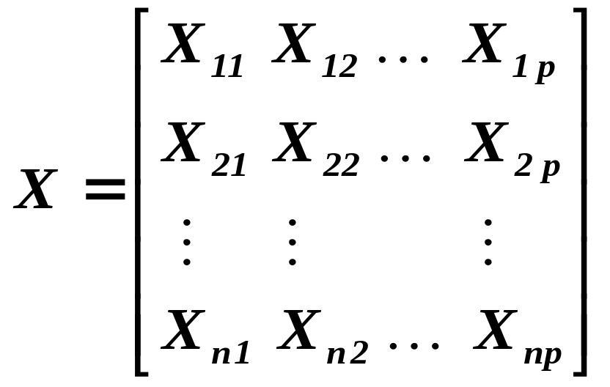
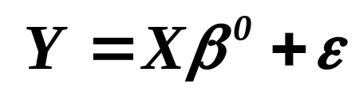
REGRESSION MODEL
Design matrix
(matice plánu)
Full rank
(plné hodnosti)
Notice please - no transposition !
„Matrix“ form

Slide 19

Types of data
The data, we have spoken about today, are called
The order of
rows is not
relevant.
“Cross-sectional data”
(On every row there is one patient, one industry, etc.
Usually we say that on any row there is one case.)
The data, describing development in time of one patient
(one industry etc.), are called
“Panel data”
The order of
rows is
relevant.
(So, on rows the values of given patient
(industry, etc.) at time are given.)
Combinations of both types are also assumed.

Slide 20
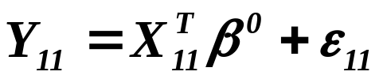
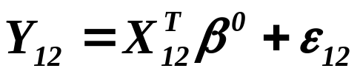

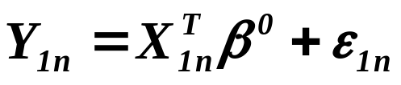

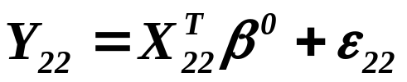
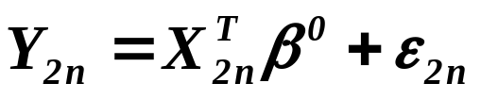
These data are also called “Panel data”.
The order of
rows in blocks is
relevant.
1. block
The order of
blocks is
irrelevant.
2. block
etc., up to K blocks

Slide 21
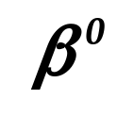
REGRESSION MODEL
Galton, F. (1886): Regression towards
mediocrity in hereditary stature.
(Návrat k průměru ve zděděné postavě.)
Journal of the Anthropological Institute vol.~15, pp. 246-263.
How to estimate from data?

Slide 22
What is to be learnt from this lecture for exam ?
Just one thing – what is
and of course, the names for its components
what notations we usually accept,
and what variants of the model we employ.
REGRESSION MODEL
All what you need is on
http://samba.fsv.cuni.cz/~visek/Econometrics_Up_To_2010

