Slide 1

Tuesday, 14.00 – 15.20
Charles University
Charles University
Econometrics
Econometrics
Jan Ámos Víšek
Jan Ámos Víšek
FSV UK
Institute of Economic Studies
Faculty of Social Sciences
Institute of Economic Studies
Faculty of Social Sciences
STAKAN III
Fourth lecture

Slide 2

Schedule of today talk
A summary of previous results.
The best unbiased quadratic estimator
of the variance of disturbances.
Distribution of quadratic forms - Fisher-Cochran lemma.
Distribution of the unbiased estimator of variance.
Distribution of studentized estimators
of regression coefficients.

Slide 3
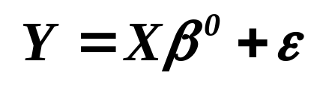
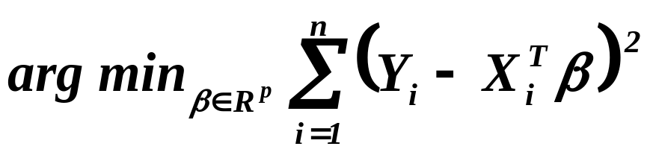
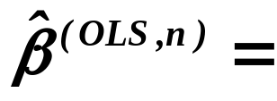
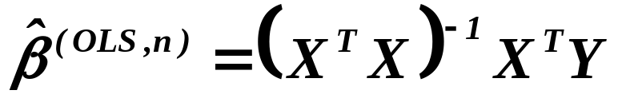
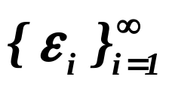
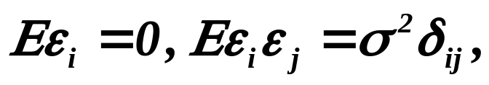




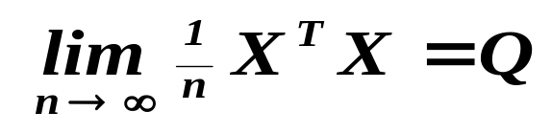
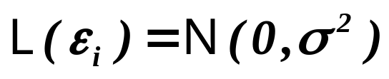
What we already know about the linear regression model
is BLUE
is consistent
is asymptotically normal
is the best among all unbiased estimators

Slide 4
What haven’t we discussed, up to now,
about the linear regression model ?
In the literature written by a statistician
the disturbances are usually called “error term”.
It is probably reason why ( especially in the Czech texts )
we can meet with the interpretation of disturbances as
“random errors of measurement”
of response variable. But then it is likely that also explanatory
variables were measured with “random errors” and then
the OLS-estimator is biased !!!!
( We shall prove it later and propose a remedy.)
Hence this interpretation is not tenable !!!
Because if we accept it, we should use
udržitelný, obhajitelný
something else than OLS from the very beginning !!!

Slide 5
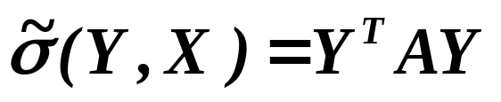
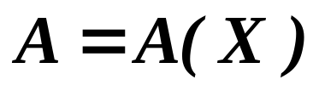

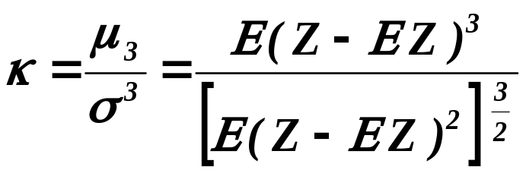
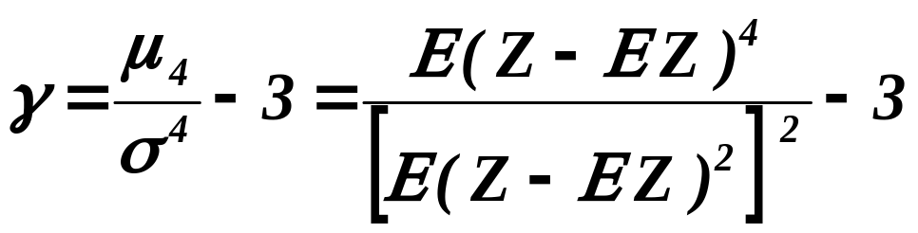
Conclusion
We know how to estimate all coefficients
of linear regression model, except of one.
Which is it ?
Definition
An estimator where
is matrix, is called the quadratic estimator .
Definition (recalling skewness and kurtosis - šikmost a špičatost)
skewness
We’ll need it
in minute.
kurtosis

Slide 6
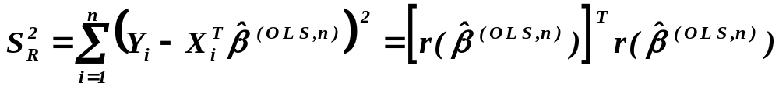
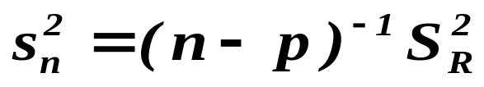





Theorem
Assumptions
Let be iid. r.v’s, .
Denote sum of squared residuals ( residual sum of squares )
and
.
If or the diagonal elements of the projection
matrix are all the same,
Assertions
then is the best unbiased estimator of among all un-
biased quadratic estimators with positive definite matrix .

Slide 7


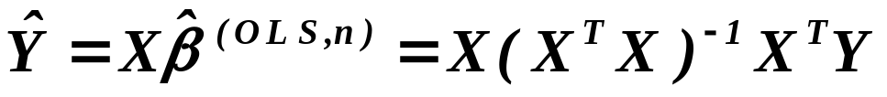
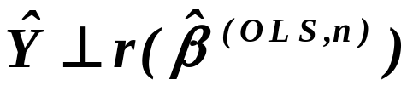

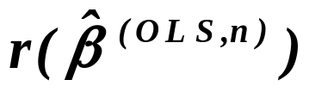
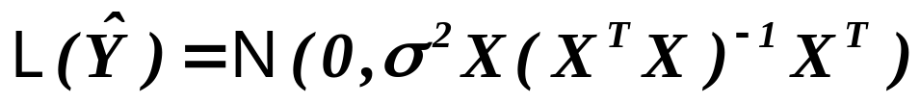
Lemma 1
Assumptions
Let be r.v’s with
Denote the projection of on by
.
Assertions
Then and hence they are not correlated.
Assumptions
If morover ,
Assertions
and are independent. Finally
and
.

Slide 8
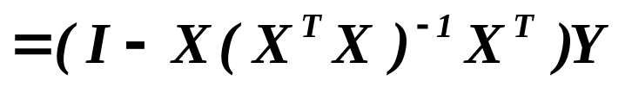
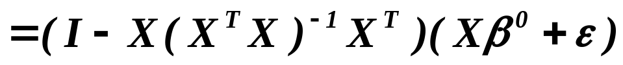
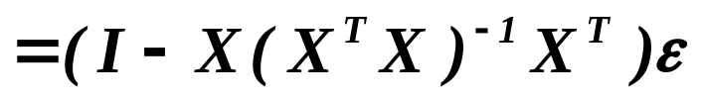

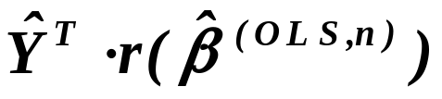
Proof
We conclude that both and are linear combinations
of disturbances, hence they are normally distributed.
From the orthogonality we conclude that and are not cor-
related and from it, under normality, that they are independent.

Slide 9
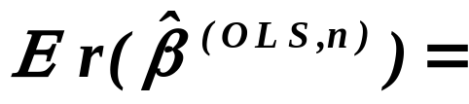
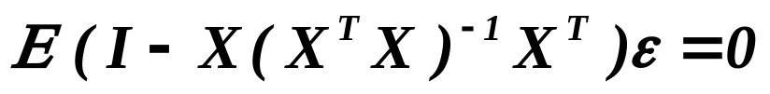
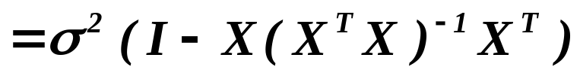
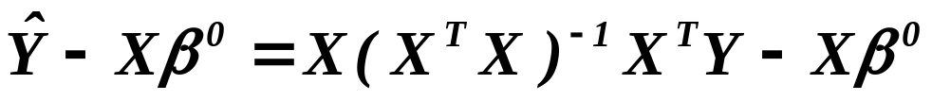
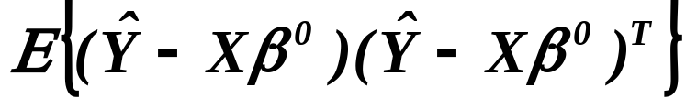
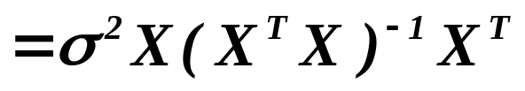
Proof
continued
Let us evaluate mean values and covariance matrices of and .

Slide 10
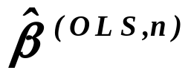
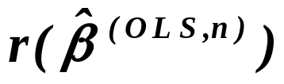
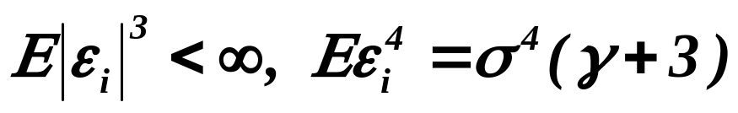
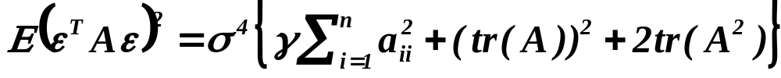
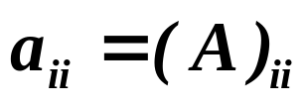




Corollary
Under , and
are independent.
Assertion 1
Let be r.v’s with
. Then for any symmetric matrix
where “tr” stays for “trace”. Moreover .
Assertion 2
Assertion 3
Let be idempotent, i.e. .Then .

Slide 11



Recalling that the eigenvector
and eigenvalue of a matrix are given as
Remark
The eigenvalues and eigenvectors are generally complex valued
(of course, they always exist).
Assertion 4
Let be positive definite (semidefinite), then the eigenvalues
are positive (nonnegative).
Assertion 5
Let be symmetric, then the eigenvalues are real
and the eigenvectors can be selected also real.

Slide 12





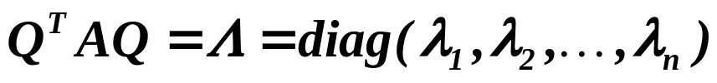




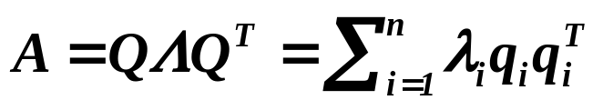
Assertion 6
Let be matrix of type . Then for any vector
there is an eigenvector .
Assertion 7 - Spectral Decomposition ( of matrix )
Assumptions
Let be real symmetric matrix (of type ).
Assertions
Then there is an orthogonal real matrix
such that
where are the eigenvalues of the matrix
( while are the eigenvectors of it ). Of course,
.
,
and

Slide 13


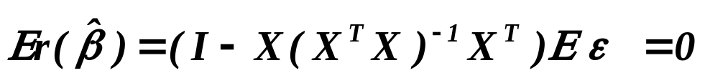
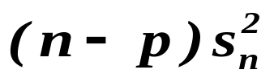
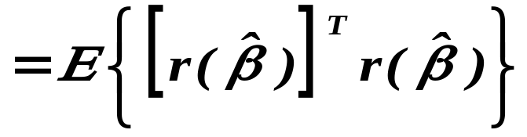
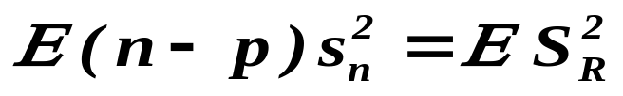
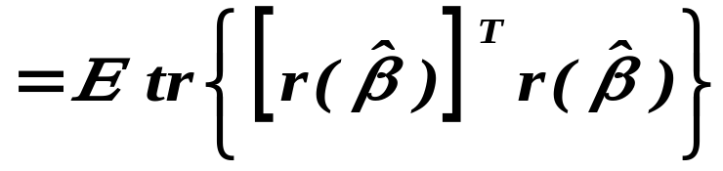
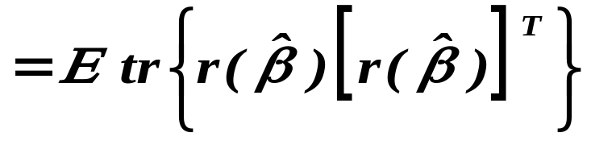
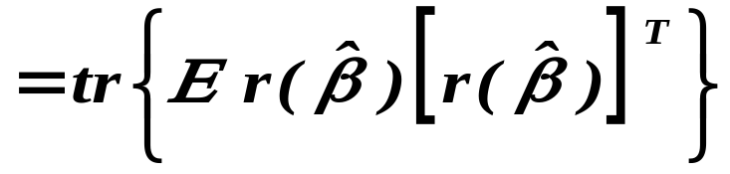
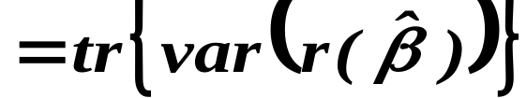
Proof of Theorem
Write instead of .
In what follows consider instead of .

Slide 14
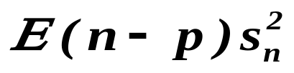
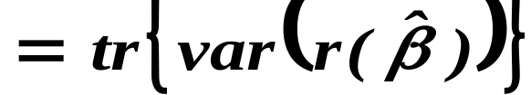

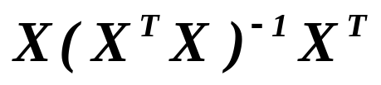
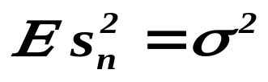
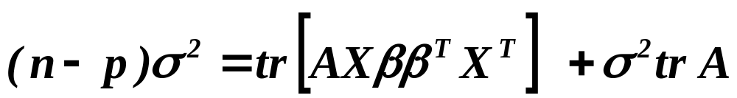
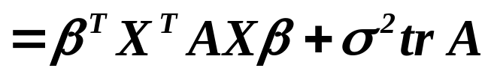

is idempotent
Consider an alternative estimator
( real , symmetric, positive definite)
It cannot depend on

Slide 15


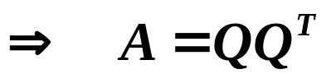





,
,
positive definite
Denote
and write
,

Slide 16







Put
It does not depend on the selection of matrix ,
so let us minimize .
For ( i.e. e.g. ) , we need
.

Slide 17






For , we have
.
Since , minimum is attained for .
Remember that
and
which concludes the proof.

Slide 18









DISTRIBUTION of QUADRATIC FORMS
Definition
The function where
is symmetric matrix, is called the quadratic form .
Lemma (Fisher-Cochran)
Assumptions
Let , independent .
Moreover, let
. Put
. Finally, let
.
Assertions
Then are mutually independent and
iff . Then moreover .

Slide 19









Proof of Lemma
Assume that .
symmetric
eigenvectors of with nonzero eigenvalue
Put

Slide 20









Put
It has to hold for all , hence and
is regular .
is positive definite
. Put , then has
independent coordinates and .

Slide 21



Moreover
hence with
and
.

Slide 22






Opposite direction of the proof.
Assume that the quadratic forms are independent
and have .
Then their sum has d.f. . On the left
hand side we have with d.f. .
Hence and
.

Slide 23


DISTRIBUTION of THE ESTIMATOR of VARIANCE
of RESIDUALS
and of STUDENTIZED ESTIMATORS
of THE REGRESSION COEFFICIENTS
Let us recall that
Lemma
Assumptions
Let be iid. r.v’s.
Moreover, let .
, .
Assertions
Then
.

Slide 24



Proof of Lemma

Slide 25









Lemma
Assumptions
Let be iid. r.v’s .
Moreover, let
and be regular.
Put
Assertions
Then
.
Assumptions
Put
where
,
is called
then
,
studentization.
where
This transformation
,
is called
studentization.
Assertions
Then
,
i.e. is distributed as Student with degrees
of freedom.

Slide 26






Proof of Lemma
Recalling that , we conclude
that
where
.
Recalling that is independent from
and that , the proof follows from
the definition of Student which symbolically reads
.

Slide 27



Corollary
Assumptions
Let be iid. r.v’s .
Moreover, let
and be regular.
Assertions
Then
.
is Fisher-Snedecorovo .
The proof is based on the employment of spectral matrix decom-
position of which shows that the numerator can be written
as a sum of squares of normally distributed
and independent r.v’s.

Slide 28
What is to be learnt from this lecture for exam ?
The best unbiased quadratic estimator
of the variance of disturbances.
Spectral decomposition of matrix.
Distribution of quadratic forms - Fisher-Cochran lemma.
Distribution of the unbiased estimator of variance.
Distribution of studentized estimators
of regression coefficients.
All what you need is on
http://samba.fsv.cuni.cz/~visek/

