Slide 1

Tuesday, 12.30 – 13.50
Charles University
Charles University
Econometrics
Econometrics
Jan Ámos Víšek
Jan Ámos Víšek
FSV UK
Institute of Economic Studies
Faculty of Social Sciences
Institute of Economic Studies
Faculty of Social Sciences
STAKAN III
First Lecture
(summer term)

Slide 2

Schedule of today talk
Recapitulating winter term
Smoothing time series
• Decomposition of time series
• Smoothing by a function from a given class
• Adaptive smoothing by moving averages
• How far the seasonal term is overtaken
into the smoothed “series”

Slide 3



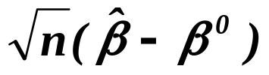
Recapitulating winter term
●
Type of data (cross-sectional, panel)
●
Regression model
●
Estimators of regression coefficients
and of variance of disturbances – conditions
●
B(L)UE of and BQUE of
●
Asymptotic normality of
●
Coefficient of determination, role of intercept
●
Studentized version of estimates of coeffs

Slide 4
Recapitulating winter term
continued
●
Confidence interval, testing submodels, Chow test
●
Verification of assumptions:
*
mean value equal zero - no
*
homoscedasticity - please yes !!
~ correcting heteroscedasticity
- please no
*
not correlated disturbances
- please no for cross sectional data
*
normality of disturbances - please yes !!
(remember - one-eyed ....)
other assumptions - design of experiment
*

Slide 5
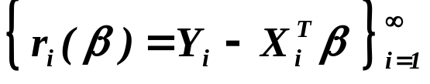

Recapitulating winter term
continued
●
Collinearity - indicators and remedies
- combining forecasts
●
Random carriers - quite different philosophy
from deterministic ones
(remember are i.i.d. for any )
- modification of assumptions
- instrumental variables
- specification test

Slide 6
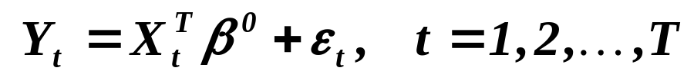
Starting summer term
Panel data
- the simplest case
- one subject (patient, industry, etc.)
and his/her/its development in time
Regression model
Task is again
Estimate the regression coefficients
and the variance of disturbances
(and, of course, verify assumptions,
guarantee “correctness” of model etc.)

Slide 7

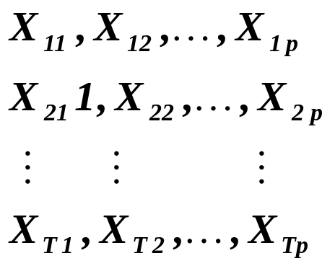

Starting summer term
Panel data
- the simplest case
- one subject (patient, industry, etc.)
and his/her/its development in time
Time series (časové řady)

Slide 8
Time series (časové řady)
●
Smoothing (vyrovnávání) time series by curves
- sometimes stochastic background
- sometimes “purely” mechanical
topic
for today
Barlett, M. S.: Smoothing Periodogram from
Time Series with Continuous Spectra.
Nature, Cambridge, 1948.
●
Spectral Analysis (Fourier transformation)
topic for
the next week
Granger, C. W. J., M. Hatanaka :
Spectral Analysis of Economic Time Series.
Princeton University Press, Princeton, 1964.
●
Modeling time series by stochastic models
- Box-Jenkins methodology
topic for
the next week
Box, G. E. P., G. M. Jenkins: Time Series
Analysis, Forecasting and Control.
Holden Day, San Francisco, 1970.

Slide 9
Smoothing time series
Barlett, M. S.: Smoothing Periodogram from
Time Series with Continuous Spectra.
Nature, Cambridge, 1948.
Recommended
Cipra, T.: Analýza časových řad s aplikacemi v ekonomii.
SNTL/ALFA, Praha, 1986.
Nerlove,M., D. M. Grether, J. L. Carvallo:
Analysis of Economic Time series.
Academic Press, NY, 1979.
Kozák, J., R. Hindls, J. Arlt: Úvod do analýzy
ekonomických časových řad.
VŠE, Fakulta informatiky a statistiky, 1994.
Hamilton, L. C.: Time Series Analysis.
Princeton University Press, Princeton, 1994.

Slide 10


Recalling time series
or
Recorded values
Smoothed values

Slide 11






Decomposition of time series
- trend in , some smooth function
(polynomial , exponential, logarithmic, logistic, etc.)
- cyclic part, of course again in ,
i.e. representing economic cycle
- seasonal part, again in ,
i.e. representing seasonal trend(s)
- irregular part, maybe in ,
representing some nonstochastic, rarely occurring
events (oil-shocks, terrorist attacks, wars, etc.)
- regular stochastic part, is time index,
either i.i.d. r.v.’s or some process,
frequently assumed to be (at least) stationary,
represented by one of “Box-Jenkins scheme”

Slide 12



Decomposition of time series
continued
Additive form
Multiplicative form
Various combined forms
The task is to extract the components, i.e. to “explain”
the mechanism generating given time series,
or “at least” to predict future values
(for one or a few steps ahead).

Slide 13







Decomposition of time series
continued
The simplest additive form
i.i.d. r.v.’s
There is (or even are) code-list(s) of trend curves:
1) Polynomials of K degree
2a) Simple or modified exponentials
2b) Gompertz curve
2c) Logistic curve
3a) Power (index) curve
3b) Johnson curve
3b) Gryck-Haustein curve

Slide 14

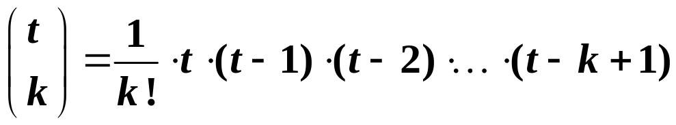
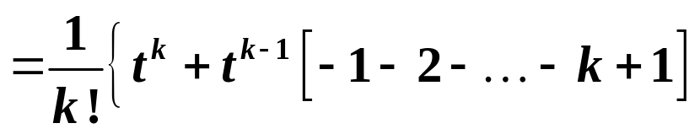
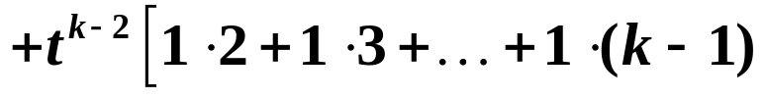
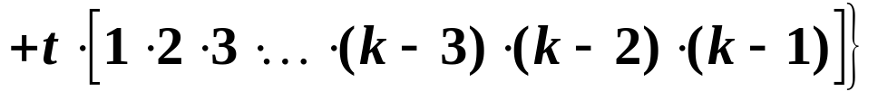
Decomposition of the simplest additive form
Sometimes we are able to recognize the type of trend:
Consider

Slide 15
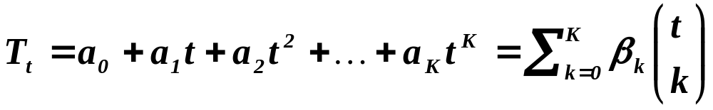
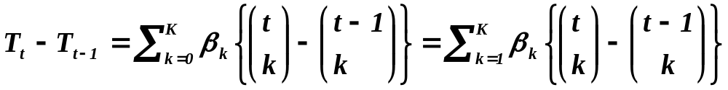

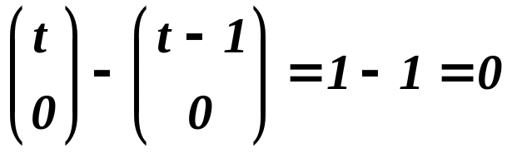
Decomposition of the simplest additive form
continued
Polynomials of K degree, an alternative form
Consider
since for we have

Slide 16
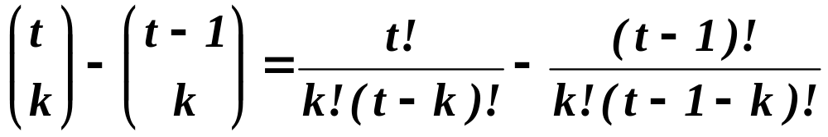
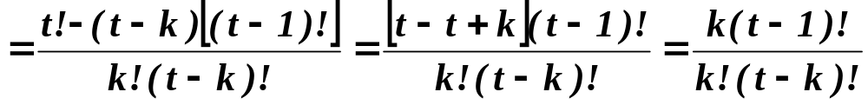
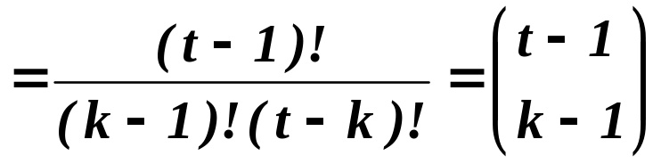
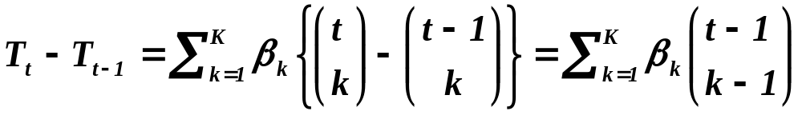
Decomposition of the simplest additive form
continued
Now let us evaluate
Hence

Slide 17

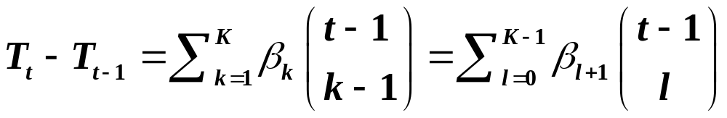









Decomposition of the simplest additive form
continued
i.e. for
i.e. is a polynomial of degree . Denote
We have
is a polynomial of degree ,
etc.
is a polynomial of degree , i.e. constant.
So . Let’s turn our attention to disturbances ‘s.

Slide 18

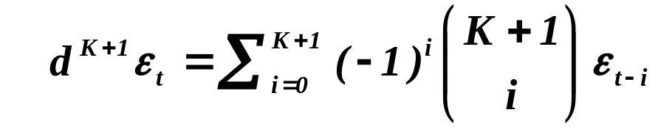
Decomposition of the simplest additive form
continued
(proof can be carried out by induction)
So this is random term of differences of time series.
It has obviously zero mean and variance (next slide)

Slide 19
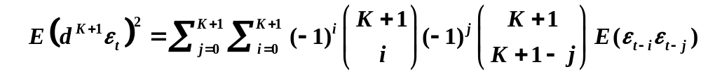
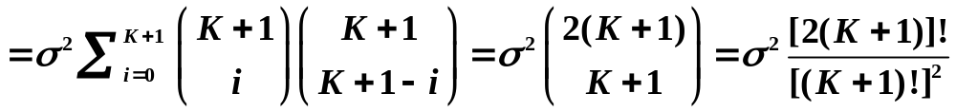
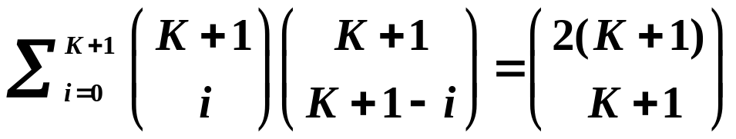
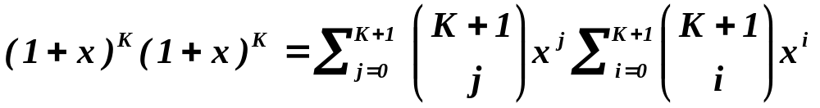
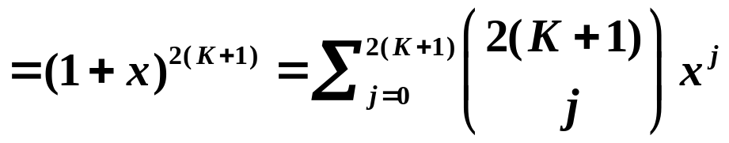
Decomposition of the simplest additive form
continued
(Moreover
which can be proved using the equality

Slide 20
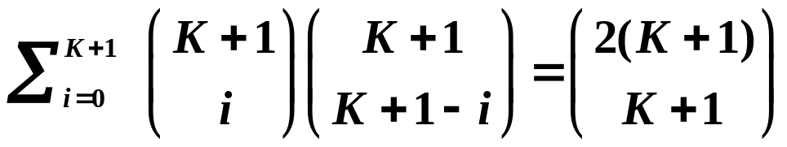
Decomposition of the simplest additive form
continued
and hence
.)
Recapitulation:
We make successively differences of time series up to the mo-
ment when we think that the rest is random fluctuation around
zero. Then, using just derived variance of random term, we test
whether the “residual noise” is really only noise.

Slide 21
Mechanical smoothing (adaptive smoothing by moving averages)
Again the simplest additive form
i.i.d. r.v.’s
We look for a “local” optimal smoothing by polynomials
of order k; “local” means that we take into account only
2m + 1 points.
Smoothing time series at this point
we take into account 5 green points
and create the red one.

Slide 22
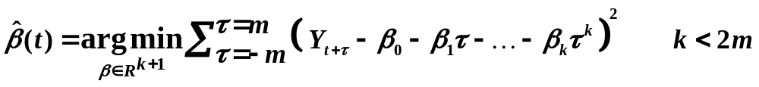

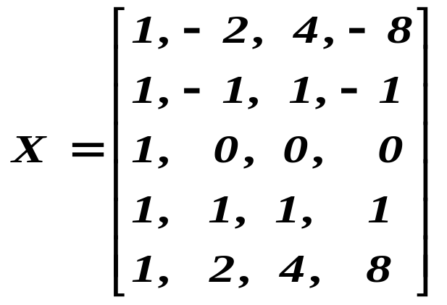
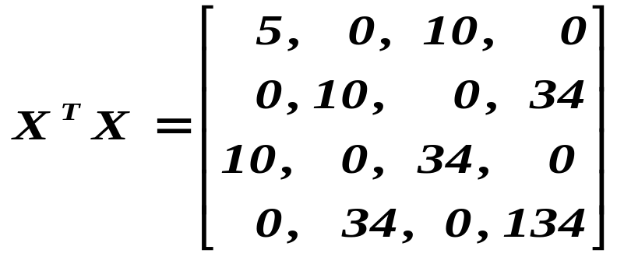
Smoothing the simplest additive form by moving averages
continued
i.i.d. r.v.’s
So we look for
n … number of observations
Design matrix for m=2 and k=3

Slide 23
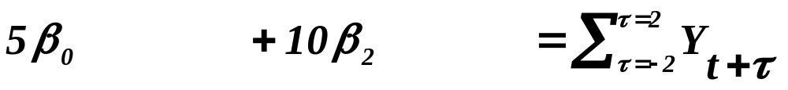
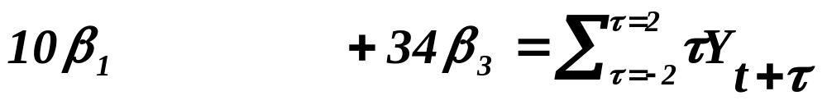
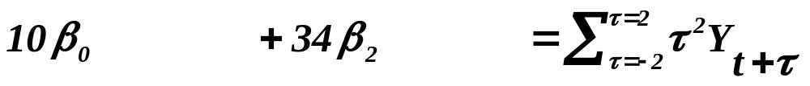
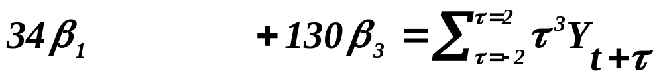


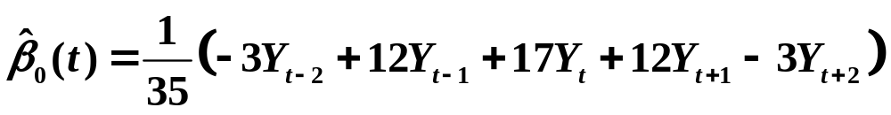
Smoothing the simplest additive form by moving averages
continued
i.i.d. r.v.’s
Hence the normal equations are
Since we shall utilize the “local” polynomial for smoothing time
series at the point , we need to evaluate from normal equ-
ations only . We obtain

Slide 24
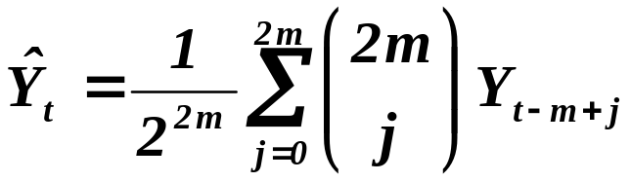
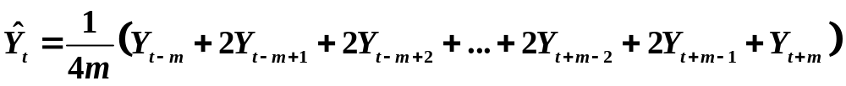
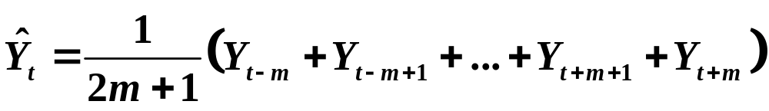
Smoothing the simplest additive form by moving averages
continued
Sometimes binomial “mean”, i.e.
.
Frequently however only simple mean
on an odd number of points
,
or even only
.

Slide 25
Smoothing the simplest additive form by moving averages
continued
What is result of smoothing by moving averages
for seasonal term and for cyclic term?
Again the simple additive form
i.i.d. r.v.’s
What is a character of seasonal term?
Number of points
at which we measure
during the season
Please,
remember
this form
Phasic shift, i.e. when
we arrive at maximum
Frequency, i.e. how frequently we arrive
at the same value of the seasonal term.
Let us explain
details by giving
an example.
Amplitude, i.e. absolute value at the point
where we add maximal value of seasonal term.

Slide 26
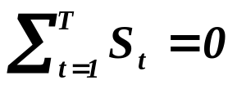
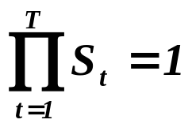
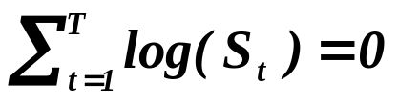
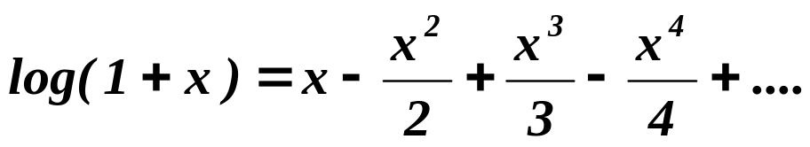
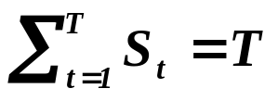
Smoothing the simplest additive form by moving averages
continued
There are, at least, 2 general assumptions on seasonal term:
1) During one season the seasonal term attains its maximum
and minimum (of course, once).
2) During one season the seasonal term is neutral, i.e.
a) in the case of additive time series - ,
b) in the case of multiplicative time series - ,
i.e. , recalling that
we have
and finally
Compare, please!
.

Slide 27
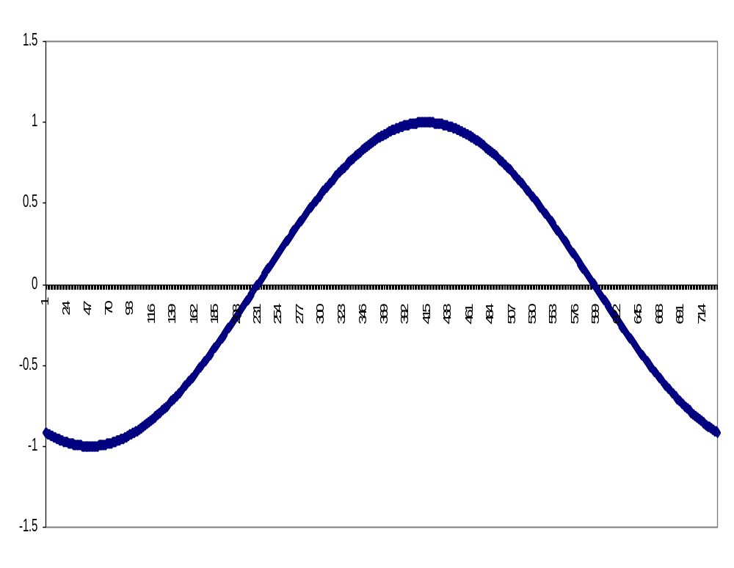
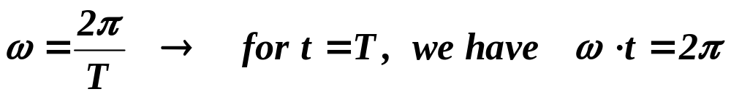

Smoothing the simplest additive form by moving averages
continued
There is a simple example of a seasonal term:
A

Slide 28


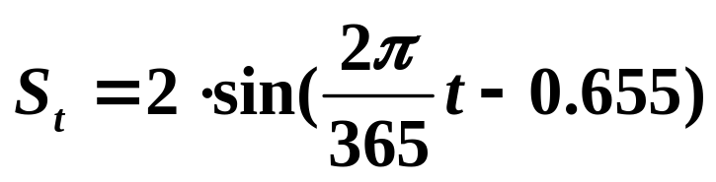

Smoothing the simplest additive form by moving averages
continued
Assume that we measure time “in days” and the season is year,
i.e. (say) T = 365 days.
E. g. and , then
.
Then .
Now we are ready to answer the question:
What is result of smoothing by moving averages
for seasonal term and for cyclic term?

Slide 29
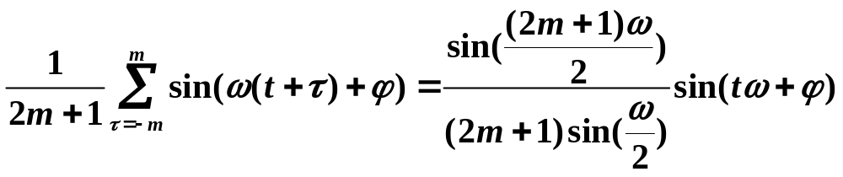


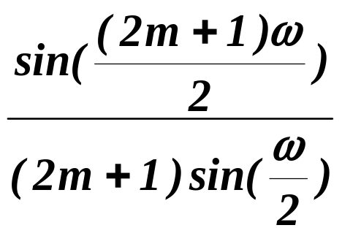
Smoothing the simplest additive form by moving averages
continued
Let us recall (Karel Rektorys, Přehled užité matematiky,
SNTL Praha 1981) :
.
In words: Moving average transforms
the sinusoid with frequency and phase shift
on the sinusoid with frequency and phase shift
but there is a coefficient .
How large is it?

Slide 30
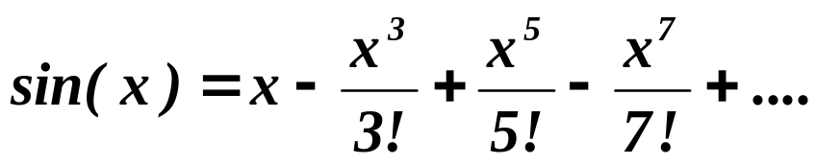
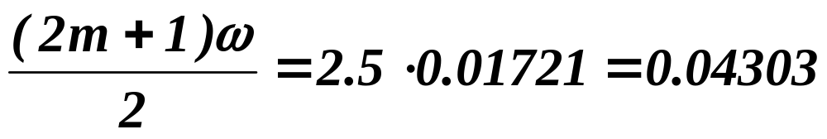
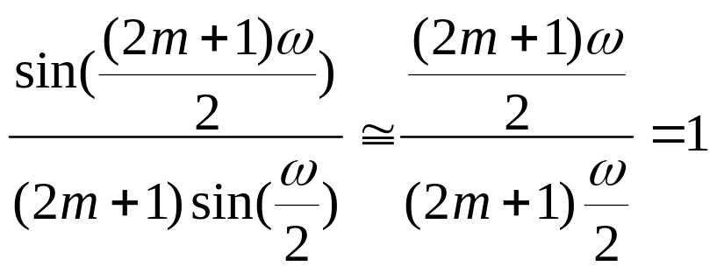
Smoothing the simplest additive form by moving averages
continued
Remember that
e.g. sin(0.06885)=0.0688, sin(0.23238)=0.23030,
etc. sin(0.5)=0.479 .
Remember we have used in the example of smoothing
by moving averages m=2. Then
, i. e.
.

Slide 31
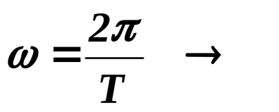
Smoothing the simplest additive form by moving averages
continued
CONCLUSION:
If is small, the seasonal term is contained properly
in the smoothed values of time series – automatically!
When is small?
Remember if we record data
in a large number of points, is small.
Since cyclic part has usually lower frequency than seasonal,
i.e. is smaller than for the seasonal term, the cyclic term
can be assumed to be properly “transformed” into
the smoothed “process”.
So, both the seasonal as well as the cyclic terms are usually
appropriately transferred into the “smoothed” process
by mechanical smoothing.

Slide 32
What is to be learnt from this lecture for exam ?
• Time series and its decomposition
• Smoothing by a function from a given class
• Estimating degree of polynomial smoothing
• Adaptive smoothing by moving averages
• Is the seasonal term overtaken
into the smoothed “series” ?
All what you need is on
http://samba.fsv.cuni.cz/~visek/

