Slide 1

Charles University
Founded 1348

Slide 2
Tuesday, 12.30 – 13.50
Charles University
Charles University
Econometrics
Econometrics
Jan Ámos Víšek
Jan Ámos Víšek
FSV UK
Institute of Economic Studies
Faculty of Social Sciences
Institute of Economic Studies
Faculty of Social Sciences
STAKAN III
Tenth Lecture
(summer term)

Slide 3

Schedule of today talk
A motivation for robust regression
M-estimators in regression
Invariance and equivariance of scale-estimator
Breakdown point
and subsample sensitivity of M-estimators
Evaluation of M-estimators
Regression quantiles

Slide 4
Schedule of today talk
continued
A challenge of finding
high breakdown point estimators in regression
Repeated median
Definition, never implemented
The least median of squares
Definition, properties and evaluation
The least trimmed squares
Definition and properties
Can small change of data
cause a large change of estimator ?

Slide 5
Schedule of today talk
continued
The least trimmed squares
Evaluation: algorithm and its properties
The least trimmed squares
How to apply
The least weighted squares
Definition, properties and evaluation
Debts of robust regression

Slide 6
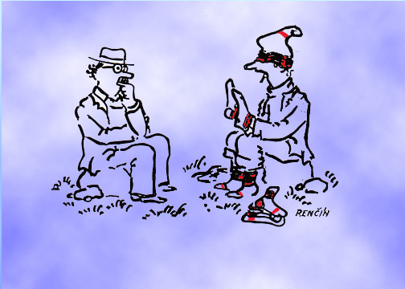
I have red that every man wears, in mean,
8.3 pairs of socks. But I can’t understand how ?

Slide 7
Why robust methods in regression ?
What about to consider
a minimal elipsoid containing
a priori given number of observations.

Slide 8
Why robust methods in regression ?
continued
So the solution seems to be simple !

Slide 9
Why robust methods in regression ?
continued
I am sorry but we have to invent
a more intricate solution.

Slide 10
Recalling that is breakdown point
Minimal number of observations
which can cause that estimator breaks down.
So, for the OLS we have
in fact following situation !

Slide 11
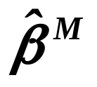
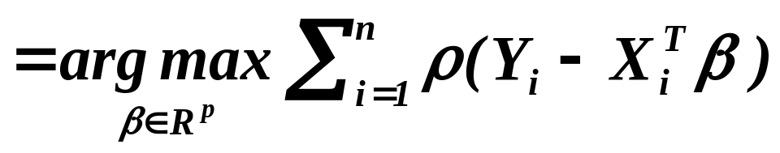
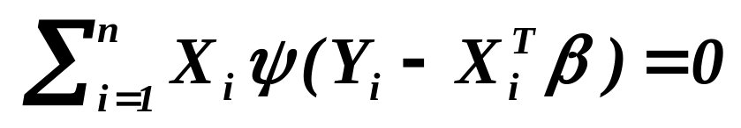

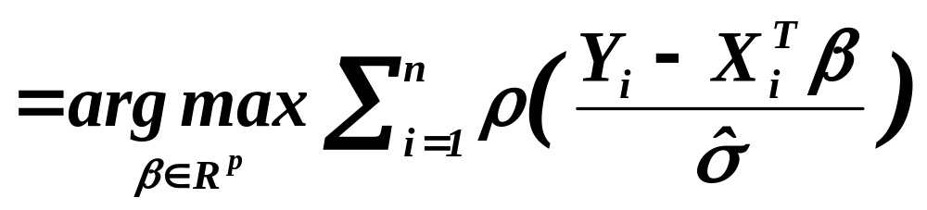
Robust estimators of regression coefficients
M-estimators
Unfortunately they are not scale-
and regression-equivariant
Necessity of studentization by an estimate
of scale of disturbances
however ….

Slide 12

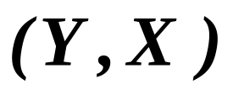
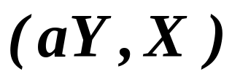

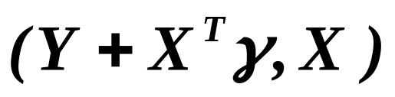

However
- to reach scale- and regression-equivariance of -
the estimator of scale has to be scale-equivariant
and regression-invariaant.
Bickel (1975), Jurečková, Sen (1984)
Equivariance in scale
If for data
the estimate is
,
than for data
the estimate is .
Scale equivariant
Invariance in regression
If for data
the estimate is
,
for data
the estimate is again .
Affine invariant
For see Víšek (1999) - heuristics and numerical study

Slide 13
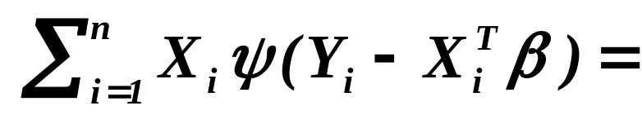



Another spot on beauty
Sensitivity to leverage points
Disappointing result -
- breakdown point equal to .
( is dimension of model )
Maronna and Yohai (1981)
Uncontrollable subsample sensitivity
for discontinuous -function, i.e.

Slide 14
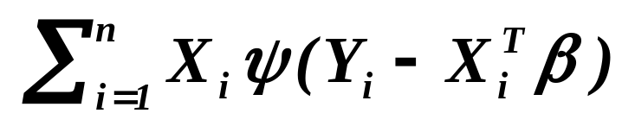
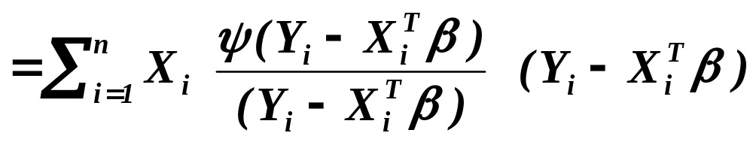
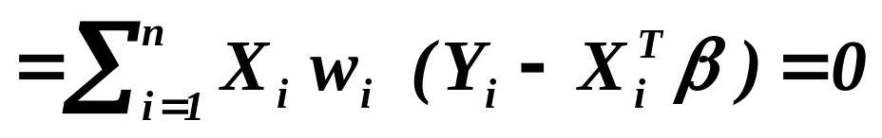
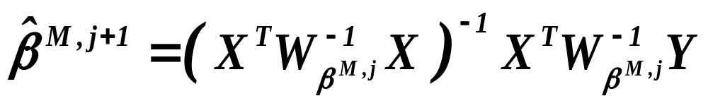
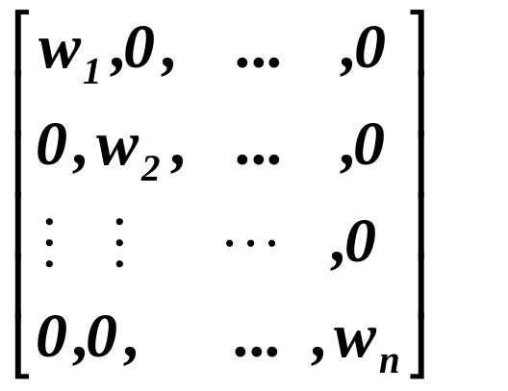



An advantage – M-estimators can be easy evaluated:
E.g. 300 iterations
moves to .
This is in fact the classical
weighted least squares.

Slide 15

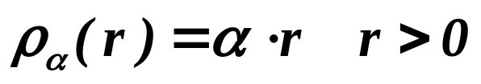
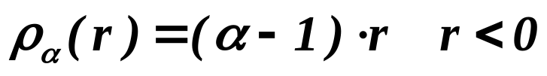

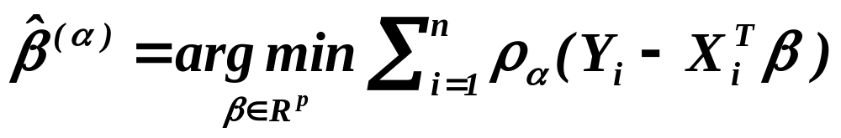
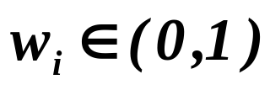
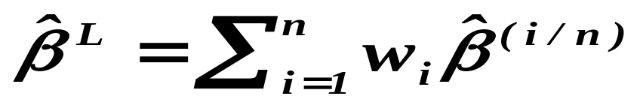
Regression quantiles
Koenker, Bassett (1978)
Regression -quantile
L-estimator & M-estimators
By the way quantiles are the only statistics
which are simultaneously L- and M-estimators.
Šindelář (1991)
L-estimator

Slide 16
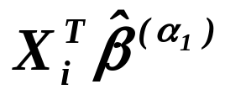
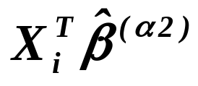
An advantage
Evaluation by means of software
for linear programming.
A disadvantage
Regression quantiles are M-estimators,
hence they are sensitive to leverage points
(and they are not equivariant,
of course, with possibly low breakdown point).
The trimmed least squares
The OLS are applied on the observations,
response variable of which are between
of and .
Ruppert and Carroll (1980)

Slide 17
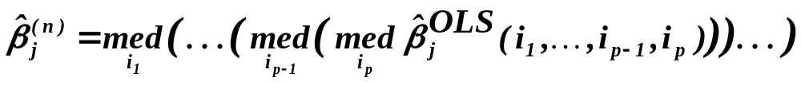
Motto:
Median is 50% breakdown point
estimator of location.
Challenge:
Can we establish an estimator
of regression coefficients
having also 50% breakdown point?
A pursuit lasted since Bickel (1972) to Siegel (1983):
Repeated median
To my knowledge - never implemented

Slide 18
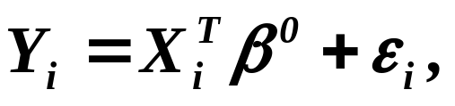


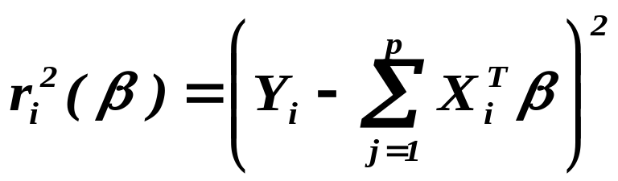
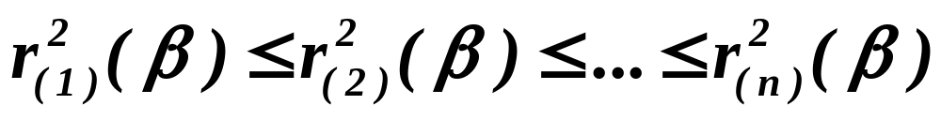


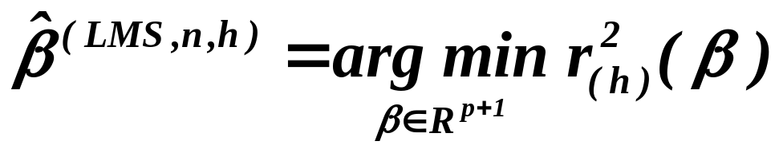

The Least Median of Squares
The first really applicable 50% breakdown point estimator
Rousseeuw (1983)
Let us recall that for any
and let us define the order statistics
.
Then for any
The optimal .

Slide 19

The Least Median of Squares
Continued
Advantages
- evidently 50% breakdown point
- scale- and regression-equivariant
Disadvantages
- only -consistent and not asymptotically normal
- not easy evaluate
First proposal - repeated selection of subsample of p+1 points
Rousseeuw, Leroy (1987) - PROGRESS
Later improved - due to a geometric characterization
Joss, Marazzi (1990)
Still unreliable, usually bad – I’m sorry

Slide 20
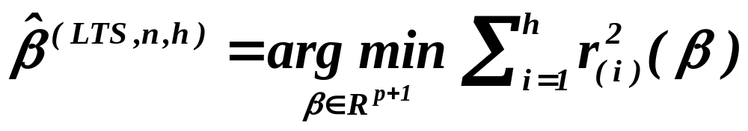
The Least Trimmed Squares
The second applicable 50% breakdown point estimator
Rousseeuw (1983)
Let us recall once again that for any
and that the order statistics are given by
.
Then for any
Again the optimal .

Slide 21

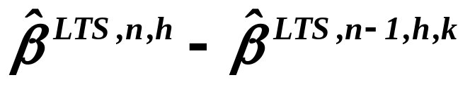
The Least Trimmed Squares
Continued
Advantages
- evidently 50% breakdown point
- scale- and regression-equivariant
-consistent and asymptotically normal
- nowadays easy to evaluate
Disadvantages
- high subsample sensitivity, i.e.
can be (arbitrarily) large
First proposal – based on LMS, in fact, the trimmed least squares.
Rousseeuw, Leroy (1987) – PROGRESS
It did not work satisfactorily, sometimes very bad.
Probably still in S-PLUS, e.g..

Slide 22
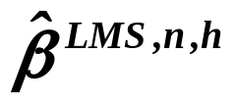
Hettmansperger, T.P., S. J. Sheather (1992):
A Cautionary Note on the Method of Least Median Squares.
The American Statistician 46, 79--83.
Engine knock data - 16 cases, 4 explanatory variables
- a small change of data
caused a large change of .
Evaluated by S-PLUS
A first reaction:
The robust methods probably work in another way
than we have assumed – disappointment !!
A new algorithm was nearly immediately available.
Boček, P., P. Lachout (1995):
Linear programming approach to LMS-estimation.
Mem. vol. Comput. Statist. & Data Analysis 19(1995), 129 - 134.
It removed the “paradox”.

Slide 23

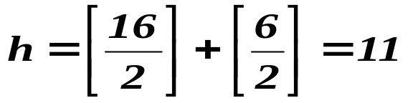
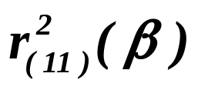
Engine knock data
Number of observations: 16
Response variable: Number of knocks of an engine
Explanatory variables:
- the timing of sparks
ratio air / fuel
intake temperature
exhaust temperature
Method | Intrc. | spark | air | intake | exhaust | •
Progress | -86.5 | 4.59 | 1.21 | 1.47 | .069 | .328
Boček | 48.4 | -.732 | 3.39 | .195 | -.011 | .203

Slide 24
The second reaction:
A small change of data can really cause
a large change of any high breakdown point estimator.
Let us agree, for a while,
that the majority of data determines the “true” model.
Then
What is the problem ?
The method too much relies on selected “true” points !

Slide 25
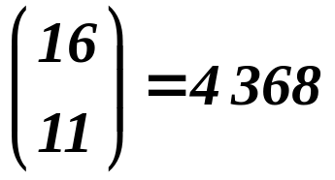
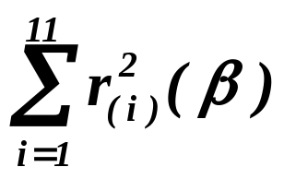

Engine knock data
Number of observations: 16,
hence number of all subsamples of size 11 is ,
so for this case we may find
the precise solution of the LTS-extremal problem,
just applying OLS on all subsamples of size 11.
by Boček and Lachout
Method | Intrc. | spark | air | intake | exhaust
LMS | 48.4 | -.732 | 3.39 | .195 | -.011 | 1.432 | .203
LTS | -88.7 | 4.72 | 1.06 | 1.57 | .068 | .728 | .291
Since Boček-Lachout LMS is “better” than precise LTS,
it is probably really good.

Slide 26
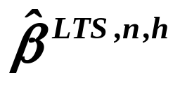
Algorithm for for the case when n is large.
A
Select randomly p+1 observations
and find regression plane through them.
Evaluate squared residuals for all observations.
Choose h observations with the smallest squared resi-
duals and evaluate the sum of these squared residuals.
Is this sum of squared residuals smaller than
the sum from the previous step?
No
Yes
Apply OLS on just selected observations,
i.e. find new regression plane.
B

Slide 27
Algorithm for the case when n is large.
Continued
B
Have we found already 20 identical models
or have we exhausted a priori given number
of repetitions ?
Yes
No
End of evaluation
Return to A

Slide 28
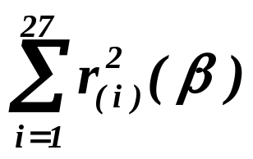
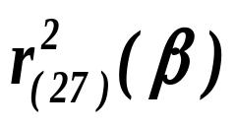
A test of algorithm - Educational data
Number of observations: 50,
hence number of all subsamples of size 27 is too large
so we have to use just described algorithm.
Response: Expenditure on education
per capita in 50 U.S. states in 1970
Explanatory: percentage of residents in urban areas,
personal income per capita, percentage of inhabitants under 18
by Boček and Lachout
Method | Intrc. | urban | income | young
LMS | -272.4 | .090 | .034 | .962 | 3734.8 | 281.6
LTS | -143.5 | .043 | .035 | .639 | 3414.5 | 362.5
h selected according to “optimal choice”, giving 50% breakdown
point

Slide 29
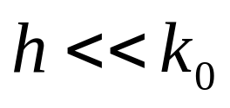

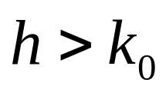

How to select h reasonably?
Number of points of this „cloud“ is .
is only a “bit” smaller than

Slide 30
Algorithm for the case when n is large
is described in:
Víšek, J.Á. (1996): On high breakdown point estimation.
Computational Statistics (1996) 11, 137 – 146.
Víšek, J.Á. (2000): On the diversity of estimates
Computational Statistics and Data Analysis, 34, (2000),
67 – 89.
Čížek, P., J. Á. Víšek (2000): Least trimmed squares.
XPLORE, Application guide, 49 – 64.
One implementation is available in package
XPLORE (supplied by Humboldt University),
TURBO-PASCAL-version from me, MATLAB
version from my PhD-student Libora Mašíček.

Slide 31
Disadvantage of LTS
High subsample sensitivity, i.e.
can be rather large
(without control by design of experiment)
Víšek, J.Á. (1999):
The least trimmed squares - random carriers.
Bulletin of the Czech Econometric Society,
10/1999, 1 - 30.
See also
Víšek, J.Á. (1996):
Sensitivity analysis of M-estimates.
Annals of the Instit. of Statist. Math. 48 (1996), 469 – 495.
Sensitivity analysis of M-estimates
of nonlinear regression model: Influence of data subsets.
Annals of the Institute of Statistical Mathematics, 261 - 290, 2002.

Slide 32
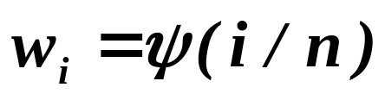
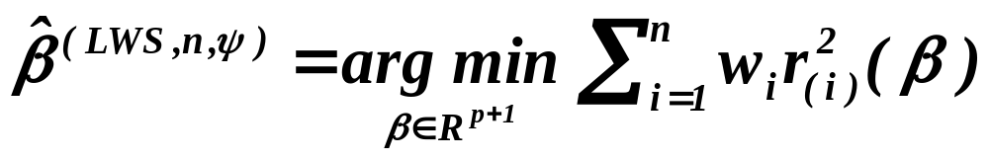
Disadvantege of LTS ……
Hence
The Least Weighted Squares
non-increasing
Víšek, J.Á. (2002):
The least weighted squares I. The asymptotic linearity of normal equations.
Bulletin of the Czech Econometric Society, no.15, 31 - 58, 2002.
The least weighted squares II. Consistency and asymptotic normality.
Bulletin of the Czech Econometric Society, no. 16, 1 - 28, 2002.

Slide 33
Classical OLS developed :
- diagnostic tools for verifying the assumptions
(of course, a posteriori),
e.g. test of normality (firstly Theils residuals,
later usual tests of good fit, Durbin-Watson
statistics, White tests of homoscedasticity,
Hausman test of specification etc.,
- carried out sensitivity studies, i.e.
- offers a lot of modifications of OLS
and / or accompanying tools,
e.g. ridge regression, instrumental variables,
White estimate of covariance matrix of estimates
of regression coefficients,probit and logit models, etc. .

Slide 34
May be that one reason why the robust methods
are not widely used is the debt of ……
(see previous slide).
Something is already done also for robust methods :
Robust instruments.
Robust'98 (ed. J. Antoch & G. Dohnal, Union of Czechoslovak
Mathematicians andPhysicists), 1998, pp. 195 - 224.
Robust specification test.
Proceedings of Prague Stochastics'98 (eds. M. Hušková, P. Lachout, Union
of Czechoslovak Mathematicians andPhysicists), 1998, pp. 581 - 586.
Over- and underfitting the M-estimates.
Bulletin of the Czech Econometric Society, vol. 7/2000, 53 - 83.
Durbin-Watson statistic for the least trimmed squares.
Bulletin of the Czech Econometric Society, vol. 8, 14/2001, 1 – 40.

Slide 35
What is to be learnt from this lecture for exam ?
• Main reasons for constructing
robust estimators for regression model
- influence of outliers and leverae points
• M-estimators in regression,
their breakdown point and evaluation
• The least median of squares
• The least trimmed squares, their evaluation
and selection of number of residuals
to be taken into account
• The least weighted squares
All what you need is on
http://samba.fsv.cuni.cz/~visek/

Slide 36

THANKS for ATTENTION

