Slide 1

Tuesday, 12.30 – 13.50
Charles University
Charles University
Econometrics
Econometrics
Jan Ámos Víšek
Jan Ámos Víšek
FSV UK
Institute of Economic Studies
Faculty of Social Sciences
Institute of Economic Studies
Faculty of Social Sciences
STAKAN III
Third Lecture
(summer term)

Slide 2

Plan of the whole year
Regression models for various situations
● Division according to character of data
(with respect to time):
* Cross-sectional data (winter term)
* Panel data (summer term)

Slide 3
Plan of the whole year
Regression models for various situations
● Division according to character of variables
* Continuous response
(and nearly arbitrary) explanatory variables
(winter and part of summer term)
* Qualitative and limited response
(and nearly arbitrary) explanatory variables
(summer term)

Slide 4
Plan of the whole year
Regression models for various situations
● Division according to contamination of data
* Classical methods, neglecting contamination
(winter and most of of summer term)
* Robust methods
(three lectures in summer term)

Slide 5
Schedule of today talk
● The Generalized Least Squares
● Modeling time series by AR(p) and MA(q)
* Stationarity, Dickey-Fuller tests of unit roots
* Convertibility
* Moments and covariance matrices

Slide 6
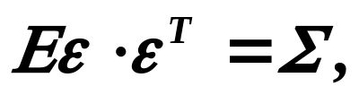


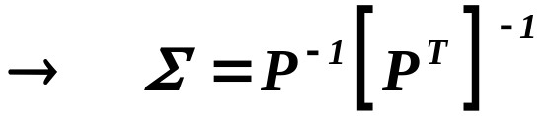
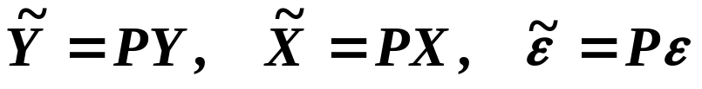
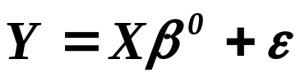

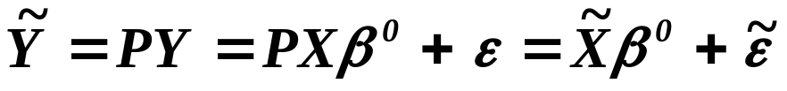
The Generalized Least Squares
Let us assume that
- regular,
i.e. homoscedasticity is broken.
- regular and symmetric
and put
.
multiplying the basic model from the left
by
.

Slide 7

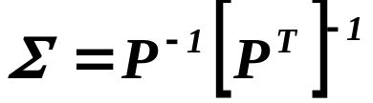

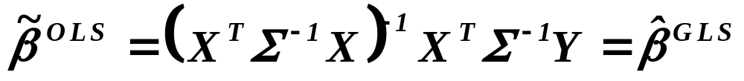
continued
The Generalized Least Squares
For we have
,
i.e. we have reached homoscedasticity. Then
.
Recalling that
,
i. e.
Generalized Least Squares

Slide 8
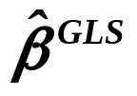
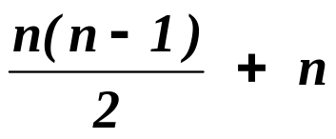

continued
The Generalized Least Squares
What is problem with application of ?
contains of unknown elements
above the diagonal
on the diagonal
which cannot be estimated due to the fact that we have
at hand only observations !
But sometimes we know the structure of
and moreover it can be determined by a few parameters !!

Slide 9
Modeling time series by stochastic models
- Box-Jenkins methodology
Box, G. E. P., G. M. Jenkins: Time Series
Analysis, Forecasting and Control.
Holden Day, San Francisco, 1970.
Judge, G.,G., W.,E. Griffiths, R.C. Hill,
H. Lutkepohl, T.,C. Lee:
The Theory and Practice of Econometrics.
J.Wiley and Sons, New York, 1985.
Recommended
Cipra, T.: Analýza časových řad s aplikacemi v ekonomii.
SNTL/ALFA, Praha, 1986.
Brockwell, P. J., R. A. Davis:
Time Series: Theory and Methods.
Springer Verlag, New York, 1991.

Slide 10
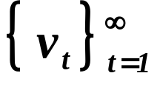
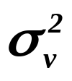
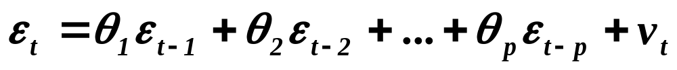
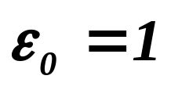
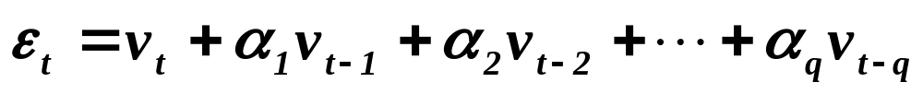
Modeling time series by AR(p) and MA(q)
continued
Let be a sequence of i.i.d. r.v.’s. with zero mean and
variance equal to . Then put
(1)
with . The sequence of r.v.’s given by (1) is called
autoregressive process of order p and denoted by AR(p).
Put also
(2)
The sequence of r.v.’s given by (2) is called moving -average
process of order q and denoted MA(q). Finally, put
(3)

Slide 11
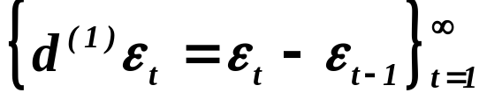
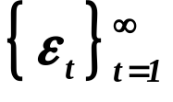
Modeling time series by AR(p) and MA(q)
continued
The sequence of r.v.’s given by (3) is called autoregressive
moving -average process (of order (p,q)) and denoted by
ARMA(p,q).
If the process is ARMA(p,q), then
the original process is called the integrated
autoregressive moving-average process (of order (p,1,q) )
and denoted by ARIMA(p,1,q).

Slide 12
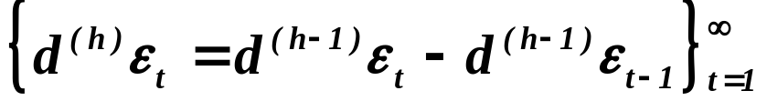
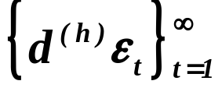
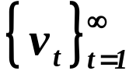

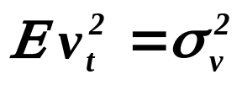
Modeling time series by AR(p) and MA(q)
continued
Put
If the process is ARMA(p,q), then the original
process is called the integrated autoregressive
moving-average process of order (p,h,q) and denoted
by ARIMA(p,1,q).
Assumption:
is i.i.d. r.v.’s with and .

Slide 13
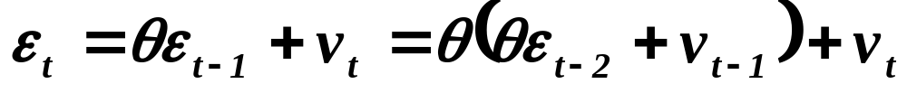



Modeling time series by AR(p) and MA(q)
continued
A very first question is, of course, how far the autoregressive
processes can be expressed as moving average and vice versa ?
For simplicity, consider AR(1) :
So we may say that is “dual” to .
( Notice that the “dual” description is much more complicated. )

Slide 14


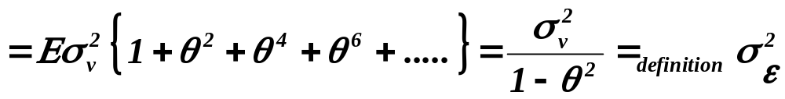
Modeling time series by AR(p) and MA(q)
continued
It immediately gives two results:
Firstly (moments of )
for

Slide 15
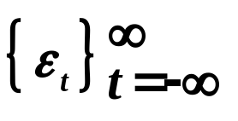
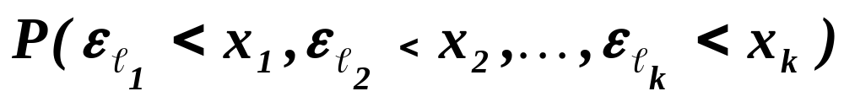
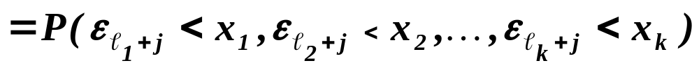
Modeling time series by AR(p) and MA(q)
continued
Secondly (conditions of stationarity for )
Let’s recall stationarity
DEFINITION
The sequence of r.v.’s is called stationary if
(this definition is easier to understand)
alternatively

Slide 16
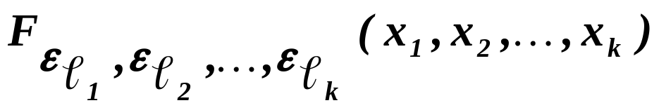
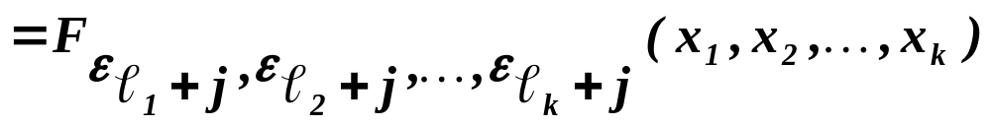
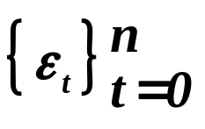
Modeling time series by AR(p) and MA(q)
continued
DEFINITION
The sequence of r.v.’s is called stationary if
(this definition is usually employed)
Of course, our sequence is not infinite on both sides,
hence the definition is to be applied in a bit modifies way.
Remark
Assuming sequence to be stationary, of course requires
some modification of the definitions.

Slide 17
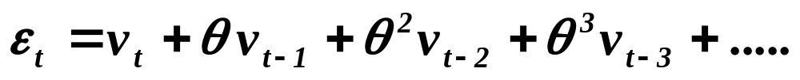
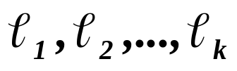
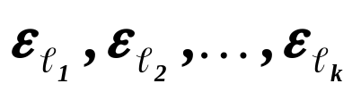

Modeling time series by AR(p) and MA(q)
continued
Returning to
,
we immediately observe that only for the variance is
finite and hence it has any sense to speak about some
distribution.
Now, return to
,
consider any k-tuple of indices and corresponding
k-tuple of r.v.’s and find ( it is sufficient in mind )
the structure of r.v.’s which generated .

Slide 18
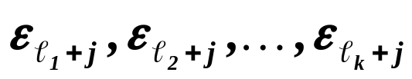
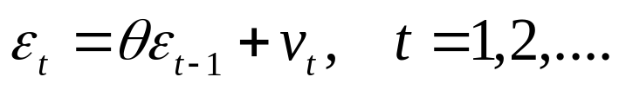
Modeling time series by AR(p) and MA(q)
continued
Finally, do the same for and find that
the both structures of r.v.’s are the same but shifted about
j. Since are i.i.d., the d.f. of both k-tuples,
and
,
are the same ( for any fixed j ). So, if , the sequence
,
is stationary.

Slide 19
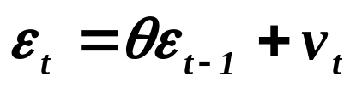


Modeling time series by AR(p) and MA(q)
continued
Let us look for a general condition for stationarity.
We may take an analogy to the equation
the polynomial .
Then , if , the solution of the polynomial ( in z )
has to be in absolute value larger that 1.
In other words, if solution of , is larger than 1,
‘s are stationary.

Slide 20

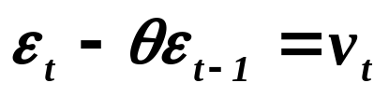
Modeling time series by AR(p) and MA(q)
continued
Similarly (and alternatively), the solution of the equation
which can be viewed as an analogy to
has to be in absolute value less that 1.
So again, if solution of , is less than 1,
‘s are stationary.

Slide 21

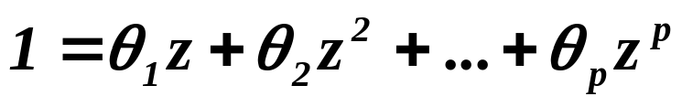
Modeling time series by AR(p) and MA(q)
continued
For general we conclude, in analogy with
,
that all roots of the polynomial
( 4 )
have to be in absolute value ( notice that they are generally
complex numbers ) larger than 1.

Slide 22
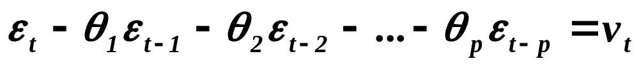
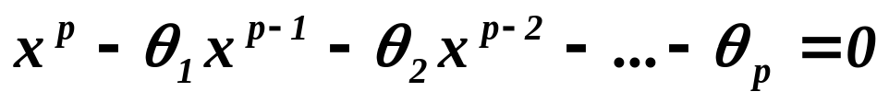
Modeling time series by AR(p) and MA(q)
continued
Again alternatively,
all roots of the polynomial
( 5 )
have to be in absolute value less than 1.
The conditions ( 4) and (5) are called
“Conditions of stationarity”
( of course, they are equivalent).

Slide 23


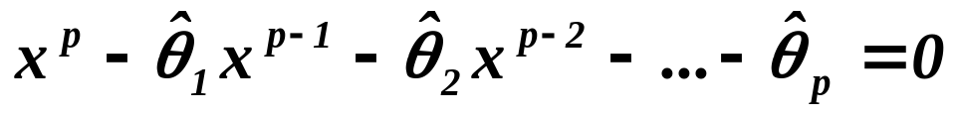


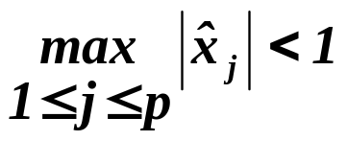
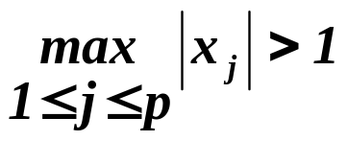
Modeling time series by AR(p) and MA(q)
continued
We have not at hand ‘s but “only” ‘s, so that we solve
and obtain, say, instead of . But
even if , we can have . Hence
we have to test whether statistically significantly.
The test is known as the “Test on unit roots”. The best known
is Dickey-Fuller test.

Slide 24
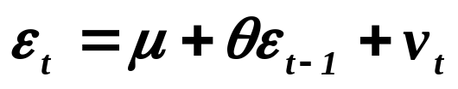
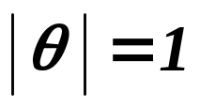

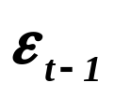
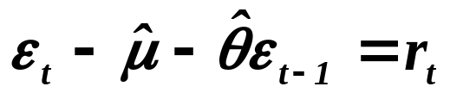

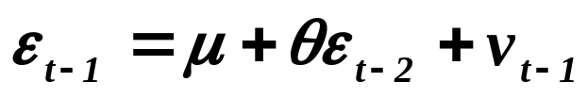
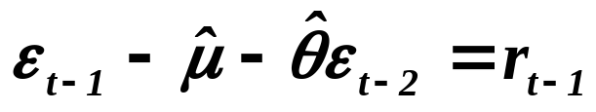

Modeling time series by AR(p) and MA(q)
continued
Dickey-Fuller test – for AR( 1 )
t-test of significance that . Since and
are not independent, we cannot use “classical” student test.
D. A. Dickey and W. A. Fuller (1979) made Monte Carlo study
and tabulated the critical values. An alternative
Augmented Dickey-Fuller test – for AR( 1 )
and test of significance whether .

Slide 25
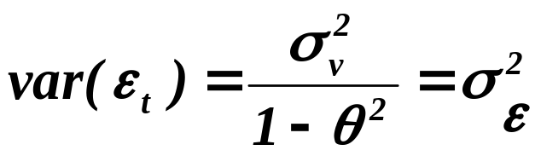
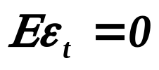


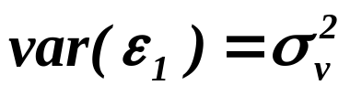



Modeling time series by AR(p) and MA(q)
continued
We already know that for AR( 1)
and for
and
and .
That is why we define (frequently)
and
.
Moreover,

Slide 26


Modeling time series by AR(p) and MA(q)
continued
.
So the covariance matrix is given as
.

Slide 27


Modeling time series by AR(p) and MA(q)
continued
and the inversion as
where
( We shall need it later. )

Slide 28








Modeling time series by AR(p) and MA(q)
continued
It is easy to verify that the inversion matrix given on the previous
slide is really inversion of . We have for the product of k-th
line of and of the ( transposed ) j-th row of ( )
1st coor.
2nd coor.
coor.
coor.
coor.
.
Similarly for .

Slide 29




Modeling time series by AR(p) and MA(q)
continued
For , i.e. for the product of k-th line of
and of the ( transposed ) k-th row of we have
1st coor.
2nd coor.
coor.
coor.
coor.
.
Along similar lines we verify that .

Slide 30






Modeling time series by AR(p) and MA(q)
continued
Let us move to MA( 1 ).
and
,
,
but and hence
etc.
So,
.
( Notice that the “dual” description is again much more
complicated. )

Slide 31



Modeling time series by AR(p) and MA(q)
continued
An analogy (or counterpart?) to the condition of stationarity for
AR( p ), there is a condition of invertibility of MA( q ) which reads:
All roots of the polynomial
have to be outside unit circle.
The condition has following sense:
DEFINITION
Let L be operator of the back-shift, i.e. for any we have
.
( The letter “L” went from “lagged” value of .)

Slide 32





Modeling time series by AR(p) and MA(q)
continued
We shall use the operator L (rather formally) in the following way
.
Returning to the MA( 1 ) and changing the sign of (but only
this moment of explanation of condition of invertibility), we have
and then
.
Assuming now that , we can the sum of the geometric series,
namely , write as
,
i.e.

Slide 33


Modeling time series by AR(p) and MA(q)
continued
and finally
.
During the derivation of the result, we have needed ,
i.e. solution of
has to be larger than 1.
Unlike for AR( p ), for MA( q ) we can easy ( without any “dual”
representation ) evaluate moments and covariance matrix.
Clearly,
and

Slide 34






Modeling time series by AR(p) and MA(q)
continued
In a similar way ( assume )

Slide 35






Modeling time series by AR(p) and MA(q)
continued
for
,
otherwise.
Specifying it for MA( 1 )
,
and
.

Slide 36




Modeling time series by AR(p) and MA(q)
continued
There are at least two or three problems:
Firstly
Why we study both AR( p ) and MA( q ), when we can convert
on and vice versa, i.e. on ?
Secondly
How to recognize that there is some dependence in the series ?
Thirdly
Which type of dependency took place? How large p or q is ?
We’ll answer them successively in the next lecture.

Slide 37
What is to be learnt from this lecture for exam ?
• The Generalized Least Squares
• AR(p), MA(q), ARMA(p,q), ARIMA(p,h,q)
• Convertibility
• Stationarity
- conditions for stationarity,
- Dickey-Fuller test – for AR( 1 ),
- augmented Dickey-Fuller test – for AR( 1 )
• Moments and covariance matrices
All what you need is on
http://samba.fsv.cuni.cz/~visek/

