Slide 1

Tuesday, 12.30 – 13.50
Charles University
Charles University
Econometrics
Econometrics
Jan Ámos Víšek
Jan Ámos Víšek
FSV UK
Institute of Economic Studies
Faculty of Social Sciences
Institute of Economic Studies
Faculty of Social Sciences
STAKAN III
Ninth Lecture

Slide 2

Schedule of today talk
We will have the only topic:
(Multi)collinearity
What is it ?
What are the consequences of (multi)collinearity ?
How to recognize (multi)collinearity?
What remedies can be prescribed ?
Prior to answering these questions,
we have find replays to the following ones:

Slide 3

What happens if the design matrix is not of full rank ?
What happens if the matrix is “nearly” singular ?
How to recognize it ?
We shall answer the first question, then the third one
and, as the last but not least of course,
the second one !
We shall see later why!

Slide 4
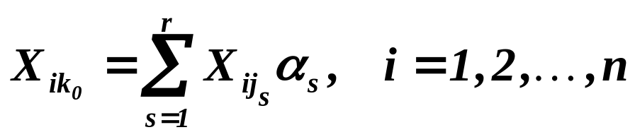
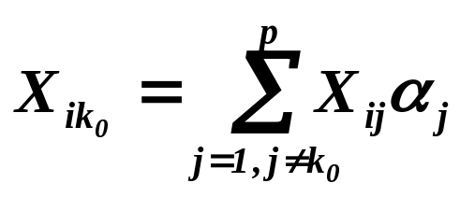

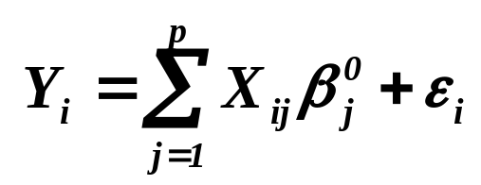
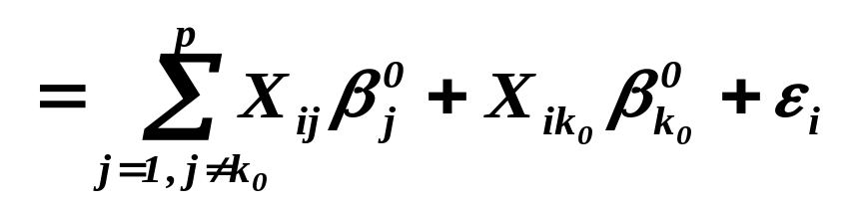
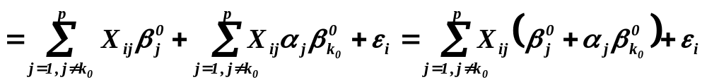
( Multi )collinearity
What happens if the design matrix is not of full rank ?
Assumptions
Then , let us write for
sake of simplicity with some ‘s being zero.
Assertions
Then
If the design matrix is not yet of full rank, we repeat the steps,
we’ve just demonstrated, up to reaching the full-rank-matrix.

Slide 5
What happens if the design matrix is not of full rank ?
Continued
The answer is simple:
NOTHING,
we just exclude the “dependent column” !!
We didn’t yet answer the question: What is (multi)collinearity!
Please be patient, we shall do it at the proper time!

Slide 6






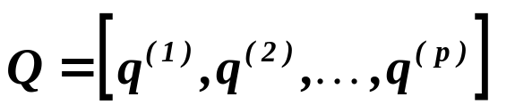

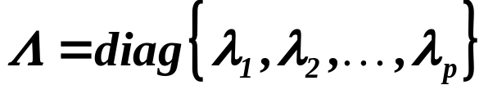


Now it seems natural to answer the question:
What happens if the matrix is “nearly” singular ?
I.e., if one column of is “nearly” a linear combination of others.
Nevertheless, it is better to start with:
How to recognize it ?
“Assumptions”
is real symmetric and regular
Assertions
spectral decomposition
 matrices and , both regular :
and .
: - eigenvectors of ,
: - eigenvalues of

Slide 7




( Multi )collinearity
How to recognize it ?
preliminary considerations
Let us recall that is real symmetric and regular. Hence
there are matrices and , both regular so that
and
( : - eigenvectors of ,
: - eigenvalues of
)
Regularity of 
 is positive definite
positive definite 
All ‘s are positive.

Slide 8


How to recognize it ?
Spectral decomposition 
with
So, we have found: Regularity of  all .
Singularity of  some .
Conclusion :
is “nearly” singular, some ‘s are “nearly” zero
Is it really so, or not?

Slide 9
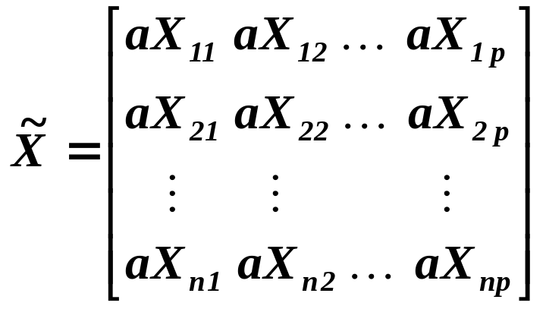

How to recognize it ?
Continued
Consider instead of the matrix
.
E.g. instead of giving FDI in millions of $ ,
we’ll give it in thousands of $ , etc. .
is still “nearly” singular - no change !!!
E.g. one column of is still “nearly” a linear combination of others.
But
.
The eigenvalues can be arbitrarily large. But .....

Slide 10
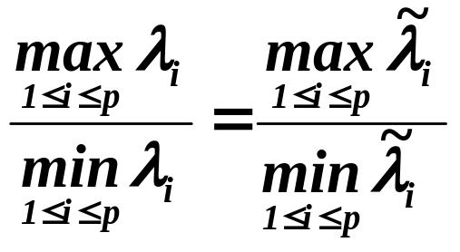
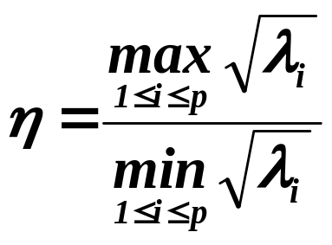
How to recognize it ?
Continued
But their ratio is stable, i.e.
.
So, we can define:
Condition number ( index podmíněnosti )
:
eigenvalues of .

Slide 11

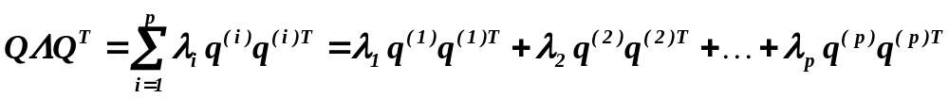
How to recognize it ?
Continued
Statistical packages usually don’t offer
the condition number
directly.
Factor analysis
Notice:
The matrix is ( up to the multiplication by )
empirical covariance matrix of the data .
Factor analysis finds the spectral decomposition
( A demonstration in STATISTICA should be given. )

Slide 12
( Multi )collinearity
Definition:
If some column(s) of the matrix is (are) “nearly”
a linear combination of other columns, we call it
(multi)collinearity.
The round parentheses indicate that sometimes we speak about
collinearity, sometimes about multicollinearity ( two dimension-
al  multidimensional case ?? ).
The words “collinearity” and “multicolinearity” means the same !!
In some textbooks the case when one column of is just
a linear combination of others, is called also (multi)collinearity
or perfect (multi)collinearity, e.g. Jan Kmenta.

Slide 13

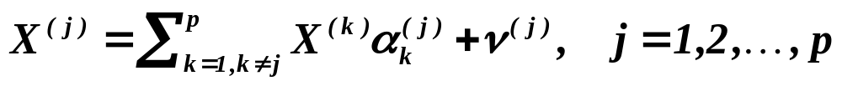
( Multi )collinearity
Continued
How to recognize it ?
Instead of the condition number the packages sometimes offer
something else, e.g. “redundancy”. It is usually a table of
the coefficients of determination of following regression models.
Recalling:
In the Second Lecture 
the j-th column of the matrix X
Let us consider the models
and their coefficients of determinations.

Slide 14
( Multi )collinearity
Continued
How to recognize it ?
If the coefficient of the j-th model is (very) large,
j-th explanatory variable can be very closely approximated
by a linear combination of some other explanatory variables
 collinearity.
The branch (or table) of statistical package
which it offers is usually called “redundancy”.
( There are cases when it fails !!)
What about to use the determinant of the matrix ,
to diagnose the collinearity?

Slide 15
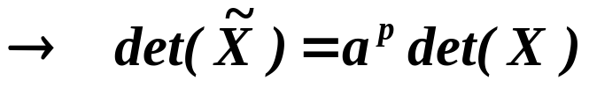
( Multi )collinearity
Continued
How to recognize it ?
We can assume that if matrix is nearly singular, its deter-
minant is nearly zero. Considering once again the matrix
However the “level of collinearity” does not change
but the determinant can be made arbitrarily large.
The determinant of the matrix
as an indicator of collinearity definitely failed !!

Slide 16
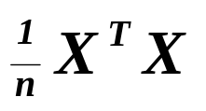
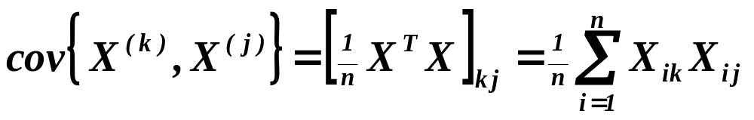
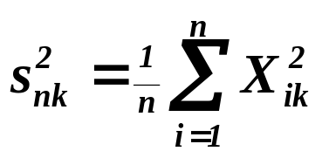
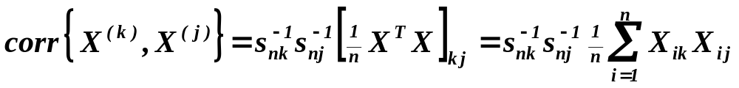
( Multi )collinearity
Continued
How to recognize it ?
Nevertheless, let us recall that the matrix
is the empirical covariance matrix of data .
Really, ( the j-th column of )
.
Putting , we have
.

Slide 17
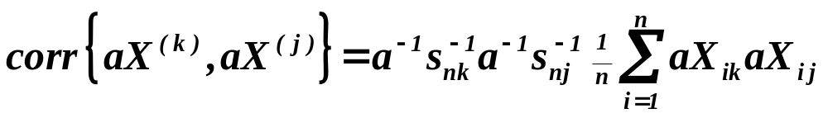
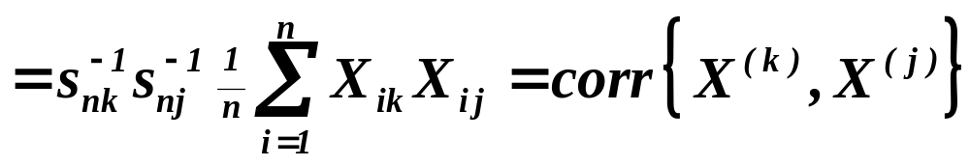
( Multi )collinearity
Continued
How to recognize it ?
Making the “trick” with multiplying all elements of
the matrix by a , we arrive at
.
The determinant of the correlation matrix of data
can serve as an indicator of collinearity.
Farrar-Glauber test
The critical values were derived under the assumption of nor-
mality of disturbances and hence it may be “biased”, pretty well.

Slide 18
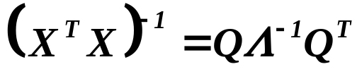
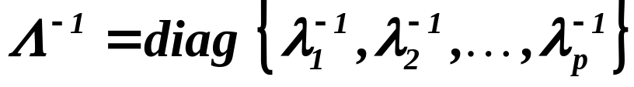
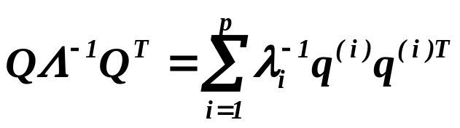

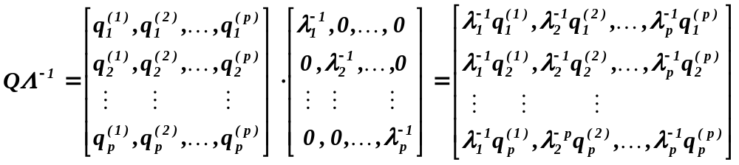
( Multi )collinearity
Continued
What happens if the matrix is “nearly” singular ?
Then
: .
Let us verify that
.
First of all, let us find what is .

Slide 19
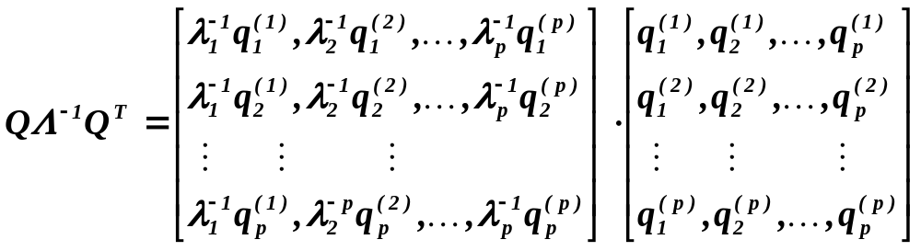
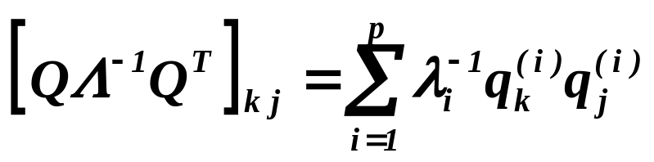
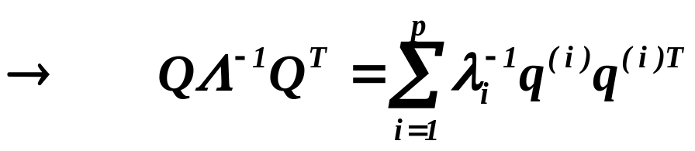
( Multi )collinearity
Continued
What happens if the matrix is “nearly” singular ?
.

Slide 20
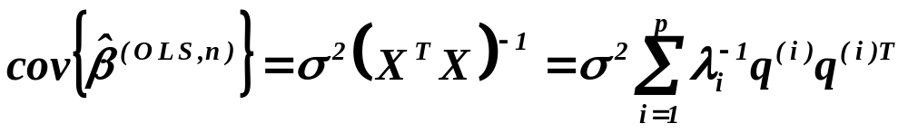
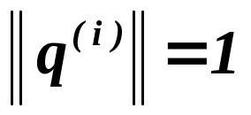
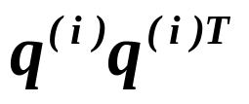
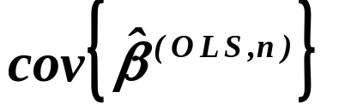
( Multi )collinearity
Continued
What happens if the matrix is “nearly” singular ?
So we have
Assertion
.
Assuming , the matrices are
“approximately of the same magnitude”.
The smaller eigenvalue is,
the larger contribution to !!!

Slide 21



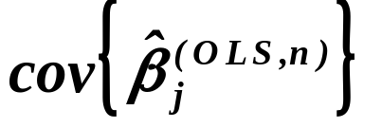


Conclusion
(Multi)collinearity can cause that the variance of
the estimates of regression coefficients can be pretty large.
What is a remedy ?
Remark :
The “increase” or “decrease” of by
 “decrease” or “increase” of by
 “decrease” or “increase” of by
for all
What is a remedy ?
To consider normed data !!
Of course, the interpretation of coefficients
need not be straightforward !!!

Slide 22



The question should be:
What is a remedy for given level
of the the condition number ?
Condition number > 100
 (at least) one column of has to be excluded
Condition number (10 (30), 100)
 a special treatment (see below) is to be applied
Condition number < 10 (30)
 everything is O.K. – there is nothing to be done

Slide 23
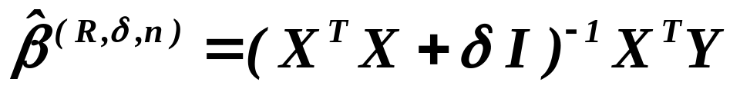
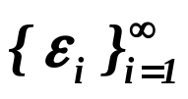
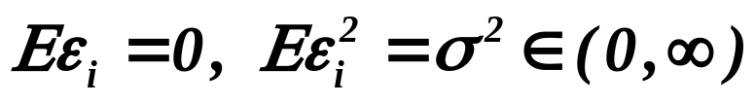
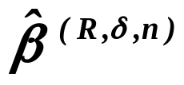
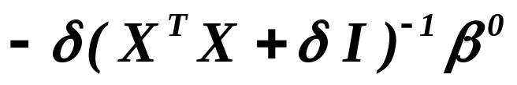
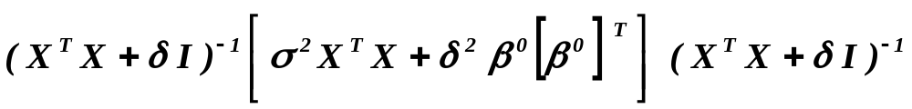
First possible treatment of collinearity
A.E.Hoerl, R.W.Kennard
1970
Ridge regression
(hřebenová regrese)
Lemma
Assumptions
Let be iid. r.v’s, .
Assertions
Bias of is and the matrix
of the mean quadratic deviations ( MSE ) has the form
.

Slide 24
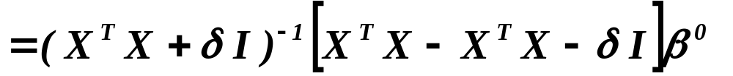
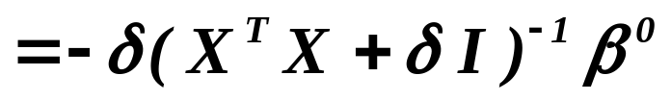
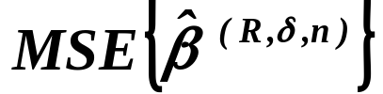



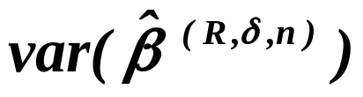
Bias
Proof of previous
lemma
Two preliminary computations – for .
Firstly
,
since
.
Putting and , this is the bias .
Secondly, let us find .

Slide 25

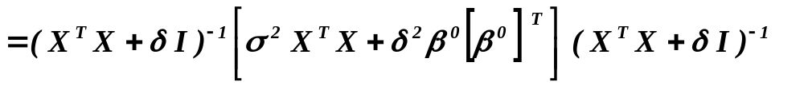
Proof - continued
We have
,
hence
Finally

Slide 26

UNBIASED OR BIASED?
William Shakespeare
An unbiased estimator
A biased estimator
(has a pretty large variance)
90% confidence
interval, although contain-
90% confidence
ing the true value,
interval is much shorter
is rather wide.
and contains the true
value, too.

Slide 27
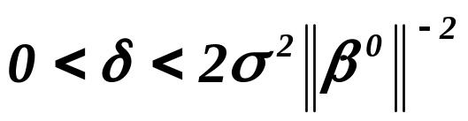
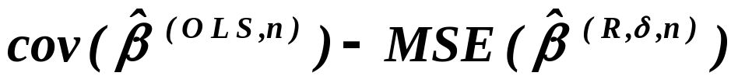



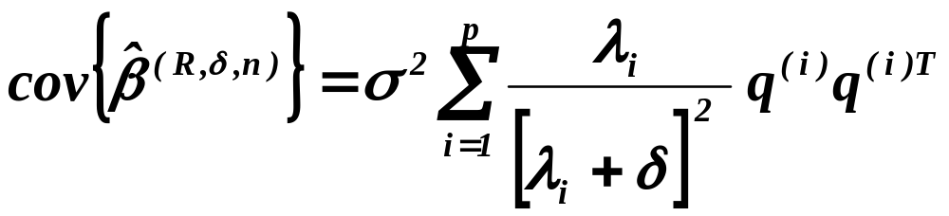
Lemma
Assumptions
Let be iid. r.v’s, ,
has full rank and .
Assertions
Then
is positive definite matrix.
Assertion
Assumptions
Proof is long and rather technical, hence it will be omitted.
Let ‘s and ‘s be eigenvalues and eigenvectors of ,
respectively.
Assertions
Then
.
Proof is only a “computation”.

Slide 28
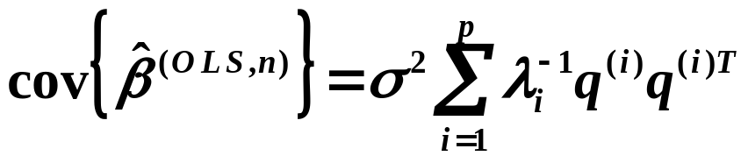
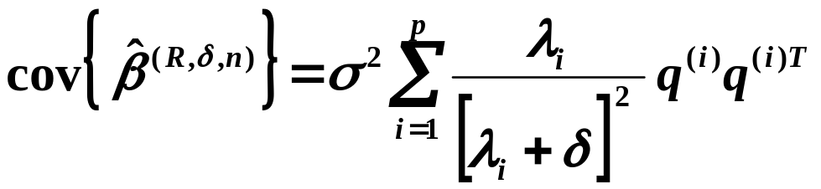

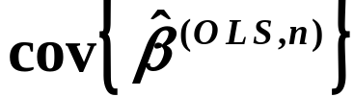




Let us compare
An example
If (minimal) , then the corresponding contribution to
is , while for this con-
tribution to is only .

Slide 29
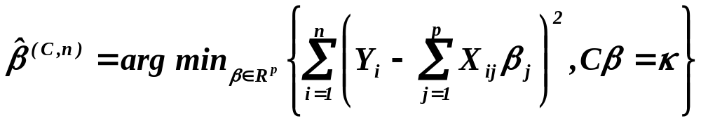


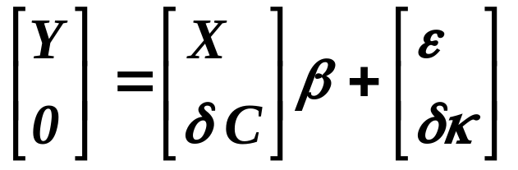

Another possibility of treating collinearity
Regression with ( linear ) constraints
( regrese s ( lineárními ) ohraničeními )
An observation
Assuming random  for
we have
.
It indicates that a theory, similar to the theory
for ridge-regression-estimator, can be derived.

Slide 30

















Another possibility of treating
regression with ( linear ) constraints
Lemma
Assumptions
Let be matrix of type .
Assertions
Then for all and any matrix of type there is
and a matrix of type and a one-to-one
mapping
such that for any we have
.
Proof
of type
so that
is regular and

Slide 31











Another possibility of treating
regression with ( linear ) constraints
Proof - continued
Let
and for any put
.
Then
.
If
and
As
is regular
linearly independent rows of
create regular matrix (of type )
i.e. is one-to-one

Slide 32





Another possibility of treating
regression with ( linear ) constraints
Proof - continued
i.e.
is on
.
Finally for any we have for and
This is residual for original data
but restricted parameters
This is residual for transformed
data and unrestricted parameters
Remember : is “on”

Slide 33



Another possibility of treating
regression with ( linear ) constraints
“Remarks” at the bottom of previous slide

Slide 34





Are there any realistic example of
regression with ( linear ) constraints
Combining forecasts of time series
Bates, J. M., C. W. J. Granger (1969): The combination of forecasts.
Operational Research Quarterly, 20, 451-468.
Granger, C. W. J. (1989): Invited review: Combining forecasts -twenty years later.
Journal of Forecasting, 8, 167-173.
Clemen, R. T. (1986): Linear constraints and efficiency of combined forecasts.
Journal of Forecasting, 6, 31 - 38.

Slide 35








It may be of interest ...
Bayesian estimate
Assumptions
1) Prior density of for the fixed variance of disturbances is
,
2) prior density of variance of disturbances is
,
i.e. -distribution with parameters c and d..
(Of course, and are assumed to be known.)
Assertions
Then the posterior mean value of is
Notice that for we obtain nearly
the same estimator as on the previous slide.

Slide 36
What is to be learnt from this lecture for exam ?
Collinearity – what is it, how to recognize it, consequences.
Ridge regression – optimality of bias.
Regression with some constraints
- random constraints,
- deterministic constraints.
All what you need is on
http://samba.fsv.cuni.cz/~visek/

