Slide 1
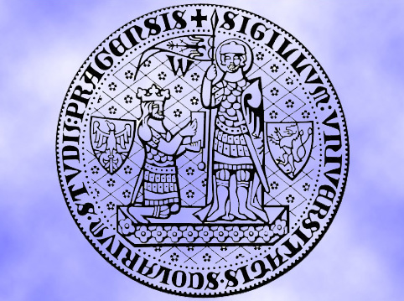
Tuesday, 14.00 – 15.20
Charles University
Charles University
Econometrics
Econometrics
Jan Ámos Víšek
Jan Ámos Víšek
FSV UK
Institute of Economic Studies
Faculty of Social Sciences
Institute of Economic Studies
Faculty of Social Sciences
STAKAN III
Second Lecture

Slide 2

Schedule of today talk
A brief repetition of the “results” of the first lecture.
The Ordinary Least Squares
What it is, does it exist at all, formula and properties
( in the form of a theorem).
An alternative method

Slide 3
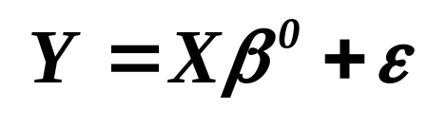
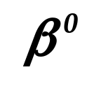
At the end of previous lecture we arrived at:
REGRESSION MODEL
Galton, F. (1886): Regression towards
mediocrity in hereditary stature.
(Návrat k průměru ve zděděné postavě.)
Journal of the Anthropological Institute vol.~15, pp. 246-263.
How to estimate from data?

Slide 4

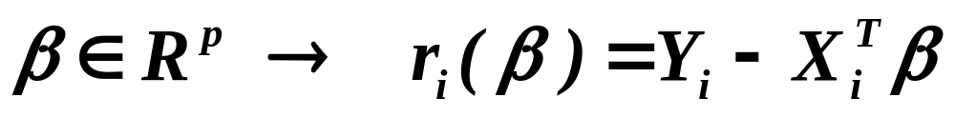
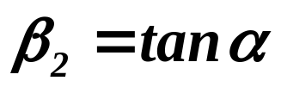
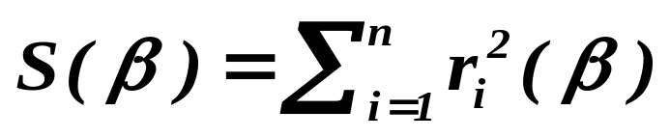



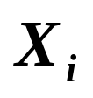

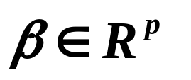
-th residual
Response
variable
Explanatory variable
Find minimum of over all !!
The method is called : The ( ordinary ) least squares

Slide 5
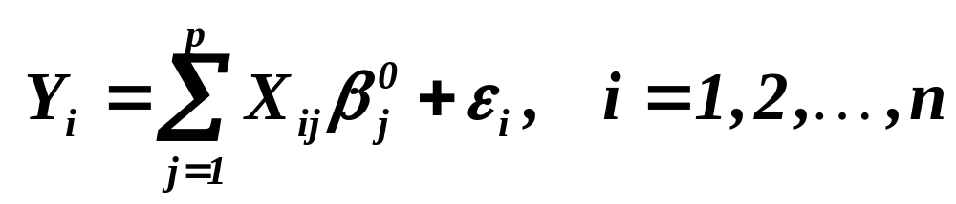
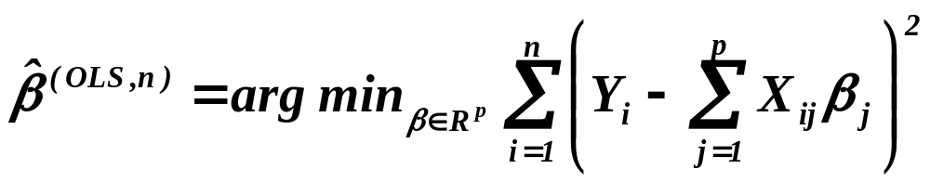
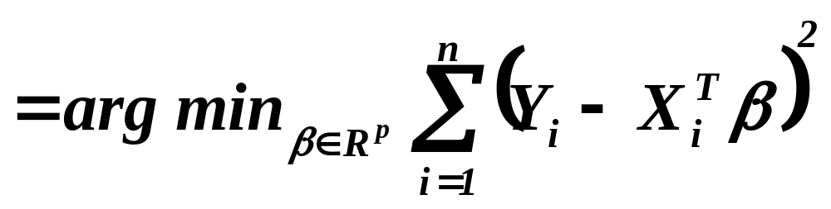
Adrien Marie Legendre (1805)
Carl Friedriech Gauss (1809)
The Ordinary Least Squares
Odhad metodou nejmenší čtverců

Slide 6
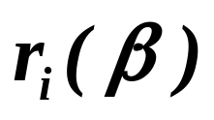
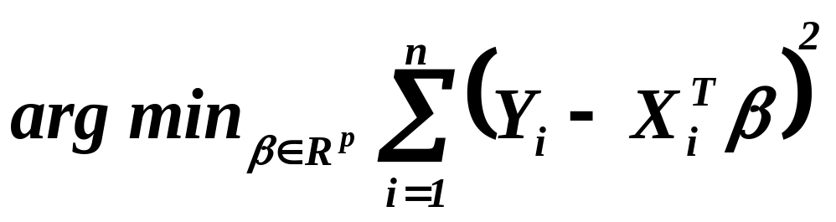
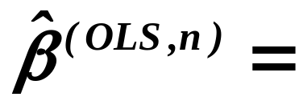

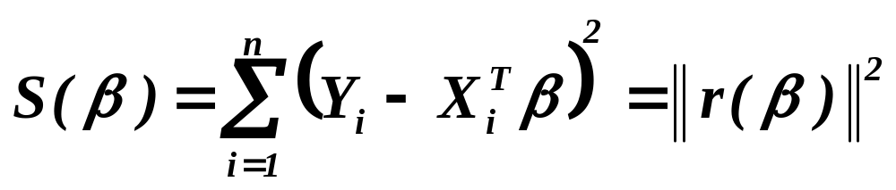
The Ordinary Least Squares
Odhad metodou nejmenší čtverců
Does it exist at all?

Slide 7

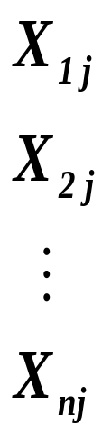
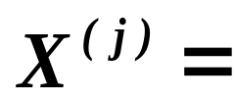
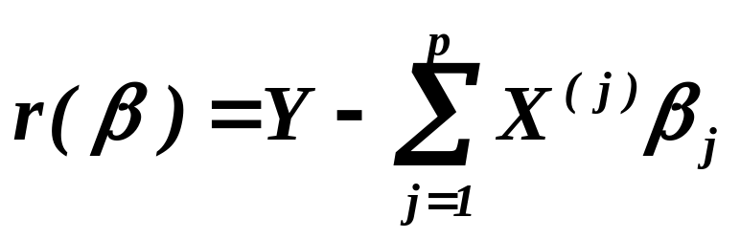
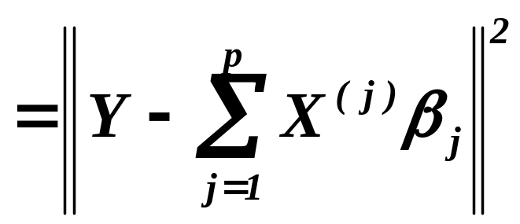
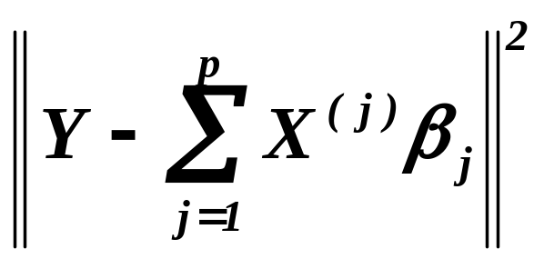
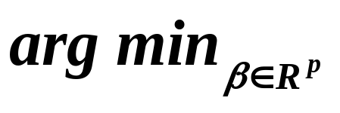
Estimate by OLS
(odhad MNČ)
-th explanatory variable
( -tá vysvětlující veličina)

Slide 8

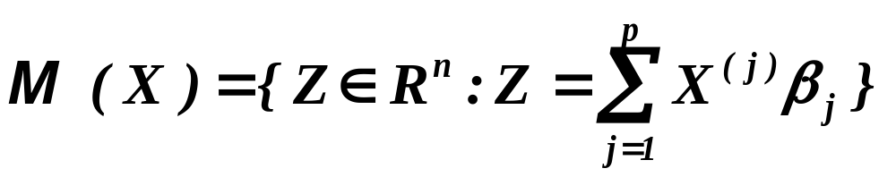
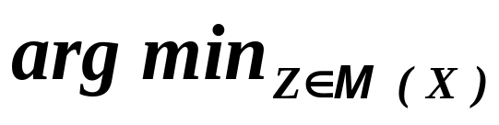
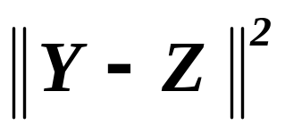

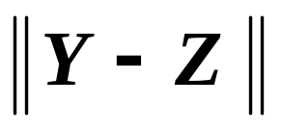
The Ordinary Least Squares
Odhad metodou nejmenší čtverců
Linear envelope of
( lineární obal )

Slide 9
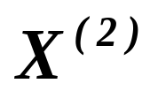
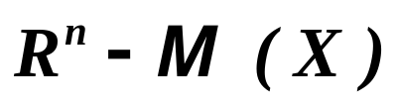




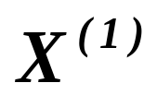
Y
.
.

Slide 10
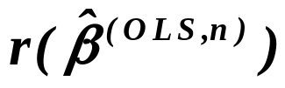

The second explanatory variable
Y
.
.
.
The first explanatory variable

Slide 11


The second explanatory variable
Y
The solution exists and is unique.
.
The first explanatory variable

Slide 12
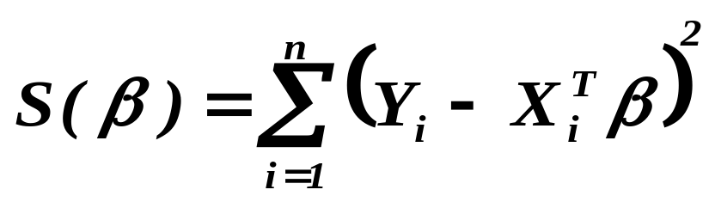
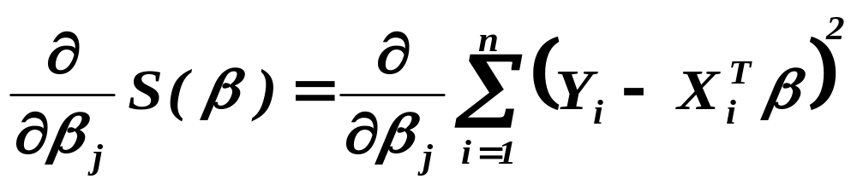
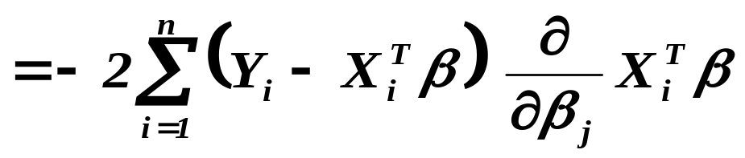
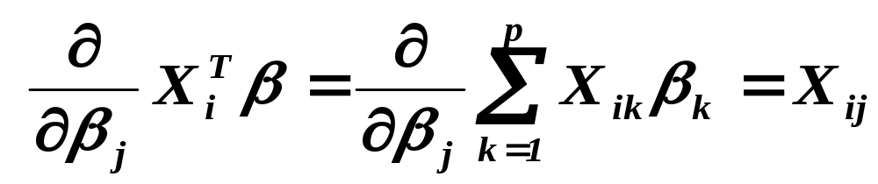
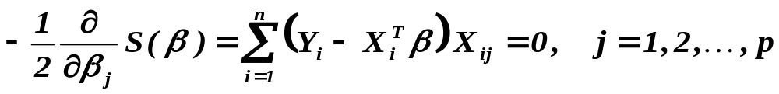
The functional to be minimized

Slide 13
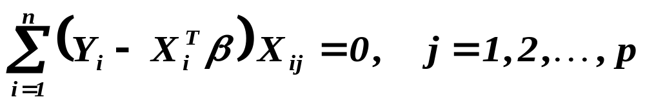
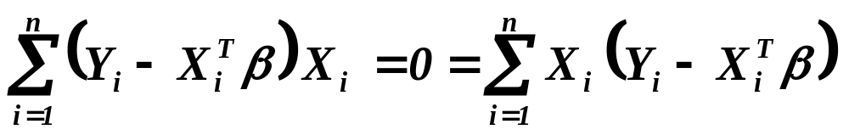
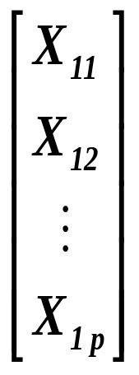
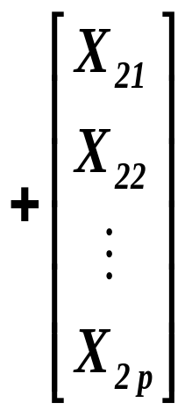
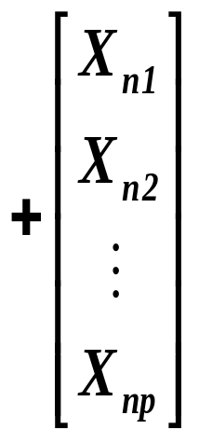
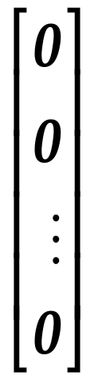
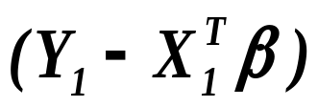
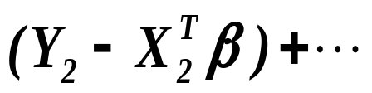
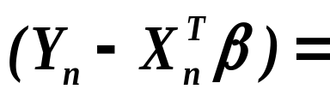
Normal equations

Slide 14
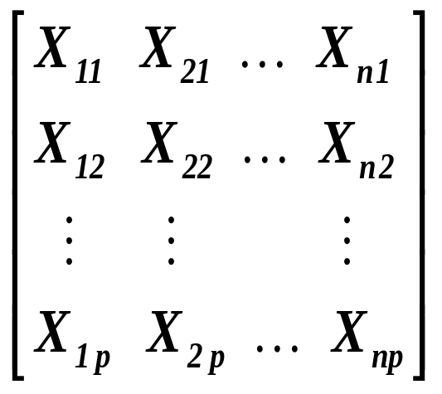
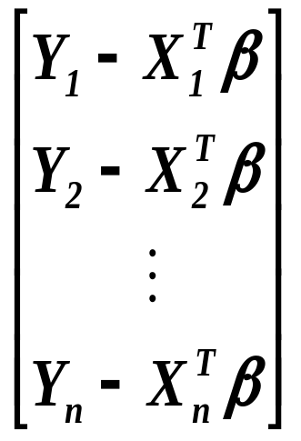

Normal equations

Slide 15
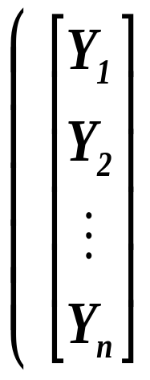
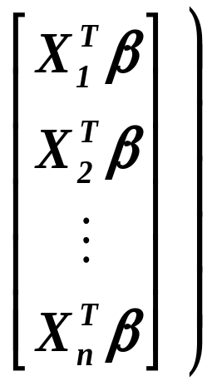

Normal equations

Slide 16
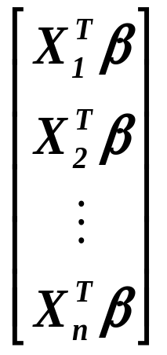
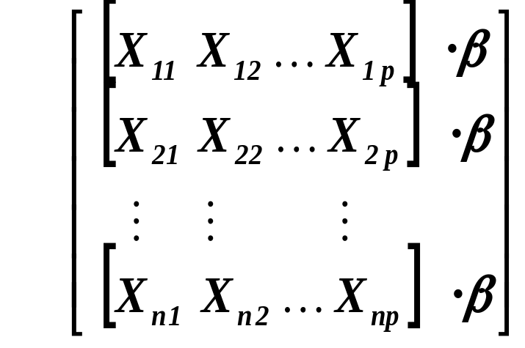
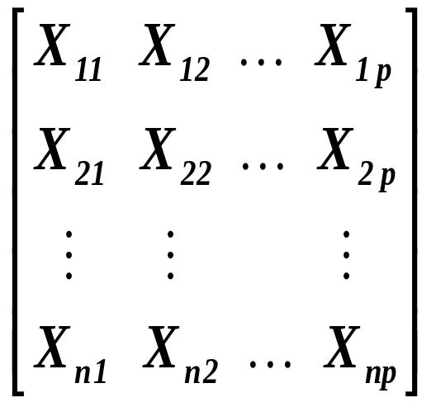




Normal equations

Slide 17




Normal equations
is of full rank, i.e. is regular
Ordinary Least Squares
(odhad metodou nejmenších čtverců)
(Please, keep this formula in mind,
we shall use it many, many times.)

Slide 18




Ordinary Least Squares
(odhad metodou nejmenších čtverců)
Having recalled the model
and substituting it here ,
we arrive at

Slide 19





Ordinary Least Squares
(odhad metodou nejmenších čtverců)
Definition
An estimator where
is matrix, is called the linear estimator .

Slide 20



- estimate
Odhad metodou nejmenší absolutních odchylek
Galileo Galilei (1632)
Roger Joseph Boscovich (1757)
Pierre Simon Laplace (1793)

Slide 21
- estimator
Odhad metodou nejmenší absolutních odchylek
Does it exist at all?

Slide 22

















Theorem
Let be a sequence of r.v’s,
. Then is the best linear unbiased estimator .
If moreover , and ‘s are
independent, is consistent. If further
where is a regular matrix, then
where
.
is Kronecker delta, i.e. if and for .

Slide 23
What is to be learnt from this lecture for exam ?
The Ordinary Least Squares (OLS) – principle and existence.
Properties of OLS and conditions necessary for them.
Alternative estimating method.
All what you need is on
http://samba.fsv.cuni.cz/~visek/Econometrics_Up_To_2010

