Slide 1

Tuesday, 14.00 – 15.20
Charles University
Charles University
Econometrics
Econometrics
Jan Ámos Víšek
Jan Ámos Víšek
FSV UK
Institute of Economic Studies
Faculty of Social Sciences
Institute of Economic Studies
Faculty of Social Sciences
STAKAN III
Seventh Lecture

Slide 2

Schedule of today talk
Verification of further assumptions for BLUE
and for consistency, and their discussion.
Verification of normality of disturbances
- by tests and graphically.
Modification of our results for the framework
with random explanatory variables.

Slide 3
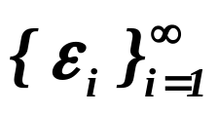
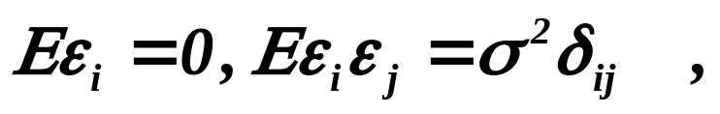






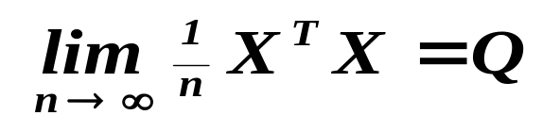

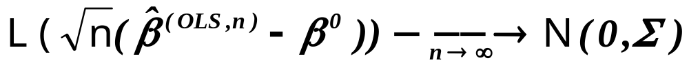
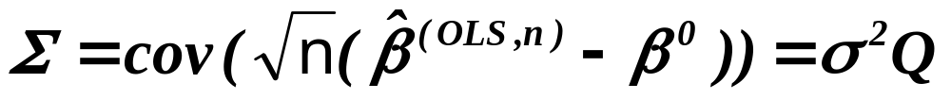
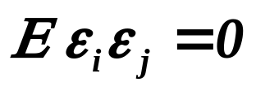

Let us recall once again - Theorem
Assumptions

Let be a sequence of r.v’s,
.
Assertions
Then is the best linear unbiased estimator .
Assumptions
If moreover , and
‘s are independent,
for
Assertions
is consistent.
Assumptions
If further , regular matrix,
Assertions
then
where .
How to verify that for
?
Of course,
It is to be deduced !!!
for cross-sectional data !

Slide 4

Remember in the First Lecture we introduced “Types of data”
“Cross-sectional data”
The order of
rows is not
relevant.
On every row there is one patient, one industry, etc.
Usually we say that on any row there is one “case.”
“Panel data”
The order of
rows is
relevant.
On the rows the values of given patient
(industry, etc.) at time are given.
The order of
rows in blocks is
relevant.
Combinations of both types are also assumed
and usually called also “Panel data”.
(Let us continue on the next slide where is a discussion
why verification of for can’t be
(principally) “statistical” but heuristic.)

Slide 5
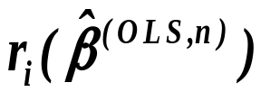

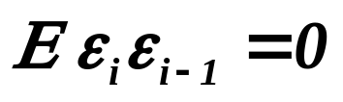
Why verification of for can’t be
(principally) “statistical” but heuristic?
✦ We use residuals ‘s as “substitutes”
for disturbances ‘s, hence for every case i we have
one “realization” of r.v. . So we have no chance to check
whether different r.v. are not correlated.
✦ What we can check, is e.g. that for all i,
( such test will be offered by Durbin-Watson statistics
for panel data ) but it is senseless for cross-sectional
data - remember that the order of data is irrelevant.

Slide 6
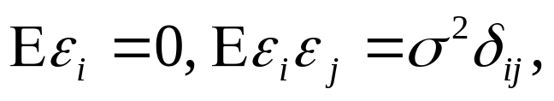
Let us recall once again - Theorem
Assumptions
Let be a sequence of r.v’s,
.
Assertions
Then is the best linear unbiased estimator .
Assumptions
If moreover , and
‘s are independent,
for
Assertions
is consistent.
Assumptions
If further , regular matrix,
Assertions
then
where .
How to verify that ,
and
?

Slide 7
The answer follows from the fact that all three conditions
, and
are in the form of limits  they can’t be verified !
Of course, they give a hint which data are suitable
to be “explained” by regression model,
or in other words, they indicate when we can expect
that the estimated regression model
is reliable “explanation” of data.
Notice that in both cases the words “explained” and “explanation”
are in converted commas !!! It has a philosophical motivation.
( We’ll discuss it later. )

Slide 8
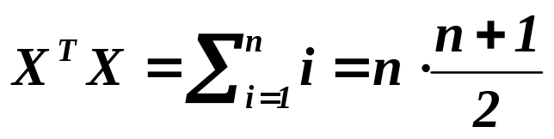

Let us consider the condition .
If the “red” distance “increases”
over any limits, the condition is not
fulfilled. From the computational
point of view it means that OLS
will consider left-lower cloud
as one point and two other points
(in right upper corner) as another
one. So the information is reduced
to two points.
The condition however can be distorted by many others type
of data, e.g. 1,2,3, ...., gives
which is not .

Slide 9
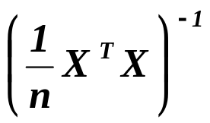
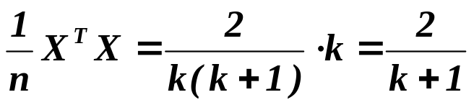
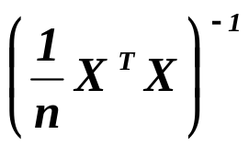
Let us consider now the condition
which means that
is bounded.
If the cloud at the center will contain
more and more points which will be
nearer and nearer to a “gravity center”,
the condition will be broken and OLS
will consider all data as one point.
The condition however can be distorted by many others type
of data, e.g. 1,0,1,0,0,1,0,0,0,1, .... . k-th “1” will appear on the po-
sition n=k(k+1)/ 2, i.e. and hence
will not be bounded..

Slide 10
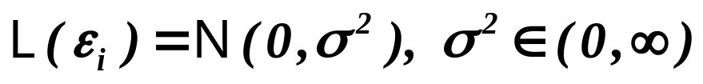

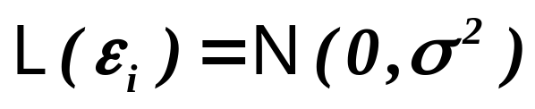
Finally, let us recall also - Theorem
Assumptions
Let be iid. r.v’s, .
Then and attains Rao-Cramer
Assertions
BLUE
lower bound, i.e. is the best unbiased estimator.
Assumptions
If is the best unbiased estimator attaining
Rao-Cramer lower bound of variance,
then and .
Assertions
Moreover, we have showed (Third Lecture) that
restricting ourselves on linear estimators is drastic,
i.e. we should guarantee that the condition under
which OLS is best among all estimators, holds.
It means that the normality of disturbances is to be checked !!

Slide 11
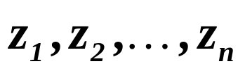


Testing whether ...... ?
We have numbers and we assume that they
represent a realization of sequence of i.i.d. random variables
governed by d.f. .
How to test this assumption ?
There are basically two types of ( statistical ) tests:
The tests based on a mutual fit of empirical and theoretical d.f.
or comparison of frequencies and theoretical density
- tests of good fit.
The tests based on some specific feature of given d.f.
- e.g. test for normality based on skewness and kurtosis.

Slide 12
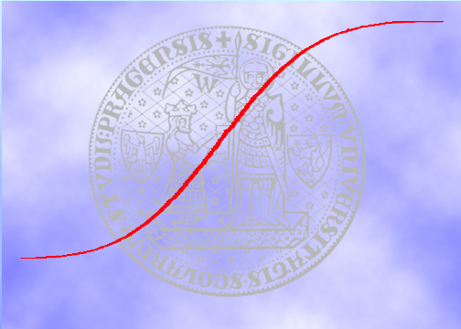
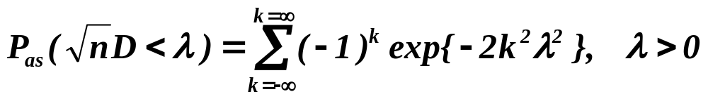
Kolmogorov-Smirnov distance D
Empirical (observed) d.f.
Theoretical (assumed) d.f.
We look for the maximal distance
D between the red and blue curve.
Available e.g. in STATISTICA
(equal zero elsewhere)

Slide 13
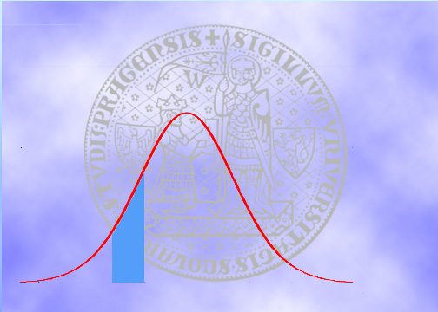




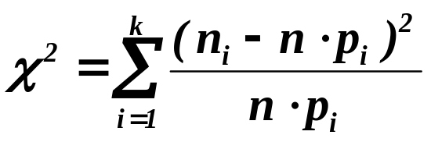
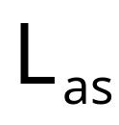
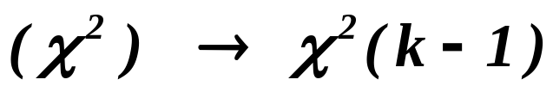
-test of good fit
Assume that probability of this area is . Then from n realizat-
ions approximately should fall in it.
If denotes real number
of observations falling in it, we
should compare and .
This is the most
frequently used
test of good fit.
Assume k areas ( exhausting
support of d.f.) and evaluate
Available also in STATISTICA

Slide 14

Can we apply -test of good fit on residuals ?
Let us recall that
and hence
.
Conclusion: residuals are not i.i.d. !!!

Slide 15
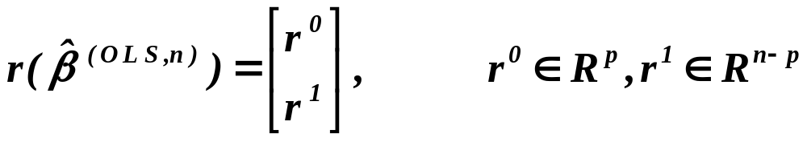
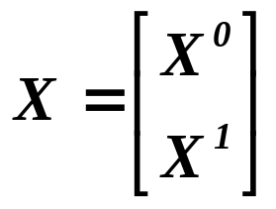


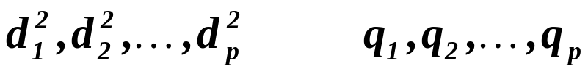

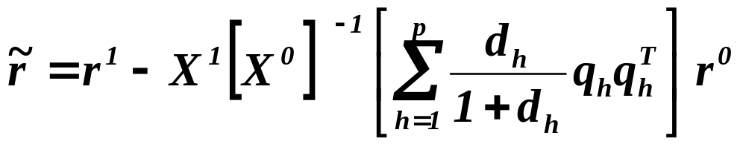


Residuals should be recalculated - Theil’s residuals
Let us put
1965
is of type , regular (assumption)
and eigenvalues
and eigenvectors of
then the coordinates of
are i.i.d. and they are normally distributed iff ‘s
are normally distributed.
Conclusion: We can apply on .

Slide 16

Should be the residuals really recalculated ?
Let us recall that the matrix
is idempotent and hence
.
It means that the diagonal elements are of order p/n. But then
the Cauchy-Schwarz inequality implies the same for nondiagonal
elements. Finally, the formulae
indicates that the correlation is weak - asymptotically zero -
and that the heteroscedasticity is low
- asymptotically disappears.

Slide 17

Residuals need not be recalculated
The approach presented in the previous text was
advised in the econometric monographs up to the mid
of seventies. Nevertheless, there were papers showing
that asymptotically the results coincide for recalculated
residuals with results for the “original” residuals
( the idea of proof was given on the previous slide ).
In 1974 a large Monte Carlo study by Bolch
and Huang manifested that the result may be even
better for the “original” residuals than for recalculated.
Conclusion: Nowadays we usually apply on .

Slide 18
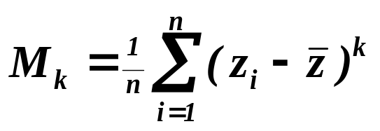
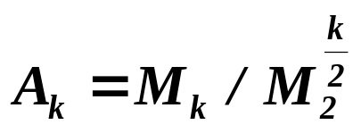


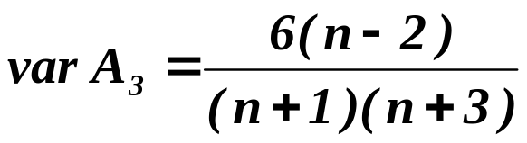
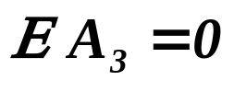
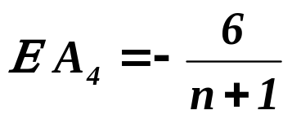
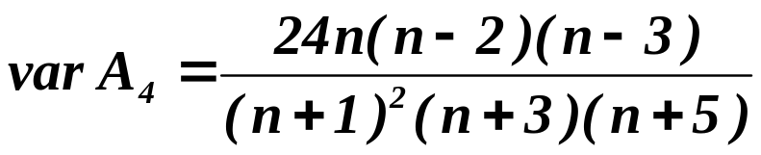
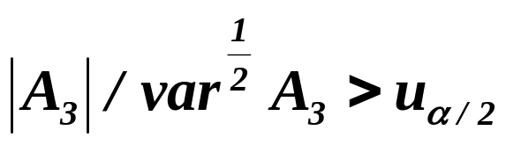
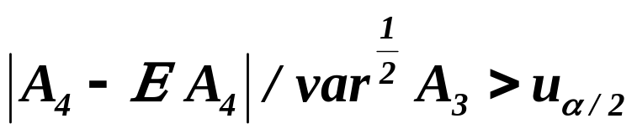

Test for normality based on skewness and kurtosis
Put and .
Then and are sample skewness and sample kurtosis,
respectively, and are asymptotically normally distributed with
.
Both tests reject the hypothesis about normality
on the level of significance .
Similar to them is Jarque-Bera test, available e.g. in TSP.

Slide 19
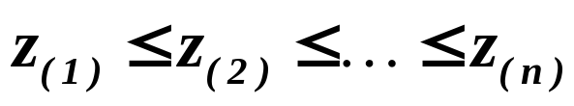
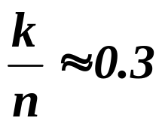
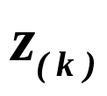
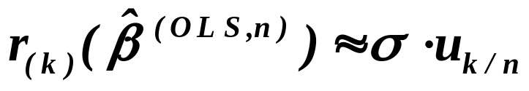
A graphical test for normality - normal plot
We have numbers and we assume that they
represent a realization of sequence of i.i.d. random variables
governed by d.f. .
How to estimate, say 30% lower quantile ?
Even a common sense would advise to order the sample, i.e.
and select such that .
Theory says that this estimation is consistent. So the ordered re-
siduals should correspond to the quantiles of underlying ( we
of course assume that of normal ) distribution. In other words,
.

Slide 20
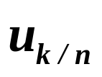
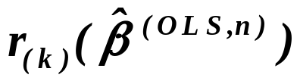
A graphical test for normality - normal plot
If the points of graph lie
( approximately) on a line,
the hypothesis of normality
can’t be rejected.

Slide 21
Let us conclude testing the normality by ....
We have recalled the Theorem
Assumptions

Let be a sequence of r.v’s,
.
Assertions
Then is the best linear unbiased estimator .
Assumptions
If moreover , and
‘s are independent,
for
Assertions
is consistent.
Assumptions
If further , regular matrix,
Assertions
then
.
and we have added
It means that the normality of disturbances is to be checked !!
It would be however better to add
It means that the normality of disturbances is to be reached !!

Slide 22
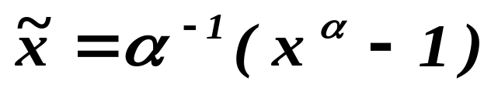


How can we say:
It means that the normality of disturbances is to be reached !!
Of course, this is closely related to the philosophy
of modeling, to the notion of causality and natural laws,
underlying “true” model, etc. .
We shall discuss it on a special lecture but later.
For a moment, let us assume that we look for
a model which works, simply.
Then of course, we can transform data
-the most frequently used transformation
is the logarithmic one.
Box and Cox, in sixties, studied transformations of type
.
Notice:

Slide 23
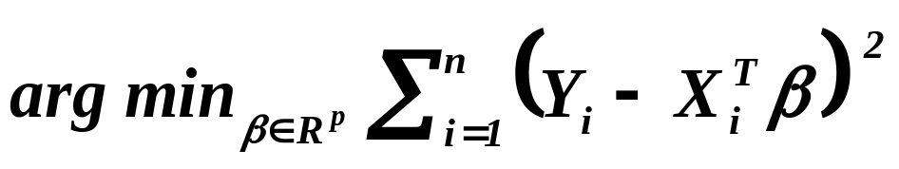
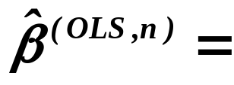
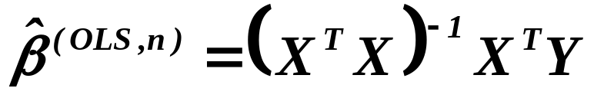
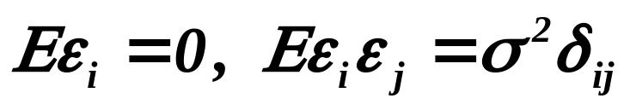

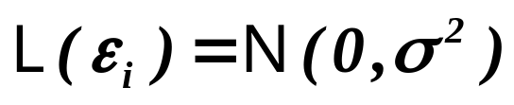
At the start of the Fourth Lecture we recalled
what we already know about the linear regression model.

is BLUE

is consistent

is asymptotically normal

is the best
among all unbiased estimators
But we did not recalled that already in the First Lecture we said
that the explanatory variables would be assumed
to be deterministic.

Slide 24
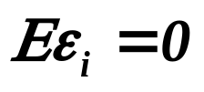
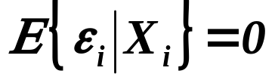
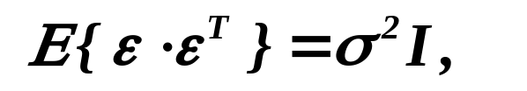

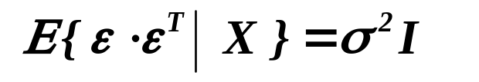
But sometimes it may be more appropriate to assume that
the explanatory variables are also random
( we speak usually about “random-carrier framework” ).
Consider e.g. that we look for oil in an Arabian desert !!
How the assumptions are to be reformulated ?
And how the theory should be modified ?
Assumptions on disturbances
Orthogonality condition

Sphericality condition

is BLUE

Slide 25




Assumptions on explanatory variables

i.i.d r.v’s
regular
is consistent and asymptotically normal
Assumptions on explanatory variables

is the best among all unbiased estimators

Slide 26
What is to be learnt from this lecture for exam ?
How to test the assumption
- that disturbances are not correlated,
- assumptions for the consistency ?
Verification of normality of disturbances
- by statistical tests and graphically.
Modifications of all, what was assumed
for model with deterministic explanatory variables,
for the model with the random ones.
All what you need is on
http://samba.fsv.cuni.cz/~visek/

