Slide 1

Tuesday, 14.00 – 15.20
Charles University
Charles University
Econometrics
Econometrics
Jan Ámos Víšek
Jan Ámos Víšek
FSV UK
Institute of Economic Studies
Faculty of Social Sciences
Institute of Economic Studies
Faculty of Social Sciences
STAKAN III
Eleventh Lecture

Slide 2

Schedule of today talk
● Inspiration for Generalized Method
of Moments estimation
● Examples of GMM-reformulation of problems
within the regression framework
● Recalling Whites results of estimating
covariance matrix of the OLS-estimator
of regression coefficients
● Recalling Cragg’s improvement
of the estimates of regression coefficients
under heteroscedasticity
● Reformulating Cragg’s approach as GMM-estimation
Prior to all: Generalized Least Squares

Slide 3
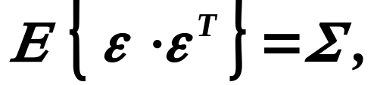


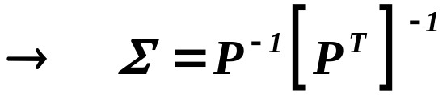
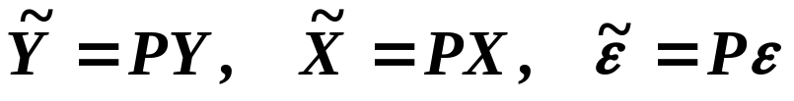
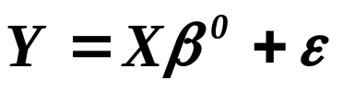

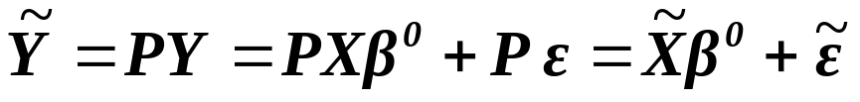
The Generalized Least Squares
Let us assume that
- regular,
i.e. homoscedasticity is broken.
- regular and symmetric
and put
.
multiplying the basic model from the left
by
.

Slide 4

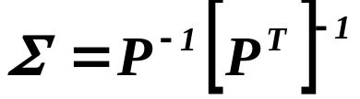

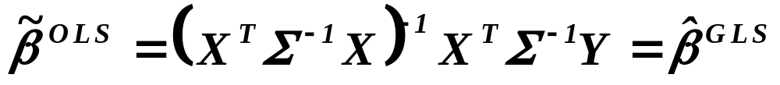
continued
The Generalized Least Squares
For we have
,
i.e. we have reached homoscedasticity. Then
.
Recalling that
,
i. e.
Generalized Least Squares

Slide 5






What is Generalized Method of Moments (GMM) ?
An example
Transactions
on the household account
Wooldridge, J. M. (2001):
Applications of generalized method of moments estimation.
J. of Economic Perspective, 15, no 4, 87 - 100.
Inspiration
taken from

Slide 6






What is Generalized Method of Moments (GMM) ?
An example
continued
Two orthogonality
conditions
which can’t be
simultaneously fulfilled !
symmetric, positive definite

Slide 7






Generalized Method of Moments
The first attempt for a general framework
A population of r.v.’s
Various covariance structure,
various distributional framework
A collection of orthogonality conditions
The empirical counterparts
symmetric, positive definite

Slide 8



Generalized Method of Moments
Another example
Let’s consider linear regression model
and the classical least squares
A collection of orthogonality conditions
The empirical counterparts = normal equations

Slide 9



Generalized Method of Moments
Another example
continued
symmetric, positive definite
The ordinary least squares

Slide 10


Generalized Method of Moments
Commonly accepted framework
Pioneering
paper
Hansen, L. P. (1982): Large sample properties
of generalized method of moments estimators.
Econometrica, 50, no 4, 1029 - 1054.
An assumed “casual” model
Observed data
We would like to estimate consistently the model
it seems that we have to believe that
the disturbances are orthogonal to the model !

Slide 11




Generalized Method of Moments
Commonly accepted framework
continued
It is evident that it can’t be generally true
we look for some instruments, being close to model,
however orthogonal to disturbances !
Disturbances
Instruments
Orthogonality conditions
This equality
defines function
Kronecker
product

Slide 12




Generalized Method of Moments
Commonly accepted framework
continued
Empirical counterpart of the orthogonality conditions
symmetric, positive definite
An estimate - symmetric, positive definite

Slide 13
Generalized Method of Moments
Another examples of the problems
in classical regression analysis
with the straightforward GMM-reformulation
● Instrumental variables
● Heteroscedastic disturbances
Discussed in details
● Collinearity

Slide 14
Can we meet with the heteroscedasticity frequently ?
● Data in question represent the aggregates over some regions.
● Explanatory variables are measured with random errors.
● Models with randomly varying coefficients.
● ARCH models.
● Probit, logit or counting models.
● Limited and censored response variable.
● Error component (random effects) model.
Heteroscedasticity is assumed
by the character (or type) of model.

Slide 15
Can we meet with heteroscedasticity frequently ?
continued
● Expenditure of households.
● Demands for electricity.
● Wages of employed married women.
● Technical analysis of capital markets.
● Models of export, import and FDI ( for industries ).
Heteroscedasticity was not assumed
but “empirically found” for given data.

Slide 16



Is it worthwhile to take seriously heteroscedasticity ?
Let’s look e. g. for a model of the export from given country

Slide 17

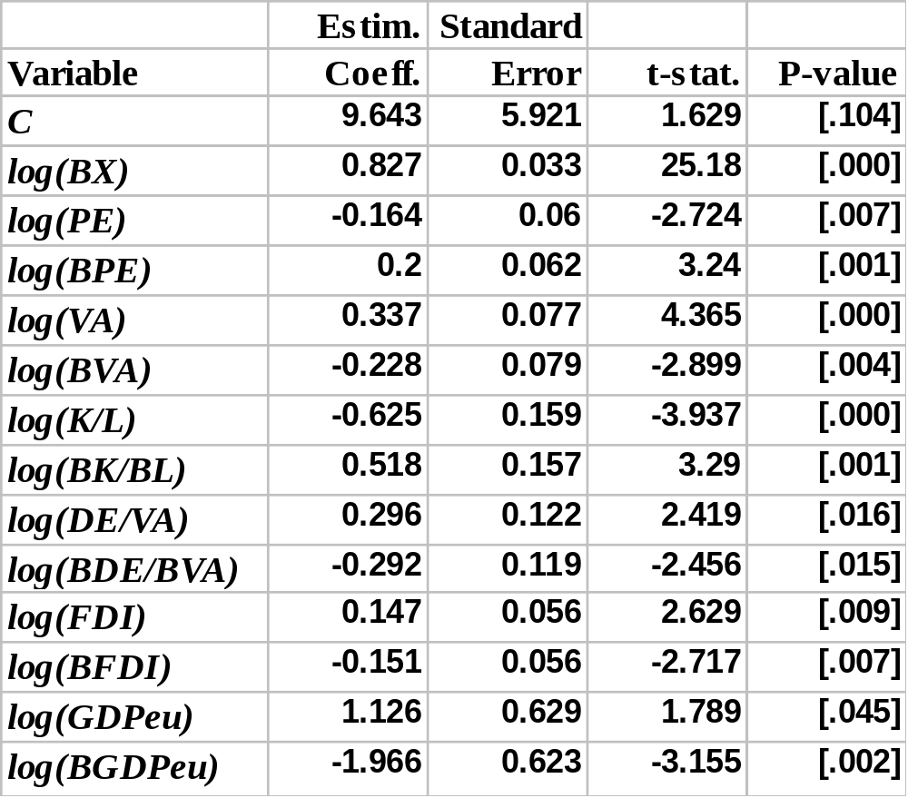
Ignoring heteroscedasticity, we arrive at:
B means
backshift

Slide 18
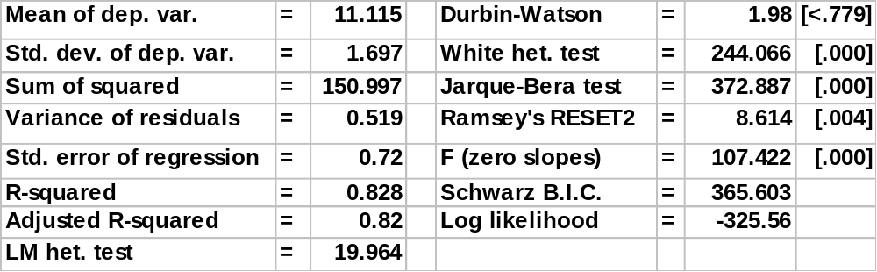
Other characteristics of model
White het. test = 244.066 [.000]

Slide 19
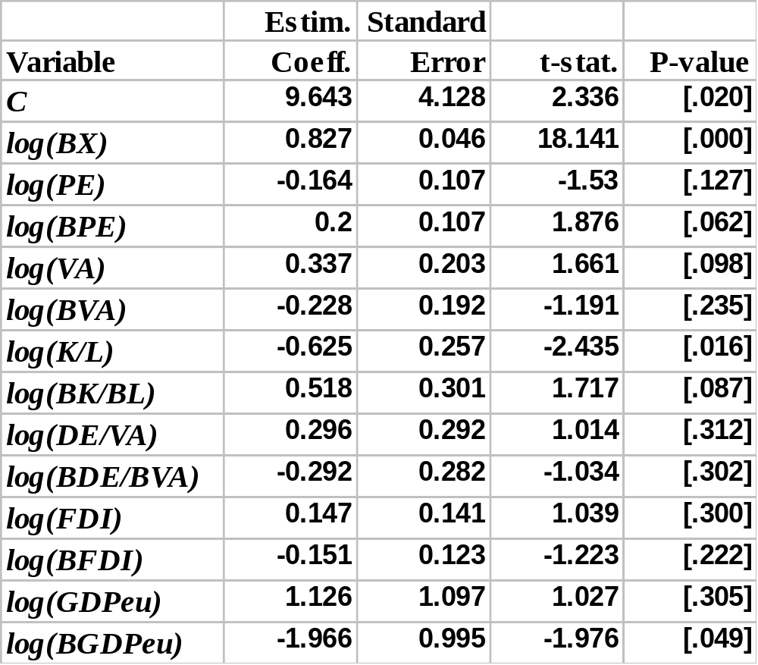
Significance of explanatory variables when White’s
estimator of covariance matrix of regression coefficients
was employed.

Slide 20

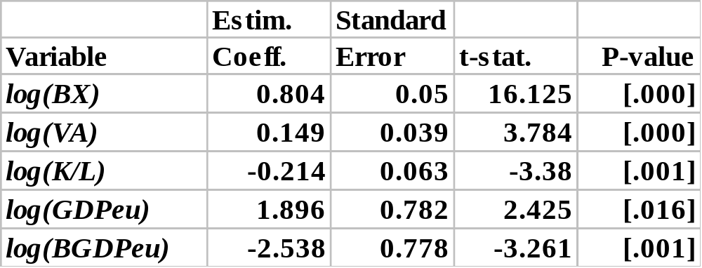
Reducing model according to effective
significance

Slide 21
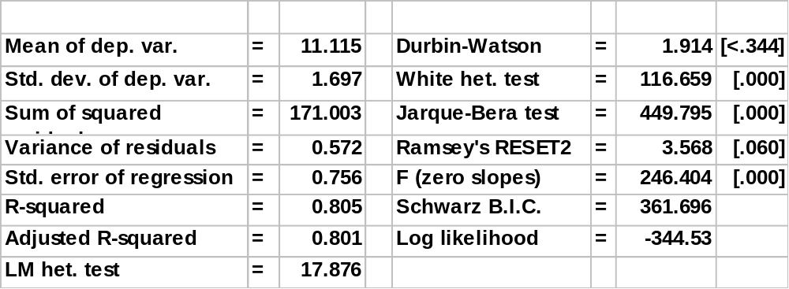
Other characteristics of model
White het. test = 116.659 [.000]

Slide 22




Recalling White’s ideas - assumptions
White, H. (1980): A heteroskedasticity-consistent covariance
matrix estimator and a direct test for heteroscedasticity.
Econometrica, 48, 817 - 838.
●
- independently (non-identically) distributed r.v.’s
,
●
- absolutely continuous d. f.’s
,
●
,

Slide 23





Recalling White’s ideas - assumptions
continued
●
,
,
,
●
for large T ,
●
for large T .
Remark.
No assumption on the type of distribution
already in the sense of Generalized Method of Moments.

Slide 24






Recalling White’s results

Slide 25



continued
Recalling White’s results

Slide 26


continued
Recalling White’s results

Slide 27






continued
Recalling White’s results

Slide 28




Recalling Cragg’s results
Cragg, J. G. (1983): More efficient estimation
in the presence of heteroscedasticity of unknown form.
Econometrica, 51, 751 - 763.
We should use
T ( T + 1 )
2
has generally elements

Slide 29




continued
Recalling Cragg’s results
Even if rows are independent
has T unknown elements, namely
We put up with

Slide 30




continued
Recalling Cragg’s results
An artificial system
of r.v.’s

Slide 31

continued
Recalling Cragg’s results
An improvement if
Should be positive definite.
Nevertheless,
is still unknown

Slide 32

continued
Recalling Cragg’s results
Asymptotic variance
Estimated asymptotic variance

Slide 33






Recalling Cragg’s results
Example – simulations
Model
Heteroscedasticity given by
T=25
1000 repetitions
Columns of matrix P

Slide 34




Recalling Cragg’s results
continued
Example
Example – simulations
Asymptotic Actual Estimated
Asymptotic Actual Estimated
j=1
LS
1.000
1.011
0.764
1.000
0.980
0.701
j=1,2
0.409
0.478
0.400
0.590
0.742
0.442
j=1,2,3
0.278
0.337
0.286
0.471
0.629
0.309
j=1,2,3,4
0.254
0.331
0.266
0.445
0.626
0.270
0.247
0.346
0.247
0.437
0.661
0.230
Asymptotic
Actual = simulated
Estimated

Slide 35


Reformulating Cragg’s results
Example
as GMM estimation
Recalling Cragg’s approach
An artificial system
of r.v.’s
I.e., the error term
The orthogonal conditions
and their covariance matrix

Slide 36



Reformulating Cragg’s results
continued
Example
as GMM estimation
Putting
Normal equations

Slide 37
What is to be learnt from this lecture for exam ?
Generalized method of moments
(inspiration, main idea – up to the slide 7).
Cragg’s recommendation in the case of heteroscedsticity.
All what you need is on
http://samba.fsv.cuni.cz/~visek/

