Slide 1

Tuesday, 12.30 – 13.50
Charles University
Charles University
E conometrics
E conometrics
Jan Ámos Víšek
Jan Ámos Víšek
FSV UK
Institute of Economic Studies
Faculty of Social Sciences
Institute of Economic Studies
Faculty of Social Sciences
STAKAN III
Fourth Lecture
(summer term)

Slide 2
Plan of the whole year
Regression models for various situations
● Division according to character of variables
* Continuous response
(and nearly arbitrary) explanatory variables
(winter and part of summer term)
* Qualitative and limited response
(and nearly arbitrary) explanatory variables
(summer term)

Slide 3
Plan of the whole year
Regression models for various situations
● Division according to contamination of data
* Classical methods, neglecting contamination
(winter and most of of summer term)
* Robust methods
(three lectures in summer term)

Slide 4
Plan of the whole year
Regression models for various situations
● Division according to character of data
(with respect to time):
* Cross-sectional data (winter term)
* Panel data (summer term)

Slide 5
Plan of the whole year
Time series
● Division according to a character of model
* Descriptive – smoothing by functions
(polynomials, exponential smoothing, intervention analysis,
tests of randomness)
* Box-Jenkins methodology
(AR(p), MA(q), ARMA(p,q), ARIMA (p,h,q))

Slide 6

Schedule of today talk
● Why we consider both AR( p ) and MA( q ) ?
● How to recognize that there is some dependence
in the series ?
● Which type of dependency took place?
● How large p or q is ?

Slide 7
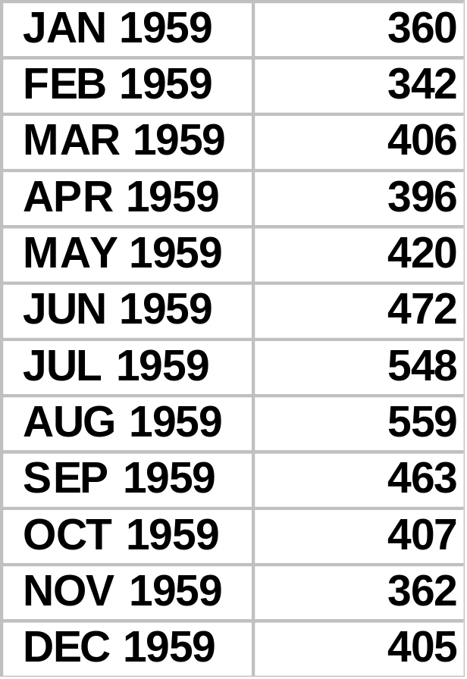
Why we consider both AR( p ) and MA( q ) ?
A pattern of data
- monthly passenger ( in 1000’s )
In fact, we shall use the data
from 1/1949 up to 12/1960

Slide 8
Why we consider both AR( p ) and MA( q ) ?
continued
Monthly passenger totals (in 1000's)
700
700
600
600
500
500
400
400
300
300
200
200
100
100
0
0
Jan 1949
Jan 1951
Jan 1953
Jan 1955
Jan 1957
Jan 1959
Jan 1950
Jan 1952
Jan 1954
Jan 1956
Jan 1958
Jan 1960

Slide 9
Why we consider both AR( p ) and MA( q ) ?
continued
Logarithms of monthly passenger totals
7.0
7.0
6.5
6.5
6.0
6.0
5.5
5.5
5.0
5.0
4.5
4.5
4.0
4.0
Jan 1949
Jan 1951
Jan 1953
Jan 1955
Jan 1957
Jan 1959
Jan 19530
Jan 1952
Jan 1954
Jan 1956
Jan 1958
Jan 1960

Slide 10
Why we consider both AR( p ) and MA( q ) ?
continued
Differenciated logarithms of monthly passenger totals
0.3
0.3
0.2
0.2
0.1
0.1
0.0
0.0
-0.1
-0.1
-0.2
-0.2
-0.3
-0.3

Slide 11
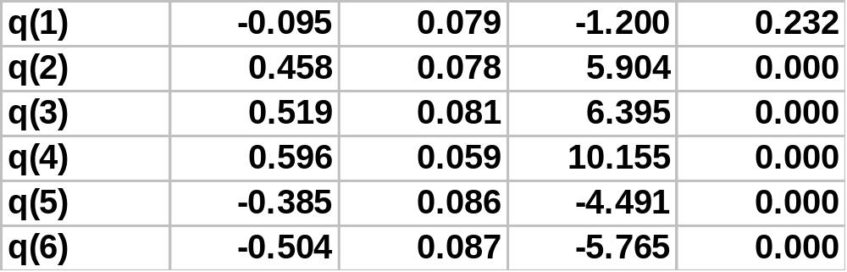
Why we consider both AR( p ) and MA( q ) ?
continued
Trying to estimate MA( 6 )
( this the best possible one ), we obtain
with
Initial SS=1.6250 Final SS=1.1491 (70.71%)

Slide 12
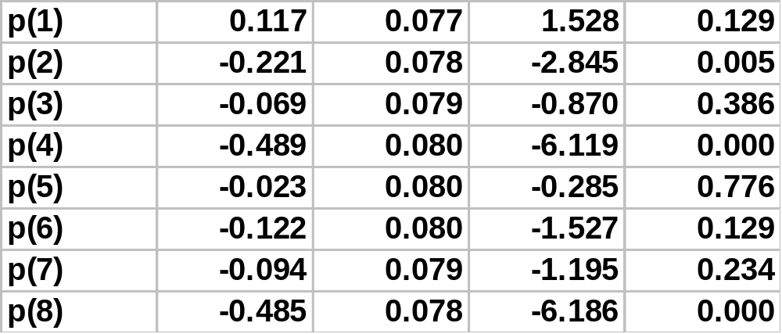
Why we consider both AR( p ) and MA( q ) ?
continued
Trying to estimate AR( 8 )
( this the best possible one ), we obtain
with
Initial SS=1.6250 Final SS=1.0144 (62.42%)
(STATISTICA doesn’t allow to estimate AR model leaving aside
insignificant lags.)

Slide 13
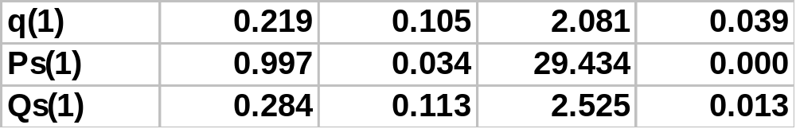
Why we consider both AR( p ) and MA( q ) ?
continued
Trying to estimate ARMA( 0,1 )( 1,1 )
( this the best possible one ), we obtain
with
Initial SS=1.6250 Final SS=.33582 (20.67%)

Slide 14
Why we consider both AR( p ) and MA( q ) ?
continued
Recapitulating:
MA( 6 ) :
Initial SS=1.6250 Final SS=1.1491 (70.71%)
AR( 8 ) :
Initial SS=1.6250 Final SS=1.0144 (62.42%)
ARMA( 0,1 ) (1,1) :
Initial SS=1.6250 Final SS=.33582 (20.67%)
Conclusion:
The last model is evidently simpler than others
and it explains by far most of variability
of the series .

Slide 15
How to recognize that there is some dependence in the series ?
The question can be enlarged:
Why we need to learn it ?
The answer should be structured according to the situation
which the series was generated in !
● We have just a time series and we would like
to test whether its elements are independent or not.
● We have just a time series and we would like
to test whether its elements are independent or not.
● We have estimated a regression model and we need
to test whether the residuals are independent or not.
● We have constructed ARIMA ( p,d,q) model and we want
to test whether the residuals are already independent.
● We have constructed ARIMA ( p,d,q) model and we want
to test whether the residuals are already independent.
● We have estimated a regression model and we need
to test whether the residuals are independent or not.

Slide 16
How to recognize that there is some dependence in the series ?
continued
We have just a time series and we would like
to test whether its elements are independent or not.
Why?
Having identified an ARIMA model for the time series
in question, we can describe it by a few parameters
( and hence we can also forecast ).
An example – transmition of digitalized speech signal:
1) The speech signal is cut into rather small segments
- the length is about 25 the microseconds.
In every segment the signal is measured digitally
at 50 points, say, and modeled as AR( 4 +12th).
3) The 5-tuple of the estimates are sent ( by a code-book)
to the receiver and then reconstructed.

Slide 17


How to recognize that there is some dependence in the series ?
continued
We have just a time series and we would like
to test whether its elements are independent or not.
Remember:
Tests of randomness
Test based on signs of differences of residuals
Test based on number of points of reverses
Test based on Kendall’s or Spearmen’s
Median test, etc.
So, the answer is simple: Use one of tests of randomness,
if the independence is rejected, try to model the time series
by a model of Box-Jenkins. Then try independence of residuals.

Slide 18
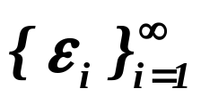
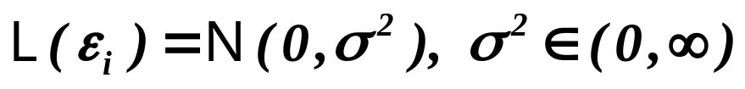


How to recognize that there is some dependence in the series ?
continued
We have estimated a regression model and we need
to test whether the residuals are independent or not.
Why?
Remember:
Theorem
Assumptions
Let be iid. r.v’s, .
Assertions
Then and attains Rao-Cramer
lower bound, i.e. is the best unbiased estimator.
From independence and normality of disturbances we conclude
that is the Best Unbiased Estimator.
It is not “if and only if ”, there are examples that when ignoring
dependence of disturbances we still have the best unbiased estimator.

Slide 19



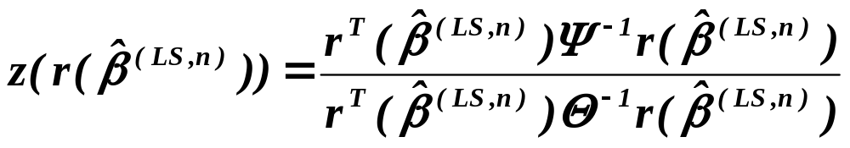
How to recognize that there is some dependence in the series ?
continued
We have estimated a regression model and we need
to test whether the residuals are independent or not.
James Durbin and G.S. Watson 1952 D-W statistics
The story is as follows:
In 1948 T.W. Anderson constructed the most powerful test of
H: L ( )= N ( )
A: L ( )= N ( )
by the statistics

Slide 20
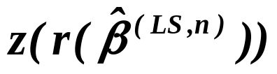


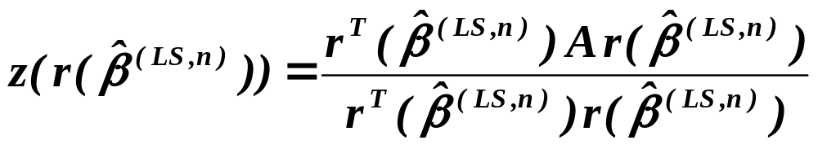
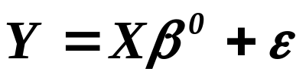
How to recognize that there is some dependence in the series ?
continued
Since
( 1 )
i.e.
depends on design matrix X .
J. Durbin and G.S. Watson 1952 considered:
hypothesis is independence
and they wrote A instead of .
Then (remember in what follows – A is symmetric)
Plugging the model in ( 1 ), we obtain

Slide 21




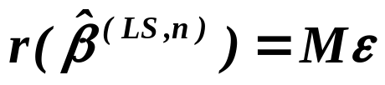
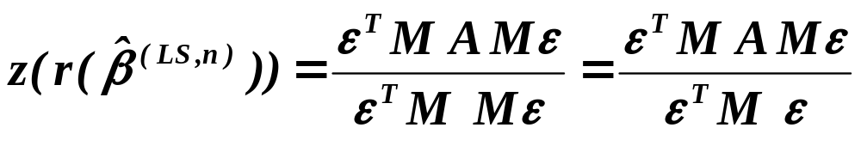
How to recognize that there is some dependence in the series ?
continued
.
Put and notice that
and , i.e. and
.
Notice that
.

Slide 22



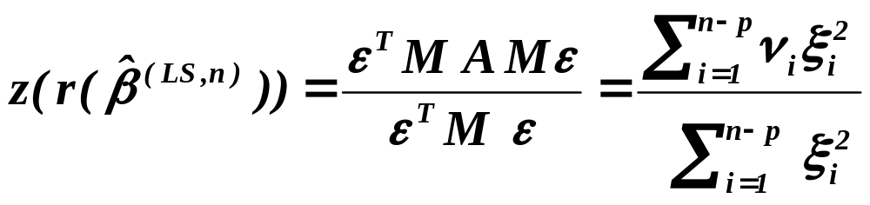
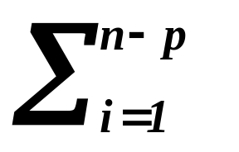
How to recognize that there is some dependence in the series ?
continued
We are going to show :
and
,
so that putting
,
we have
.

Slide 23






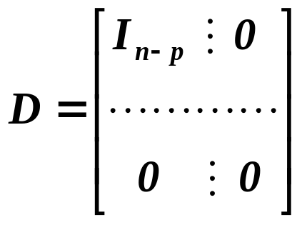

How to recognize that there is some dependence in the series ?
continued
- real and symmetric
:
and , - diagonal matrix of eigenvalues of matrix .
and
.
Now, write
, i.e.

Slide 24
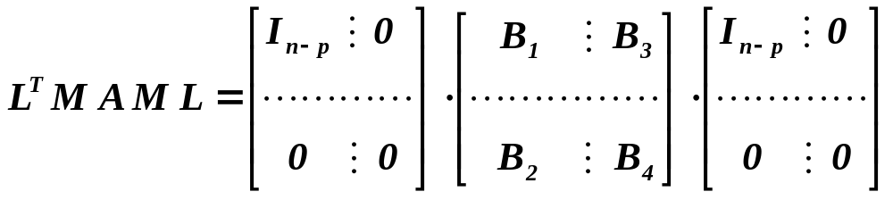
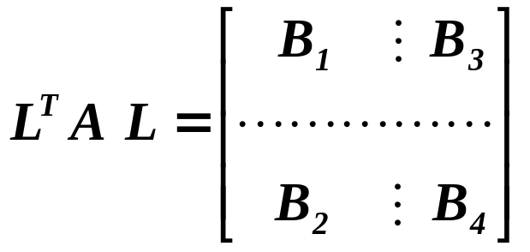



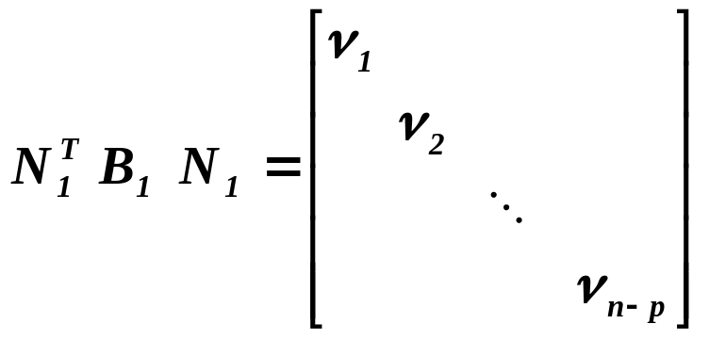

How to recognize that there is some dependence in the series ?
continued
i.e.
.
where
(remember– A is symmetric)
.
is symmetric and real
:
.
Notice that ‘s are the eigenvalues of matrix .

Slide 25
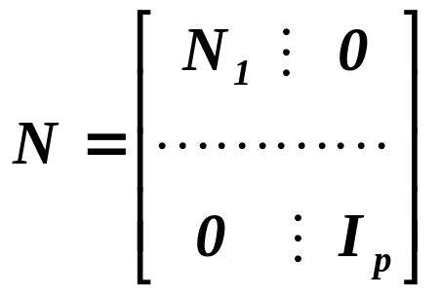
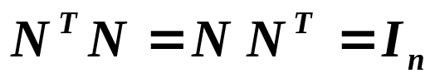


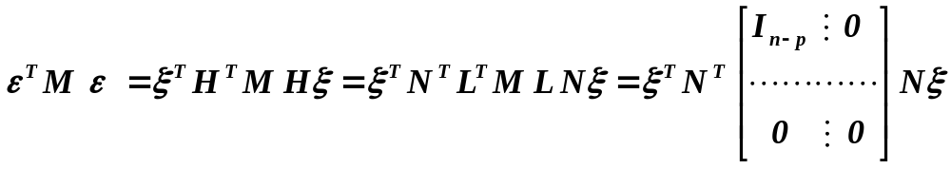
How to recognize that there is some dependence in the series ?
continued
Put
.
Let further
,
and put
.
Then
denominator of

Slide 26

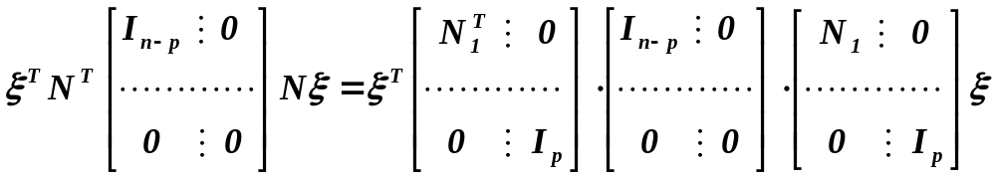
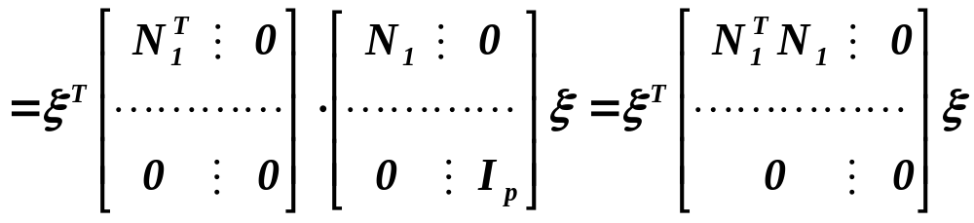
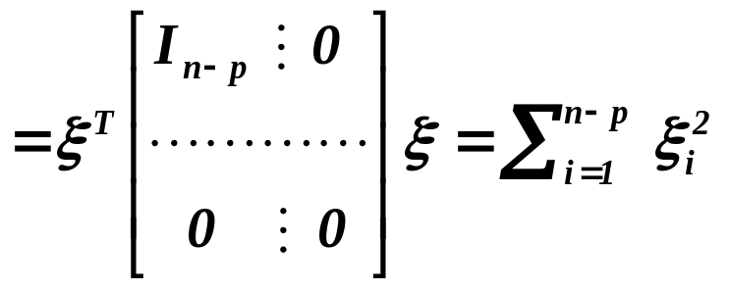
How to recognize that there is some dependence in the series ?
continued
.

Slide 27
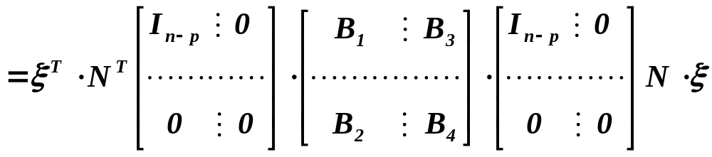
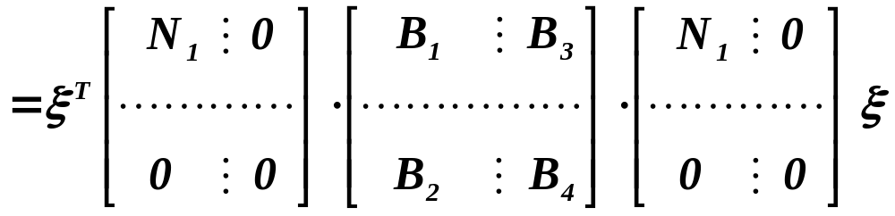
How to recognize that there is some dependence in the series ?
continued
Now, along similar lines ( for numerator of )

Slide 28
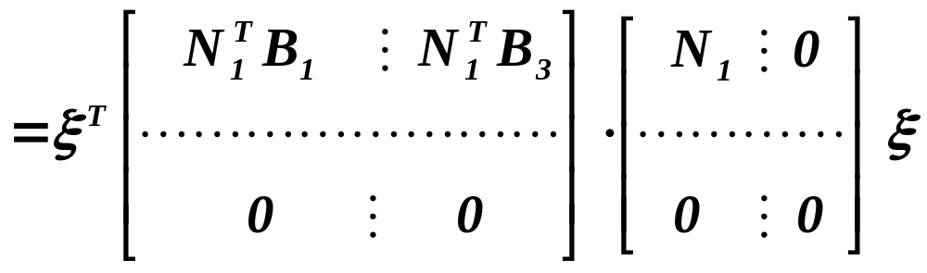
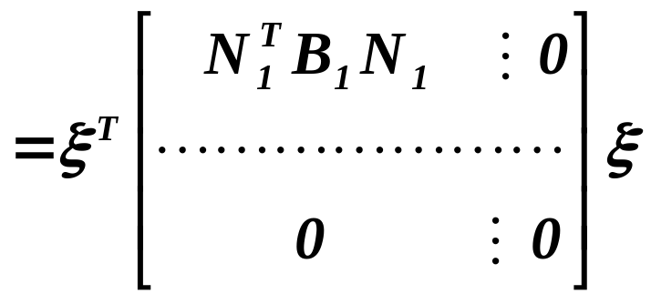
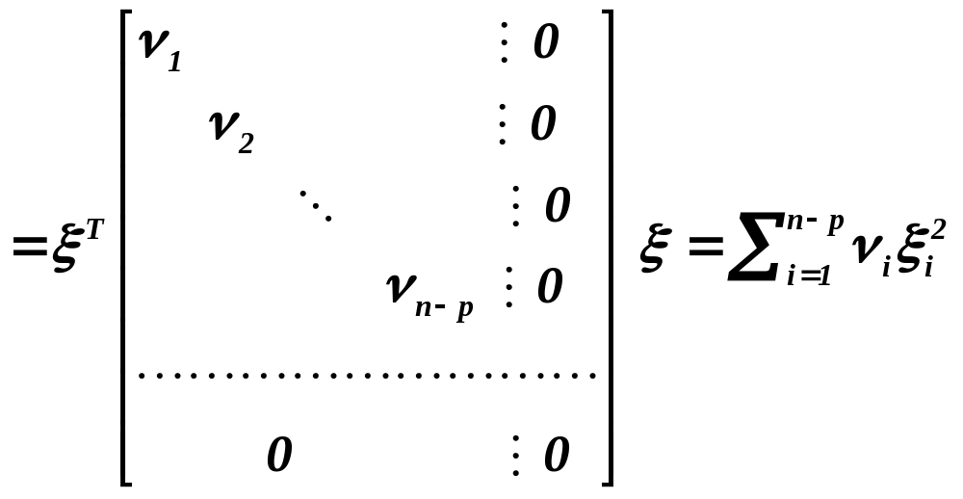
How to recognize that there is some dependence in the series ?
continued
.

Slide 29
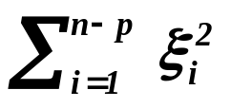
How to recognize that there is some dependence in the series ?
continued
So, we have
and
.
Finally,
.

Slide 30
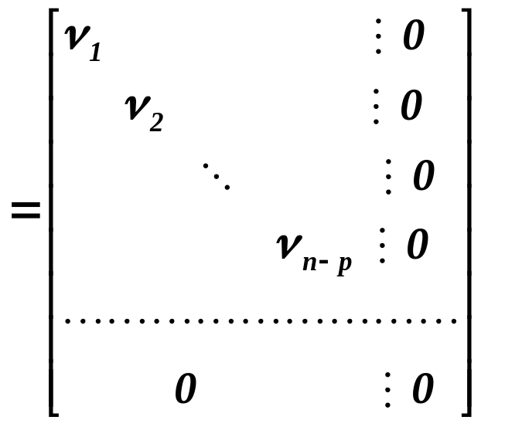
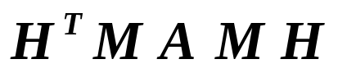


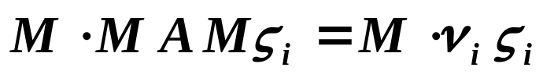
How to recognize that there is some dependence in the series ?
continued
By the way, we have found that
which implies that
‘s are also the eigenvalues of matrix ,
i.e.
.
Remember that M is the projection matric, i.e.
.
Then
,

Slide 31

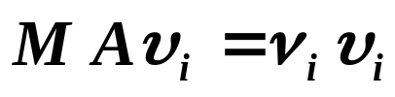

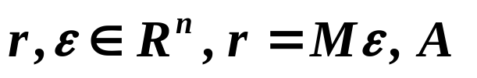
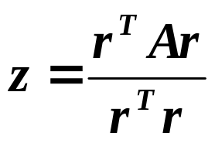
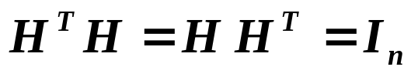
How to recognize that there is some dependence in the series ?
continued
i.e. putting
which implies that
‘s are also the eigenvalues of matrix .
So, we have prooved a part of
Theorem, J. Durbin, G.S. Watson (1952)
Assumptions
Let be a real, symmetric positive definite
matrix and
.
Assertions
Then:
There is an orthogonal transformation , so that

Slide 32
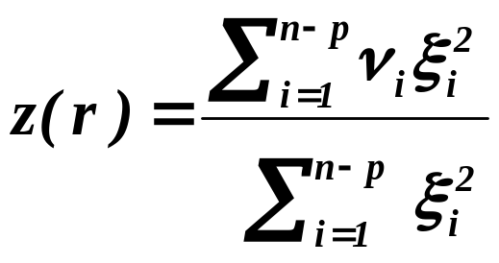




Theorem
continued
where ‘s are nonzero eigenvalues of the matrix .
Assumptions
Let n-p-s of columns of matrix X be linear combination of n-p-s
of eigenvectors of the matrix A.
Assertions
Then n-p-s numbers ‘s correspond to these eigenvectiors.
Reindex the other ‘s so that
and
where ‘s are eigenvalues of the matrix A, then
.

Slide 33
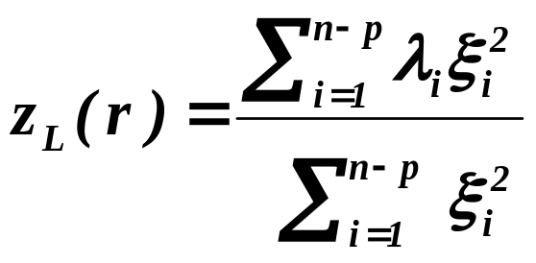
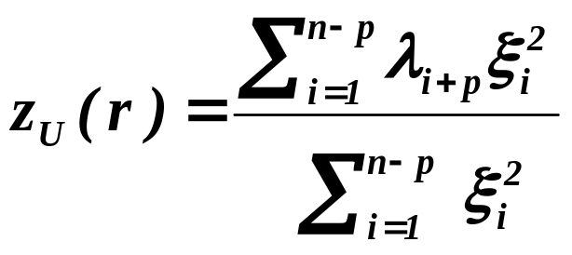
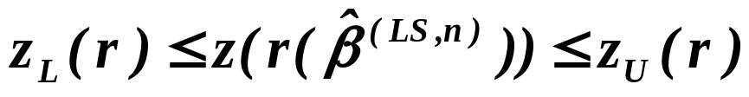
An econometrical folklore says that the approximate critical values
were found by
Corollary
Assertions
For
and
we have
.
In fact, it was as follows.

Slide 34
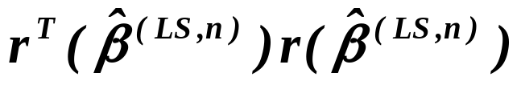
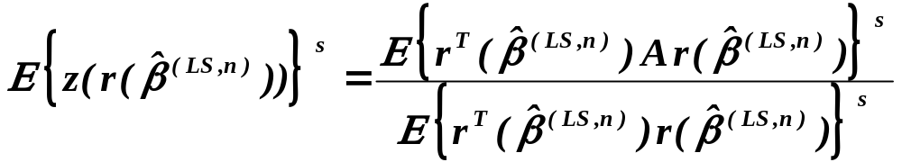
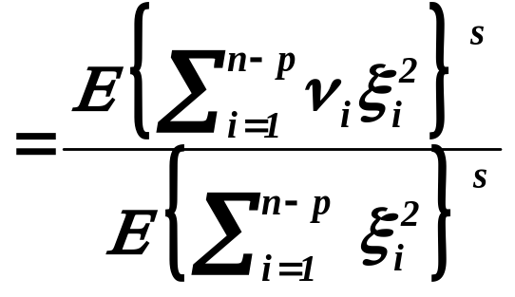
E.J.G. Pitman (1937) and J. von Neumann (1941)
and
are independent, i.e.
, i.e.

Slide 35


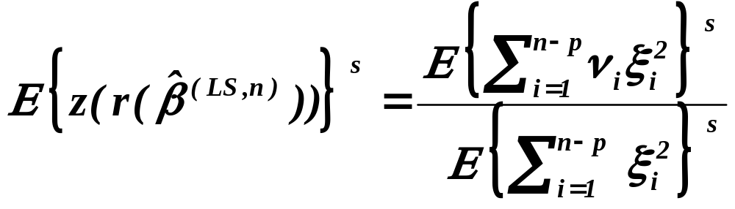


Now, under hypothesis
,
so that denominator of depend on the design
matrix X .
Employing Durbin-Watson theorem and
we can evaluate the lower and the upper bounds of moments of
and utilizing some expansions for d.f. (e.g.
Egworth’s ones), we can find the lower and the upper bounds
of the critical values , say and – under
assumption that we know the eigenvalues ‘s of the matrix A .

Slide 36


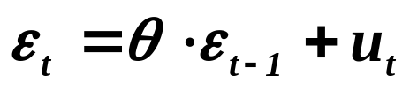
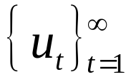
Remember that:
In 1948 T.W. Anderson constructed the most powerful test of
H: L ( )= N ( )
A: L ( )= N ( )
Remember also that J. Durbin and G.S. Watson specified
and they wrote A instead of .
Further in their paper they assumed
of course with being i.i.d. r.v.’s.
We have already showed ( in previous lecture ) that then

Slide 37
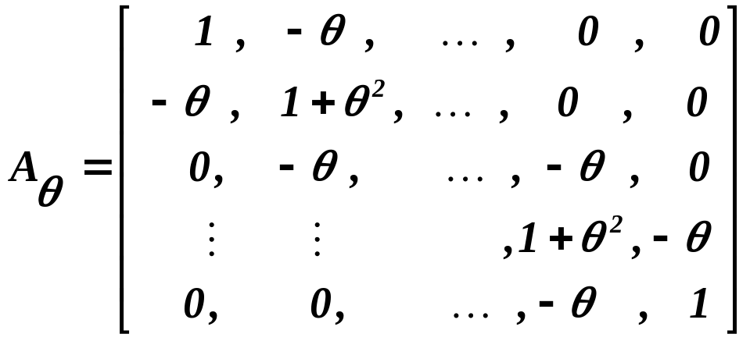


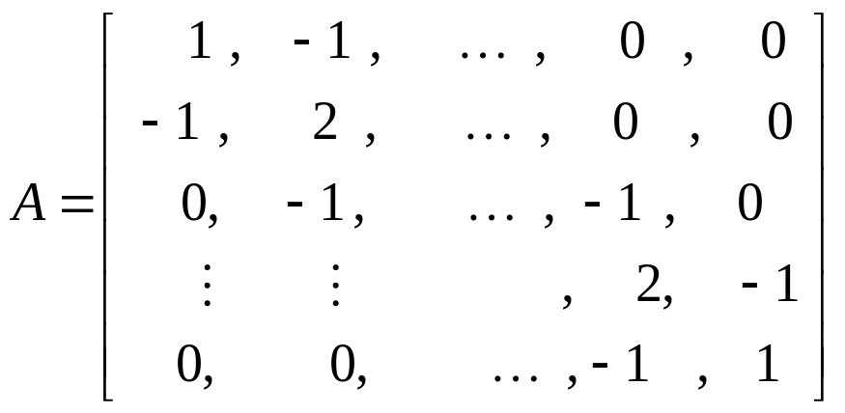
with (and we have neglected a constant in front of the
brackets). Taking for the extreme value 1, we have

Slide 38
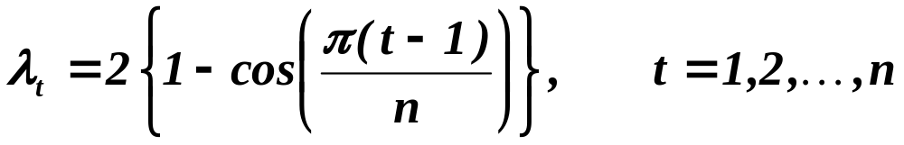

For the matrix A Jerzy von Neumann ( 1941 ) ( in a completely
different context, solving completely different problems ) found
and the Durbin-Watson statistic attains (finally) the form
which is commonly used.

Slide 39





Carrying out the square in the numerator
For
, i.e.
for independence of disturbances
.

Slide 40





For application we have :
in green zone - not rejecting independence
in red zone - rejecting independence
0
2
4
in blue zone - not being able to decide
We have to use some approximations !!!
( The critical values were tabulated , see e.g. J. Kmenta (1990). )

Slide 41




In 1971 Durbin and Watson proposed an approximation:
Evaluate at first
,
,
,
Solve equations
and

Slide 42






where
and were tabulated e.g. in Judge et al.
( 1986 ).
Approximation for exact critical value is then
.
Nowadays, there are some other ( more complicated
approximations ), so that statistical packages give directly
i.e.
0
2
4

Slide 43
Warning:
Assume that we consider regression model for cross-sectional data,
hence order of rows can be arbitrary.
The disturbances of individual observations are then independent,
except of special cases when there can be some correlations
between ( or among ) cases due to some special circumstances,
e.g. correlation between neighboring regions, correlations inside
some group of industries, etc. That is necessary to judge basically
heuristically, for one set of cross-sectional data no test is possible.
Assume independence of cases and
independence of hence disturbances .
What is the consequence ?

Slide 44
continued
Warning:
Any order of rows is possible, i.e. there are n! possible values
of D-W statistic. The frequencies of values should correspond
to the theoretical density of distribution of , so
for an appropriate number of orders of rows the D-W statistic
should attain values in the critical region.
In some econometric textbook D-W statistic is recommended
for cross-sectional data to be indication of misspecification
of model - such utilization should be accompanied
with a very high caution !!!!

Slide 45
We should consider the last problem:
We have constructed ARIMA ( p,d,q ) model and we want
to test whether the residuals are already independent.
As the first case we are going to assume that we have AR(p) model.
Very first idea can be to use just D-W statistic.
Unfortunately D-W statistic doesn’t work when among
the explanatory variables is ( are ) lagged values of
response variable !
There are two types f tests:
1) h-tests
,
2) m-tests
.

Slide 46





h-test, J. Durbin (1970)
Consider model
with
The null hypothesis :
h-test:
,
under the null hypotheses
.
However h-test cannot be used when

Slide 47



m-test, J. Durbin (1970)
Let’s assume the same framework.
m-test:
Consider the model
and test significance of
.
The advantage of m-test is that it can test also AR( p) , just by
testing the significance of in the model

Slide 48





Secondly, let’s assume that we have MA(1) model, i.e. .
In this case D-W test is approximately optimal. Exactly optimal
is the tests based on
where d is D-W statistic.
The test based on
where are residuals from the model estimated so
that we have taken into account that the disturbances are MA(1),
is the most powerful test of null hypothesis against the alternative
that or , critical values tabulated in King (1980).

Slide 49
It remains to answer
● How to recognize whether it is AR( p )
or MA( q ) ?
● How to estimate regression coefficients
when disturbances are AR( p ) or MA ( q ) ?
We shall do it in the next lecture !

Slide 50
What is to be learnt from this lecture for exam ?
• Reasons for studying all types of models
- AR(p), MA(q), ARMA(p,q), ARIMA(p,h,q)
• Durbin-Watson statistic
• Which type of model is to be used ?
• How large p, q and h shold be taken ?
All what you need is on
http://samba.fsv.cuni.cz/~visek/

