Slide 1

Tuesday, 12.30 – 13.50
Charles University
Charles University
Econometrics
Econometrics
Jan Ámos Víšek
Jan Ámos Víšek
FSV UK
Institute of Economic Studies
Faculty of Social Sciences
Institute of Economic Studies
Faculty of Social Sciences
STAKAN III
Second Lecture
(summer term)

Slide 2

Schedule of today talk
Recapitulating last lecture
Smoothing time series
• Exponential smoothing
(of the first, the second and the third order)
• Exponential smoothing
• Tests of randomness
• Intervention analysis
• Spectral analysis

Slide 3


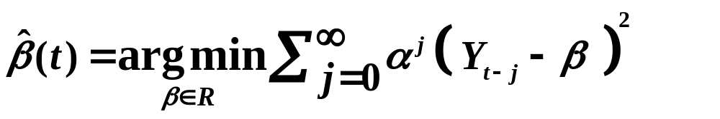

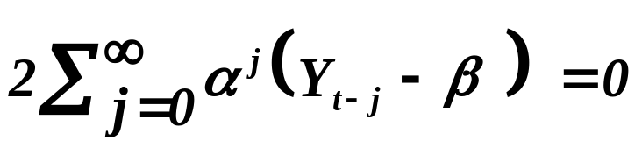
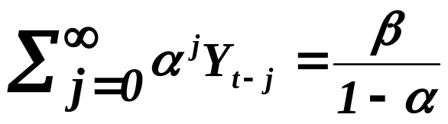

Exponential smoothing
“Exponential” indicates that the past values of the time series
are weighted down in an exponential rate.
In fact, we approximate the time series by a polynomial
of order k and the weights for the past values are
for some .
Exponential smoothing
of the first order, i.e. k=1
Notice, no
assumptions about
decomposition of
Normal equation
(notice please, that )

Slide 4
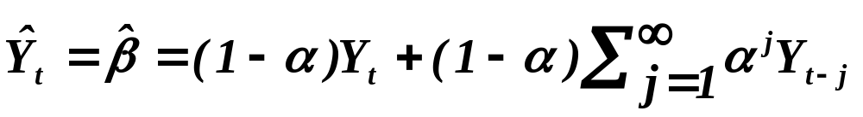
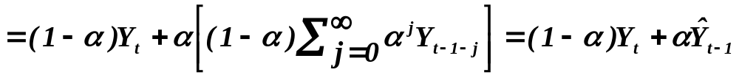

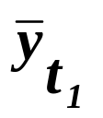
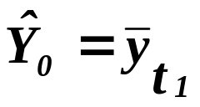
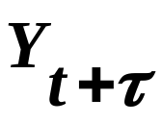


Exponential smoothing
continued
(1)
It means that the smoothed value can be evaluated recurrently.
Algorithm:
i) For some initial values evaluate mean
and put .
ii) Start recurrent evaluation as in .
(1)
iii) Predict any for small but for .

Slide 5


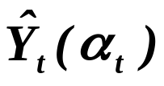




Exponential smoothing
continued
Optimality of . The following approach was usually advised:
Start with , about which you assume, due some ex-
periences, that is optimal. In every step evaluate next approxima-
tion for .
Finally, evaluate and select
that for which is the smallest. In practice, it means
that at every step we take into account that for which
is smallest. So, the algorithm is adaptive to the time series.
Nowadays, due to new computational technique you can invent
a lot of much more sophisticated approaches.

Slide 6
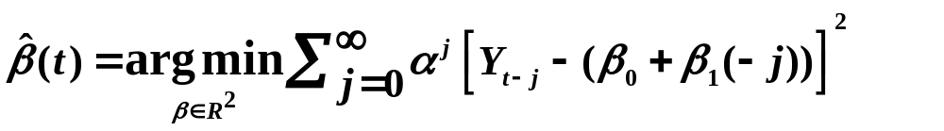
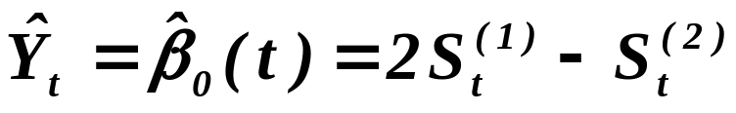
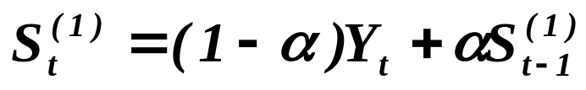
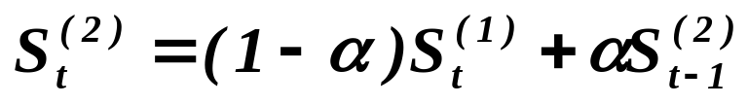
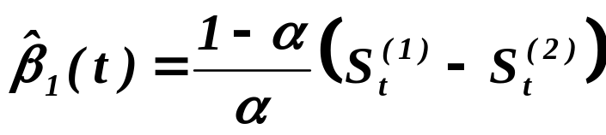
Exponential smoothing
continued
Exponential smoothing
of the second order, i.e. k=2
Solving normal equations we arrive at

Slide 7
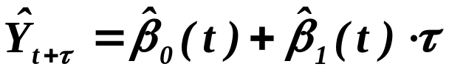
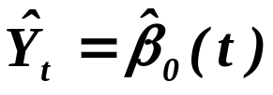
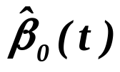
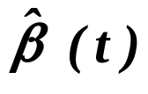
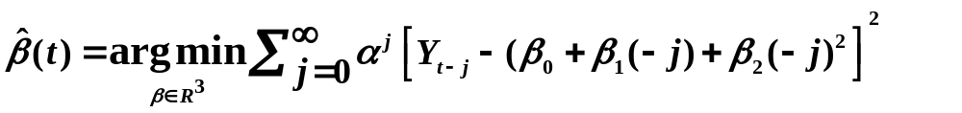
Exponential smoothing
continued
of the second order
and we may predict by
.
Notice that we have again , i.e. the smoothed value
of the time series is given by intercept of the regression model
but present is different from evaluated in the ex-
ponential smoothing of the first order !!
Exponential smoothing
of the third order, i.e. k=3

Slide 8


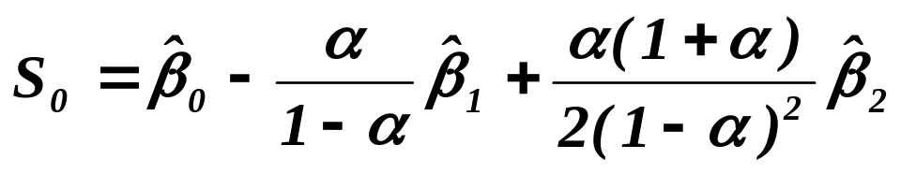
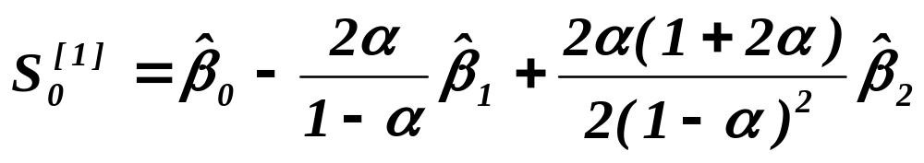

continued
Exponential smoothing
of the third order, i.e. k=3
Technicalities are, of course, a bit more complicated
than in the previous cases but manageable on PC:
From some n initial values of time series we evaluate, just
using OLS estimates of and . Then we put

Slide 9

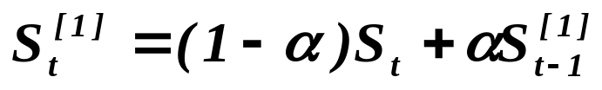
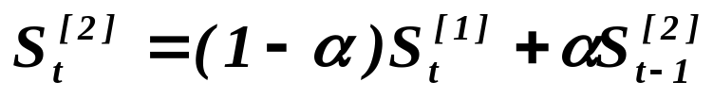
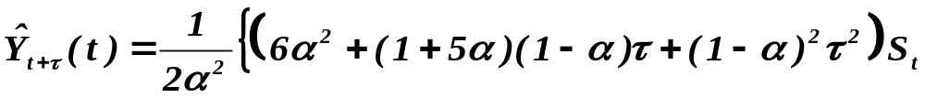
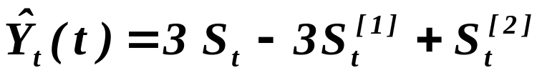
continued
Exponential smoothing
of the third order, i.e. k=3
Then
,
,
,
and
.

Slide 10

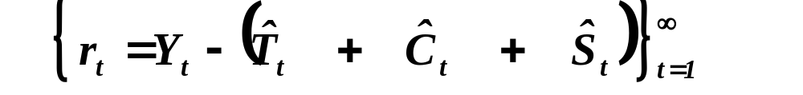
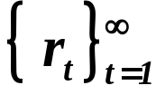
Smoothing time series
Remember, we have assumed
How we can learn that we have extracted properly all terms ?
Let us assume for a while that
and that we have properly extracted all term. Then
is approximately the sequence of i.i.d. r.v.’s.
So, we should test the sequence whether it is
(approximately) i.i.d. !
Moreover, remember, how we tested normality in linear
regression model (and “cancel” the word “approximately”)!

Slide 11





Tests of randomness
Test based on signs of differences of residuals
Put
and
.
Our plan is:
We shall find distribution function of ‘s, prove that they are i.i.d.
(except of neighbors), find their moment and employ CLT.
(Wolfowitz (1944))
If we assumed the d.f. of ‘s absolutely continuous,
So, we need to evaluate

Slide 12
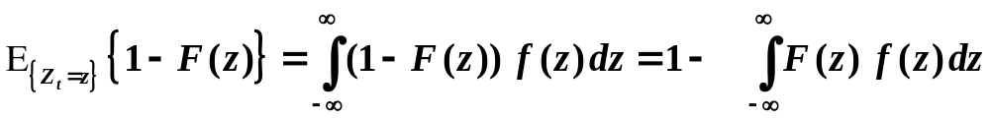
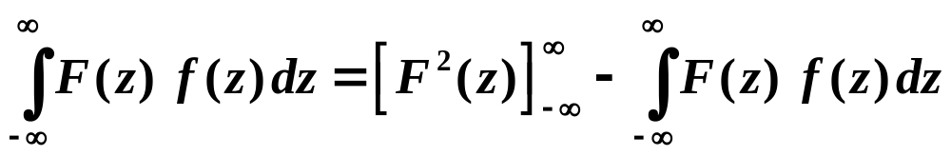
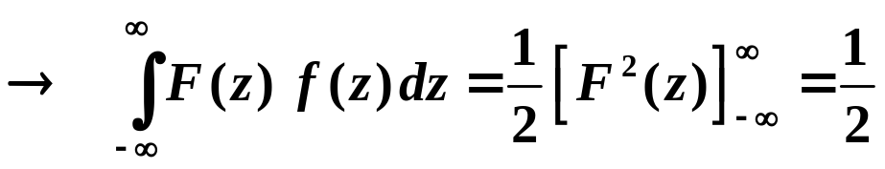
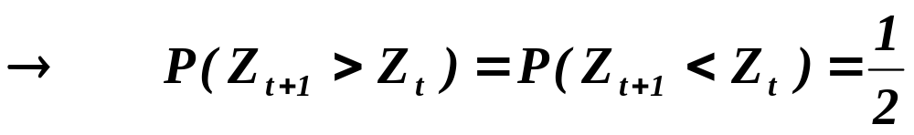
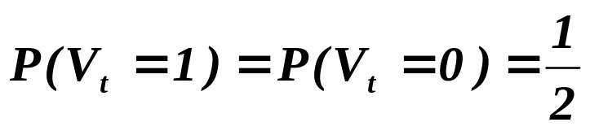
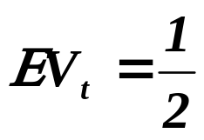
continued
Tests of randomness
Test based on signs of differences of residuals
,
that is what we need evaluate.
(After all, the common sense gives the same hint.)
Finally
and
.

Slide 13
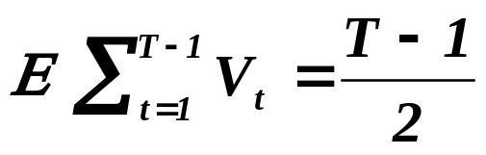
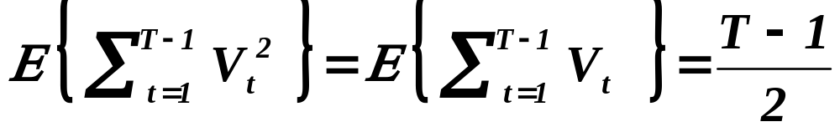
continued
Tests of randomness
Test based on signs of differences of residuals
So
(notice that we assume that we have observations from 1 to T ,
we have for t from 1 to T-1)
.
Now, we need
.
Notice that
.

Slide 14
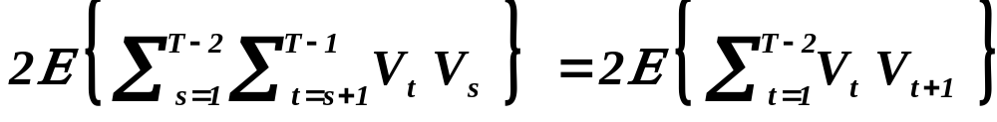
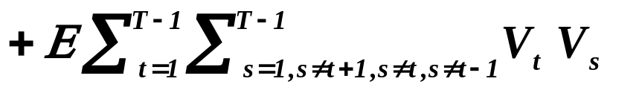






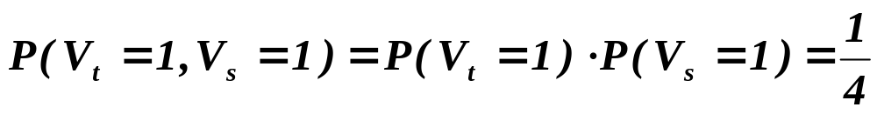

continued
Tests of randomness
Test based on signs of differences of residuals
So, we need to evaluate
.
So, we have to find
, two cases: either
or
.
For , and are evidently independent,
hence
,
notice again that we don’t need
etc. .

Slide 15

continued
Tests of randomness
Test based on signs of differences of residuals
Prior to looking for the probability for , let us find
how many cases we have for .
For
possibilities,
possibilities,
possibilities,
possibilities.
Totally, we have
possibilities.

Slide 16
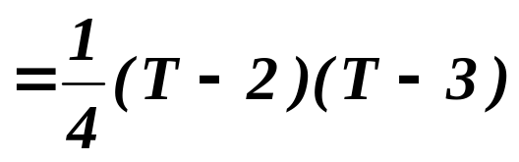
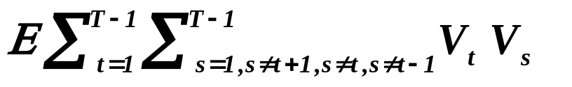


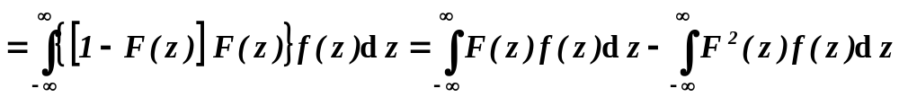
continued
Tests of randomness
Test based on signs of differences of residuals
So
.
For , we can assume (without loss of generality)
,
= ½
Is to be evaluated.

Slide 17
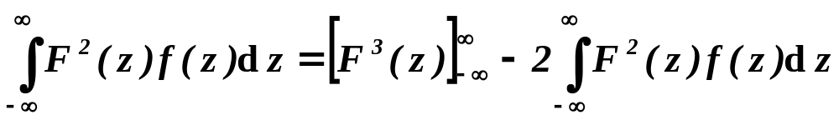
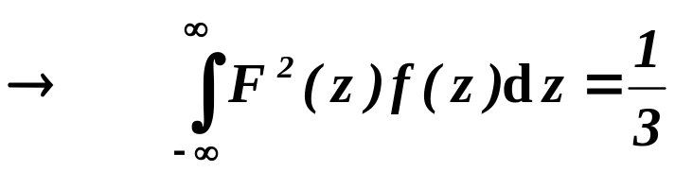
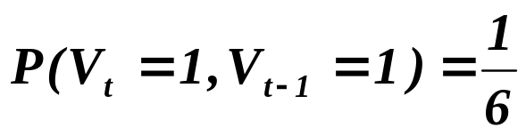
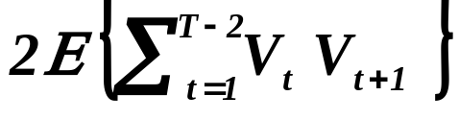

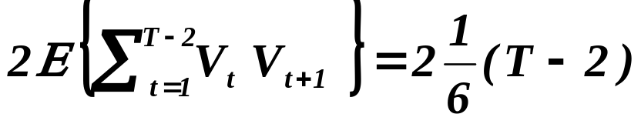
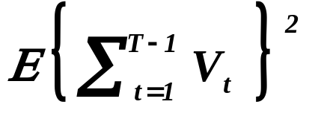
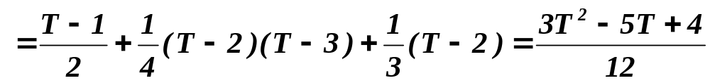
continued
Tests of randomness
Test based on signs of differences of residuals
.
Finally,
.
The sum has terms, hence
Finally, we have

Slide 18
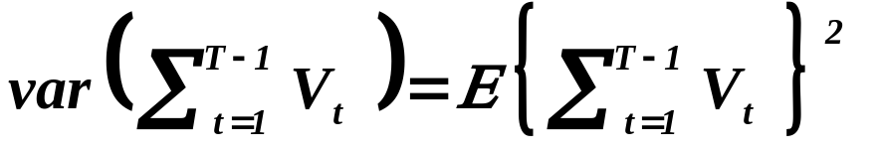
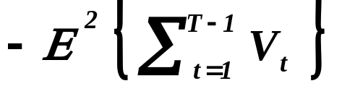



continued
Tests of randomness
Test based on signs of differences of residuals
So, we have find that
,
i.e. if
we reject the hypothesis about randomness of residuals
at α% significance level.

Slide 19





continued
Tests of randomness
Test based on number of points of reverses
Upper
,
lower
reverse.
r – number of (upper and lower) reverses
.
Finally,
+ corresponding test.

Slide 20





Intervention analysis
Let us recall once again that we have assumed
- irregular part,
representing some nonstochastic, rarely occurring
events (oil-shocks, terrorist attacks, wars, etc.)
There are several possibilities:
1) At the “suspicious” point, say , we put
,
2) from the “suspicious” point , we put
.

Slide 21






continued
Intervention analysis
How to test that the intervention is significant ?
Explanation by standard regression analysis:
Assume model
Assume model
(RESTRICTED)
with
and as an alternative one
(UNRESTRICTED)
with
and employ
which has (asymptotically) distribution.
(S² … sum of squared residuals)

Slide 22




continued
Intervention analysis
How to test that the intervention is significant ?
An alternative possibility:
Assume model
(RESTRICTED)
with
and as an alternative one
(UNRESTRICTED)
with
and employ
q columns
which has (asymptotically) distribution.

Slide 23
continued
Intervention analysis
How to test that the intervention is significant ?
In the same way we may test the significance of the estimated
value(s) of the irregular term , just evaluating F statistic
and comparing it with the corresponding F-quantile.

Slide 24




Spectral analysis of time series
The main idea is based on representation of function
by Fourier series (we shall restrict ourselves on this idea).
Any real function of real argument can be assumed to be
a vector with such number of coordinates as
is the number of real numbers.
- the vector space of functions ,
which are squared integrable,
i.e. the integral
is finite.
We are used that the base of the vector space contains number
of vectors equal to the dimension of given space (which is equal
to the number of coordinates of every vector).

Slide 25





continued
Spectral analysis of time series
However has countable base, i.e. there is a system of
functions such that for any
there is a sequence of real numbers such that
.
Theorem.
The system of complex functions
( where i is the imaginary unit ) is orthonormal complete system
in .
We shall not prove that it is complete but we show that it is
orthonormal.

Slide 26






continued
Spectral analysis of time series
To show that the elements of the base are orthonormal,
we need to find that
Recall that
For
this is everywhere

Slide 27




continued
Spectral analysis of time series
as follows from the antisymmetry
of sin(x), i.e. that sin(-x) = -sin(x)
For
.

Slide 28




continued
Spectral analysis of time series
Consider a function
.
From the Theorem
we know that there is a sequence of real numbers such
that
.
Moreover, it is possible to prove that
.
How to find coefficients of Fourier expansion?
The answer is surprisingly simple!

Slide 29






continued
Spectral analysis of time series
Evaluate for a fixed
where is the complex-conjugate function to ,
i.e. e.g. the function
to the function
.

Slide 30







continued
Spectral analysis of time series
Having values of time series, say , we evaluate
empirical counterparts to as
for all for which where
is a priori assigned constant, determining preciseness
of smoothing.
Finally we put
.

Slide 31
What is to be learnt from this lecture for exam ?
• Time series - exponential smoothing
- the first order,
- the second order,
- the third order.
• Tests of randomness
• Intervention analysis
• Spectral analysis
All what you need is on
http://samba.fsv.cuni.cz/~visek/

