Slide 1

Tuesday, 14.00 – 15.20
Charles University
Charles University
Econometrics
Econometrics
Jan Ámos Víšek
Jan Ámos Víšek
FSV UK
Institute of Economic Studies
Faculty of Social Sciences
Institute of Economic Studies
Faculty of Social Sciences
STAKAN III
Tenth Lecture

Slide 2

Schedule of today talk
Confidence intervals and regions
Testing hypothesis about submodels
Chow’s test of identity of models

Slide 3
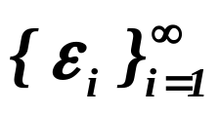
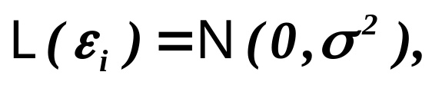


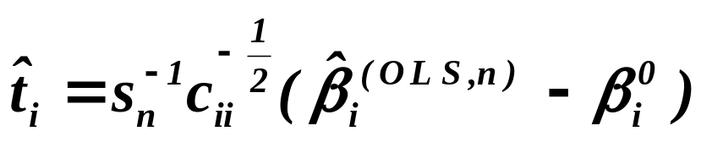
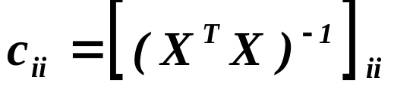
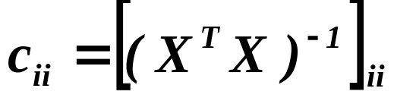
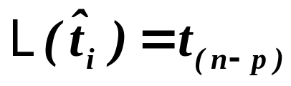





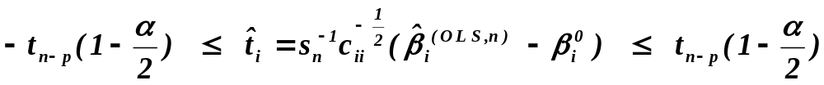
In the fourth lecture we had
Lemma
Assumptions
Let be iid. r.v’s .
Moreover, let
and be regular. Put
where .
where
,
Assertions
then
is called
Then
,
studentization.
,
i.e. is distributed as Student with d. f..
It immediately gives % confidence interval for the i-th coordina-
te of
(We shall start with this row on the next slide.)

Slide 4
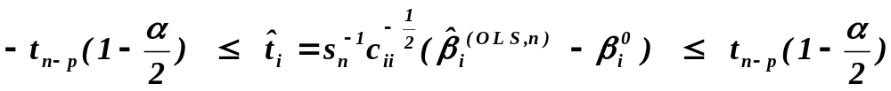
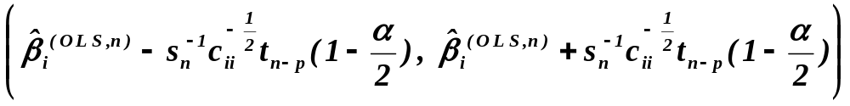


So, the promised row:
Hence the interval
covers with probability .
What about a confidence interval for several parameters,
simultaneously?
At sixties, the rectangular confidence intervals were studied,
employing mainly so called Bonferroni inequality.
From the beginning of seventies, due to fact that better results about
joint d.f. were available, mostly confidence intervals of the shape
of rotational ellipsoids were considered.

Slide 5
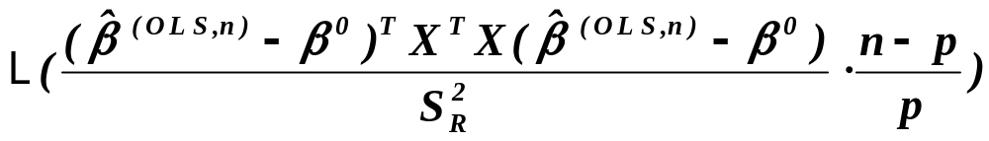


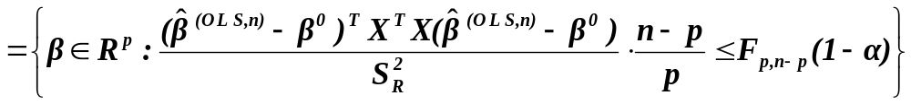

Also in the fourth lecture we had
Corollary
Assumptions
Let be iid. r.v’s .
Moreover, let
and be regular.
Assertions
Then
.
is Fisher-Snedecorovo .
It immediately gives % confidence interval for ( as vector )

Slide 6




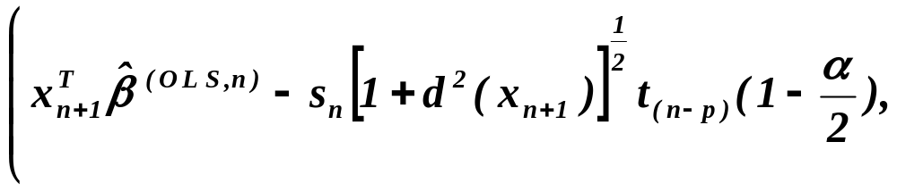
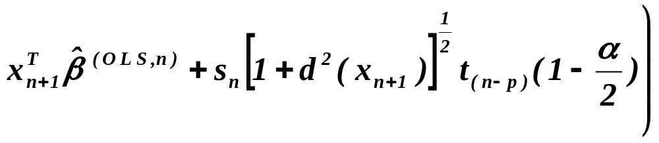

Confidence interval for at
Lemma
Assumptions
Let be iid. r.v’s .
Moreover, let
and be regular. For put
.
where
,
Assertions
then
is called
Then confidence interval
,
studentization.
covers with probability .

Slide 7



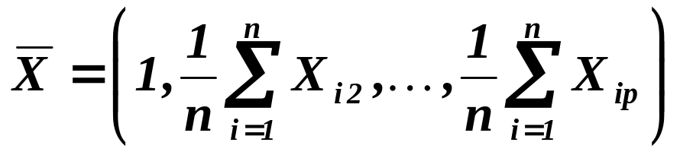
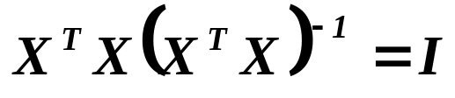
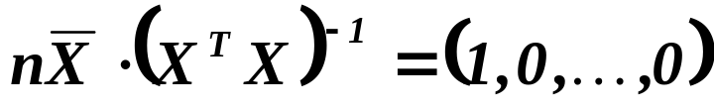
Prior to proving the lemma ......
Let us make an idea what represents
(assuming intercept in model).
The first row (and of course also column) of is
where
.
Hence

.
Then

Slide 8
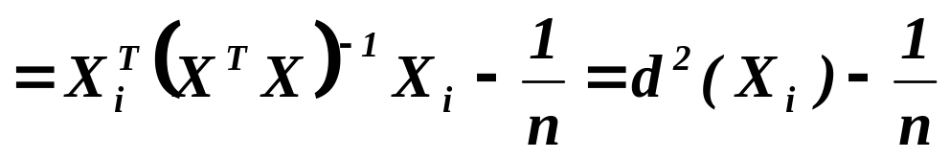
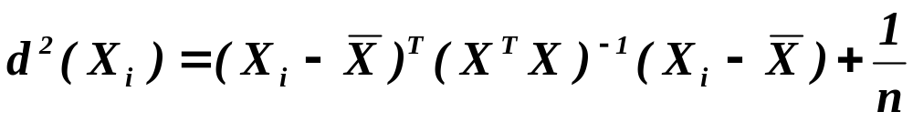
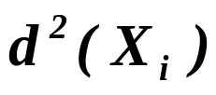



Let us make an idea what represents
continued
(assuming intercept in model).
Finally
,
in words : is a distance of from (i.e. from
a “gravity center”) in Riemann space with the metric tensor
which is constant over the whole space.

Slide 9
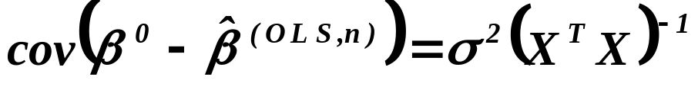
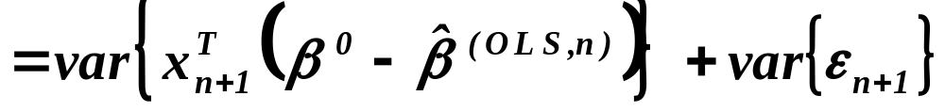
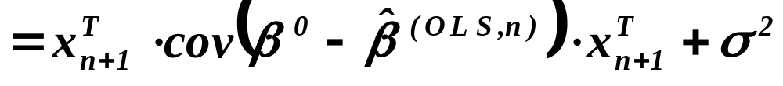
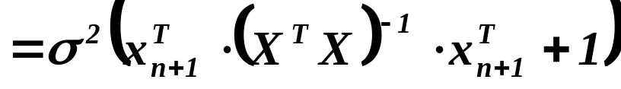
Proof of Lemma
Let’s recall that
We have
.
and

Slide 10
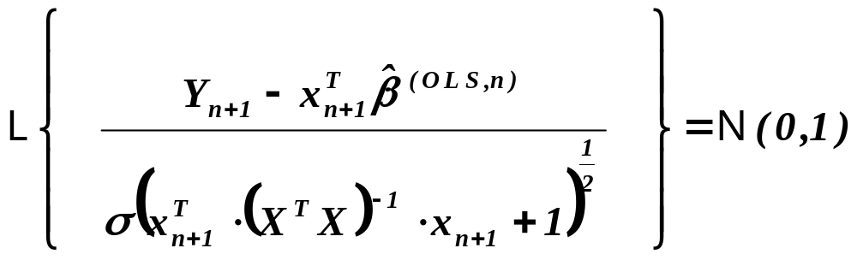
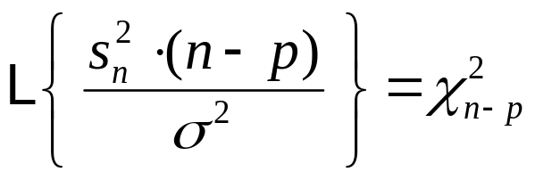
Proof - continued
From

,

.
From the 4-th lecture
and is (statistically) independent from .

Slide 11
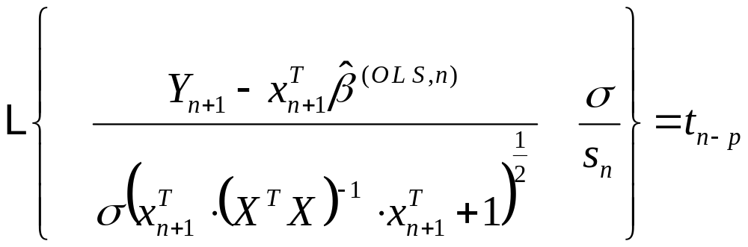
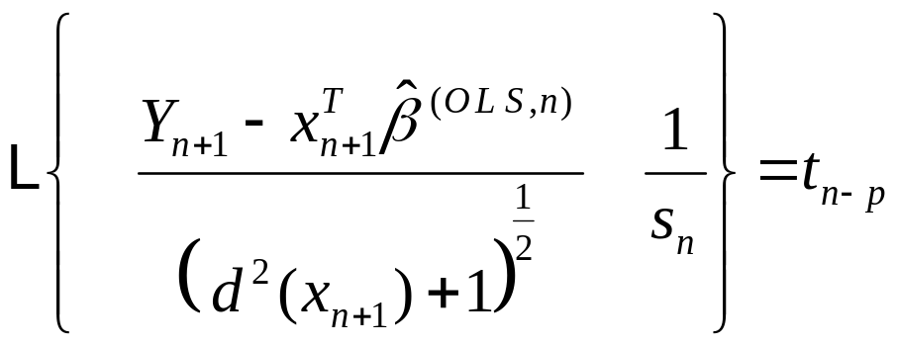
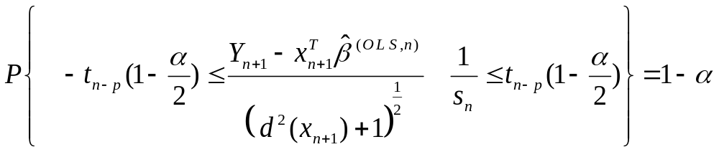
Proof - continued
Hence
,
i.e.
.
From it
QED

Slide 12
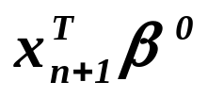
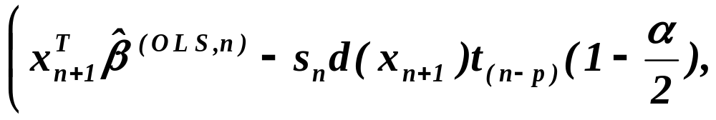
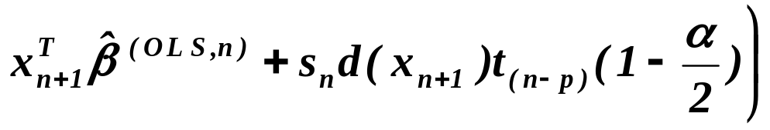
Confidence interval for
Lemma
Assumptions
Let be iid. r.v’s .
Moreover, let
and be regular. For put
.
where
,
Assertions
then
is called
Then confidence interval
,
studentization.
covers with probability .

Slide 13
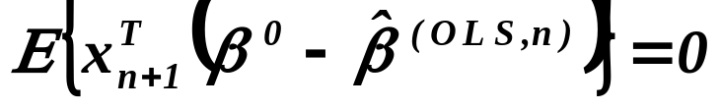
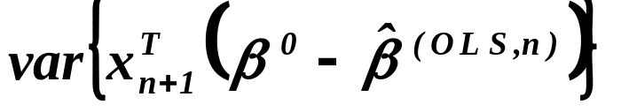
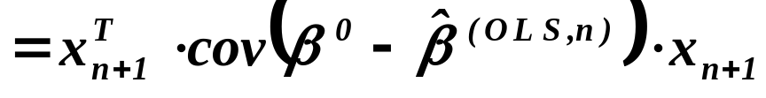
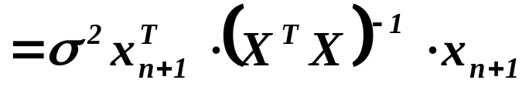

Proof
We have already recalled that
We have
and
.
From normality of

,

Slide 14
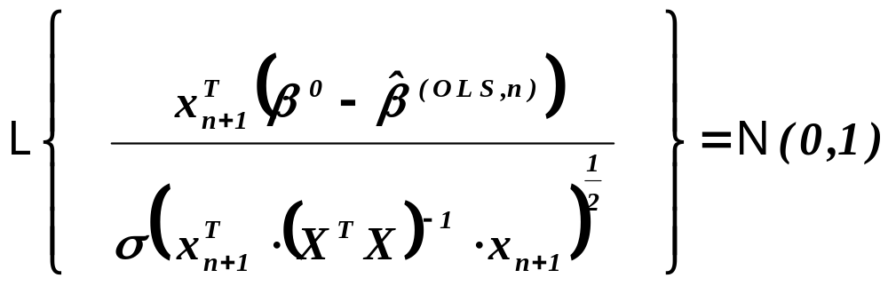
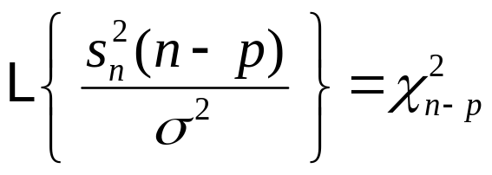
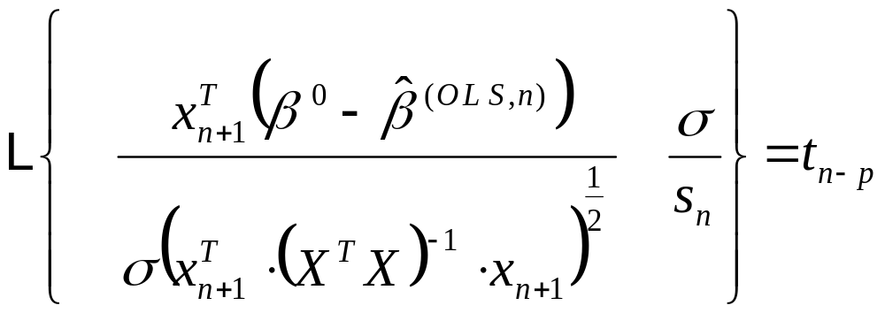
Proof - continued

.
Again from the 4-th lecture
and is (statistically) independent from .
Hence
,

Slide 15
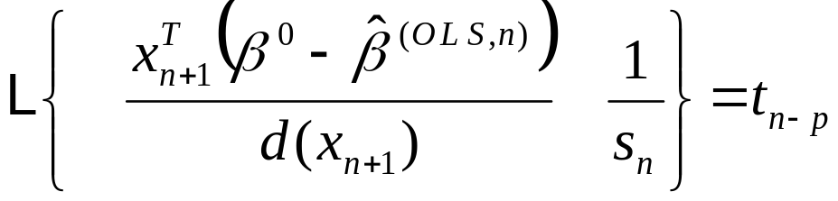
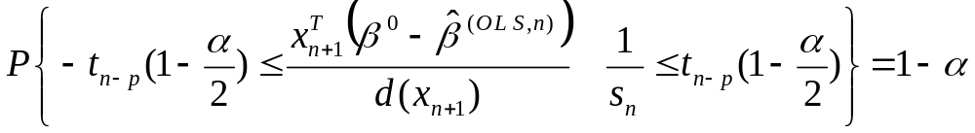
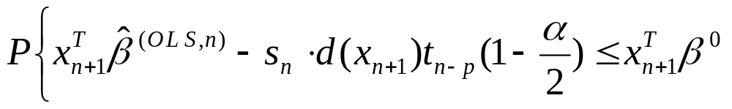
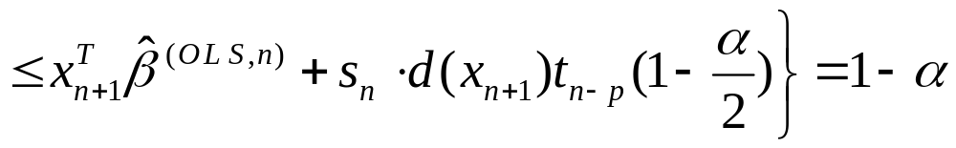
Proof - continued
i.e.
.
From it
and it finally gives
.
QED

Slide 16
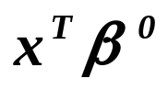
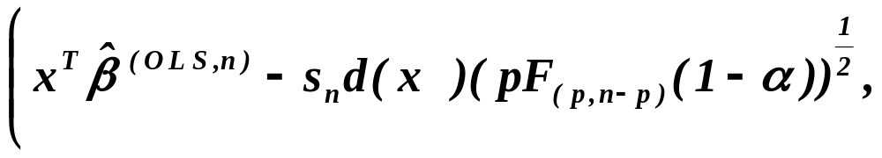
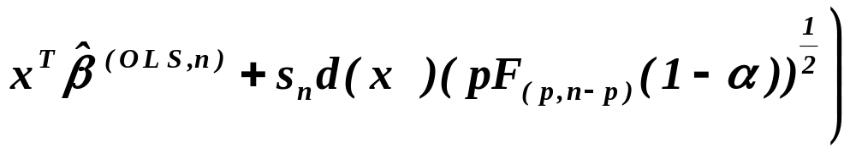

Confidence interval for
Lemma
Assumptions
Let be iid. r.v’s .
Moreover, let
and be regular. For put
.
where
,
Assertions
then
is called
Then the confidence region
,
studentization.
covers for all simultaneously
with probability .
The proof is a bit more involved and will be omitted.

Slide 17



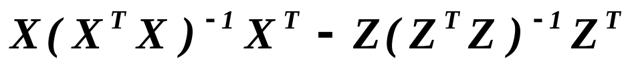
Testing submodels
We shall test the hypothesis that the “true” model is
against the alternative that the “true” model is
under assumption that
.
Assertion
Assumptions
First of all
Let .
where
,
Assertions
then
is called
Then the matrix
,
studentization.
is a projection matrix, i.e. symmetric and idempotent.

Slide 18
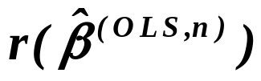

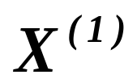

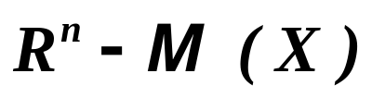

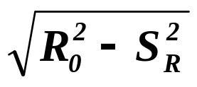



Testing submodels
Y
.

Slide 19



Proof of Assertion
Since
the projection of matrix into the space
gives the same matrix
, i.e.
.
Since the projection matrices are symmetric, we have also
Let’s calculate
QED

Slide 20










Testing submodels
continued
Lemma
Assumptions
Let be iid. r.v’s .
Moreover, let
and and be regular,
with ranks and , respectively. Further, let ,
, and be corresponding the least squares esti-
mator of and sums squares with respect to and .
where
,
Assertions
then
is called
Then
,
studentization.
,
i.e. the statistic
is distributed as Fisher-Snedecor with and
degrees of freedom.

Slide 21


Proof of Lemma
Let us decompose
.
Both matrices and are
idempotent 
and
,
i.e.
.
The matrix
is also
idempotent, i.e.

Slide 22




Proof - continued
Along the same lines and since
,
Fisher-Cochram lemma says that
,
and the quadratic forms are independent. Moreover

Slide 23



Proof - continued
Along the same lines
,
and finally
.
Finally
.
QED

Slide 24






Chow test
Framework of the problem:
Let us consider as a hypothesis the model
,
(1)
.
E.g. the super index “1” stays for the first period ( in question )
while the super index “2” stays for the second one.
As an alternative we consider the model
,
(2)
.
In words, the alternative says that the parameters ‘s were
the same in the both periods.

Slide 25


Chow test
Let us modify the framework :
H:
,
A:

Slide 26

Chow test
It is immediately evident that
,
It is immediately evident that we can obtain q first column
of the left matrix as combinations of 2q first columns of
of the right matrix. So, we may utilize previous lemma for
testing the “left” model as a submodel of the “right” one.

Slide 27






Chow test
Lemma
Assumptions
Let and be sums of the squared residuals in
the model (1) and (2), respectively.
where
,
Assertions
then
is called
Then
,
studentization.
i.e. the statistic
is distributed as Fisher-Snedecor with and
degrees of freedom.

Slide 28
Confidence intervals and regions
Testing hypothesis about submodels
Chow’s test of identity of models

Slide 29
What is to be learnt from this lecture for exam ?
Confidence intervals and regions
- of individual regression coefficients,
- simultaneous for all coefficients,
- for value of model at given point,
- for response variable.
Testing submodels.
Chow’s test.
All what you need is on
http://samba.fsv.cuni.cz/~visek/

