Slide 1

Tuesday, 12.30 – 13.50
1
Charles University
Charles University
Econometrics
Econometrics
Jan Ámos Víšek
Jan Ámos Víšek
FSV UK
Institute of Economic Studies
Faculty of Social Sciences
Institute of Economic Studies
Faculty of Social Sciences
STAKAN III
Eighth Lecture
(summer term)

Slide 2

2
Schedule of today talk
● Limited Response Variable
● Model with Varying Coefficients

Slide 3
Limited Response Variable
3
The pioneering paper:
James M. Tobin (1958): Estimation of relationship for limited
dependent variables. Econometrica, 26, 24 – 36.
Examples:
● Expenditure of households on durable goods
Purchase is not made until “desire” or “need”
to buy the good exceeds a certain level.
So, either the “desire” is close to this level or is very low,
the zero is in data for the corresponding household.
In other words, the response variable is cut by zero,
since “negative” expenditure corresponding to various
levels of “desire” fall under the treshold.

Slide 4
continued
Limited Response Variable
4
● Wage of married women
Only the wages of women who are in labor force,
are recorded.
In other words, the wages of women
whose “reservation wage”,
i.e. a prize of work made for family at home,
is larger than their market wage is zero (in data).
It means that all women who work for their families,
without distinction whether her “reservation wage” barely
exceeds their market wage or is much larger than it,
have zero in data (at the column “wage”).
The restriction on response variable matters in the case
when the probability of “cutting the true value of response”
is not negligible, i.e. it is when probability of falling below
the treshold is not very small.

Slide 5
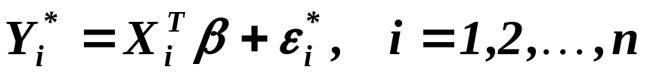



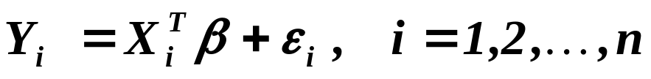


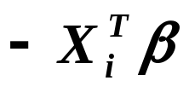
Limited Response Variable
continued
5
Assume that the process is governed by
but we observe ‘s only if they are positive, i.e. we observe
and
.
So, we have
where ‘s are truncated from below by 0 and ‘s by .
Such model is called censored or Tobit.

Slide 6
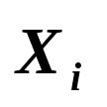
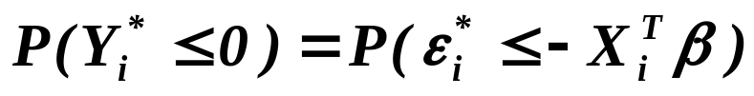

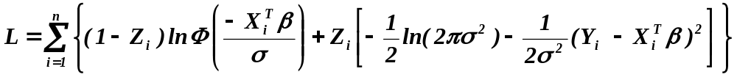


Limited Response Variable
continued
6
We may meet with situation when also ‘s are truncated
and then we usually speak about truncated model,
Takeshi Amemiya (1984): Tobit models: A survey. J. of Econometrics, 3 – 61.
In what follows – Tobin models, only. We have
,
( * )
so assuming that the disturbances are normally distributed ( with
variance ), we can write
where
and
otherwise.

Slide 7
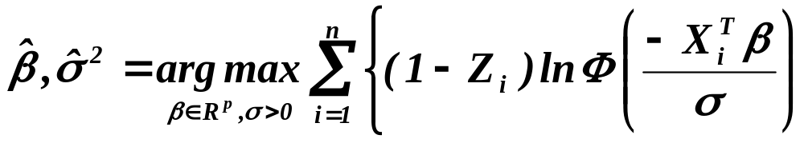
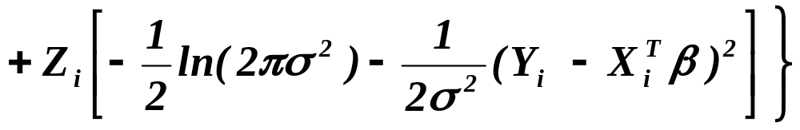
Limited Response Variable
continued
7
So we put
and solve it numerically, e.g. by EM algorithm
(expectation-maximizing algorithm – see e.g.
William H. Greene (2000): Econometric Analysis, Prentice-Hall).

Slide 8
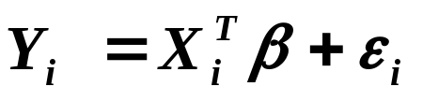

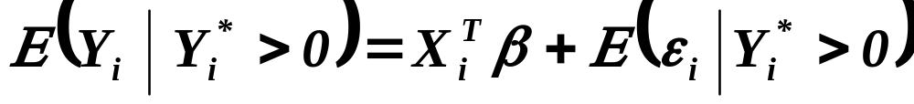
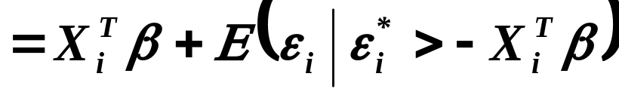
Limited Response Variable
continued
8
Two-Step Estimation - James J. Heckman (1979): Sample selection bias
as a specification error. Econometrica 47, 153 – 161.
Assume that for m from n observation
i.e.
.
For them we have
where ‘s and ‘s have truncated normal distribution ( with
variance ), i.e. we have

Slide 9
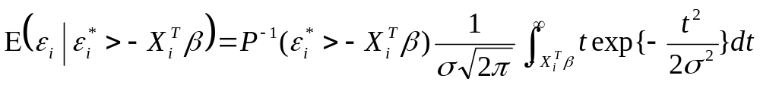
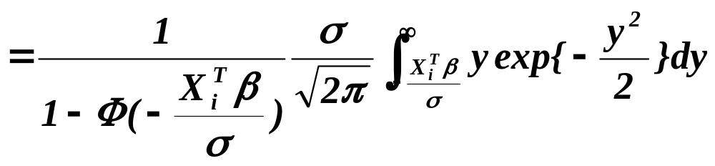
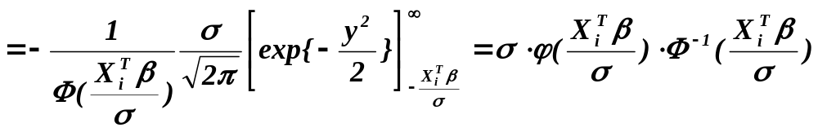
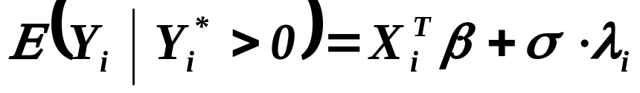
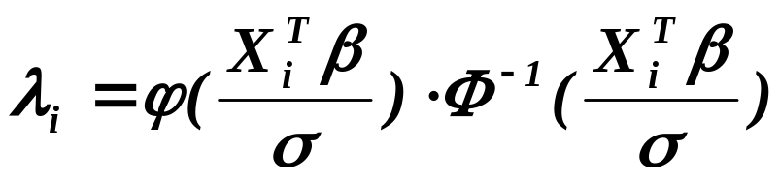
Limited Response Variable
continued
9
So, we have
with
.

Slide 10
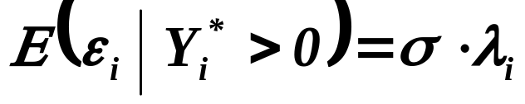
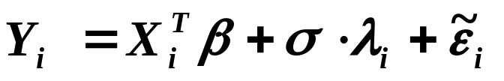
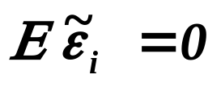



Limited Response Variable
continued
10
In fact, we have found
and so we can write
( 1 )
where already
.
Were ‘s available (observable ), we can estimate coeffs in
( 1 )
consistently and efficiently.
Nevertheless, putting
and
,

Slide 11
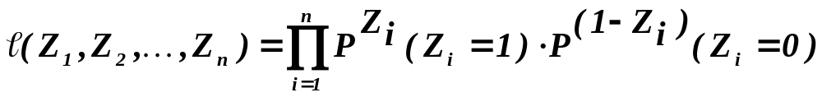
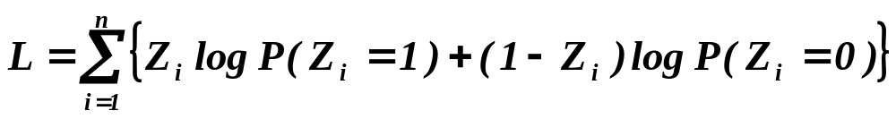
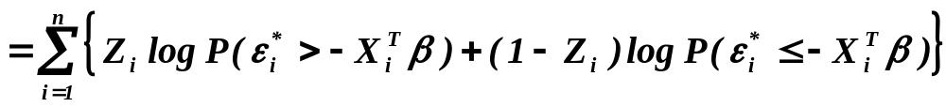
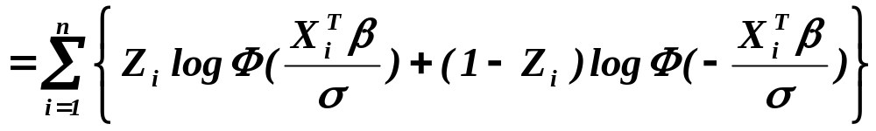
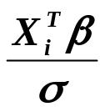
Limited Response Variable
continued
11
we have likelihood
( * )
and hence log-likelihood (see a few slides back)
( 2 )
But is of course the log-likelihood of a probit model
( 2 )
and hence we can consistently estimate , i.e. also .

Slide 12
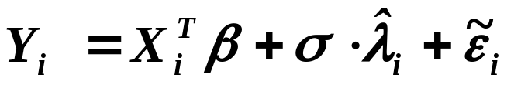

Limited Response Variable
continued
12
Then we put
,
and estimate, by means of OLS, consistently
(but not efficiently) .
However, nowadays there is a way how to improve this estimate
just to add the third step – in fact applying GMM-estimation.
(We shall return to it later – may be in the last lecture of term.)
OLS corrected for asymptotic bias - William H. Greene (1981):
On the asymptotic bias of the ordinary least squares estimator of Tobit model.
Econometrica 49, 505 – 513.

Slide 13
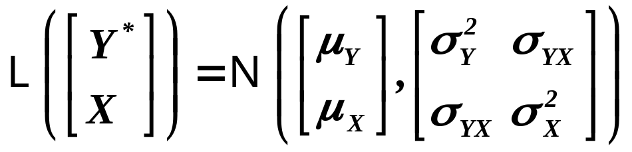

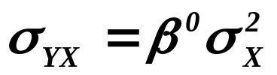
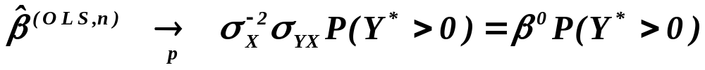
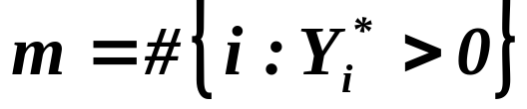
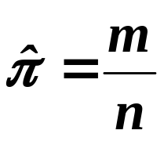
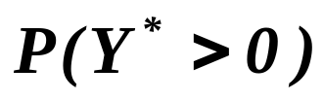
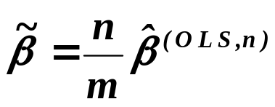

Limited Response Variable
continued
13
Theorem (Greene, 1981, Econometrica, Kmenta)
Assumptions
Assume for the simple regression model that
with
and
.
Assertions
Then
Put , then is the consistent estimator of
and hence is the consistent estimator of .

Slide 14
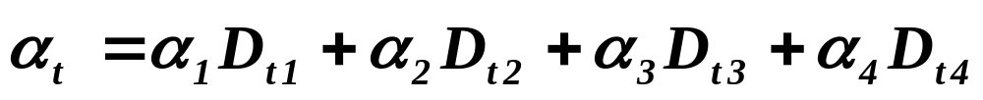
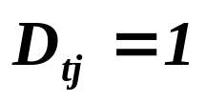

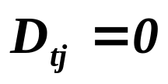
Model with Varying Coefficients
14
Systematic coefficients variation
Three examples:
Seasonal variation of coeffs -
– usually intercept is different for different seasons
with
and
for the j-th quarter
otherwise.
The model is frequently called season-dependent model.

Slide 15
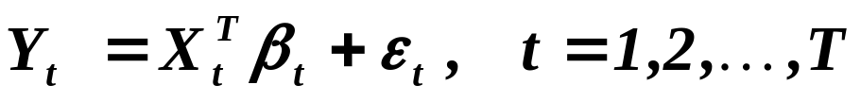


Model with Varying Coefficients
continued
15
Systematic coefficients variation
Time variation of coeffs -
– usually slopes are dependent on time
( 1 )
with
.
( 2 )
The model is frequently called trend-dependent model.
The substitution of ( 2 ) into ( 1 ) gives
and the test of significance of coeffs is the test of hypothesis
that the model is not trend-dependent.

Slide 16
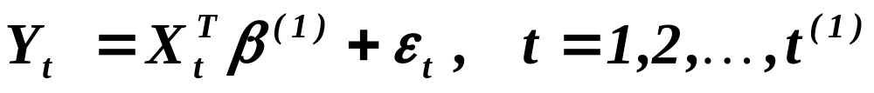
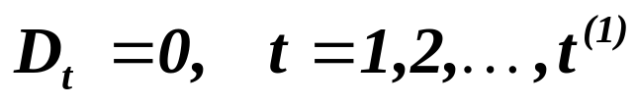
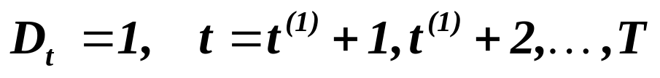
Model with Varying Coefficients
continued
16
Systematic coefficients variation
Switching regression -
– there are several regimes among which the model “moves”
and
.
The model can be written as
with
and
.

Slide 17
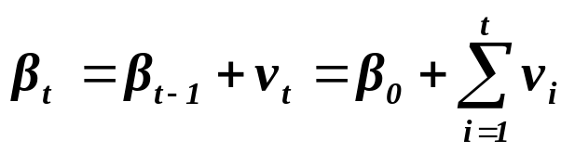



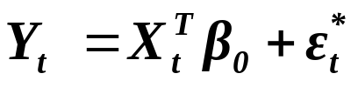
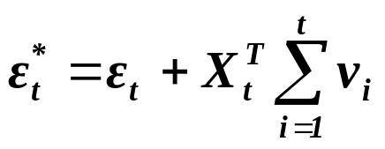
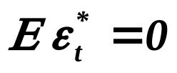


Model with Varying Coefficients
17
Random coefficients variation
Generalizing a bit Time variation of coefficients model
( 1 )
with
( 2 )
i.i.d., independent from , positive definite
( the model is frequently called adaptive regression model)
Substituting ( 2 ) into ( 1 ) gives
with
,
yielding
,
and
.

Slide 18
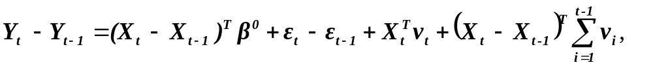

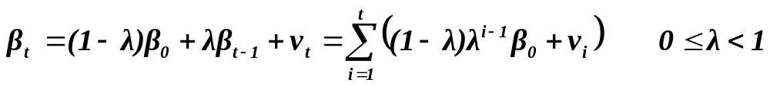
Model with Varying Coefficients
continued
18
Random coefficients variation
So, the model is heteroscedastic with correlated disturbances.
Nevertheless, from
coefficients can be estimated consistently (of course without bias).
J. Johnston (1984): Econometric Methods. McGraw-Hill, NY.
Convergent parameter model
( 1 )
with
( 2 )
i.i.d., independent from , positive definite
Substituting again ( 2 ) into ( 1 ) gives

Slide 19

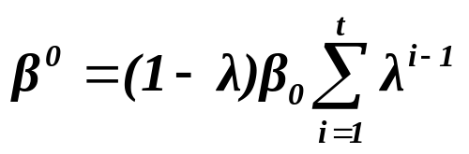
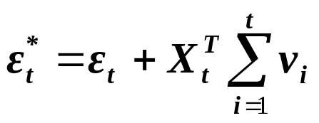
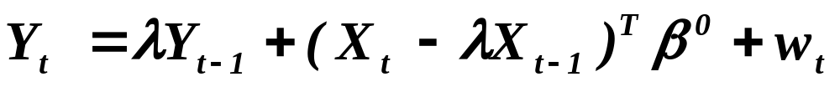
Model with Varying Coefficients
continued
19
Random coefficients variation
with ,
.
It implies
,
and
.
So, the disturbances are heteroscedastic and correlated. Again
,

Slide 20
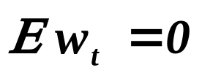
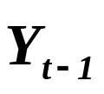




Model with Varying Coefficients
continued
20
Random coefficients variation
Clearly
and
.
Moreover, is correlated with through
.
So, we have to employ instrumental variables
( as a “natural” instrument, we can use ).
B. Rosenberg (1973): The analysis of a cross section of time series
by stochastically convergent parameter regression.
Ann. of Economic and Social Measurement, 2, 399 - 428.

Slide 21





Model with Varying Coefficients
continued
21
Random coefficients variation
Random coefficient model
C. Hildreth, J. Houck (1968): Some estimator of linear model
with random coefficients.
J. of the American Statistical Association 63, 584 – 595.
( 1 )
with
where is a d.f.. So, we may write
( 2 )
with
.

Slide 22





Model with Varying Coefficients
continued
22
Random coefficients variation
The substitution of ( 2 ) into ( 1 ) gives
with
and hence
,
and
.
So, the disturbances are heteroscedastic but uncorrelated.
The coefficients can be estimated either by ML or by GMM .
The models are equivalent to ARCH
(autoregressive conditionally heteroscedastic) models
(you will meet with them next year).

Slide 23
What is to be learnt from this lecture for exam ?
• Limited response variable
- Tobit model and idea of its estimation in one step,
- Heckman’s idea of two step estimation,
- Green’s idea of correcting asymptotic bias.
• Model for seasonal variation of coeffs
• Time variation of coefficients model
- adaptive regression model
• Random coefficient model
All what you need is on
http://samba.fsv.cuni.cz/~visek/

