Slide 1

Tuesday, 12.30 – 13.50
Charles University
Charles University
Econometrics
Econometrics
Jan Ámos Víšek
Jan Ámos Víšek
FSV UK
Institute of Economic Studies
Faculty of Social Sciences
Institute of Economic Studies
Faculty of Social Sciences
STAKAN III
Seventh Lecture
(summer term)

Slide 2

1
Schedule of today talk
We shall discuss in this lecture the only topic:
● Qualitative (Discrete) Response Variable
i) The Linear Probability Model
ii) The Probit Model
iii) The Logit Model

Slide 3
Qualitative (Discrete) Response Variable
2
Frequently we meet with:
● response variable represents some zero-one state,
e.g. employed – unemployed, smoker – nonsmoker,
literate – illiterate, liquid – solid, etc.
● response variable is result of some counting process,
e.g. number of consumers arriving to fuel station,
number of children in family , etc.
● response variable is coded “purely” qualitative variable,
e.g. agree without objections, agree with some objections,
doesn’t know, disagree, strongly disagree, etc.
● response variable is continuous but measured discretely,
e.g. number of working hours per day, distance in kilometers,
input in kilowatts, load in horse-powers, etc.

Slide 4

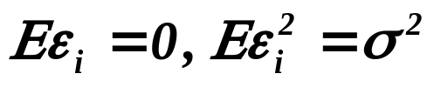


Qualitative (Discrete) Response Variable
continued
3
We shall restrict ourselves to binary response variable (BRV).
Problems with BRV:
Let us consider a simple regression model:
of course with i.i.d. disturbances, .
Then
and also
.
So
and hence the model is called
the Linear Probability Model

Slide 5


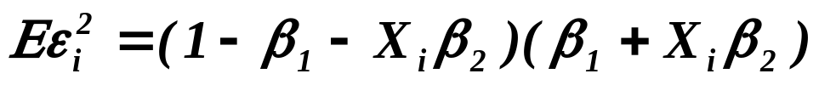
Linear Probability Model
4
Problems :
,
,
then
and hence
.
Finally,
,
so we have heteroscedasticity.

Slide 6




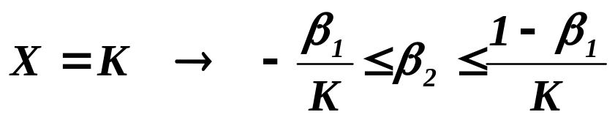
Linear Probability Model - problems
continued
5
Moreover, we have to have
for all admissible values of ‘s .
It requires some restrictions on parameters which consequently
may seriously influence all up to now derived results and ideas.
Example.
with
.
Then
and
,
and finally

Slide 7

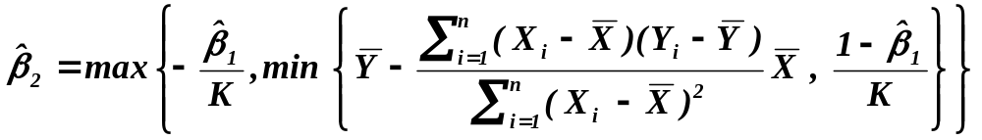


The Linear Probability Model - problems
continued
6
together with
.
Notice that the formula for includes
and vice versa estimation can be rather complicated
(we shall return to it later).
To avoid it, let us consider an inspiring example:

Slide 8



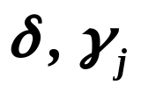
Binary Choice Model
7
utility of i-th individual decision maker ( i.d.m. )
when he/she decided for j-th choice
vector of the (profit or utility) characteristics
as perceived by i-th i.d.m. under j-th choice
vector of socio-economic characteristics of i-th i.d.m.
vectors of regression coefficients (since the socio-
-economic characteristics “brings different benefit”
under different circumstances, the corresponding reg-
ression coefficients are different for different choices).

Slide 9



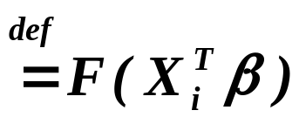
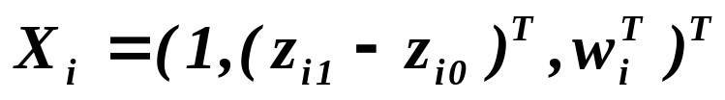


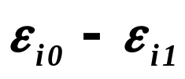
Binary Choice Model
continued
8
Put
and
otherwise.
Then
with
,
and is (cumulative) distribution of .

Slide 10

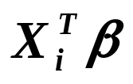
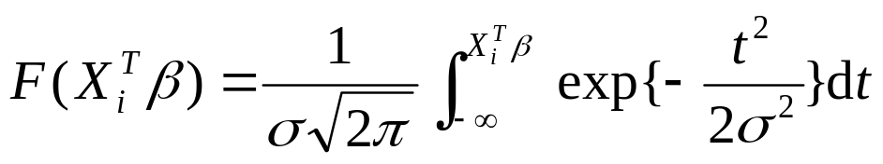
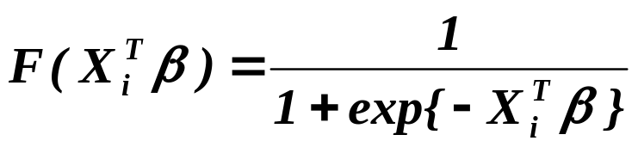
Qualitative (Discrete) Response Variable
continued
9
Following three possibilities are usually considered:
● The Linear Probability Model -
● The Probit Model -
● The Logit Model -
Prior to continuing, let’s make following remark.

Slide 11


Qualitative (Discrete) Response Variable
continued
10
Let us recall that
are theoretical probabilities
(let us write them in what follows as ),
while we observe the empirical probabilities
(usually frequencies ) – let us denote them by .
It means that we try to identify the model
.
Now, let’s start with the linear probability model.

Slide 12
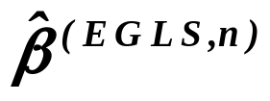
Linear Probability Model
11
There are basically two possibilities:
a) Take into account that there is a heteroscedasticity, i.e.
Evaluate “naive” estimate of regression coefficient.
If linear restriction are fulfilled, estimate
the covariance matrix of estimates of regression
coefficients and evaluate .
b) The step i) is the same as in previous but
ii) Estimate the covariance matrix of estimates
  of regression coefficients and solve the extremal
  problem

Slide 13
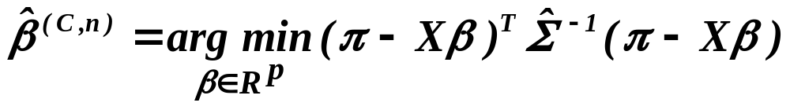





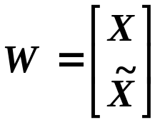
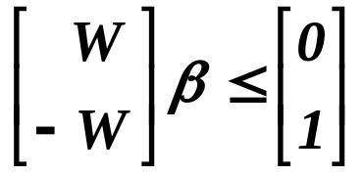
Linear Probability Model
continued
12
under the linear restrictions
and .
It may happen ( and may be rather surprising that relatively
frequently) we may know at the moment of estimating parameters
m points of factor space at which the prediction of response va-
riable will be required. Then we need for some
to fulfil also
and .
Denoting , we may write both pairs of restriction as
.

Slide 14






Linear Probability Model
continued
13
Then we may employ the method of Lagrange multipliers, i.e.
the Lagrangian function will be
where are Lagrange multipliers and we need
to solve a system of equations
and
.

Slide 15









Linear Probability Model
continued
14
Putting
and , we have
with bilinear conditions
and
with non-negativity conditions
and
.
Such system can be routinely solved by the Simplex Method
( the implementation available in good packages
for stochastic programming).

Slide 16
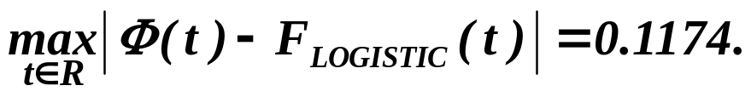
Qualitative (Discrete) Response Variable
15
Prior to turning our attention to the probit and logit model:
Why we use just these two distribution function?
In the background of this specification is the CLT . We may
imagine that the decision of the individual man/woman is
based on an individual “taste” index created as an aggre-
gation of many small reasons, ideas, events, etc.
Then such index can have normal distribution.
The reason for employment of logistic d.f. is just pragmatic.
In the time when the models for qualitative response were
invented, there were no reliable, tight approximations for c.d.f.
of normal d.f. . The logistic d.f. represent reasonable “substitute”
for it, although

Slide 17
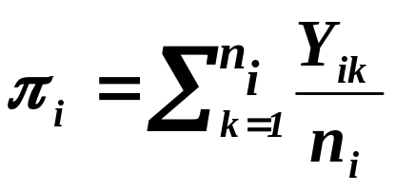


Qualitative (Discrete) Response Variable
continued
16
We should consider two situations:
There are sufficiently large number of repetitions
of the decisions of every individual decision maker.
There are only a few observations (or even only one)
of the response for every individual decision maker.
In the first case we have estimates of probabilities
where is the realization of Bernoulli r.v. attaining value 1
if in the k-th repetition .

Slide 18
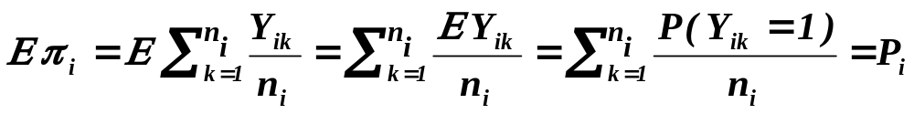

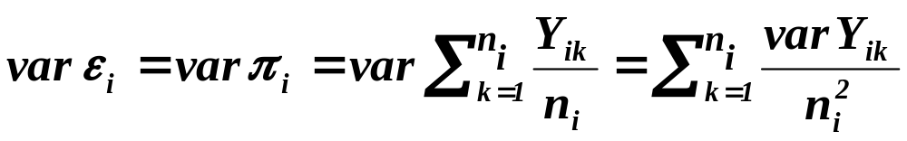
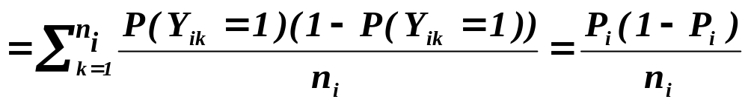
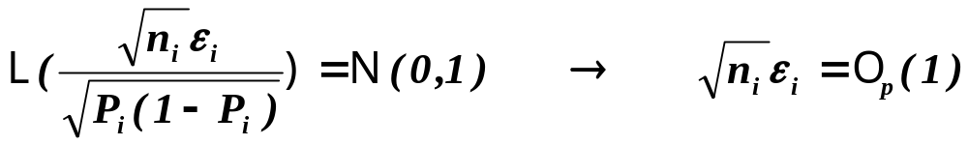
Qualitative (Discrete) Response Variable
continued
17
Let us recall that we estimate model
.
where
and hence for and
.
Then
.

Slide 19
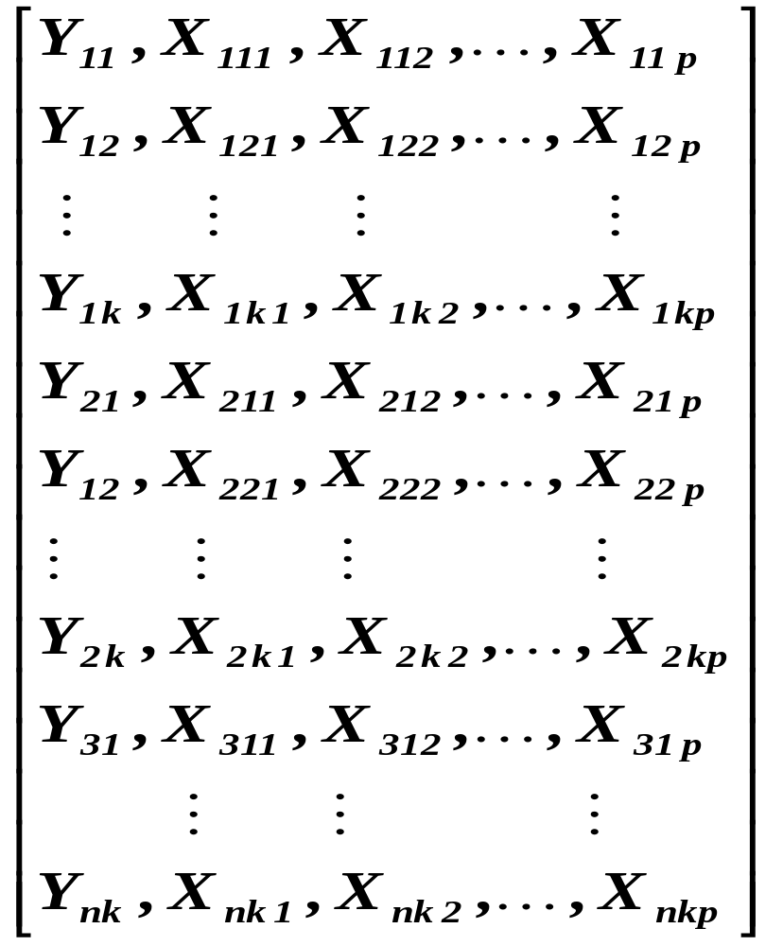

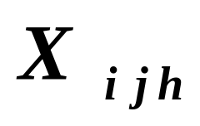

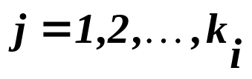
Estimating Probit Model - large number of repetitions
18
First of all, let us realize that the data then look like this:
Block
for
1. individual
index of subject
index
Block
for
2. individual
of explanatory
variable
index of repetition

Slide 20

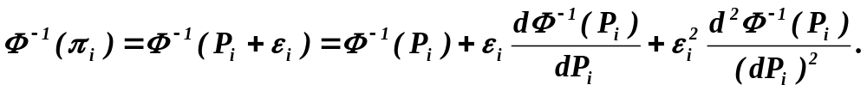


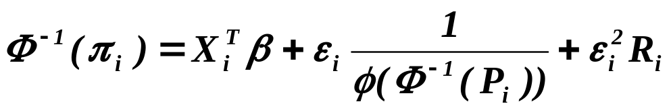
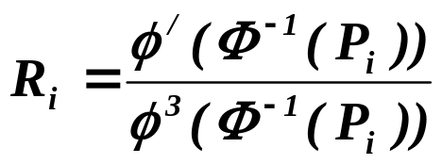
Estimating Probit Model - large number of repetitions
19
Denoting standard normal distribution, we have
from model
Recalling that
we have ( denotes the density of standard normal distribution)
where
.

Slide 21
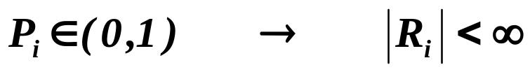

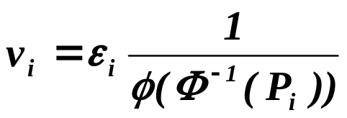
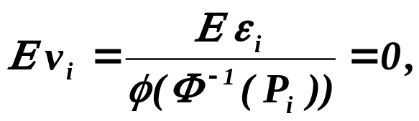
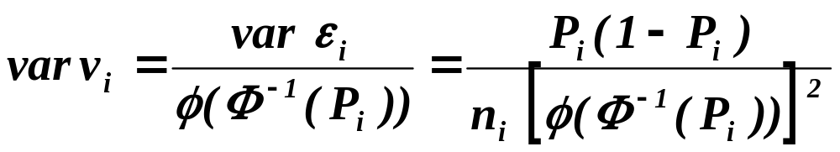

Estimating Probit Model - large number of repetitions
20
continued
Then of course
and hence
.
Putting
,
we have
So, denoting , we estimate regression
coefficients in model

Slide 22

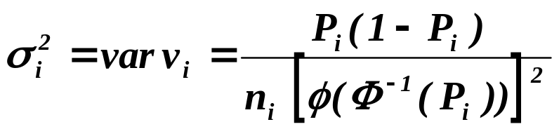

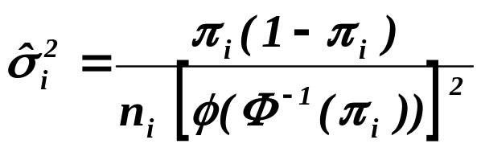


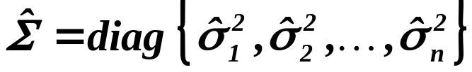


Estimating Probit Model - large number of repetitions
21
continued
with and .
Estimating
we finally find
where
and .
is called the observed probit, while the true probit.

Slide 23


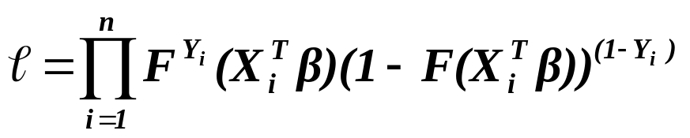
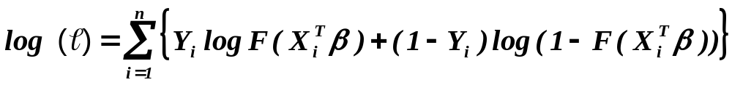
Estimating Probit Model - small number of repetitions
22
Recalling that
and
,
we have
and hence the likelihood function is
.
Then
.

Slide 24
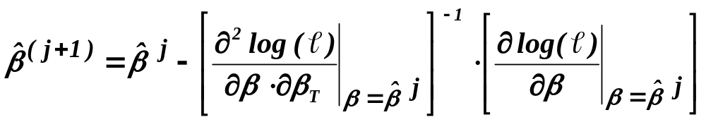
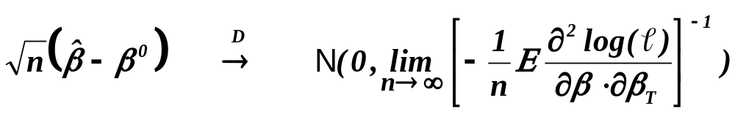
Estimating Probit Model - small number of repetitions
23
continued
Finally, we find the estimate by an iterative process
( say, Newton-Raphson)
and under some technical conditions we can show that
.

Slide 25
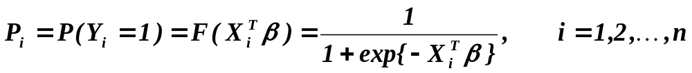
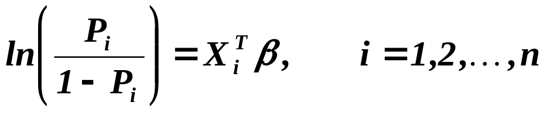
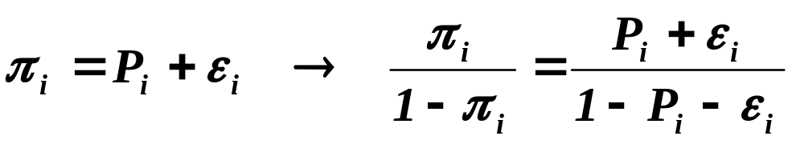

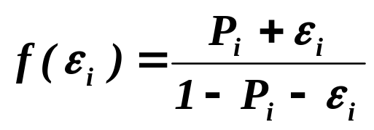

Estimating Logit Model
24
Let us recall once again that
.
Let us give only a basic steps of deriving the estimate. From previous
.
Then
.
Expanding where
by Taylor expansion at

Slide 26
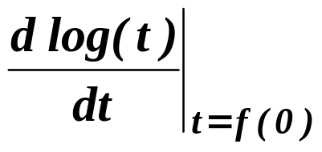

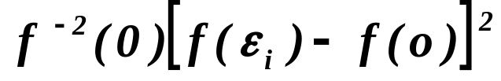
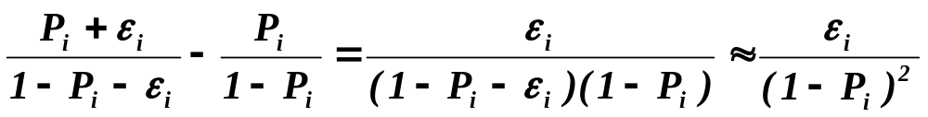

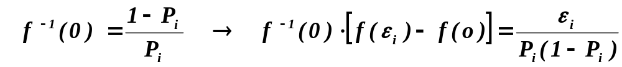
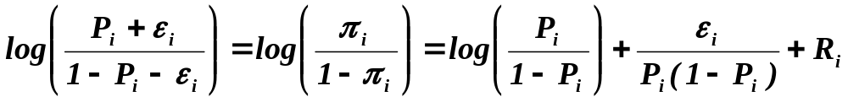
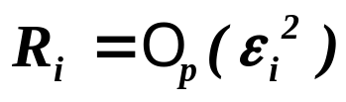
Estimating Logit Model
continued
25
and taking into account successively that
( where is a rest which is of order )
,
and
we arrive at
where .

Slide 27
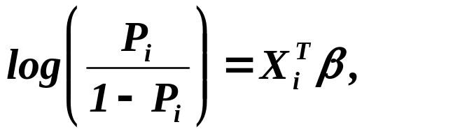
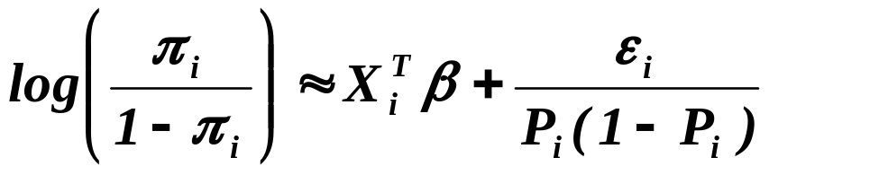




Estimating Logit Model
continued
26
Recalling that
we have
.
So, denoting
,
we can consider model
with
and .
The rest of considerations, how to estimate regression coeffs
in the logit model, is the same as for the probit model.

Slide 28




Discussing the employment of probit and logit model
27
Some other distributions where studied, too – popularity
of probit and logit is still very large (maybe due to the fact
that they are easy available in packages).
2) Assume the case, when regressors are (statistically) independent .
In classical regression model then the magnitude of given
coefficient indicates the change of response which is due
to (unit) change of corresponding regressor.
In probit and logit model the magnitude of given coefficient
indicates the change of
and of , respectively.
Assume, e.g. that and even a large
change of induce a (very small) change of .

Slide 29






Discussing the employment of probit and logit model
continued
28
Consider now testing
against
where is an estimate obtained by the method described
in previous.
Denote
.
At first, let us assume that there is only one subject
and n repetitions was performed with m successes.
Then, assuming model with intercept, we have
and hence

Slide 30




Discussing the employment of probit and logit model
continued
29
Along similar lines, we may find as well as
for more complicated situations.
As a test statistic is then used
with asymptotic distribution .

Slide 31
What is to be learnt from this lecture for exam ?
• Problems with discrete response variable
• Linear probability model
• Probit model, logit model
• Estimation for
- repeated (i.e. large number of)
observations for one case
- one observation (or small number of observation)
for one case
• What is an analogy of coefficient of determination ?
All what you need is on
http://samba.fsv.cuni.cz/~visek/

