Slide 1

Tuesday, 14.00 – 15.20
Charles University
Charles University
Econometrics
Econometrics
Jan Ámos Víšek
Jan Ámos Víšek
FSV UK
Institute of Economic Studies
Faculty of Social Sciences
Institute of Economic Studies
Faculty of Social Sciences
STAKAN III
Sixth Lecture

Slide 2
Schedule of today talk
First pattern of output from statistical package.
Misinterpretations of results and how to avoid it.
Is the estimated model acceptable or not?
(Verifying the assumptions for OLS to be BLUE.)
(Consistency and normality will be next time.)

Slide 3
Types of statistical libraries (packages)
Menu-oriented
→ all required evaluations
are made “by clicking the mouse”
STATISTICA , E-views
Key-oriented
→ required evaluations are performed
as sequence of orders written
by means of key-words
TSP, SAS , S-PLUS, R
Combined

Slide 4
A first pattern of statistical package output
Regression Summary for Dependent Variable: CCAS
R= .92364067 R²= .85311209 Adjusted R²= .82961003
F(4,25)=36.299 p<.00000 Std.Error of estimate: 28.671
 |  | St. Err. |  | St. Err.
 | BETA | of BETA | B | of B | t(25) | p-level
Intercept |  |  | -3.6186 | 56.1027 | -0.0645 | 0.9491
VAHA | 0.6466 | 0.1463 | 1.2676 | 0.2869 | 4.4188 | 0.0002
PULS | -0.0604 | 0.0992 | -0.5252 | 0.8628 | -0.6087 | 0.5482
SILA | -0.2547 | 0.1240 | -0.5050 | 0.2459 | -2.0536 | 0.0506
ZCAS | 0.5667 | 0.1086 | 3.9030 | 0.7477 | 5.2199 | 0.0000
Estimates of coefficients
in model for transformed
data.
Estimates of coefficients
in model for original data.
(For further discussion
Remember the Fifth Lecture
of columns of the table see the next slide.)

Slide 5
A first pattern of statistical package output
Regression Summary for Dependent Variable: CCAS
R= .92364067 R²= .85311209 Adjusted R²= .82961003
F(4,25)=36.299 p<.00000 Std.Error of estimate: 28.671
 |  | St. Err. |  | St. Err.
 | BETA | of BETA | B | of B | t(25) | p-level
Intercept |  |  | -3.6186 | 56.1027 | -0.0645 | 0.9491
VAHA | 0.6466 | 0.1463 | 1.2676 | 0.2869 | 4.4188 | 0.0002
PULS | -0.0604 | 0.0992 | -0.5252 | 0.8628 | -0.6087 | 0.5482
SILA | -0.2547 | 0.1240 | -0.5050 | 0.2459 | -2.0536 | 0.0506
ZCAS | 0.5667 | 0.1086 | 3.9030 | 0.7477 | 5.2199 | 0.0000
Clearly insignificant, but .....
Slightly insignificant
Remember again
Surely significant
Evidently insignificant
the Fifth Lecture

Slide 6
One of frequently appearing misinterpretation of model:
Assume that the result of regression analysis was
Time Total = -3.62 + 1.27 * Weight - 0.53 * Puls
- 0.51 * Strength + 3.90 * Time per ¼-mile.
Then we can frequently meet with a conclusion of type
“As the estimate of regression coefficient for Weight is positive,
the Weight has positive impact on Time Total .”
or (even)
“Although the coefficient of determination is small, the po-
larity of the estimated coefficients corresponds to our ideas.”.
The first assertion can be true, under some circumstances,
but generally we cannot claim anything like that.
The second assertion can have, under some circumstances,
a sense but generally is false.
Why?

Slide 7




Let us consider following, a bit academic, example:
The regression model has random explanatory variables
and the shape
.
(1)
Moreover,
but we are not aware of this relation between
and and we take into account only (1).
If we conclude that has positive impact on ,
it is surely false conclusion.
Remember “Ceteris paribus” -
What to do?
- unfortunately, it’s an academic illusion !!

Slide 8

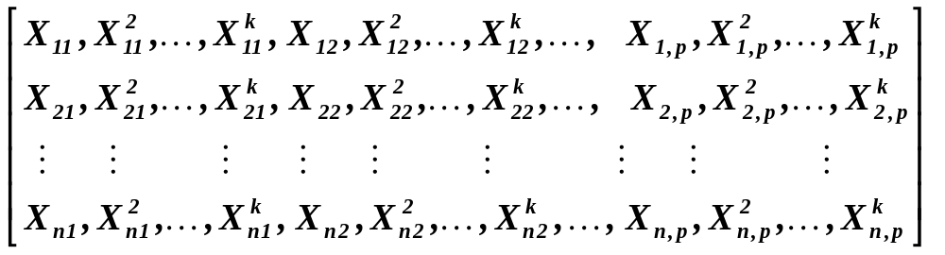

The relation
(2)
or a similar one
cannot be “discovered” by correlation analysis.
The correlation indicates only linear relations among r.v.’s. Sorry!
But if we take into account correlation matrix of
( with , of course )
we have a chance, again due to Weierstrass theorem, to find
some latent relations between (keep in mind that not among)
the explanatory variables.
Denote this matrix by .

Slide 9


Of course, the best is to try to regress
one explanatory variable on various combinations
of others, their functions, powers etc.
Clearly, it is tiresome, time-consuming job,
full of routine, etc.
In STATISTICA
Running regression , we obtain as an indication
of collinearity the table “Redundancy” containing all coef-
ficients of determination of models which regresses
one column of on all other columns.
We shall speak about collinearity later on.

Slide 10
Sometimes, a grain of intuition
is better than hours of routine.
I would like to have a drop of good luck,
or a barrel of intelligence !!
Menandros, 342 – 293 B.C.
After all, analysis of data is, at least partially, an art.
(Or the art ?!)
Let us recall that we have already showed another possible
misinterpretation - namely how misleading can be to infer
on the impact of given explanatory variable on the res-
ponse from the magnitude of estimated coefficient.
See the Fifth Lecture,
the fourth slide

Slide 11
We already know that we should ......
To estimate the model which includes only significant explana-
tory variables. To check that the coefficient of determination is
acceptably large. To find out the mutual relations of explanato-
ry variables.
Can we then accept model and interpret it?
I am sorry, not yet !!
What should we do more?
A hint: The answer can be deduced
from what was already given !!!
The answer is as simple as follows:
We should check the assumptions
under which the OLS are optimal estimator !!

Slide 12
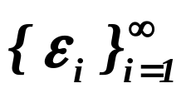
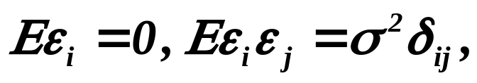





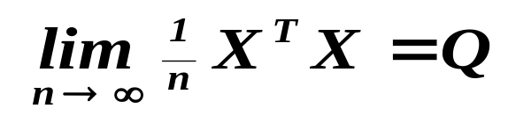

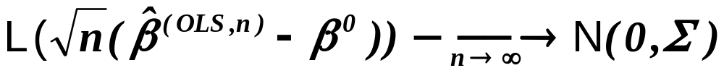
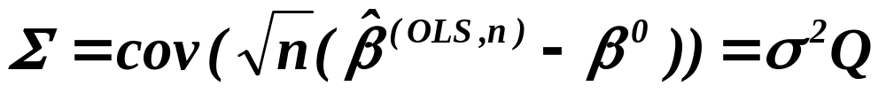
Let us recall - Theorem
Assumptions
Let be a sequence of r.v’s,
.
Assertions
Then is the best linear unbiased estimator .
Assumptions
If moreover , and
‘s are independent,
Assertions
is consistent.
Assumptions
If further , regular matrix,
Assertions
then
where .
Prior to looking for a way how to verify the assumptions,
let us also recall the picture, graphically showing ......

Slide 13

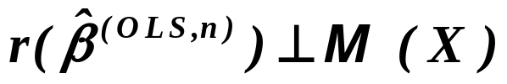
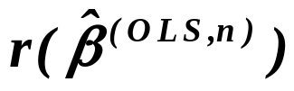

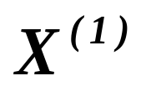

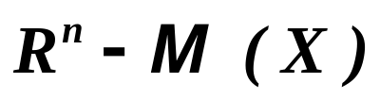

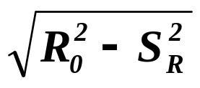


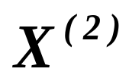
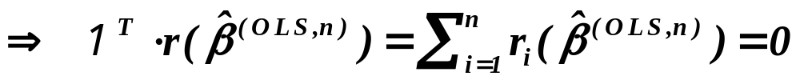
Recall that
and
Y
.

Slide 14

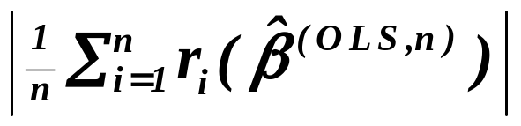

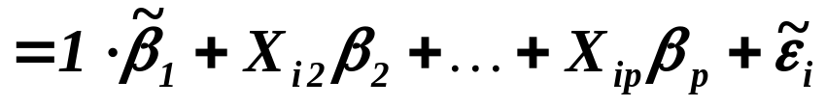

Testing validity of the assumptions
Sometimes we can meet with idea that showing that
is small, the assumption will be verified. However, as we have
seen on previous slide, it holds always.
Moreover, the assumption is in fact accommodated
by the ( linear ) regression model. Notice that in the case when
,
we can consider model
with .
In other words, the assumption
cannot be and even need not be verified.

Slide 15
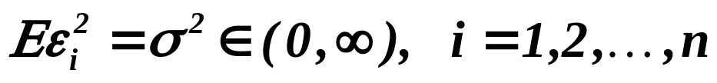
Testing validity of the assumptions
(homoscedasticity)
The most of test of the homoscedasticity are based on testing
an idea about the model of heteroscedasticity.
We are going to show one of them
but there are plenty of such tests – rarely implemented.
Another test will not be from this class, it is based
on surprisingly simple idea and it is frequently used.

Slide 16





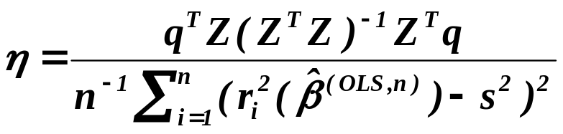

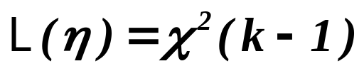
Breusch-Pagan test (1979)
Assumptions
Assume that where h is a (smooth) function
and . Denoting ,
we observe that if null hypothesis
is valid, then are not significant ( we will learn
later how to test simultaneously whether several coefficients
are not significant).
Assertions
The locally most powerful test can be based on the statistic
powerful against
skew d.f. of ’s
with
,
.

Slide 17
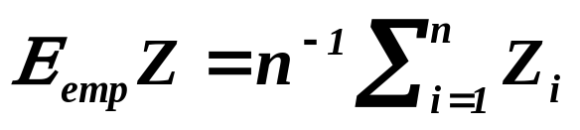



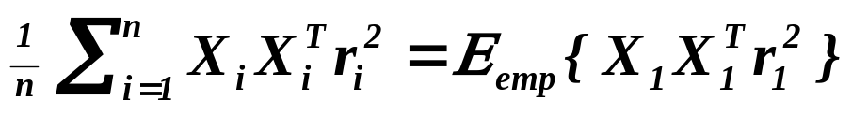
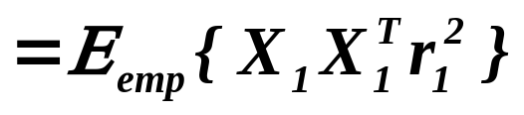
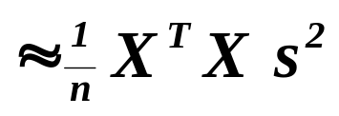
White’s test (1980)
Prior to the explanation notice that
Technicalities
and recall that
.
Moreover, if random variables and are independent,
.
The idea of test is given by
.

Slide 18
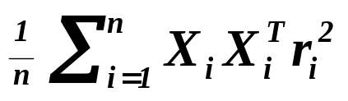
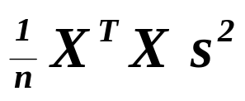
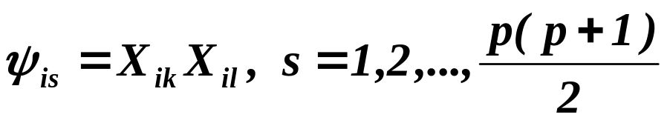

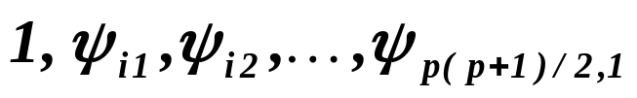


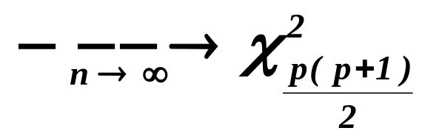
White’s test (1980)
Continued
So, the idea of test is to compare two matrices
and
.
Test is in fact carried as follows (Halbert White, 1980)
Assumptions
Put
and regress on , i.e.
consider the regression model
.
Assertions
Then for its coefficient of determination we have
L ( )
.

Slide 19
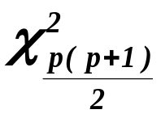
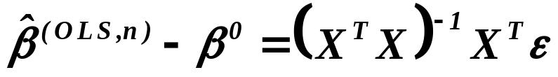
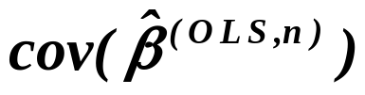
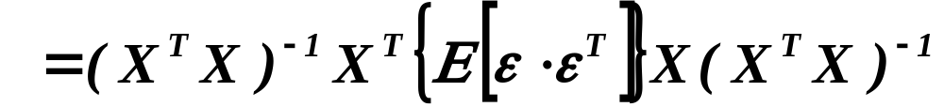
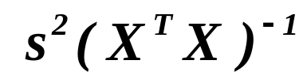
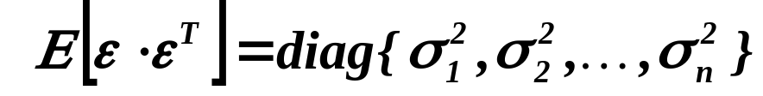
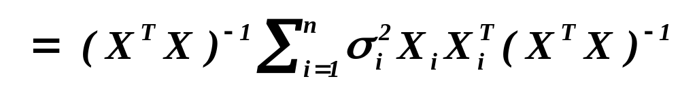
White’s test (1980)
Continued
Of course, libraries (e.g. TSP, E-Views) give the corresponding
p-value that r.v. is larger than value of result-
ing from the regression given on the previous slide.
Again technicalities
Let us recall that and hence
and hence can be estimated by .
However, if , we obtain
Remember this matrix!
.

Slide 20
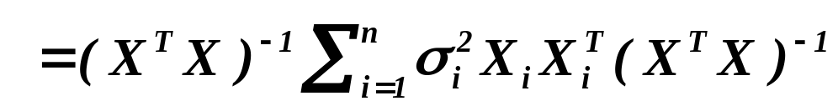
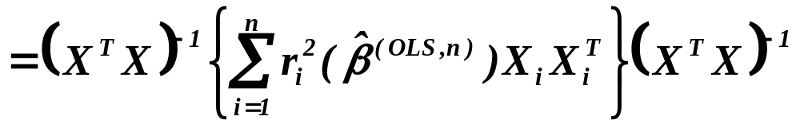
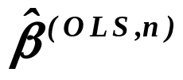
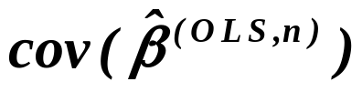
White’s test (1980) – consequence for looking for a model
Continued
Halbert White showed that
can be consistently estimated by
.
So if the hypothesis about homoscedasticity is rejected, we should
(or better, has to) studentize the coordinates of estimate
by the square root of diagonal elements of matrix
.
We shall recall what it is on the next slide !

Slide 21
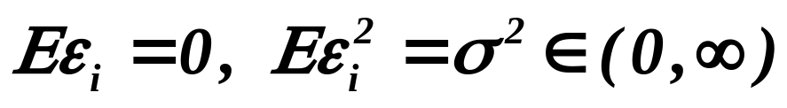
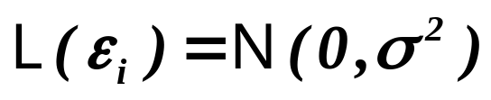

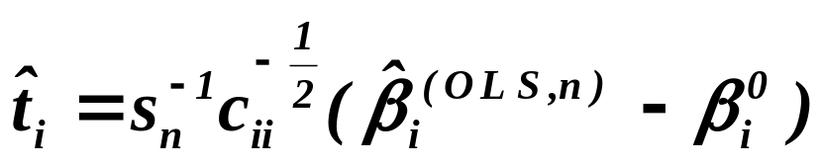
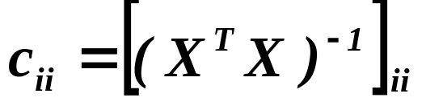

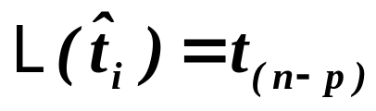



Lemma
Recalling studentization
Assumptions
Let be iid. r.v’s, .
Moreover, let and be regular.
Put
Assertions
Then
.
Assumptions
Put
where
,
is called
then
,
studentization.
where
This transformation
.
is called
studentization.
By it we rid of
Then
,
which is unknown.
i.e. is distributed as Student with degrees
of freedom.
Assertions

Slide 22
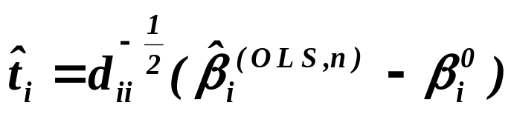
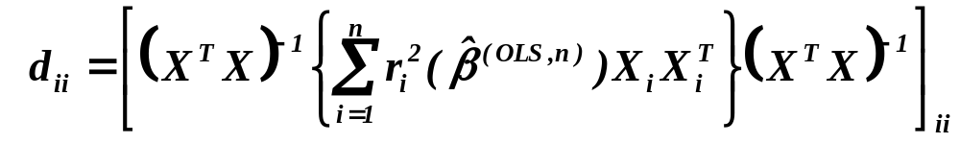
White’s test (1980) – consequence for looking for a model
Continued
Lemma
Assumptions
So, similarly as in previous, we put
where however now
.
Assertions
Then again
.
What can happen if heteroscedasticity is recognized
but ignored, demonstrates the example on the next slide.

Slide 23
Model of export from the Czech republic into EU
29 industries:
Agriculture and hunting , Forestry and logging , Fishing , Mining
of coal and lignite , Other mining , Manufacture of food products
and beverages , Man.of tobacco products , Man. of textiles , Man.
of textile products for the household , Man. of footwear, Man. of
wood and of products of wood , Man. of pulp, paper and paper pro-
ducts , Publishing, printing and reproduction, Man. of coke, refined
petroleum products and nuclear fuel , Man. of chemicals and phar-
maceuticals, Man. of rubber and plastic products , Man. of bricks,
tiles, constr. products and glass, Man. of basic metals , Man. of struc-
tural metal products , Man. of machinery , Man. of office machinery ,
Manufacture of electrical machinery and apparatus, Radio, television
and communication equipment , Medical, precision and optical
instruments , Motor vehicles , Transport equipment , Furniture ,
Recycling , Electricity, gas, steam and hot water supply
1993 - 2001

Slide 24
Response variable:
Export from the Czech republic into EU
Explanatory variables :
PE/kg, PI/kg, Tariffs from EU on X, Tariffs CZ
on M, Prize deflator (base 94), FDI stock , K/L,
EMPloyment, Value Added, GDPeu (total),
GDPcz (total), REER, Wages, Annual cost, Total
expenditure, Debts
Some preliminary analysis ( we shall speak about it later -
- may be in summer term ) indicated that also past values
of explanatory variables should be used.

Slide 25
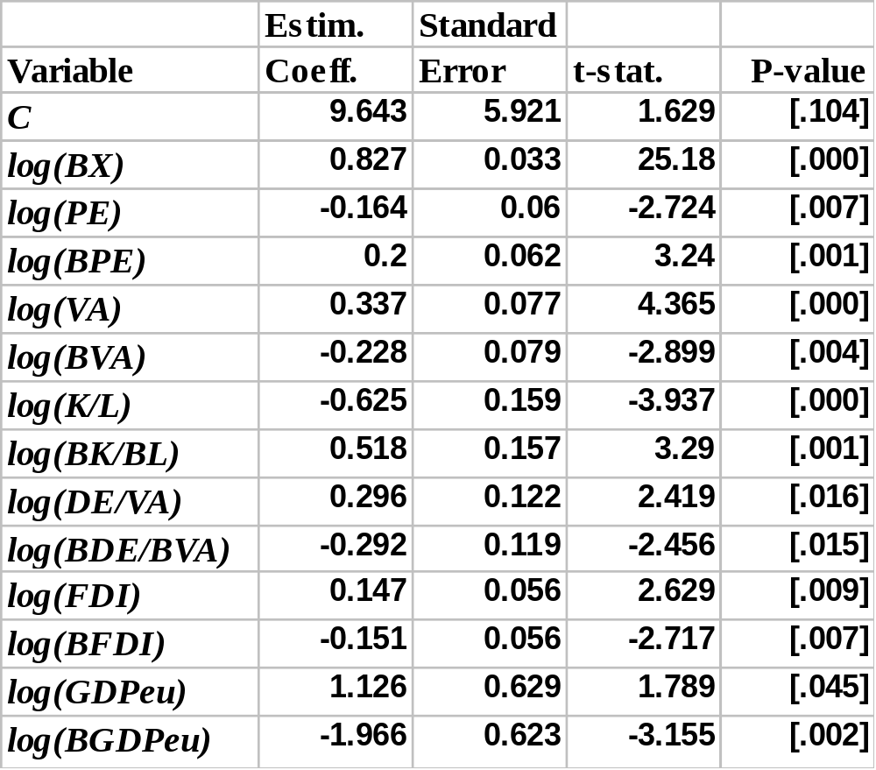
Example of model ignoring heteroscedasticity
Notice that
all explanatory
variables are
significant!

Slide 26
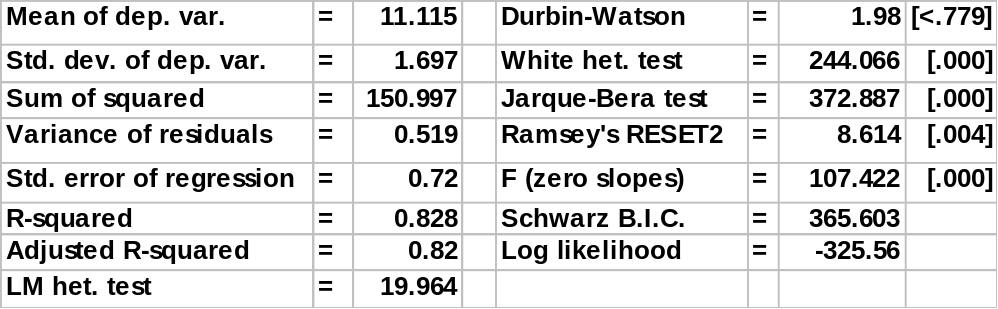
Other characteristics of model

Slide 27
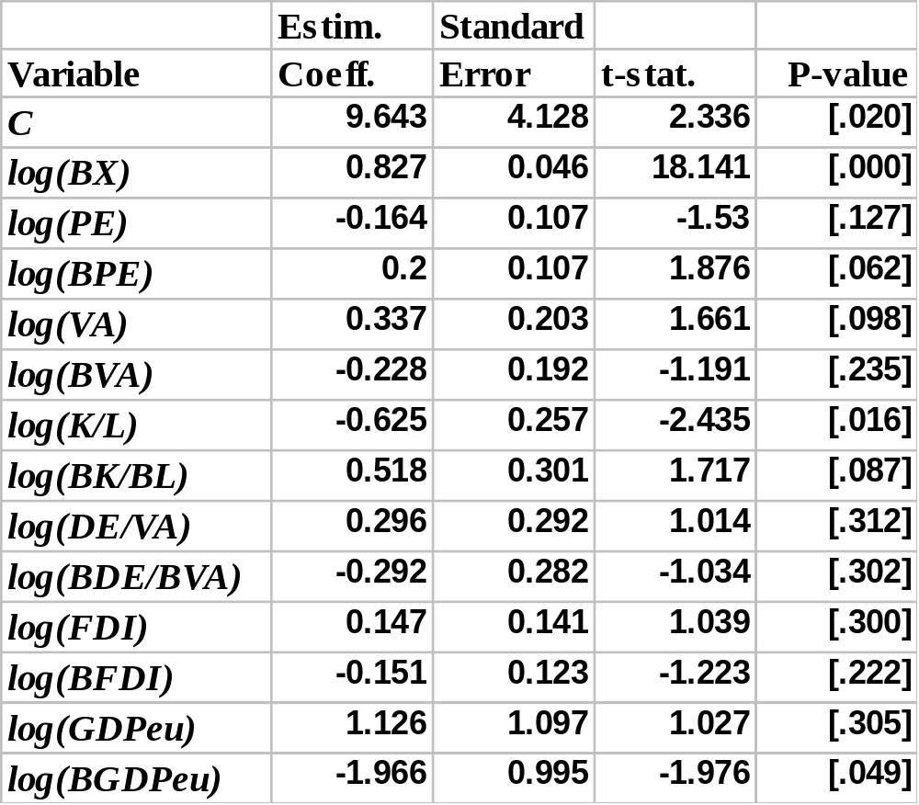
This is the signifikance of coefficients when White
estimate of covariance matrix was employed
Notice that
nearly
all explanatory
variables are
non-significant!

Slide 28
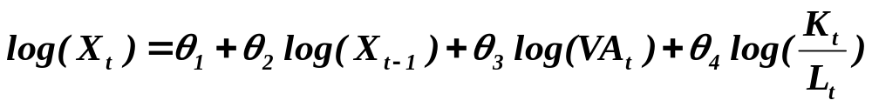
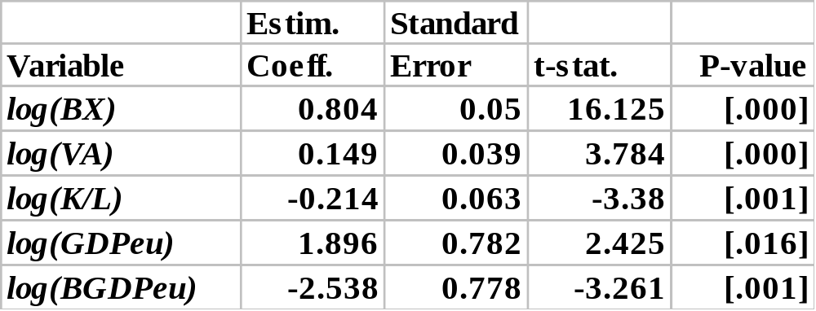
Employing White estimate of covariance matrix
of the estimates of regression coefficients
Resulting model is considerably simpler !!!

Slide 29

Other characteristics of model
Notice that the heteroscedasticity is not removed,
only (?) the significance was judged on modified values
of studentized estimates of regression coefficients !!

Slide 30
Warning !!!
Attempts of removing heteroscedasticity by
a transformation of data is typically the reliable way to hell !!!
The only exception may be when the shape
of heteroscedasticity is know with high degree of reliability.
An example:
Data are aggregated values of some economic, demographic,
sociologic, educational, etc. characteristics over districts of
a country. Then the variance of these givens are inversely
proportional to the number of inhabitants, economic
subjects, etc. Then there is a grain of hope that .........

Slide 31


Analyzing homoscedasticity by graphic tools
The idea:
If , then
should not depend on i .
So plotting against i , we should not obtain
any regular or periodical shape of graph. Such graph is called
index plot .
A “handicap” of the idea is that the shape of graph depends on
the order of observations in analyzed data. Hence one can easily
reorder the data so that we obtain a regular shape of graph.
A remedy is simple !

Slide 32


Analysing homoscedasticity by graphic tools
The refined idea:
If then
should not depend on and/or . So plotting
e.g. against , we should not obtain any regular shape ...... .
(An example is on the next slide.)
Looking for heteroscedasticity by circumstances
Assume the consumption of households. Those with large income
do not consume all but save some money and buy, from time to
time, TV-set, fridge, car, etc. . It means that their consumption is
sometimes smaller sometimes larger while the consumption of
poorer households is nearly the same all the time.
Hence the consumption will not be (usually) homoscedatic.

Slide 33

Squared residuals plotted against predicted values of response.
The result indicates that a suspicion
on a slight heteroscedasticity can arise.

Slide 34
Let us recall once again - Theorem
Assumptions
Let be a sequence of r.v’s,
.
Assertions
Then is the best linear unbiased estimator .
Assumptions
If moreover , and
‘s are independent,
Assertions
is consistent.
Assumptions
If further , regular matrix,
Assertions
then
where .
There are still some assumptions to be verified.
We’ll discuss them on the next lecture.

Slide 35
What is to be learnt from this lecture for exam ?
Linearity of estimator and of model
– what advantages and restrictions do they represent ?
How to test basic assumptions:
- ,
- homoscedasticity : White test versus tests based
on model of heteroscedasticity,
i.e. two approaches based on different ideas ?
- graphic tests?
What means : “The estimator is the best in the class of ….”
OLS is the best unbiased estimator - the condition(s) for it.
All what you need is on
http://samba.fsv.cuni.cz/~visek/

