Slide 1

Tuesday, 14.00 – 15.20
Charles University
Charles University
Econometrics
Econometrics
http://samba.fsv.cuni.cz/~visek/Econometrics_Up_To_2010/
http://samba.fsv.cuni.cz/~visek/Econometrics_Up_To_2010/
Jan Ámos Víšek
Jan Ámos Víšek
FSV UK
Institute of Economic Studies
Faculty of Social Sciences
Institute of Economic Studies
Faculty of Social Sciences
STAKAN III
Third Lecture

Slide 2

Schedule of today talk
Recalling OLS and definition of linear estimator.
Proof of the theorem given at the end of last lecture.
Definition of the best ( linear unbiased ) estimator.
Discussion of restrictions on linearity
in the case of estimators and of models.
Under normality of disturbances OLS is BUE.

Slide 3
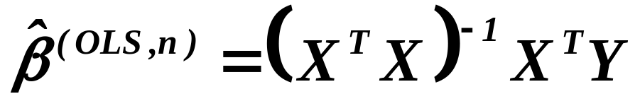
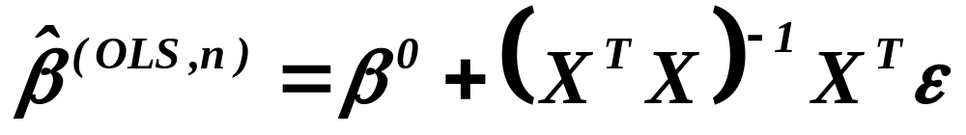
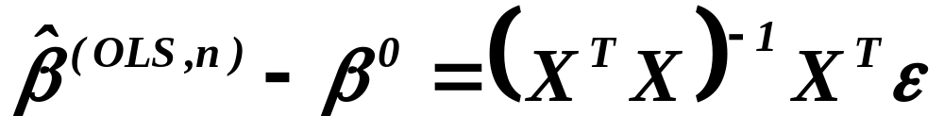
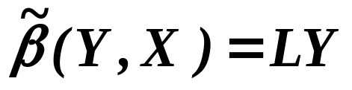
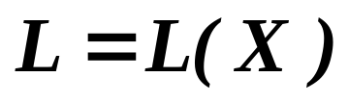

Ordinary Least Squares
(odhad metodou nejmenších čtverců)
Definition
An estimator where
is matrix, is called the linear estimator .

Slide 4
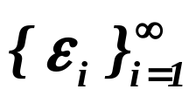
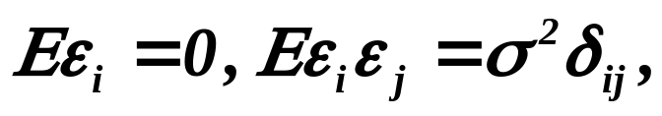





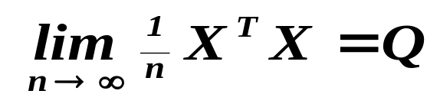

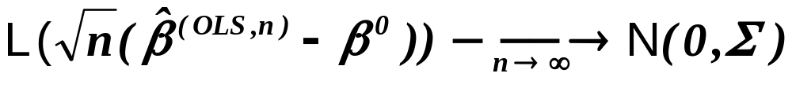
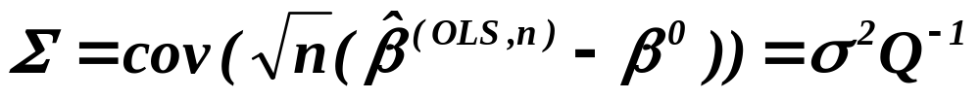

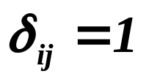

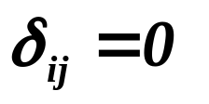

Theorem
Assumptions
Let be a sequence of r.v’s,
.
Assertions
Then is the best linear unbiased estimator .
Assumptions
If moreover , and
‘s are independent,
Assertions
is consistent.
Assumptions
If further , regular matrix,
Assertions
then
where .
is Kronecker delta, i.e. if and for .

Slide 5
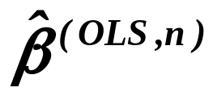
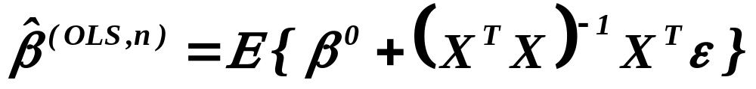

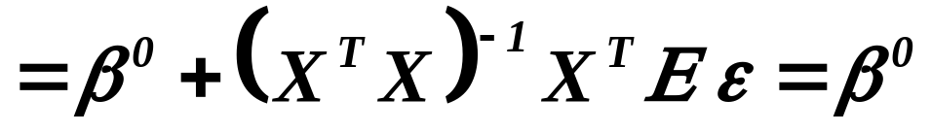
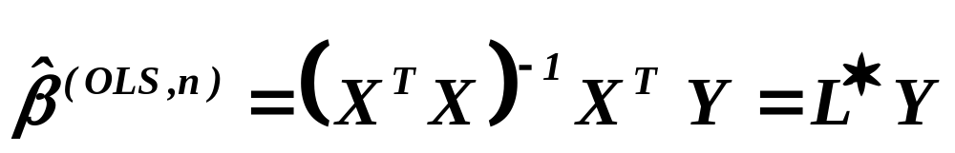


Proof
is BLUE
is unbiased
is linear
Remember that we have denoted by .

Slide 6


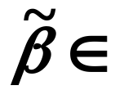
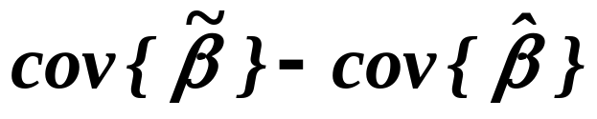

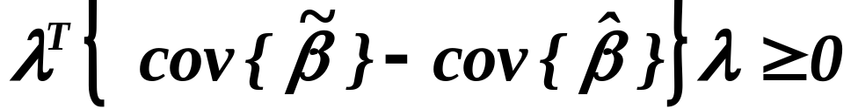
Definition
The estimator is the best one in given class of estimators
if for any other , the matrix
is positive definite, i.e. for any , we have
.
Recalling that

Slide 7
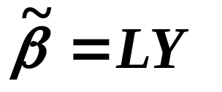
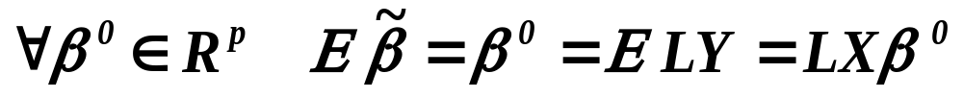

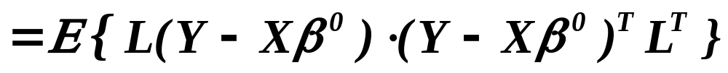
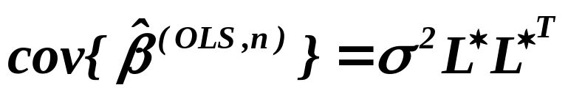
is the best
in the class of unbised linear estimators
,
i.e. (unit matrix)

Slide 8
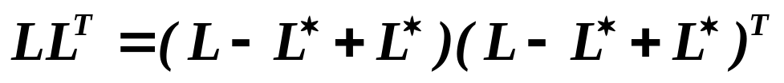
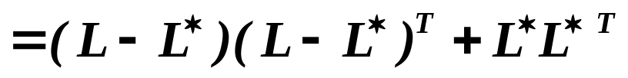

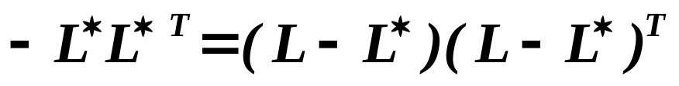
is the best
in the class of unbised linear estimators

Slide 9
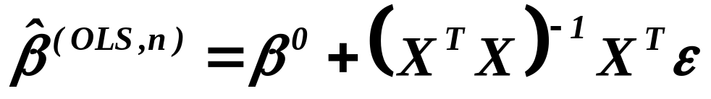
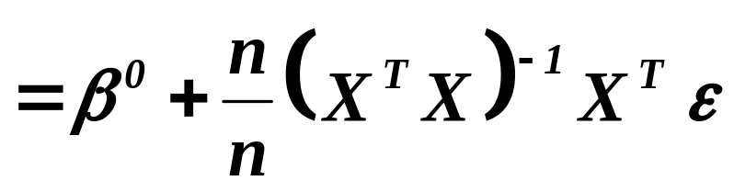
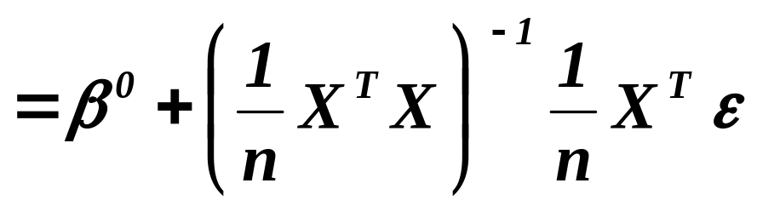
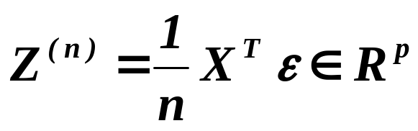
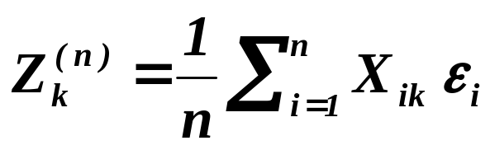
is consistent
Denote
then
and put

Slide 10
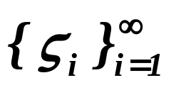
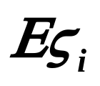


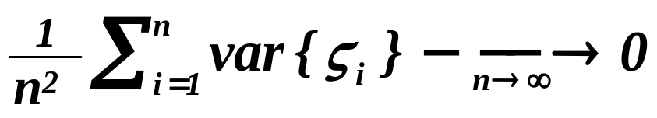
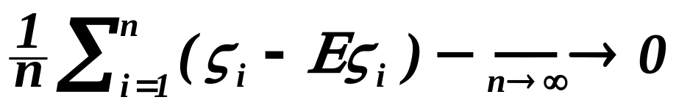

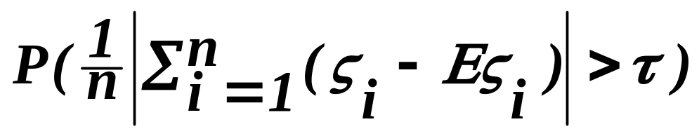
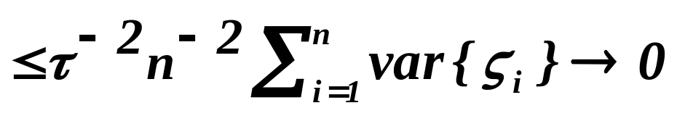
is consistent
Lemma – law of large numbers
Let be a sequence of independent r.v’s with
finite means and positive variances , .
Let moreover
.
Then
in probability .
Proof :
For any

Slide 11
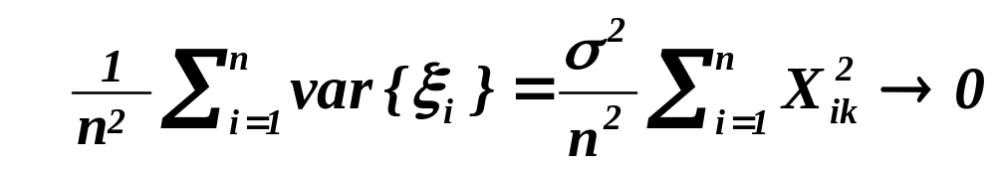
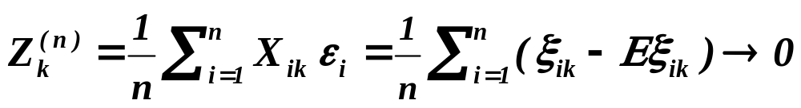
is consistent
Recalling previous slide: Lemma – law of large numbers
Let be a sequence of independent r.v’s with
finite means and positive variances , .
Let moreover
.
Then
in probability .
in probability .

Slide 12
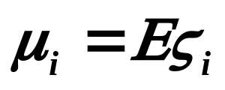
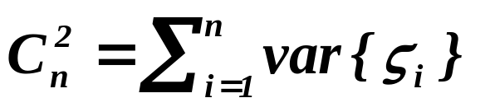
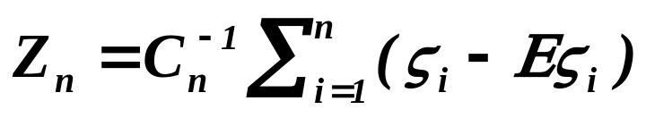
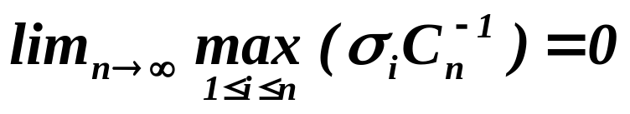
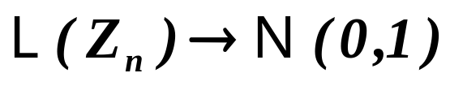

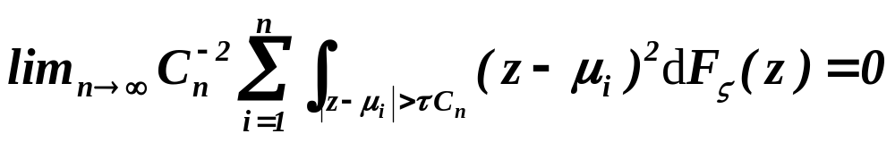
is asymptotically normal
Central Limit Theorem - Feller- Lindeberg
Let be a sequence of independent r.v’s with
finite means and positive variances ,
. Let moreover
and
.
Then
and
if and only if for any
.

Slide 13
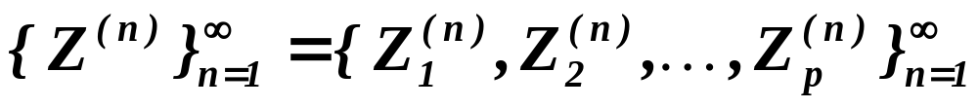



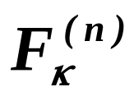
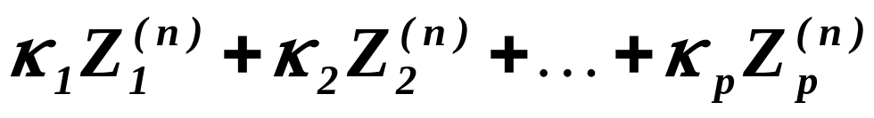

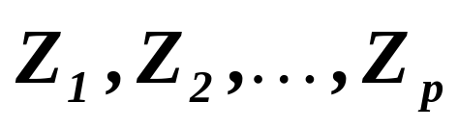
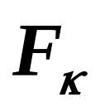




is asymptotically normal
Varadarajan theorem
Let
be sequence of vectors from with d.f. .
Further let for any be the d.f. of
.
Moreover, let be d.f. of
and be d.f. of
.
If for any , then .

Slide 14




is asymptotically normal
Firstly we verify conditions of Feller-Lindeberg theorem for
, for arbitrary and secondly we apply Vara-
darajan theorem. Then we transform asymptotically normally
distributed vector by matrix .

Slide 15





REMARK
is the best
in the class of unbiased linear estimators
Normal equations
If either for some
or for some
are large,
it may cause serious problems when solving normal equations
and solution can be rather strange.
(See the next slides ! )

Slide 16
Outlier
Solution given by OLS
A “reasonable” model, neglecting the outlier

Slide 17
Leverage point
Solution given by OLS
A “reasonable” model, neglecting the leverage point

Slide 18



Conclusion I
Solution given by OLS may be different
from that expected by common sense.
One reason is that is the best only among linear estimators.
Drawing the data from previous slide on the screen of PC,
the common sense propose to reject the leverage point
and then apply OLS.
We obtain than “reasonable” model but it can’t be written
as where is the response for all data. So this
estimator is not linear.
Conclusion II
Restriction on the linear estimators can appear to be drastic !!

Slide 19
And what represents the restriction on the linear model ?
Remember, we have considered model
Time total = -3.62 + 1.27 * Weight - 0.53 * Puls
- 0.51 * Strength + 3.90 * Time per ¼-mile
But it is easy to test whether the model
2
Time total = -3.62 + 1.27 * Weight + a* Weight
- 0.53 * Puls + b* Puls - 0.51 * Strength
+ c* log(Strength) + 3.90 * Time per ¼-mile
3
is not a better one.
Weierstrass approximation theorem
System of all polynomials is dense in the space
of continuous functions on a compact space.
Conclusion III
Restriction on the linear regression model is not substantial.

Slide 20
What is a mutual relations
of linearity of the estimator of regression coefficients
linearity of regression model ?
and
The answer is simpler then one would expect :
NONE

Slide 21
And why OLS became so popular ?
Firstly
It has a simple geometric interpretation,
implying existence of solution together
with an easy proof of its properties.
Secondly
There is a simple formula for evaluating it,
although the evaluation need not be straightforward.
Nowadays however there is a lot of implementation
which are safe against numerical difficulties.
Conclusion IV
We should find the conditions under which OLS are (is)
the best estimator among all unbiased estimators.
( and to use OLS only under these conditions ).

Slide 22






Maximum Likelihood Estimator
(maximálně věrohodný odhad)
Recalling the definition
Let and be the density of the distribution
Theorem
Assumptions
Let be iid. r.v’s, .
Then and attains Rao-Cramer
Assertions
BLUE
lower bound, i.e. is the best unbiased estimator.
Assumptions
If is the best unbiased estimator attaining
Rao-Cramer lower bound of variance,
then and .
Assertions

Slide 23






Maximum Likelihood Estimator
under assumption of normality of disturbances
A monotone transformation doesn’t change location of extreme!
This is a constant with respect to
The change of sign  changes “max” to “min” !

Slide 24





Recalling Rao-Cramer lower bound
of variance of unbiased estimator
Denote joint density of disturbances by
write instead of
If is unbiased, then
Let us divide both sides by

Slide 25









So we have
Assume that ,
. Then let .
was arbitrary hence write instead of it
In matrix form
Multiply it by from the left-hand-side and by from the right-one.

Slide 26





So we have for any
Intermediate considerations

Slide 27






So we have for any
Further intermediate considerations
But then
Finally write as

Slide 28





So we have for any
Applying Cauchy-Schwarz inequality

Slide 29








So we have for any
Notice, both r.v. are scalars!!
,
i. e.

Slide 30










Since it holds for any , we have
( in the sense of positive semidefinite matrices)
Assuming regularity of
Select with

Slide 31





Since it holds for any , we have
and
(inequality is in the sense of positive semidefinite matrices).
We would like to reach equality !
Cauchy-Schwarz inequality has been applied on

Slide 32








Hence the equality is reached iff is a linear function of
, i.e.
where is a matrix and .
Remember the joint density of disturbances is

Slide 33








Hence
,
.
cannot depend on
.
So
is to be unbiased, i.e. for any
and so with .
Finally
.

Slide 34





The proof of opposite direction.
If attains Rao-Cramer lower bound,
then the equality in Cauchy Schwarz inequality is reached
and hence
( write instead of )
(notice that after integration )

Slide 35









This we only rewrote from the previous slide
Since , for any regular matrix ,
there is a vector so that .
It has to hold for any and any of type
and

Slide 36

Imposing the marginal conditions, we obtain finally

Slide 37
What is to be learnt from this lecture for exam ?
Linearity of estimator and of model
– what advantages and restrictions do they represent ?
What means : “The estimator is the best in the class of … .”?
OLS is the best unbiased estimator - the condition(s) for it.
All what you need is on
http://samba.fsv.cuni.cz/~visek/Econometrics_Up_To_2010

