Slide 1

Tuesday, 14.00 – 15.20
Charles University
Charles University
Econometrics
Econometrics
Jan Ámos Víšek
Jan Ámos Víšek
FSV UK
Institute of Economic Studies
Faculty of Social Sciences
Institute of Economic Studies
Faculty of Social Sciences
STAKAN III
Fifth Lecture

Slide 2

Schedule of today talk
Recalling the last lemma of the previous lecture,
we shall discuss how to apply it.
How can we make an idea about the magnitude
of impact of given explanatory variable on the response?
What is the role of intercept in the model?
Coefficient of determination -
- an overall characteristic of model .
Distribution of the coefficient of determination -
- Fisher-Snedecor F.

Slide 3
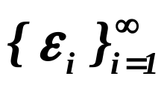
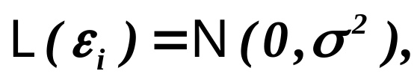
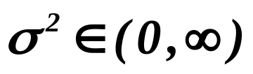

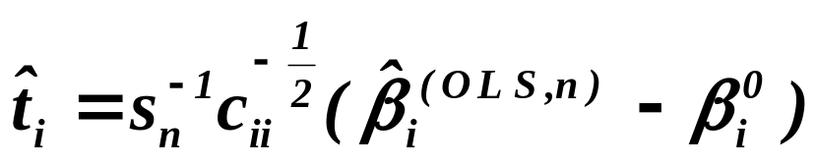
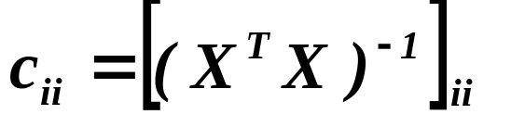
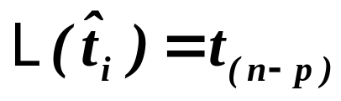



Recalling the lemma proved on the previous lecture
Assumptions
Let be iid. r.v’s .
Moreover, let
and be regular.
Put
Assertions
Then
.
Assumptions
Put
where
,
is called
then
,
where
This transformation
,
is called
studentization.
Assertions
Then
,
i.e. is distributed as Student with degrees
of freedom.
We are going to show how to employ it.

Slide 4
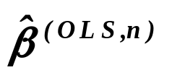
Data
, i.e. we find an estimate of model, say
Time total = -3.62 + 1.27 * Weight - 0.53 * Puls
- 0.51 * Strength + 3.90 * Time per ¼-mile
Is WEIGHT significant for explanation of data or not ?
It cannot be indicated by the magnitude
of the estimate of the coefficient !
Assume that WEIGHT was given in kilograms
and imagine that WEIGHT will be given in grams !!
Then the above given model will change to
Time total = -3.62 + 0.00127 * Weight - 0.53 * Puls
- 0.51 * Strength + 3.90 * Time per ¼-mile
although both models are identical.

Slide 5
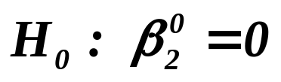
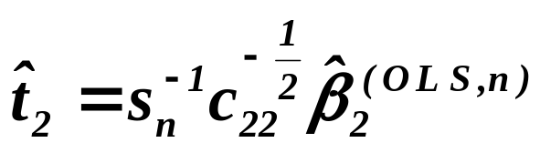
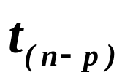

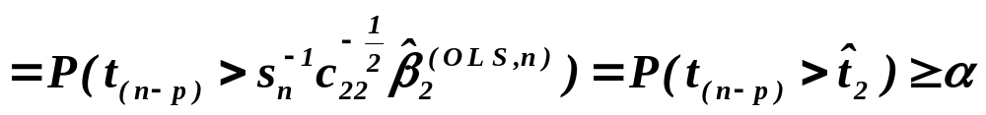
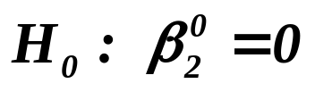


Assume that WEIGHT is not significant, i.e. model
Time total = -3.62 - 0.53 * Puls
- 0.51 * Strength + 3.90 * Time per ¼-mile
can be accepted as well . Under
is distributed as Student .
Fix some . If p-value
p
cannot be rejected on the significance level .
In fact, it cannot be rejected on any level p .
It means that the corresponding explanatory variable
can be (surely not ”should be”) excluded from the model.

Slide 6



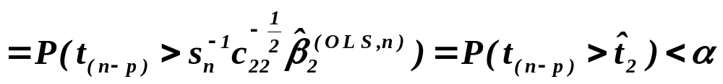
Sometimes, one can read in textbook:
“We cannot claim that with probability larger than p .”
or some similar statement . Any probabilistic statement about
is of course false, is constant. The only justifiable
conclusion is that, if , the event of probability p ap-
peared . If p-value
p
can be rejected on the significance level .
It means that the corresponding explanatory variable
should be included into the model.

Slide 7
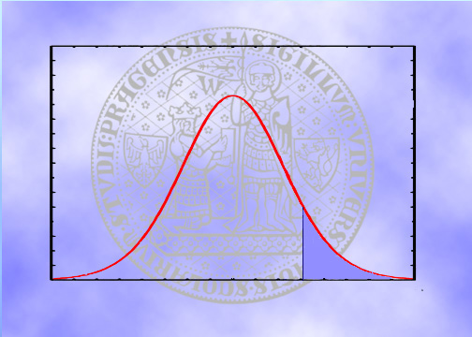
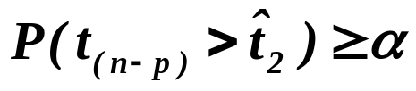
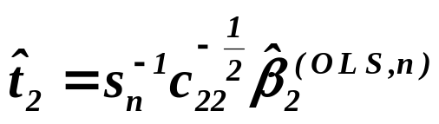
What is p-value ?
Student density
with n-p d.f.
If blue area is at least 0.05, say,
we “delete” the corresponding explanatory
variable from the model.
This area is equal
to p-value.

Slide 8
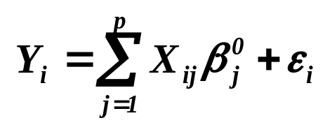


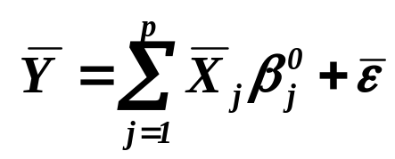
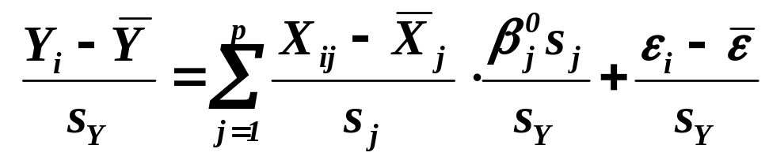
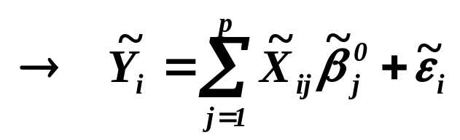
On some previous slide:
“It (i.e. significance of given explanatory variable)
cannot be indicated by the magnitude
of the estimate of the coefficient !”
In other words,
a size (extent) of the influence of given explanatory
variable on the response one cannot be concluded from
the magnitude of (the estimate of) coefficient!
Sum up over and divide by .
subtract it from the original model and
divide by sample standard deviations

Slide 9
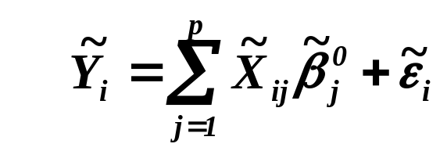
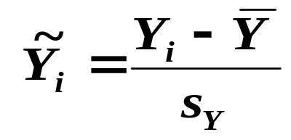
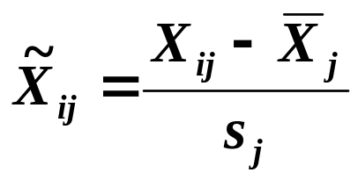
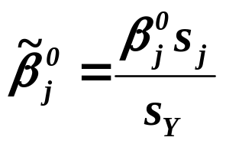
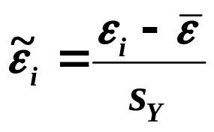
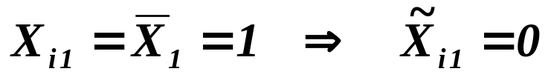

Assume regression model for the transformed data
where of course
,
,
and
.
Notice that, if the original model had the intercept,
, i.e. the transformed model
is without the intercept. So we may consider model
which runs through the origin. Moreover, all variables
have the population variance equal to 1.
So in this model the magnitude of the estimate of regression
coefficient indicates its impact on the response variable.

Slide 10
A comment on the role of intercept in model
When data are far away from origin,
a small shift of one observation may
cause a large change of intercept.
Intercept
So that a bit atypical random fluctuation
of one observation may cause that the inter-
cept seems to be zero, it may be insignificant,
although it is not.
Intercept
Moreover, not including the intercept in model,
we force the regression to run through origin,
with consequence explained on one of previous slides.

Slide 11
Conclusion
We already know how to estimate coefficients of
the regression model and to decide which of them
are significant for the model to explain data.
Next step
We are going to learn how to decide
whether the estimated model is “acceptable”,
as the model for given data.

Slide 12
COEFFICIENT of DETERMINATION
Let us look for an inspiration
What about considering sum of squared residuals?
Evidently, the “red” and “green”
model have not very different
sum of squares.
Now, the “red” and “green”
model have considerably
different sum of squares.

Slide 13
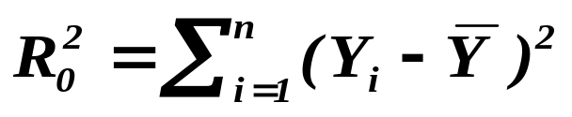
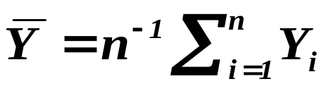
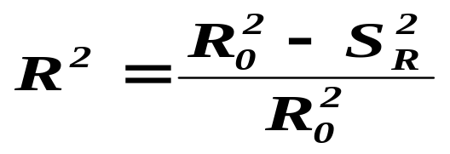
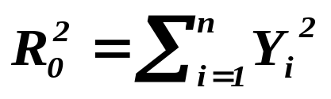

COEFFICIENT of DETERMINATION
Definition
Let the regression model include the intercept. Then put
where
. Then
the coefficient of determination is given as
(1)
.
If the regression model does not include the intercept, put
. Then
the coefficient of determination
is again given by (1).
Let us try direct interpretation, .

Slide 14
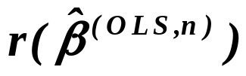
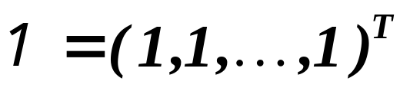

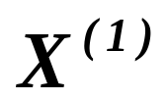

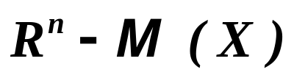

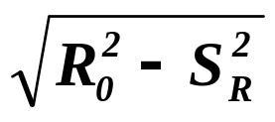


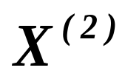
Geometric interpretation of
COEFFICIENT
of DETERMINATION
Denote
Y
.

Slide 15

Geometric interpretation of
COEFFICIENT
of DETERMINATION
Denote
.
Y

Slide 16
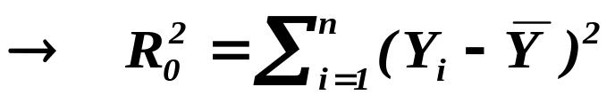
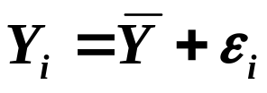
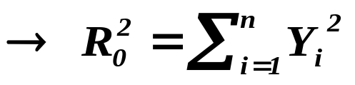

COEFFICIENT of DETERMINATION
Comments
1) The model includes intercept
Our model is compared with the model
.
2) The model does not include intercept
Our model is compared with the model
.
Warning
Excluding the intercept from model may cause
a dramatic increase of coefficient of determination BUT .......
See the next slide !

Slide 17
COEFFICIENT of DETERMINATION
Sum of “green” squares
will be compared
Sum of “green” squares
will be compared with
the sum of “red” squares.
again with the sum
of “red” squares.
They will not be too different,
hence the estimated model will
not be accepted.
The “green” sum will be conside-
rably smaller than the “red” one,
hence the model will be accepted,
ALTHOUGH THE “RIGHT” MODEL IS WORSE THAN THE “LEFT” ONE !!!!

Slide 18
COEFFICIENT of DETERMINATION
Comments
What values of the coefficient of determination are acceptable?
In exact and technical sciences 0.6 and more
In social sciences 0.2 and more
REMEMBER – Econometrics is already exact science !!!!
(It is a part of mathematics, of course.)
Coefficient of determination is only one of a set
of indicators of “quality” of model.

Slide 19
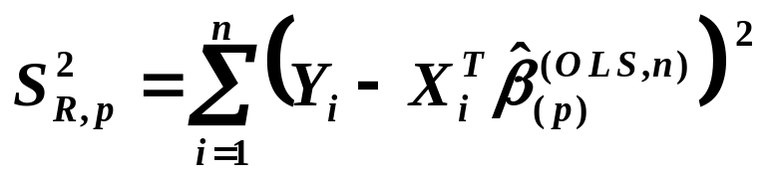
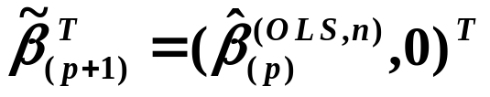
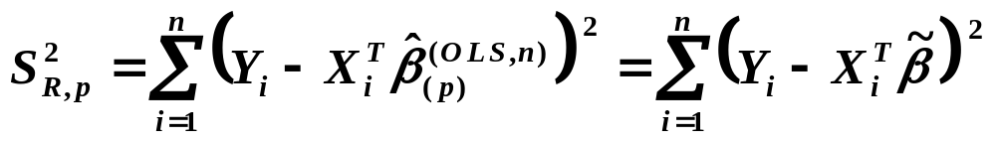
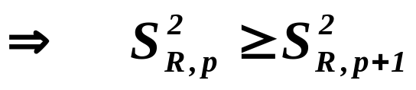
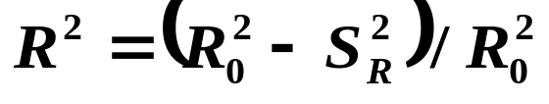
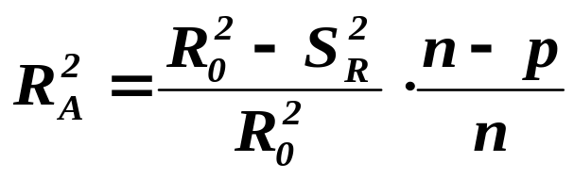
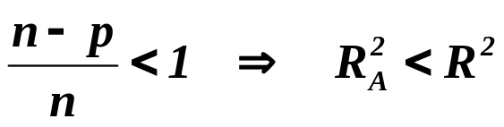
Coefficient of determination
What will change if we include one additional explanatory variable?
Recalling ,
consider .
Then
Recalling also , we conclude that coeff of
determination does not decrease with increasing number
of explanatory variables.
Adjusted coefficient of determination
Notice that

Slide 20

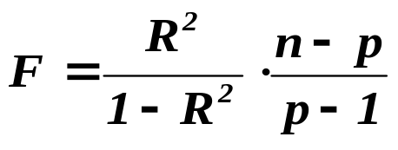

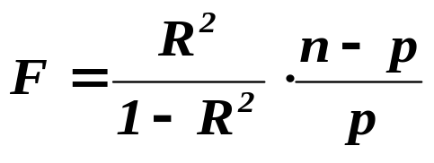
FISHER-SNEDECOR
Definition
Let the regression model include the intercept. Then put
where is the coefficient of determination.
If the regression model does not include the intercept, put
is usually called Fisher-Snedecor F .

Slide 21
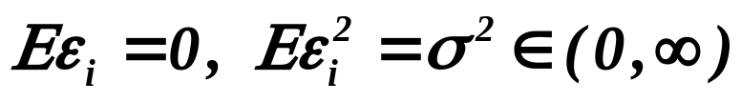
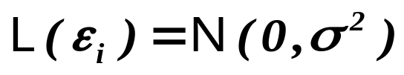






Lemma
Assumptions
Let be iid. r.v’s,
Moreover, let and be regular. If
the regression model does not include the intercept and ,
Assertions
then
i.e. is distributed as Fisher-Snedecor with and
degrees of freedom.
Assumptions
If the regression model includes the intercept and ,
Assertions
then
.

Slide 22


Proof
Let . Define the matrix
.

Slide 23
Recall that
Geometric “proof”
Y
.

Slide 24






From previous slide
and also
Q.E.D.

Slide 25
Let us summarize:
We already know how to estimate model.
We already know how to find
which explanatory variables are significant.
We already know how to decide whether
the model is acceptable as such.
What should we do next:
To learn how to find all “results”
(given in the frame above)
in the output from a statistical package.
To learn how to verify whether the assumptions
we have used, really hold to be enabled to employ
whole still explained theory at all.

Slide 26
What is to be learnt from this lecture for exam ?
Significance of given explanatory variable
- it is to be included into the model.
Impact of given explanatory variable on the response one.
What is the role of intercept in model
- can be its significance judged from t-statistic?
Coefficient of determination
- its distribution, role and importance for model.
All what you need is on
http://samba.fsv.cuni.cz/~visek/

