Slide 1

Tuesday, 12.30 – 13.50
Charles University
Charles University
Econometrics
Econometrics
Jan Ámos Víšek
Jan Ámos Víšek
FSV UK
Institute of Economic Studies
Faculty of Social Sciences
Institute of Economic Studies
Faculty of Social Sciences
STAKAN III
Eighth Lecture

Slide 2

Schedule of today talk
What happens when orthogonality condition
does not hold?
Instrumental variable, when we should use them?
Hausman specificity test, does it work reliably?
(Multi)collinerity – today only questions.

Slide 3
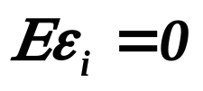
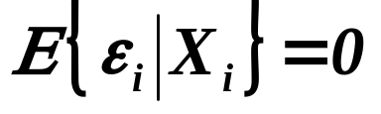


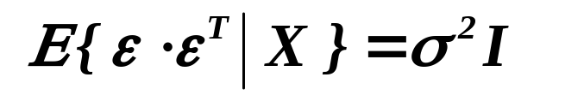

At the end of previous lecture we discussed
the reformulation of OLS for the random-carriers framework.
Let us recall that “Assumptions on disturbances” were modified to
Orthogonality condition

Sphericality condition

etc. with other assumptions.
We have seen in the Sixth Lecture that need not be
verified, it is built-in the model and hence in fact in the “determi-
nistic-carriers framework” it is always unbiased.
Is it also true for “random-carriers framework”?
Unfortunately, NO !!

Slide 4
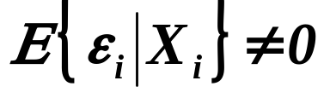
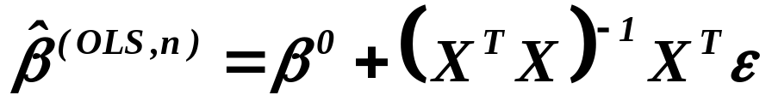
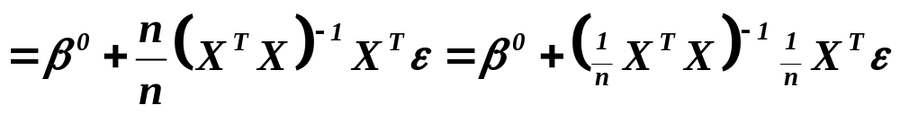
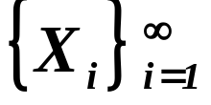

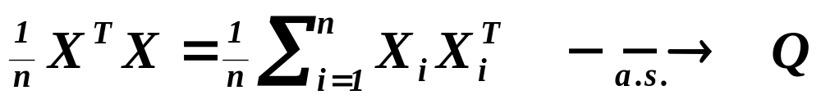
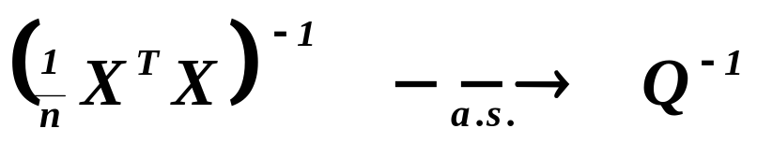
What happens if and how to recognize it ?
We have seen in the Third Lecture that
.
Assumptions
For the random-carriers framework we have assumed
i.i.d r.v’s
regular,
Assertions
hence
.
Then also
.

Slide 5
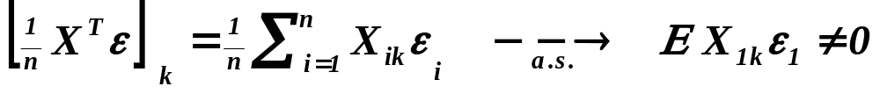
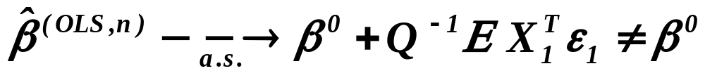
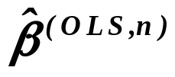

What happens if and how to recognize it ?
( continued )
Moreover, we have
.
Assertions
Then however
,
i.e. is not consistent and generally also not unbiased.
We need another estimator for .
( We shall answer the question “How to recognize it?” later.)
Let us look for an inspiration how to define an alternative
estimator.

Slide 6


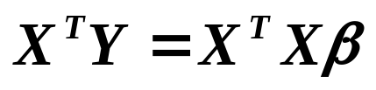
Looking for an alternative estimator
1. step: Let us recall that was obtained as the solution
of the normal equations
.
Let us write them as
and keep in mind this form of them !!
Let us forget ( for a moment ) how we have derived them
and try to “discover” them in another way.

Slide 7

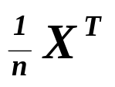
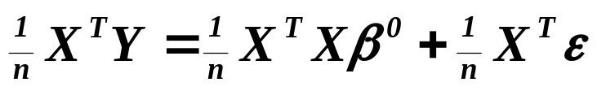
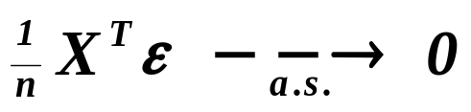
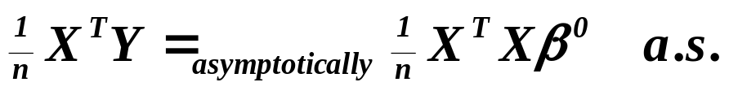
Looking for an alternative estimator
2. step: Remember that the regression model is given as
,
so that multiplying the model from the left by we obtain
.
If ,
and it might be an inspiration for looking for an estimator
as a solution of
,
i.e as the solution of normal equations.

Slide 8


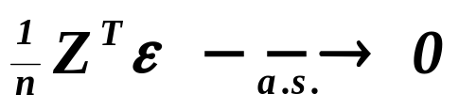

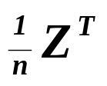
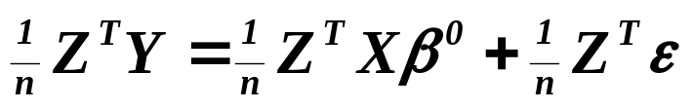
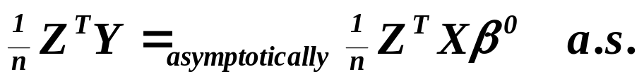
Looking, in the case when , for an alternative estimator
( continued )
Crucial step:
Try to find a matrix of type such that
and “similar” to .
Multiplying then the model
from the left by we obtain
and it implies that
.

Slide 9
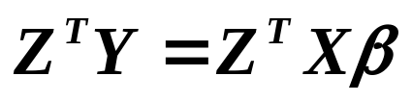
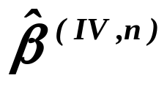
Looking, in the case when , for an alternative estimator
( continued )
It may indicate ( or hint ) that the estimator defined as the solution
of equations
can be acceptable instead of OLS. The method is known as
“the estimation by means of instrumental variables”
and the estimator is usually denoted
.
Prior to continuing:
The matrix is called the matrix of instrumental variables,
i.e. its columns are those instrumental variables.

Slide 10
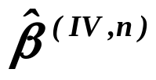

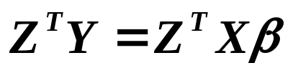
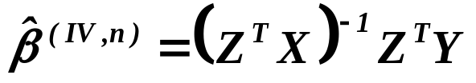
Instrumental variables estimator
So let us repeat:
We consider a matrix of type such that
and is simultaneously “similar” to .
An example clarifying the word “similar” will be given.
Moreover, we usually assume that is regular. The estimation
realized by the estimator defined as the solution of equations
will be called the
“Estimation by means of instrumental variables”
and the estimator will be denoted
.

Slide 11
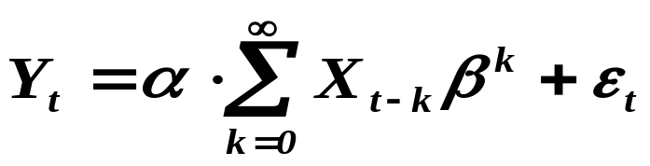


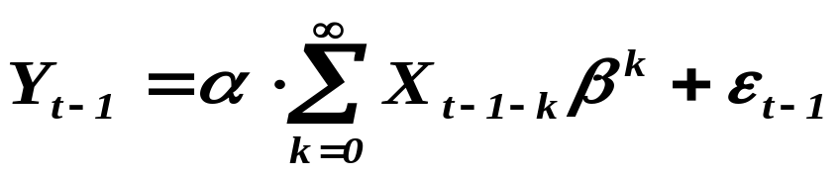
Instrumental variables estimator
( an example )
Remenber:
The OLS are “black box”, while the IV “requires
a decision about what to use as instrumental variables”.
We put data in and the value of estimator comes out.
Let us consider the model with one explanatory variable in which
the lagged values of the explanatory variable are relevant
for the response variable
.
We are not able to estimate and directly, so let us write

Slide 12
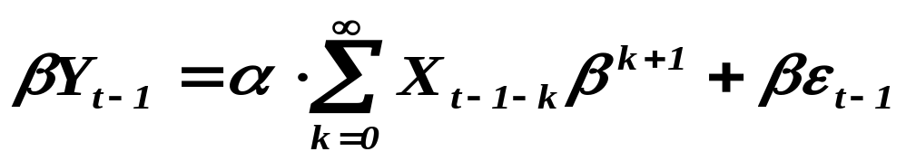
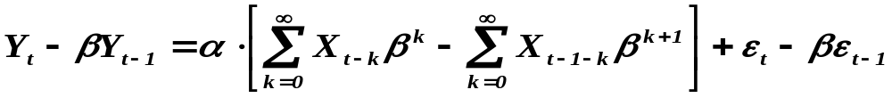
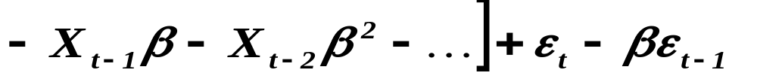
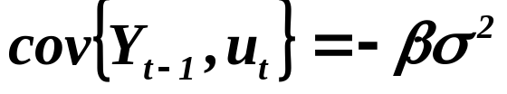
Instrumental variables estimator
( an example - continued )
multiply the last equation by
and finally subtract it from the original model. We arrive at
.
with estimable coefficients but also with .

Slide 13



Instrumental variables estimator
( an example - continued )
So we need for an instrumental variable ( sometimes
we say simply an instrument ). Since we have
,
is proportional ( mainly ) to and we can take as
the instrument . Then we obtain from
the model
.

Slide 14
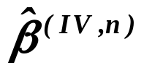
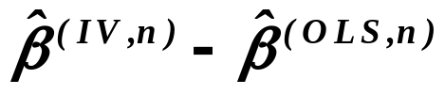
Now let us return to the question:
.... and how to recognize it ?
First of all, observe:
If  is biased
while is unbiased.
If , both estimators are unbiased.
In other words:
The difference
is likely large iff .
“iff” means “if and only if”
.

Slide 15
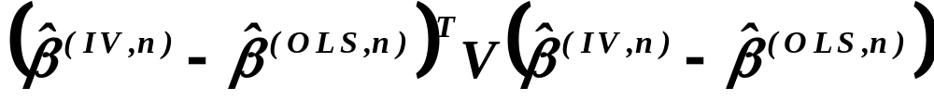
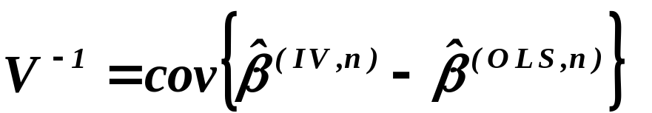
.... and how to recognize it ?
( continued )
Jerry A. Hausman (1978) specified what means “large difference”
He proposed to consider the quadratic form
where
.
The test is now known as
Hausman specification test
By the way, the idea came from the Neyman-Pearson lemma.

Slide 16


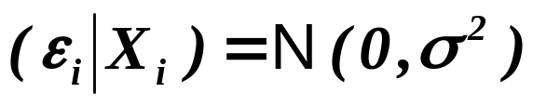
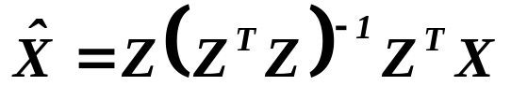


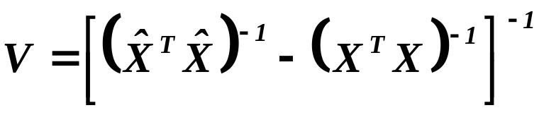



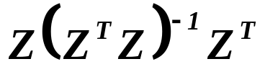

Hausman specification test
Assumptions
Assume that the disturbances ‘s are i.i.d. and
.
Moreover, let us put
and both and are regular. Denote finally
and put
.
Assertions
Then we have
Notice that is a projection
.
of X by into
We are going to sketch a proof.
.

Slide 17
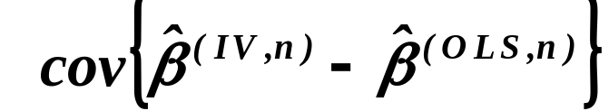
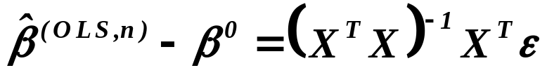
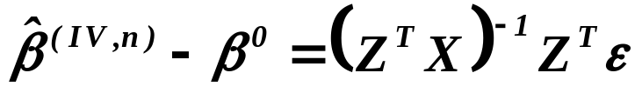
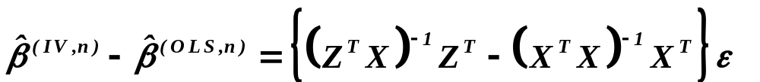



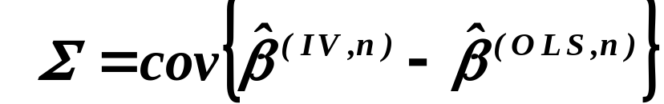
Hausman specification test - proof
First of all, let us find
.
From the Third lecture we have
and along similar lines we can find that
,
.
Then
with
.

Slide 18
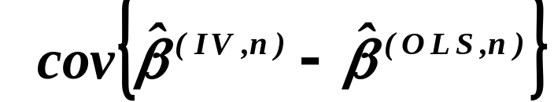
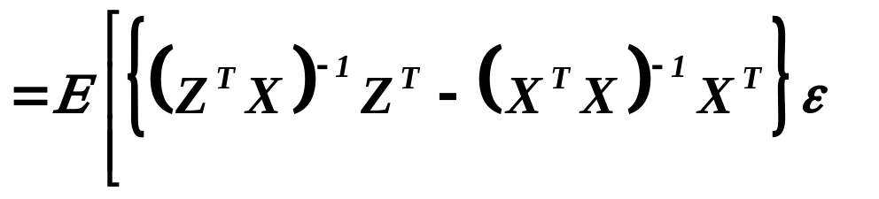
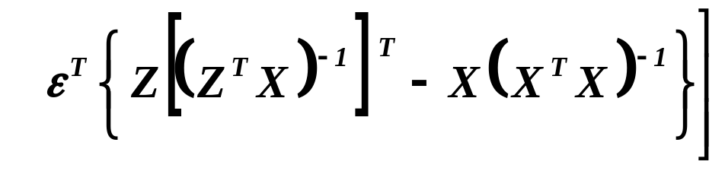
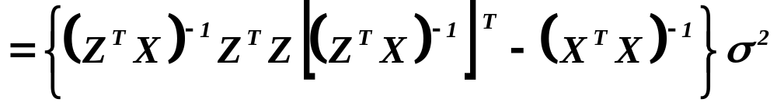
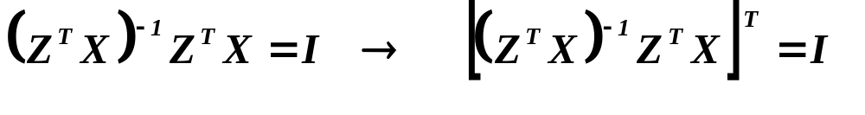


Hausman specification test - proof
( continued )
Let us evaluate

Slide 19








Hausman specification test - proof
( continued )
So we know that
Since is projection matrix, it is idempotent, i.e.
.
Then
.

Slide 20






Hausman specification test - proof
( continued )
Recalling that we have denoted
and ,
we have
.
and finally
.
Since is real and symmetric, it can be
written as ( see Third Lecture ) , i.e. there is a regular
matrix such that
.

Slide 21






Hausman specification test - proof
( continued )
Now, put
.
Then
and hence
.
It means that
and hence
.

Slide 22


Hausman specification test - proof
( continued )
On the other hand, recalling that
.
and
,
i.e.
and
.
Finally, let us recall that
we can write
,

Slide 23







Hausman specification test - proof
( continued )
.
Q.E.D.
Remark
Since is unknown, it is substituted by . Then however only
.
We can rid of also the assumption of normality of disturbances,
since
.
The proof is only a bit more complicated, however neither
nor are optimal ( BUE ). Hence it is worthless.

Slide 24


Hausman specification test - let us repeat that we proved:
Assume that the disturbances ‘s are i.i.d. and ....... ....... put
.
Then we have
.
Remark
Imagine that , i.e. is biased. However
we select instruments in a not very appropriate way, so that, although
is unbiased, it is far away from but may be unfortunately
close to . Then can be small and we conclude that
. Of course, one can easy imagine also “opposite”
error.

Hausman test is to be employed with a “high” care !!

Slide 25

What shall we do on the next lecture ?
( Multi )collinearity
From the First Lecture we have assumed :
Design matrix
to be of full rank
What happens if the design matrix is not of full rank ?
What happens if the design matrix is “nearly” singular ?
How to recognize it ?
What is a remedy for such situation ?
The answers will be given on the next lecture !!

Slide 26
What is to be learnt from this lecture for exam ?
Orthogonality condition
- what does it happen if it is broken ?
Instrumental variable
- measuring explanatory variables with random errors,
- lagged response variable as an explanatory one
- the method and examples of instruments.
Hausman specificity test, how does it work ?
All what you need is on
http://samba.fsv.cuni.cz/~visek/

