Slide 1

Tuesday, 12.30 – 13.50
Charles University
Charles University
Econometrics
Econometrics
Jan Ámos Víšek
Jan Ámos Víšek
FSV UK
Institute of Economic Studies
Faculty of Social Sciences
Institute of Economic Studies
Faculty of Social Sciences
STAKAN III
Fifth Lecture
(summer term)

Slide 2

1
Schedule of today talk
● How to recognize whether it is AR( p )
or MA( q ) ?
● How to estimate regression coefficients
when disturbances are AR( p ) or MA ( q ) ?

Slide 3
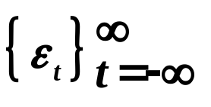
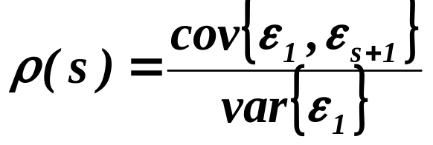
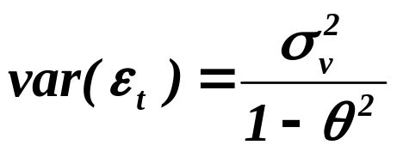
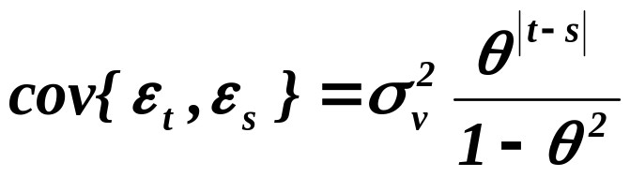

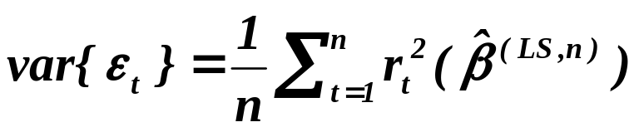
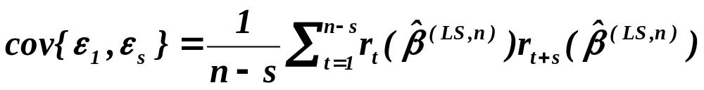

DEFINITION
For the sequence of stationary r.v.’s the function
is called correlogram.
For AR( 1 ) :
So, that evaluating
and
,
we have
2

Slide 4










3
We should obtain following picture
1
2
3
4
5
6
7
8
9
It is even possible to estimate by means
of empirical correlogram the order of AR process.
(We shall not go into details.)

Slide 5
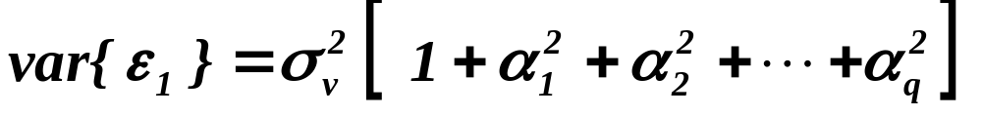

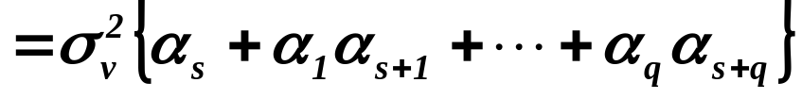
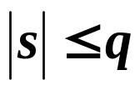

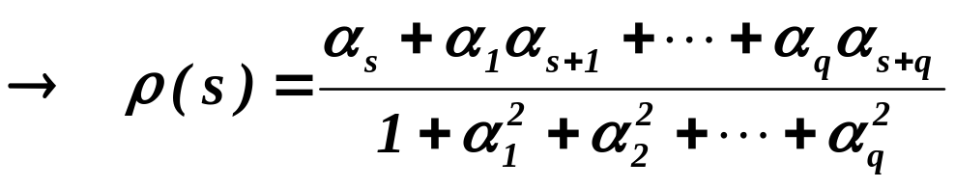
4
For MA( 1 ) :
for
,
otherwise.
,
otherwise.

Slide 6
5
We should obtain following picture
1
2
3
4
5
6
7
8
9
It is again possible to estimate by means
of empirical correlogram the order of MA process.

Slide 7
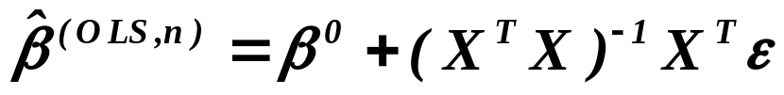
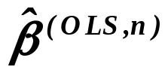
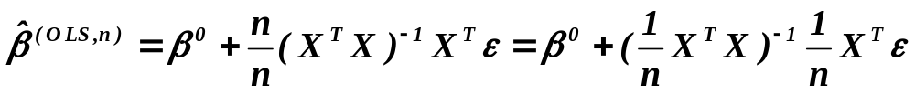
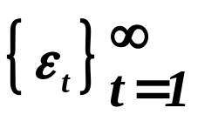
What happens if we don’t take into account the fact that
6
the disturbances are not independent r.v.’s ?
i.e.
,
so that is unbiased. Similarly
under stationarity of disturbances

Slide 8
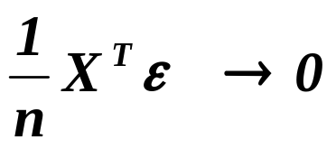
7
,
so that is consistent. So, it seems that the only
consequence of ignoring existence of correlations between
disturbances is a loss of efficiency.
● Is it really so ?
● And how large the loss can be, i.e. when is it worthwhile
to make some measures hopefully improving situation ?
● Which type of measures we can make to cope with situation ?
Prior to answering the first question, let’s briefly recall

Slide 9
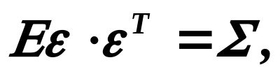


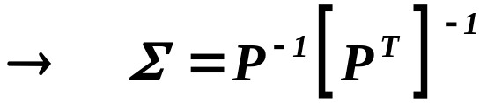

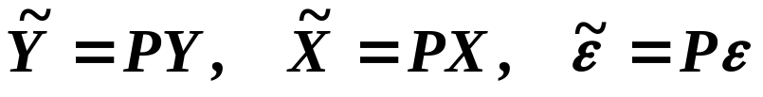
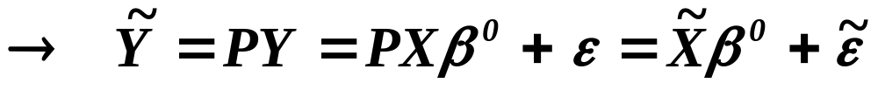
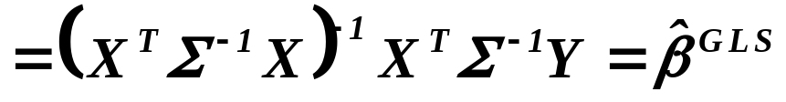
Generalized Least Squares
8
- regular and symmetric
,
putting
and
.
Finally
.

Slide 10
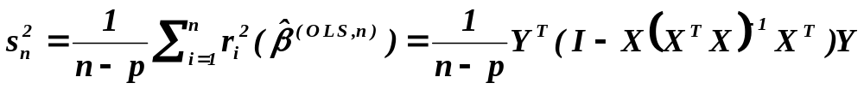

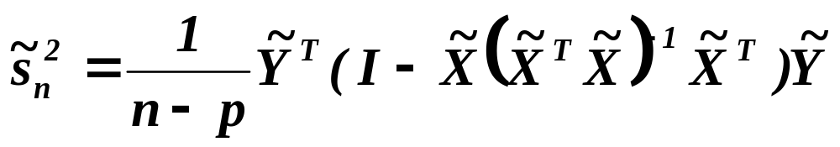
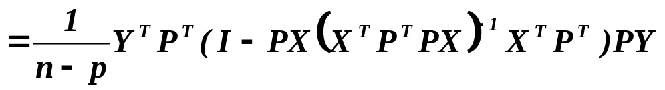
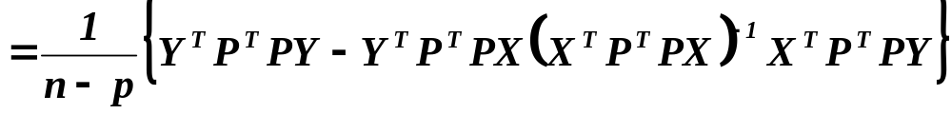
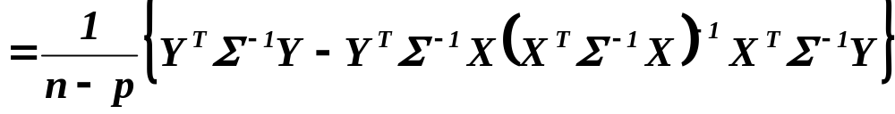
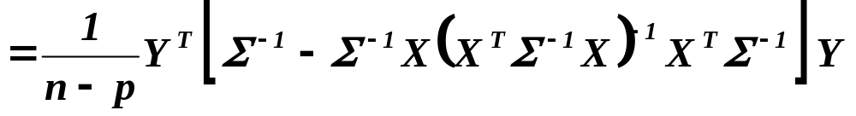
Ignoring the correlation of disturbances, we use
9
as the estimate for although it should be used

Slide 11



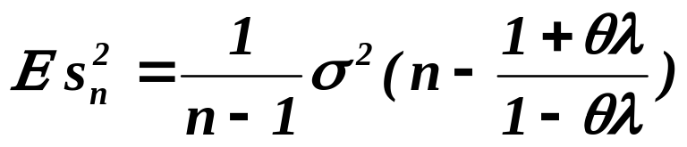

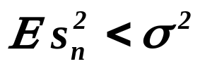
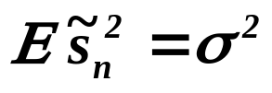
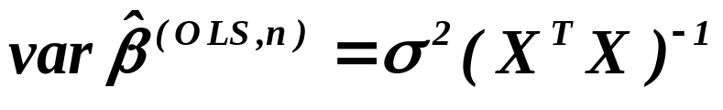
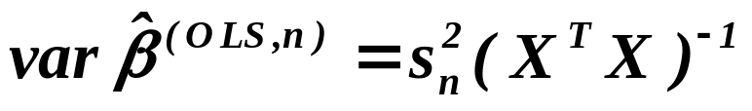
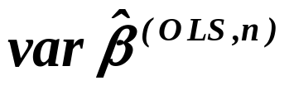
Assuming
10
with
and
,
then
,
while of course
.
Remember that
and hence
underestimates .

Slide 12
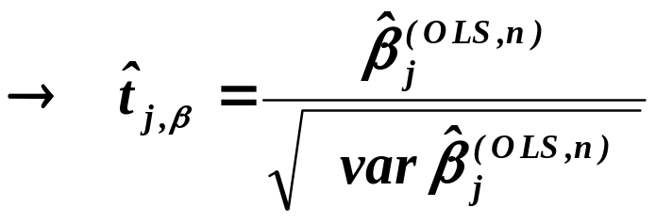
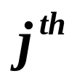
11
Warning: Although the previous analysis was carried out for
one dimensional case, the conclusion is usually taken to be
granted for the multidimensional as well.
If however valid in multidimensional case
overestimated
p-value is underestimated
explanatory variable is included into model
although it can be insignificant
model can be unnecessarily complicated
and variances of the estimates of coeffs large
( See an example of similar situation
which is due to heteroscedasticity in the sixth lecture of winter term.)

Slide 13






So, another unpleasant consequence,
except of a loss of efficiency,
can be misleading conclusion about significance
of explanatory variables.
12
On the other hand, the loss of efficiency is not inevitable,
let’s demonstrate it.
Assume that
- regular and
where consists of p eigenvectors of the matrix
( remember that is matrix of type , regular
there are n mutually orthogonal vectors )
and is a regular matrix ( of course of type ).

Slide 14


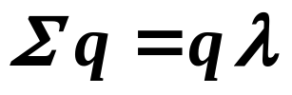
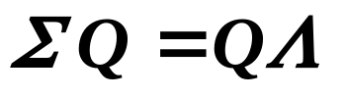

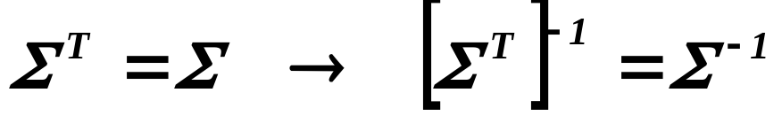
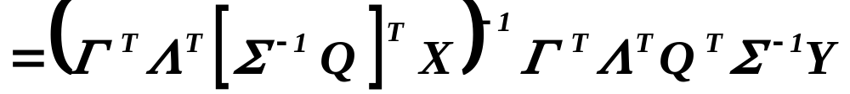
Let’s recall that for any eigenvector there is an eigenvalue
so that
hence
for some diagonal matrix of type .
Finally,
13

Slide 15
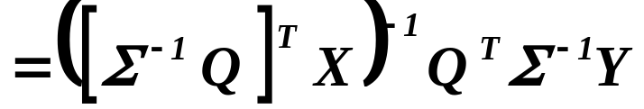
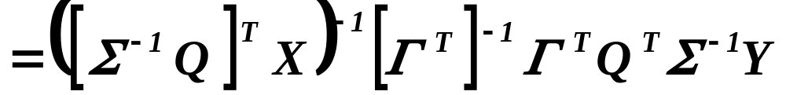
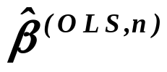
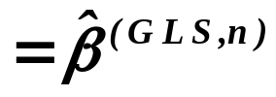
,
i.e.
Let’s now answer the question:
And how large the loss can be, i.e. when is it worthwhile
to make some measures hopefully improving situation ?
Let us assume again
with
and
.
14

Slide 16
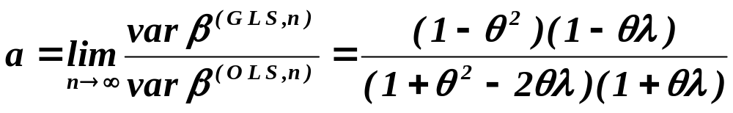


Then
.
Hence
,
but
,
so when the disturbances are heavily correlated,
the loss of efficiency can be considerable.
Finally, we shall consider problem :
How to estimate coefficients of regression model
when the disturbances are correlated ?
15

Slide 17
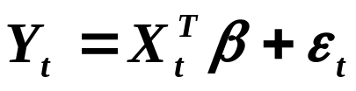
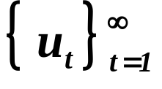
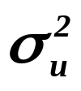
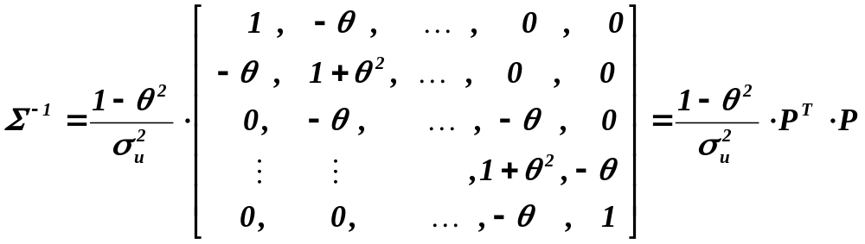
Estimating regression model with AR( 1 ) disturbances.
with
,
explanatory variables are assumed to be deterministic,
being a sequence of i.i.d. r.v.’s. with
zero mean
and variance equal to . Recalling that
16

Slide 18
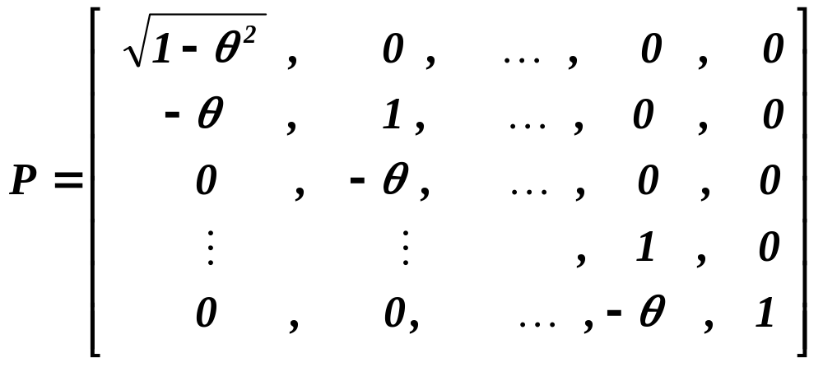
Estimating regression model with AR( 1 ) disturbances.
continued
where
and employing the transformation
and
,
we arrive at
17

Slide 19
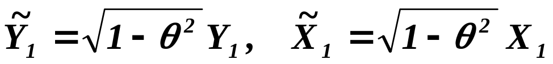
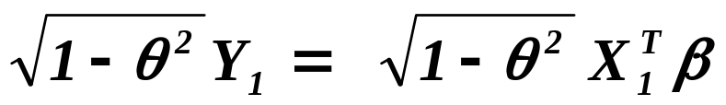
Estimating regression model with AR( 1 ) disturbances.
continued
Prais-Winsten transformation (1954)
It means that the equations yielding the estimates
of regression coefficients are
Ignoring the first row of Prais-Winsten transformation,
i.e. assuming only
18

Slide 20





Estimating regression model with AR( 1 ) disturbances.
continued
we speak about
Cochrane-Orcutt transformation (1949)
It means that the regression coefficients are estimated by .
The problem is that we usually don’t know !
One possibility is to estimate . Recalling that
19

Slide 21


Estimating regression model with AR( 1 ) disturbances.
continued
So, finally
So, much more frequently
Prais-Winsten estimator is 2SLS or EGLS
given by normal equations
and the same applies for
Cochrane-Orcutt
.
20

Slide 22


Estimating regression model with AR( 1 ) disturbances.
continued
Sometimes, it is advised to make iterations so long the estimates
of regression coefficients become stabilized ,
i.e. formally
and
21

Slide 23





Estimating regression model with AR( 1 ) disturbances.
continued
22
,
repeated unless
for some a priori selected .
The asymptotic properties of two-stage and iterated estimators
are the same ( consistency, efficiency
– of course in the framework of the assumed model ).

Slide 24


Estimating regression model with AR( 1 ) disturbances.
continued
Within the context of iterated estimator some proposals of
refined estimators of have appeared.
H. Theil (1954)
A.L. Nagar, H. Theil (1961)
where d is Durbin-Watson statistic.
23

Slide 25
What is to be learnt from this lecture for exam ?
• Correlogram
– tool for recognizing which model is to be used
• Prais-Winsten estimator (2SLS or EGLS)
• Cochrane-Orcutt estimator
• Estimation of coefficient of the corresponding AR(1)
All what you need is on
http://samba.fsv.cuni.cz/~visek/

