Slide 1

Tuesday, 12.30 – 13.50
Charles University
Charles University
Econometrics
Econometrics
Jan Ámos Víšek
Jan Ámos Víšek
FSV UK
Institute of Economic Studies
Faculty of Social Sciences
Institute of Economic Studies
Faculty of Social Sciences
STAKAN III
Sixth Lecture
(summer term)

Slide 2

1
Schedule of today talk
We shall complete only one question:
● How to estimate regression coefficients
when disturbances are AR( p ) or MA ( q ) ?

Slide 3
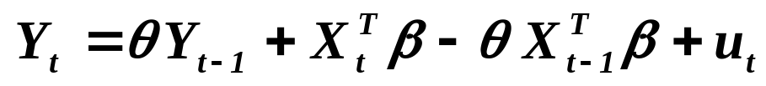

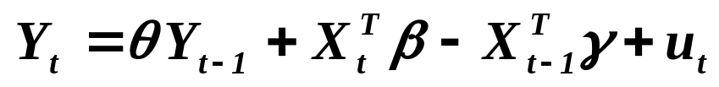


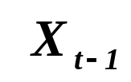

Estimating regression model with AR( 1 ) disturbances.
2
continued
Alternative possibilities:
J. Durbin (1960): Let’s write Cochrane-Orcutt’s estimating
equality
in the form
i.e. denoting
.
( * )
Notice that
as well as and are not correlated
with and hence the estimates given by ( * ) are unbiased
and consistent .

Slide 4
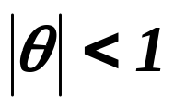
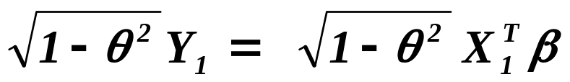

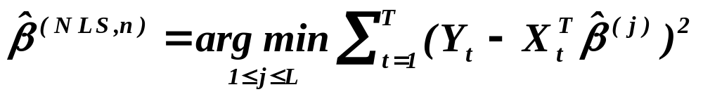
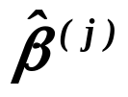


Estimating regression model with AR( 1 ) disturbances.
3
continued
Another possibility, due to the fact that , is to evaluate
solution of
( + )
for sufficiently dense partition of ( -1,1 ), say
and put
where is solution of ( + ) for ( “NLS” means
“the nonlinear least squares”).
Of course, the procedure can be then repeated for a partition of,
say,
, etc.

Slide 5
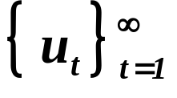
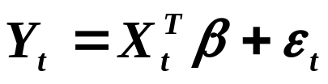


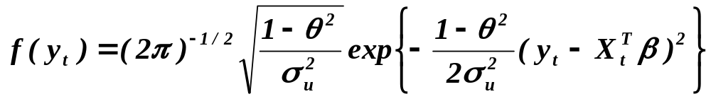
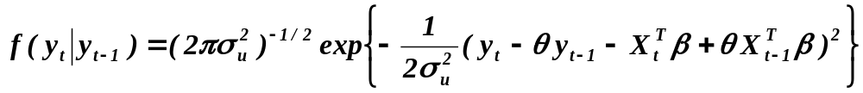
Estimating regression model with AR( 1 ) disturbances.
4
continued
Another possibility is ML estimate. Under assumption that
innovative sequence in the model
with
is normally distributed, i.i.d. with zero mean and variance ,
we have
,
with likelihood function
.

Slide 6
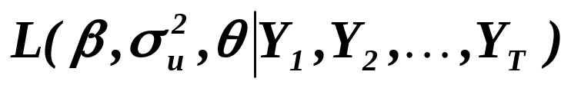
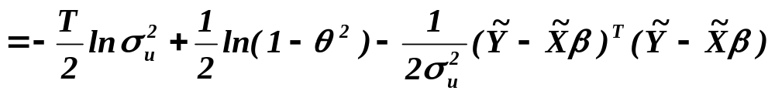
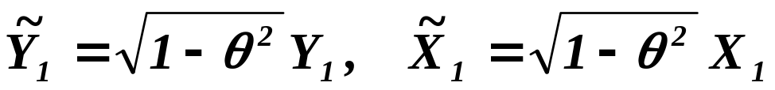
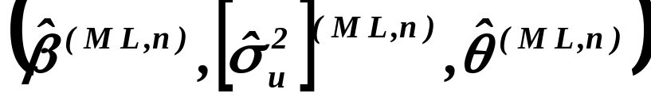
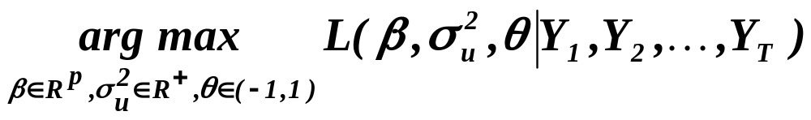
Estimating regression model with AR( 1 ) disturbances.
5
continued
The log-likelihood function is then
with
Finally,

Slide 7

Estimating regression model with AR( 1 ) disturbances.
6
continued
Bayesian statistics – Thomas Bayes (1701 – 1761),
priest of Anglican church and Nonconformist minister
in Turbridge Wells (about 35 miles from London),
Fellow of the Royal Society in 1742.
Mathematical inheritance posthumously rediscovered
by Richard Price and “popularized” by Pierre Simon Laplace.
The main idea:
Let us assume that parameters are also random variables,
why not. We may imagine that there is some “meta-world”
and the situation, when we look for estimates of parameters
employing some observations is a one given
realization of this random scheme.Then we may express our
prior knowledge about parameters by a density of these
parameters and, taking into account the observations, we may
find posterior density of parameters. Utilizing then posterior
density we may establish an estimate of unknown parameter.

Slide 8
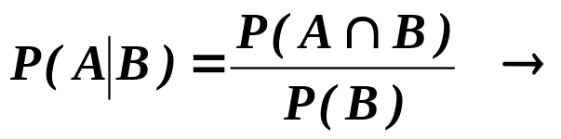
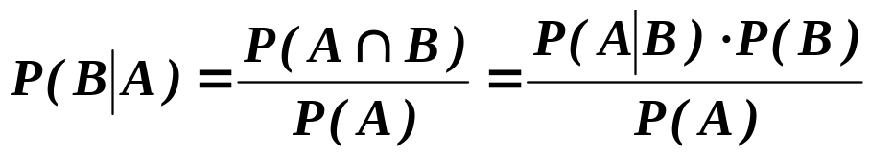
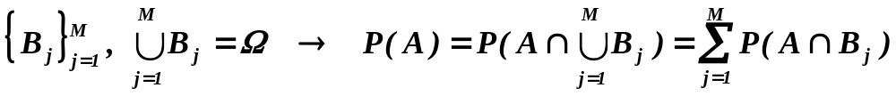
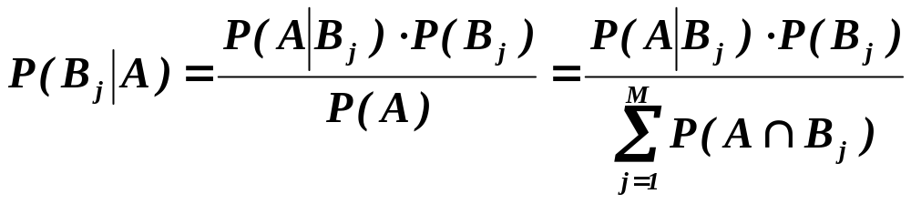


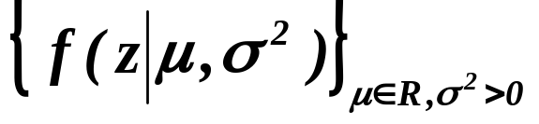
Estimating regression model with AR( 1 ) disturbances.
7
continued
Technicalities:
Employing then some asymptotic considerations ( with ),
for the prior density and system of conditional densities
of r.v.’s
we arrive at

Slide 9
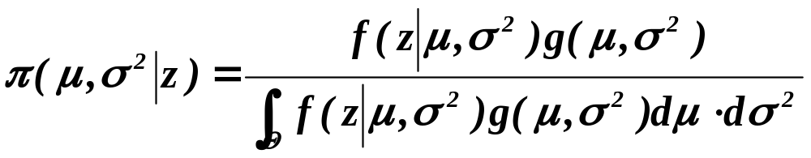

Estimating regression model with AR( 1 ) disturbances.
8
continued
( 1 )
(So, it was how to become Bayesian statistician – quick and easy.)
So, if we have some prior knowledge about parameters, we may
utilize this. One of favorite prior density is
.
If system
consists of normal densities, then we obtain as posterior density

Slide 10
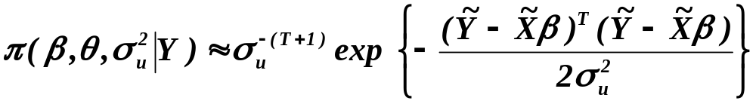

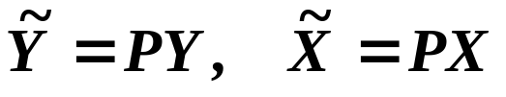
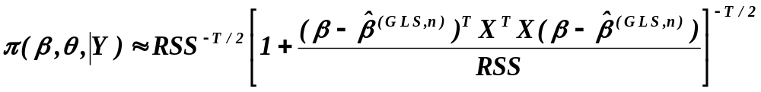

Estimating regression model with AR( 1 ) disturbances.
9
continued
( 2 )
(previous
slide)
where “ “ indicates that we write only numerator of ( 1 ) ,
since the denominator is a constant which can be at the end
specified by integrating over the entire space, and where of course
.
Carrying integration in ( 2 ) over we have
with
,
,

Slide 11




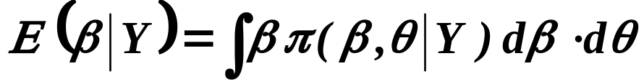
Estimating regression model with AR( 1 ) disturbances.
10
continued
so that the posterior density of and is multidimensional
t-density with the mean . In other words, if is known,
the bayesian estimate with the quadratic loss function is equal to
(since the quadratic loss is minimized by (conditional)
mean; realize however that as well as RSS depend on ).
If is unknown, we can take as the (point) estimate of
( 3 )
(there is no closed formula for it, it is necessary to integrate
numerically by PC, of course).

Slide 12
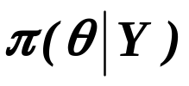
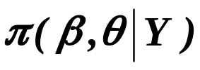
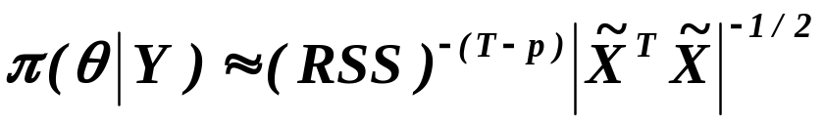
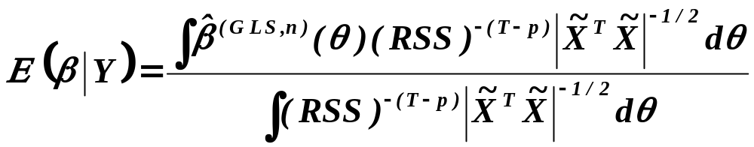
Estimating regression model with AR( 1 ) disturbances.
11
continued
Writing
In fact, looking for as the marginal density of
we find that
so that we can write
.

Slide 13
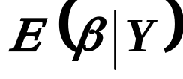

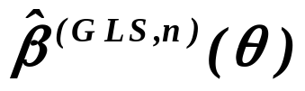
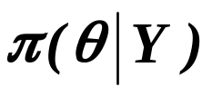
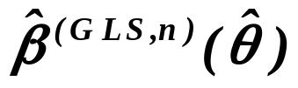
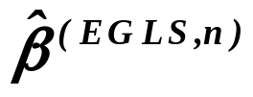
Estimating regression model with AR( 1 ) disturbances.
12
continued
As takes into account all possible values of ,
weighting the corresponding values of by ,
it is assumed by some authors to be better than i.e.
than .
Remark. Although AR( 1 ) model is the simplest one among Box-
-Jenkins ones, the structure is already sufficiently pregnant that
it is not possible to show that some of estimators is the uniformly
best .
Prior to paying an attention to AR( 2 ),
let us “evaluate” autocorrelations in AR( p ).

Slide 14
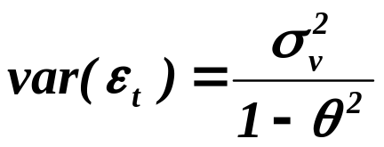
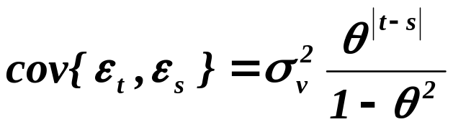

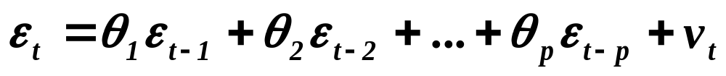


Finding autocorrelation function for AR( p ).
13
Let’s recall that for AR( 1 ) :
,
For AR( p ) :
,
multiplying it by
,
taking mean value and dividing it by , we arrive at
.
The equations are called Yule-Walker equations.

Slide 15

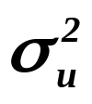
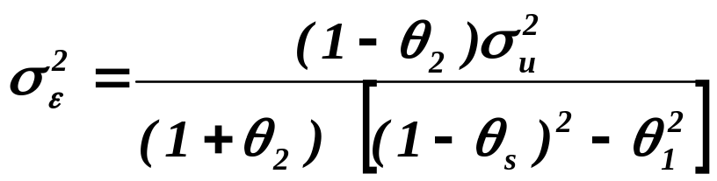
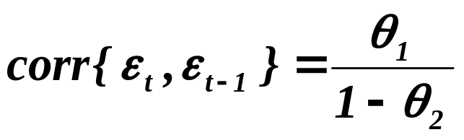
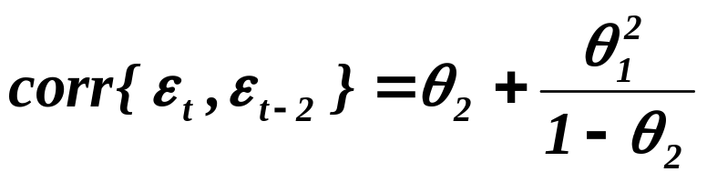
Estimating regression model with AR( 2 ) disturbances.
14
with
,
explanatory variables are assumed to be deterministic,
being a sequence of i.i.d. r.v.’s. with
zero mean
and variance equal to . Conditions for stationarity are
,
and
.
Then
,
,
and
.

Slide 16
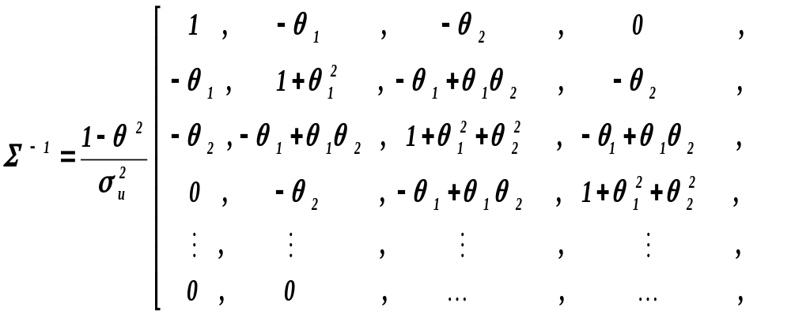
Estimating regression model with AR( 2 ) disturbances.
15
continued
and the matrix is symmetric around both diagonals .
Instead of giving the matrix P (as in previous),
we are going to present an analogy of Prais-Winsten equations.

Slide 17
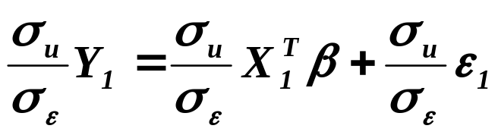
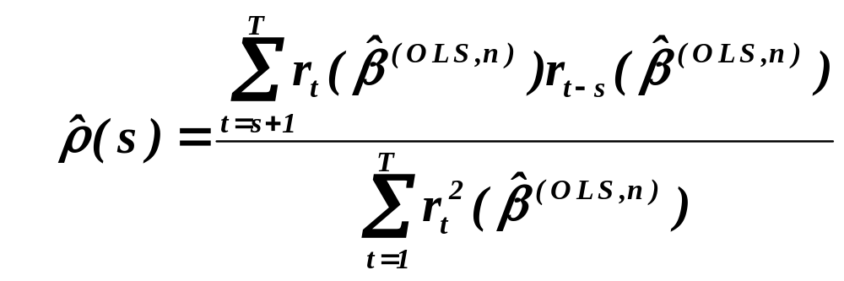
Estimating regression model with AR( 2 ) disturbances.
16
continued
Prais-Winsten equations for AR ( 2 )
,
,
and they are again used with estimated values for all unknown
items.
So, firstly we estimate
,

Slide 18
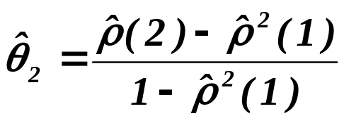
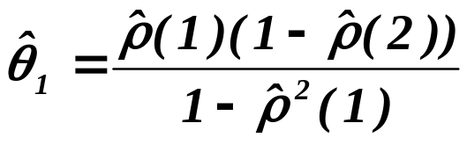
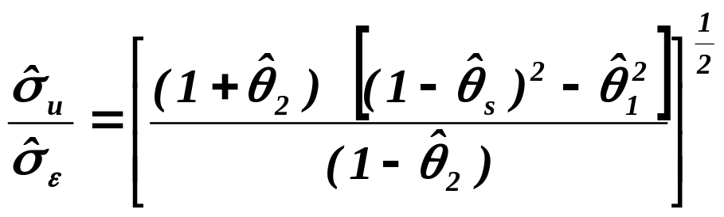


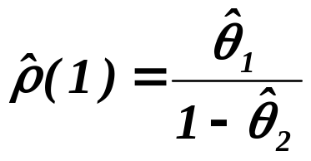
Estimating regression model with AR( 2 ) disturbances.
17
continued
put
,
and
.
(1)
An alternative way is to estimate and from
,
put
and employ (1).
Similarly as for AR( 1 ), ML, NLS and bayesian estimators are
considered but technicalities are a bit more tiresome.

Slide 19

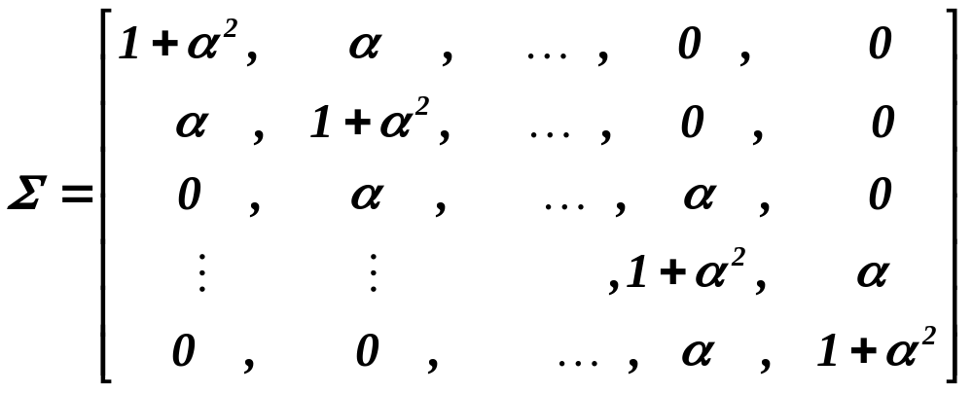
Estimating regression model with MA( 1 ) disturbances.
18
For estimating regression coefficient in the model
with
,
don’t exist tractable close precise formulas, since the expressions
for inverse of covariance matrices are too complicated. They are
“dual” to the matrices for AR(1) model. Covariance matrix for
our model is

Slide 20




Estimating regression model with MA( 1 ) disturbances.
19
continued
In the past, when the computation required much more time and
efforts, a lot of approximate algorithms were invented. Neverthe-
less they required iterative computing, sometimes with only slow
convergence.
That is why for MA( 1 ) ML-estimators became more popular.
For the multidimensional normal density ( with covariance
matrix ) we have
.
Likelihood is then (remember that matrix is of type and
stays on every line)

Slide 21



Estimating regression model with MA( 1 ) disturbances.
20
continued
Estimating by
.
Hence

Slide 22



Estimating regression model with MA( 1 ) disturbances.
21
continued
Let’s evaluate
.
Create new matrix by deleting the first row and the second
column of
.

Slide 23






Estimating regression model with MA( 1 ) disturbances.
22
continued
Then evidently (we evaluate determinant by expansion along
the first row of )
.
(1)
We evaluate directly and
.
Then according to (1)

Slide 24



Estimating regression model with MA( 1 ) disturbances.
23
continued
and prove by induction that
Then

Slide 25









Estimating regression model with MA( 1 ) disturbances.
24
continued
where
for such that . Putting and
( i.e , etc.)
and

Slide 26




Estimating regression model with MA( 1 ) disturbances.
25
continued
we have
.
Then
,
putting
(of course, the decomposition is not very simple). Nevertheless,
it allows to transform on by
.

Slide 27



Estimating regression model with MA( 1 ) disturbances.
26
continued
Finally, we can numerically, by an iterative algorithm,
solve either
or
and put
.

Slide 28




Estimating regression model with MA( 1 ) disturbances.
27
continued
There are several simplified methods, e.g. we may take
and for , putting ,
minimize again iteratively either

Slide 29

Estimating regression model with MA( 1 ) disturbances.
28
continued
or
.
Under some technical conditions, all four estimators are
asymptotically equivalent.
Warning !!
Similarly as many other methods, just described “corrections”
work (only) when the “underlying” generating process is that
one, we have assumed when establishing the “corrections” !!
We are going to show how, at least, to try
to avoid false conclusions.

Slide 30






An illustrative example - by Grayham E. Mizon
29
In 1995 Grayham E. Mizon published the paper:
A simple message for autocorrelation correctors: Don’t
J. Econometrics 68, 267 - 288
He considered data generating process (DGP) as follows
,
,
i.i.d. with
with
and
.

Slide 31





Mizon’s warning
30
First of all, knowing the true DGP, one can assume that having
at hand data
,
we should estimate in the model
,
leaving ( completely ) aside ‘s. That’s wrong idea, since ‘s
are ( highly ) correlated with ‘s and hence they bear significant
information for explaining ‘s. Including ‘s into the estimated
model could then improve accuracy of the estimate of .
But we don’t know the true DGP and hence :

Slide 32





continued
Mizon’s warning
31
Having at hand data
,
we try to estimate linear model M1
.
First of all, we shall discuss what we really do,
not knowing true DGP.
Nevertheless, prior to it, we shall make an idea about value of .
Of course, we have
.
( 1 )
To have consistent and unbiased, we need .
As follows from
( 1 )

Slide 33

continued
Mizon’s warning
32
and it yields
.
Now we may continue in “processing data”.
We shall use numerical results of the Monte Carlo study
made by Grayham Mizon.
He generated data according to DGP (given in previous) and he
took into account observations starting with 1001 repetition up to
1100 repetition. Then he estimated by OLS the model M1 (adding
into it a constant term). He obtained:

Slide 34


continued
Mizon’s warning
33
,
(the figures in square brackets are heteroscedastic
consistent standard errors) .
DW statistic indicates that something is to be done since there is
probably rather “heavy” correlation of disturbances. But some
other test, as for normality of disturbances or RESET test for
misspecification or test stability of coefficients, didn’t indicate any
problem.
However, due to the fact that we know true DGP, we can be dis-
satisfied with the estimated value 1.025 for 0.9. Finally, the value
of estimated variance of disturbances 0.794 is rather large.

Slide 35

continued
Mizon’s warning
34
We may employ some corrections of the type Cochran-Orcutt or
Prais-Winsten, i.e. we may assume model M2
.
We obtain
,
.
First of all, tests for normality reject it, White tests of heteroscedas-
ticity indicates problems and correlogram hints that there can be
correlation in the residuals at lags 1, 4 and 5. So the improvement
is questionable!!

Slide 36







continued
Mizon’s warning
35
Let’s now discuss the situation employing the fact
that we know true DGP:
Since the model doesn’t take into account ,
it cannot be congruent ( ! ) and moreover we shall show that
‘s are serially correlated and hence it contains a valuable
information for modeling . If ‘s are AR( 1 ), the estimator
is consistent, but it is inefficient. Moreover, , as the esti-
mate of , is also inefficient and generally biased (as we shall
prove).
Let’s start with proving serial correlation of .
Recalling that , we easy find that

Slide 37



continued
Mizon’s warning
36
( 2 )
Since also , we have from
( 3 )
and
,
( 4 )
.
Let’s evaluate terms of the right-hand-side.
( 2 ) yields
.

Slide 38



continued
Mizon’s warning
37
For further term we have
( 5 )
as well as
.
( 6 )
Finally,
.
From ( 3 ), ( 4 ), ( 5 ) and ( 6 ) then follows
.
So, we have shown that is serially correlated.

Slide 39



continued
Mizon’s warning
38
We are going to show that can’t be AR( 1 ).
Returning to ( 3 )
and substituting, according to the assumed model, for
we obtain
.
As mentioned above, we have to select so that
which implies that

Slide 40





continued
Mizon’s warning
39
with
and
.
Continuing in analysis, we obtain
.
If is AR( 1 ), then
.
But we have found in previous that
.
So, can’t be AR( 1 ).
It implies that the estimate of as well as of is
inevitably biased.

Slide 41


continued
Mizon’s warning
40
We are going to show that can’t be MA( 1 ).
Writing
( 3’ )
,
,
( 4’ )
( 5’ )
and
.
( 6’ )
Again from ( 3’ ), ( 4’ ), ( 5’ ) and ( 6’ ) follows
It implies that is not MA( 1 ).

Slide 42



continued
Mizon’s warning
41
In the next, let us show that the estimation in the framework of
models M1 and M2 leads to generally biased estimate of variance
of disturbances.
Let’s recall, how we have verified that
is unbiased. We have just calculated
.

Slide 43




continued
Mizon’s warning
42
Also recalling that
,
we have
.
If ,

Slide 44



continued
Mizon’s warning
43
and
.
If ,
and consequently
( with possible misspecification of significance of explanatory
variables in given model ).
Knowing the true DGP, how can we arrive at the optimal model
for explaining ‘s ?

Slide 45



continued
Mizon’s warning
44
Let’s recall the true DGP:
,
,
.
As we know that ‘s and ‘s are ( heavily ) correlated,
we may regress ‘s on ‘s and we obtain
with
.
Moreover, due to independence of ‘s and of ‘s, we have

Slide 46


continued
Mizon’s warning
45
So, wanting to substitute the true DGP ( with correlated disturban-
ces ) by another true DGP ( with uncorrelated disturbances ),
we arrive at
,
,
.
How can we imagine which model to estimate, having at hand just
“only” data ?

Slide 47

continued
Mizon’s warning
46
The only possibility is to consider some model which we assume
to be encompassing and to test all reduced model with respect to it !
In our case it means that we can propose to take into account
the models:
M1:
,
M2:
,
M3:
,
M4:
.

Slide 48
47
We find that the model M4 fulfills all test as the best but
when testing the hypothesis that the model M3 is correct
against the alternative that the correct is model M4,
the hypothesis cannot be rejected !!

Slide 49
What is to be learnt from this lecture for exam ?
• Durbin’s idea of estimating regression coefficients
when disturbances are AR(1) (or AR(p) – even)
• NLS and ML estimators
• Prais-Winsten equations for AR ( 2 )
• What is a source of problems
when estimating regression coefficients
when disturances are MA(1) ?
• Main idea of solving them
All what you need is on
http://samba.fsv.cuni.cz/~visek/

