Slide 1

1
Charles University
Founded 1348

Slide 2
Tuesday, 12.30 – 13.50
2
Charles University
Charles University
Econometrics
Econometrics
Jan Ámos Víšek
Jan Ámos Víšek
FSV UK
Institute of Economic Studies
Faculty of Social Sciences
Institute of Economic Studies
Faculty of Social Sciences
STAKAN III
Ninth Lecture
(summer term)

Slide 3

Schedule of today talk
3
The weighted least squares
A motivation for robust studies
Huber’s versus Hampel’s approach
Prohorov distance - qualitative robustness
Influence function - quantitative robustness
gross-error sensitivity
local shift sensitivity
rejection point
Breakdown point
Recalling linear regression model
Scale and regression equivariance

Slide 4
Schedule of today talk
4
continued
Introducing robust estimators
Maximum likelihood(-like) estimators
- M-estimators
Other types of estimators - L-estimators
R-estimators
minimum distance
minimum volume
Advanced requirement on the point estimators

Slide 5
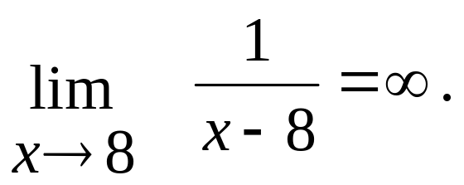
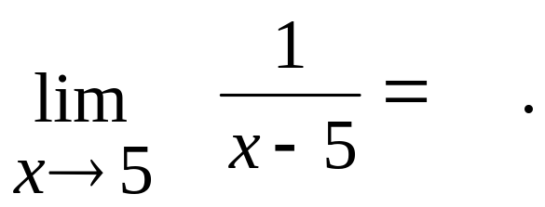
AN EXAMPLE FROM READING THE MATH
5
Having explained what is the limit,
an example was presented:
To be sure that the students
really understand what is in question,
they were asked to solve the exercise :
The answer was as follows:

Slide 6




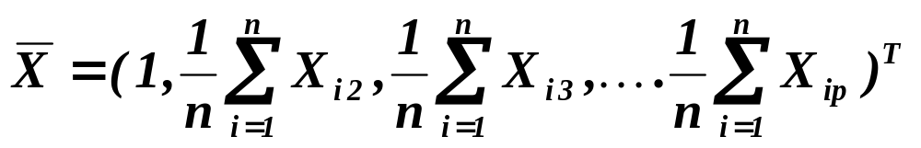


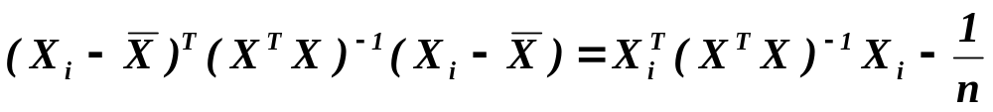
The Weighted Least Squares
6
The reasons for weighting (down) the residuals of observations.
An example – diagonal elements of hat matrix
Assuming intercept in model
has
in the first column (and row) and , respectively
From
see the next slide for geometry of situation

Slide 7



continued
The Weighted Least Squares
7
The i-th diagonal element
of hat matrix

Slide 8

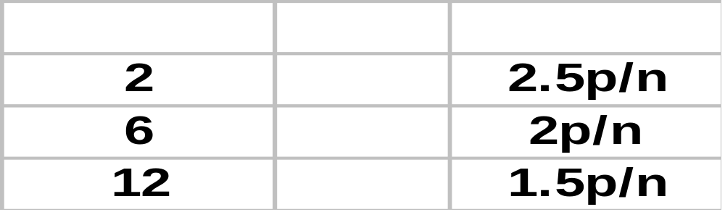
continued
The Weighted Least Squares
8
Moreover, is idempotent, i.e.
“mean value” of the diagonal element of is .
For the case of random regressors -
Chatterjee, S., A. S. Hadi (1988):
Sensitivity Analysis in Linear Regression.
New York: J. Wiley & Sons,
gave an approximation of 95% upper quantile.
Denote this as
the 1. approx. to
critical values
p larger then approx to quantile

Slide 9


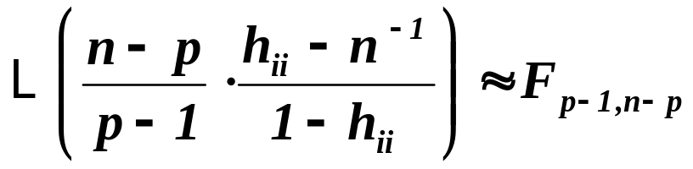


continued
The Weighted Least Squares
9
More precise analysis is in:
D.A. Belsley, E. Kuh, R.E. Welsch (1980): Regression Diagnostics:
Identifying Influential Data and Sources of Collinearity.
New York: J. Wiley & Sons.
Theorem
Assumptions
If has i.i.d. rows with p-dimensional
normal d.f. ( where ), then
Assertions
.
Of course, if rows of the matrix are independent, the rows of
can’t be independent. But the correlation is
of order , i.e. for large n we can employ the result. Then

Slide 10
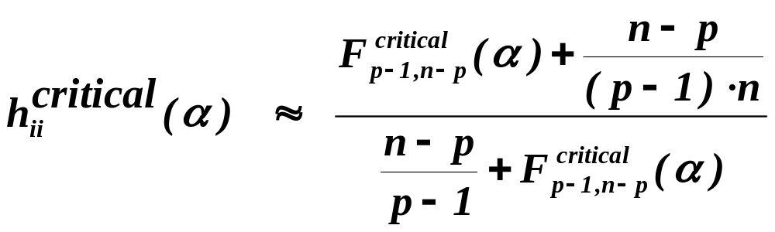
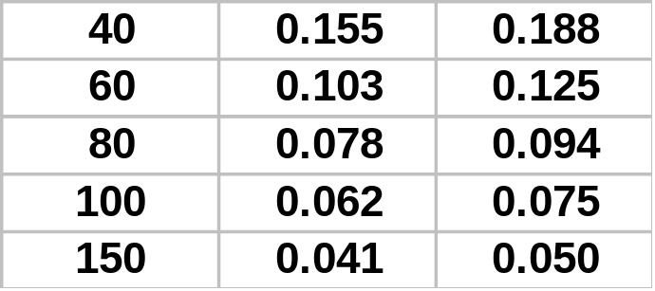
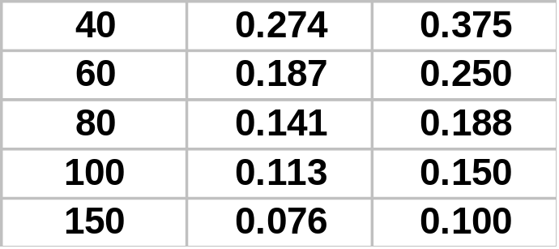


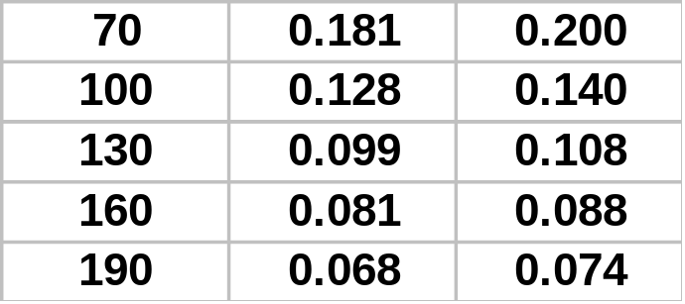
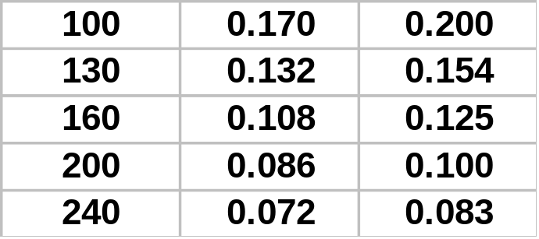


continued
The Weighted Least Squares
10
The 2. approx. to
critical values
The 1. approx. to
critical values
Number of observations

Slide 11
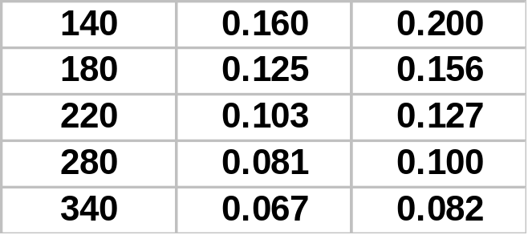
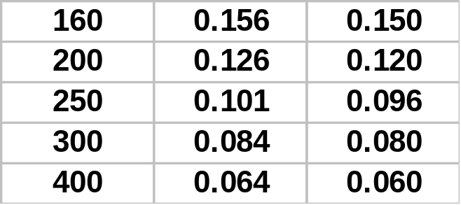


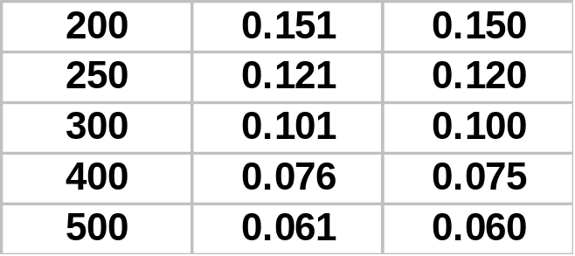
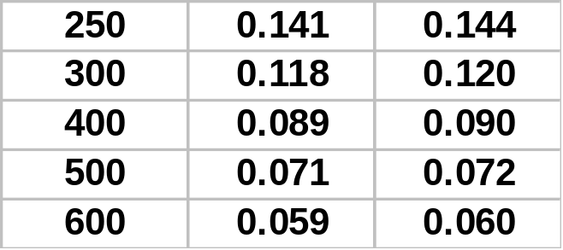



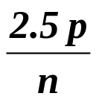
continued
The Weighted Least Squares
11
The 2. approx. to
critical values
The 1. approx. to
critical values
Number of observations
If the diagonal term of the hat matrix is larger than or even
, we should search whether it is outlier or leverage point.
It can be reason to for weighing it down !!

Slide 12

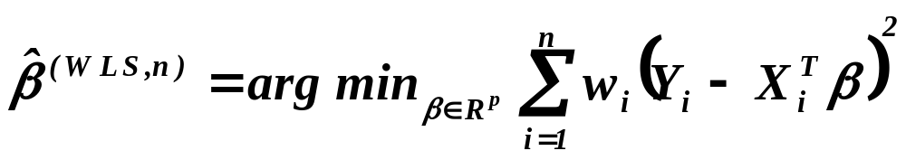

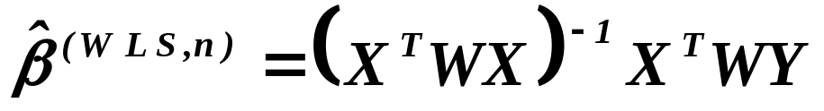
continued
The Weighted Least Squares
12
Let . Then the weighted least squares
are given as follows:
Odhad metodou vážených nejmenší čtverců
Putting , the normal equations are
and finally
.

Slide 13
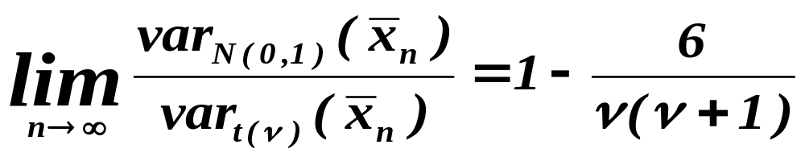
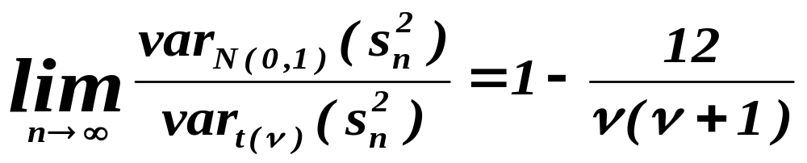
13
Why the robust methods should be also used?
Fisher, R. A. (1922): On the mathematical foundations
of theoretical statistics.
Philos. Trans. Roy. Soc. London Ser. A 222, pp. 309--368.

Slide 14
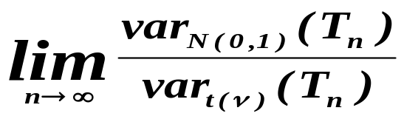


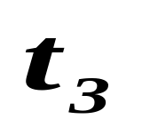
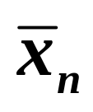
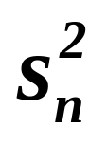
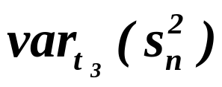
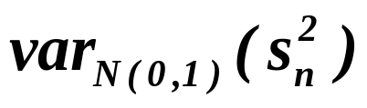
14
Why the robust methods should be also used?
Continued
0.93
0.80
0.50
0.83
0.40
0 !
is asymptotically
infinitely larger than

Slide 15
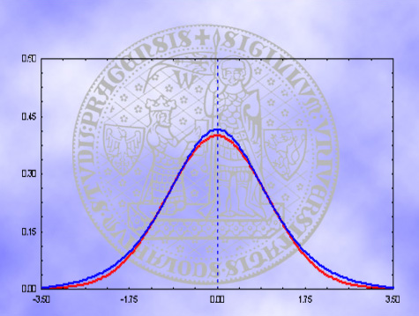
Is it easy to distinguish between
normal and student density?
15
Student density with 5 degree of freedom
Standard normal density

Slide 16
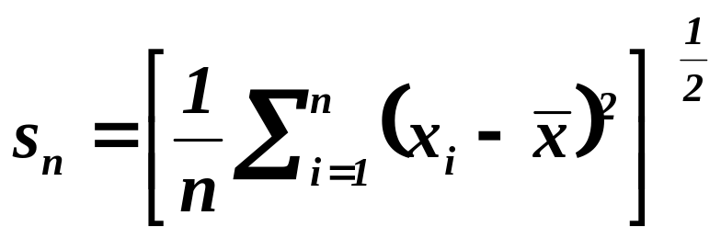
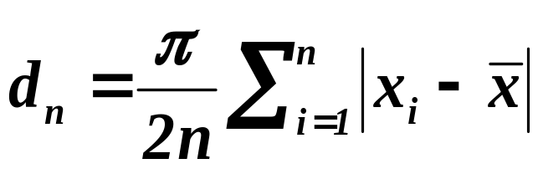
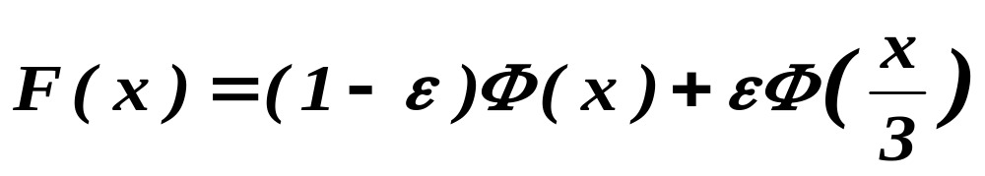
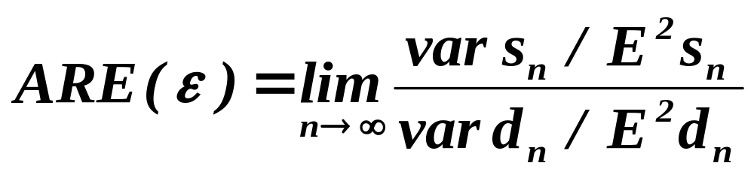
Why the robust methods should be also used?
16
Continued
Huber, P.J.(1981): Robust Statistics.
New York: J.Wiley & Sons

Slide 17

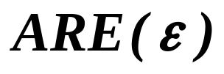
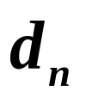

Why the robust methods should be also used?
17
Continued
 | 0 | .001 | .002 | .05
 | .876 | .948 | 1.016 | 2.035
So, only 5% of contamination makes
two times better than .
Is 5% of contamination much or few?
E.g. Switzerland has 6% of errors
in mortality tables, see Hampel et al..
Hampel, F.R., E.M. Ronchetti, P. J. Rousseeuw,
W. A. Stahel (1986):
Robust Statistics - The Approach Based on Influence Functions.
New York: J.Wiley & Sons.

Slide 18
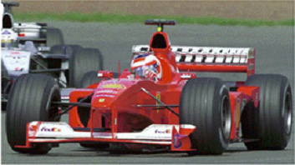

18
Conclusion: We have developed efficient monoposts
which however work only on special F1 circuits.
What about to utilize,
if necessary, a comfortable sedan.
It can “survive”
even the usual roads.
A proposal: Let us use both. If both work, bless the God.
We are on F1 circuit. If not, let us try to learn why.

Slide 19
19
Huber’s approach
One of possible frameworks
of statistical problems is to consider
a parameterized family of distribution functions.
Huber’s proposal:
Let us consider the same structure of parameter space
but instead of each distribution function
let us consider a whole neighborhood of d.f. .
Finally, let us employ usual statistical technique
for solving the problem in question.

Slide 20


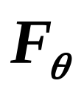
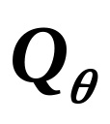

Huber’s approach
20
continued - an example
Let us look for an (unbiased, consistent, etc.) esti-
mator of location with minimal (asymptotic)
variance for family .
For each let us define
,
i.e. consider instead of single d.f. the family .
Finally, solve the same problem
as at the beginning of the task.
Let us look for an (unbiased, consistent, etc.) estimator
of location with minimal (asymptotic) variance
for family of families .

Slide 21
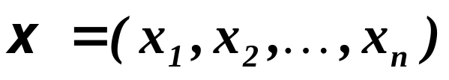
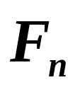
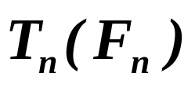
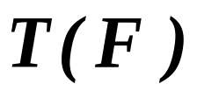
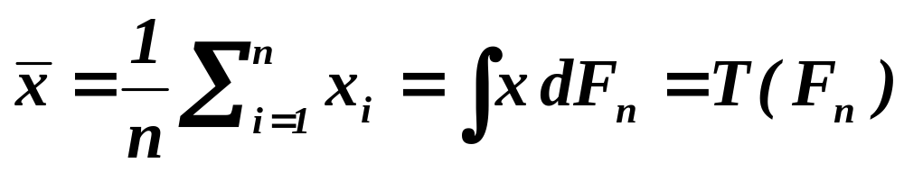
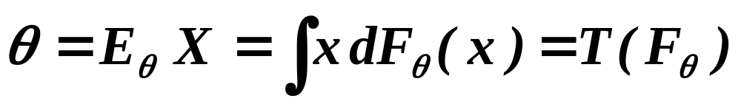
21
Hampel’s approach
The information in data
is the same as information in empirical d.f. .
An estimate of a parameter of d.f. can be
then considered as a functional .
has frequently a (theoretical) counterpart .
An example:

Slide 22
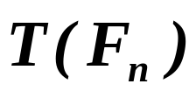

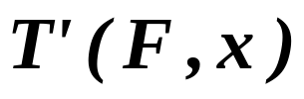
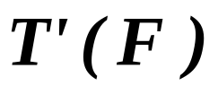
22
Hampel’s approach
continued
Expanding the functional at
in direction to , we obtain:
where is e.g. Fréchet derivative - details below.
Local properties of can be studied
through the properties of .
Message: Hampel’s approach is an infinitesimal one,
employing “differential calculus” for functionals.

Slide 23
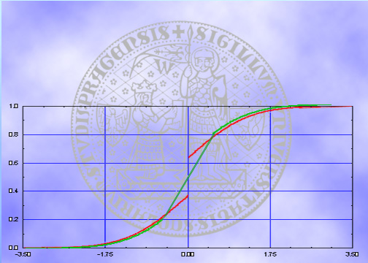

23
Qualitative robustness
Let us consider a sequence of “green” d.f.
which coincide with the red one,
up to the distance from the Y-axis .
Does the “green” sequence
converge to the red d.f. ?

Slide 24
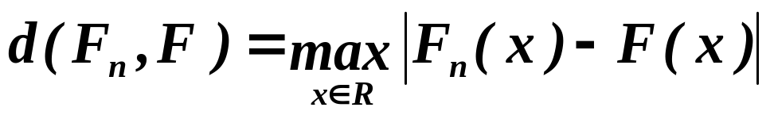
24
Qualitative robustness
continued
Let us consider Kolmogorov-Smirnov distance, i.e.
K-S distance
of any “green” d.f.
from the red one is equal
to the length of yellow
segment.
Independently on n,
unfortunately.
CONCLUSION:
The “green” sequence
does not converge in K-S metric
to the red d.f. !

Slide 25
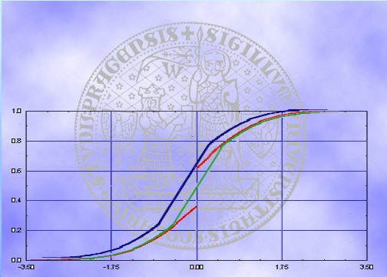
Qualitative robustness
25
continued
Prokhorov distance
In words:
We look for a minimal length,
we have to move the green d.f.
- to the left and up -
to be above the red one.
CONCLUSION:
Now, the sequence
of the green d.f. converges
to the red one.

Slide 26
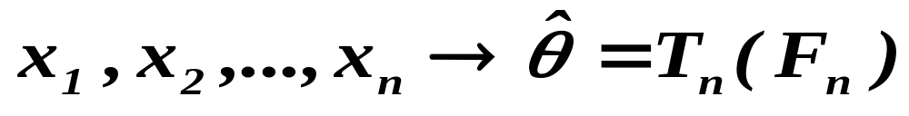
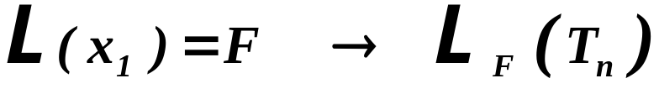

Qualitative robustness
26
i.i.d.
DEFINITION
In words: Qualitative robustness is the continuity
with respect to Prohorov distance.
E.g., the arithmetic mean is qualitatively robust at normal d.f. !?!
Conclusion : For practical purposes we need
something “stronger” than qualitative robustness.

Slide 27



27
Quantitative robustness
Influence function
The influence function is defined where the limit exists.

Slide 28




28
Quantitative robustness
continued
Characteristics derived from influence function
Gross-error sensitivity
Local shift sensitivity
Rejection point

Slide 29




Breakdown point
29
Definition – please, don’t read it
obsession
(especially in regression
– discussion below)
(The definition is here only to show that the description
of breakdown which is below, has good mathematical basis. )
In words
is the smallest (asymptotic) ratio
which can destroy the estimate
in the sense that the estimate tends
(in absolute value ) to infinity or to zero.

Slide 30





30
Robust estimators of parameters
An introduction - motivation
Let us have a family
and data .
Of course, we want to estimate .
Maximum likelihood estimators :
What can cause a problem?

Slide 31









31
Robust estimators of parameters
What can cause a problem?
An example
Consider normal family with unit variance:
So we solve the extremal problem
(notice that does not depend on ).

Slide 32





Robust estimators of parameters
32
A proposal of a new estimator
Maximum likelihood-like estimators :
Once again:
What caused the problem in the previous example?
So what about

Slide 33







33
Robust estimators of parameters
linear part
quadratic part

Slide 34






34
Robust estimators of parameters
The most popular estimators
M-estimators
maximum likelihood-like estimators
L-estimators
based on order statistics
R-estimators
based on rank statistics

Slide 35




35
Robust estimators of parameters
Robust estimators of parameters
The less popular estimators
but still well known.
Minimal distance estimators
based on minimazing distance
between empirical d.f. and theoretical one.
Minimal volume estimators
based on minimazing volume containing given
part of data and applying “classical”
(robust) method.

Slide 36
36
Algorithms for evaluating robust estimators
Robust estimators of parameters
The classical estimator, e.g. ML-estimator,
has typically a formula to be employed for evaluating it.
Extremal problems
(by which robust estimators are defined) have not
(typically) a solution in the form of closed formula.
Firstly
To find an algorithm how to evaluate
an approximation to the precise solution.
Secondly
To find a trick how to verify that the appro-
ximation is tight to the precise solution.

Slide 37
37
High breakdown point
obsession
(especially in regression
– discussion below)
Hereafter let us have in mind that we speak implicitly about
REGRESSION MODEL

Slide 38







38
Recalling the model
Linear regression model
where
.
Put
( if intercept
),
and
.

Slide 39
39
Recalling the model graphically
Linear regression model
So we look for a model
“reasonably” explaining data.

Slide 40
40
Recalling the model graphically
Linear regression model
This is a leverage point
and this is an outlier.

Slide 41






41
Equivariance of regression estimators
We arrive probably easy to an agreement
that the estimates of parameters of model
should not depend on the system of coordinates.
Formally it means:
Equivariance in scale
If for data
the estimate is
,
than for data
the estimate is
Scale equivariant
Equivariance in regression
If for data
the estimate is
,
than for data
the estimate is
Affine equivariant

Slide 42
Advanced (modern?) requirement
on the point estimator
42
Unbiasedness
Consistency
Asymptotic normality
Low Gross-error sensitivity
Reasonably high efficiency
Low local shift sensitivity
Finite rejection point
Controllable breakdown point
Scale- and regression-equivariance
Algorithm with acceptable complexity
and reliability of evaluation
Heuristics, the estimator is based on,
is to really work
Still not
exhaustive

Slide 43
What is to be learnt from this lecture for exam ?
• Weigted least squares
• Main reasons for constructing robust estimators
- influence of outliers in estimating mean and variance
• Influence function
and indicators of robustness based on it
• Break down point
• M-estimators and minimal distance estimators
All what you need is on
http://samba.fsv.cuni.cz/~visek/

