Slide 1
Machine Learning(Boosting Algorithm) - Regression
What is Boosting Algorithm??
Boosting(means strength/value improviser)algorithm(means set of instruction’s/procedures) in machine learning refers to ‘ensemble learning (means group producing single effect) method’ which sequentially combines multiple weaker models to produce a robust model.
Types of Boosting Algorithm:
AdaBoost – Adaptive Boosting Algorithm.
XGBoost – ExtremeGradientBoosting Algorithm.
LGBoost – LightGradientBoosting Algorithm.

Slide 2
Machine Learning(Boosting Algorithm) - Regression
AdaBoost, XGradientBoosting, LightGradientBoosting are Ensemble methods that use weaker models as base models to make predictions.
What is Gradient??
Gradient means measure of steepness or slope of road or a line.
What is Ensemble??
Ensemble means A group producing a single effect.
Ensemble is a Treebased Algorithm.
Also its a meta(many) learning method that use to address problems like classification and regression.
All three algorithm can handle a mixture of regression and classification features and can capture complex non-linear relation between feature and target variables.

Slide 3
Machine Learning(Boosting Algorithm) - Regression
All three algorithms require hyperTuning parameter’s to prevent overfiting, improve the performance of model which helps to chose best learning mode.
Methodology of 3 Boosting Algorithm:
GradientBM, ExtremeGBM using a similar approach to build the sequence of models, where each subsequent(comes after) models to minimize the error of the previous model.
In contrast, AdaBoost uses a different approach, where each subsequent model tries to focus on the samples which were misclassified by the previous model.
Speed of 3 Boosting Algorithm:
XGBM is faster than predecessor GBM, as it includes several optimization techniques. AdaBoost is slower than GradientBM and XGBM as it requires multiple iteration to build the sequence of models.
All three algorithm are powerful machine-learning technique that used to solve a wide range of problems, XGBoost is an optimized version of GBM, while AdaBoost uses a different approach to build the sequence of models.
The Choice of algorithm depends on the requirement of the Client.

Slide 4
Machine Learning(Boosting Algorithm) - Regression
HyperTunning Parameter’s & PIP python:
Hypertuning is the process of assigning the values to the variables before the beginning of learning to find the best values for a machine learning algorithm's which also improves evaluation metrics score for example:Rsquare.
PIP python:
package installer for Python packages. It is used to install packages(consist of classes and function) which do not come with python, also upgrades and removes the packages.
Commands to install, upgrade and remove.
a. pip install lightgbm==3.3.5(package name)
b. python -m pip install --upgrade pip
c. python uninstall lightgbm==3.35(package name)

Slide 5
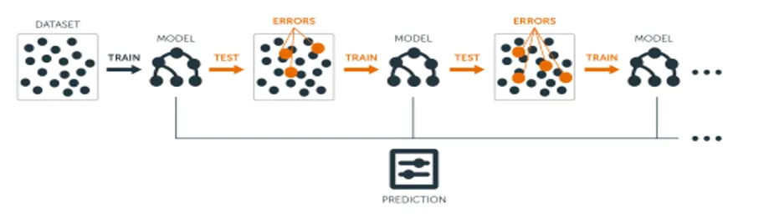
Machine Learning(Boosting) - Regression
Trees are grown sequentially.
Each tree is grown using information from previous grown trees.
Family of weak learners should have a minimum correlation between them.

