Slide 1
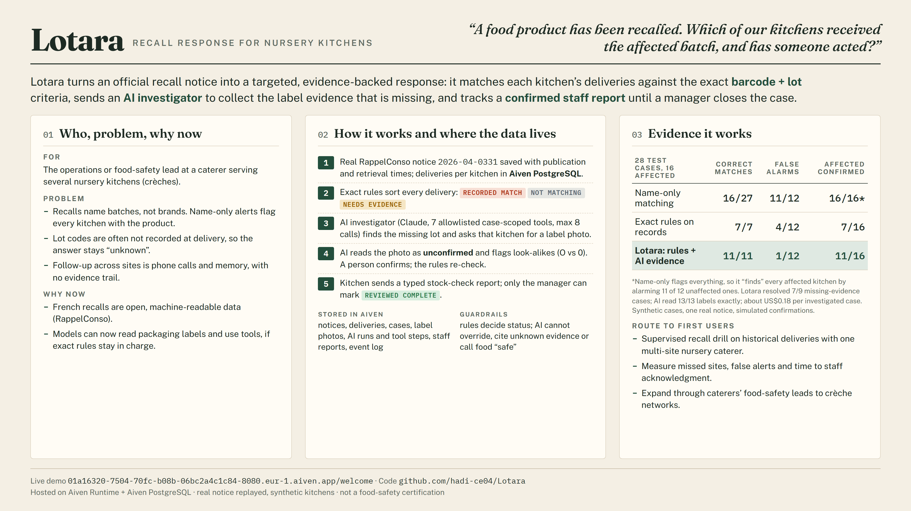
Notes:
Lotara: which of our nursery kitchens received the recalled batch, and has someone acted? Real RappelConso notice, exact barcode + lot rules on Aiven PostgreSQL, AI investigator collects the missing label evidence, person confirms, kitchen reports, manager closes. On 28 labelled cases: 11/11 correct matches and 1/12 false alarms vs 16/27 and 11/12 for name-only matching. Live demo: https://01a16320-7504-70fc-b08b-06bc2a4c1c84-8080.eur-1.aiven.app/welcome

