Slide 1
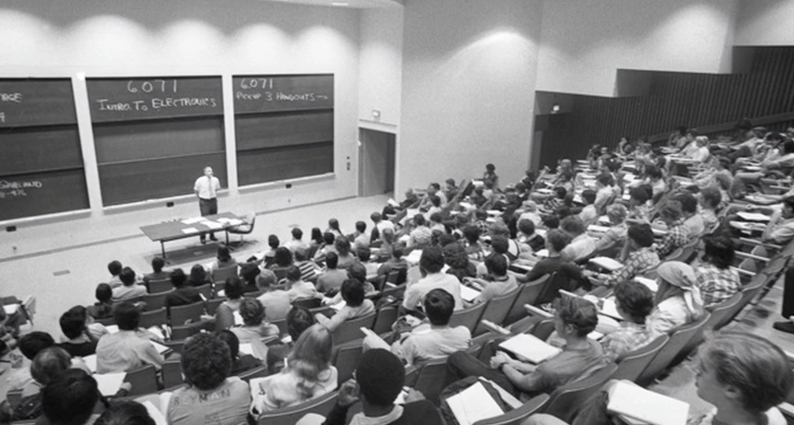
Empower edX:
Increasing student engagement in
massive open online courses
Hadi Ebrahimnejad
      MIT (1960)

Slide 2

Education: past and present
In spite of tremendous technological advancements, education hasn't really
changed for centuries.
      MIT (2010)

Slide 3

Using online technologies
Online technologies can transform education in both scale and access.

Slide 4
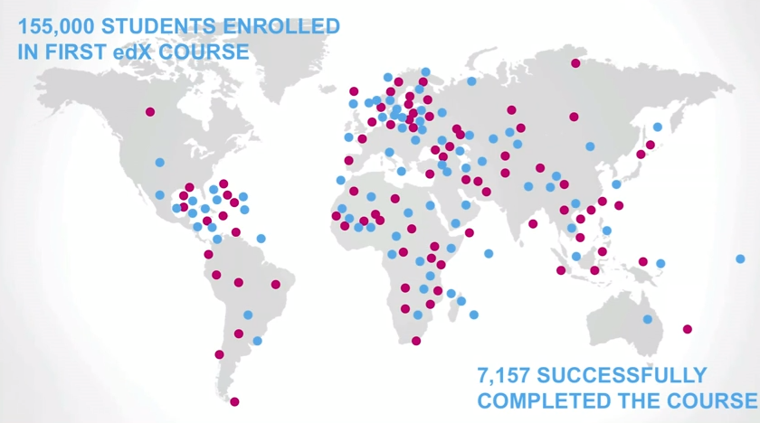
Impact of massive open online courses
Online technologies can transform education in both scale and access.

Slide 5
Impact of massive open online courses
Online technologies can transform education in both scale and access.
More than entire
MIT alumni

Slide 6
Impact of massive open online courses
Online technologies can transform education in both scale and access.
More than entire
MIT alumni
40 years of
lecture time

Slide 7
edX data
Data is aggregated from a series of 17 online courses offered in 2012-2013 by Harvard & MIT on edX (445000 active registrants).
videos watched
chapters studied
days active
registration date
last interaction date
level of education
age
gender
subject
instructor
start date
end date
Students
Courses

Slide 8
The Funnel
73%
8%
4%

Slide 9
Point of maximal interest
Certification is highest for student who register near course launch.
It rapidly drops for those registered later.

Slide 10
Course timeline
Performance of late registrants (grp 2 & 3) suffers from shorter/missed deadlines.

Slide 11
Course timeline
Performance of late registrants (grp 2 & 3) suffers from shorter/missed deadlines.
Early registrants (grp 0 & 1) have to wait longer to get access to course content.

Slide 12
'course view' nagatively affected by timeline
viewed course content
didn't view course content
Early registrants (grp 0 & 1) have to wait longer to get access to course content.

Slide 13
Current timeline

Slide 14

Current timeline
close the gap

Slide 15
Synchronous timeline

Slide 16
Synchronous timeline
RF classification of student certification
Synchronous timeline
interrupts communication
among different groups
of students.
Chapters read
Days active
Last visit to launch
Videos played
Age
However, communication
is irrelevant for student
certification.
Level of education
Gender
Posts on forum

Slide 17
Summary
Course timelines need to be synchronized with student registration:
  Current solid timelines are against open design of online courses.
'Gender, age and level of education' have little relevance to 'certification'.
'Certification' should not be the focus in online courses:
  73% 'viewed the course content' vs 4% 'certified'

Slide 18

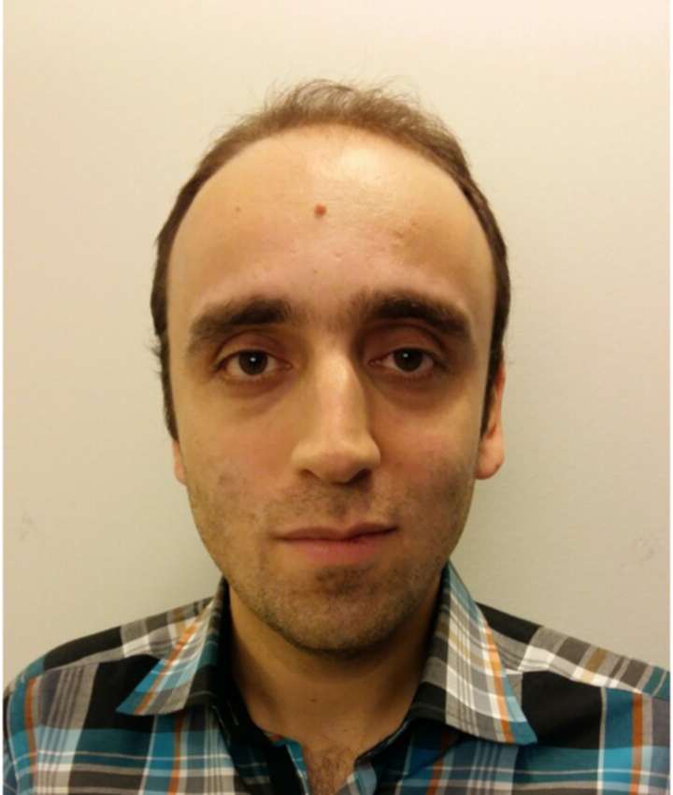
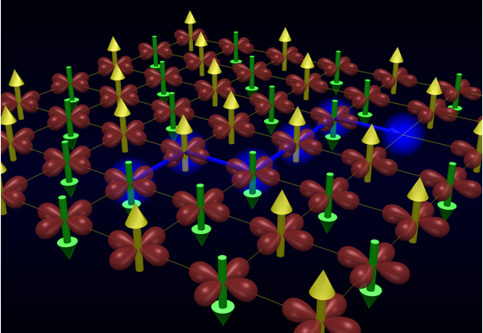
Hadi Ebrahimnejad
Holes in magnetic materials

Slide 19

Hadi Ebrahimnejad
Holes in magnetic materials
High-temperature superconductors

Slide 20

Hadi Ebrahimnejad
Holes in magnetic materials
High-temperature superconductors

Slide 23
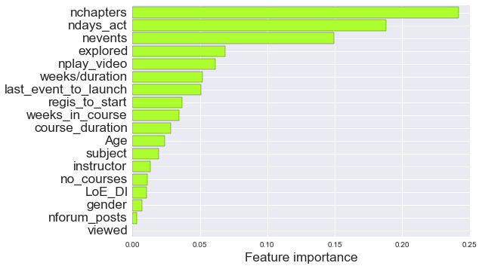
Predicting student churn
Data is aggregated from a series of 17 online courses offered in 2012-2013 by Harvard & MIT on edX (445000 active registrants).
Can we construct a churn predictor
for student certification?
Chapters read
Days active
Interactions
Videos played
Course length
Age
Instructor
Courses registered
Level of education
Gender
Posts on forum
accuracy: 97%
recall: 97%
precision: 99%
RF classification of a balanced population

Slide 24
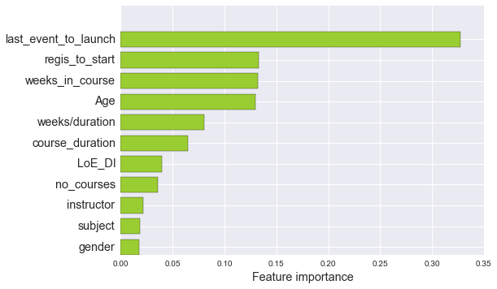
Predicting 'course view'
ROC curve
accuracy: 84%
recall: 91%
precision: 87%
important predictors of 'course view'
Last visit to course relative to launch
Registration to launch
Weeks spent in course
Age
Weeks/course duration
Course duration
Level of education
no. courses registered
Instructor
Subject
Gender
Feature importance

Slide 25
Effect of enrollment date
Certification rate rapidly declines after course launch.
 | Before course launch | After course launch | Overall
Registration | 48% | 52% | 100%
Certification rate | 5.3% | 2.6% | 3.9%
Course view rate | 65% | 80% | 73%

Slide 26
Thinking in terms of probabilities
ROC curve
accuracy: 84%
recall: 91%
precision: 87%

