Slide 1

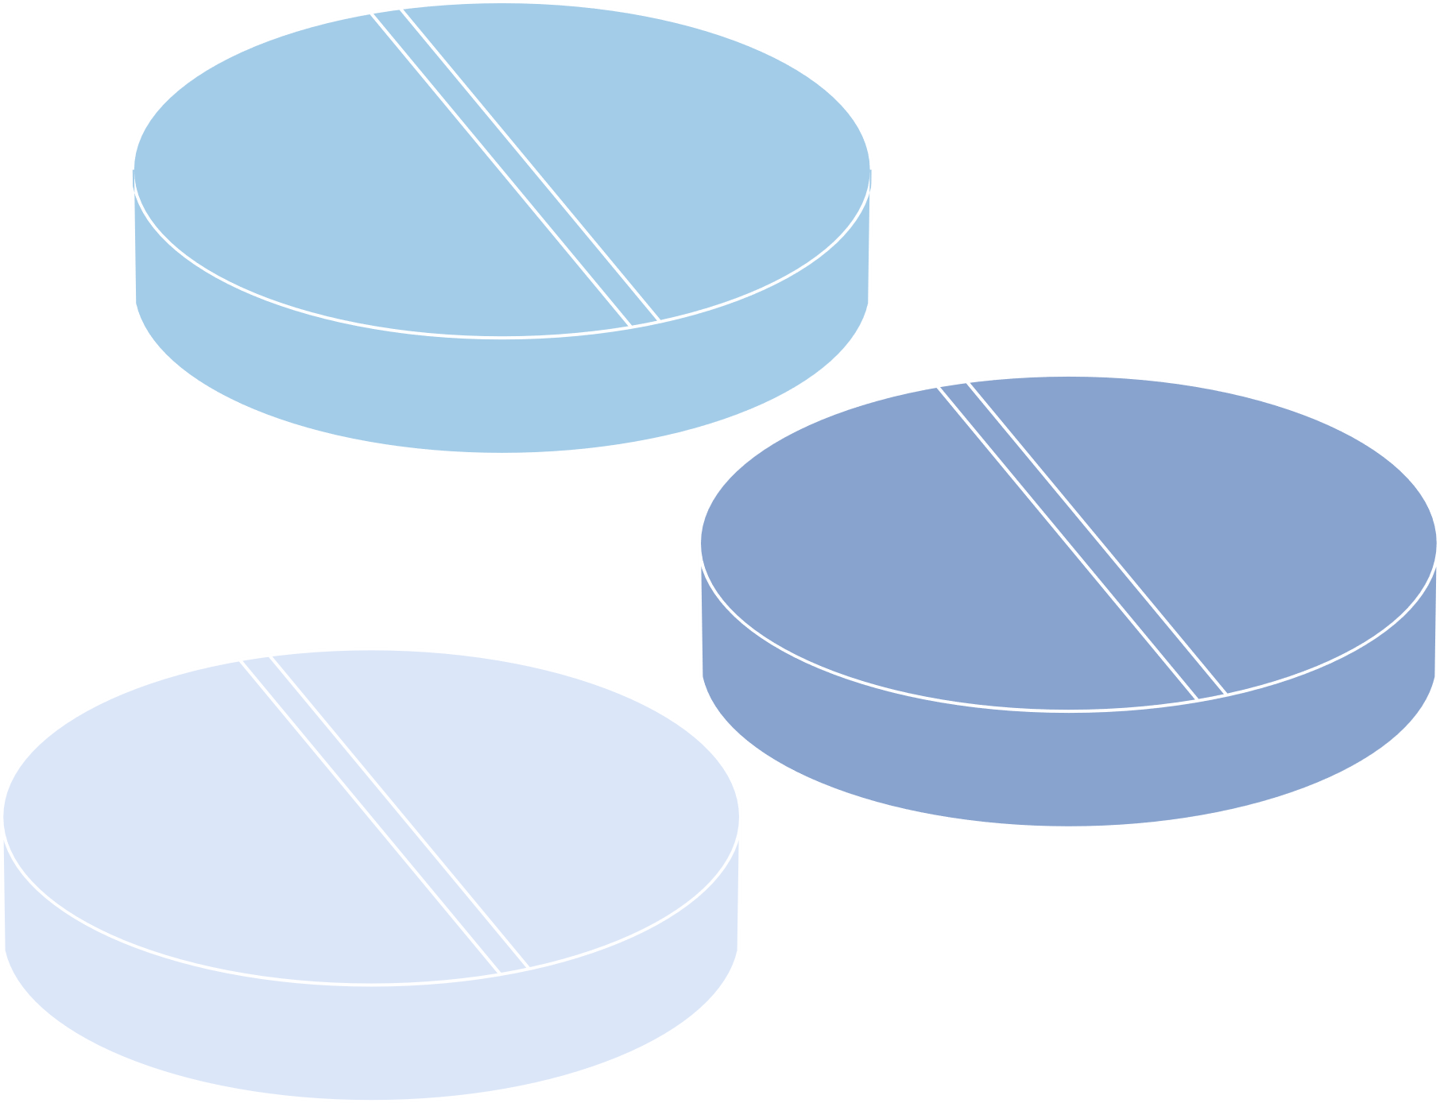







Beirut Arab University
Harnessing Machine Learning for Diabetes Risk Prediction

Slide 2



Business Problem
How can the healthcare organization effectively utilize demographic, lifestyle, and medical data to predict diabetes risk and tailor preventive interventions, thereby reducing disease prevalence and enhancing overall patient health outcomes?

Slide 3
Put Simply
A healthcare organization wants to improve preventive care by identifying individuals at high risk of developing diabetes.
By predicting diabetes risk based on demographic, lifestyle, and medical data, the organization aims to prioritize at-risk individuals with tailored interventions, thereby reducing the prevalence of diabetes and improving overall patient outcomes.

Slide 4
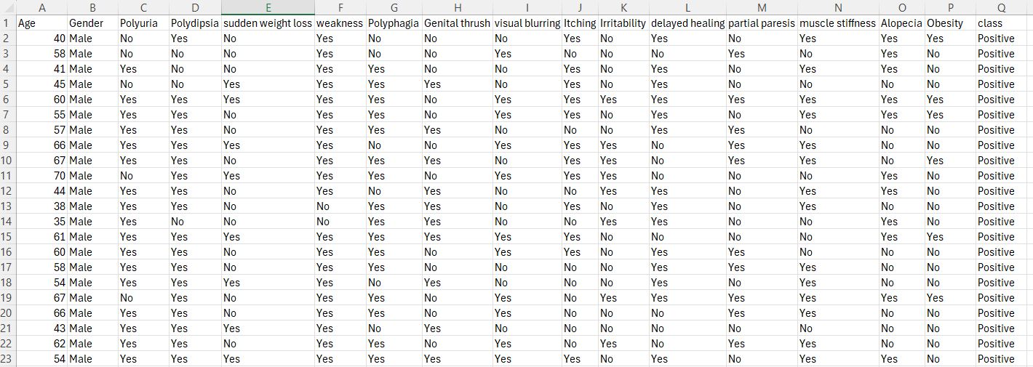
Dataset
https://www.kaggle.com/datasets/rcratos/diabetes-risk-prediction/data

Slide 5


Dataset Features:
Age: Age of the individual.
Gender: Gender of the individual (e.g., Male, Female).
Polyuria: Frequent urination (Yes/No).
Polydipsia: Excessive thirst (Yes/No).
Sudden weight loss: Indicates sudden and unexplained weight loss (Yes/No).
Weakness: General weakness or fatigue (Yes/No).
Polyphagia: Excessive hunger (Yes/No).

Slide 6
Dataset
Features:
Genital thrush: Presence of genital thrush (Yes/No).
Visual blurring: Blurred vision (Yes/No).
Itching: Skin itching (Yes/No).
Irritability: Mood irritability (Yes/No).
Delayed healing: Delayed wound or cut healing (Yes/No).
Partial paresis: Weakness or partial paralysis (Yes/No).
Muscle stiffness: Muscle stiffness or tightness (Yes/No).
Alopecia: Hair loss or baldness (Yes/No).
Obesity: Presence of obesity (Yes/No).
Class: Target variable indicating diabetes status (Positive/Negative).

Slide 7
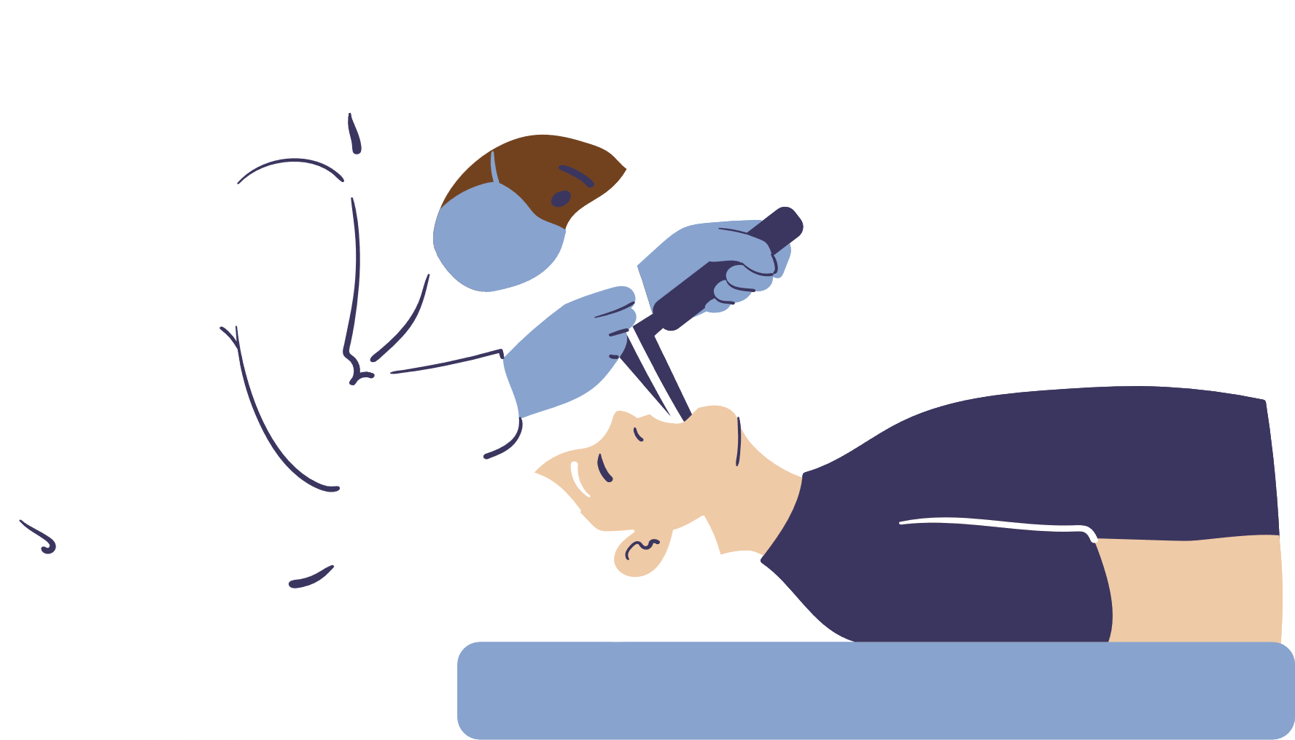
Data Preprocessing
and Preliminary Analysis:
1- data cleaning
2- data transformation
3- exploratory data analysis

Slide 8
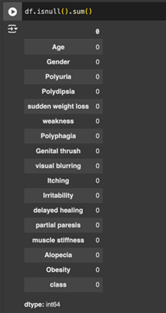
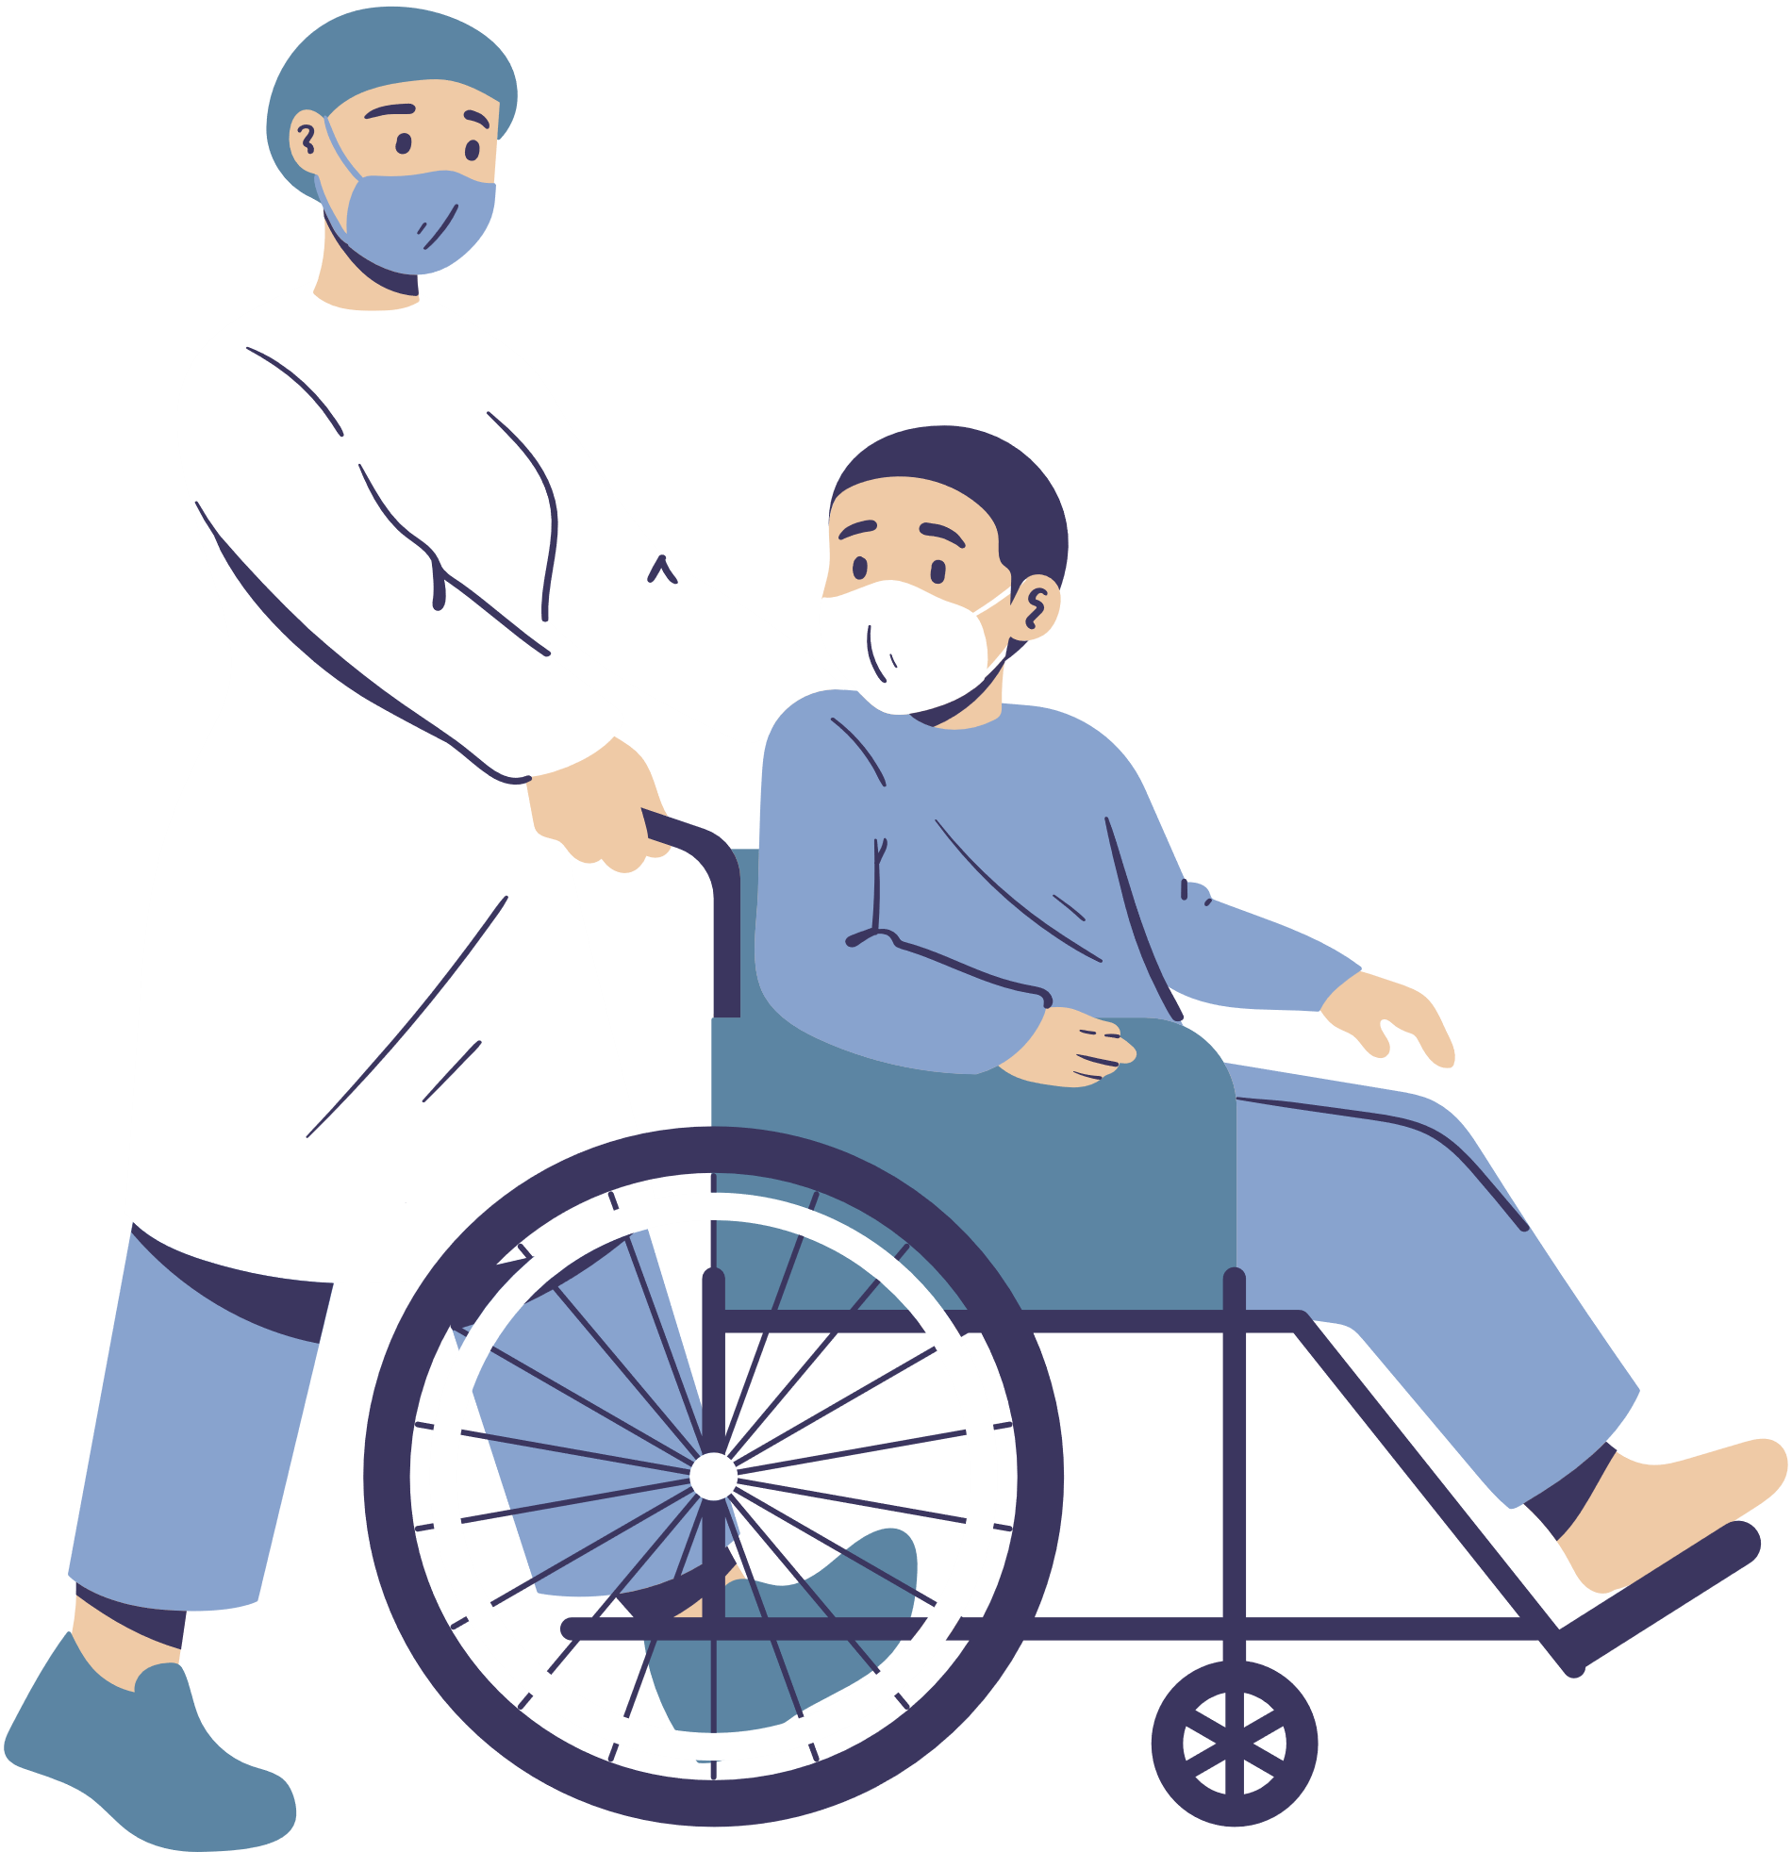

1- Data cleaning:

Slide 9
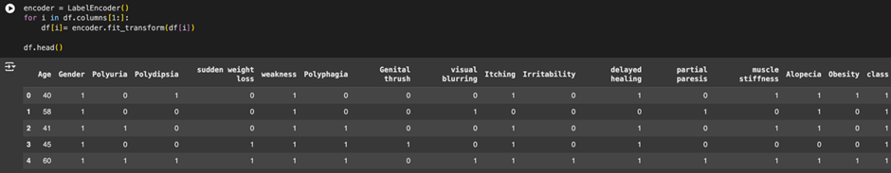
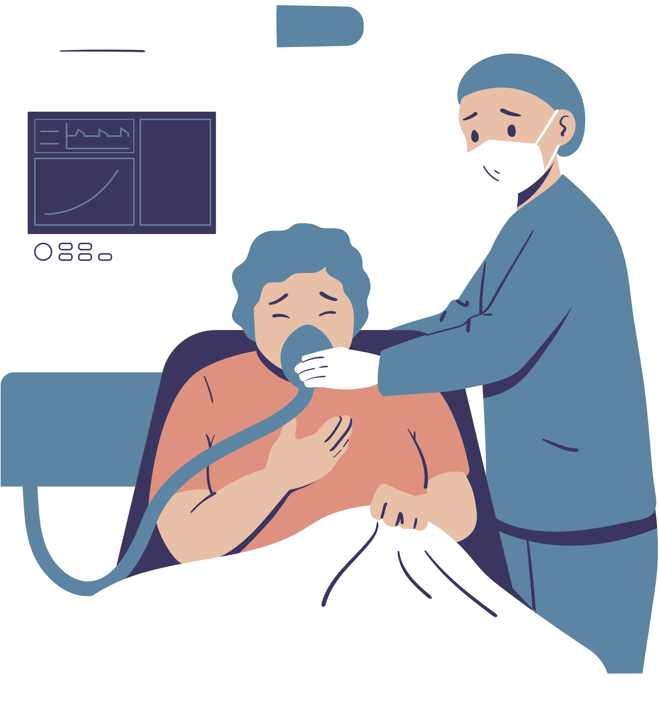
2- Data Transformation:

Slide 10
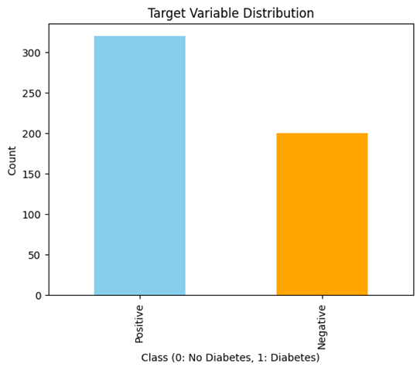

3-Exploratory Data Analysis (EDA):
A-Target Variable Distribution
Insight: The imbalance suggests that the model may need techniques like resampling (e.g., oversampling the minority class) to ensure the classifier performs well on both classes.
The bar chart illustrates the distribution of the target variable (class), which indicates whether an individual has diabetes (Positive) or not (Negative).
The dataset is imbalanced, with more positive cases (approximately 320) than negative cases (around 200).
Relevance: The imbalance in the target variable (class) highlights that most cases in the dataset are positive for diabetes. This also suggests the need for targeted screening campaigns and preventive measures to focus on identifying diabetic individuals early.

Slide 11
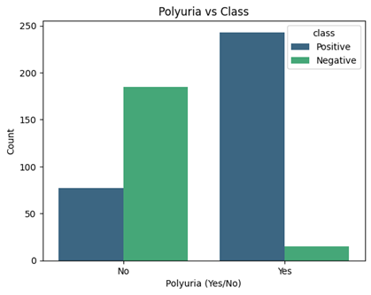
B-Polyuria vs Class
Insight: Polyuria is a strong predictor of diabetes, as a significant proportion of positive cases exhibit this symptom. This reinforces the importance of this feature in the model's predictions.
This shows the relationship between the symptom Polyuria (frequent urination) and diabetes diagnosis (class).
Relevance: The strong correlation between Polyuria (frequent urination) and diabetes provides a clear signal for risk prediction. This symptom is easily identifiable in patients, making it an accessible feature for early diagnosis.
Most individuals with Polyuria are diabetic (Positive), while most without Polyuria are non-diabetic (Negative).

Slide 12
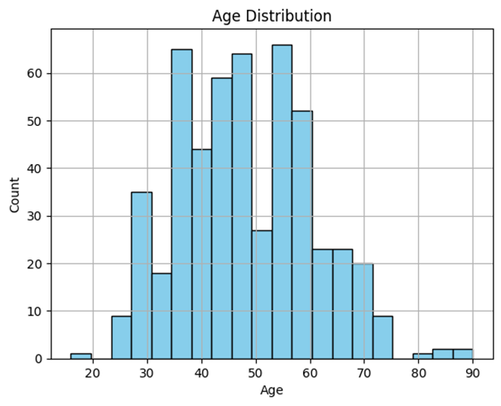
C- Age Distribution
Insight: The dataset has a normal age distribution, with the majority of cases occurring in middle-aged individuals. Older individuals may have a higher risk of diabetes, which could make Age an important feature for predictions.
Relevance: The age distribution shows that middle-aged and older individuals are more likely to have diabetes, aligning with known risk factors. This insight can guide the prioritization of screening efforts toward higher-risk age groups.
This histogram represents the distribution of ages in the dataset.
The age range is from approximately 20 to 90 years, with most individuals between 40 and 60 years old.

Slide 13
Selecting the Best ML Model Type:
Supervised Machine learning
·Target Variable: The dataset has a clear target variable (class), which labels individuals as "Positive" (diabetes) or "Negative" (no diabetes).
·Objective: Predict specific outcomes (whether an individual is at risk of diabetes) based on the provided features.
·Learning Type: Supervised Learning is appropriate since labeled data is available to train the model.

Slide 14
RANDOM FOREST
Handles Mixed Data Types: | Reduces Overfitting: | Identifies Key Features: | Captures Complex Relationships: | Better Alternative to Other Models:
Works effectively with both categorical (e.g., Polyuria, Polydipsia) and numerical features (e.g., Age) without extensive preprocessing. | Uses an ensemble of decision trees, averaging results to improve generalization and robustness against overfitting. | Provides feature importance scores, highlighting the most influential factors for diabetes risk, aiding in actionable healthcare decisions. | Models non-linear relationships between features and the target variable, which is crucial in healthcare datasets. | Logistic Regression assumes linear relationships. Decision trees are prone to overfitting. Gradient Boosting provides strong performance but requires extensive tuning.

Slide 15
Implementation
in Google Colab:
https://colab.research.google.com/drive/1fsFcWuWbuP89xJO-xaIh-fajN9bcLu54?usp=sharing

Slide 16
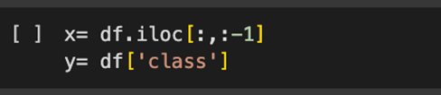
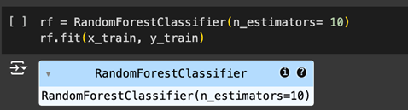
Model Training and Evaluation:
1- Feature and Target Selection:
1- Data splitting: Splits the data into:
a. Training Set: 80% of the data, used to train the model.
b. Test Set: 20% of the data, used to evaluate the model's performance.
1- Model Initialization and Training:
a. Initializes a Random Forest model with 10 decision trees.
b. Trains the Random Forest model using the training data (x_train and y_train).

Slide 17
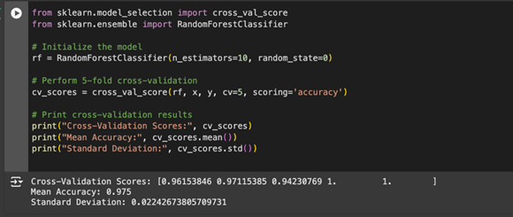
Optimization using cross-validation.
Cross-Validation Scores:
1. [0.96153846, 0.97115385, 0.94230769, 1.0, 1.0]
These represent the accuracy scores for each of the 5 folds in cross-validation.
Accuracy remains consistently high across all folds, ranging from 94.2% to 100%, indicating the model generalizes well.
2. Mean Accuracy: 0.975 (97.5%)
The average accuracy across all folds. This reflects the model's overall performance and confirms its reliability.
3. Standard Deviation: 0.0224 (2.24%)
This low standard deviation shows that the accuracy is stable and consistent across the folds, meaning the model isn't highly sensitive to different subsets of data.

Slide 18
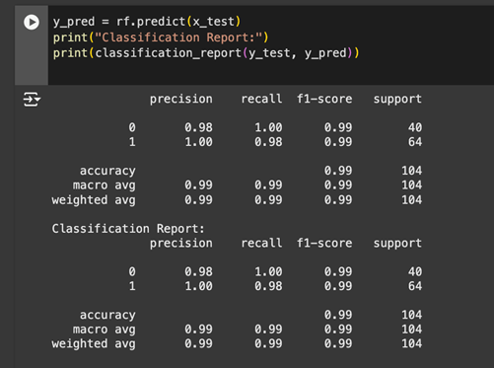
Performance Assessment:
1- The trained Random Forest model (rf) generates predictions (y_pred) for the test dataset (x_test).
2- Then it compares the predicted values (y_pred) to the actual test labels (y_test) and computes evaluation metrics.

Slide 19
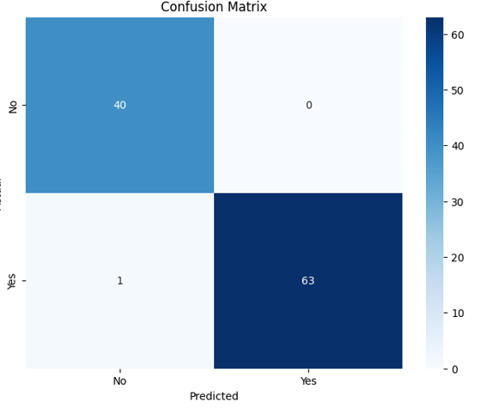
Confusion Matrix:
1. Top-left (True Negatives - TN): 40
• The model correctly predicted "No" for 40 individuals who actually do not have diabetes.
2. Top-right (False Positives - FP): 0
• The model did not incorrectly predict "Yes" for any individual who does not have diabetes.
3. Bottom-left (False Negatives - FN): 1
• The model incorrectly predicted "No" for 1 individual who actually has diabetes.
4. Bottom-right (True Positives - TP): 63
• The model correctly predicted "Yes" for 63 individuals who actually have diabetes
X-axis (Predicted): The predictions made by the model
(No, Yes for diabetes status).
Y-axis (Actual): The actual labels in the dataset
(No, Yes for diabetes status).

Slide 20
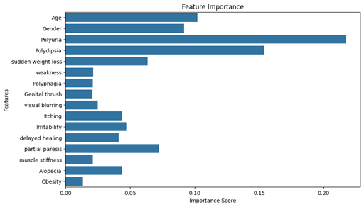
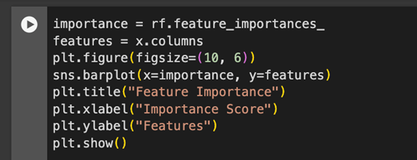
Analysis and Interpretations:
Feature importance: Feature importance helps identify which features contribute the most to the Random Forest model's predictions. Random Forest inherently calculates feature importance as part of its training process.

Slide 21
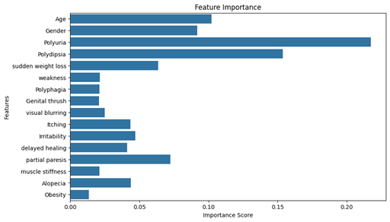
FEATURE IMPORTANCE
Feature importance helps identify which features contribute the most to the Random Forest model's predictions. Random Forest inherently calculates feature importance as part of its training process
1. Most Important Features:
o Polyuria (Frequent urination): Strongly correlated with diabetes.
o Polydipsia (Excessive thirst): A key clinical indicator.
2. Moderately Important Features:
o Age: Reflects increased diabetes risk with age.
o Sudden Weight Loss: Critical indicator often linked to diabetes onset.
3. Less Important Features:
o Weakness, Genital Thrush, and Itching contribute but have lower impact.
4. Negligible Features:
o Obesity: Unexpectedly low importance, possibly due to dataset characteristics or feature interactions.

Slide 22
Business Recommendations
and Decision-Making

Slide 23
01
02
03
Insights
Insights
Recommendations:
· The Random Forest model identified key features like Polyuria, Polydipsia, Age, and Sudden Weight Loss as the most important predictors of diabetes risk.
· imbalance in the target variable suggests that most cases are diabetic, emphasizing the need for tailored preventive measures.
Symptom-Based Screening
Age-Focused Outreach
Symptom-Based Screening
Age-Focused Outreach
Use key features to develop targeted screening tools.
Implement symptom checklists
Prioritize individuals aged 40-60 for awareness campaigns and regular health checkups.
Translating Insights and Recommendations
04
05

Slide 24

DECISION MAKING
Resource Allocation
Preventive Programs
Healthcare Campaigns
3
2
1

Slide 25
IMPACT ANALYSIS:
· Improved Early Detection
· Reduced Healthcare Costs
· Enhanced Patient Outcomes
· Operational Efficiency

Slide 26
Thank you for your attention

