Slide 1

PHANSITE
By Hadi Ibrahim

Slide 2

Outline
Application scenario
Project description
DB model
Class diagram
Demonstration
Challenges
Future Work

Slide 3
Application scenario
It’s December 2020. Joe Biden was elected president of the united states. Many people accused him of committing a fraud, and the USA’s general opinion about this matter is not clear, hence you’re too afraid to get out and state your opinion.
That’s the scenario that Phansite handles. It’s a social media that guarantees anonymity of the user, but also privately verifies their identity.

Slide 4

Project Description
Phansite is a website to share thoughts and discuss opinions, via open discussion posts, and weekly voting polls.

Slide 5

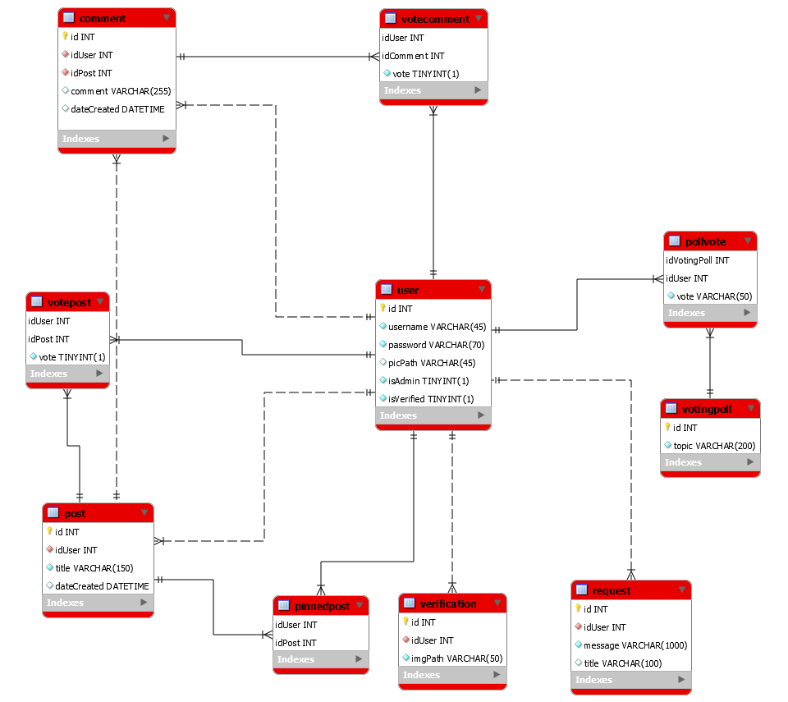
DB model

Slide 6
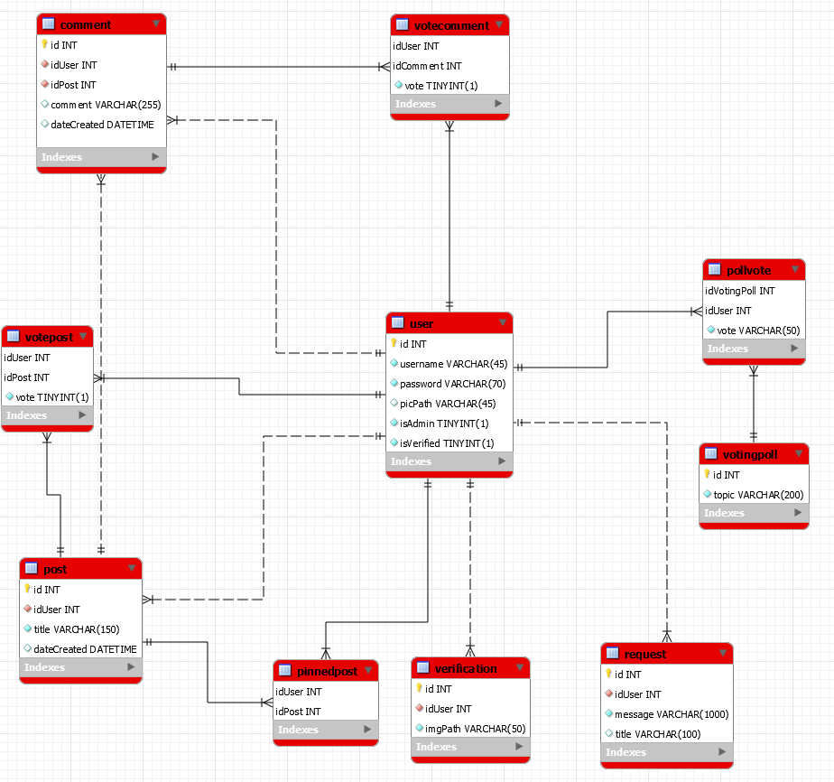
Class Diagram

Slide 7

Demonstration
Initial landing page before sign up

Slide 8
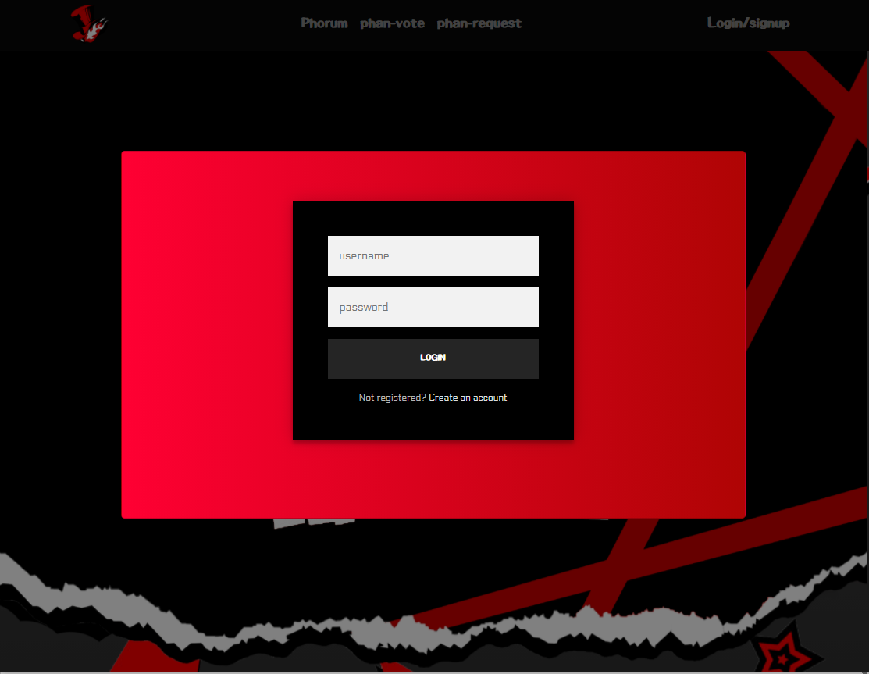
Once the user clicks on Login/signup, a modal will popup and overlay on top of the page.

Slide 9

Clicking on “Create an account” will toggle the “Sign up” form instead of the sign in form.
At any time, the user can toggle back and forth to both frames by clicking on the corresponding links.

