Slide 1


Welcome to Codra
By SE. Hadi Karnib
&
SE. Hussein Al Assidih

Slide 2

We introduce to you the free version of “CODRA” online editor
A space for the Cobras in the Coding Community

Slide 3
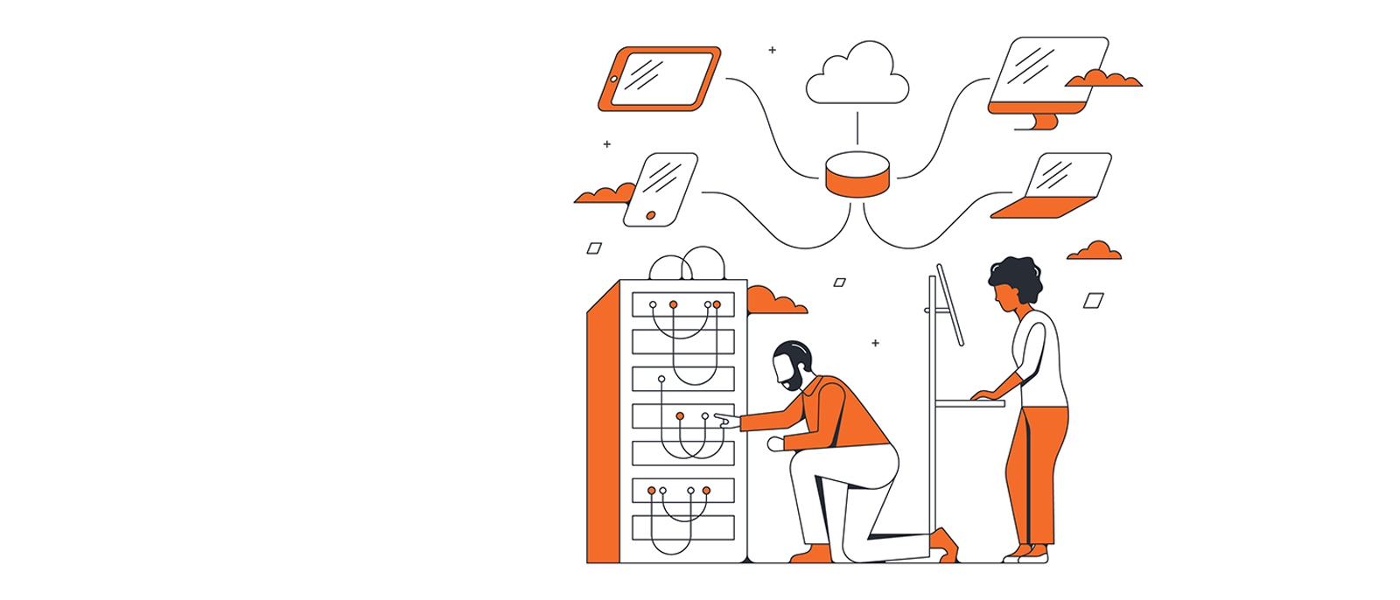
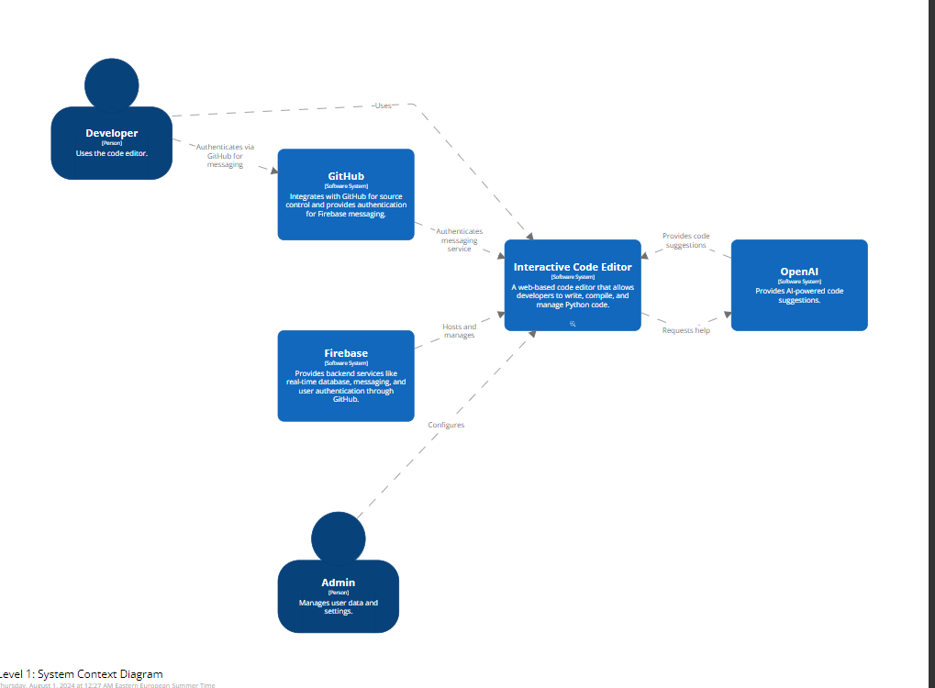

Slide 4
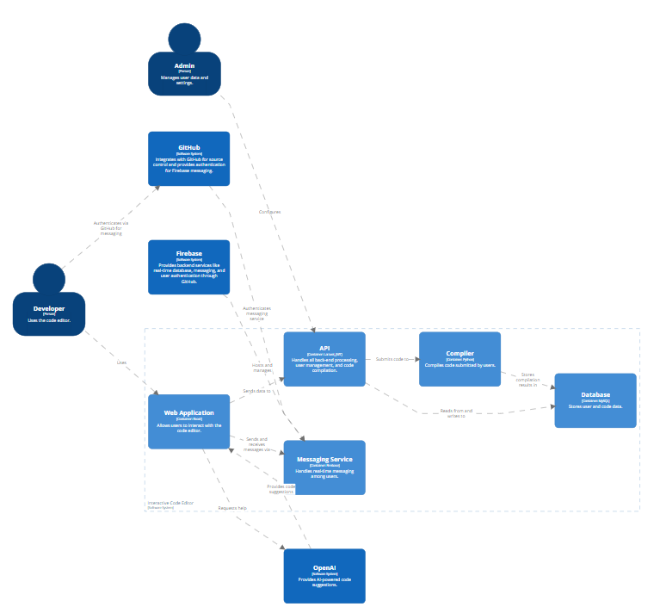

Slide 5
THANK You

