Slide 1
A Seminar Report on Software Engineering
Seminar Incharge :-
Ms. Divya
Assi. Prof.
Cs department
Presenting By,
Abdul Hadi BP
Bsc CS
Roll No: 03

Slide 2
Introduction
The Software Development Life Cycle (SDLC) refers to a methodology with clearly defined processes for creating high-quality software.
Incremental model
Iterative model

Slide 3
Incremental Model

Slide 4
Incremental Model is a process of software development where requirements are broken down into multiple standalone modules of software development cycle. Incremental development is done in steps from analysis design, implementation, testing/verification, maintenance.

Slide 5
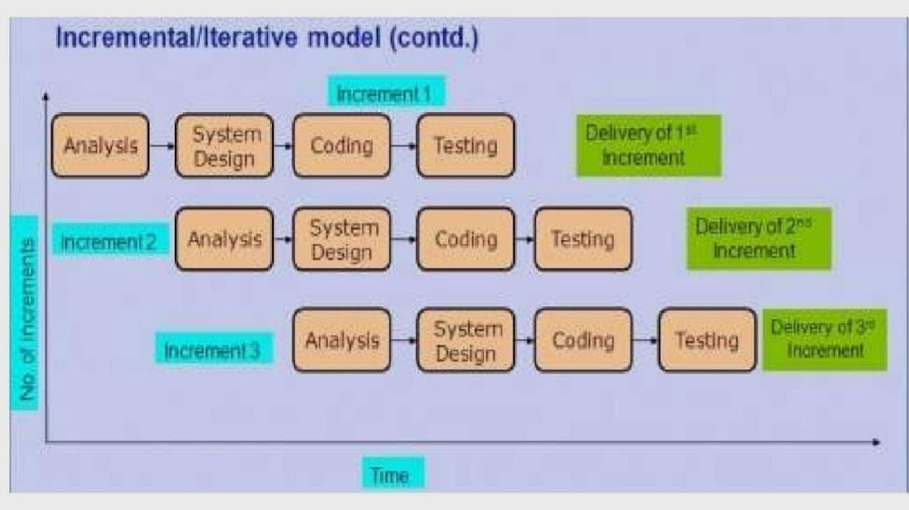

Slide 6
The various phases of incremental model are as follows:

Slide 7
Requirement analysis:
In the first phase of the incremental model, the product analysis expertise identifies the requirements. And the system functional requirements are understood by the requirement analysis team. To develop the software under the incremental model, this phase performs a crucial role.

Slide 8
2. Design & Development:
In this phase of the Incremental model of SDLC, the design of the system functionality and the development method are finished with success. When software develops new practicality, the incremental model uses style and development phase.

Slide 9
3. Testing:
In the incremental model, the testing phase checks the performance of each existing function as well as additional functionality. In the testing phase, the various methods are used to test the behavior of each task.

Slide 10
4. Implementation:
Implementation phase enables the coding phase of the development system. It involves the final coding that design in the designing and development phase and tests the functionality in the testing phase. After completion of this phase, the number of the product working is enhanced and upgraded up to the final system product

Slide 11
Advantage of Incremental Model
Errors are easy to be recognized.
The software will be generated quickly during the software life cycle.
It is flexible and less expensive to change requirements and scope.
Errors are easy to be identified
This model is less costly compared to others

Slide 12
Disadvantage of Incremental Model
Need for good planning designing.
Total Cost is high.
Well defined module interfaces are needed.
Problems might cause due to system architecture as such not all requirements collected up front for the entire software lifecycle.
Each iteration phase is rigid and does not overlap each other.
Rectifying a problem in one unit requires correction in all the units and consumes a lot of time.

Slide 13
ITERATIVE MODEL

Slide 14
• Also called Incremental Model
• Project is break into small modules which can be delivered
• A working version of software is produced during the first module.
• Each subsequent release of the module adds functionality to the previous release. The process continues till the complete system is achieved.
• Model very successfully when working with new technology
• More than one iteration can be going at the same time

Slide 15
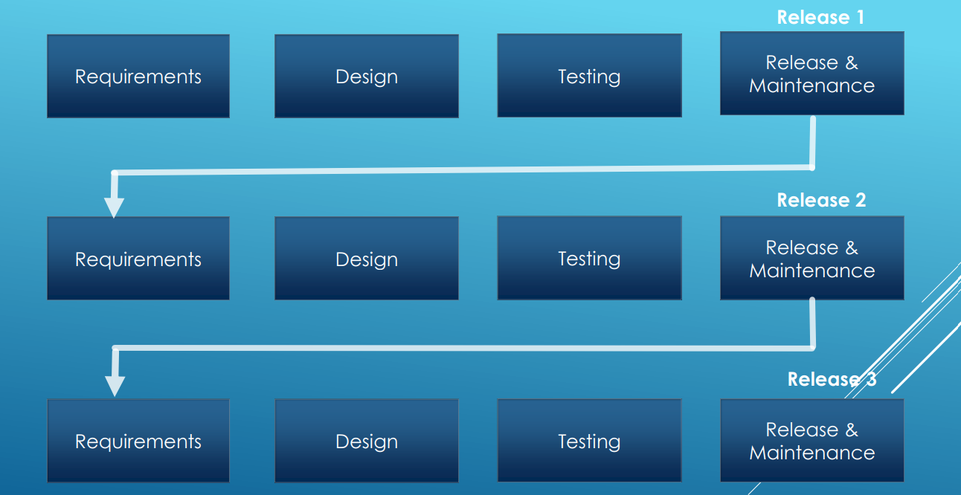

Slide 16
Advantages of Iterative Model:
•Quick software is released during early phases of Software life cycle.
•Less costly to change requirements as compared to other models.
•Easier to develop and test when iterations are small
•Customer can give his feedback quickly.
•More than one iteration can be going parallel at same time

Slide 17
Dis-Advantages of Iterative Model:
Comparatively more resources are required
Skilled Manager is needed to manage otherwise Project costing is increased.
Project started with complete Project architecture design, can result issues in future.
Cost is higher than Waterfall model

Slide 18
Questionair:
What is incremental process mode ?
What is iteration model?
Reqiurement analysis?

Slide 19
Conclusion:
Iterative and incremental development is any combination of both iterative design or iterative method and incremental build model for development.

Slide 20
Reference:
Incremental model:
Iterative model:
https://en.wikipedia.org/wiki/Incremental_build_model.
https://www.youtube.com/watch?v=yd6uxnBIIQg
https://en.wikipedia.org/wiki/Iterative_and_incremental_development
https://www.youtube.com/watch?v=vl-IWe0DkwU

Slide 21
Thank you

