Slide 1
Understanding the difficulty of training Graph Neural Networks
Final Project for ENSF 619 – L05
Researchers: Hadi Aghazadeh
Amirhossein Ahmadi
Fatma Mutlu Kipirti
Dec-06-2022

Slide 2

Outline
Why GNNs?
Background
Motivation
Methodology
Experiments and Results
Conclusion
References

Slide 3
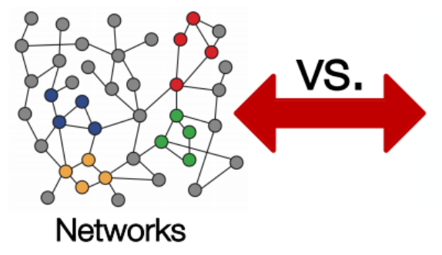
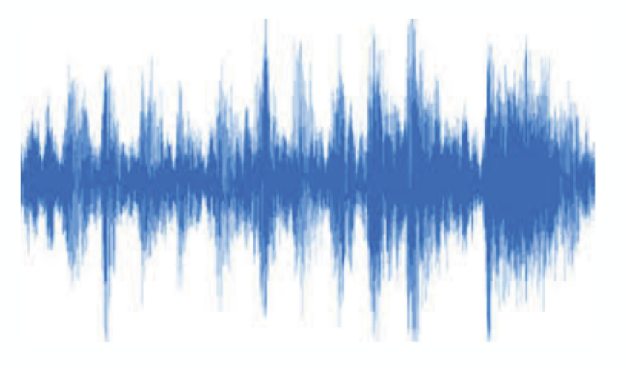
Why Graph Neural Nets?
Datasets in deep learning applications such as
video processing (video)
image processing (image)
speech recognition (speech)
natural language processing (text)
forecasting (time series)
are sequences represented in the Euclidean space with the same structure and size
[Image credit: http://web.stanford.edu/class/cs224w]
Notes:
A lot of real-world data does not “live” on grids (Euclidean Space)
Arbitrary size and complex topological structure
No fixed node ordering or reference point
Often dynamic and have multimodal features

Slide 4

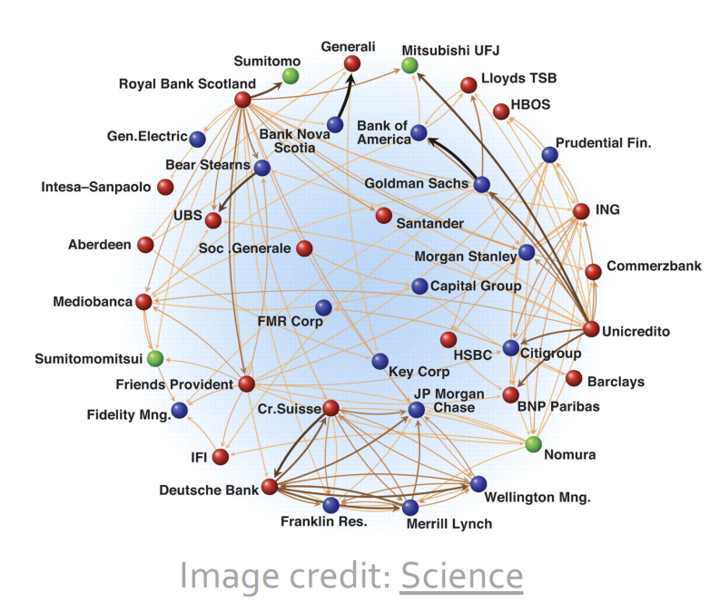
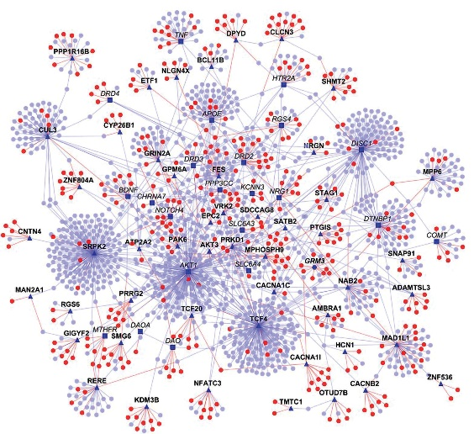
Why Graph Neural Nets?
There is an increasing number of applications where data are generated from non-Euclidean domains with
complex relationships and high interdependency
Image credit: Madhavicmu / Wikimedia Commons/CC-BY-SA-4.0
Social Networks
Economic Networks
Protein Interaction Networks

Slide 5
Background
Graphs are powerful data structures that allow us to easily express these relationships without a fixed form, which can be categorized into:
directed vs undirected
weighted vs unweighted
simple vs multigraphs.
GNN is a class of end-to-end learning models for processing graph data, which can be classified into:
Simplified Graph Convolution (SGC)
Graph Convolutional Networks (GCN)
Graph Attention Network (GAT)
Residual Gated Graph Convolutional (Res GCN)
etc.

Slide 6
Motivation
In [8] it is concluded that random initialization is doing so poorly with deep neural networks.
In [8] they found that, as the number of layers increases, the logistic sigmoid activation is unsuited for deep networks with random initialization.
In [10] it is shown that dropout significantly reduces overfitting and improves the performance and generalizability of CNNs by reducing the co-adaption effect among hidden neurons.
In [11], it is indicated that poor activation function can result in slower training time or gradient vanishing problems.

Slide 7
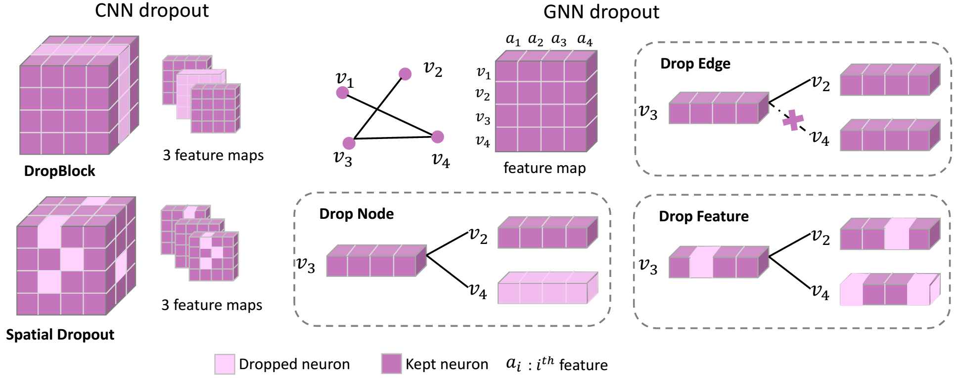
Motivation
Despite the functional similarities among CNN and GNNs, there are notable differences in their training process.
CNNs receive structured fixed-size data while GNNs get unstructured data without a fixed size

Slide 8
Motivation
CNNs contain several feature maps, thus, dropping out leads to construct the next layer in a very robust way with a reduced co-adaption effect.
However, in GNNs, there is only one feature map and changes in topology structure like dropping out a certain neuron/feature does not lead to a robust and expressive representation.
For graph data, the dependency structure exists naturally and is modeled by the message-passing mechanism in GNNs, but in CNNs, the neurons are fully connected manually.
Hence, feature missing adds more uncertainty to GNN models.
Contrary to deep CNN models, the over-smoothing problem is a notorious phenomenon for GNNs preventing them from going deeper.
Hence, dropout on graph structure/features may break the message-passing process making the node embedding becomes less expressive to distinguish nodes as the network goes deeper, thus slowing down the pace of over-smoothing
Different GNNs such as SCN, GCN, GAT, and ResGCN have different structures and it is possible they will respond differently to different initialization, activation functions, and dropout rates.

Slide 9
Methodology
Three datasets: Cora, CiteSeer, and PubMed
Dropout rate: 10%, 30%, 50%, 70%, and 90%
Four layers: SGC, GCN, GAT, and ResConv
Activation function: ReLU, Leaky ReLU, Tanh, and Sigmoid
Initialization methods: Random, Glorot, Uniform, and Kaiming Uniform
Dataset | Cora | CiteSeer | PubMed
Node Size | 2700 | 3327 | 19717
Edge Size | 1433 | 3703 | 500
Node to Edge Rate | 1.88 | 0.90 | 40.00

Slide 10
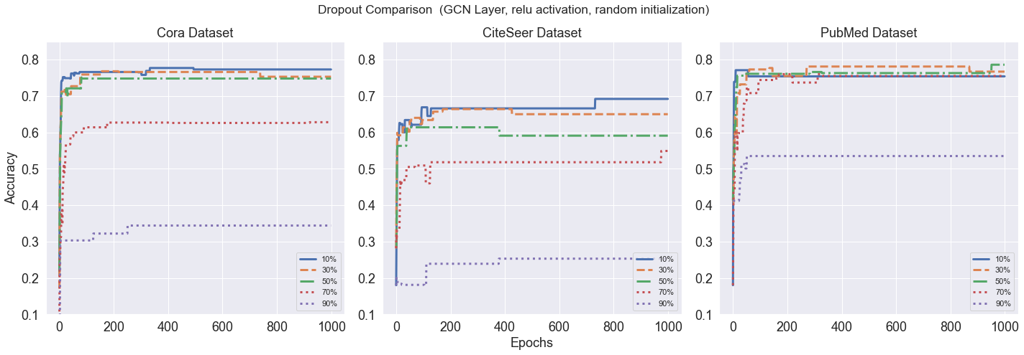
Experiments and Results: Dropout Rate, GCN Layer

Slide 11
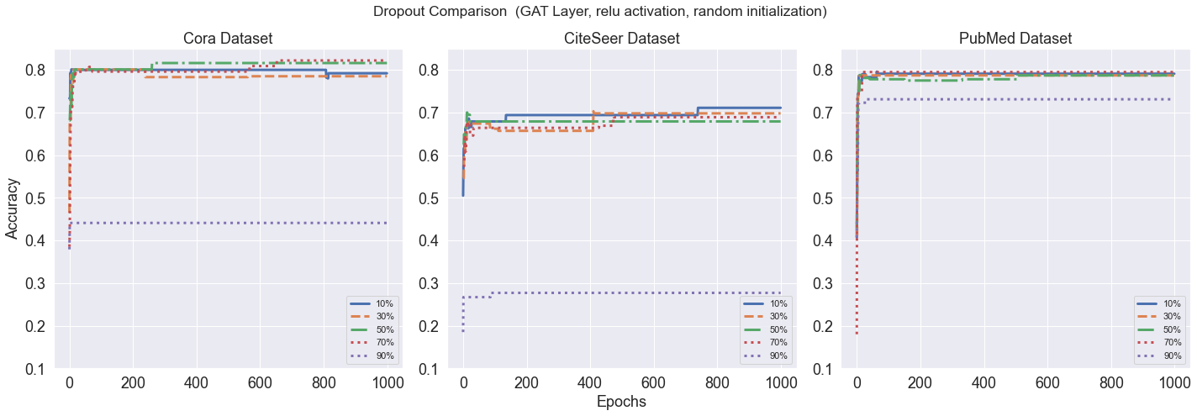
Experiments and Results: Dropout Rate, GAT Layer

Slide 12
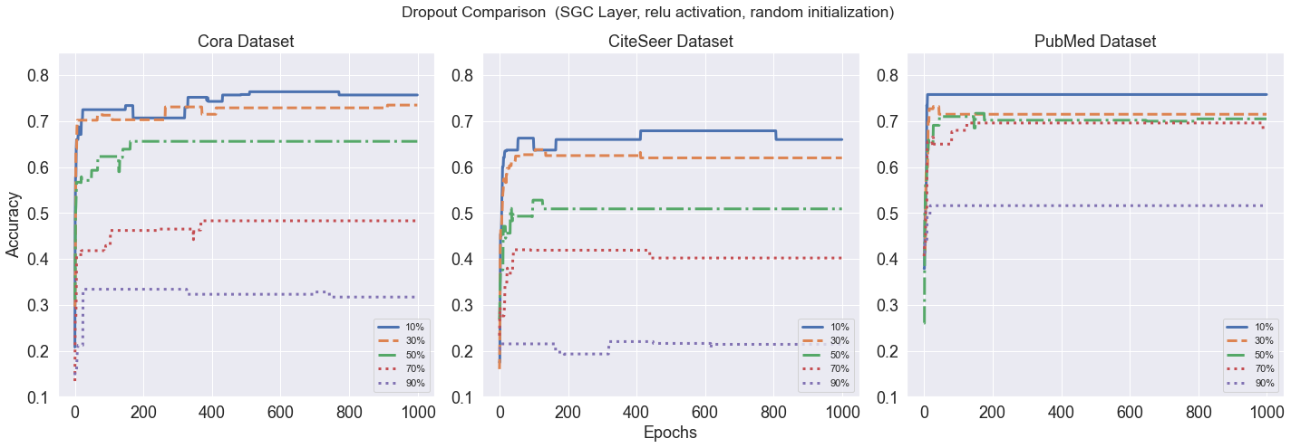
Experiments and Results: Dropout Rate, SGC Layer

Slide 13
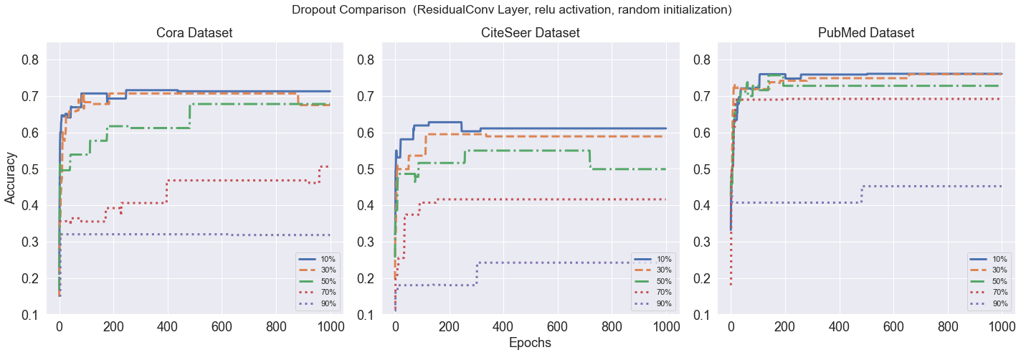
Experiments and Results: Dropout Rate, Res Layer

Slide 14
Experiments and Results: Dropout Rate
The key finding is the ratio of the node to edge is quite important in the model’s robustness when a dropout rate increases. Moreover, GAT shows more robustness regards its counterparts for different dropout rates

Slide 15
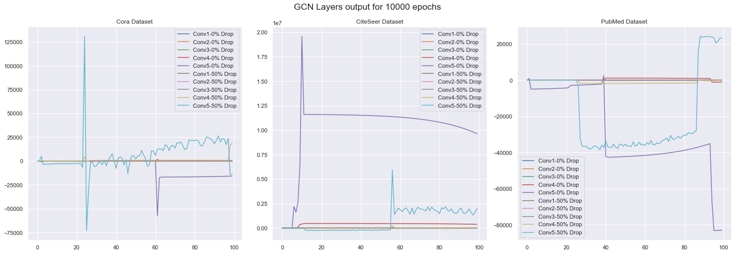
Experiments and Results: Number of Layers

Slide 16
Experiments and Results: Number of Layers
The main explanation for this phenomenon is that by increasing the number of convolution layers, the embedding model of a convolution layer tends to move from local and neighbor connections into global embedding, and in this case, the model losses its discrimination abilities, which is called over-smoothing problem. Although it is claimed that dropout on graph structure or dropout on features can slow down the pace of over-smoothing, our results do not corroborate this

Slide 17
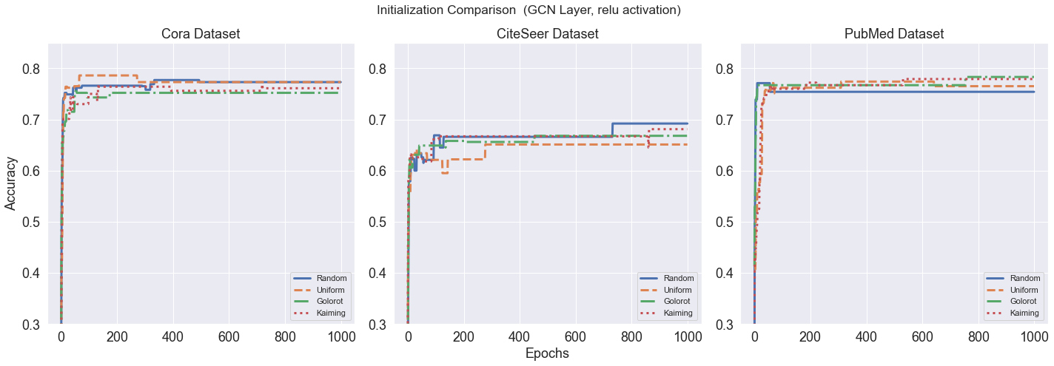
Experiments and Results: Initialization Methods, GCN Layer

Slide 18
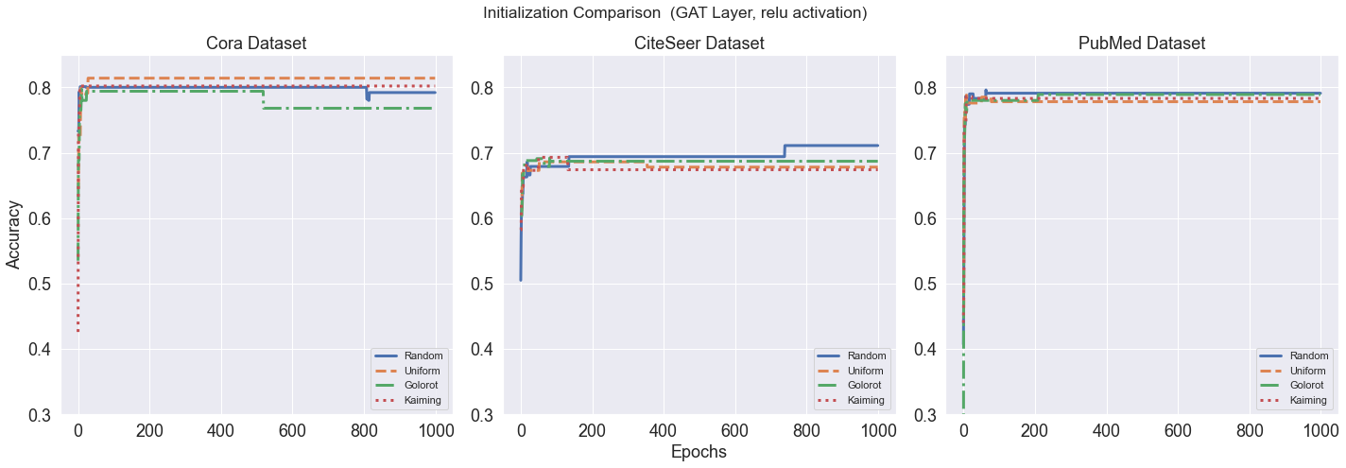
Experiments and Results: Initialization Methods, GAT Layer

Slide 19
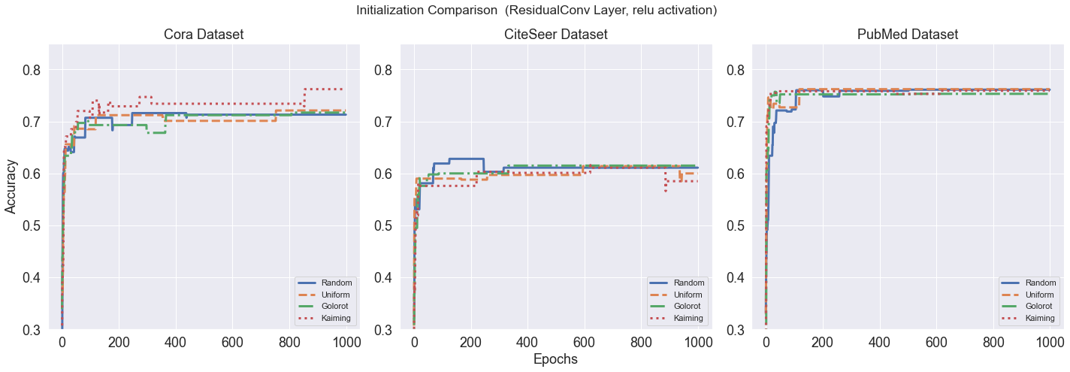
Experiments and Results: Initialization Methods, Res Layer

Slide 20
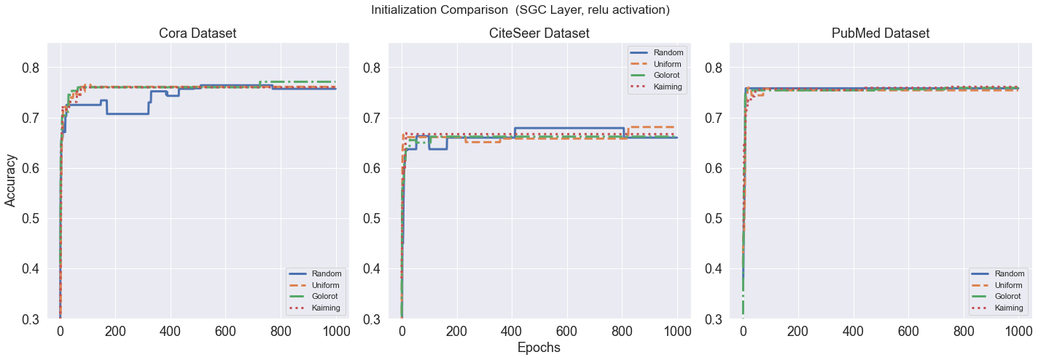
Experiments and Results: Initialization Methods, SGC Layer

Slide 21
Experiments and Results: Initialization Methods
As the complexity of the data increase, the effect of the type of initialization methods tends to vanish in the final output and accuracy

Slide 22
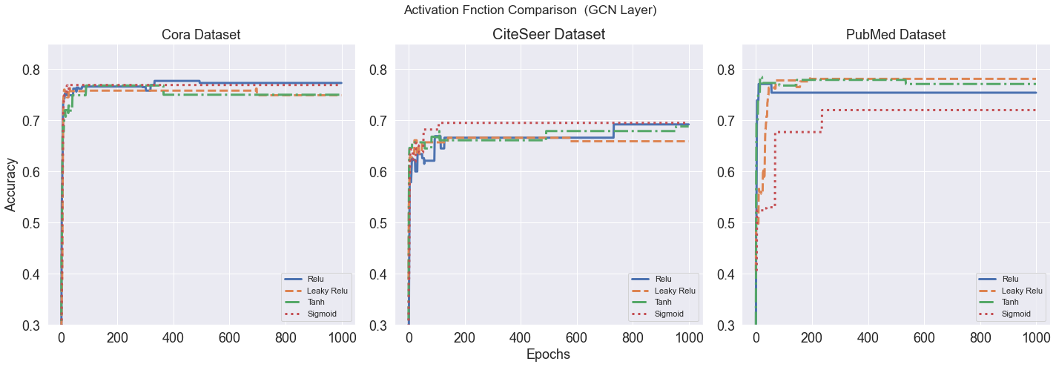
Experiments and Results: Activation Functions, GCN Layer

Slide 23
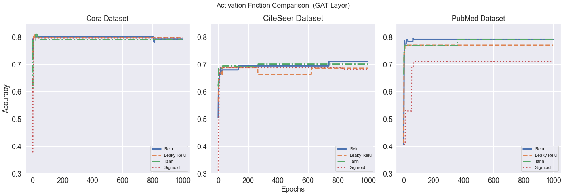
Experiments and Results: Activation Functions, GAT Layer

Slide 24
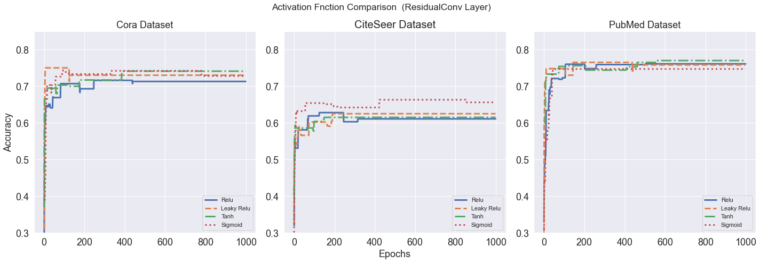
Experiments and Results: Activation Functions, Res Layer

Slide 25
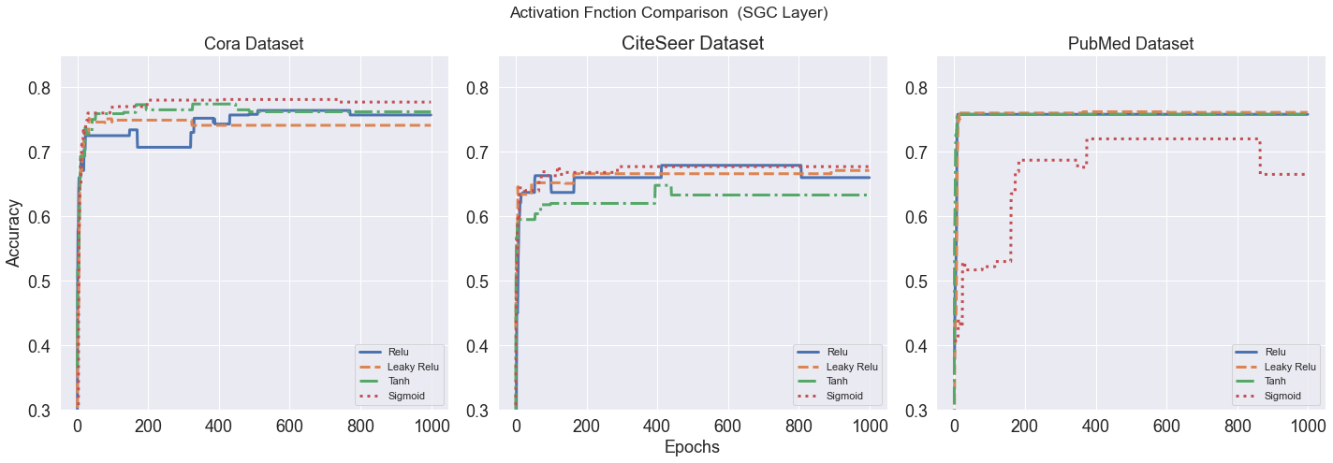
Experiments and Results: Activation Functions, SGC Layer

Slide 26
Experiments and Results: Activation Functions
In simple datasets like Cora, there is no big difference among different activation functions, however, as the dataset gets more complicated, ReLU and Leaky ReLU start to show better results.

Slide 27
Conclusion
Choices that address locality and neighborhood in graph data have a more important effect than choosing initialization methods, activation functions, etc.
Because of this phenomenon, GAT Layer performs the best in most the cases
There is great potential for adding localized features to classical deep-learning training configurations like initialization methods or activation functions for graph data

Slide 28
References
[1] Yann LeCun, L ́eon Bottou, Yoshua Bengio, and Patrick Haffner. Gradient-based learning applied to document recognition. Proceedings of the IEEE, 86(11):2278–2324, 1998.
[[2] Kenta Oono and Taiji Suzuki. Graph neural net-works exponentially lose expressive power for node classification. arXiv preprint arXiv:1905.10947, 2019.
[3] Petar Veliˇckovi ́c, Guillem Cucurull, Arantxa Casanova, Adriana Romero, Pietro Lio, and Yoshua Bengio. Graph attention networks. arXiv preprint arXiv:1710.10903, 2017.
[4] Juan Shu, Bowei Xi, Yu Li, Fan Wu, Charles Kamhoua, and Jianzhu Ma. Understanding dropout for graph neural networks. In Companion Proceed- ings of the Web Conference 2022, pages 1128–1138, 2022.
[5] Thomas N Kipf and Max Welling. Semi-supervised classification with graph convolutional networks. arXiv preprint arXiv:1609.02907, 2016.
[6] Felix Wu, Amauri Souza, Tianyi Zhang, Christopher Fifty, Tao Yu, and Kilian Weinberger. Simpli-fying graph convolutional networks. In International conference on machine learning, pages 6861–6871.PMLR, 2019.
[7] Xavier Bresson and Thomas Laurent. Residual gated graph convnets. arXiv preprint arXiv:1711.07553, 2017.
[8] Xavier Glorot and Yoshua Bengio. Understanding the difficulty of training deep feedforward neural networks. In Proceedings of the thirteenth interna- tional conference on artificial intelligence and statistics, pages 249–256. JMLR Workshop and Conference Proceedings, 2010.
[9] Kaiming He, Xiangyu Zhang, Shaoqing Ren, and Jian Sun. Deep residual learning for image recognition. In Proceedings of the IEEE conference on computer vision and pattern recognition, pages 770–778, 2016.
[10] Nitish Srivastava, Geoffrey Hinton, Alex Krizhevsky, Ilya Sutskever, and Ruslan Salakhutdinov. Dropout: a simple way to prevent neural networks from overfitting. The journal of machine learning research, 15(1):1929–1958, 2014.
[11] Kaiming He, Xiangyu Zhang, Shaoqing Ren, and Jian Sun. Delving deep into rectifiers: Surpassing human-level performance on imagenet classification. In Proceedings of the IEEE international conference on computer vision, pages 1026–1034, 2015.
[12] Diederik P Kingma and Jimmy Ba. Adam: A method for stochastic optimization. arXiv preprint arXiv:1412.6980, 2014.

Slide 29
Thanks for your attention!

