Slide 1
ECO346 — DATA VISUALIZATION TECHNIQUES FOR ECONOMISTS
Annual Earnings Distribution and Earnings by Age
Assignment 1 · Variant 7 — Balochistan Urban
Registration Number: FA24-BED-087
Software: R and Python
Notes:
Title slide. ECO346 Assignment 1, FA24-BED-087, Variant 7 — Balochistan Urban. Topic: annual earnings distribution and earnings by age. Software: R and Python.

Slide 2
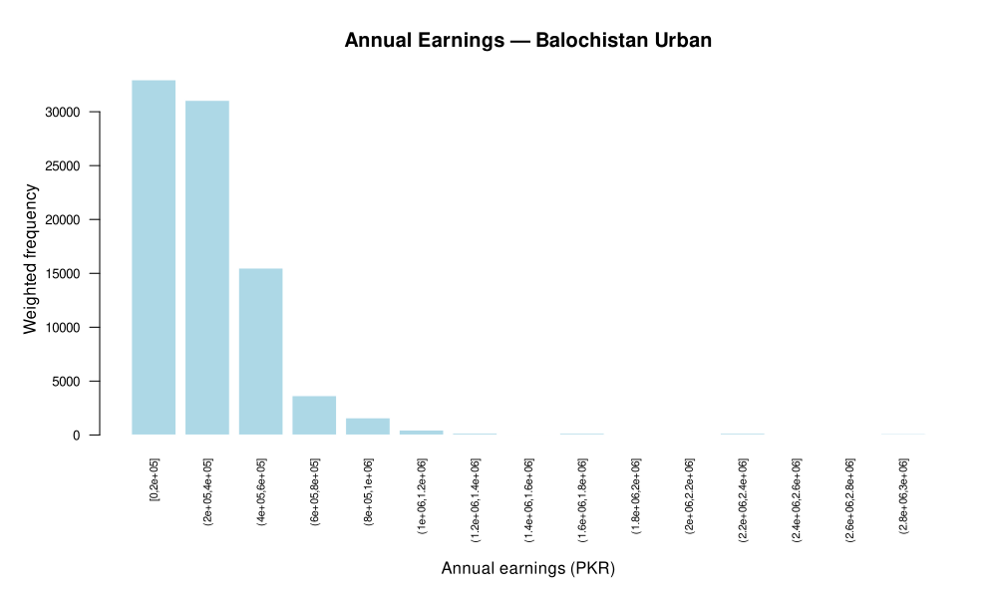
Q2 · Distribution of Annual Earnings
Weighted histogram of annual earnings — Balochistan Urban
486
Rs 250,000
earners in the sample
weighted median
Rs 264,000
5.62
unweighted median
90th-to-10th percentile ratio
Right-skewed: weighted frequency is concentrated in the lowest bins, with a thin upper tail.
Weights matter: weighted median is below the unweighted median.
Dispersion: P10 = Rs 96,000 and P90 = Rs 540,000. Earners excluded: 0.
Weighted histogram of annual earnings (PKR)
Notes:
Q2: 486 earners; weighted median Rs 250,000; unweighted median Rs 264,000; weighted P10 Rs 96,000; weighted P90 Rs 540,000; P90/P10 ratio 5.62; 0 earners excluded from the histogram. Figure is the original R output.

Slide 3
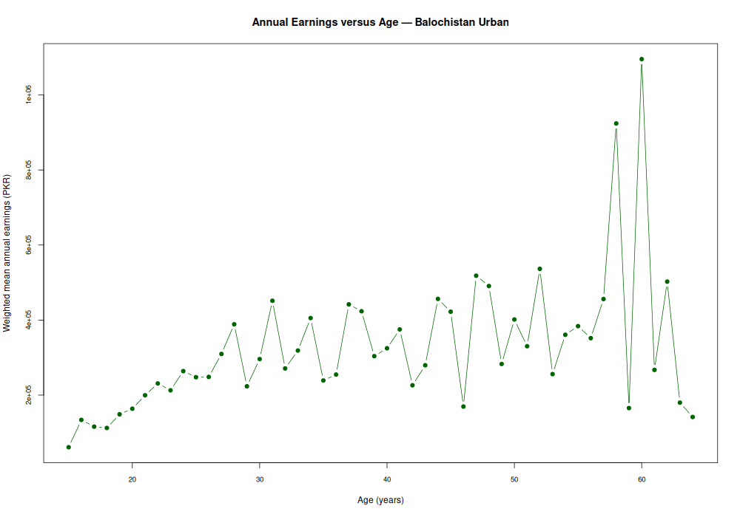
Q3 · Annual Earnings versus Age
Weighted mean annual earnings by age — Balochistan Urban
Age band | Obs. | Weighted mean (Rs)
15–19 | 22 | 113,382.46
20–24 | 56 | 220,435.42
25–29 | 69 | 307,993.90
30–34 | 62 | 316,658.92
35–39 | 80 | 302,070.95
40–44 | 60 | 316,146.86
45–49 | 47 | 372,723.28
50–54 | 55 | 399,249.56
55–59 | 19 | 350,772.06
60–64 | 16 | 476,422.01
Earnings rise with age overall, from Rs 113,382 (15–19) to Rs 476,422 (60–64), but not steadily: 55–59 (Rs 350,772) is below 50–54 (Rs 399,250). The oldest bands rest on few observations (19 and 16).
Weighted mean annual earnings (PKR) by single year of age
Notes:
Q3: weighted mean annual earnings by age band, as in the table. The figure is the original R plot by single year of age; the table gives the age-band results. Note the small observation counts in the 55–59 (19) and 60–64 (16) bands.

Slide 4
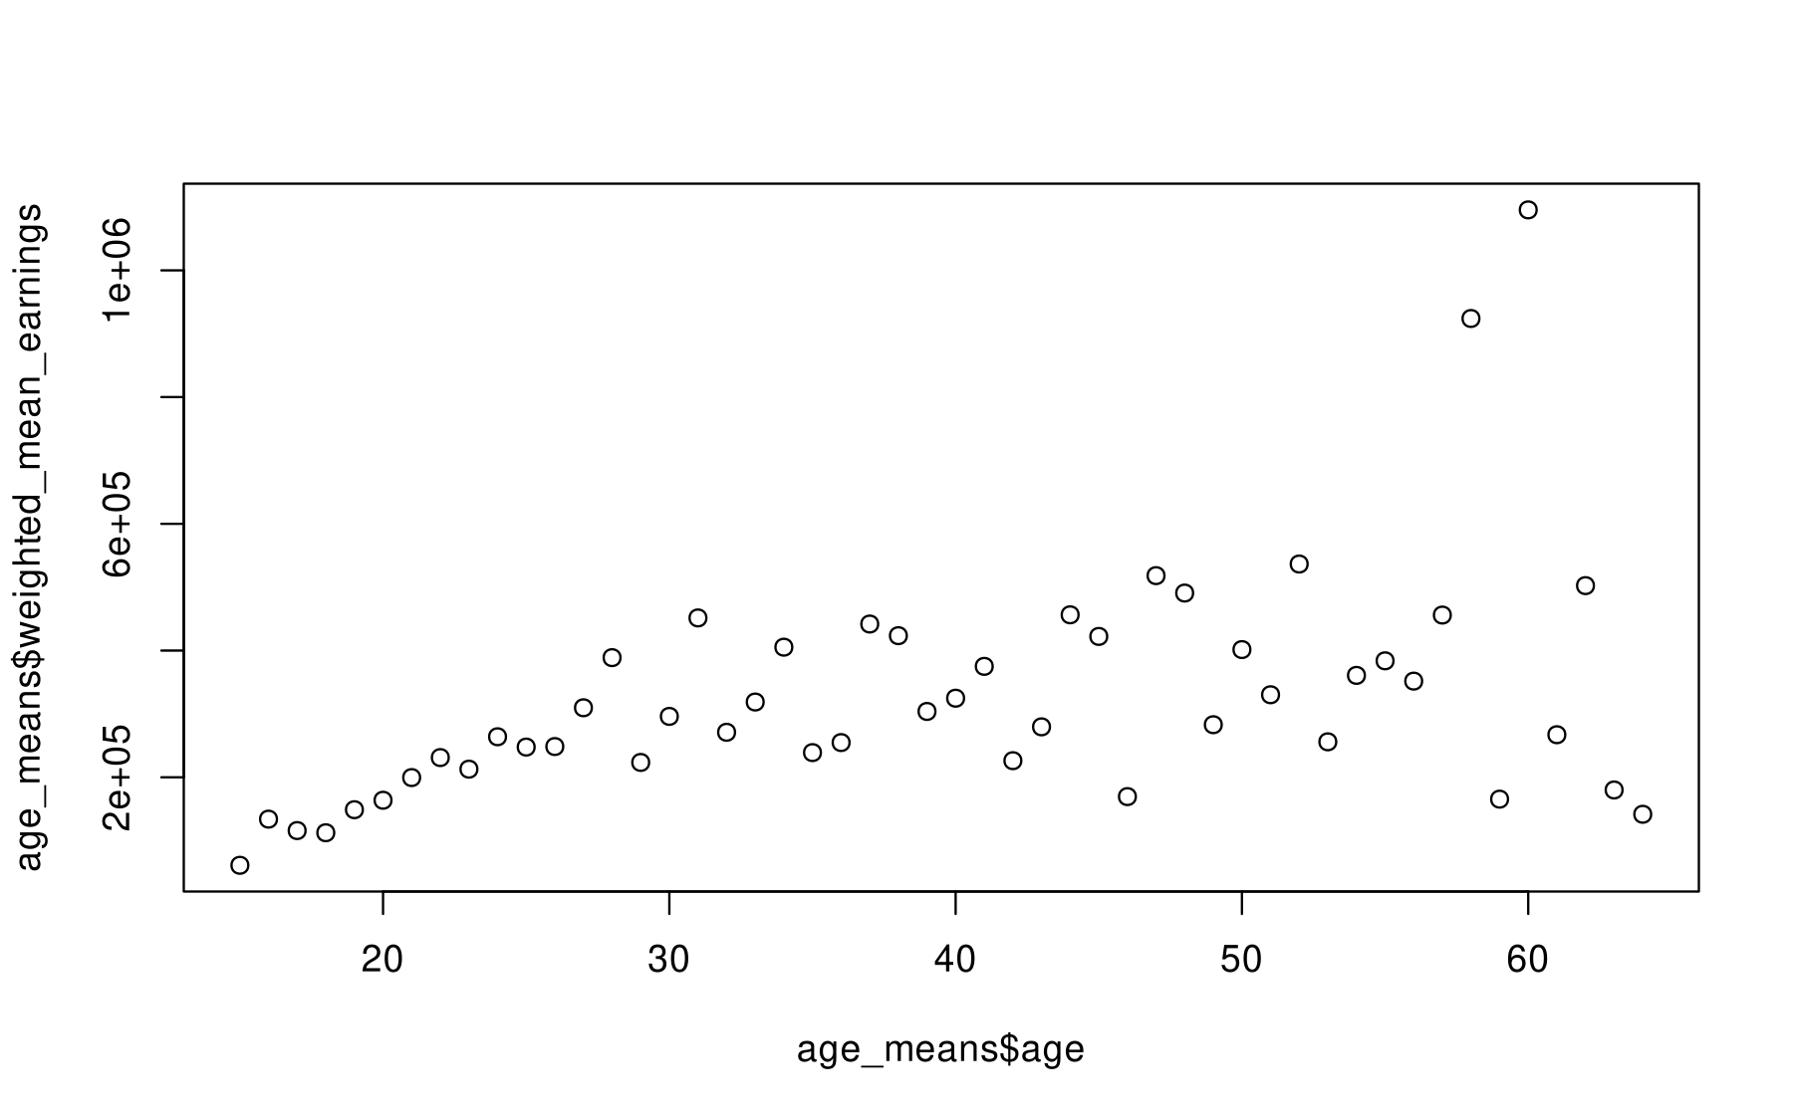
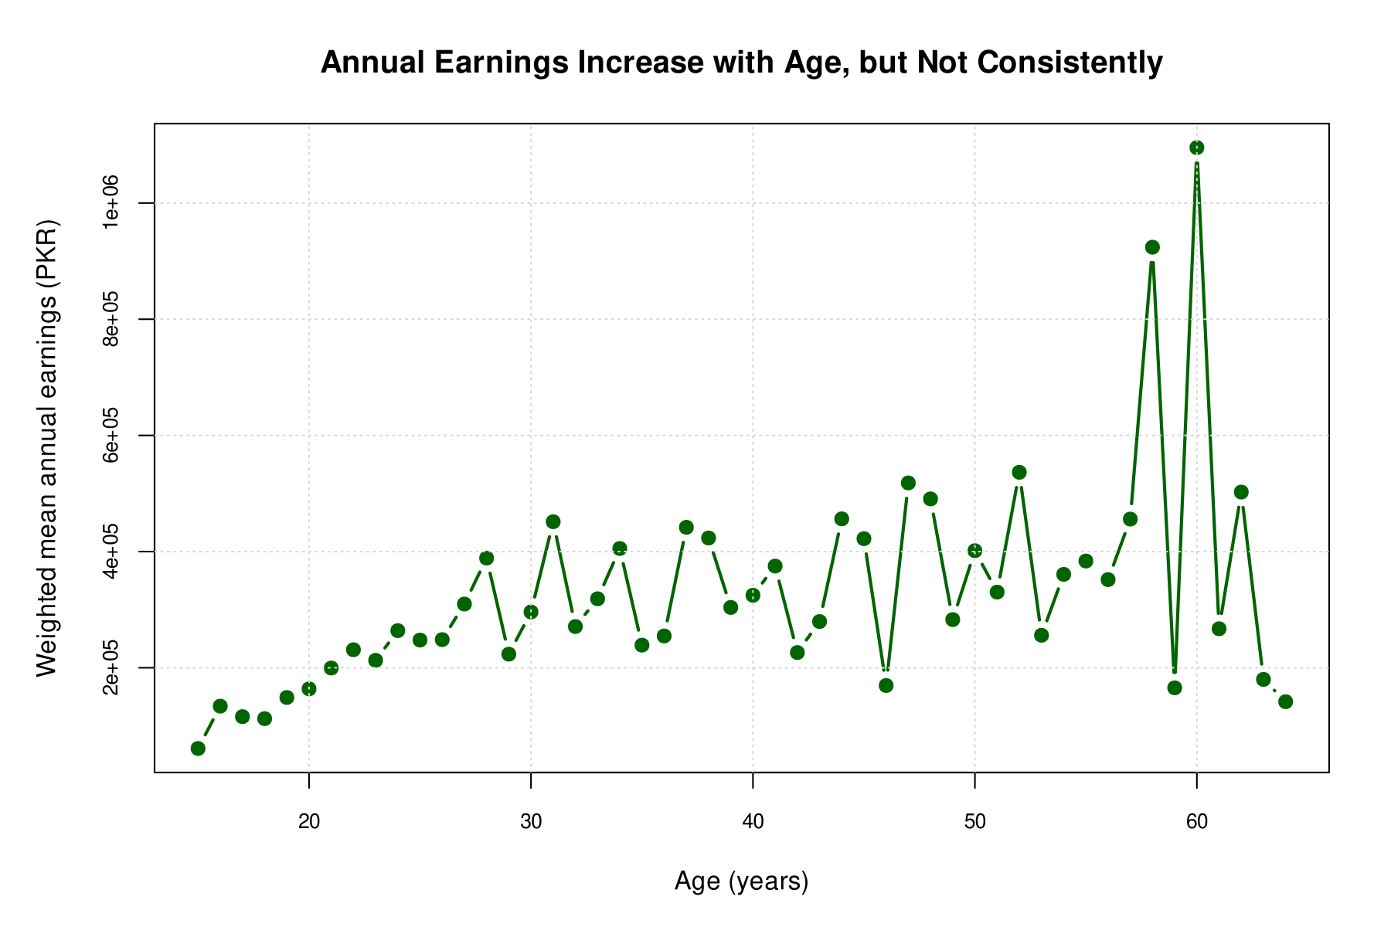
Q4 · Default Plot versus Redesigned Plot
Same data, same relationship — redesigned for clearer communication
DEFAULT
REDESIGNED
Informative title
States the finding instead of leaving the plot untitled.
Readable labels
“Age (years)” and “Weighted mean annual earnings (PKR)” replace variable names.
Clearer encoding
Filled markers, a connecting line and light gridlines show the age pattern.
Notes:
Q4: default R plot (variable-name axis labels such as age_means$age, no title) versus the redesigned plot titled "Annual Earnings Increase with Age, but Not Consistently" with labelled axes with units, larger filled markers, connecting line and light gridlines. Figures converted from the original SVG files.

Slide 5
THANK YOU
ECO346 · Assignment 1 · FA24-BED-087
Variant 7 — Balochistan Urban

