Slide 1
ECO346 — Data Visualization Techniques for Economists
Annual Earnings and Age in Urban Balochistan
Assignment 1
Research objective
To examine how annual earnings vary across age groups using weighted PSLM survey data.
Registration Number: FA24-BED-087
Variant 7: Urban Balochistan
Illustrative graphic only
Notes:
Introduce the topic and the research objective. The bar graphic is decorative and does not show real data.

Slide 2
Data and Methodology
1
2
3
4
Data
Cleaning and Filtering
Weighted Analysis
Visualization
PSLM person-level and household-level datasets
Merged using household ID (hhid)
Urban Balochistan only
Ages 15–64
Positive annual earnings only
Household weights (hhweight)
Weighted mean earnings by age and age band
Weighted histogram
Earnings vs. age chart
Age-band summary table
Tools
R — data preparation, weighted statistics, charts
Python — independent check of age-band means
Notes:
Workflow: Data, Cleaning and Filtering, Weighted Analysis, Visualization. Python reproduced the age-band weighted means (q5_reproduction.py).

Slide 3
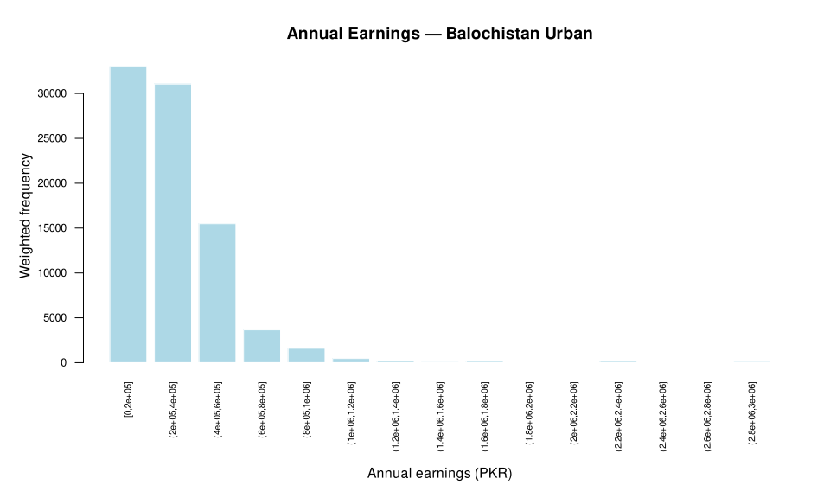
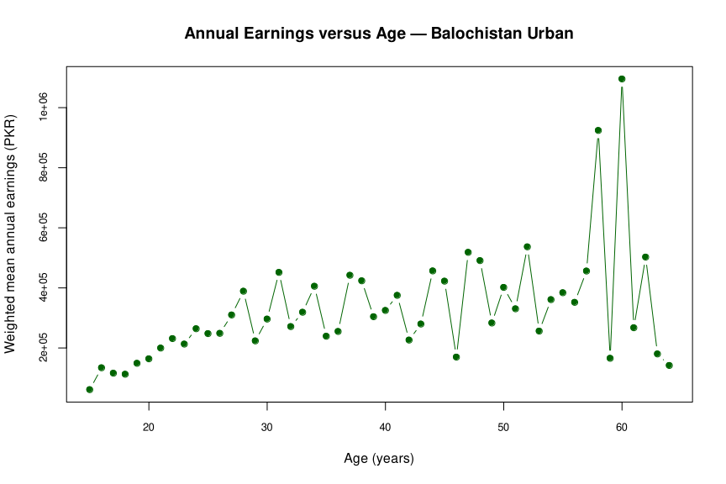
Key Findings and Visualizations
Most weighted earners fall in the lowest earnings bins
Mean earnings rise with age, but not steadily
Ages 15–19
PKR 113,382
Lowest band
Ages 50–54
PKR 399,250
Above ages 55–59
Ages 55–59
PKR 350,772
Lower than ages 50–54
Ages 60–64
PKR 476,422
Highest age band
Notes:
Charts are the project outputs Q2_weighted_histogram.svg and Q3_earnings_vs_age.svg (rendered without changing aspect ratio). Figures in the cards come from Q5_age_band_means.csv (weighted mean annual earnings, PKR).

Slide 4
Conclusion and Limitations
Conclusion
Limitations
Weighted mean annual earnings generally rise across age groups, but not uniformly.
The highest observed age-band mean is for ages 60–64.
Weighting and clear visualizations help summarize survey data.
Some age bands have few observations. Interpret these estimates cautiously.
This is a descriptive analysis. It does not show that age causes higher earnings.
n = 22
Ages 15–19
n = 19
Ages 55–59
n = 16
Ages 60–64
“Weighted visualizations reveal useful earnings patterns, but small age-group samples require caution.”
Notes:
Counts per age band come from Q5_age_band_means.csv.

