Slide 1

Principles of Computer Architecture
CSE 240A
Fall 2024
Hadi Esmaeilzadeh
hadi@ucsd.edu
University of California, San Diego
Notes:
Color code: 6699CC, 3399CC

Slide 2
Branch Prediction
or
sometimes you just have to guess

Slide 3
Looking for Instruction Level Parallelism (ILP)
We want to identify and exploit ILP – instructions that can potentially be executed at the same time.
Branches are 15-20% of instructions
Implications?
Can only keep the pipeline full if we can consistently keep fetching well past unresolved branches.
Can only exploit high levels of parallelism if we consistently have multiple basic blocks in the processor at once.
Lots of branches
Small basic blocks

Slide 4
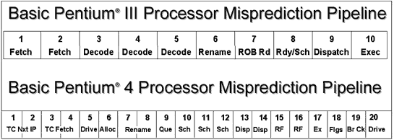
Importance of Branch Prediction
MIPS R2000 -- branch hazard of 1 cycle, 1 instruction issued per cycle
delayed branch
next generation – 2-3 cycle hazard, 1-2 instructions issued per cycle
cost of branch misprediction goes up
Pentium 4

Slide 5
Importance of Branch Prediction
Branch fetched
4-wide superscalar
20-stage pipeline
Notes:
Show resolved, show corrected

Slide 6
Branch Prediction
Easiest (static prediction)
always not taken, always taken
forward not taken, backward always taken
compiler predicted (branch likely, branch not likely)
Question next..., then dynamic

Slide 7
Branch Prediction
Easiest (static prediction)
always not taken, always taken
forward not taken, backward always taken
compiler predicted (branch likely, branch not likely)
What's the problem with static prediction?
Selection | Problem
A | Requires ISA change
B | Limited by branches bias
C | Both
D | Neither
Notes:
Correct answer C
For B, remember the branches with 51% bias vs 99% bias

Slide 8
Branch Prediction
for(int i = 0; i<n; i++) {
if(i % 2 == 0) {
blah;
}
else {
foo;
}
}
Are we entirely stuck?
Notes:
The branch is 50% taken
This can be separated to two independent loops
For (i=0, i< n, I +=2)
blah
For(i=1; i<n; +=2)
foo

Slide 9
Branch Prediction
Easiest (static prediction)
always not taken, always taken
forward not taken, backward always taken
compiler predicted (branch likely, branch not likely)
What's else could you do to help the compiler?
Restructure code, profile code.
Less likely, use value range propagation.

Slide 10
Branch Prediction
Easiest (static prediction)
always not taken, always taken
forward not taken, backward always taken
compiler predicted (branch likely, branch not likely)
Static prediction is limited.
Dynamic branch prediction

Slide 11
Dynamic Branch Prediction
What can we use to predict outcomes?

Slide 12
Branch Prediction
Easiest (static prediction)
always not taken, always taken
forward not taken, backward always taken
compiler predicted (branch likely, branch not likely)
Next easiest (1-bit dynamic)
remember last taken/not taken per branch (1 bit)
per branch approximated
per I cache line
use part of address
what happens on a loop?
for (i=0;i<5;i++) { loop: …
… …
} bnez r1, loop:

Slide 13
Paper Reading
Lets’ put this in context that this work created a
HUGE area of research.

Slide 14
Context
What makes this interesting, for those who are well acquainted with branch prediction already…
Before pipelined machines, branches were not problematic
This paper has no real context in terms of prior work on branch prediction
We get to see Jim Smith working through the first set of reasonable choices.

Slide 15
Branch Predictor Strategies
Strategy 1: Predict that all branches will be taken.
Strategy la: Predict that only certain branch operation codes will be taken.
Strategy 2: Always predict that a branch will be decided as on its last execution.
Strategy 3: Predict that only backward branches will be taken.
Strategy 4: Maintain a table of the m most recent branches not taken. Predict that only branches found in table will be not taken.
Strategy 5: Maintain a history bit in cache and predict according to the history bit in cache and predict according to the history bit (a 64-word instruction cache was used).
Strategy 6: Hash the branch address to m bits and access a 2^{m} word RAM containing history bits, and predict according to the history bit.
Strategy 7: Like Strategy 6, but use counters instead of a single history bit.

Slide 16
Branch Confidence
In the paper, branch confidence is suggested as a technique to avoid a high-cost penalty of having mispredicted and fetched the wrong path, rather than doing nothing. Such a penalty is not applicable today, but this idea has been re-examined more recently, why?
Throttle fetch on poor confidence

Slide 17
1-bit branch prediction
For a 1-bit predictor and a branch whose pattern is:
TTTTN
What will it's prediction accuracy be (over many, many executions, assume no aliasing)?
program counter
1
0
1
Selection | Accuracy
A | 50%
B | 60%
C | 80%
D | 100%
E | None of the above
Notes:
Too easily swaye:
Consider the second iterations of the loop
TTTTNTTTTN
Correct answer is B, 60%

Slide 18
1-bit branch prediction
For a 1-bit predictor and a branch whose pattern is:
TNTNTN
What will it's prediction accuracy be (over many, many executions, assume no aliasing)?
program counter
1
0
1
Selection | Accuracy
A | 0%
B | 25%
C | 50%
D | 100%
E | None of the above

Slide 19
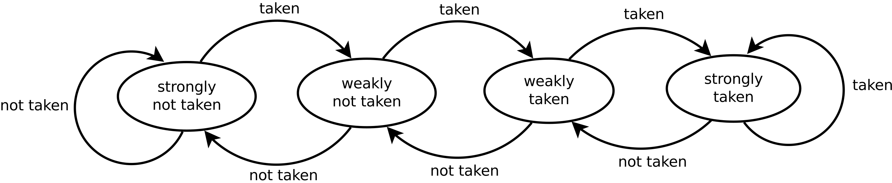
2-bit branch prediction
Strongly Taken
11
Saturating counter
Weakly Taken
10
Decrement when not taken
Weakly Not Taken
01
Increment when taken
01
10
11
00
Strongly Not Taken
00
Notes:
There

Slide 20
2-bit branch prediction
Often referred to as a “saturating counter”
Loops?
Strongly Taken
11
Weakly Taken
10
for (I=0;I<5;I++) { loop: …
… …
} bnez r1, loop:
Decrement when not taken
Weakly Not Taken
01
Increment when taken
Strongly Not Taken
00
Saturating counter

Slide 21
Bimodal Predictor
has limited size
2 bits by N (e.g. 4K)
uses low bits of branch address to choose entry
BHT
branch address
00
Why low bits?

Slide 22
2-bit branch prediction
For a 2-bit predictor and a branch whose pattern is:
TTTTN
What will it's prediction accuracy be (over many, many executions, assume no aliasing)?
BHT
branch address
??
Selection | Accuracy
A | 50%
B | 60%
C | 80%
D | 100%
E | None of the above
Notes:
The correct answer is 80% D
Look at the second iteration
TTTTNTTTTN
ST, ST, ST, ST, WT, ST… Only ne misprediction instead of two

Slide 23
2-bit branch prediction
For branches with the following pattern:
TNTNTN
How much better will the 2-bit predictor do on average than the 1-bit predictor?
BHT
branch address
??
Selectionx | Better
A | 0%
B | 25%
C | 50%
D | 75%
E | None of the above
Notes:
Walk through all starts, either
0% or 50%, actual correct
is ~38%
Correct answer is E none of the above:
TNTNTN
00 M,C,M,C,M => 50%
01 M,M,M,M,M => 0%
10 C,M,C,M,C => 50%
11 C,M,C,M,C,C => 50%
150% + 0% / 4 => 37.5%
0, M, M,M,M
1 C,M,M,M,M for long iterations can be approximated with 0 percent

Slide 24
2-bit branch prediction
What happens when the low order bits map to the same location in the BHT?
BHT
branch address
00
Selection | Effect
A | The aliasing is detected, the old value is cleared, and we restart for the new branch
B | The aliasing is allowed and interference may occur
C | The aliasing is allowed only if the two branches have the same bias
D | A new set of bits are chosen to determine a new hash function
E | None of the above
Notes:
A,C,D – I wish.
B is a real problem
B is the correct answer

Slide 25
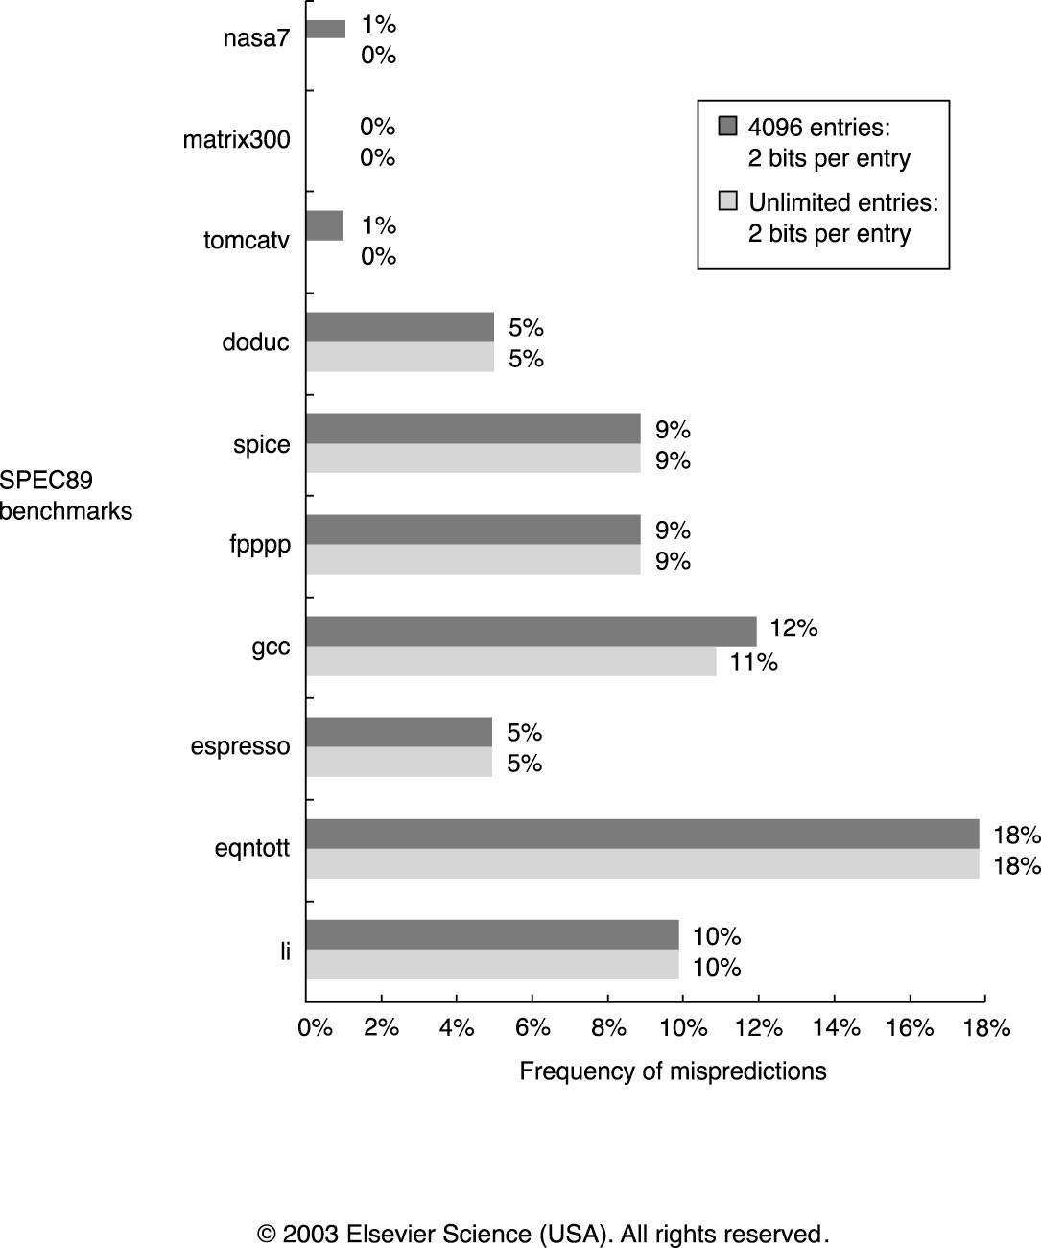
2-bit prediction accuracy
Is this good enough?

