Slide 1

Principles of Computer Architecture
CSE 240A
Fall 2024
Hadi Esmaeilzadeh
hadi@ucsd.edu
University of California, San Diego
Notes:
Color code: 6699CC, 3399CC

Slide 2
Branch Prediction
or
sometimes you just have to guess

Slide 3
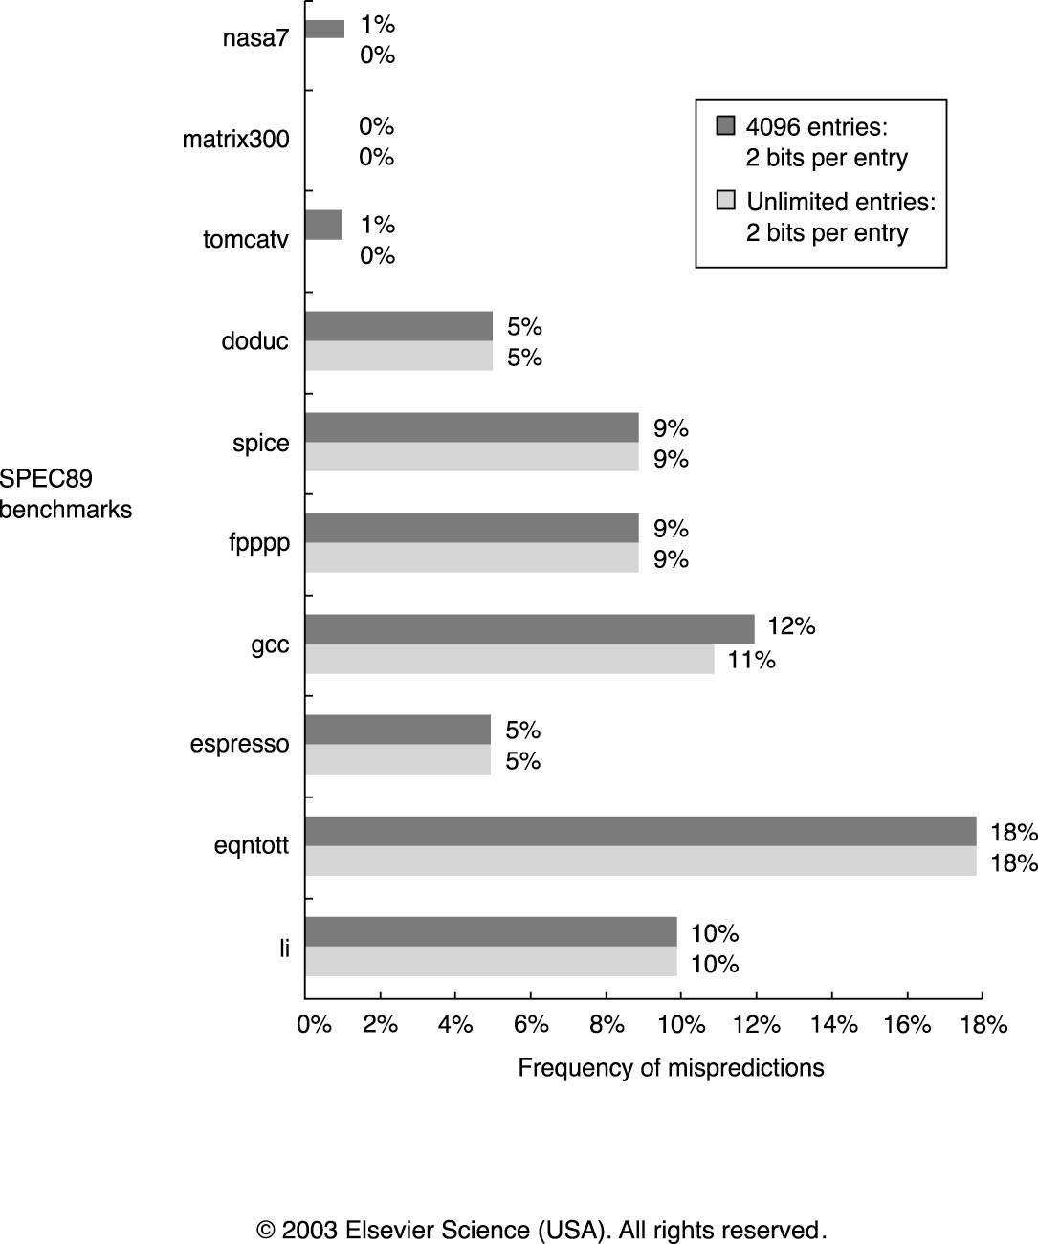
2-bit prediction accuracy
Is this good enough?

Slide 4
Can We Do Better?
Can we get more information dynamically than just the general history of this branch?

Slide 5
Can We Do Better?
Can we get more information dynamically than just the general history of this branch?
We can look at patterns (local predictor) for a particular branch.
last eight branches 00100100, then it is a good guess that the next one is “1” (taken)
even/odd branch?
BHT
address
000000
00
111111
00
001001
000000
11

Slide 6
Can We Do Better?
For a local predictor and a branch whose pattern is:
TNTNTNTN
What will it's prediction accuracy be (over many, many executions, assume no aliasing)?
BHT
address
000000
00
111111
00
001001
000000
Selection | Accuracy
A | ~50%
B | ~75%
C | ~100%
D | Can't tell from the information provided
11
Notes:
The PC will be mapping to the same location
But the pattern in that location will be alternating between
010101 -> 11
101010 -> 00
That are mapped to completely separate locations

Slide 7
Illustrating branch predictors

Slide 8
1-bit BHT
program counter
for (i=0;i<10;i++) {
...
...
}
1st iteration
Branch Taken
(predicted not taken)
History -> 1
1
0
1
...
...
subi $i, $i, #1
bnez $i, loop
Notes:
Initialized with NT -> Misprediction

Slide 9
1-bit BHT
program counter
for (i=0;i<10;i++) {
...
...
}
2nd iteration
Branch Taken
(predicted taken)
History -> 1
1
1
1
...
...
subi $i, $i, #1
bnez $i, loop
Notes:
Correct prediction

Slide 10
1-bit BHT
program counter
for (i=0;i<10;i++) {
...
...
}
3rd iteration
Branch Taken
(predicted taken)
History -> 1
1
1
1
...
...
subi $i, $i, #1
bnez $i, loop
Notes:
Misprediction

Slide 11
1-bit BHT
program counter
for (i=0;i<10;i++) {
...
...
}
10th iteration
Branch Not Taken
(predicted taken)
History -> 0
1
1
1
...
...
subi $i, $i, #1
bnez $i, loop

Slide 12
1-bit BHT
program counter
for (i=0;i<10;i++) {
...
...
}
1st iteration again
Branch Taken
(predicted not taken)
History -> 1
1
0
1
...
...
subi $i, $i, #1
bnez $i, loop
Notes:
Coming back to the second time we are executing the loop
We will have another misprediction

Slide 13
2-bit Branch History Table
BHT
branch address
1st iteration
Branch Taken
(predicted not taken)
History -> ?
01
Notes:
Misprediction
History will be updated to 10

Slide 14
2-bit Branch History Table
BHT
branch address
2nd iteration
Branch Taken
(predicted taken)
History -> ?
10

Slide 15
2-bit Branch History Table
BHT
branch address
3rd iteration
Branch Taken
(predicted taken)
History -> ?
11
Notes:
Correct prediction

Slide 16
2-bit Branch History Table
BHT
branch address
10th iteration
Branch Not Taken
(predicted taken)
History -> ?
11
Notes:
Misprediction -> The history is going to change to 10

Slide 17
2-bit Branch History Table
BHT
branch address
1st iteration again
Branch Taken
(predicted taken)
History -> ?
10
Notes:
Second time we are executing the entire loop
Then we have correct prediction and the history is updated to 11

Slide 18
Local predictor
Pattern
History
Table
BHT
address
000000
00
111111
01
First iteration
Branch Taken
Predicted not taken
BHT -> 10
Pattern Hist Table -> 101101
011011
Entry
011011
101101
110110
000000
01
01
01
11
Assume a loop that repeatedly executes three iterations (thus, the
branch is TTNTTNTTN…
Notes:
Push 1 from left to the entry in 011011
Mispredict and push the 1 frm left and update the BHT to 10

Slide 19
Local predictor
Pattern
History
Table
BHT
address
000000
00
111111
01
Second iteration
Branch Taken
Predicted not taken
BHT -> 10
Pattern Hist Table -> 110110
101101
Entry
011011
101101
110110
000000
10
01
01
11
Assume a loop that repeatedly executes three iterations (thus, the
branch is TTNTTNTTN…
Notes:
101101
The BHT in that location is 01 -> Mipredict and update to 10

Slide 20
Local predictor
Pattern
History
Table
BHT
address
000000
00
111111
01
Third iteration
Branch not taken
Predicted not taken
BHT -> 00
Pattern Hist Table -> 011011
110110
Entry
011011
101101
110110
000000
10
10
01
11
Assume a loop that repeatedly executes three iterations (thus, the
branch is TTNTTNTTN…
Notes:
110110
Correct prediction -> It should not be taken and the BHT is decremented to 00

Slide 21
Local predictor
Pattern
History
Table
BHT
address
000000
00
111111
01
First iteration, again
Branch taken
Predicted taken
BHT -> 11
Pattern Hist Table -> 101101
011011
Entry
011011
101101
110110
000000
10
10
00
11
Assume a loop that repeatedly executes three iterations (thus, the
branch is TTNTTNTTN…
Notes:
011011 -> Correct prediction -> updated to 11

Slide 22
Local predictor
Pattern
History
Table
BHT
address
000000
00
111111
01
Second iteration, again
Branch taken
Predicted taken
BHT -> 11
Pattern Hist Table -> 110110
101101
Entry
011011
101101
110110
000000
11
10
00
11
Assume a loop that repeatedly executes three iterations (thus, the
branch is TTNTTNTTN…
Notes:
Correct prediction -> BHT is updated to 11

Slide 23
Local predictor
Pattern
History
Table
BHT
address
000000
00
111111
01
Third iteration, again
Branch not taken
Predicted not taken
BHT -> 00
Pattern Hist Table -> 011011
110110
Entry
011011
101101
110110
000000
11
11
00
11
Assume a loop that repeatedly executes three iterations (thus, the
branch is TTNTTNTTN…
Notes:
Correct prediction, not taken and the BHT is not updated

Slide 24
Local predictor
Pattern
History
Table
BHT
address
000000
00
111111
01
First iteration, yet again
Branch taken
Predicted taken
BHT -> 11
Pattern Hist Table -> 101101
011011
Entry
011011
101101
110110
000000
11
11
00
11
Assume a loop that repeatedly executes three iterations (thus, the
branch is TTNTTNTTN…
Notes:
Correct prediction of taken and the BHT is constnt

Slide 25
This seems great!
BHT
Is this just better then? When might it do well, and when might it struggle?
address
000000
00
111111
00
001001
000000
Two ways to alias
Long time to train
11

Slide 26
Can We Do Better?
Correlating Branch Predictors also look at other branches for clues
if (i == 0)
...
if (i > 7)
...
Often use two indices
Global history register (GHR) --> history of last m branches (e.g., 0100011)
branch address
If (I < 10) j = 5;
If (j == 5) blah;

Slide 27
Correlating Branch Predictors
The global history register is a shift register that records the last n conditional branches (of any address) encountered by the processor.
ghr
BHT
00
01
2-bit predictors
00
11

Slide 28
Yeh and Patt Alternative Implementations of Two Level Adaptive Branch Prediction

Slide 29
Yeh and Patt
Described and evaluated some of these same predictors, although their terminology didn’t stick.
Pattern
History
Table
address
BHT
000000
00
ghr
BHT
111111
01
011011
Entry
011011
101101
110110
00
000000
01
01
01
2-bit predictors
01
00
11
11
Local Predictor == PAg
Correlating Predictor == GAg

Slide 30
Yeh and Patt
What conclusions do they come to?
They like saturating counter vs other state machines
- mention automaton A1 appeared in prior text
Versions, came from a Patterson paper.
They like 2-level adaptive (local)

Slide 31
Yeh and Patt
What conclusions do they come to?
How do you handle context switches?
Do nothing.
Impact on perf is minimal.
State of old program likely to be better than some iniitialized state.

Slide 32
Two-level correlating branch predictors
Can use both the PC address and the GHR
If the combining function is xor, this is called the _________ predictor.
ghr
BHT
00
01
2-bit predictors
PC
00
combining
function
11
Notes:
This is called the gshare

Slide 33
Gshare
For a gshare predictor and a branch whose pattern is:
TNTNTNTN
What will it's prediction accuracy be (over many, many executions, assume no aliasing)?
ghr
BHT
00
01
2-bit
predictors
PC
00
combining
function
Selection | Accuracy
A | ~50%
B | ~75%
C | ~100%
D | Can't tell from the information provided
11
Notes:
C is the correct answer
010101 -> 00 100% accuracy
101010 -> 11
D is also acceptable because we don’t know the PC and some of the aliasing that might happen

Slide 34
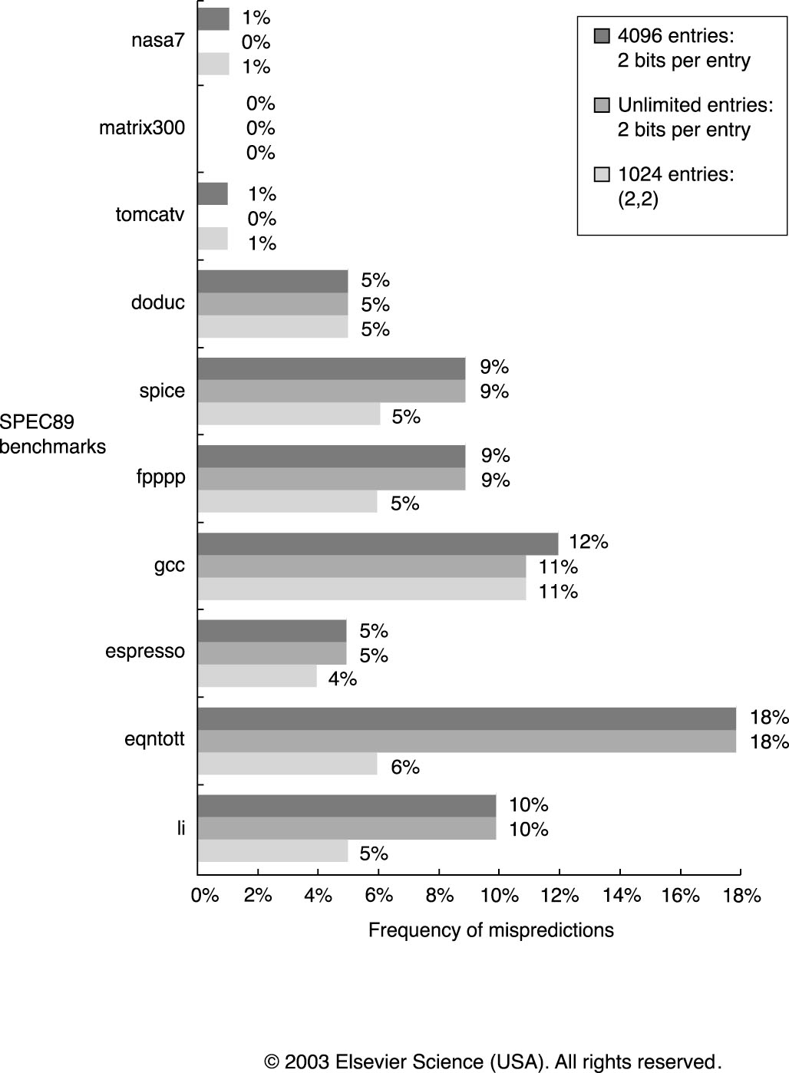
Performance of 2-level Correlating Branch Prediction

Slide 35
Are we happy yet????

