Slide 1

Principles of Computer Architecture
CSE 240A
Fall 2024
Hadi Esmaeilzadeh
hadi@ucsd.edu
University of California, San Diego
Notes:
Color code: 6699CC, 3399CC

Slide 2
Branch Prediction
or
sometimes you just have to guess

Slide 3
Are we happy yet????

Slide 4
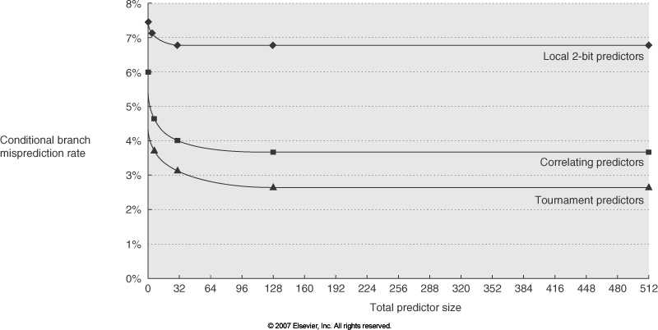
More BP performance

Slide 5
Are we happy yet????
Combining branch predictors or tournament predictors use multiple schemes and a voter to decide which one typically does better for that branch.
P1
P2
use P2
PC

Slide 6
But hang on a sec...
When do we need to do the prediction to avoid any control hazards on a correct prediction?
A taken/not taken prediction only helps us if....?

Slide 7
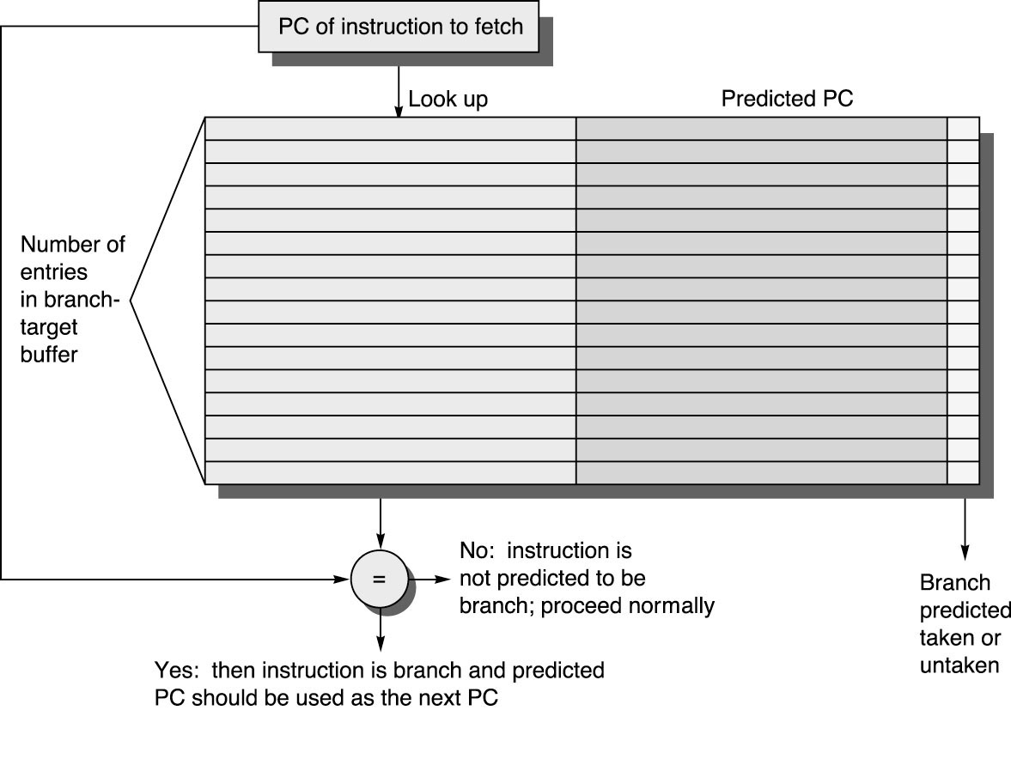
Branch Target Buffers
predict the location of branches in the instruction stream
predict the destination of branches

Slide 8
BTB Operation
use PC (all bits) for lookup
match implies this is a branch
if match and predict bits => taken, set PC to predicted PC
if branch predict wrong, must recover (same as branch hazards we’ve already seen)
but what about dynamically scheduled (out of order) processor??
if decode indicates branch when no BTB match, two choices:
look up prediction now and act on it
just predict not taken
when branch resolved, update BTB (at least prediction bits, maybe more)

Slide 9
Can we use this for prediction?
There's an idea to clean up the logic and reduce aliasing by just keeping the prediction bits in the BTB. Is this a good idea?
Selection | Good idea?
A | Yes
B | No
Notes:
Correct answer B
Big problem, replacement. This is a small table and it not enough to hold all the information.
Minor problem: bias loss.
But not a bad place to put stuff entirely…

Slide 10
BTB Performance
Two things that can go wrong
didn’t predict the presence of branch (misfetch)
mispredicted a branch (mispredict)
Can use (now, always use) both BTB and branch predictor
have no prediction bits in BTB
presence of PC in BTB indicates a lookup in branch predictor to predict whether the branch will go to destination address in BTB.

Slide 11
What about indirect jumps/returns?
Branch predictor does really well with conditional jumps
BTB does really well with unconditional jumps (jump, jal, etc.)
Indirect jumps often jump to different destinations, even from the same instruction. Indirect jumps most often used for return instructions. Sometimes used for case. Heavily used in object-oriented languages.
Return easily handled by a stack.
jal -> push PC+4
return -> predict jump to address on top of stack, pop stack
Most processors include a hardware return address stack (RAS), used only for prediction.

Slide 12
Real BP -- PowerPC 620
256-entry 2-way set-associative BTB
2048-entry BHT indexed by PC
return-address stack

Slide 13
Power 4
Up to 2 branches per cycle predicted
PC GHR
XOR
16K
16K
16K
BHT gshare chooser (use bht or gshare result?)

Slide 14
Pentium Pro
512-entry BTB 4-way set-associative
2-level predictor (1st level in BTB, one per set, 4 bits)
return stack
branch
pattern
branch PC
target
branch PC
target
BHT

Slide 15
Compaq/Digital Alpha 21264
Global
Predictor
Chooser
Local Predictor
PC
10
3
2
GHR
2
10
12
next-cache-line field in I-cache replaces BTB
return address stack
Branch Prediction

Slide 16
The YAGS Branch Prediction Scheme A. N. Eden and T. Mudge,
What’s the big problem they are trying to solve
What does aliasing do to the predictor?
What are some general techniques to reduce the impact of aliasing?
Only predict some (remove bias)
Create different hash functions
Group by bias

Slide 17
Aliasing
Constructive
Neutral
Destructive
How does the two-level local predictor do wrt aliasing?
21264 tournament predictor?

Slide 18
Local predictor aliasing?
BHT
address
000000
00
111111
00
001001
000000
11

Slide 19
21264 Aliasing?
Global
Predictor
Chooser
Local Predictor
PC
10
3
2
GHR
2
10
12
Branch Prediction

Slide 20
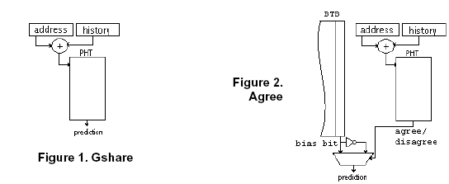
Anti-Aliasing Predictors

Slide 21
Anti-Aliasing Predictors

Slide 22
Anti-Aliasing Predictors

Slide 23
Case Study
Creating Artificial Global History to Improve Branch Prediction Accuracy.
Leo Porter, and Dean M. Tullsen.
In Twenty-Third International Conference on Supercomputing, June, 2009.
Accurate Branch Prediction for Short Threads.
Bumyong Choi, Leo Porter, and Dean M. Tullsen.
In Thirteenth International Conference on Architectural Support for Programming Languages and Operating Systems, March, 2008.

Slide 24
Rapid Migration
Core 0
Core 1
Core Hopping for thermal
Thread scheduling for Heterogeneous Cores
Hardware-based load balancing on CMP of SMTs
Speculative Multithreading (SpMT)

Slide 25
For SpMT the GHR is unknown
P0 P1
GHR= ????
SP
CQIP
Notes:
Segue – but, in the SpMT scenario, we do not know the correct GHR when we spawn a new thread.

Slide 26
A meaningful GHR value (Oracle)
P0 P1
GHR= NT…NN
SP
CQIP
Notes:
Segue – but, in the SpMT scenario, we do not know the correct GHR when we spawn a new thread.

Slide 27
Policy = PC
P0 P1
GHR= PC(CQIP) >> 2
SP
CQIP

Slide 28
Overall – A puzzle

Slide 29
Branch Correlation
Prior work has shown that a large percentage of branches correlate with a relatively small number of prior branches (Evers ‘98)
If x values are consistent, predictors learn.
0xxx1xx1
GHR
PHT
branch address
Consistent
00

Slide 30
Branch Correlation
If x values are uncorrelated and inconsistent, predictors may access more table entries causing slow learning and aliasing becomes more likely.
0xxx1xx1
GHR
PHT
branch address
Noise
01
Notes:
Key word here is 32x as many entries as needed.

Slide 31
Branch Correlation
If this branch entirely lacks correlation (all noise), the predictors learn slowly and aliasing becomes more likely.
xxxxxxxx
GHR
PHT
branch address
Noise
01
University of California, San Diego

Slide 32
An experiment
Analyzed branch prediction using 2-bit predictors per unique history per branch
Similar to infinite gshare with no aliasing
Compared the accuracy of branch bias against the accuracy of the non-aliasing infinite gshare predictor
75% biased but 90% accuracy with history
75% biased but 50% accuracy with history
Notes:
Give an example of both positive and negative

Slide 33
Global History Benefit
Diminishing Returns
Increasing Negative Impact
Gshare/
filter
More modern predictors try to
Get more history, without the
Detriment. Positive is limited to gshare, could do better
Notes:
Mention lengths have been increasing with recent implementations
Ideal goal is to decrease negative impact while retaining positive impact

Slide 34
Branch Prediction Key Points
Significant improvement in predictor accuracy overshadowed by increases in pipeline depth and superscalar width.
2-bit predictors capture tendencies well.
Correlating predictors improve accuracy, particularly when combined with 2-bit predictors.
Accurate branch prediction does no good if we don’t know there was a branch to predict
BTB identifies branches in (or before) IF stage.
BTB combined with branch prediction table identifies branches to predict, and predicts them well.
Modern codes can create significant aliasing in branch predictor tables.

