Slide 1

Principles of Computer Architecture
CSE 240A
Fall 2024
Hadi Esmaeilzadeh
hadi@ucsd.edu
University of California, San Diego
Notes:
Color code: 6699CC, 3399CC

Slide 2
Memory Subsystem Design Caches – Part 1
or
Nothing Beats Cold, Hard Cache

Slide 3
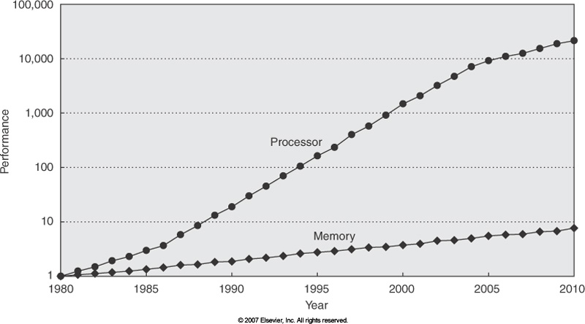
Who Cares about Memory Hierarchy?
Processor Only Thus Far in Course
CPU-DRAM Gap
1980: no cache in µproc;
1995 2-level cache, 60% trans. on Alpha 21164 µproc
Notes:
The point – this is a log scale, so gap getting exponentially large
Soon, main memory will be 1000 cycles away

Slide 4
Memory Cache
cpu
memory
Notes:
The point – memory is slow, because it needs to be big and inexpensive. But we can have small memories that are faster.

Slide 5
Memory Cache
Can put small, fast memory close to processor.
What do we put there?
cpu
cache
memory
Notes:
The point – memory is slow, because it needs to be big and inexpensive. But we can have small memories that are faster.

Slide 6
Memory Locality
Memory hierarchies take advantage of memory locality.
Memory locality is the principle that future memory accesses are near past accesses.
Memory hierarchies take advantage of two types of locality
Temporal locality -- near in time => we will often access the same data again very soon
Spatial locality -- near in space/distance => our next access is often very close to our last access (or recent accesses).
1,2,3,1,2,3,8,8,47,9,10,8,8...
Notes:
Beat locality into them. Give examples. Identify the type of locality for each access at the bottom

Slide 7
Locality and cacheing
Memory hierarchies exploit locality by cacheing (keeping close to the processor) data likely to be used again.
This is done because we can build large, slow memories and small, fast memories, but we can’t build large, fast memories.
If it works, we get the illusion of SRAM access time with disk capacity
SRAM (static RAM) -- 5-20 ns access time, very expensive (onchip much faster -- < 1 ns)
DRAM (dynamic RAM) -- 60-100 ns, cheaper
disk -- access time measured in milliseconds, very cheap

Slide 8
A typical memory hierarchy
CPU
small
expensive $/bit
memory
on-chip cache (s)
memory
off-chip cache
memory
main memory
memory
big
disk
cheap $/bit
so then where is my program and data??
The programmer has a logical view of memory that has little to do with reality.
Notes:
Point – program and data are distributed all over this picture. The programmer has a logical view of memory that has little to do with reality.

Slide 9
Cache Fundamentals
cache hit -- an access where the data
is found in the cache.
cache miss -- an access which isn’t
hit time -- time to access the higher cache
miss penalty -- time to move data from
lower level to upper, then to cpu
hit ratio -- percentage of time the data is found in the
higher cache
miss ratio -- (1 - hit ratio)
cpu
highest-level
cache
lower-level
memory/cache
Notes:
Go slowly over these two slides

Slide 10
Cache Fundamentals, cont.
cache block size or cache line size-- the
amount of data that gets transferred on a
cache miss.
instruction cache -- cache that only holds
instructions.
data cache -- cache that only caches data.
unified cache -- cache that holds both.
cpu
lowest-level
cache
next-level
memory/cache

Slide 11
Accessing a simple cache
blocksize = 4 words (16 bytes), cache size = 2 blocks (32 bytes), associativity = full
Memory
0000 00 00
0000 01 00
0000 10 00
0000 11 00
0
63
4
37
8
4
12
149
Cache
0001 00 00
0001 01 00
0001 10 00
0001 11 00
16
12
20
82
24
2
CPU
28
3
0010 00 00
0010 01 00
0010 10 00
0010 11 00
32
4
36
5
40
17
44
3245
0011 00 00
0011 01 00
0011 10 00
0011 11 00
48
63
52
37
56
4
CPU reads addresses 8, 0, 4, 0, 4, 8, 12, 16, 20,
write val 30 to address 12,
reads 8, 20, 28, 56, 20, 60, 12
60
149
0100 00 00
0100 01 00
0100 10 00
0100 11 00
64
12
68
82
72
21
76
92
Notes:
Work this example carefully. Somewhat sophisticated example, to make sure they get the point that data comes into the cache on aligned boundaries. Let them tell you all the answers.

Slide 12
Cache Characteristics
Cache Organization (size, associativity, block size)
Cache Access
Cache Replacement
Write Policy

Slide 13
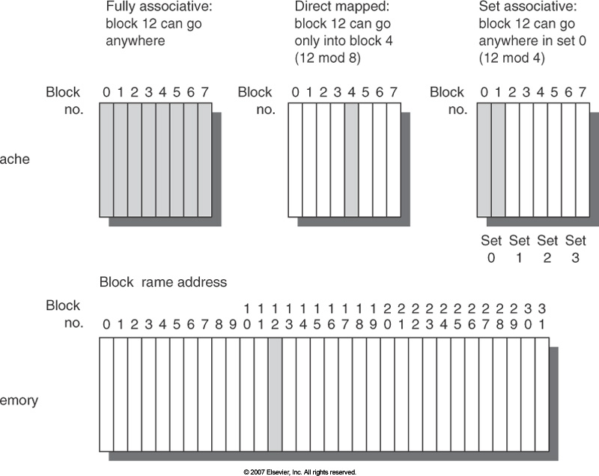
Cache Organization: Where can a block be placed in the cache?
Block 12 placed in 8-block cache:
Fully associative, direct mapped, n-way set associative
index = pointer to the set in the cache where a memory location might be cached
(associativity = degree of freedom in placing a particular block of memory)
(set = a collection of cache blocks with the same cache index)

Slide 14
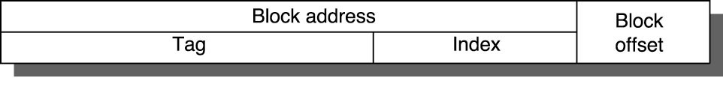
Cache Access: How Is a Block Found In the Cache?
Tag on each block
No need to check index or block offset
Increasing associativity shrinks index, expands tag
Address
FA: No index, large tags
DM: Large index, smaller tags
tags
data
Cache

Slide 15
Cache Organization -- Overview
A typical cache has three dimensions
tag index block offset
tag data
tag data
tag data
tag data
tag data
tag data
tag data
tag data
Number of sets (cache size)
tag data
Blocks/set (associativity)
tag data
tag data
tag data
.
.
.
tag data
tag data
tag data
tag data
Bytes/block (block size)

Slide 16
Cache Access
16 KB, 4-way set-associative cache, 32-bit address, byte-addressable memory, 16-byte cache blocks/lines
At what index would you find the word at address 0x200356A4?
A. 0x56
0x6A
0xA4
0x56A
None of the above
index
tag data
tag data
tag data
tag data
Notes:
16 * 2 ^ 10
16 byte cache blocks and byte addressable -> 2 ^ 4 -> 4 bits for the offset
# of lines: 16 KB / 16 -> 1 K lines
1 K lines / 4 (way sets) = 256 sets that needs to be indexed
# bits for index = log(2) 256 -> 8
4 bits offset, 8 bits of index, the rest is tag
The correct answer is 0x6A

Slide 17
A set-associative cache
address string:
4 0000 01 00
8 0000 10 00
12 0000 11 00
4 0000 01 00
8 0000 10 00
20 0001 01 00
4 0000 01 00
8 0000 10 00
20 0001 01 00
24 0001 10 00
36 0010 01 00
4 0000 01 00
20 0001 01 00
00000100
tag
data
tag
data
4 entries, each block holds one word, each word
in memory maps to one of a set of n cache lines
A cache that can put a line of data in exactly n places is called n-way set-associative.
The cache lines that share the same index are a cache set.
Notes:
Work through this example, carefully pulling out the index and tag from each address, and writing it into the correct place in the cache.

Slide 18
Which Block Should be Replaced on a Miss?
Direct Mapped is Easy
Set associative or fully associative:
longest till next use (ideal, impossible)
least recently used (best practical approximation)
pseudo-LRU (e.g., NMRU, NRU)
random (easy)
how many bits for LRU?

Slide 19
Which Block Should be Replaced on a Miss?
Direct Mapped is Easy
Set associative or fully associative:
longest till next use (ideal, impossible)
least recently used (best practical approximation)
pseudo-LRU (e.g., NMRU, NRU)
random (easy)
how many bits for LRU?
Associativity: 2-way 4-way 8-way
Size LRU Random LRU Random LRU Random
16 KB 5.18% 5.69% 4.67% 5.29% 4.39% 4.96%
64 KB 1.88% 2.01% 1.54% 1.66% 1.39% 1.53%
256 KB 1.15% 1.17% 1.13% 1.13% 1.12% 1.12%

Slide 20
Cache Access
32-bit address, and 128 KB cache with 64-byte blocks, 4-way set associative.
4 blocks/set
32
?? sets
Sets = size / (assoc * block)
2^17 / (2^2 * 2^6)
Sets = 2^9 = 512

Slide 21
Cache Access
48-bit address, and 1 MB cache with 64-byte blocks, 8-way set associative.
8 blocks/set
48
?? sets
Sets = size / (assoc * block)
2^20 / (2^3 * 2^6)
Sets = 2^11 = 2048

Slide 22
Cache Access
64-bit address, and 32 KB cache with 32-byte blocks, direct-mapped.
4 blocks/set
64
?? sets
Sets = size / (assoc * block)
2^15 / (1 * 2^5)
Sets = 1024

Slide 23
What Happens on a Write?
Write through: The information is written to both the block in the cache and to the block in the lower-level memory.

Slide 24
What Happens on a Write?
Write through: The information is written to both the block in the cache and to the block in the lower-level memory.
Write back: The information is written only to the block in the cache. The modified cache block is written to main memory only when it is replaced.
is block clean or dirty?

Slide 25
What Happens on a Write?
Write through: The information is written to both the block in the cache and to the block in the lower-level memory.
Write back: The information is written only to the block in the cache. The modified cache block is written to main memory only when it is replaced.
is block clean or dirty?
Pros and Cons of each:
WT: read misses cannot result in writes (because of replacements)
WB: no writes of repeated writes

Slide 26
What Happens on a Write?
Write through: The information is written to both the block in the cache and to the block in the lower-level memory.
Write back: The information is written only to the block in the cache. The modified cache block is written to main memory only when it is replaced.
is block clean or dirty?
Pros and Cons of each:
WT: read misses cannot result in writes (because of replacements)
WB: no writes of repeated writes
WT always combined with write buffers so that don’t wait for lower level memory

Slide 27
What happens on a write miss?
write-allocate -- make room for the cache line in the cache, fetch rest of line from memory.

Slide 28
What happens on a write miss?
write-allocate -- make room for the cache line in the cache, fetch rest of line from memory.
no-write-allocate (write-around) -- write to lower levels of memory hierarchy, ignoring this cache.

Slide 29
What happens on a write miss?
write-allocate -- make room for the cache line in the cache, fetch rest of line from memory.
no-write-allocate (write-around) -- write to lower levels of memory hierarchy, ignoring this cache.
Tradeoffs?
Which makes most sense for write-back?
Which makes most sense for write-through?
Write Back -> write allocate
For write back , we miss in the caches, allocate the memory block, and then write ->
Then you have to keep dirty bits per individual byte if you don’t bring the data from memory and change the word
Write Through -> no-write allocate
If you are doing write through, it is better to just go change the memory and use the write buffers.
Notes:
Write Back -> write allocate
For write back , we miss in the caches, allocate the memory block, and then write -> Then you have to keep dirty bits per individual byte if you don’t bring the data from memory and change the word
If you are doing write through, it is better to just go change the memory and use the write buffers.
Write Through -> Write no-allocate

Slide 30
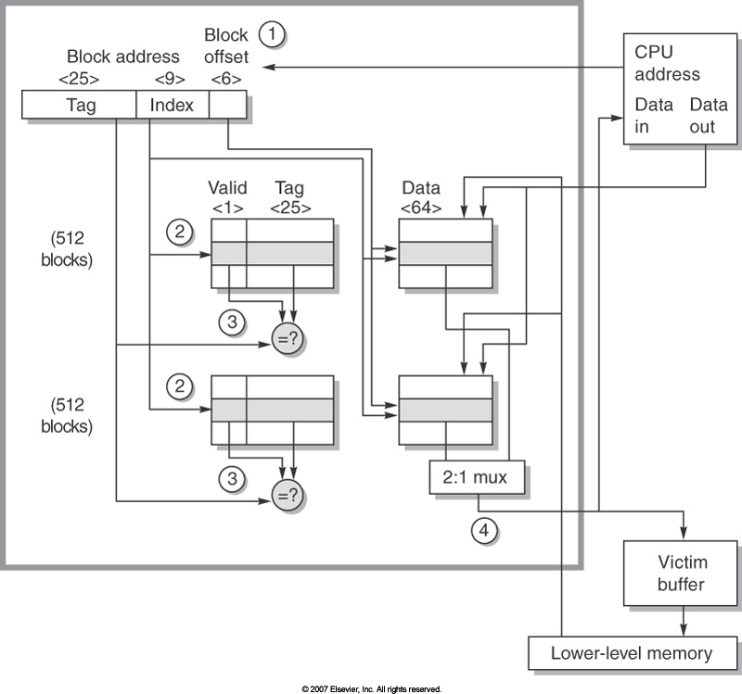
21264 L1 Data Cache
64 KB, 64-byte blocks, 2-way set associative, ? blocks, ? sets
write-back
Victim cache later
Separate Tag and Data Array
Notes:
Just tell them we’ll talk about victim buffer later

Slide 31
Cache Organization: Separate Instruction and Data Caches?
Size Instruction Cache Data Cache Unified Cache
1 KB 3.06% 24.61% 13.34%
2 KB 2.26% 20.57% 9.78%
4 KB 1.78% 15.94% 7.24%
8 KB 1.10% 10.19% 4.57%
16 KB 0.64% 6.47% 2.87%
32 KB 0.39% 4.82% 1.99%
64 KB 0.15% 3.77% 1.35%
128 KB 0.02% 2.88% 0.95%
Why separate the caches?
Most are instructions. Different associativity. Not as much about miss rate as bandwidth. Need high bandwidth to each as both are accessed at the same time
Notes:
Main point – not really about miss rate – more about bandwidth.

Slide 32
Cache Performance
CPU time = (CPU execution clock cycles + Memory stall clock cycles) x clock cycle time
Memory stall clock cycles = Memory accesses x Miss rate x Miss penalty
Or, if you have more detail…
Memory stall clock cycles = (Reads x Read miss rate x Read miss penalty + Writes x Write miss rate x Write miss penalty)
Or…
Memory stall clock cycles = (Inst Cache Reads x IC miss rate x IC miss penalty + Data Cache accesses x DC miss rate x DC miss penalty)
Etc.
These are approximations – assume you stall immediately when you miss
Notes:
These are approximations. What are reasons that this is not accurate? (assume stall immediately on miss)
But these are reasonable 1st-level models.

Slide 33
Cache Performance
CPUtime = IC x (CPI_{execution} + Memory stalls per instruction) x Clock cycle time
CPUtime = IC x (CPI_{execution} + Mem accesses per instruction x Miss rate x Miss penalty) x Clock cycle time
(includes hit time as part of CPI)
(note, I will typicall call “memory stalls (cycles) per instruction” MCPI)

Slide 34
Cache Performance
Instruction cache miss rate of 4%, data cache miss rate of 10%, Base CPI (no memory stalls) = 1.1, 20% of instructions are loads and stores, miss penalty = 12 cycles,
What is the CPI?
A. 1.436
1.82
2.78
None of the above
Notes:
Correct answer -> B
1.1 + 0.04 (I$ Miss Rate) * 12 (Penalty) + 0.2 (Ld/St Percent) * 0.1 (D$ miss rate) * 12 (Penalty)
CPI = 1.1 + (1)(.04)12 + .2(.10)(12)
=1.1 + .48 + .24 = 1.82

Slide 35
Cache Performance
CPUtime = IC x (CPI_{execution} + Memory stalls per instruction) x Clock cycle time
CPUtime = IC x (CPI_{execution} + Mem accesses per instruction x Miss rate x Miss penalty) x Clock cycle time
(includes hit time as part of CPI)
(Alternate view of memory performance)
Average memory-access time = Hit time + Miss rate x Miss penalty (ns or clocks)

Slide 36
Improving Cache Performance
Average memory-access time = Hit time + Miss rate x Miss penalty (ns or clocks)
How are we going to improve cache performance??
1. Reduce Hit Time
2. Reduce Miss Rate
3. Reduce Miss Penalty
Notes:
The responses are, reduce hit time, reduce miss rate, reduce miss penalty.
This slide is supposed to be a bridge to the next section.
reduce hit time, reduce miss rate, reduce miss penalty.

Slide 37
Reducing Misses
Classifying Misses: 3 Cs
Compulsory—The first access to a block is not in the cache, so the block must be brought into the cache. These are also called cold start misses or first reference misses.
Capacity—If C is the size of the cache (in blocks) and there have been more than C unique cache blocks accessed since this cache was last accessed.
Conflict—Any miss that is not a compulsory miss or capacity miss must be a byproduct of the cache mapping algorithm. A conflict miss occurs because too many active blocks are mapped to the same cache set.
How To Measure
Misses in infinite cache
Non-compulsory misses in size X fully associative cache
Non-compulsory, non-capacity misses
Notes:
The point – we can more intelligently attack misses if we know what caused them.

Slide 38
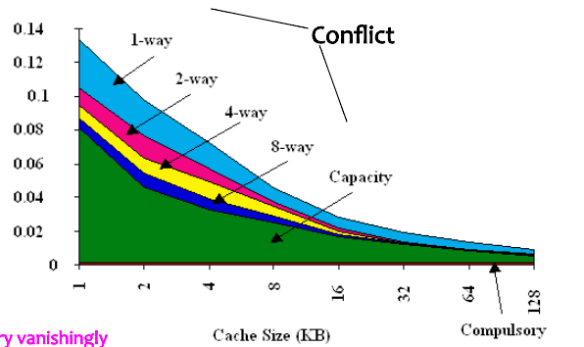
3Cs Absolute Miss Rate
Notes:
This picture didn’t come out the way the authors intended, so you’ll have to work with it.
Compulsory misses at the bottom (small), constant
Capacity misses are the ones between 8-way and compulsory (ones that even high associativity can’t get). That’s the lower black region.
Rest, depending on actual configuration, are conflict.
Most interesting point here – as cache gets larger, both capacity and conflict decrease.

Slide 39
How To Reduce Misses?
Compulsory Misses?
Capacity Misses?
Conflict Misses?
What can the compiler do?
Notes:
Compulsory only non-obvious. Large cache blocks, prefetching, …

Slide 40
Caches, pt I: Key Points
CPU-Memory gap is a major performance obstacle
Caches take advantage of program behavior: locality
Designer has lots of choices -> cache size, block size, associativity, replacement policy, write policy, ...
Time of program still only reliable performance measure

