Slide 1

Principles of Computer Architecture
CSE 240A
Fall 2024
Hadi Esmaeilzadeh
hadi@ucsd.edu
University of California, San Diego
Notes:
Color code: 6699CC, 3399CC

Slide 2
Memory Subsystem Design
or
Nothing Beats Cold, Hard Cache

Slide 3
Assume a 1KB Cache with 64 byte blocks. Assume the following byte-address are repeatedly accessed in a loop.
1
2
3
000000 0000 000000
000000 1000 000100
000001 0000 000000
000000 0000 000000
000000 0100 000100
000001 0000 000000
000000 0000 000000
000000 0100 000100
000001 1000 000000
*The addresses above are broken up (bitwise) for a DM Cache.
For which of the address streams above does a 2-way set-associative cache (same size cache, same block size) suffer a worse hit rate than a DM cache?
Selection | Address Stream
A | 1
B | 2
C | 3
D | More than one of the above
E | None of the above
1: 33% DM, 0% 2-way
2: 33% DM, 100% 2-way
3: 100% DM, 100% 2-way
Notes:
Correct Answer – A
64 bytes -> offset bits = 6
Direct Map 2 ^ 10 / 2 ^ 6 -> 2 ^ 4 -> index bits will be 4
2-Way -> 2 ^ 10 / 2 * 2 ^ 6 -> 2 ^ 3 -> index bits will be 3

Slide 4
Caches, pt I: Key Points
CPU-Memory gap is a major performance obstacle
Caches take advantage of program behavior: locality
Designer has lots of choices -> cache size, block size, associativity, replacement policy, write policy, ...
Time of program still only reliable performance measure

Slide 5
Improving Cache Performance
Average memory-access time = Hit time + Miss rate x Miss penalty (ns or clocks)
How are we going to improve cache performance??
1. Reduce miss rate
2. Reduce miss penalty
3. Reduce hit time
reduce miss rate, reduce miss penalty, reduce hit time.
Notes:
The responses are, reduce hit time, reduce miss rate, reduce miss penalty.
This slide is supposed to be a bridge to the next section.

Slide 6
Miss Type
Suppose you experience a cache miss on a block (let's call it block A). You have accessed block A in the past. There have been precisely 1027 different blocks accessed between your last access to block A and your current miss. Your block size is 32-bytes and you have a 64KB cache. What kind of miss was this?
Selection | Cache Miss
A | Compulsory
B | Capacity
C | Conflict
D | Both Capacity and Conflict
E | None of the above
Explain the way to know if it
Is a capacity vs. conflict – awould
A fully associative cache of the
Same size get a miss
Notes:
64 KB / 32 -> 2048 entries
Have enough capacity
This is a conflict miss
Correct answer is C

Slide 7
Reducing Misses
Classifying Misses: 3 Cs
Compulsory—The first access to a block is not in the cache, so the block must be brought into the cache. These are also called cold start misses or first reference misses.
Capacity—If C is the size of the cache (in blocks) and there have been more than C unique cache blocks accessed since this cache was last accessed.
Conflict—Any miss that is not a compulsory miss or capacity miss must be a byproduct of the cache mapping algorithm. A conflict miss occurs because too many active blocks are mapped to the same cache set.
How To Measure
Misses in infinite cache
Non-compulsory misses in size X fully associative cache
Non-compulsory, non-capacity misses
Notes:
The point – we can more intelligently attack misses if we know what caused them.

Slide 8
3Cs Absolute Miss Rate
Conflict
Source UCR CS162
Notes:
This picture didn’t come out the way the authors intended, so you’ll have to work with it.
Compulsory misses at the bottom (small), constant
Capacity misses are the ones between 8-way and compulsory (ones that even high associativity can’t get). That’s the lower black region.
Rest, depending on actual configuration, are conflict.
Most interesting point here – as cache gets larger, both capacity and conflict decrease.

Slide 9
“2:1 Cache Rule” miss rate 1-way associative cache size X = miss rate 2-way associative cache size X/2
Conflict
Source UCR CS162
Notes:
This picture didn’t come out the way the authors intended, so you’ll have to work with it.
Compulsory misses at the bottom (small), constant
Capacity misses are the ones between 8-way and compulsory (ones that even high associativity can’t get). That’s the lower black region.
Rest, depending on actual configuration, are conflict.
Most interesting point here – as cache gets larger, both capacity and conflict decrease.

Slide 10
How To Reduce Misses?
Compulsory Misses?
Capacity Misses?
Conflict Misses?
What can the compiler do?
Talk these through
Notes:
Compulsory only non-obvious. Large cache blocks, prefetching, …

Slide 11
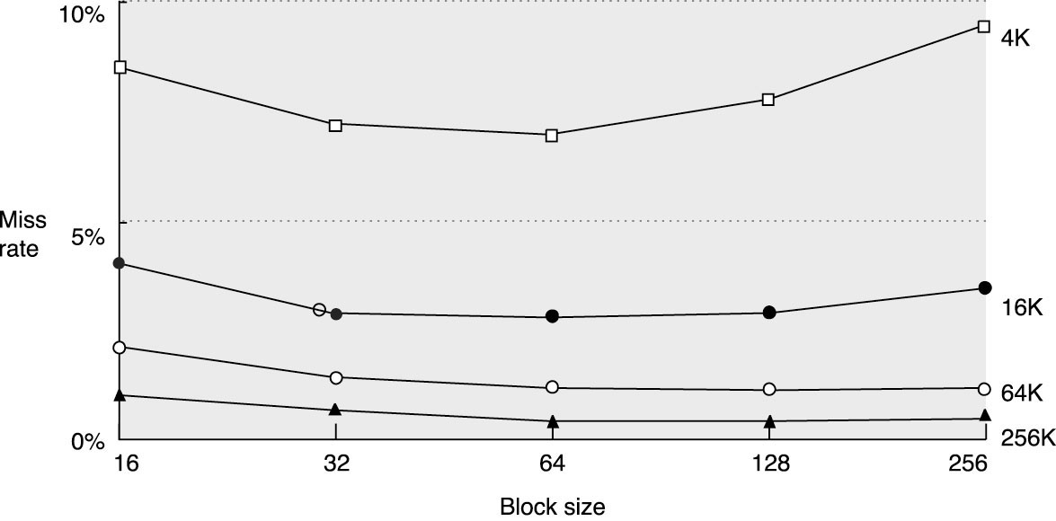
Reduce (Compulsory) Misses via Larger Block Size

Slide 12
Reduce Misses via Larger Block Size
16K cache, miss penalty for 16-byte block is 42 cycles, 32-byte is 44 cycles, and 64-byte is 48 cycles. Miss rates are 3.94, 2.87, and 2.64% respectively. Which gives best performance (lowest AMAT)?
Selection | Best Performance
A | 16 byte
B | 32 byte
C | 64 byte
.0394*42 = 1.6548
.0287*44 = 1.2628
0.264*48 = 1.2672
Miss rate isn't everything
Notes:
16-byte AMAT= 1 + 42 * 3.94 % => 2.65
32-byte AMAT= 1 + 44 * 2.87 % => 2.263 => Correct answer is 32
64-byte AMAT= 1 + 48 * 2.64 % => 2.267

Slide 13
Reduce Misses via Higher Associativity
Beware: Execution time is only final measure!
Will Clock Cycle time increase?
Hill [1988] suggested hit time external cache +10%, internal + 2% for 2-way vs. 1-way
Hill, Mark D. "A case for direct-mapped caches." Computer 12 (1988): 25-40.

Slide 14
Example: Avg. Memory Access Time vs. Miss Rate
Example: assume CT = 1.10 for 2-way, 1.12 for 4-way, 1.14 for 8-way vs. CT direct mapped
Cache Size Associativity
(KB) 1-way 2-way 4-way 8-way
1 7.65 6.60 6.22 5.44
2 5.90 4.90 4.62 4.09
4 4.60 3.95 3.57 3.19
8 3.30 3.00 2.87 2.59
16 2.45 2.20 2.12 2.04
32 2.00 1.80 1.77 1.79
64 1.70 1.60 1.57 1.59
128 1.50 1.45 1.42 1.44
AMAT
Again, miss rate
Isn't all…
Notes:
Again, miss rate not end-all. Bold, red numbers indicate the 8-way cache, although it will have lower miss rate, will have higher AMAT.

Slide 15
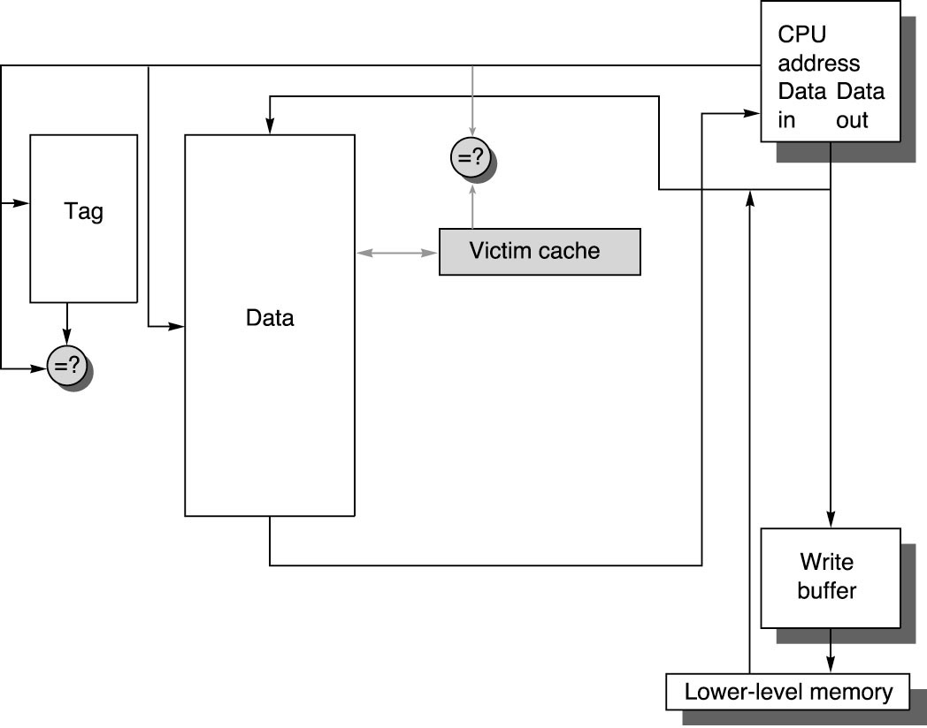
Reducing Misses by emulating associativity: Victim Cache
HR of associative + access time of direct mapped?
Add buffer to hold data recently discarded from cache
Jouppi [1990]: 4-entry victim cache removed 20% to 95% of conflicts for a 4 KB direct mapped data cache
Notes:
Segue – we will now start looking at less straightforward optimizations. A very large number of proposed technologies have attempted to get associative hit rates with DM access times. Here are a couple of them.

Slide 16
Victim Cache
Data cache is 16K, write-through, 8-way SA, 64 byte blocks, 32-bit byte-addresses. You add an 8 entry fully associative Victim cache. How many bits does it take to implement the victim cache?
Selection | Best Performance
A | 4096
B | 4304
C | 4312
D | 4336
E | None of the above
8*64*8 for data is 4096 bits
8*(32-6) for tag is 208 bit
4304
Notes:
Correct answer without LRU as C 4312
Correct answer with LRU as D
Write-Through ->One valid bit
64-Byte Blocks -> I don’t need to keep 6 bits of the byte offset
32 – 6 = 26 bits for the TAG
1 bit for valid
0 bits for dirty
64 bytes per entry
3 bits for LRU
8 entry Victim Cache
8 * (64 * 8 + 26 + 1) = 4312
If you consider the LRU bits
8 * (64 * 8 + 26 + 1 + 3) = 4336

Slide 17
Reducing Misses by HW Prefetching of Instruction & Data
E.g., Instruction Prefetching
Alpha 21064 fetches 2 blocks on a miss
Extra block placed in stream buffer
On miss check stream buffer
Works with data blocks too:
Jouppi [1990] 1 data stream buffer got 25% misses from 4KB cache; 4 streams got 43%
Palacharla & Kessler [1994] for scientific programs for 8 streams got 50% to 70% of misses from 2 64KB, 4-way set associative caches
Prefetching relies on extra memory bandwidth that can be used without penalty

Slide 18
Reducing Misses by SW Prefetching Data
Data Prefetch
Load data into register (HP PA-RISC, IA64, Tera)
Cache Prefetch: load into cache (MIPS IV, PowerPC, SPARC)
Special prefetching instructions cannot cause faults; a form of speculative execution
Issuing Prefetch Instructions (including address calculation) takes time
Is cost of prefetch issues < savings in reduced misses?
Possibly even more powerful: “helper thread prefetching” (speculative precomputation)

Slide 19
Reducing Misses by Various Compiler Optimizations
Instructions
Reorder procedures in memory so as to reduce misses
Profiling to look at conflicts
McFarling [1989] reduced cache misses by 75% on 8KB direct mapped cache with 4 byte blocks
Data
Merging Arrays: improve spatial locality by single array of compound elements vs. 2 arrays
Loop Interchange: change nesting of loops to access data in order stored in memory
Loop Fusion: Combine 2 independent loops that have same looping and some variables overlap
Blocking: Improve temporal locality by accessing “blocks” of data repeatedly vs. going down whole columns or rows
Notes:
Try and go quickly over the software slides, but without losing them.

Slide 20
Merging Arrays Example
/* Before */
int val[SIZE];
int key[SIZE];
/* After */
struct merge {
int val;
int key;
};
struct merge merged_array[SIZE];
Why might the "after" layout be better?
Better spatial locality
Fewer conflict misses
Both
Neither
Notes:
A is correct
You could have fewer conflict misses if the two arrays are not kicking each other out
Maybe both
Definitely A

Slide 21
Loop Interchange Example
/* Before */
for (k = 0; k < 100; k = k+1)
for (j = 0; j < 100; j = j+1)
for (i = 0; i < 5000; i = i+1)
x[i][j] = 2 * x[i][j];
/* After */
for (k = 0; k < 100; k = k+1)
for (i = 0; i < 5000; i = i+1)
for (j = 0; j < 100; j = j+1)
x[i][j] = 2 * x[i][j];
Sequential accesses instead of striding through memory every 100 words
Big idea for this and next few optimizations – same accesses, but different order -> an order that exhibits better locality.
Notes:
Big idea for this and next few optimizations – same accesses, but different order -> an order that exhibits better locality.

Slide 22
Loop Fusion Example
/* Before */
for (i = 0; i < N; i = i+1)
for (j = 0; j < N; j = j+1)
a[i][j] = 1/b[i][j] * c[i][j];
for (i = 0; i < N; i = i+1)
for (j = 0; j < N; j = j+1)
d[i][j] = a[i][j] + c[i][j];
/* After */
for (i = 0; i < N; i = i+1)
for (j = 0; j < N; j = j+1)
{ a[i][j] = 1/b[i][j] * c[i][j];
d[i][j] = a[i][j] + c[i][j];}
2 misses per access to a & c vs. one miss per access

Slide 23
Blocking Example
/* Before */
for (i = 0; i < N; i = i+1)
for (j = 0; j < N; j = j+1)
{r = 0;
for (k = 0; k < N; k = k+1){
r = r + y[i][k]*z[k][j];};
x[i][j] = r;
};
Two Inner Loops:
Read all NxN elements of z[]
Read N elements of 1 row of y[] repeatedly
Write N elements of 1 row of x[]
Capacity Misses a function of N & Cache Size:
Idea: compute on BxB submatrix that fits in cache
worst case => 2N³ + N².

Slide 24
Blocking Example
/* After */
for (jj = 0; jj < N; jj = jj+B)
for (kk = 0; kk < N; kk = kk+B)
for (i = 0; i < N; i = i+1)
for (j = jj; j < min(jj+B-1,N); j = j+1)
{r = 0;
for (k = kk; k < min(kk+B-1,N); k = k+1) {
r = r + y[i][k]*z[k][j];};
x[i][j] = x[i][j] + r;
};
B called Blocking Factor
This one not so obvious. While jj is not changing, will keep reusing same region of z[][] over and over again. If that region fits in cache (it had better – that’s why you chose B), then only have misses on z when jj changes.
Capacity Misses from 2N3 + N2 to 2N3/B +N2
Notes:
This one not so obvious. While jj is not changing, will keep reusing same region of z[][] over and over again. If that region fits in cache (it had better – that’s why you chose B), then only have misses on z when jj changes.

Slide 25
Key Points
3 Cs: Compulsory, Capacity, Conflict Misses
Reducing Miss Rate
1. Reduce Misses via Larger Block Size
2. Reduce Misses via Higher Associativity
3. Reducing Misses via Victim Cache
4. Reducing Misses by HW Prefetching Instr, Data
5. Reducing Misses by SW Prefetching Data
6. Reducing Misses by Compiler Optimizations
Remember danger of concentrating on just one parameter when evaluating performance
Next: reducing Miss penalty

Slide 26
Improving Cache Performance
1. Reduce the miss rate,
2. Reduce the miss penalty, or
3. Reduce the time to hit in the cache.
Notes:
Will attack several elements of the miss penalty
-- queueing delay (behind writes)
-- data transfer time
-- queueing delay (behind other misses)

Slide 27
Reducing Miss Penalty: Write Back
Write Back Caches?
Read miss may require write of dirty block
Normal: Write dirty block to memory, and then do the read
Instead copy the dirty block to a write buffer, then do the read, and then do the write
CPU stalls less since it can restart as soon as read completes

Slide 28
Early Restart and Critical Word First
Don’t wait for full block to be loaded before restarting CPU
Early restart—As soon as the requested word of the block arrives, send it to the CPU and let the CPU continue execution
Critical Word First—Request the missed word first from memory and send it to the CPU as soon as it arrives; let the CPU continue execution while filling the rest of the words in the block. Also called wrapped fetch and requested word first
Most useful with large blocks,
Spatial locality a problem; often we want the next sequential word soon, so not always a benefit.
Was more critical when bandwidth was more critical
- Spatial locality issue is that you often need more words in that cache line than just the one requested

Slide 29
But…
The primary way to reduce miss penalty…
cpu
cache
Sound familiar?
Memory
Notes:
Memory too slow. How to get illusion of faster access time? This question sounds familiar…

Slide 30
But…
The primary way to reduce miss penalty…
cpu
cache
cache
Memory

Slide 31
Miss Penalty Reduction: Second Level Cache
L2 Equations
AMAT = Hit Time_{L1} + Miss Rate_{L1} x Miss Penalty_{L1}
Miss Penalty_{L1} = Hit Time_{L2} + Miss Rate_{L2} x Miss Penalty_{L2}
AMAT = Hit Time_{L1} + Miss Rate_{L1} x (Hit Time_{L2} + Miss Rate_{L2} + Miss Penalty_{L2})
Definitions:
Local miss rate— misses in this cache divided by the total number of memory accesses to this cache (Miss rate_{L2})
Global miss rate—misses in this cache divided by the total number of memory accesses generated by the CPU (Miss Rate_{L1} x Miss Rate_{L2})
L1 cache local miss rate 10%, L2 local miss rate 40%. What are the global miss rates?
cpu
lowest-level
cache
next-level
memory/cache

Slide 32
Multi-level Caches, cont.
L1 highest priority is fast hit time. L2 typically low miss rate.
Design L1 and L2 caches in concert.

Slide 33
Multi-level Caches, cont.
Property of inclusion -- if it is in L1 cache, it is guaranteed to be in the L2 cache
Property of exclusion – if it is in L1 cache, it is guaranteed NOT to be in the L2 cache

Slide 34
Multi-level Caches, cont.
Property of inclusion -- if it is in L1 cache, it is guaranteed to be in the L2 cache
Property of exclusion – if it is in L1 cache, it is guaranteed NOT to be in the L2 cache
In what scenario is exclusion better than inclusion?
Selection | Scenario
A | L2 is much larger than the L1
B | L2 is only slightly larger than L1
C | In a multi-processor situation
D | All of the above
E | None of the above
Notes:
Correct answer is B

Slide 35
Multi-level Caches, cont.
What is a major drawback to inclusion? (Hint, think about what happens on replacement in L1/L2.)
Selection | Drawback
A | L2 makes poor LRU decisions
B | L1 makes poor LRU decisions
C | Complicates L1 Victim Cache
D | All of the above
E | None of the above
L2 does not know about L1 hits => …
Notes:
A is correct -> L2 makes poor LRU decisions.
B is definitely irrelevant.

Slide 36
Multi-level Caches, cont.
L2 cache can have different associativity (good idea?) or block size (good idea?) than L1 cache.
These principles can continue to be applied recursively to Multilevel Caches
Danger is that time to DRAM will grow with multiple levels in between
Notes:
Good idea! We have time so we spend it on associativity!

Slide 37
Reducing Miss Penalty Summary
Two techniques
Early Restart and Critical Word First on miss
Multi-level Caches

Slide 38
Next…
Suppose you could predict which way (in a set-associative cache) will get the hit. Would this be valuable?
Selection | Drawback
A | Not really
B | Might, it'd help hit time
C | Might, it'd help miss penalty
D | Might, it'd help miss rate
E | None of the above
Notes:
Might help with hit time
Correct answer is B

Slide 39
Review: Improving Cache Performance
1. Reduce the miss rate,
2. Reduce the miss penalty, or
3. Reduce the time to hit in the cache.

Slide 40
DM Hit Time + Associative Hit Rate -> Way Prediction
Add bits (?) to each cache line to predict which way is going to hit.
How is that going to help?
tag
data
tag
data
lru
wp
Pc indexing table can be even better as the same load tends to hit the same block (spatial locality across loops or accessing the same global variable)
Reducing Set-Associative Cache Energy via Way-Prediction and Selective Direct-Mapping Michael D. Powellr, Amit Agarwalr, T. N. Vijaykumarr, Babak Falsafit, and Kaushik Royr

Slide 41
DM Hit Time + Associative Hit Rate -> Way Prediction
Add bits (?) to each cache line to predict which way is going to hit.
How is that going to help?
Read one tag & compare
Speculatively read data from that one block
Next cycle
Read other tags and compare
Pentium 4
tag
data
tag
data
lru
wp

Slide 42
Cache Bandwidth: Trace Caches
Fetch Bottleneck – Cannot execute instructions faster than you can fetch them into the processor.
Cannot typically fetch more than about one taken branch per cycle, at best (why? Why one taken branch?)
Trace cache is an instruction cache that stores instructions in dynamic execution order rather than program/address order.
Implemented on the Pentium 4

Slide 43
Trace Cache
A
B
C
beq J:
D
E
F
J: G
H
jsr W
…
W
X
ret
A B C beq D E F G
H jsr I J K L M N
W X ret …
Conventional Cache

Slide 44
Trace Cache
A
B
C
beq J:
D
E
F
J: G
H
jsr W
…
W
X
ret
A B C beq D E F G
A B C beq GH jsr W X ret I
H jsr I J K L M N
W X ret …
Conventional Cache Trace Cache

Slide 45
One more technique – but this could be a larger discussion
With Virtual Memory, you need to translate a virtual address to a physical address
Most caches are physically addressed
In series, translation then cache lookup can be slow
"page offset" bits require no translation, so…
Ensure index is within the page offset so in parallel:
Lookup physical page number from TLB
Read cache at the specified index
Then compare the tag from the physical address to tags in cache
Terminology of optimization is "virtually indexed, physically tagged"

Slide 46
Cache Optimization Summary
+ - 0
+ - 1
+ + 2
+ maybe-MP 2
+ 0
+ 0
+ 2
+ 2
+ 0
+
+ 0-2
Technique MR MP HT Complexity
Larger Block Size Higher Associativity Victim Caches HW Prefetching of Instr/Data Compiler Controlled Prefetching Compiler Reduce Misses
Early Restart & Critical Word 1st Second Level Caches
Small & Simple Caches
Way Prediction Avoiding Address Translation

Slide 47
Cache Research at UCSD
Hardware prefetching of complex data structures (e.g., pointer chasing)
Event-driven compilation – while main thread runs, hw monitors identify problematic loads, then fork new compilation thread (on SMT or CMP) to alter code.
Dynamic value specialization
Inline software prefetching
Helper thread prefetching (speculative precomputation)
Spawn threads at runtime to calculate addresses of delinquent (problematic) loads and prefetch → creates prefetcher from application code.
Software Data Spreading
Insert migration calls in loops with large data sets, spreading the data over multiple private caches.
Inter-core Prefetching
Prefetch thread runs ahead of main thread, but in another core. After an interval, they swap cores. The main thread finds all of its data preloaded into the new cache, and the prefetcher starts prefilling the next cache.
Thread Migration
For scenarios where threads migrate cores frequently. Determine the working set and pre-load it into the destination core.

