Slide 1
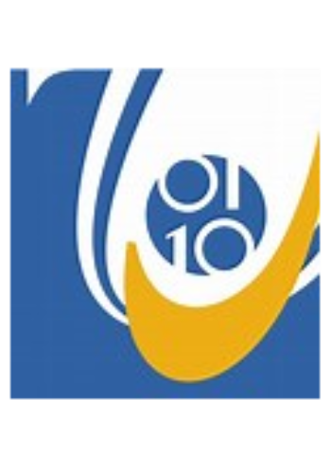

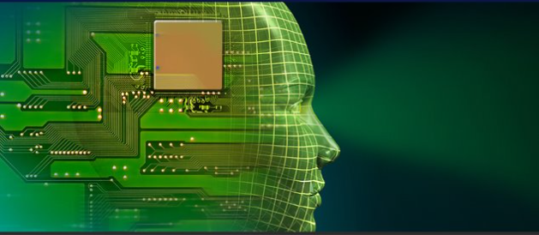
Fighting Covid-19:
Detection of facemask wearing
Senior Project
Ali Al Hadi Ayache
Third year – English
2020-2021
Supervised by:
Dr. Rola El Osta
Jury:
Dr. Mohamad Khatib
Dr. Tamim Fltiti
Dr. Michel Khoury
Dr. Anis Ismail
14/07/2021

Slide 2
Contents
Objectives................................................................................2
Background Material ...….......................................................3
YOLO: You Only Look Once ……….…………………….4
Face Mask Detection...............................................................6
Model………………………………..………………………7
Experimental Platform ..………………………………….…8
Methodology…………………………………...…………..11
Results …..............................................................................12
Conclusion and Future Works...............................................13

Slide 3
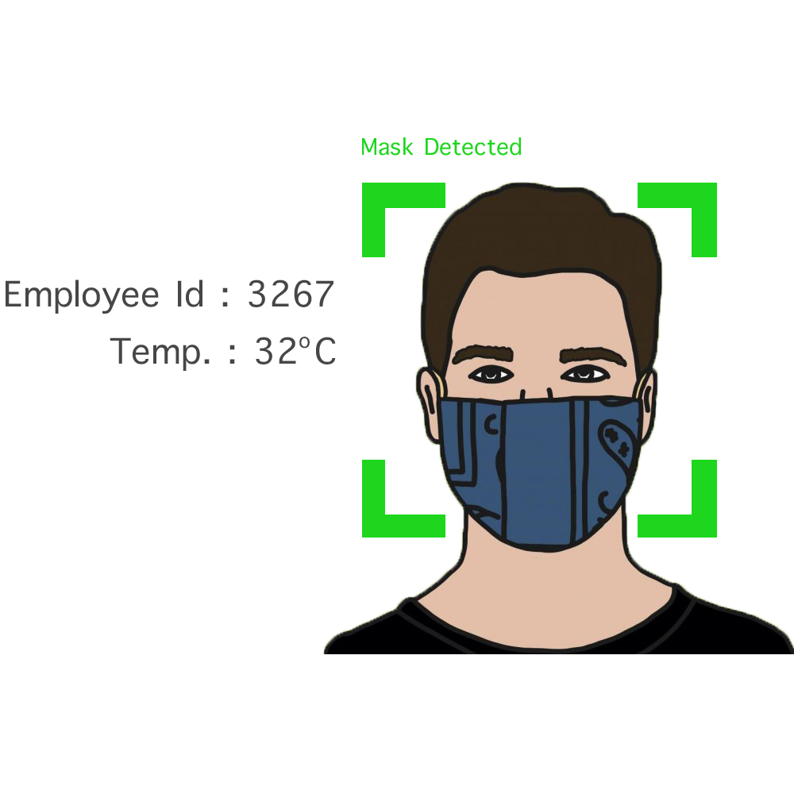
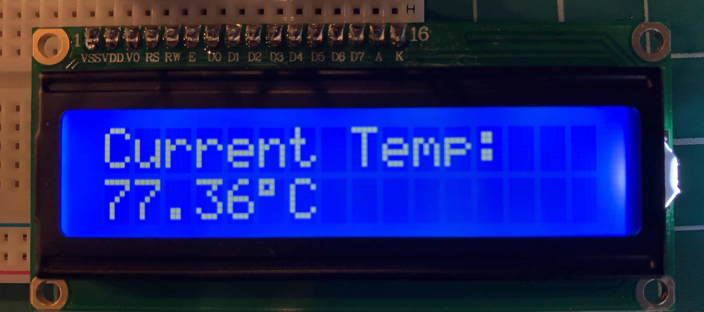
Objectives
To study face detection and recognition techniques.
To design a system that can detect and recognize faces wearing a mask or not in real time in the pandemic days.
To measure body temperature measurement.
To simulate and obtain results using OpenCV with Python.
To implement the system on Arduino.
Wearing a face mask during this pandemic is a critical defensive in times when social distancing is hard to maintain.
2

Slide 4
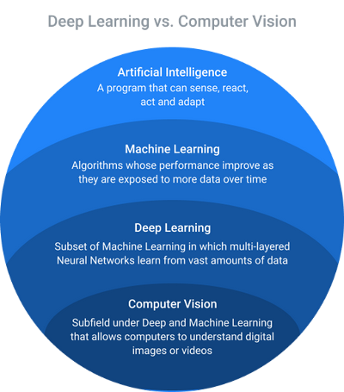
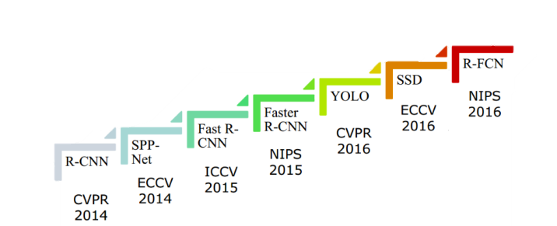
Background Material
computer-vision-versus-deep-learning-AI-400
object detection algorithms
3

Slide 5
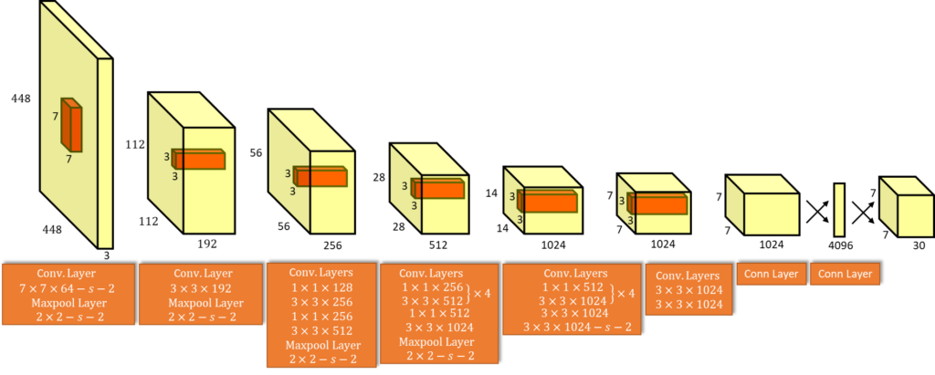
YOLO:You Only Look Once
YOLO-Algorithm
The YOLO framework (You Only Look Once) on, deals with object detection in a different way.
The biggest advantage of using YOLO is its super speed – it’s incredibly fast and can process 45 frames per second. YOLO also understands generalized object representation.
4

Slide 6
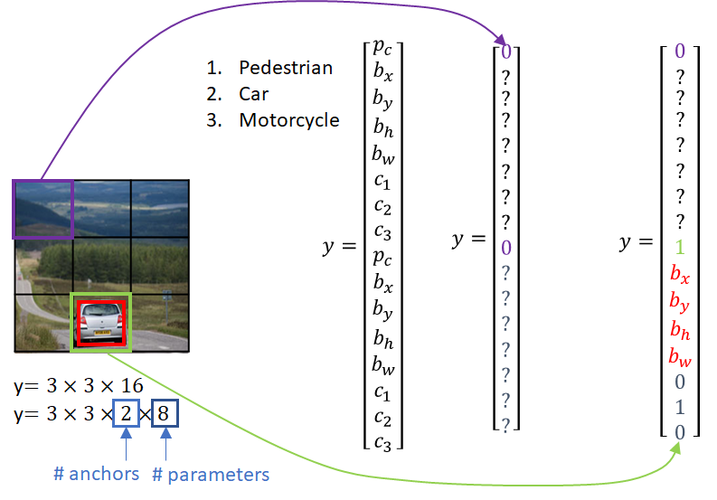
YOLO:You Only Look Once
YOLO-Design
It takes the image in a single instance and predicts the bounding box coordinates and class probabilities for these boxes.

Slide 7
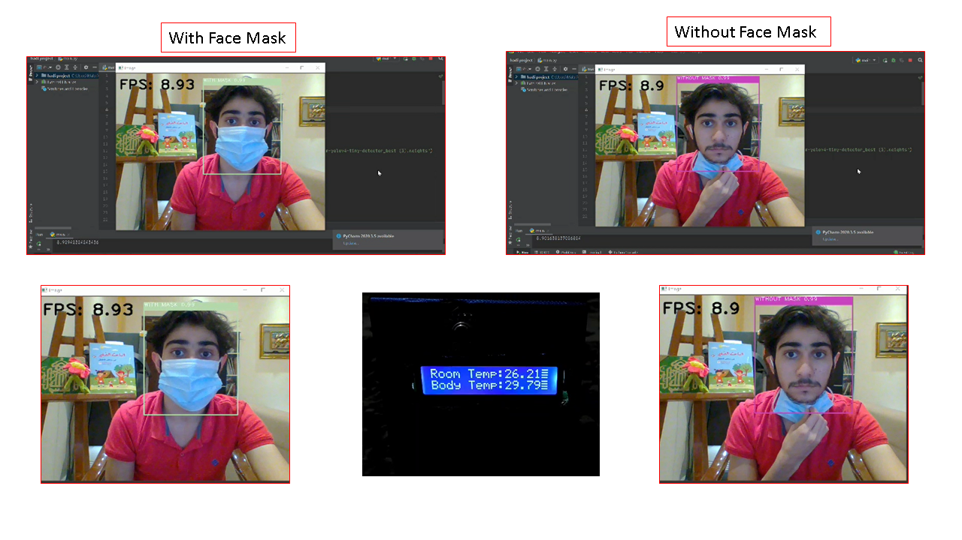
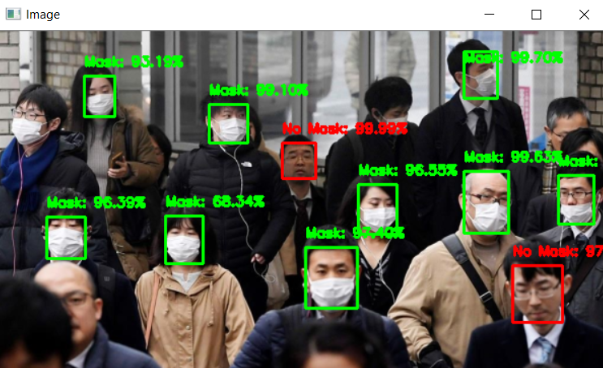
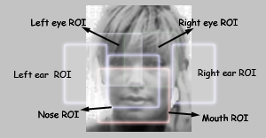
Face Mask Detection
ROI face detection
6

Slide 8
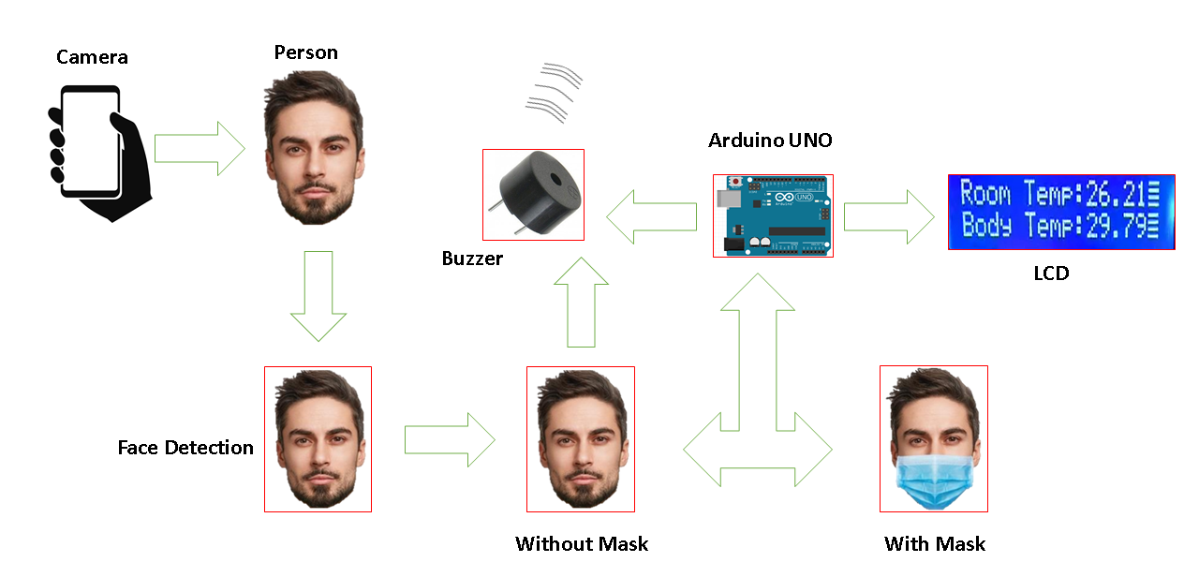
Model
7

Slide 9

Experimental Platform
Tools and Technology
Operating System: Windows 10, 64 bit
Hardware: 4 GB-RAM, Webcam
Programming Language: Python
Computer Vision Library: OpenCV
8

Slide 10
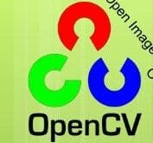
Experimental Platform
Software
We used OpenCV-Python to implement the project.
OpenCV-Python is a library of python bindings designed to solve computer vision problems.
OpenCV-Python utilizes NumPy.
NumPy is a highly optimized library for numerical operations.
All the Open-CV array structures are converted to and from NumPy arrays.
PySerial is a library for make connection between Python and Arduino.

Slide 11
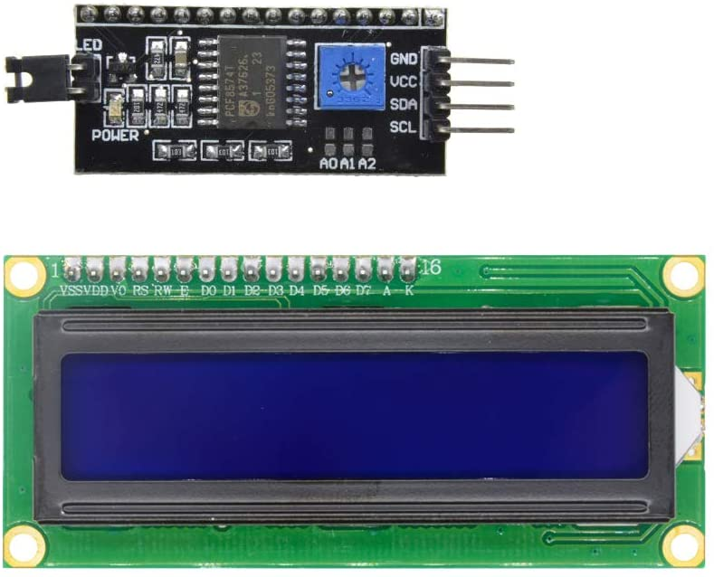
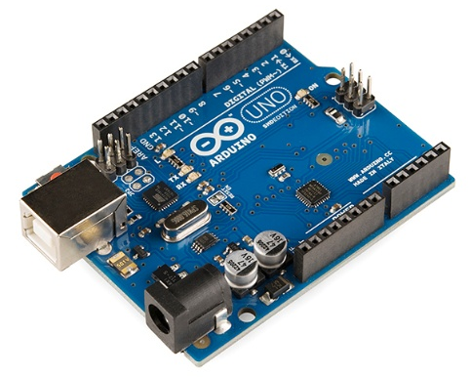
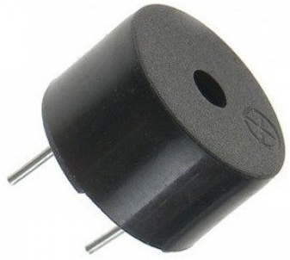
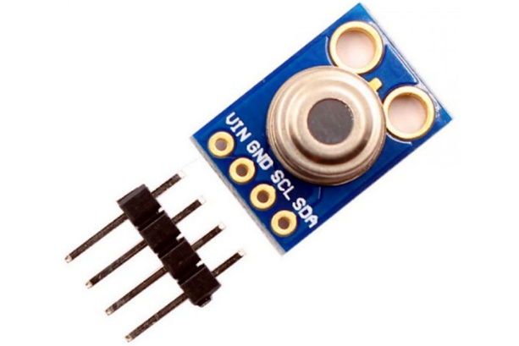

Experimental Platform
LCD 2ic
Arduino UNO
Buzzer
Mlx90614 Sensor
IP Webcam

Slide 12
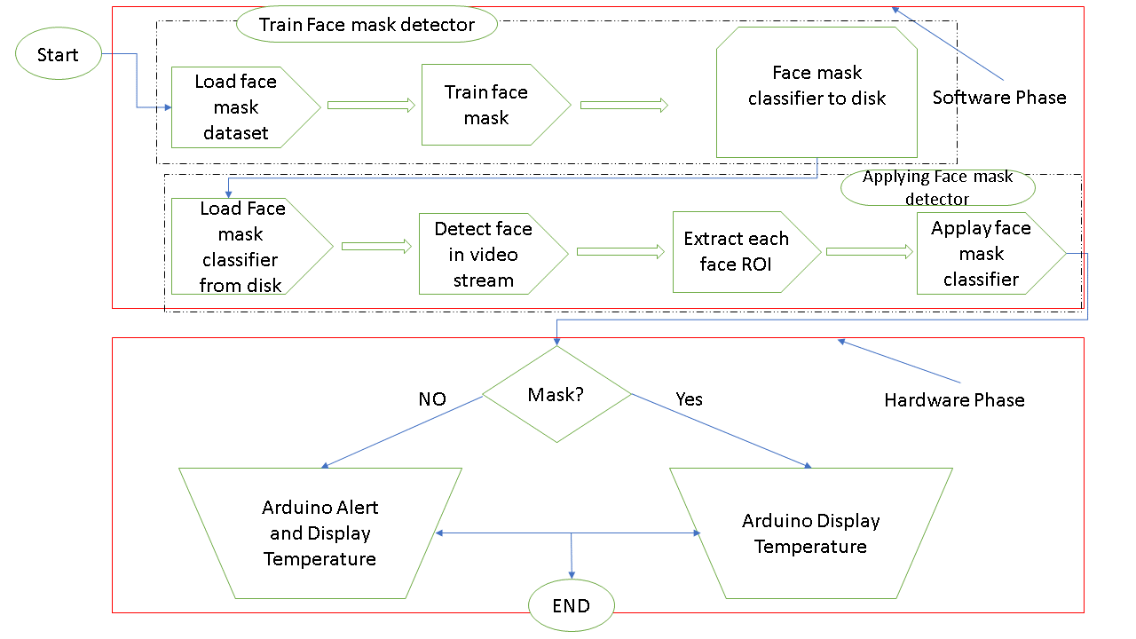
Methodology
11

Slide 13
Results
12

Slide 14
Conclusions
We used yolov4-tiny to detect whether people were wearing face masks or not.
We can used it in hospital, mall when social distancing is hard to maintain.
The model was tested with images and real-time video streams.
Even though the accuracy of the model is around 80%, the optimization of the model is a continuous process
13

Slide 15
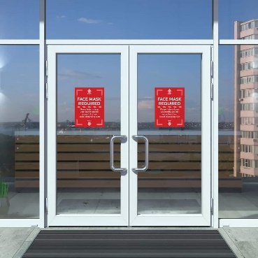
Future Works
We can upgrade this application and merge it with many different systems, e.g. open the door of a mall.
We can improvement this project to give ability for more classes like error in mask example mask under nose.

Slide 16
Thank You for your attention! I would be glad to answer your questions.

