Slide 1
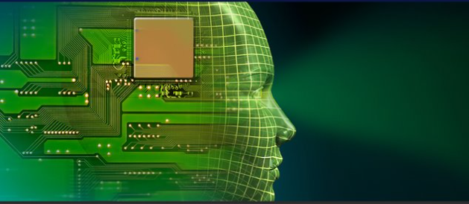
Driver Drowsiness Detection
ADVP Project
Ali Al Hadi Ayache
17/05/2022

Slide 2
Contents
Objectives................................................................................2
Background Material ...….......................................................3
CNN:Convolution Neural Network…………………………4
YOLO: You Only Look Once ……….……………….……..5
Face Detection........................................................................6
Model………………………………..………………………7
Experimental Platform ..………………………………….…8
Methodology…………………………………...…………..11
Results …..............................................................................12
Conclusion and Future Works...............................................13

Slide 3
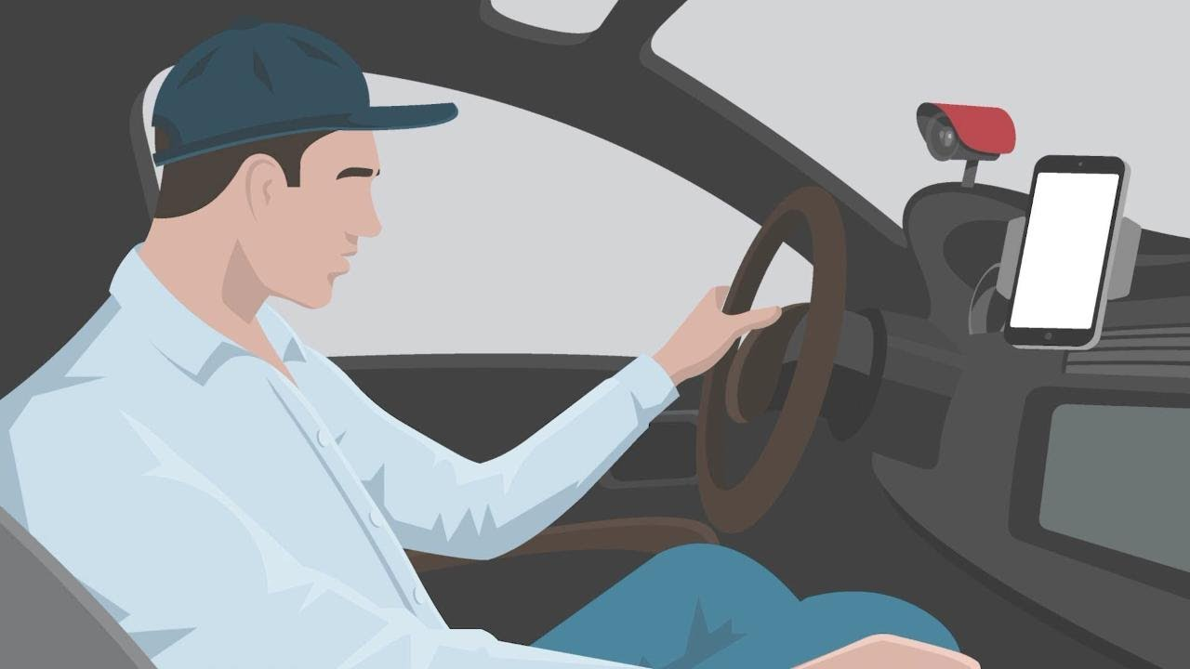
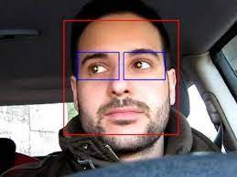
Objectives
To study eyes detection and recognition techniques.
To design a system that can detect and recognize open or closed eyes not in real time
To implement the system on Arduino.
The method attains accuracy up to 97.80%
2

Slide 4
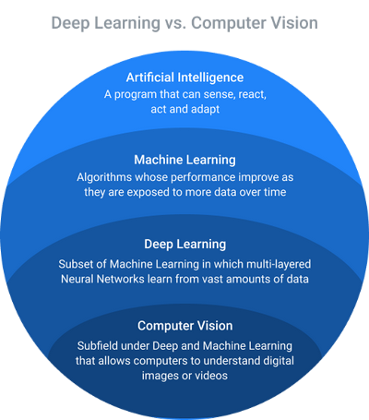
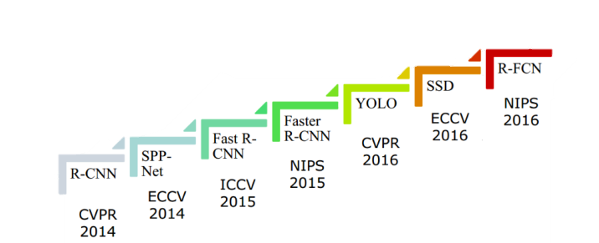
Background Material
computer-vision-versus-deep-learning-AI-400
object detection algorithms
3

Slide 5
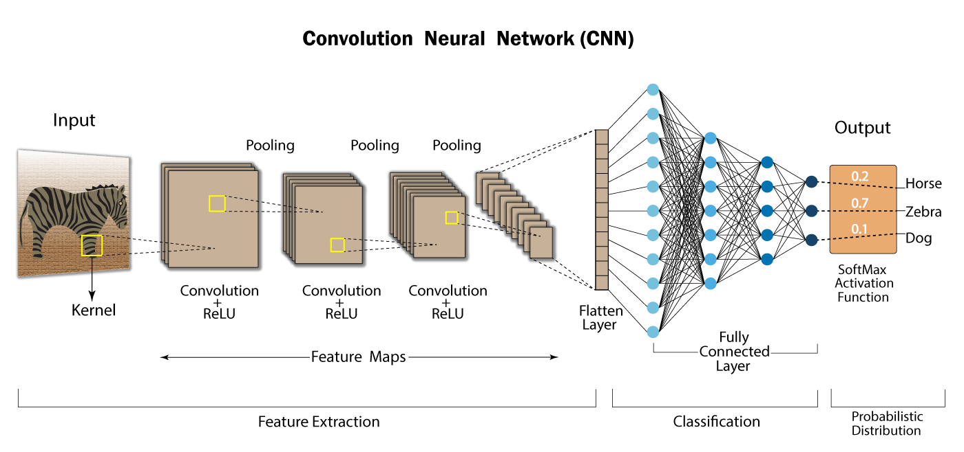
CNN:Convolution Neural Network
4

Slide 6
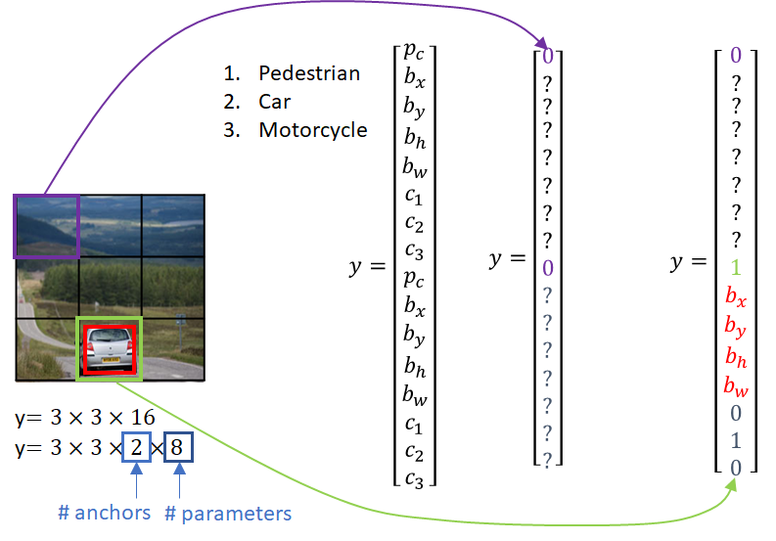
YOLO:You Only Look Once
YOLO-Design
It takes the image in a single instance and predicts the bounding box coordinates and class probabilities for these boxes.
The biggest advantage of using YOLO is its super speed – it’s incredibly fast and can process many frames per second. YOLO also understands generalized object representation.
5

Slide 7
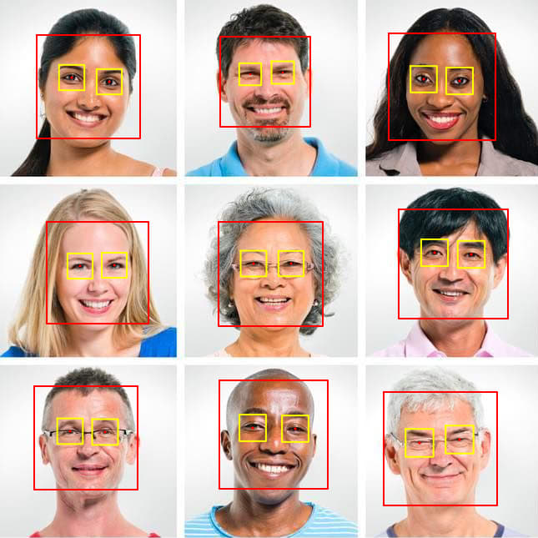
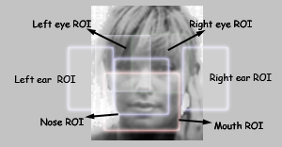
Face Detection
ROI face detection
6

Slide 8
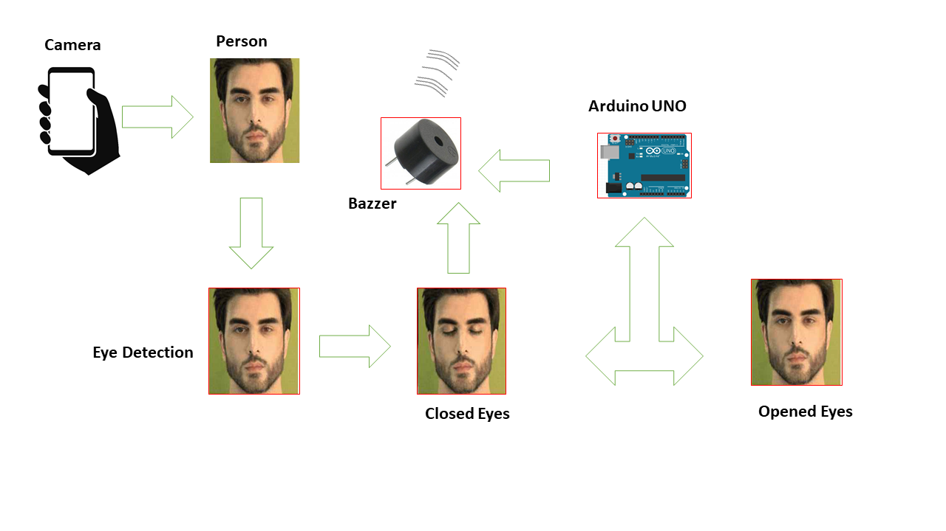
Model
7

Slide 9

Experimental Platform
Tools and Technology
Operating System: Windows 10, 64 bit
Hardware: 8 GB-RAM, Webcam-Arduino
Programming Language: Python-C
Computer Vision Library: OpenCV
8

Slide 10
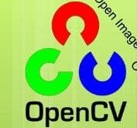
Experimental Platform
Software
We used OpenCV-Python to implement the project.
OpenCV-Python is a library of python bindings designed to solve computer vision problems.
OpenCV-Python utilizes NumPy.
NumPy is a highly optimized library for numerical operations.
All the Open-CV array structures are converted to and from NumPy arrays.
PySerial is a library for make connection between Python and Arduino.

Slide 11
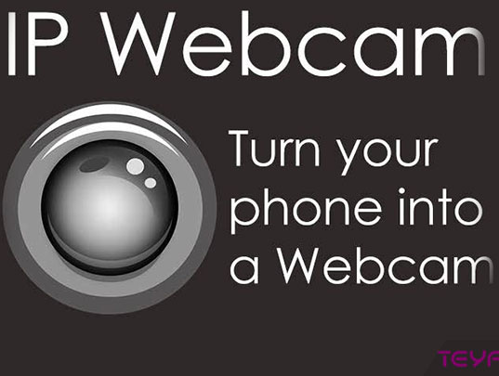
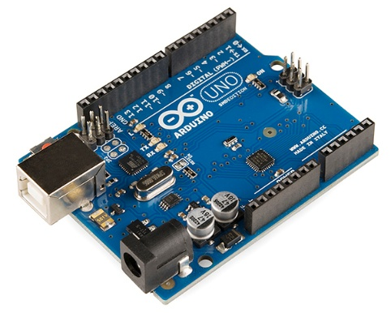
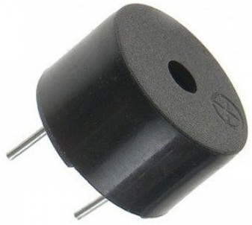
Experimental Platform
IP Webcam
Arduino UNO
Buzzer

Slide 12
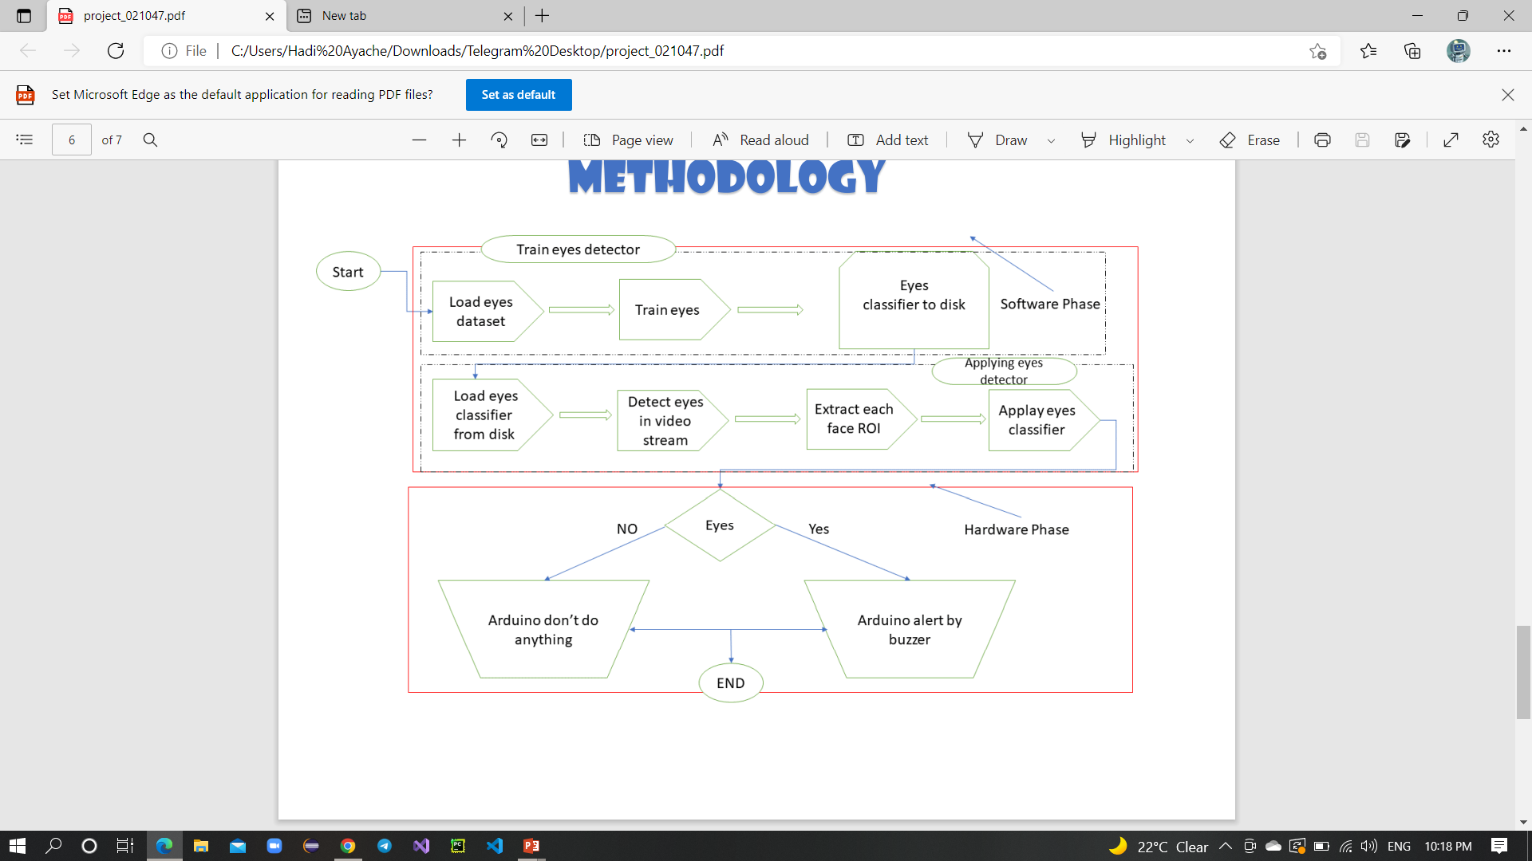
Methodology
11

Slide 13
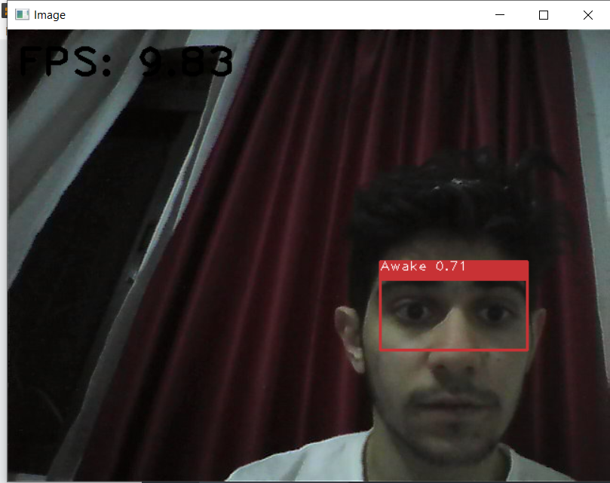
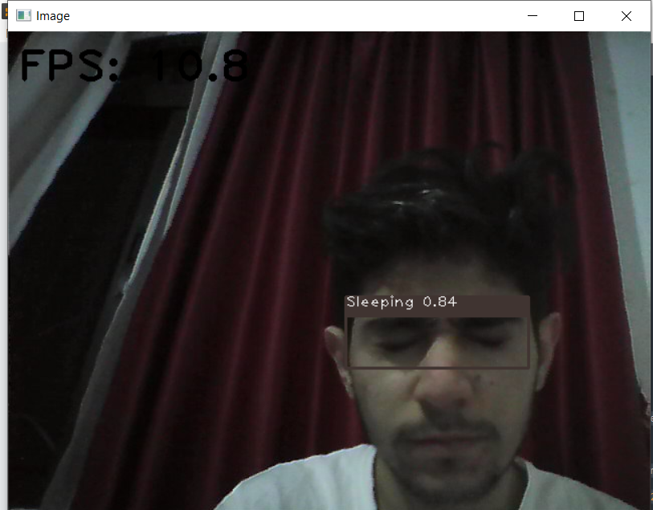
Results
AWAKE
SLEEPING
12

Slide 14
Conclusions
We used yolov4-tiny to detect whether people were detect closed-open eyes.
We can used it in car or train.
The model was tested with images and real-time video streams.
Even though the accuracy of the model is around 80%, the optimization of the model is a continuous process
13

Slide 15
Future Works
We can improve this project to give ability for more classes, if a guy is having only one eye open.
We can upgrade this application with self driven cars that can handle the situation.
We can add emergency call if the person does not wake up.

Slide 16
Thank You for your attention! I would be glad to answer your questions.

