Slide 1
Face Morphing
Ali Al Hadi Ayache
06/01/2023

Slide 2
Objectives
To blending the images of two faces together.
Extract fabricated facial image that contains features of the two original faces.
Trying to get the best result.

Slide 3
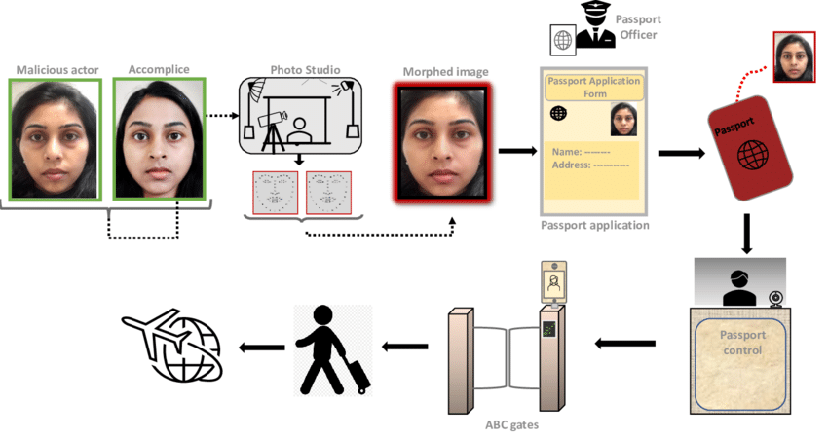
What are the risk?
It could open the door to a flood of fraudulently obtained but genuine (FOG) passports.

Slide 4

Experimental Platform
OpenCV-Python
NumPy
dlib

Slide 5
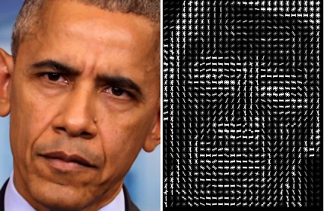
Image Detection
HOG algorithm
Face detection using histogram of oriented gradients.
dlib.get_frontal_face_detector()

Slide 6
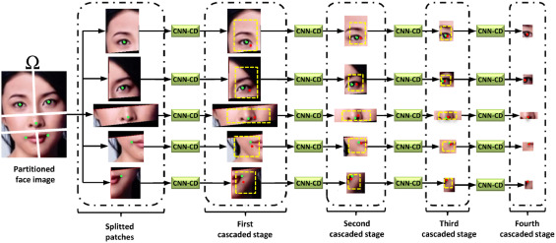
Image Detection
CNN
Feature extraction using land mark detection
dlib.shape_predictor(“shape_predictor_68_face_landmarks.dat”)

Slide 7
Image Process
OpenCV
OpenCV is a huge open-source library for the computer vision, machine learning, and image processing.
cv2.subdiv2d
cv2.getAffineTrasform and cv2.warpAffine

Slide 8
Methodology
Start
Input two Photos
Find Point Correspondences using Facial Feature Detection
Delaunay Triangulation
Warping images and alpha blending
Alpha
Alpha=1
Second Photo
Alpha btw(0-1)
Morphed
Alpha=0
First Photo

Slide 9
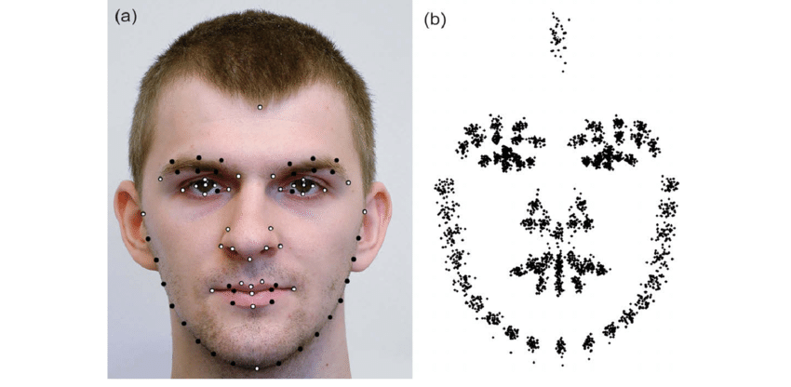
Facial landmark detection
Face landmark estimation is where we identify key points on a face, such as the tip of the nose and the center of the eye.
we've located the eyebrows, eyes, nose, lips, and chin line. And because the points are predefined, we should already know which of the points make up the eyes .

Slide 10
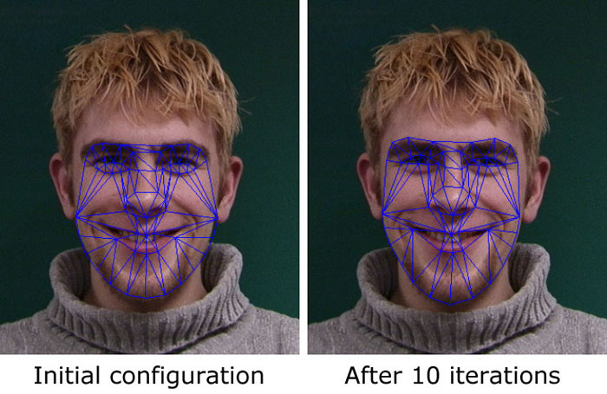
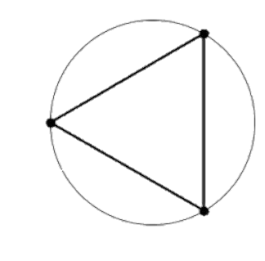
Delaunay Triangulation
The Delaunay technique constructs triangular meshes among all landmarks and is an efficient method for analyzing facial emotions . While the mesh composition only indicates whether edges are connected, we include the squared exponential kernel, radial basis function (RBF).
All triangles in the mesh produce a circumcircle which does not contain any other vertices from the mesh except for the three vertices that define the triangle.

Slide 11
Warping images and alpha blending
Find location of feature points in morphed image
Calculate affine transforms
Warp triangles
Alpha blend warped images

Slide 12
Naïve Algorithm
(x, y) = (1 - α) M (x, y) + α N (x, y)
Where I = Intermediate image
M = Original image
N = Target image
SM = {m1, m2, m3, ….., mk} and SN = {n1, n2, n3, ….., nk}
We obtain another set of point SI = {i1, i2, i3, ….., ik}, where,
ik = (1 - α) mk + α nk
Select a triangle T from the image M, its corresponding triangle V in the intermediate image I, and calculate the affine transform that converts the triangle T to V. inbuilt function getAffineTransform, in OpenCV, to obtain the transformation matrix.
Similarly, we calculate the transformation matrix of the corresponding triangle W in the image N to the triangle V.
Now we apply the transformations so obtained to all the triangles of both the images M and N, to obtain warped images M’ and N’ .
I (x, y) = (1 - α) M’ (x, y) + α N’ (x, y)

Slide 13
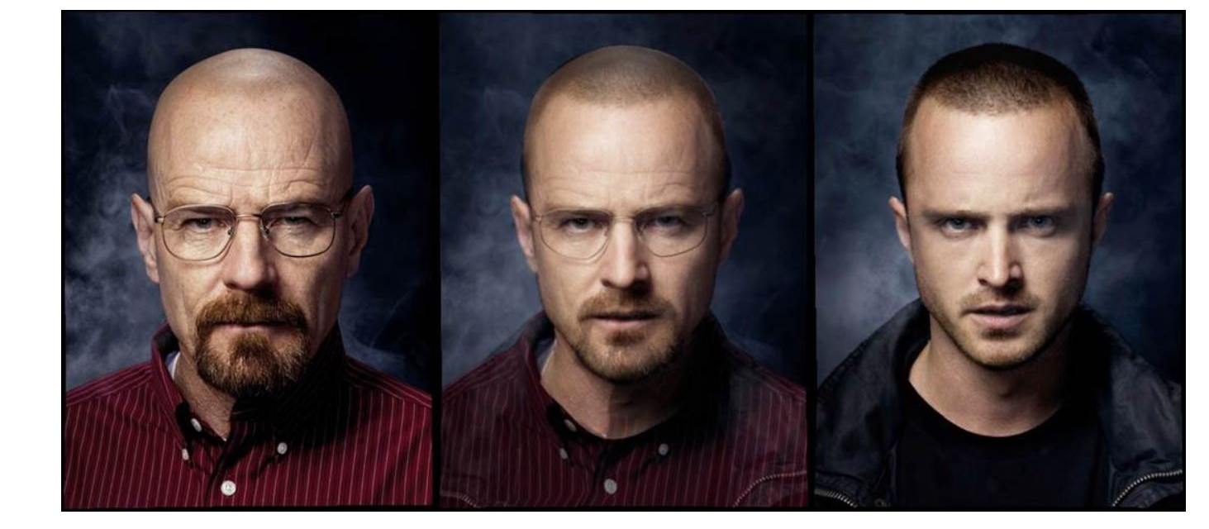
Results

Slide 14
Conclusion
We Extract image that contains features of the two original faces.
We used dlib library to detect Facial landmark
We used image processing for Delaunay Triangulation
Morphing face contain risk as example it could open the door to a flood of fraudulently obtained but genuine (FOG) passports.

Slide 15
Upgrade
Apply face morphing on video meetings

Slide 16
Future Works
Use the results to test face morphing attack detections accuracy.

