Slide 1
Improving Generative Ad Text on Facebook using Reinforcement Learning
course: Natrual language processing
student name: hadi fathipour
student number: 40411334

Slide 2
Literature Review
Overview of the Research Area
Recent advances in Natural Language Processing have shown that pre-trained large language models (LLMs) require an additional post-training or alignment phase in order to perform well on real-world tasks.
This line of research includes methods such as Supervised Fine-Tuning (SFT), Reinforcement Learning from Human Feedback (RLHF), and more recently, Reinforcement Learning using performance-based signals.
The common goal of these approaches is to align model outputs with downstream objectives that are not fully captured by likelihood-based training alone.

Slide 3







problem definition
what is the purpose in a ad text generation problem ?
what is a good language model ?
how to increase CTR ?
  CTR is behavioral and not lingual
  CTR has lots of noise
a text near to human language or high CTR ?
can we just use traditional supervised fine-tuning to increase CTR ?
should CTR be increased or perplexity ?
(modern vs old attitude approach)
can we just use traditional supervised fine-tuning to increase CTR ? (RLHF)

Slide 4

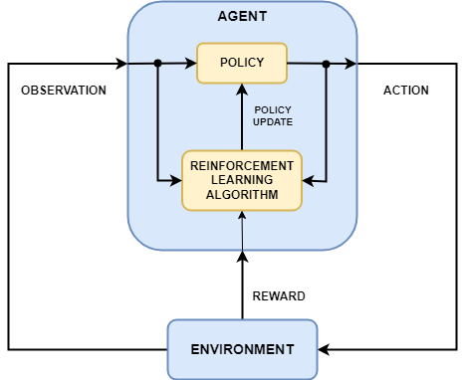


solution: use reinforcement learning (RLPF)
reward:
CTR = num of clicks / impression
policy: LLM model
sth that estimates CTR for a given text (P(CTR|txt))
enviroment:
social media and user interaction

Slide 5
Paper 1 (Survey / Foundational Work)
Ouyang et al., 2022
“Training Language Models to Follow Instructions with Human Feedback”
Main idea:
This work introduces the RLHF framework, where human preference data is used to train a reward model, and the language model is further optimized using reinforcement learning (PPO).
Strengths:
  Establishes a general alignment framework for LLMs
  Produces high-quality and controllable outputs
  Forms the foundation of systems such as ChatGPT
Weaknesses:
  Requires large amounts of costly human annotations
  Human feedback is subjective and noisy
  Limited scalability to domains with clear objective metrics
Relevance:
  This paper provides the theoretical and methodological foundation upon which later RL-based alignment methods are built.

Slide 6
Paper 2 (Post-2022 Research Paper)
Deng et al., 2022
“RLPrompt: Optimizing Discrete Text Prompts with Reinforcement Learning”
Main idea:
This paper applies reinforcement learning to optimize discrete text prompts rather than model parameters, treating prompt selection as a policy optimization problem.
Strengths:
  Demonstrates the effectiveness of RL for discrete text optimization
  Reduces reliance on labeled training data
Weaknesses:
  Focuses on prompt optimization, not full text generation
  Evaluated only in controlled experimental settings
Relation to the main paper:
RLPrompt shows that reinforcement learning can successfully optimize text-based decisions, but it does not use real-world user behavior as feedback.

Slide 7
Paper 3 (Earlier Research on RL for Text Generation)
Shi et al., 2018
“Toward Diverse Text Generation with Inverse Reinforcement Learning”
Main idea:
This work uses Inverse Reinforcement Learning (IRL) to learn a reward function for text generation, with the goal of improving diversity and quality.
Strengths:
  Early introduction of reinforcement learning into text generation
  Focuses on learning reward functions rather than hand-designed metrics
Weaknesses:
  Small-scale datasets
  No real-world or industrial evaluation
Relevance:
This paper highlights the potential of RL-based approaches for text generation but lacks practical validation.

Slide 8
Paper 4 (Analytical / Critical Perspective)
Ramamurthy et al., 2022
“Is Reinforcement Learning (Not) for Natural Language Processing?”
Main idea:
This paper critically analyzes when reinforcement learning is suitable for NLP tasks and discusses challenges such as reward design, instability, and evaluation difficulties.
Strengths:
  Provides a systematic analysis of RL challenges in NLP
  Offers a conceptual framework for understanding RL applicability
Weaknesses:
  Does not propose a large-scale applied solution
  Mainly theoretical and analytical

Slide 9
Paper 5
Jiang et al., 2025
“Improving Generative Ad Text on Facebook using Reinforcement Learning”
Main contribution:
Introduces Reinforcement Learning with Performance Feedback (RLPF)
Uses real user behavior (CTR) as the reward signal
Evaluates the model through a large-scale A/B test in a real production system
Strengths:
  Uses large-scale real-world data
  Demonstrates measurable business impact (+6.7% CTR)
  Represents one of the largest real-world evaluations of generative AI
Limitations:
  Uses offline reinforcement learning
  Optimizes a single metric (CTR)
  Does not explicitly model creativity or advertiser intent
A/B Test real:
35,000 advertiser
10 week
640,000 ads
results:
  +6.7٪ increase in CTR
  +18.5٪ in ad variation

Slide 10
future works
  Online Reinforcement Learning
  combination of CTR + Creativity
  the use of ad-provider in reward modification
  generalizable to :
    Customer Support
    Education
    Public Messaging

Slide 11
thanks for your attention 🌹

