Slide 1

Detecting Cardiovascular Disease from a Routine Check-up
Patient's Sickness Prediction · 70,000 medical examinations
Hadi Ghazi
Lebanese University
Notes:
Good morning. My project is topic two, patient's sickness prediction. The question is simple: from the values a doctor records at a routine check-up, can a model tell whether a patient has cardiovascular disease? And just as important: how good is it really, compared with what doctors already use?

Slide 2
Why this matters
OBJECTIVE
Build a model that detects cardiovascular disease from one examination, and measure honestly how good it is
17.9 million
Q1 · What does machine learning add?
Compared with a blood-pressure rule and a standard risk score
deaths a year from cardiovascular disease, the world's leading cause of death (WHO)
Q2 · How much does data handling matter?
Cleaning, and the mistakes that inflate accuracy
Many could be delayed if patients at risk were found early, at an ordinary check-up.
Q3 · Can the predictions be trusted?
Calibration, explanations, every kind of patient
Notes:
Cardiovascular diseases are the world's leading cause of death: about 17.9 million people a year. Many of those deaths can be delayed if patients at risk are found early. So the objective is a model that uses one examination's values to detect the disease. Three questions guide the evaluation. First, what does machine learning add over what a doctor already has: a blood-pressure threshold and a standard risk score? Second, how much do data-handling choices change the result? Third, can the predictions be trusted?

Slide 3
The data: 70,000 check-ups
70,000
11
50 / 50
patients
values per examination
with and without CVD
Measured
Lab result, 3 levels
Self-reported, yes / no
age
sex
cholesterol
glucose
smoking
alcohol
height
weight
physical activity
systolic pressure
diastolic pressure
Kaggle cardiovascular disease dataset (Ulianova, 2019). Its source and the definition of "disease" are not documented.
Notes:
The dataset has seventy thousand patients. For each, eleven values: age, sex, height, weight, the two blood-pressure readings, cholesterol and glucose in three levels, and three yes-or-no answers about smoking, alcohol and physical activity. Half the patients have cardiovascular disease. Two warnings from the start: we don't know where the data comes from, and we don't know how disease was defined. I come back to both at the end.

Slide 4
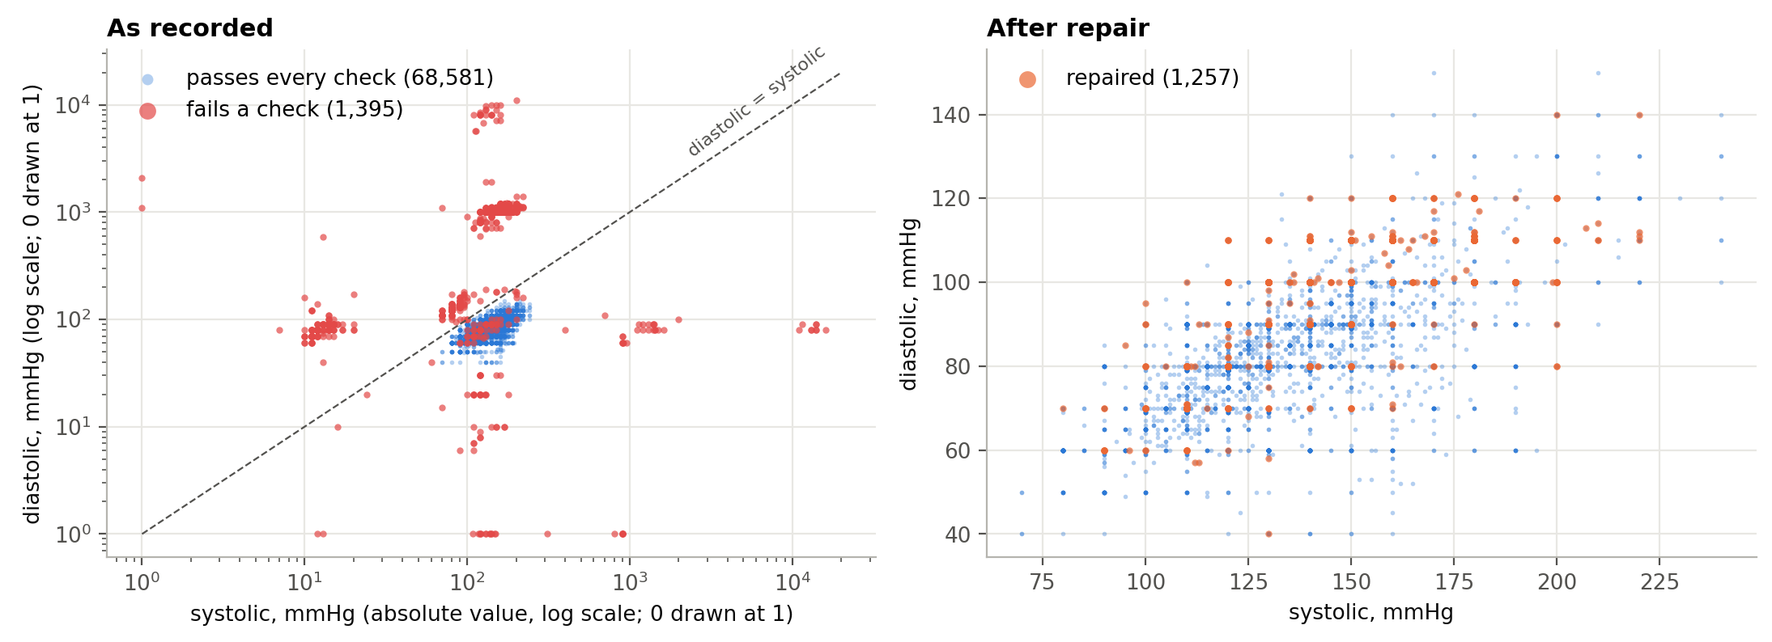
2% of the records are impossible
TYPING ERRORS WITH A PATTERN
1000 → 100
an extra zero
12 → 120
cmHg instead of mmHg
−120 → 120
a stray minus sign
80/120 → 120/80
the two readings swapped
r = 0.05
r = 0.43
How closely systolic pressure tracks the diagnosis, before and after cleaning
Notes:
The first finding came before any model. About two percent of the records hold blood pressures no living person can have: sixteen thousand, minus one hundred and fifty, zero. They are not random. Most are typing errors with a pattern: an extra zero, centimetres of mercury instead of millimetres, a stray minus sign, or the two readings swapped. I compared dropping these records with repairing them by rule. Either way the effect is dramatic: in the raw data systolic pressure barely correlates with the diagnosis, 0.05. After cleaning it is the strongest predictor, 0.43.

Slide 5
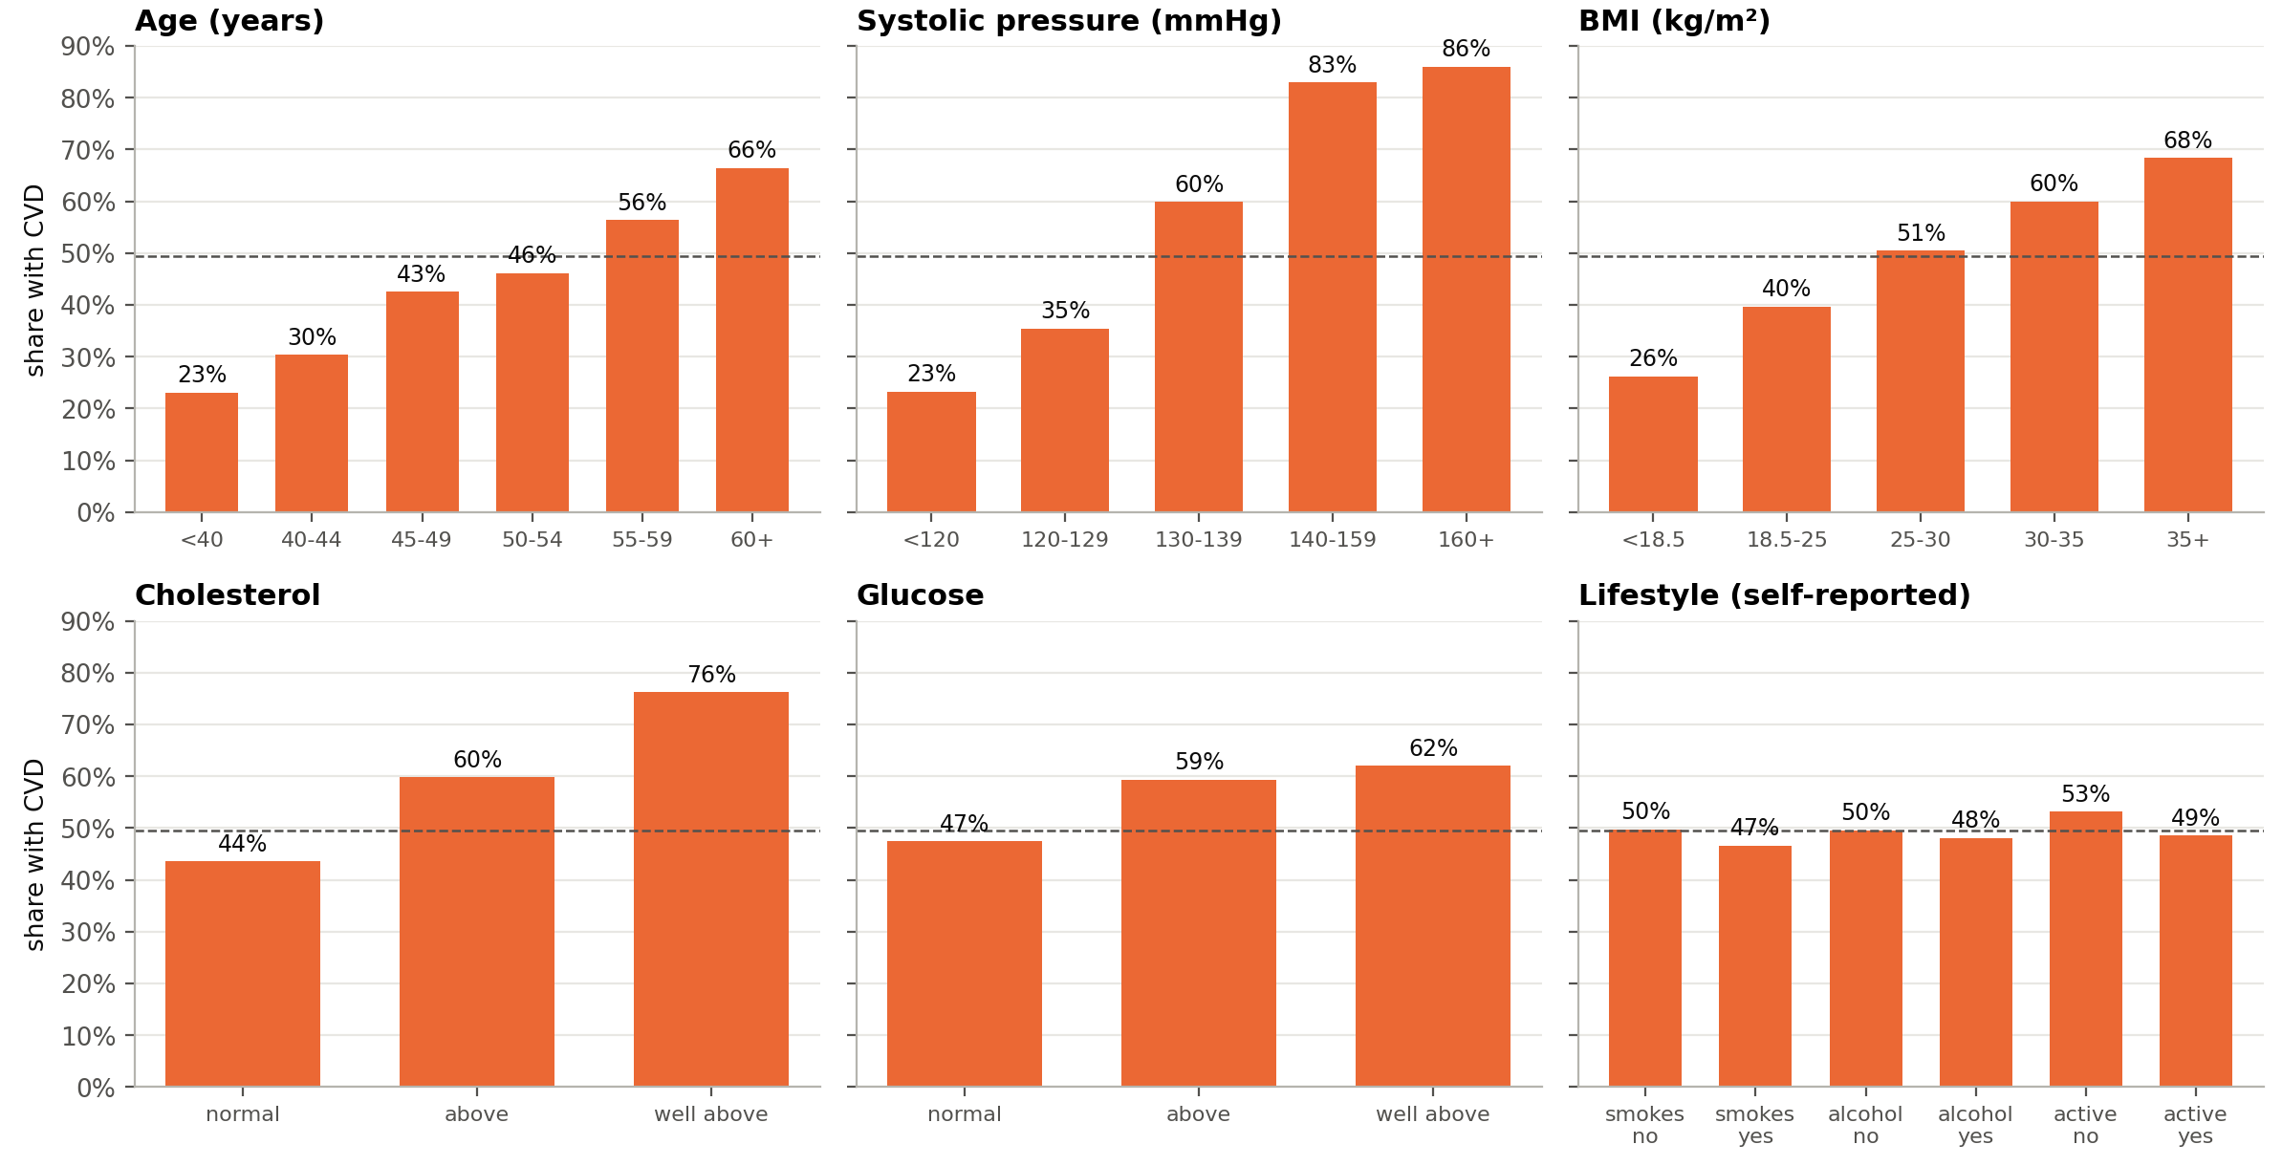
What the clean data shows
Notes:
Here is the clean data, on the training patients only. The disease rate climbs steadily with systolic pressure, from about a quarter below 120 to 86 percent at 160 and above. It almost triples with age, rises with weight, and three quarters of patients with very high cholesterol have the disease. The lifestyle answers barely move it, and two point the wrong way: smokers and drinkers have slightly less disease.

Slide 6
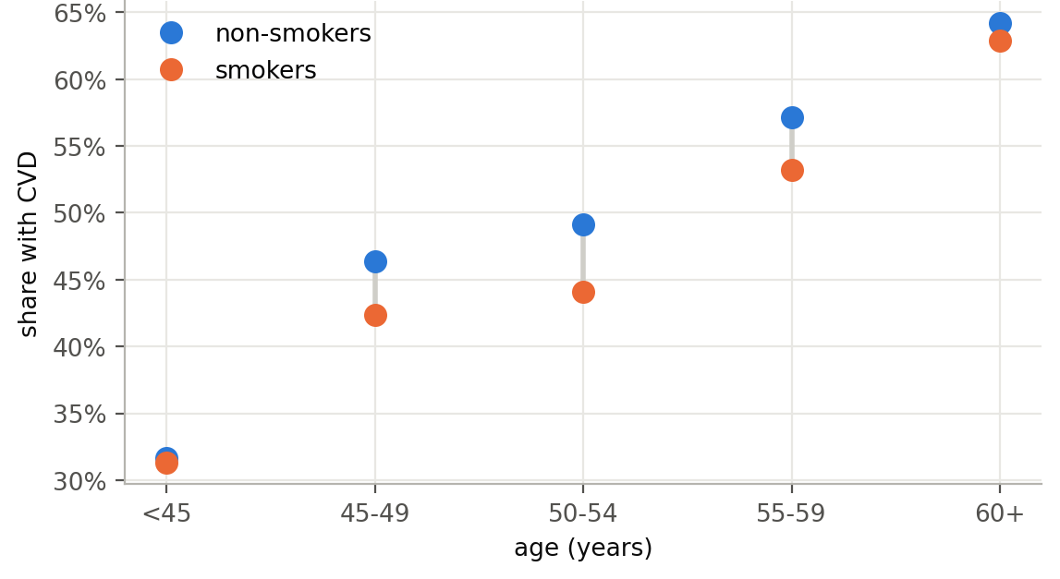
The smoking paradox
The sick quitter
Diagnosis and answers come from the same visit. Patients already diagnosed have usually been told to quit, so they answer "no".
Detection, not prediction
Associations, not causes
Men only: women hardly smoke in this data (1.8% vs 22% of men)
Notes:
That is the smoking paradox. Smoking causes heart disease, so I checked for a confounder. Almost only men smoke in this data, so I compared within men, age group by age group. The paradox survives: smokers have less disease at every age. The likely reason is how the data was collected. Diagnosis and answers come from the same visit, and patients who were diagnosed have usually been told to quit. Two consequences: this is detection of existing disease, not prediction of future disease, and every effect we find is an association, not a cause.

Slide 7
What machine learning adds
Gradient boosting
73.6% AUC 0.804
Random forest
73.4% AUC 0.803
Neural network
73.4% AUC 0.803
Logistic regression
72.6% AUC 0.793
Points score (4 factors)
72.3% AUC 0.793
Rule: systolic ≥ 130
71.3% AUC 0.712
Framingham, as published
64.6% AUC 0.693
50%
75%
100%
Accuracy on 13,722 test patients never used for training or tuning
Notes:
Now the models. Everything was tuned with five-fold cross-validation on the training patients, and these accuracies are on 13,722 test patients the models never saw. At the bottom, the Framingham score as published: 64.6 percent. It was built for a different question, a first event within ten years, and it does not transfer. The guideline rule, systolic at least 130, already gets 71.3. Logistic regression 72.6. Random forest, the neural network and gradient boosting are tied, around 73.5. The best is gradient boosting: 73.6 percent, AUC 0.804. Machine learning helps, but by about two points.

Slide 8
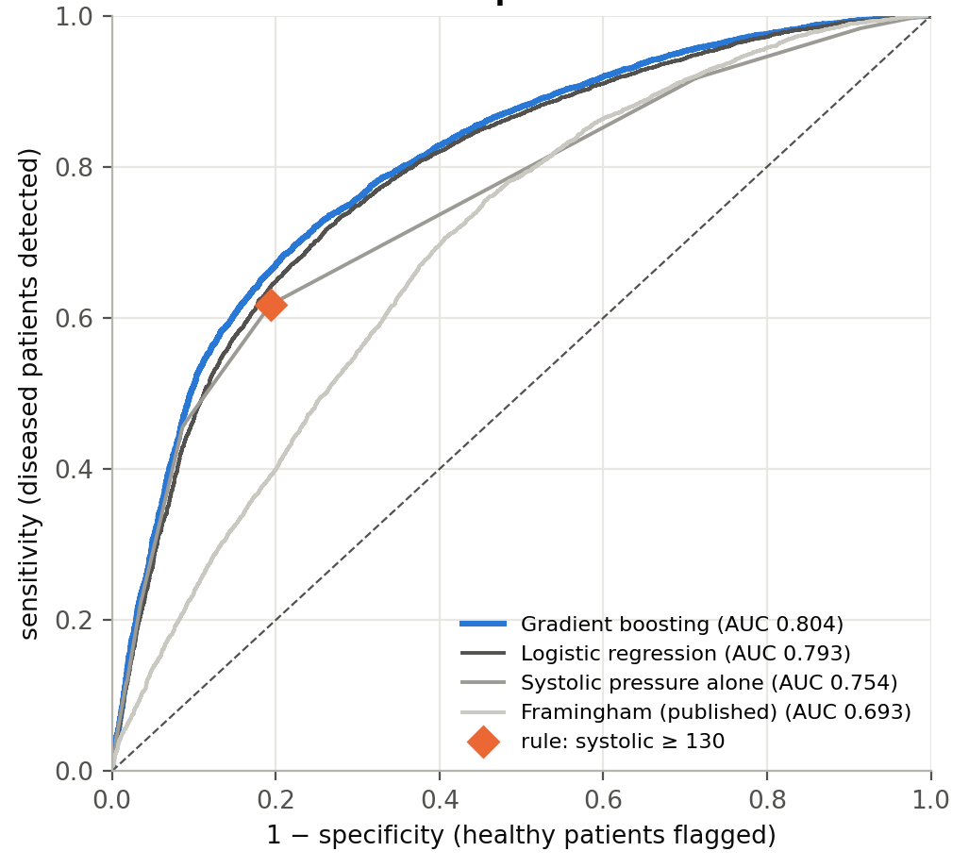
On patients the model has never seen
0.804
ROC AUC (95% CI 0.797-0.811)
73.6%
accuracy, as in cross-validation
+301
diseased patients found, at the rule's specificity
Notes:
On unseen patients, gradient boosting reaches an AUC of 0.804, with a confidence interval from 0.797 to 0.811, and 73.6 percent accuracy, the same as in cross-validation, so it did not overfit. The most concrete way to see the gain: at exactly the rule's specificity, the model finds 301 more of the 6,785 diseased patients. And the learning curve is flat, so more data of the same kind would not help: the ceiling is set by what the examination records.

Slide 9
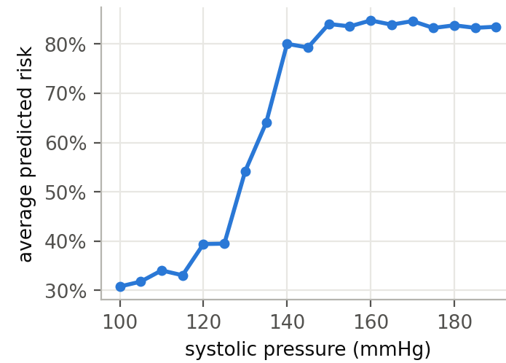
What drives the prediction
blood pressure
0.210
age
0.036
cholesterol
0.030
body size
0.007
physical activity
0.002
glucose
0.002
smoking
0.001
alcohol
0.001
sex
0.000
A switch, not a slope: predicted risk jumps from about 35% to 84% between 125 and 150 mmHg, at the guideline's thresholds.
Drop in test AUC when a factor is scrambled. Blood pressure dominates; glucose, the lifestyle answers and sex add almost nothing.
Notes:
What does the model rely on? Scramble the blood-pressure features and the AUC drops by 0.21. Age and cholesterol follow, at 0.036 and 0.030. Glucose, the lifestyle answers and sex add almost nothing. The shape matters too: predicted risk stays around a third below 125, jumps to 84 percent by 150, and then stays flat. It works like a switch at the guideline's thresholds, which is exactly what a straight-line model cannot capture.

Slide 10
A score a doctor can add up
Age
(years)
<45
45-49
50-54
55-59
60+
0
4
5
8
11
Systolic pressure
(mmHg)
<120
120-129
130-139
140-159
160+
0
5
13
25
27
BMI
(kg/m²)
<25
25-29.9
30-34.9
35+
0
2
3
4
Cholesterol
normal
above
well above
0
3
9
0 points → 13% · 10 points → 28% · 20 points → 52% · 30 points → 74% · 40 points → 89%
AUC 0.793 on the test patients, against 0.804 for the best model. The lifestyle answers are left out: they would earn negative points.
Notes:
Since the gains are small, I also built something a doctor can use with a pen. Four factors, and each band earns whole points: age, systolic pressure, BMI and cholesterol. I left out the lifestyle answers, because in this data they would earn negative points, and no one can hand out a score that rewards smoking. Add up the points and the total maps to a risk. This card reaches an AUC of 0.793, the same as logistic regression on all fifteen features, and only 0.011 below the best model.

Slide 11
How 90% accuracy happens
Honest: unseen patients
73.6% gradient boosting
Luckiest of 50 random splits
73.4%
SMOTE before the split
86.7%
Scored on its own training data
99.9%
50%
75%
100%
88% (Omkari 2024)
94.5% (Zafar 2026)
Same data, same models; only the evaluation changes. Red markers: accuracies published for this dataset.
Notes:
Back to the second question. Papers on this same dataset report 88 and even 94.5 percent. I reproduced three common mistakes. Choosing the luckiest of 50 random splits barely matters: 73.4. Oversampling with SMOTE before splitting puts near-copies of training patients into the test set: 86.7 percent. Scoring a model on its own training patients gives 99.9. Same data, same models, only the evaluation changed. I cannot know what those papers did, but on this data an accuracy far above 74 percent should be read as a sign of leakage.

Slide 12
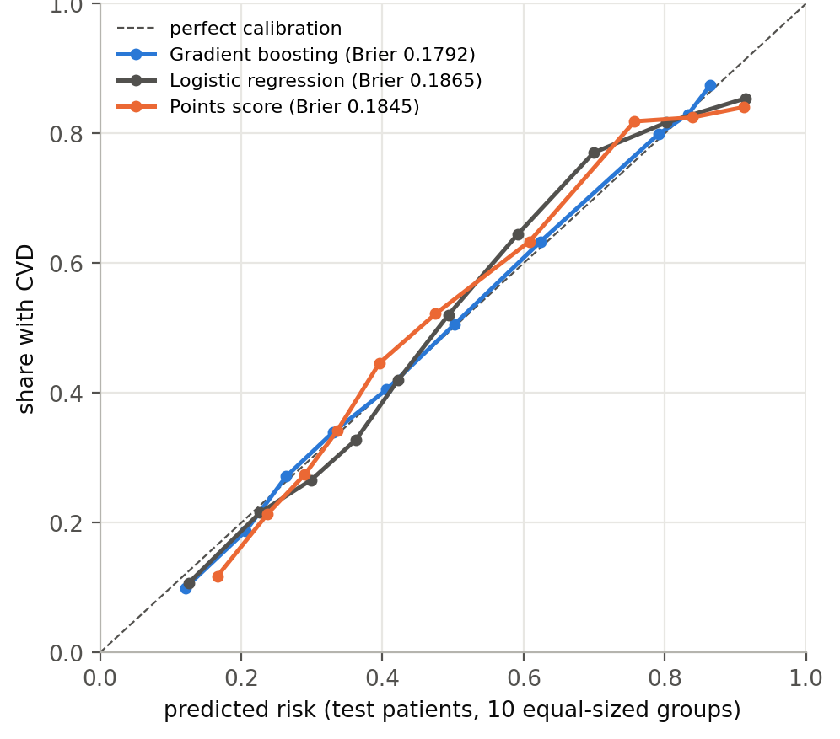
Can the predictions be trusted?
Calibrated
patients given 20% have CVD about 20% of the time
Women and men alike
AUC 0.803 and 0.808
Weaker over 60
AUC 0.72, against 0.84 under 50
1 in 5 sick? 44% of flags right
a reason to look closer, not a diagnosis
Notes:
Third question: can the risks be trusted? The model is well calibrated: patients given 20 percent have the disease about 20 percent of the time. Women and men are served equally. It is weaker for patients over 60, an AUC of 0.72 against 0.84 under 50, because most older patients have high pressure and most have the disease. And in a check-up population where one patient in five is sick, only 44 percent of flagged patients would really have it. So a positive result means: worth a closer look, not a diagnosis.

Slide 13
Checking a new patient
bundle = load_final()
assess(bundle, patient(age=62, sex="male", height=172, weight=98,
systolic=165, diastolic=100, cholesterol=3))
risk of cardiovascular disease: 87%
verdict: cardiovascular disease likely
screening (cut-off 0.38): refer for examination
clinical points score: 50 points, risk 95%
+11 Age (years): 60+
+27 Systolic pressure (mmHg): 160+
+3 BMI (kg/m²): 30-34.9
+9 Cholesterol: well above normal
patient(age=50, sex="male", ..., systolic=1400, diastolic=90)
ValueError: implausible examination values: ap_hi out of range
Notes:
The last section of the notebook turns the model into a check of a new patient. It saves the model, then assesses an examination in two lines. It rejects impossible readings, with the same rules as the cleaning, and returns the risk, the verdict at two cut-offs, one for accuracy and one for screening, and the clinical points with their breakdown. Here a 62-year-old man with stage 2 hypertension and high cholesterol gets 87 percent.

Slide 14
Conclusions
Q1 · A real but small gain
Q2 · Handling beats algorithms
Q3 · Trustworthy, within limits
+2.3 points over the guideline rule; the ceiling of about 74% is set by what the examination records
Cleaning rescues linear models; leakage can manufacture almost any accuracy
Calibrated and equal for both sexes; weaker over 60; associations, not causes
Limitations: detects existing disease, cannot forecast · undocumented source and diagnosis · no treatment data · a 50/50 sample · one dataset, no external validation
Notes:
To conclude. Machine learning adds something real but small: two points over the guideline rule, and the ceiling of about 74 percent is set by the data. Data handling matters more than the algorithm: cleaning rescues linear models, and leakage can manufacture almost any accuracy. And the predictions are trustworthy within limits. The main limitations: this detects existing disease and cannot forecast, the data's source and diagnosis definition are unknown, and treatment is not recorded. The next step would be data from a known clinic, followed over time.

Slide 15
Thank you
Questions?
hadigghazi@gmail.com
Notes:
Thank you. I am happy to take questions.

Slide 16
Backup: every candidate on the test set
Model | Test AUC | 95% CI | CV AUC | Accuracy | Sensitivity | Specificity
Gradient boosting | 0.804 | 0.797-0.811 | 0.801 | 73.6% | 68.9% | 78.2%
Random forest | 0.803 | 0.796-0.810 | 0.799 | 73.4% | 68.5% | 78.1%
Neural network (MLP) | 0.803 | 0.795-0.810 | 0.799 | 73.4% | 71.0% | 75.7%
Points score (all factors) | 0.795 | 0.788-0.803 | - | 72.5% | 64.3% | 80.6%
Logistic regression | 0.793 | 0.785-0.800 | 0.790 | 72.6% | 66.8% | 78.2%
Framingham form, refitted | 0.780 | 0.773-0.788 | 0.780 | 71.4% | 66.3% | 76.3%
Systolic pressure alone | 0.754 | 0.746-0.761 | 0.751 | 71.3% | 61.8% | 80.6%
Rule: systolic ≥ 130 mmHg | 0.712 | 0.704-0.719 | 0.712 | 71.3% | 61.8% | 80.6%
Framingham, as published | 0.693 | 0.684-0.701 | 0.696 | 64.6% | 74.0% | 55.5%
Notes:
Backup. Every candidate scored once on the test patients, with bootstrap intervals for the AUC and the cross-validated AUC for comparison. Gradient boosting's lead over random forest and the neural network is under 0.002: statistically detectable, clinically meaningless.

Slide 17
Backup: cleaning strategies
Trained on | Gradient boosting AUC | Accuracy | Logistic regression AUC | Accuracy
Raw data (69,976 records) | 0.804 | 73.6% | 0.776 | 71.8%
Implausible records dropped (68,581) | 0.804 | 73.6% | 0.793 | 72.6%
Entry errors repaired (69,838) | 0.805 | 73.6% | 0.793 | 72.6%
All six models are scored on the same test patients, those whose records pass every check.
Trees split on the order of values, so absurd readings simply land in the top branch. A straight-line model is pulled by them: its blood-pressure coefficient shrinks towards zero.
Notes:
Backup. Gradient boosting is unaffected by the cleaning strategy; logistic regression loses 0.017 AUC on the raw data. Repairing and dropping give the same result.

Slide 18
Backup: who the model serves well
Group | Patients | Share with CVD | Mean predicted | AUC | Sensitivity | Specificity
Women | 8,858 | 49.2% | 48.7% | 0.803 | 68.0% | 78.6%
Men | 4,864 | 49.9% | 50.7% | 0.808 | 70.4% | 77.6%
Age under 50 | 4,361 | 36.8% | 36.3% | 0.835 | 59.0% | 91.4%
Age 50-59 | 6,900 | 50.8% | 51.6% | 0.768 | 64.2% | 77.7%
Age 60 and over | 2,461 | 67.9% | 66.5% | 0.718 | 88.1% | 34.7%
Everyone | 13,722 | 49.4% | 49.4% | 0.804 | 68.9% | 78.2%
Notes:
Backup. Calibrated in every group: the mean predicted risk is within 1.5 points of the observed share. Discrimination falls with age, and at the 0.5 cut-off older patients are mostly flagged.

