Slide 1

Causal effect analysis

Slide 2
outline
Section 1: Examples
Section 2: Causal effect
Section 3: Causal effect in randomized experiments
Section 4: Difference-in-difference estimator
Part 5: Causality

Slide 3
Section 1
Examples

Slide 4
Example 1: Cash-debt maturity
Harford, J., S. Klasa, and W. F. Maxwell, 2014. Refinancing risk and cash holdings. The Journal of Finance, 69(3): 975-1012.
In this study, the authors try to examine the effect of debt maturity, the required time to repay the long-term debts, on cash holdings.
So, debt maturity is independent (exogenous) and cash is dependent (endogenous) variable.
In theory, the longer (shorter) time for debt repayment, the less (more) need to save cash, holding other things constant.
Ind. var.
Debt maturity
Dep. var.
Cash holdings
Part 5: Causality

Slide 5
Example 1: Cash-debt maturity (Cont’d)
What about in reverse?
One may argue that firms with higher (lower) cash reserves have potential to go for debt with shorter (longer) maturity.
So, in this view, debt maturity and cash are dependent and independent variable, respectively.
It seems there is not a simple cause-and-effect relation between debt maturity and cash holdings.
Ind. var.
Cash holdings
Dep. var.
Debt maturity
Part 5: Causality

Slide 6
Example 2: traffic fatality rate and beer tax
Stock, J. H., & Watson, M. W. (2020, p. 362). Introduction to econometrics, Fourth Ed., Pearson Education Limited.
In this example, we examine the effect of beer tax on traffic death.
In theory, higher level of tax leads to a lower level of traffic death.
Ind. var.
beer tax
Dep. var.
traffic death
Part 5: Causality

Slide 7
Example 2: traffic fatality rate and beer tax (Cont’d)
What about in reverse?
There are approximately 40,000 highway traffic fatalities each year in the US. Approximately one-fourth of fatal crashes involve a driver who was drinking.
One may argue that due to the high degrees of traffic death in previous years, government increases the level of beer tax
So, in this view, traffic death is independent variable and beer tax is the dependent one.
Ind. var.
traffic death
Dep. var.
beer tax
Part 5: Causality

Slide 8
Section 2
Causal effect

Slide 9
Endogeneity problem
The examples in the previous section refer to a situation in which independent variable (or exogenous) simultaneously can be treated as a dependent variable (or endogenous)
This problem is known as endogeneity problem or reverse causality.
In statistical terminology, endogeneity arises when the correlation between a variable and the error term in a statistical model is not equal to zero.
Part 5: Causality

Slide 10
Causal effect
The effect of independent variable in a cause-and-effect relationship is known as causal effect.
In other words, if we could establish a statistical model which does not suffer from the endogeneity problem, we can argue that the effect of variable of interest is a causal effect.
For a recent review on the importance of causal effect see:
Imbens, G. W. (2023). Causal Inference in the Social Sciences. Annual Review of Statistics and Its Application, 11.
Part 5: Causality

Slide 11
Section 3
Causal effect
in randomized experiments

Slide 12
Randomized experiments
In real world, it is very hard to establish a cause-and-effect relationship.
But in laboratory environment, we can design a study such that the estimated effect of a variable is essentially a causal one.
Such a study is known as randomized experiment.
Part 5: Causality

Slide 13
Randomized experiments (Cont’d)
In a randomized experiment study, the sample is randomly splitted into treatment and control groups- random assignment.
For simplicity, suppose the variable of interest (treatment) is a binary variable:
To receive or not a drug
To participate or not in a job training program
…
The sample in the treatment group receive the treatment while controls are not treated.
Part 5: Causality

Slide 14
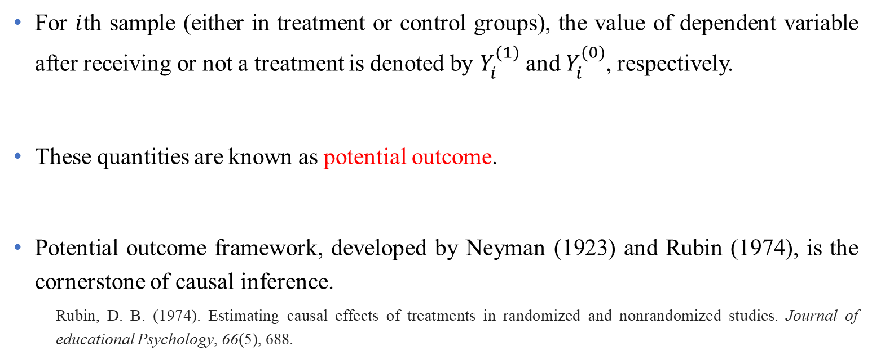
Some notations
For $i$th sample (either in treatment or control groups), the value of dependent variable after receiving or not a treatment is denoted by $Y_{i}^{(1)}$ and $Y_{i}^{(0)}$, respectively.
These quantities are known as potential outcome.
Potential outcome framework, developed by Neyman (1923) and Rubin (1974), is the cornerstone of causal inference.
Rubin, D. B. (1974). Estimating causal effects of treatments in randomized and nonrandomized studies. Journal of educational Psychology, 66(5), 688.
Part 5: Causality

Slide 15
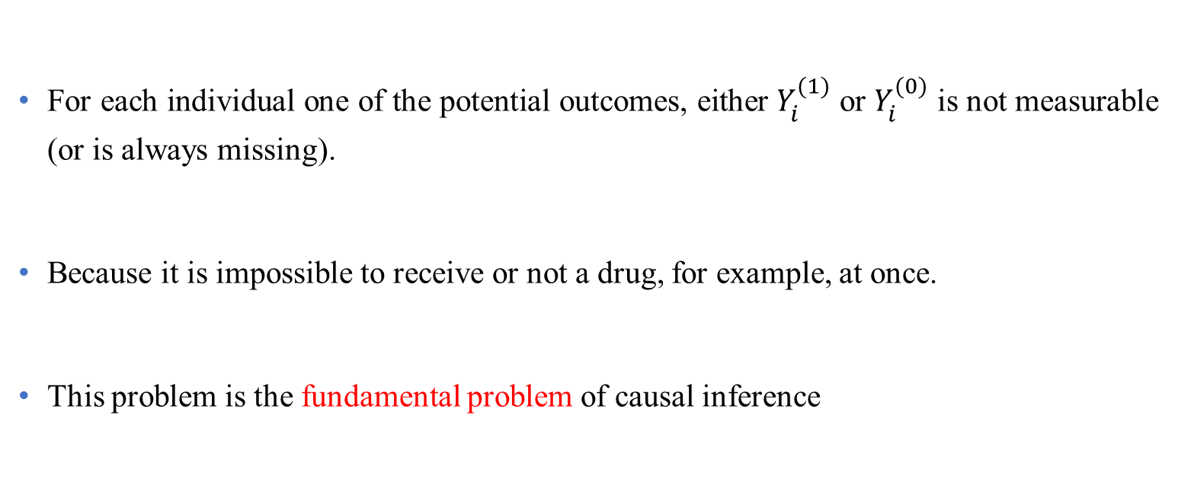
Some notations (Cont’d)
For each individual one of the potential outcomes, either $Y_{i}^{(1)}$ or $Y_{i}^{(0)}$ is not measurable (or is always missing).
Because it is impossible to receive or not a drug, for example, at once.
This problem is the fundamental problem of causal inference
Part 5: Causality

Slide 16
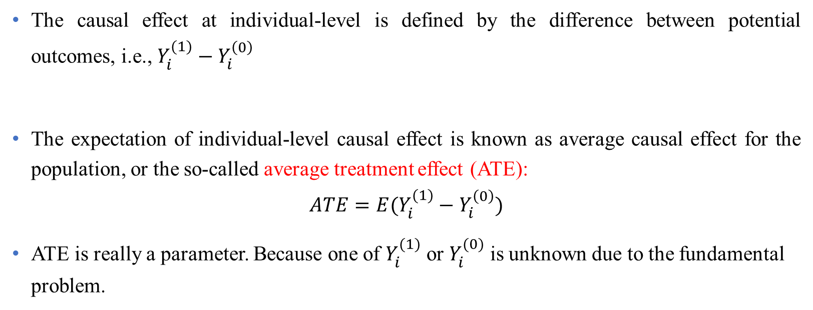
Some notations (Cont’d)
The causal effect at individual-level is defined by the difference between potential outcomes, i.e., $Y_{i}^{(1)}−Y_{i}^{\left(0\right)}$
The expectation of individual-level causal effect is known as average causal effect for the population, or the so-called average treatment effect (ATE):
$$ATE=E(Y_{i}^{(1)}−Y_{i}^{\left(0\right)})$$
ATE is really a parameter. Because one of $Y_{i}^{(1)}$ or $Y_{i}^{(0)}$ is unknown due to the fundamental problem.
Part 5: Causality

Slide 17
Section 4
Difference-in-difference (DD) method

Slide 18
Quasi-experiment
In non-laboratory study, randomized assignment, as in a randomized experiment, cannot be achieved.
But we can design a study in which randomness is introduced by variations in individual characteristics, like birth date which is out of control, that make study appear as if the treatment is randomly assigned.
These studies are known as quasi-experiment, also called a natural experiment
Part 5: Causality

Slide 19
Quasi-experiment analysis
There exist several statistical methods to analysis a quasi-experiment design like:
→ Difference-in-difference (DD) or pre-post comparison
Regression discontinuity design (RDD)
Propensity score matching (PSM)
…
Part 5: Causality

Slide 20
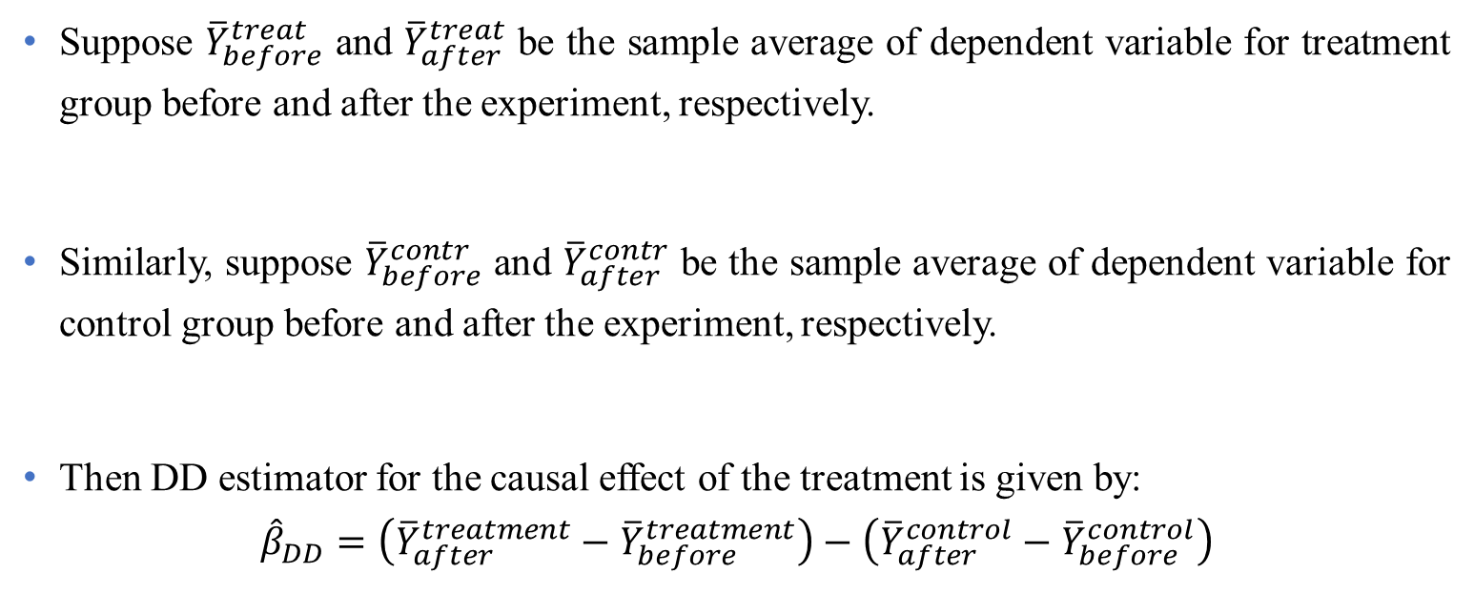
DD estimator
Suppose ${\overline{Y}}_{before}^{treat}$ and ${\overline{Y}}_{after}^{treat}$ be the sample average of dependent variable for treatment group before and after the experiment, respectively.
Similarly, suppose ${\overline{Y}}_{before}^{contr}$ and ${\overline{Y}}_{after}^{contr}$ be the sample average of dependent variable for control group before and after the experiment, respectively.
Then DD estimator for the causal effect of the treatment is given by:
$${\hat{β}}_{DD}=\left({\overline{Y}}_{after}^{treatment}−{\overline{Y}}_{before}^{treatment}\right)−\left({\overline{Y}}_{after}^{control}−{\overline{Y}}_{before}^{control}\right)$$
Part 5: Causality

Slide 21
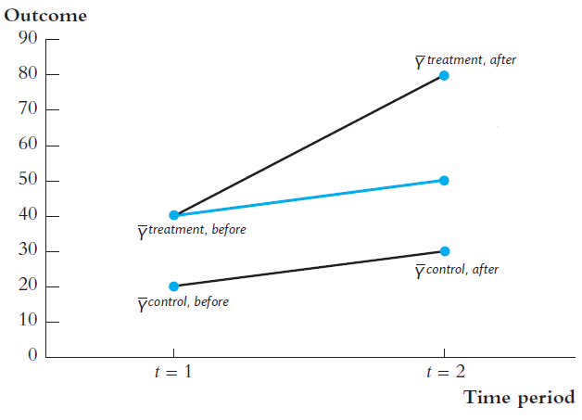
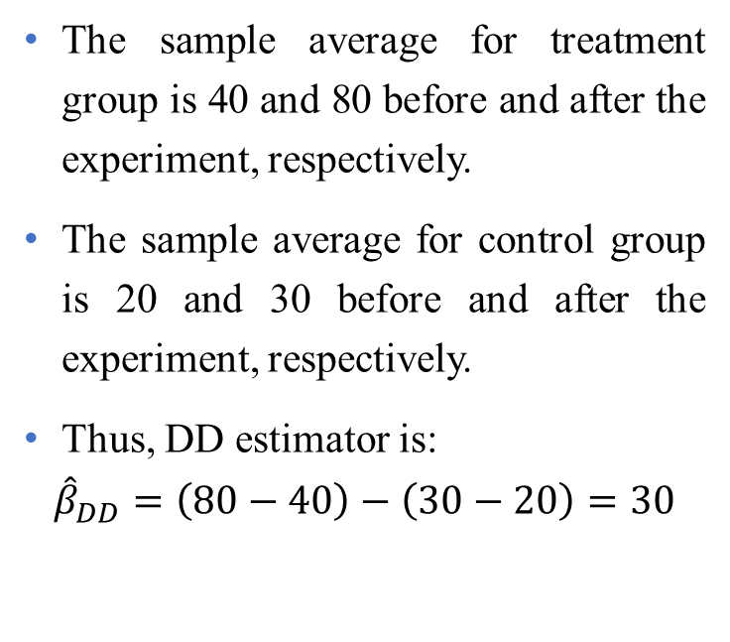
Example
The sample average for treatment group is 40 and 80 before and after the experiment, respectively.
The sample average for control group is 20 and 30 before and after the experiment, respectively.
Thus, DD estimator is:
$${\hat{β}}_{DD}=\left(80−40\right)−\left(30−20\right)=30$$
Stock, J. H., & Watson, M. W. (2020, p. 493). Introduction to econometrics, Fourth Ed., Pearson Education Limited.
Part 5: Causality

Slide 22

DD estimator using regression model
It can be shown that DD estimator is the OLS estimator of $β_{1}$in the following model:
$$∆Y_{i}=β_{0}+β_{1}X_{i}+e_{i}$$
where $∆Y_{i}$is the post-experimental value of $Y$ for the $i$th individual minus the pre-experimental value
Part 5: Causality

Slide 23
DD estimator with multiple time periods
The described DD estimator considers two time periods, before and after the experiment.
The differences-in-differences estimator can be extended to multiple time periods using the panel data regression methods.
Callaway, B., & Sant’Anna, P. H. (2021). Difference-in-differences with multiple time periods. Journal of econometrics, 225(2), 200-230.
Part 5: Causality

Slide 24
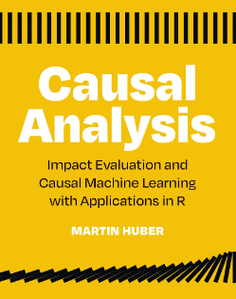
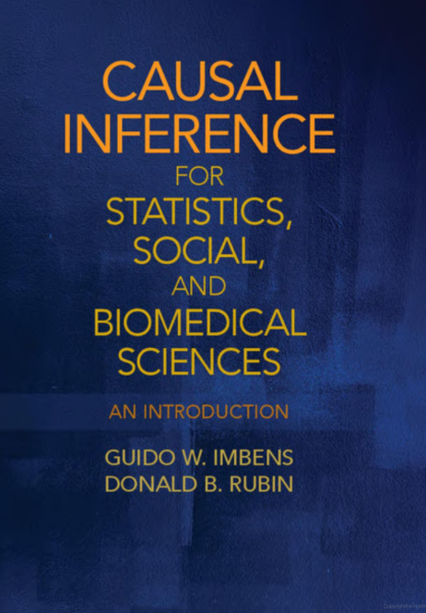
Further readings
Huber, M. (2023). Causal analysis: Impact evaluation and Causal Machine Learning with applications in R. MIT Press.
Imbens, G. W., & Rubin, D. B. (2015). Causal inference in statistics, social, and biomedical sciences. Cambridge University Press.

