Slide 1

Data Science and Machine Learning in Finance: Problem set 2
Hadi Movaghari
2022-2023

Slide 2
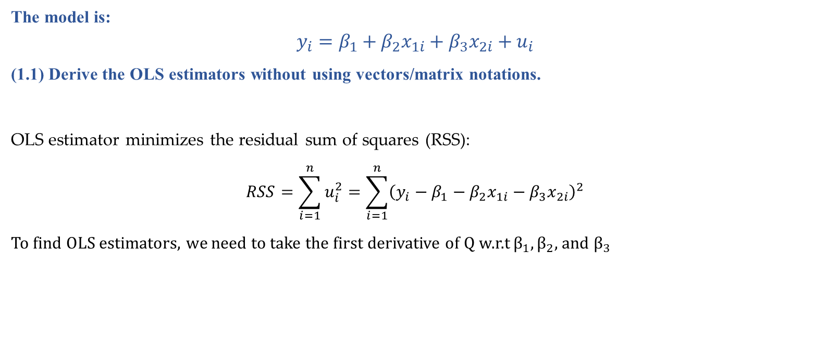
Question 1
The model is:
$$y_{i}=β_{1}+β_{2}x_{1i}+β_{3}x_{2i}+u_{i}$$
(1.1) Derive the OLS estimators without using vectors/matrix notations.
OLS estimator minimizes the residual sum of squares (RSS):
$$RSS=\sum_{i=1}^{n}{u_{i}^{2}}=\sum_{i=1}^{n}{{\left(y_{i}−β_{1}−β_{2}x_{1i}−β_{3}x_{2i}\right)}^{2}}$$
To find OLS estimators, we need to take the first derivative of Q w.r.t $β_{1}, β_{2},$ and $β_{3}$
Data Science & Machine Learning in Finance: Problem set 2
University of Glasgow
2022-2023

Slide 3
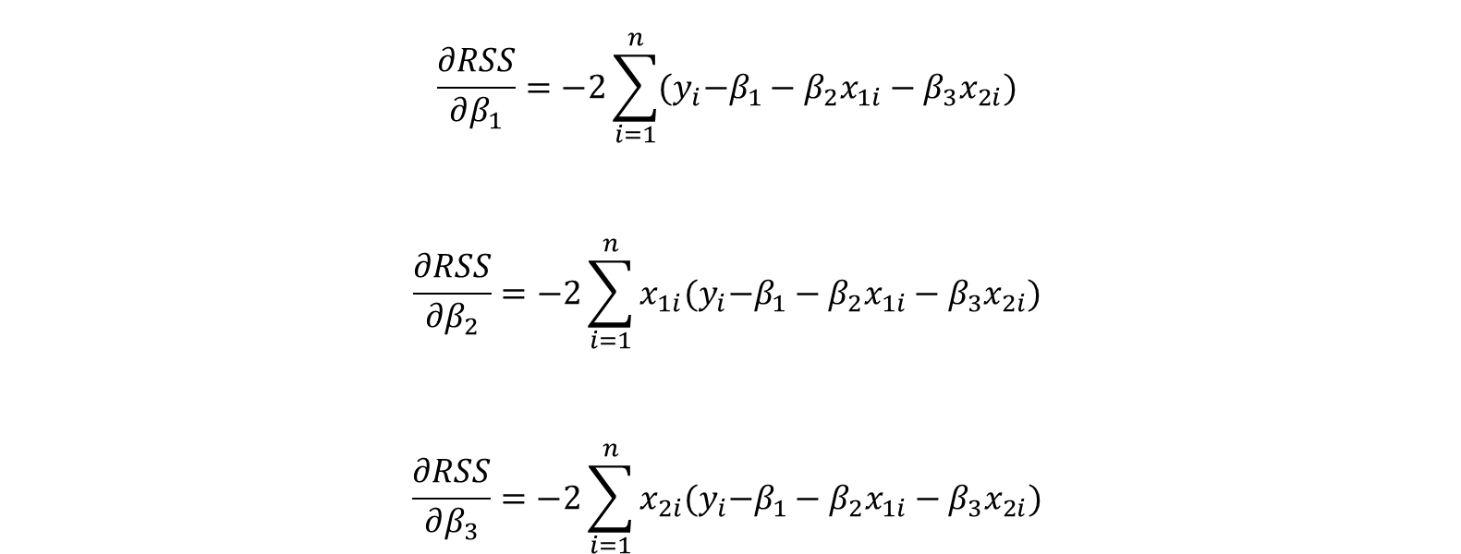
Question 1 (Cont’d)
$$\frac{∂RSS}{∂β_{1}}=−2\sum_{i=1}^{n}{{(y}_{i}−β_{1}−β_{2}x_{1i}−β_{3}x_{2i})}$$
$$\frac{∂RSS}{∂β_{2}}=−2\sum_{i=1}^{n}{x_{1i}{(y}_{i}−β_{1}−β_{2}x_{1i}−β_{3}x_{2i})}$$
$$\frac{∂RSS}{∂β_{3}}=−2\sum_{i=1}^{n}{x_{2i}{(y}_{i}−β_{1}−β_{2}x_{1i}−β_{3}x_{2i})}$$
Data Science & Machine Learning in Finance: Problem set 2
University of Glasgow
2022-2023

Slide 4
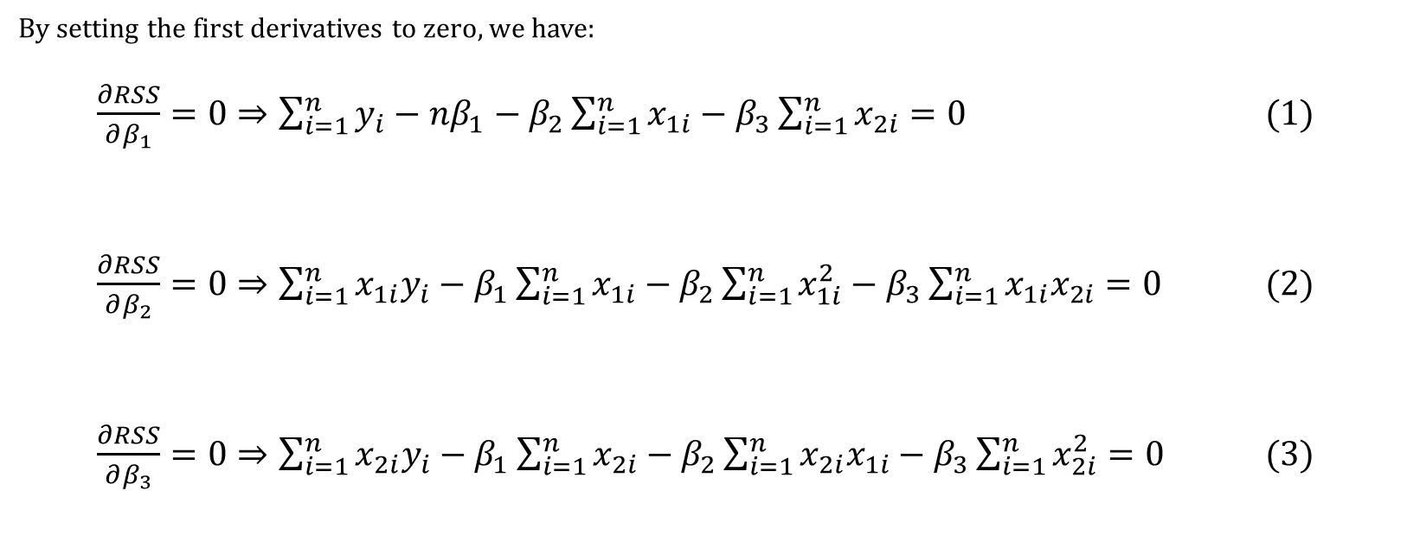
Question 1 (Cont’d)
By setting the first derivatives to zero, we have:
$\frac{∂RSS}{∂β_{1}}=0⇒\sum_{i=1}^{n}{y_{i}}−nβ_{1}−β_{2}\sum_{i=1}^{n}{x_{1i}}−β_{3}\sum_{i=1}^{n}{x_{2i}}=0$ (1)
$\frac{∂RSS}{∂β_{2}}=0⇒\sum_{i=1}^{n}{x_{1i}y_{i}}−β_{1}\sum_{i=1}^{n}{x_{1i}}−β_{2}\sum_{i=1}^{n}{x_{1i}^{2}}−β_{3}\sum_{i=1}^{n}{{x_{1i}x}_{2i}}=0$ (2)
$\frac{∂RSS}{∂β_{3}}=0⇒\sum_{i=1}^{n}{x_{2i}y_{i}}−β_{1}\sum_{i=1}^{n}{x_{2i}}−β_{2}\sum_{i=1}^{n}{{x_{2i}x}_{1i}}−β_{3}\sum_{i=1}^{n}{x_{2i}^{2}}=0$ (3)
Data Science & Machine Learning in Finance: Problem set 2
University of Glasgow
2022-2023

Slide 5

Question 1 (Cont’d)
We note that:
$$\sum_{i=1}^{n}{y_{i}=n\overline{y}}$$
$$\sum_{i=1}^{n}{x_{1i}}=n{\overline{x}}_{1}$$
$$\sum_{i=1}^{n}{x_{2i}}=n{\overline{x}}_{2}$$
Then, equation (1) gives:
${\hat{β}}_{1}=\overline{y}−{\hat{β}}_{2}{\overline{x}}_{1}−{\hat{β}}_{3}{\overline{x}}_{2}$ (4)
Data Science & Machine Learning in Finance: Problem set 2
University of Glasgow
2022-2023

Slide 6
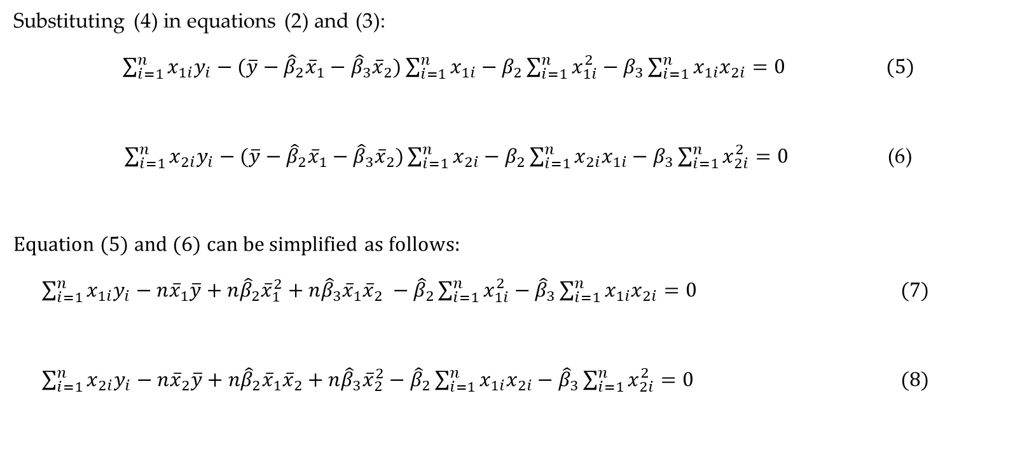
Question 1 (Cont’d)
Substituting (4) in equations (2) and (3):
$\sum_{i=1}^{n}{x_{1i}y_{i}}−(\overline{y}−{\hat{β}}_{2}{\overline{x}}_{1}−{\hat{β}}_{3}{\overline{x}}_{2})\sum_{i=1}^{n}{x_{1i}}−β_{2}\sum_{i=1}^{n}{x_{1i}^{2}}−β_{3}\sum_{i=1}^{n}{{x_{1i}x}_{2i}}=0$ (5)
$\sum_{i=1}^{n}{x_{2i}y_{i}}−(\overline{y}−{\hat{β}}_{2}{\overline{x}}_{1}−{\hat{β}}_{3}{\overline{x}}_{2})\sum_{i=1}^{n}{x_{2i}}−β_{2}\sum_{i=1}^{n}{{x_{2i}x}_{1i}}−β_{3}\sum_{i=1}^{n}{x_{2i}^{2}}=0$ (6)
Equation (5) and (6) can be simplified as follows:
$\sum_{i=1}^{n}{x_{1i}y_{i}}−n{\overline{x}}_{1}\overline{y}+n{\hat{β}}_{2}{\overline{x}}_{1}^{2}+n{\hat{β}}_{3}{\overline{x}}_{1}{\overline{x}}_{2} −{\hat{β}}_{2}\sum_{i=1}^{n}{x_{1i}^{2}}−{\hat{β}}_{3}\sum_{i=1}^{n}{{x_{1i}x}_{2i}}=0$ (7)
$\sum_{i=1}^{n}{x_{2i}y_{i}}−n{\overline{x}}_{2}\overline{y}+n{\hat{β}}_{2}{\overline{x}}_{1}{\overline{x}}_{2}+n{\hat{β}}_{3}{\overline{x}}_{2}^{2}−{\hat{β}}_{2}\sum_{i=1}^{n}{{x_{1i}x}_{2i}}−{\hat{β}}_{3}\sum_{i=1}^{n}{x_{2i}^{2}}=0$ (8)
Data Science & Machine Learning in Finance: Problem set 2
University of Glasgow
2022-2023

Slide 7

Question 1 (Cont’d)
We note that:
$$\sum_{i=1}^{n}{x_{1i}y_{i}}−n{\overline{x}}_{1}\overline{y}=Cov\left(x_{1},y\right)≡σ_{1y}, \sum_{i=1}^{n}{x_{2i}y_{i}}−n{\overline{x}}_{2}\overline{y}=Cov\left(x_{2},y\right)≡σ_{2y}$$
$$\sum_{i=1}^{n}{x_{1i}^{2}}−n{\overline{x}}_{1}^{2}=Var\left(x_{1}\right)≡σ_{11}, \sum_{i=1}^{n}{x_{2i}^{2}}−n{\overline{x}}_{2}^{2}=Var\left(x_{2}\right)≡σ_{22}$$
$$\sum_{i=1}^{n}{{x_{1i}x}_{2i}}−n{\overline{x}}_{1}{\overline{x}}_{2}=Cov\left(x_{1},x_{2}\right)≡σ_{12}$$
Data Science & Machine Learning in Finance: Problem set 2
University of Glasgow
2022-2023

Slide 8

Question 1 (Cont’d)
To ease in writing, we can rewrite equations (7) and (8) as follows:
$$\left\{\begin{matrix}σ_{1y}−{\hat{β}}_{2}σ_{11}−{\hat{β}}_{3}σ_{12}=0 \\ σ_{2y}−{\hat{β}}_{3}σ_{22}−{\hat{β}}_{2}σ_{12}=0 \end{matrix}\right.$$
From the system of equations, we can show that OLS estimators for ${\hat{β}}_{2}$ and ${\hat{β}}_{3}$ can be written as:
$${\hat{β}}_{2}=\frac{(σ_{1y}.σ_{22})−{(σ}_{2y}.σ_{12})}{σ_{11}σ_{22}−σ_{12}^{2}}$$
$${\hat{β}}_{3}=\frac{(σ_{2y}.σ_{11})−{(σ}_{1y}.σ_{12})}{σ_{11}σ_{22}−σ_{12}^{2}}$$
Data Science & Machine Learning in Finance: Problem set 2
University of Glasgow
2022-2023

Slide 9
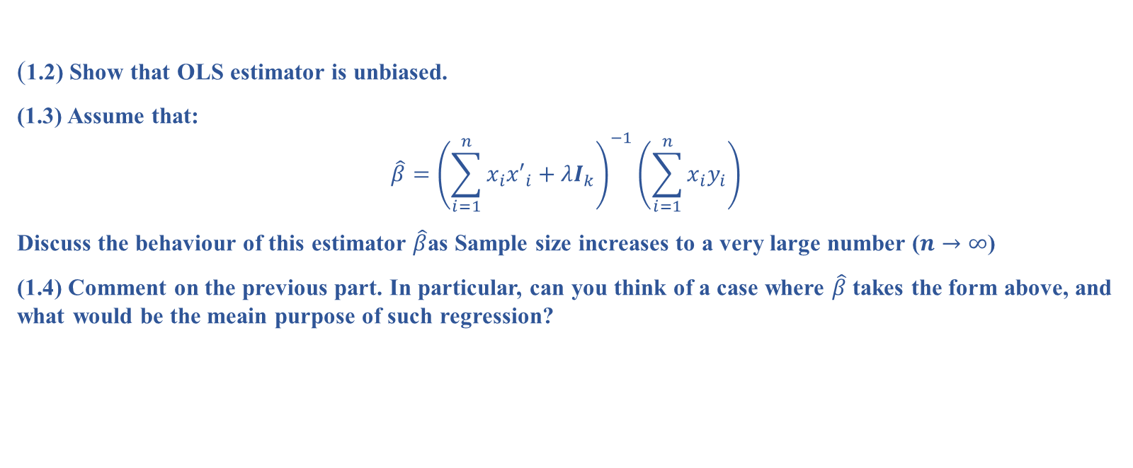
Question 1
(1.2) Show that OLS estimator is unbiased.
(1.3) Assume that:
$$\hat{β}={\left(\sum_{i=1}^{n}{x_{i}{x′}_{i}}+λI_{k}\right)}^{−1}\left(\sum_{i=1}^{n}{x_{i}y_{i}}\right)$$
Discuss the behaviour of this estimator $\hat{β}$as Sample size increases to a very large number ($n→∞$)
(1.4) Comment on the previous part. In particular, can you think of a case where $\hat{β}$ takes the form above, and what would be the meain purpose of such regression?
Data Science & Machine Learning in Finance: Problem set 2
University of Glasgow
2022-2023

Slide 10
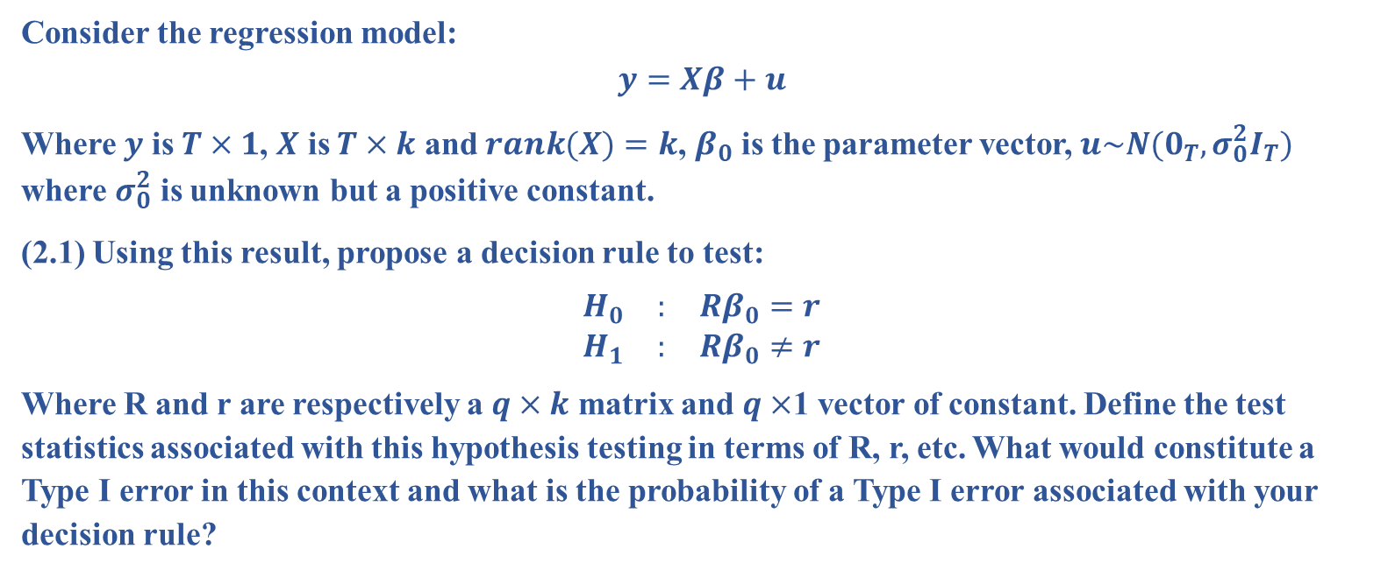
Question 2
Consider the regression model:
$$y=Xβ+u$$
Where $y$ is $T×1$, $X$ is $T×k$ and $rank(X)=k$, $β_{0}$ is the parameter vector, $u\sim N(0_{T},σ_{0}^{2}I_{T})$ where $σ_{0}^{2}$ is unknown but a positive constant.
(2.1) Using this result, propose a decision rule to test:
$$\begin{matrix}H_{0} & : & Rβ_{0}=r \\ H_{1} & : & Rβ_{0}≠r\end{matrix}$$
Where R and r are respectively a $q×k$ matrix and $q×$1 vector of constant. Define the test statistics associated with this hypothesis testing in terms of R, r, etc. What would constitute a Type I error in this context and what is the probability of a Type I error associated with your decision rule?
Data Science & Machine Learning in Finance: Problem set 2
University of Glasgow
2022-2023

Slide 11
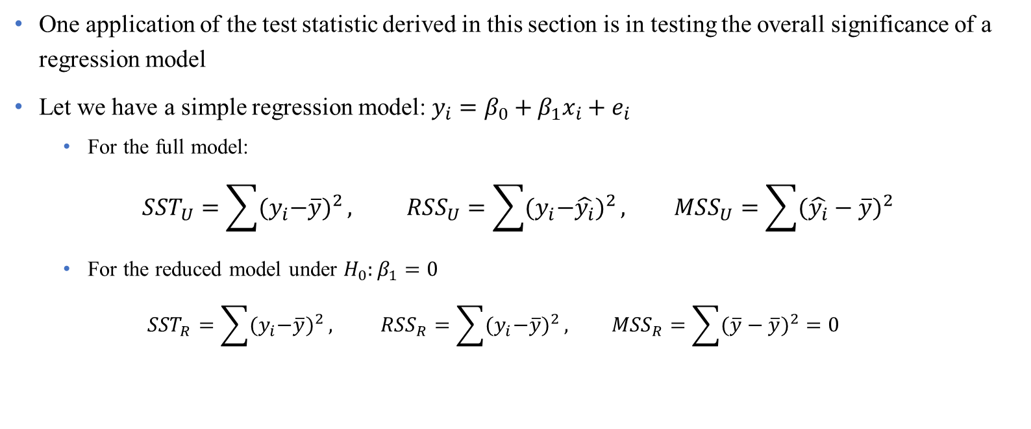
Question 2 (Cont’d)
One application of the test statistic derived in this section is in testing the overall significance of a regression model
Let we have a simple regression model: $y_{i}=β_{0}+β_{1}x_{i}+e_{i}$
For the full model:
$${SST}_{U}=\sum{{{(y}_{i}−\overline{y})}^{2}}, {RSS}_{U}=\sum{{{(y}_{i}−\hat{y_{i}})}^{2}}, {MSS}_{U}=\sum{{(\hat{y_{i}}−\overline{y})}^{2}}$$
For the reduced model under $H_{0}:β_{1}=0$
$${SST}_{R}=\sum{{{(y}_{i}−\overline{y})}^{2}}, {RSS}_{R}=\sum{{{(y}_{i}−\overline{y})}^{2}}, {MSS}_{R}=\sum{{(\overline{y}−\overline{y})}^{2}}=0$$
Data Science & Machine Learning in Finance: Problem set 2
University of Glasgow
2022-2023

Slide 12
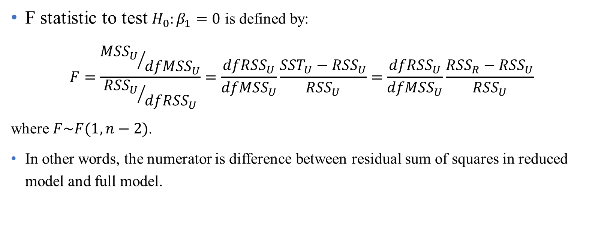
Question 2 (Cont’d)
F statistic to test $H_{0}:β_{1}=0$ is defined by:
$$F=\frac{{{MSS}_{U}}/{{dfMSS}_{U}}}{{{RSS}_{U}}/{{dfRSS}_{U}}}=\frac{{dfRSS}_{U}}{{dfMSS}_{U}}\frac{{SST}_{U}−{RSS}_{U}}{{RSS}_{U}}=\frac{{dfRSS}_{U}}{{dfMSS}_{U}}\frac{{RSS}_{R}−{RSS}_{U}}{{RSS}_{U}}$$
where $F\sim F(1,n−2)$.
In other words, the numerator is difference between residual sum of squares in reduced model and full model.
Data Science & Machine Learning in Finance: Problem set 2
University of Glasgow
2022-2023

Slide 13
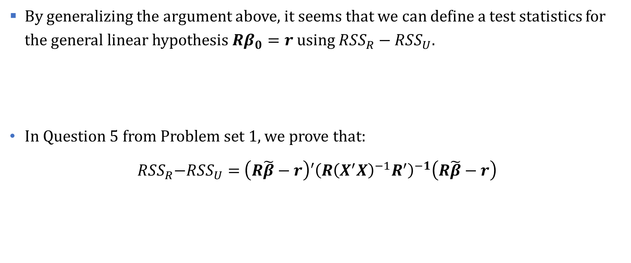
Question 2 (Cont’d)
By generalizing the argument above, it seems that we can define a test statistics for the general linear hypothesis $Rβ_{0}=r$ using ${RSS}_{R}−{RSS}_{U}$.
In Question 5 from Problem set 1, we prove that:
${{RSS}_{R}\text{−}RSS}_{U}=$ $\left(R\tilde{β}−r\right)′{\left(R{\left(X^{′}X\right)}^{−1}R^{′}\right)}^{−1}\left(R\tilde{β}−r\right)$
Data Science & Machine Learning in Finance: Problem set 2
University of Glasgow
2022-2023

Slide 14
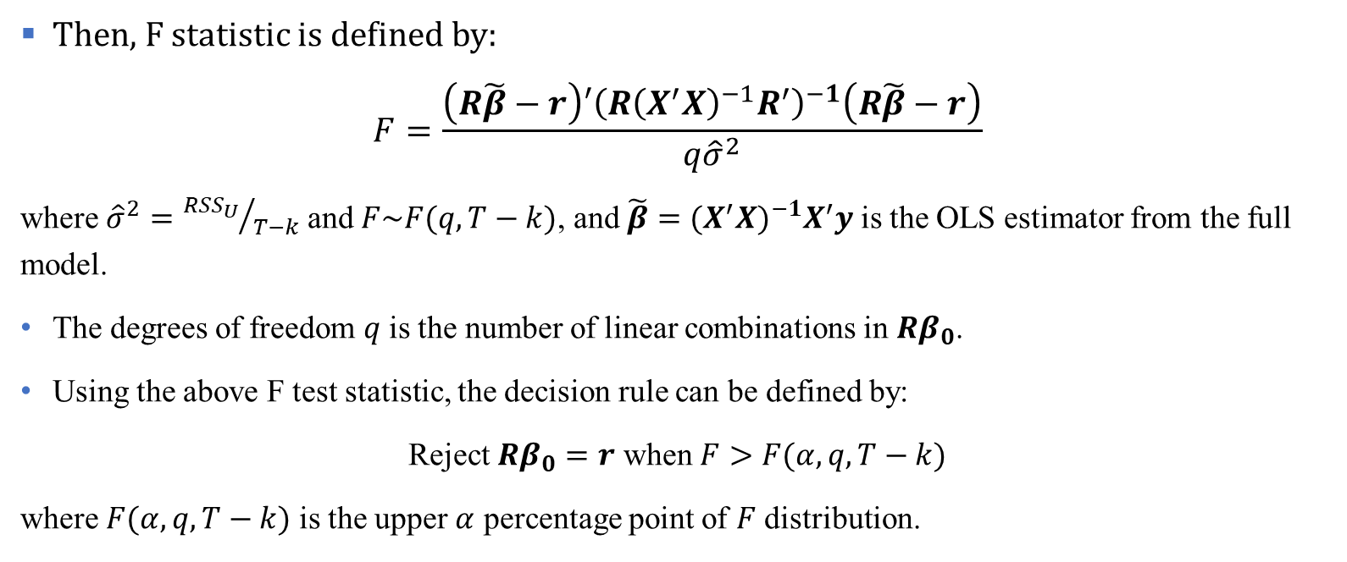
Question 2 (Cont’d)
Then, F statistic is defined by:
$$F=\frac{\left(R\tilde{β}−r\right)′{\left(R{\left(X^{′}X\right)}^{−1}R^{′}\right)}^{−1}\left(R\tilde{β}−r\right)}{q{\hat{σ}}^{2}}$$
where ${\hat{σ}}^{2}={{RSS}_{U}}/{T−k}$ and $F\sim F(q,T−k)$, and $\tilde{β}={(X^{′}X)}^{−1}X^{′}y$ is the OLS estimator from the full model.
The degrees of freedom $q$ is the number of linear combinations in $Rβ_{0}$.
Using the above F test statistic, the decision rule can be defined by:
Reject $Rβ_{0}=r$ when $F>F(α,q,T−k)$
where $F(α,q,T−k)$ is the upper $α$ percentage point of $F$ distribution.
Data Science & Machine Learning in Finance: Problem set 2
University of Glasgow
2022-2023

Slide 15

Question 2 (Cont’d)
Using the introduced decision rule, the type I error occurs if:
$F>F(α,q,T−k)$ but $Rβ_{0}=r$ is true
The probability of committing the type I error is denoted by $α$.
Data Science & Machine Learning in Finance: Problem set 2
University of Glasgow
2022-2023

Slide 16

Question 2 (Cont’d)
(2.2) Define the $p$-value of the test in previous part.
p-value as a data-driven value is defined by:
$$p−value=\operatorname{Pr}\left(F>F^{∗}\right)$$
where $F$ is the test statistic with $F(q,T−k)$ and $F^{∗}$ is the observed value of this statistic.
Data Science & Machine Learning in Finance: Problem set 2
University of Glasgow
2022-2023

Slide 17
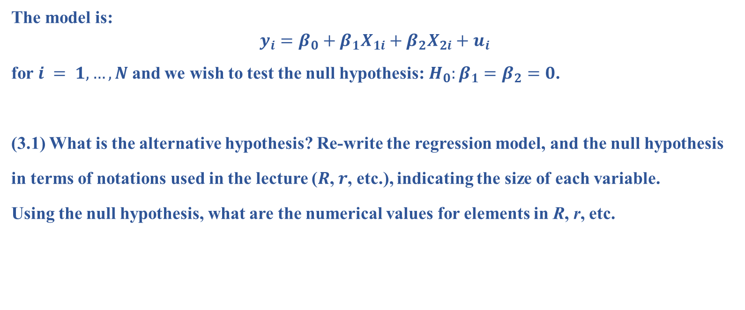
Question 3
The model is:
$$y_{i}=β_{0}+β_{1}X_{1i}+β_{2}X_{2i}+u_{i}$$
for $i = 1,…,N$and we wish to test the null hypothesis: $H_{0}:β_{1}=β_{2}=0$.
(3.1) What is the alternative hypothesis? Re-write the regression model, and the null hypothesis
in terms of notations used in the lecture ($R$, $r$, etc.), indicating the size of each variable.
Using the null hypothesis, what are the numerical values for elements in R, r, etc.
Data Science & Machine Learning in Finance: Problem set 2
University of Glasgow
2022-2023

Slide 18

Question 3 (Cont’d)
Matrix expression of the model is given by:
$$y = Xβ +e$$
where y is $N×1$ vector, $X$ is a $N×3$ matrix, $β$ is $3×1$ vector and $e$ is $N×1$ vector.
The null hypothesis can be written in the following format:
$$\left(\begin{matrix}0 & 1 & 0 \\ 0 & 0 & 1\end{matrix}\right)\left(\begin{matrix}β_{0} \\ β_{1} \\ β_{2}\end{matrix}\right)=\left(\begin{matrix}0 \\ 0\end{matrix}\right)$$
Data Science & Machine Learning in Finance: Problem set 2
University of Glasgow
2022-2023

Slide 19

Question 3 (Cont’d)
(3.2) What is the test statistic and its distribution when the variance of the error term is unknown?
According to Question 2, with two linear restrictions $F\sim F(2,N−1−2)$.
Data Science & Machine Learning in Finance: Problem set 2
University of Glasgow
2022-2023

Slide 20
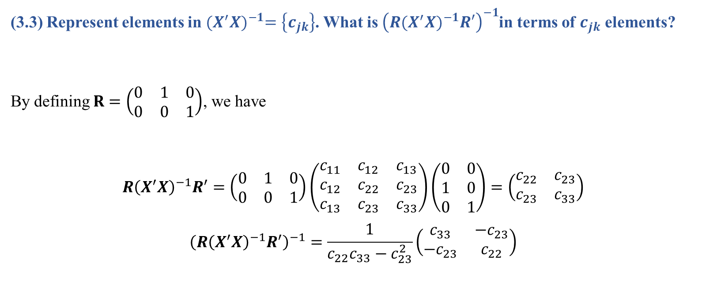
Question 3 (Cont’d)
(3.3) Represent elements in ${(X^{′}X)}^{−1}=\left\{c_{jk}\right\}$. What is ${\left(R{(X^{′}X)}^{−1}R′\right)}^{−1}$in terms of $c_{jk}$ elements?
By defining $R=\left(\begin{matrix}0 & 1 & 0 \\ 0 & 0 & 1\end{matrix}\right)$, we have
$$R{\left(X^{′}X\right)}^{−1}R^{′}=\left(\begin{matrix}0 & 1 & 0 \\ 0 & 0 & 1\end{matrix}\right)\left(\begin{matrix}c_{11} & c_{12} & c_{13} \\ c_{12} & c_{22} & c_{23} \\ c_{13} & c_{23} & c_{33}\end{matrix}\right)\left(\begin{matrix}0 & 0 \\ 1 & 0 \\ 0 & 1\end{matrix}\right)=\left(\begin{matrix}c_{22} & c_{23} \\ c_{23} & c_{33}\end{matrix}\right)$$
$${\left(R{\left(X^{′}X\right)}^{−1}R^{′}\right)}^{−1}=\frac{1}{c_{22}c_{33}−c_{23}^{2}}\left(\begin{matrix}c_{33} & {−c}_{23} \\ {−c}_{23} & c_{22}\end{matrix}\right)$$
Data Science & Machine Learning in Finance: Problem set 2
University of Glasgow
2022-2023

Slide 21
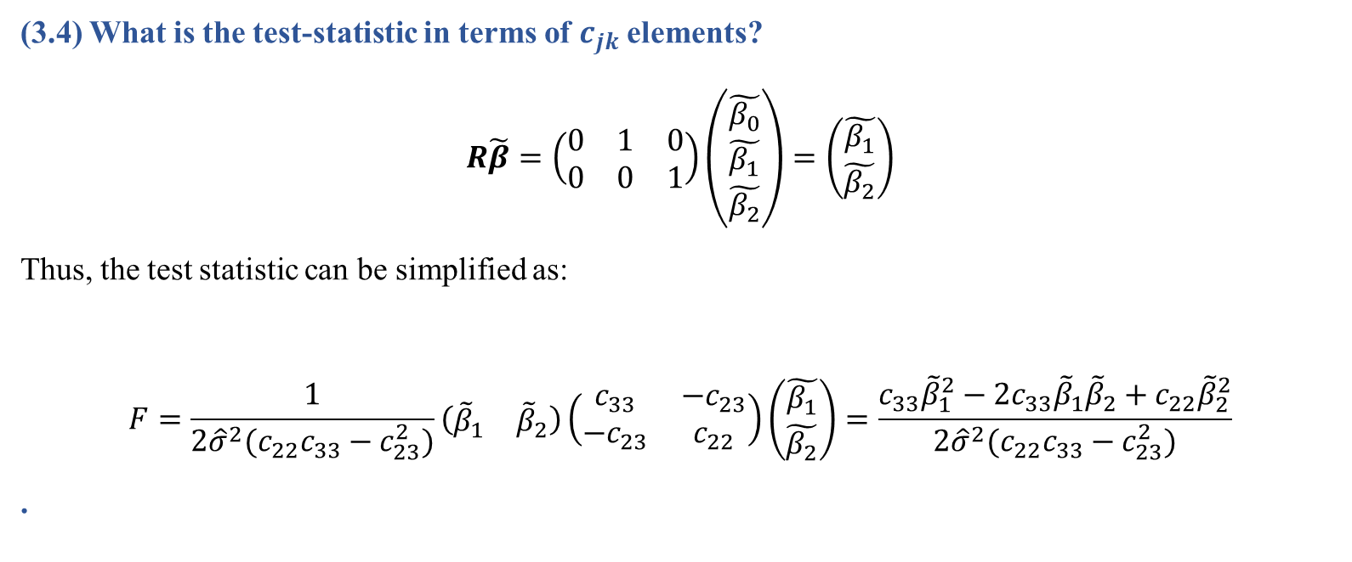
Question 3
(3.4) What is the test-statistic in terms of $c_{jk}$elements?
$$R\tilde{β}=\left(\begin{matrix}0 & 1 & 0 \\ 0 & 0 & 1\end{matrix}\right)\left(\begin{matrix}\tilde{β_{0}} \\ \tilde{β_{1}} \\ \tilde{β_{2}}\end{matrix}\right)=\left(\begin{matrix}\tilde{β_{1}} \\ \tilde{β_{2}}\end{matrix}\right)$$
Thus, the test statistic can be simplified as:
$$F=\frac{1}{2{\hat{σ}}^{2}{(c}_{22}c_{33}−c_{23}^{2})}\left(\begin{matrix}{\tilde{β}}_{1} & {\tilde{β}}_{2}\end{matrix}\right)\left(\begin{matrix}c_{33} & {−c}_{23} \\ {−c}_{23} & c_{22}\end{matrix}\right)\left(\begin{matrix}\tilde{β_{1}} \\ \tilde{β_{2}}\end{matrix}\right)=\frac{c_{33}{\tilde{β}}_{1}^{2}−2c_{33}{\tilde{β}}_{1}{\tilde{β}}_{2}+c_{22}{\tilde{β}}_{2}^{2}}{2{\hat{σ}}^{2}{(c}_{22}c_{33}−c_{23}^{2})}$$
.
Data Science & Machine Learning in Finance: Problem set 2
University of Glasgow
2022-2023

Slide 22
Question 3
(3.5) Suppose the test conclusion is to reject the null, comment on this conclusion.
(3.6) Suppose the test conclusion is to fail-to-reject the null, comment on this conclusion.
Data Science & Machine Learning in Finance: Problem set 2
University of Glasgow
2022-2023

Slide 23
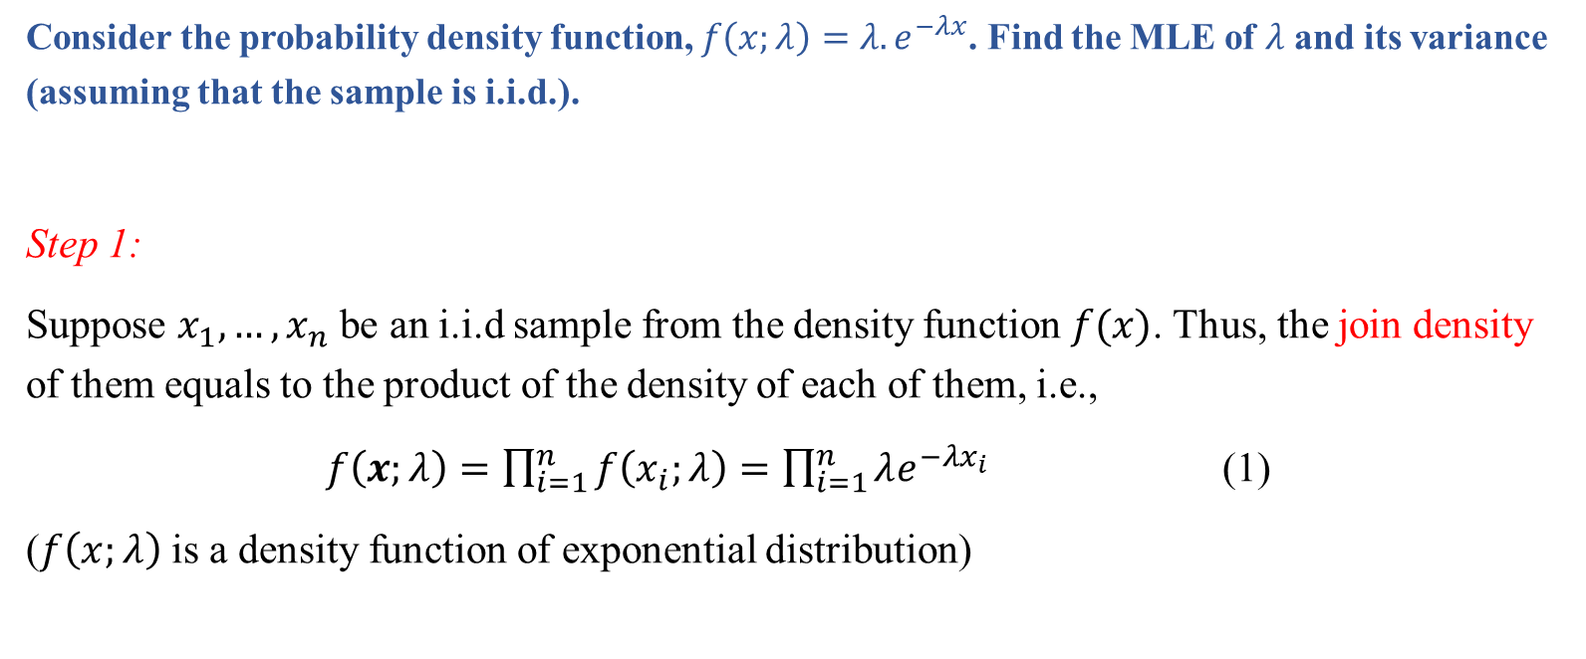
Question 4
Consider the probability density function, $f\left(x;λ\right)=λ{.e}^{−λx}$. Find the MLE of $λ$and its variance (assuming that the sample is i.i.d.).
Step 1:
Suppose $x_{1},…,x_{n}$ be an i.i.d sample from the density function $f(x)$. Thus, the join density of them equals to the product of the density of each of them, i.e.,
$f\left(x;λ\right)=\prod_{i=1}^{n}{f\left(x_{i};λ\right)}=\prod_{i=1}^{n}{λe^{−λx_{i}}}$ (1)
($f\left(x;λ\right)$ is a density function of exponential distribution)
Data Science & Machine Learning in Finance: Problem set 2
University of Glasgow
2022-2023

Slide 24
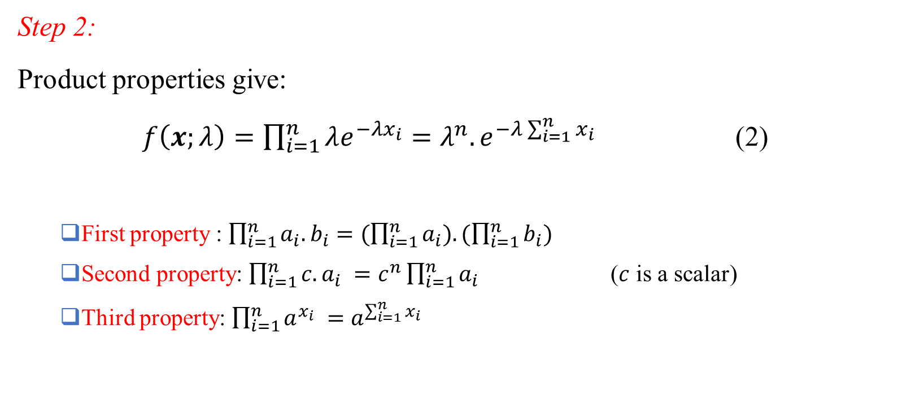
Question 4 (Cont’d)
Step 2:
Product properties give:
$f\left(x;λ\right)=\prod_{i=1}^{n}{λe^{−λx_{i}}}=λ^{n}.e^{−λ\sum_{i=1}^{n}{x_{i}}}$ (2)
First property : $\prod_{i=1}^{n}{a_{i}.b_{i}}=(\prod_{i=1}^{n}{a_{i}).(\prod_{i=1}^{n}{b_{i})}}$
Second property: $\prod_{i=1}^{n}{{c.a}_{i} }=c^{n}\prod_{i=1}^{n}{a_{i}}$ ($c$ is a scalar)
Third property: $\prod_{i=1}^{n}{a^{x_{i}} }=a^{\sum_{i=1}^{n}{x_{i}}}$
Data Science & Machine Learning in Finance: Problem set 2
University of Glasgow
2022-2023

Slide 25
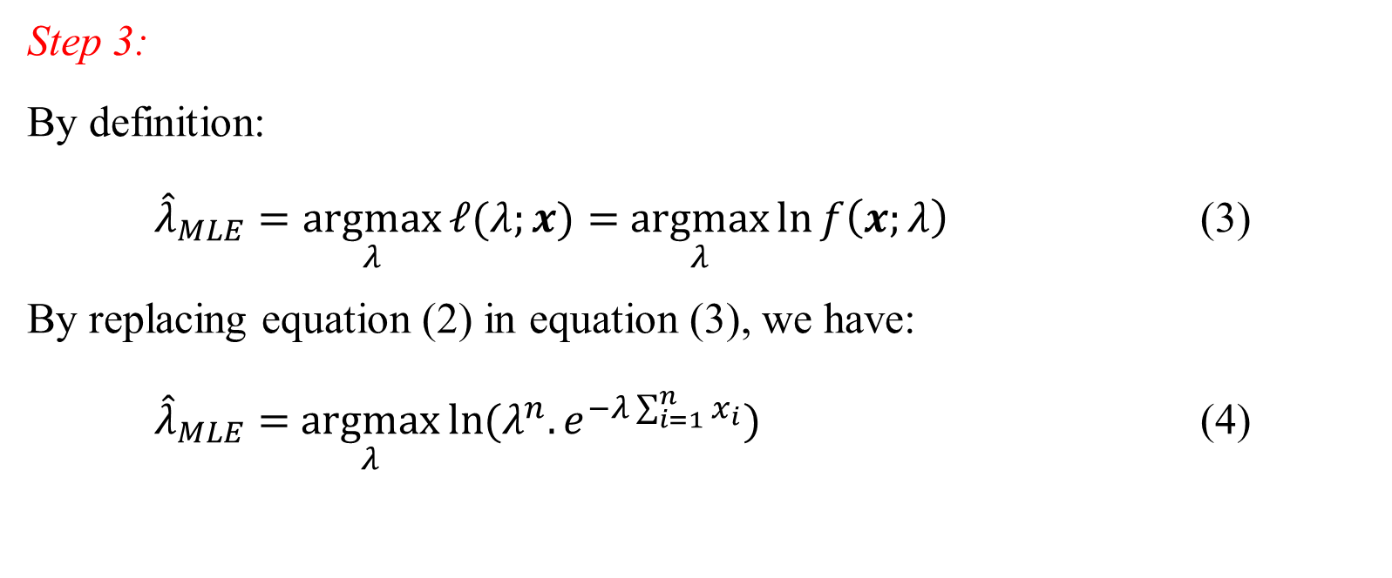
Question 4 (Cont’d)
Step 3:
By definition:
${\hat{λ}}_{MLE}=\underset{λ}{argmax}{ℓ(λ;x)}=$ $\underset{λ}{argmax}{\ln{f\left(x;λ\right)}}$ (3)
By replacing equation (2) in equation (3), we have:
${\hat{λ}}_{MLE}=$ $\underset{λ}{argmax}{\ln{(λ^{n}.e^{−λ\sum_{i=1}^{n}{x_{i}}})}}$ (4)
Data Science & Machine Learning in Finance: Problem set 2
University of Glasgow
2022-2023

Slide 26

Question 4 (Cont’d)
Step 4:
Logarithm properties give:
${\hat{λ}}_{MLE}=$ $\underset{λ}{argmax}\left\{n\ln{λ}−λ\sum_{i=1}^{n}{x_{i}}\right\}$ (5)
First property: $\ln{ab}=\ln{a}+\ln{b}$
Second property: $\ln{a^{n}}=n\ln{a}$
Third property: $\ln{e}=1.$
Data Science & Machine Learning in Finance: Problem set 2
University of Glasgow
2022-2023

Slide 27
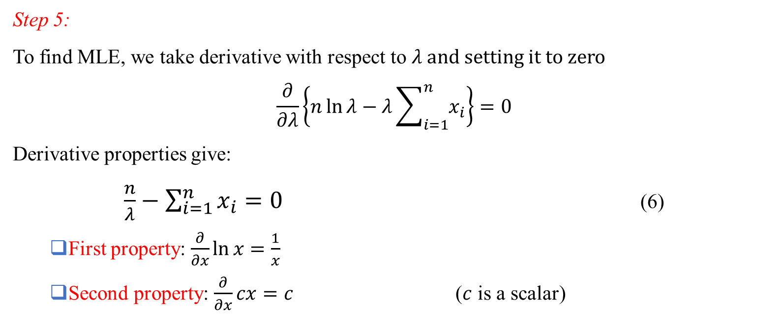
Question 4 (Cont’d)
Step 5:
To find MLE, we take derivative with respect to $λ$ and setting it to zero
$$\frac{∂}{∂λ}\left\{n\ln{λ}−λ\sum_{i=1}^{n}{x_{i}}\right\}=0$$
Derivative properties give:
$\frac{n}{λ}−\sum_{i=1}^{n}{x_{i}}=0$ (6)
First property: $\frac{∂}{∂x}\ln{x}=\frac{1}{x}$
Second property: $\frac{∂}{∂x}cx=c$ ($c$ is a scalar)
Data Science & Machine Learning in Finance: Problem set 2
University of Glasgow
2022-2023

Slide 28
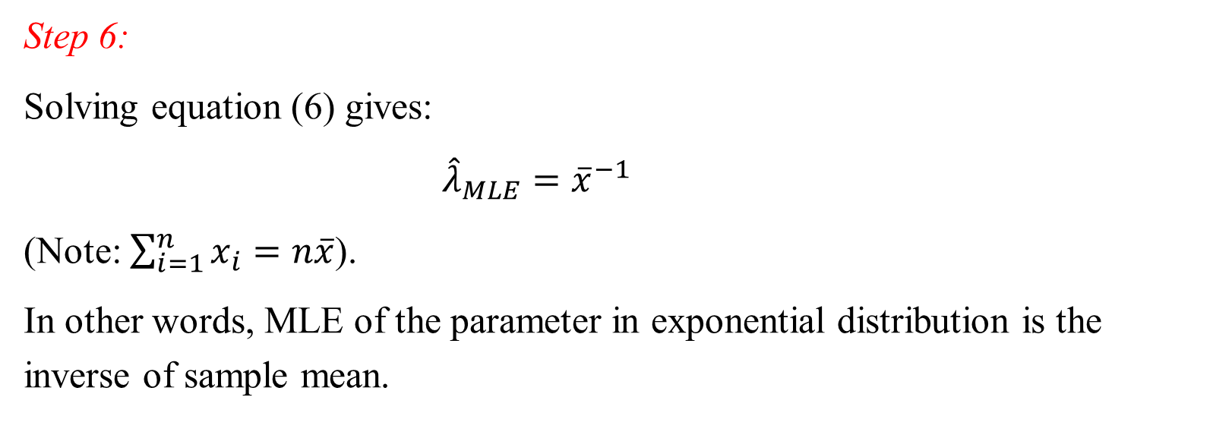
Question 4 (Cont’d)
Step 6:
Solving equation (6) gives:
${\hat{λ}}_{MLE}={\overline{x}}^{−1}$
(Note: $\sum_{i=1}^{n}{x_{i}}=n\overline{x}$).
In other words, MLE of the parameter in exponential distribution is the inverse of sample mean.
Data Science & Machine Learning in Finance: Problem set 2
University of Glasgow
2022-2023

Slide 29
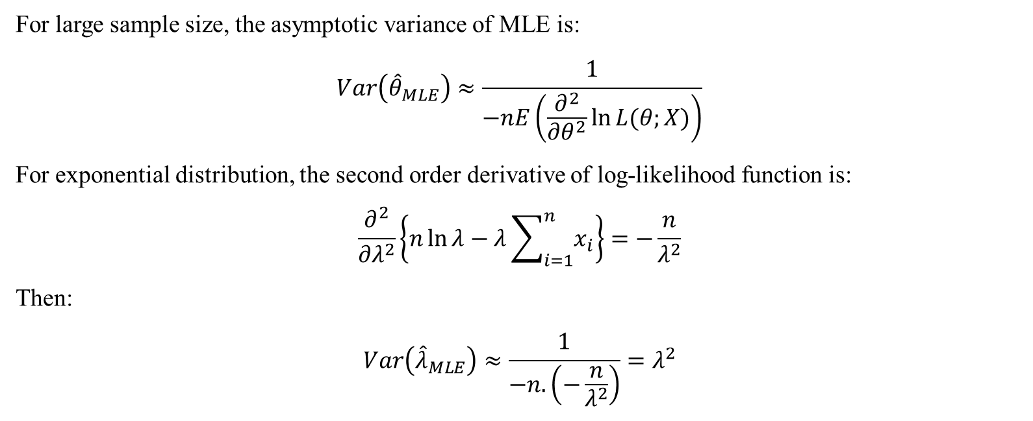
Question 4 (Cont’d)
For large sample size, the asymptotic variance of MLE is:
$$Var\left({\hat{θ}}_{MLE}\right)≈\frac{1}{−nE\left(\frac{∂^{2}}{∂θ^{2}}\ln{L(θ;X)}\right)}$$
For exponential distribution, the second order derivative of log-likelihood function is:
$$\frac{∂^{2}}{∂λ^{2}}\left\{n\ln{λ}−λ\sum_{i=1}^{n}{x_{i}}\right\}=−\frac{n}{λ^{2}}$$
Then:
$$Var\left({\hat{λ}}_{MLE}\right)≈\frac{1}{−n.\left(−\frac{n}{λ^{2}}\right)}=λ^{2}$$
Data Science & Machine Learning in Finance: Problem set 2
University of Glasgow
2022-2023

Slide 30
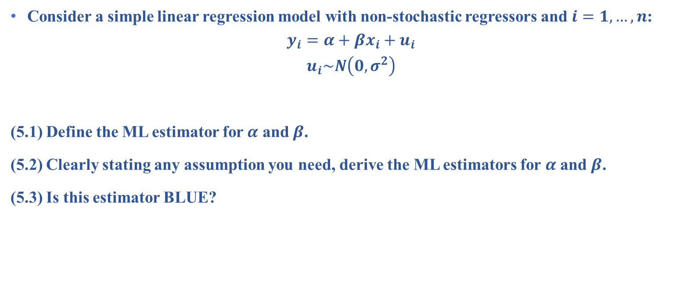
Question 5
Consider a simple linear regression model with non-stochastic regressors and $i=1,…,n$:
$$y_{i}=α+βx_{i}+u_{i}$$
$$u_{i}\sim N\left(0,σ^{2}\right)$$
(5.1) Define the ML estimator for $α$ and $β$.
(5.2) Clearly stating any assumption you need, derive the ML estimators for $α$ and $β$.
(5.3) Is this estimator BLUE?
Data Science & Machine Learning in Finance: Problem set 2
University of Glasgow
2022-2023

Slide 31
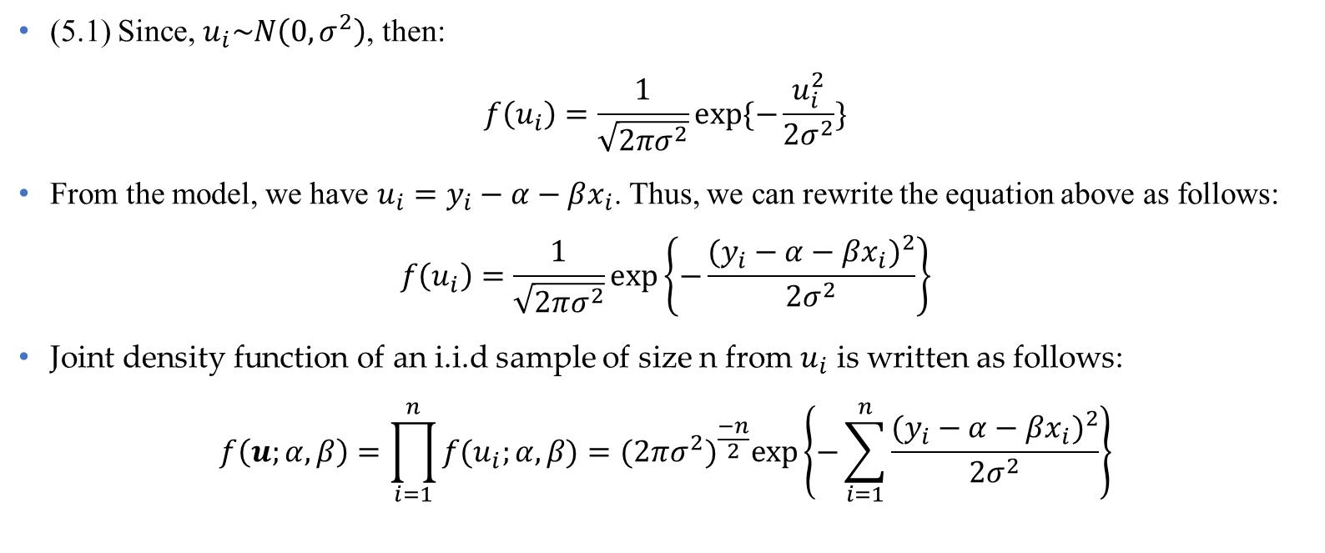
Question 5 (Cont’d)
(5.1) Since, $u_{i}\sim N\left(0,σ^{2}\right)$, then:
$$f\left(u_{i}\right)=\frac{1}{\sqrt{2πσ^{2}}}exp⁡\{−\frac{u_{i}^{2}}{2σ^{2}}\}$$
From the model, we have $u_{i}=y_{i}−α−βx_{i}$. Thus, we can rewrite the equation above as follows:
$$f\left(u_{i}\right)=\frac{1}{\sqrt{2πσ^{2}}}exp\left\{−\frac{{(y_{i}−α−βx_{i})}^{2}}{2σ^{2}}\right\}$$
Joint density function of an i.i.d sample of size n from $u_{i}$ is written as follows:
$$f\left(u;α,β\right)=\prod_{i=1}^{n}{f(u_{i};α,β)}={(2πσ^{2})}^{\frac{−n}{2}}exp⁡\left\{−\sum_{i=1}^{n}{\frac{{(y_{i}−α−βx_{i})}^{2}}{2σ^{2}}}\right\}$$
Data Science & Machine Learning in Finance: Problem set 2
University of Glasgow
2022-2023

Slide 32
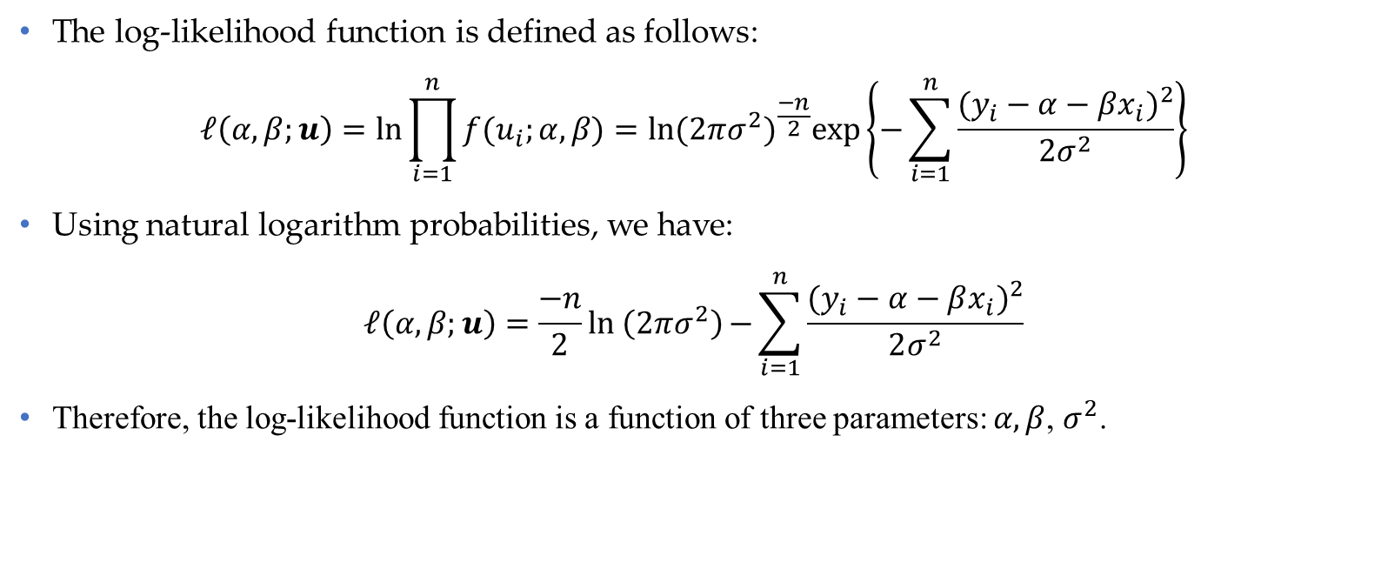
Question 5 (Cont’d)
The log-likelihood function is defined as follows:
$$ℓ\left(α,β;u\right)=ln\prod_{i=1}^{n}{f(u_{i};α,β)}=\ln{{(2πσ^{2})}^{\frac{−n}{2}}exp⁡\left\{−\sum_{i=1}^{n}{\frac{{(y_{i}−α−βx_{i})}^{2}}{2σ^{2}}}\right\}}$$
Using natural logarithm probabilities, we have:
$$ℓ\left(α,β;u\right)=\frac{−n}{2}ln \left(2πσ^{2}\right){−\sum_{i=1}^{n}{\frac{{(y_{i}−α−βx_{i})}^{2}}{2σ^{2}}}}$$
Therefore, the log-likelihood function is a function of three parameters: $α,β$, $σ^{2}$.
Data Science & Machine Learning in Finance: Problem set 2
University of Glasgow
2022-2023

Slide 33
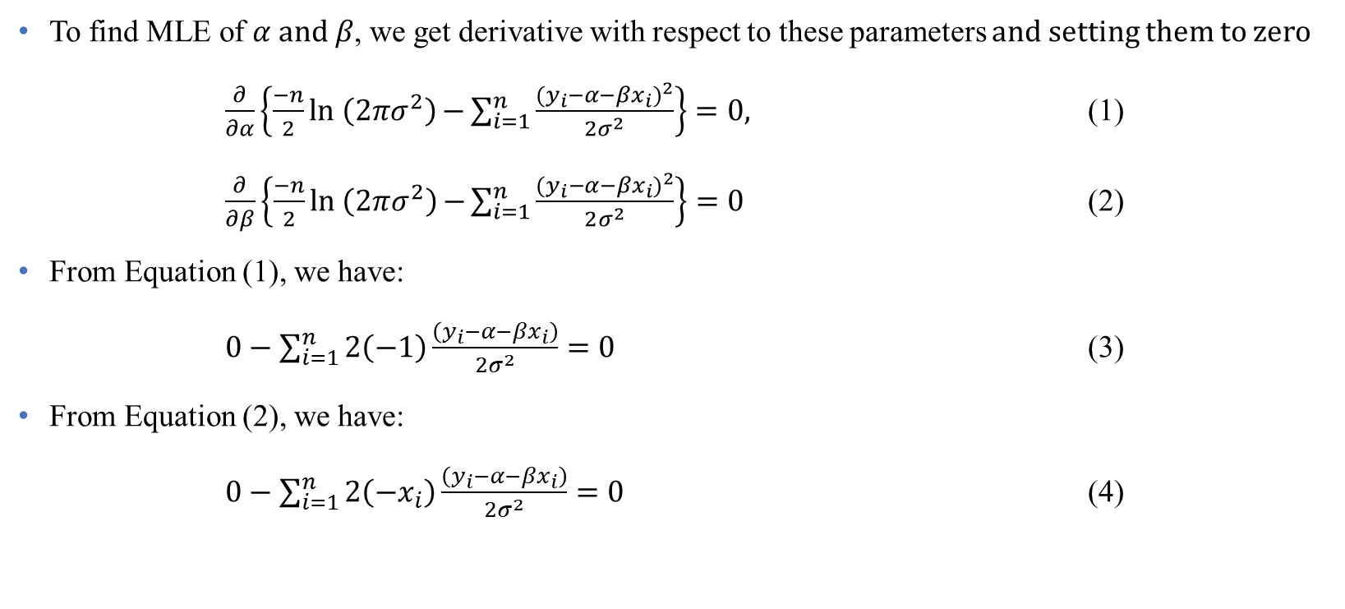
Question 5 (Cont’d)
To find MLE of $α and β$, we get derivative with respect to these parameters and setting them to zero
$\frac{∂}{∂α}\left\{\frac{−n}{2}ln \left(2πσ^{2}\right){−\sum_{i=1}^{n}{\frac{{(y_{i}−α−βx_{i})}^{2}}{2σ^{2}}}}\right\}=0,$ (1)
$\frac{∂}{∂β}\left\{\frac{−n}{2}ln \left(2πσ^{2}\right){−\sum_{i=1}^{n}{\frac{{(y_{i}−α−βx_{i})}^{2}}{2σ^{2}}}}\right\}=0$ (2)
From Equation (1), we have:
$0−\sum_{i=1}^{n}{2\left(−1\right)\frac{\left(y_{i}−α−βx_{i}\right)}{2σ^{2}}}=0$ (3)
From Equation (2), we have:
$0−\sum_{i=1}^{n}{2\left(−x_{i}\right)\frac{\left(y_{i}−α−βx_{i}\right)}{2σ^{2}}}=0$ (4)
Data Science & Machine Learning in Finance: Problem set 2
University of Glasgow
2022-2023

Slide 34
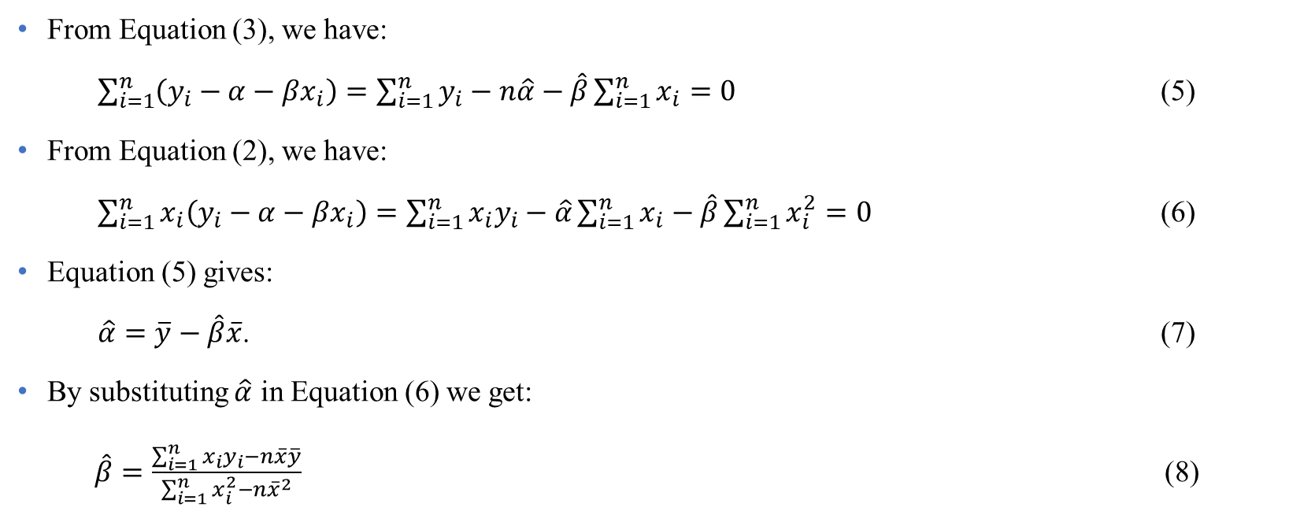
Question 5 (Cont’d)
From Equation (3), we have:
$\sum_{i=1}^{n}{\left(y_{i}−α−βx_{i}\right)}=\sum_{i=1}^{n}{y_{i}}−n\hat{α}−\hat{β}\sum_{i=1}^{n}{x_{i}}=0$ (5)
From Equation (2), we have:
$\sum_{i=1}^{n}{x_{i}\left(y_{i}−α−βx_{i}\right)}=\sum_{i=1}^{n}{x_{i}y_{i}−\hat{α}}\sum_{i=1}^{n}{x_{i}}−\hat{β}\sum_{i=1}^{n}{x_{i}^{2}}=0$ (6)
Equation (5) gives:
$\hat{α}=\overline{y}−\hat{β}\overline{x}$. (7)
By substituting $\hat{α}$ in Equation (6) we get:
$\hat{β}=\frac{\sum_{i=1}^{n}{x_{i}y_{i}}−n\overline{x}\overline{y}}{\sum_{i=1}^{n}{x_{i}^{2}}−n{\overline{x}}^{2}}$ (8)
Data Science & Machine Learning in Finance: Problem set 2
University of Glasgow
2022-2023

Slide 35

Question 5 (Cont’d)
Thus, ML estimators of $α,β$ are identical to the OLS estimators. In other words,
If the dependent variable in a regression is normally distributed, maximum likelihood and ordinary least squares produce the same parameter estimates.
Data Science & Machine Learning in Finance: Problem set 2
University of Glasgow
2022-2023

