Slide 1

Data Science & Machine Learning in Finance: Solution to Exercises 2.12
Hadi Movaghari
2022-2023

Slide 2
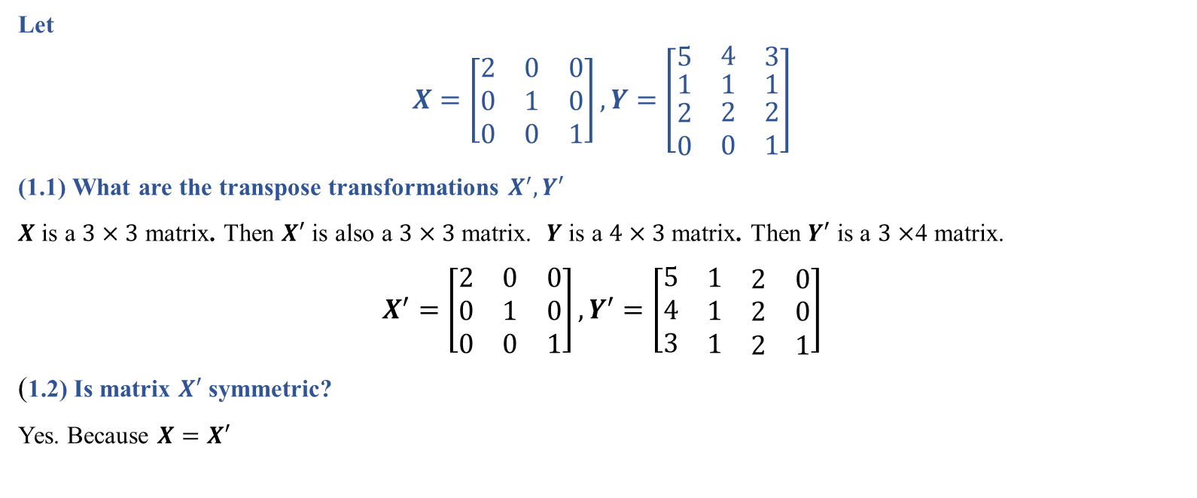
Question 1
Let
$$X=\left[\begin{matrix}2 & 0 & 0 \\ 0 & 1 & 0 \\ 0 & 0 & 1\end{matrix}\right], Y=\left[\begin{matrix}\begin{matrix}5 \\ \begin{matrix}1 \\ \begin{matrix}2 \\ 0\end{matrix}\end{matrix}\end{matrix} & \begin{matrix}4 \\ \begin{matrix}1 \\ \begin{matrix}2 \\ 0\end{matrix}\end{matrix}\end{matrix} & \begin{matrix}3 \\ \begin{matrix}1 \\ \begin{matrix}2 \\ 1\end{matrix}\end{matrix}\end{matrix}\end{matrix}\right]$$
(1.1) What are the transpose transformations $X^{′}, Y′$
$X$ is a $3×3$ matrix. Then $X′$ is also a $3×3$ matrix. $Y$ is a $4×3$ matrix. Then $Y′$ is a $3×$4 matrix.
$X^{′}=\left[\begin{matrix}2 & 0 & 0 \\ 0 & 1 & 0 \\ 0 & 0 & 1\end{matrix}\right], Y^{′}=\left[\begin{matrix}\begin{matrix}5 & \begin{matrix}1 & \begin{matrix}2 & 0\end{matrix}\end{matrix}\end{matrix} \\ \begin{matrix}4 & \begin{matrix}1 & \begin{matrix}2 & 0\end{matrix}\end{matrix}\end{matrix} \\ \begin{matrix}3 & \begin{matrix}1 & \begin{matrix}2 & 1\end{matrix}\end{matrix}\end{matrix}\end{matrix}\right]$
(1.2) Is matrix $X′$ symmetric?
Yes. Because $X=X′$
Data Science & Machine Learning in Finance: Solution to Exercises 2.12
University of Glasgow
2022-2023

Slide 3
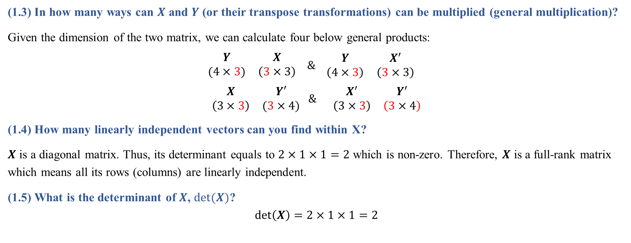
Question 1 (Cont’d)
(1.3) In how many ways can $X$ and $Y$ (or their transpose transformations) can be multiplied (general multiplication)?
Given the dimension of the two matrix, we can calculate four below general products:
$$\begin{matrix}Y & X \\ (4×3) & \left(3×3\right)\end{matrix} \& \begin{matrix}Y & X^{′} \\ \left(4×3\right) & \left(3×3\right)\end{matrix}$$
$$\begin{matrix}X & Y′ \\ \left(3×3\right) & (3×4)\end{matrix} \& \begin{matrix}X^{′} & Y^{′} \\ \left(3×3\right) & \left(3×4\right)\end{matrix}$$
(1.4) How many linearly independent vectors can you find within X?
$X$ is a diagonal matrix. Thus, its determinant equals to $2×1×1=2$ which is non-zero. Therefore, $X$ is a full-rank matrix which means all its rows (columns) are linearly independent.
(1.5) What is the determinant of $X$, $det⁡(X)$?
$$det\left(X\right)=2×1×1=2$$
Data Science & Machine Learning in Finance: Solution to Exercises 2.12
University of Glasgow
2022-2023

Slide 4
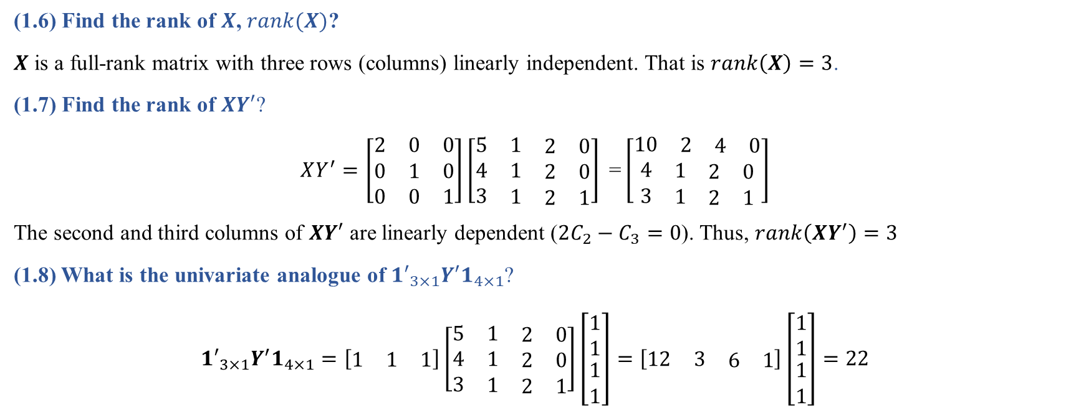
Question 1 (Cont’d)
(1.6) Find the rank of $X$, $rank(X)$?
$X$ is a full-rank matrix with three rows (columns) linearly independent. That is $rank\left(X\right)=3$.
(1.7) Find the rank of $XY′$?
$$XY^{′}=\left[\begin{matrix}2 & 0 & 0 \\ 0 & 1 & 0 \\ 0 & 0 & 1\end{matrix}\right]\left[\begin{matrix}\begin{matrix}5 & \begin{matrix}1 & \begin{matrix}2 & 0\end{matrix}\end{matrix}\end{matrix} \\ \begin{matrix}4 & \begin{matrix}1 & \begin{matrix}2 & 0\end{matrix}\end{matrix}\end{matrix} \\ \begin{matrix}3 & \begin{matrix}1 & \begin{matrix}2 & 1\end{matrix}\end{matrix}\end{matrix}\end{matrix}\right] \text{=}\left[\begin{matrix}\begin{matrix}10 & \begin{matrix}2 & \begin{matrix}4 & 0\end{matrix}\end{matrix}\end{matrix} \\ \begin{matrix}4 & \begin{matrix}1 & \begin{matrix}2 & 0\end{matrix}\end{matrix}\end{matrix} \\ \begin{matrix}3 & \begin{matrix}1 & \begin{matrix}2 & 1\end{matrix}\end{matrix}\end{matrix}\end{matrix}\right]$$
The second and third columns of $XY′$ are linearly dependent ($2C_{2}−C_{3}=0$). Thus, $rank\left(XY^{′}\right)=3$
(1.8) What is the univariate analogue of ${1′}_{3×1}Y′1_{4×1}$?
$${1′}_{3×1}Y^{′}1_{4×1}=\left[\begin{matrix}1 & 1 & 1\end{matrix}\right]\left[\begin{matrix}\begin{matrix}5 & \begin{matrix}1 & \begin{matrix}2 & 0\end{matrix}\end{matrix}\end{matrix} \\ \begin{matrix}4 & \begin{matrix}1 & \begin{matrix}2 & 0\end{matrix}\end{matrix}\end{matrix} \\ \begin{matrix}3 & \begin{matrix}1 & \begin{matrix}2 & 1\end{matrix}\end{matrix}\end{matrix}\end{matrix}\right]\left[\begin{matrix}1 \\ 1 \\ \begin{matrix}1 \\ 1\end{matrix}\end{matrix}\right]=\left[\begin{matrix}12 & 3 & \begin{matrix}6 & 1\end{matrix}\end{matrix}\right]\left[\begin{matrix}1 \\ 1 \\ \begin{matrix}1 \\ 1\end{matrix}\end{matrix}\right]=22$$
Data Science & Machine Learning in Finance: Solution to Exercises 2.12
University of Glasgow
2022-2023

Slide 5
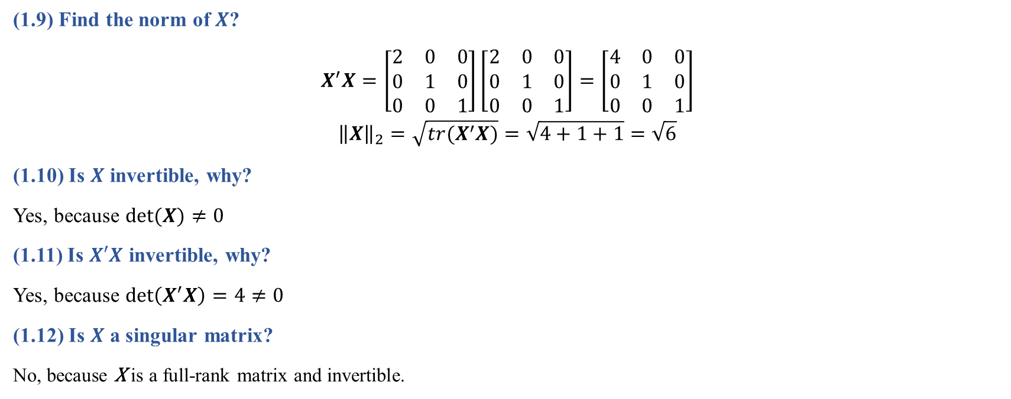
Question 1 (Cont’d)
(1.9) Find the norm of $X$?
$$X^{′}X=\left[\begin{matrix}2 & 0 & 0 \\ 0 & 1 & 0 \\ 0 & 0 & 1\end{matrix}\right]\left[\begin{matrix}2 & 0 & 0 \\ 0 & 1 & 0 \\ 0 & 0 & 1\end{matrix}\right]=\left[\begin{matrix}4 & 0 & 0 \\ 0 & 1 & 0 \\ 0 & 0 & 1\end{matrix}\right]$$
$${\left\|X\right\|}_{2}=\sqrt{tr(X^{′}X)}=\sqrt{4+1+1}=\sqrt{6}$$
(1.10) Is $X$ invertible, why?
Yes, because $det⁡(X)≠0$
(1.11) Is $X′X$ invertible, why?
Yes, because $\det\left(X^{′}X\right)=4≠0$
(1.12) Is $X$ a singular matrix?
No, because X is a full-rank matrix and invertible.
Data Science & Machine Learning in Finance: Solution to Exercises 2.12
University of Glasgow
2022-2023

Slide 6
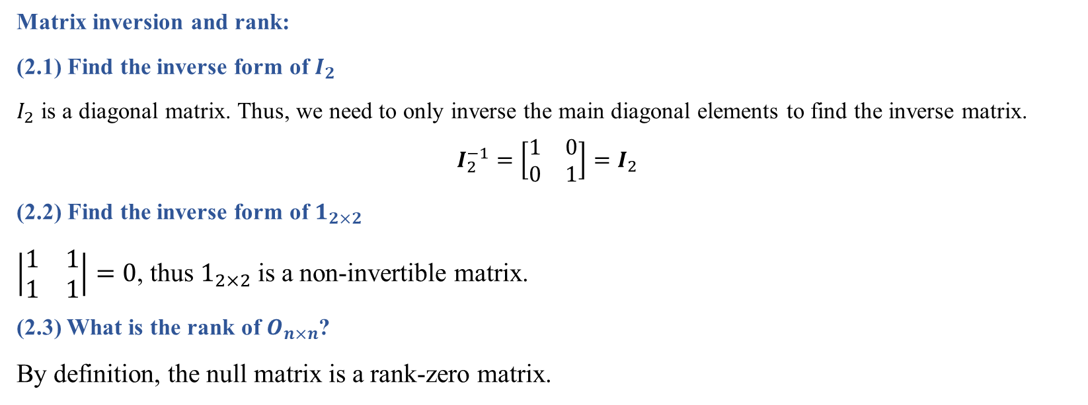
Question 2
Matrix inversion and rank:
(2.1) Find the inverse form of $I_{2}$
$I_{2}$ is a diagonal matrix. Thus, we need to only inverse the main diagonal elements to find the inverse matrix.
$$I_{2}^{−1}=\left[\begin{matrix}1 & 0 \\ 0 & 1\end{matrix}\right]=I_{2}$$
(2.2) Find the inverse form of $1_{2×2}$
$\left|\begin{matrix}1 & 1 \\ 1 & 1\end{matrix}\right|=0$, thus $1_{2×2}$ is a non-invertible matrix.
(2.3) What is the rank of $O_{n×n}$?
By definition, the null matrix is a rank-zero matrix.
Data Science & Machine Learning in Finance: Solution to Exercises 2.12
University of Glasgow
2022-2023

Slide 7

Question 3
Let
$$X=\left[\begin{matrix}2 & −2 & −4 \\ −1 & 3 & 4 \\ 1 & −2 & −3\end{matrix}\right]$$
(3.1) Find the rank and determinant of $X$.
$$det\left(X\right)=\left(2×\left(−9+8\right)\right)−\left(−2×\left(3−4\right)\right)+\left(−4×\left(2−3\right)\right)=−2−2+4=0$$
Thus, $X$ is a non-full-rank matrix.
(3.2) Is $X$ an idempotent matrix?
No because $XX≠X$
$$XX=\left[\begin{matrix}2 & −2 & −2 \\ −1 & 3 & 4 \\ 1 & −2 & −3\end{matrix}\right]\left[\begin{matrix}2 & −2 & −2 \\ −1 & 3 & 4 \\ 1 & −2 & −3\end{matrix}\right]=\left[\begin{matrix}4 & −6 & −12 \\ −1 & 3 & 2 \\ 1 & −2 & −1\end{matrix}\right]$$
Data Science & Machine Learning in Finance: Solution to Exercises 2.12
University of Glasgow
2022-2023

Slide 8

Question 4
Let
$$X=\left[\begin{matrix}1 & 1 & 1 \\ 1 & 1 & 0 \\ 1 & 0 & 0\end{matrix}\right], Y=\left[\begin{matrix}1 \\ 2 \\ 3\end{matrix}\right]$$
(4.1) What is ${(X^{′}X)}^{−1}$.
$$X^{′}X=\left[\begin{matrix}1 & 1 & 1 \\ 1 & 1 & 0 \\ 1 & 0 & 0\end{matrix}\right]\left[\begin{matrix}1 & 1 & 1 \\ 1 & 1 & 0 \\ 1 & 0 & 0\end{matrix}\right]=\left[\begin{matrix}3 & 2 & 1 \\ 2 & 2 & 1 \\ 1 & 1 & 1\end{matrix}\right]$$
$$\det\left(X′X\right)=\left(3×(2−1)\right)−\left(2×\left(2−1\right)\right)+\left(1×\left(2−2\right)\right)=3−2=1$$
$$\operatorname{adj}\left(X^{′}X\right)=\left[\begin{matrix}1 & −1 & 0 \\ −1 & 2 & −1 \\ 2 & −1 & 2\end{matrix}\right]$$
$${(X′X)}^{−1}=\frac{1}{1}\left[\begin{matrix}1 & −1 & 0 \\ −1 & 2 & −1 \\ 2 & −1 & 2\end{matrix}\right]$$
Data Science & Machine Learning in Finance: Solution to Exercises 2.12
University of Glasgow
2022-2023

Slide 9
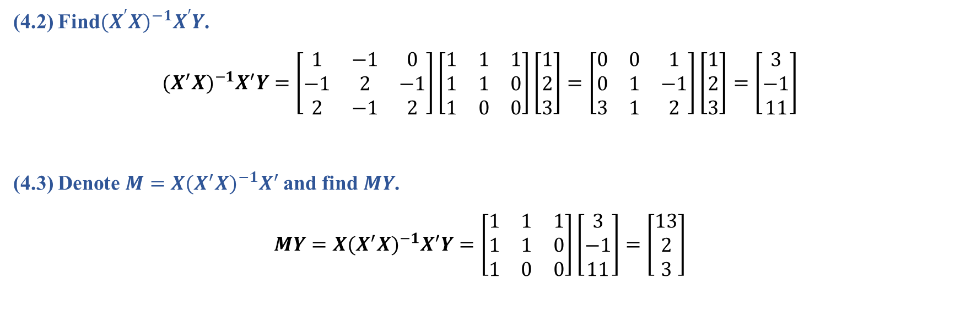
Question 4 (Cont’d)
(4.2) Find${(X^{′}X)}^{−1}X^{′}Y$.
$${(X^{′}X)}^{−1}X^{′}Y=\left[\begin{matrix}1 & −1 & 0 \\ −1 & 2 & −1 \\ 2 & −1 & 2\end{matrix}\right]\left[\begin{matrix}1 & 1 & 1 \\ 1 & 1 & 0 \\ 1 & 0 & 0\end{matrix}\right]\left[\begin{matrix}1 \\ 2 \\ 3\end{matrix}\right]=\left[\begin{matrix}0 & 0 & 1 \\ 0 & 1 & −1 \\ 3 & 1 & 2\end{matrix}\right]\left[\begin{matrix}1 \\ 2 \\ 3\end{matrix}\right]=\left[\begin{matrix}3 \\ −1 \\ 11\end{matrix}\right]$$
(4.3) Denote ${M=X(X^{′}X)}^{−1}X^{′}$and find$MY$.
$$MY={X(X^{′}X)}^{−1}X^{′}Y=\left[\begin{matrix}1 & 1 & 1 \\ 1 & 1 & 0 \\ 1 & 0 & 0\end{matrix}\right]\left[\begin{matrix}3 \\ −1 \\ 11\end{matrix}\right]=\left[\begin{matrix}13 \\ 2 \\ 3\end{matrix}\right]$$
Data Science & Machine Learning in Finance: Solution to Exercises 2.12
University of Glasgow
2022-2023

Slide 10
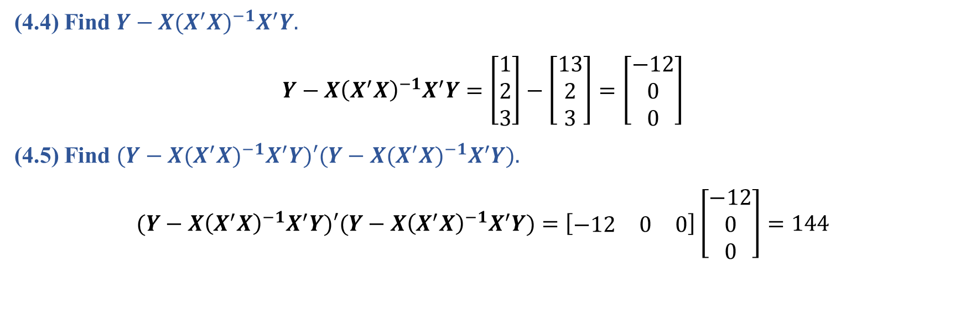
Question 4 (Cont’d)
(4.4) Find ${Y−X(X^{′}X)}^{−1}X^{′}Y.$
$$Y−{X\left(X^{′}X\right)}^{−1}X^{′}Y=\left[\begin{matrix}1 \\ 2 \\ 3\end{matrix}\right]−\left[\begin{matrix}13 \\ 2 \\ 3\end{matrix}\right]=\left[\begin{matrix}−12 \\ 0 \\ 0\end{matrix}\right]$$
(4.5) Find ${(Y−X(X^{′}X)}^{−1}X^{′}Y)′({Y−X(X^{′}X)}^{−1}X^{′}Y).$
$$(Y−{X\left(X^{′}X\right)}^{−1}X^{′}Y)′(Y−{X\left(X^{′}X\right)}^{−1}X^{′}Y)=\left[\begin{matrix}−12 & 0 & 0\end{matrix}\right]\left[\begin{matrix}−12 \\ 0 \\ 0\end{matrix}\right]=144$$
Data Science & Machine Learning in Finance: Solution to Exercises 2.12
University of Glasgow
2022-2023

Slide 11

Question 5
Let :
$$X=\left[\begin{matrix}1 & 1 \\ 1 & 1 \\ 1 & 0\end{matrix}\right], Y=\left[\begin{matrix}1 \\ 2 \\ 3\end{matrix}\right]$$
(5.1) What is ${(X^{′}X)}^{−1}$.
$$X^{′}X=\left[\begin{matrix}1 & 1 & 1 \\ 1 & 1 & 0\end{matrix}\right]\left[\begin{matrix}1 & 1 \\ 1 & 1 \\ 1 & 0\end{matrix}\right]=\left[\begin{matrix}3 & 2 \\ 2 & 2\end{matrix}\right]$$
$$\det\left(X′X\right)=\left(3×2\right)−\left(2×2\right)=6−4=2$$
$$\operatorname{adj}\left(X^{′}X\right)=\left[\begin{matrix}2 & −2 \\ −2 & 3\end{matrix}\right]$$
$${(X′X)}^{−1}=\frac{1}{2}\left[\begin{matrix}2 & −2 \\ −2 & 3\end{matrix}\right]$$

Slide 12
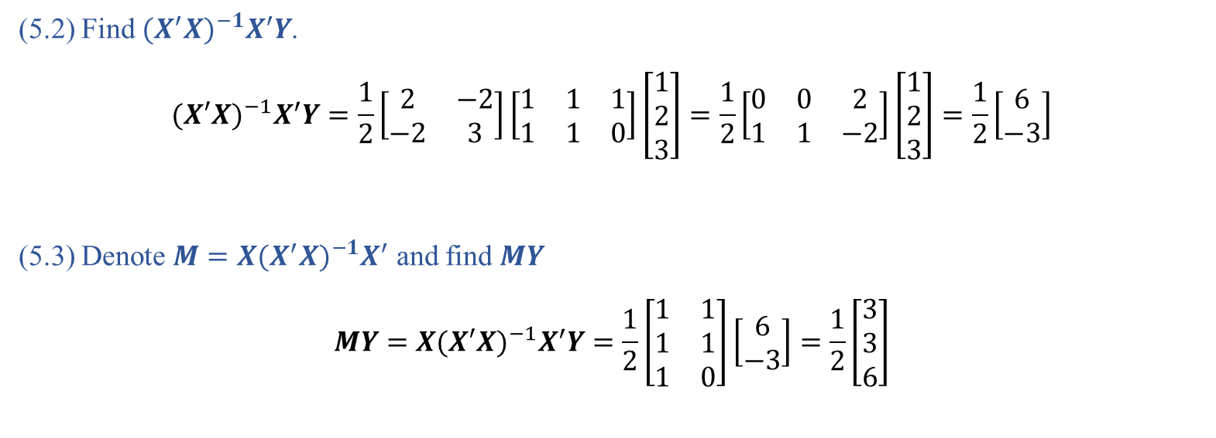
Question 5 (Cont’d)
(5.2) Find ${(X^{′}X)}^{−1}X^{′}Y$.
$${(X′X)}^{−1}X^{′}Y=\frac{1}{2}\left[\begin{matrix}2 & −2 \\ −2 & 3\end{matrix}\right]\left[\begin{matrix}1 & 1 & 1 \\ 1 & 1 & 0\end{matrix}\right]\left[\begin{matrix}1 \\ 2 \\ 3\end{matrix}\right]=\frac{1}{2}\left[\begin{matrix}0 & 0 & 2 \\ 1 & 1 & −2\end{matrix}\right]\left[\begin{matrix}1 \\ 2 \\ 3\end{matrix}\right]=\frac{1}{2}\left[\begin{matrix}6 \\ −3\end{matrix}\right]$$
(5.3) Denote ${M=X(X^{′}X)}^{−1}X^{′}$ and find $MY$
$$MY=X{(X′X)}^{−1}X^{′}Y=\frac{1}{2}\left[\begin{matrix}1 & 1 \\ 1 & 1 \\ 1 & 0\end{matrix}\right]\left[\begin{matrix}6 \\ −3\end{matrix}\right]=\frac{1}{2}\left[\begin{matrix}3 \\ 3 \\ 6\end{matrix}\right]$$

Slide 13

Question 5 (Cont’d)
(5.4) Find ${Y−X(X^{′}X)}^{−1}X^{′}Y$
$$Y−X{\left(X^{′}X\right)}^{−1}X^{′}Y=\left[\begin{matrix}1 \\ 2 \\ 3\end{matrix}\right]−\frac{1}{2}\left[\begin{matrix}3 \\ 3 \\ 6\end{matrix}\right]=\left[\begin{matrix}−\frac{1}{2} \\ \frac{1}{2} \\ 0\end{matrix}\right]$$
(5.5) Find ${(Y−X(X^{′}X)}^{−1}X^{′}Y)′({Y−X\left(X^{′}X\right)}^{−1}X^{′}Y).$
$${(Y−X(X^{′}X)}^{−1}X^{′}Y)′({Y−X\left(X^{′}X\right)}^{−1}X^{′}Y)=\left[\begin{matrix}−\frac{1}{2} & \frac{1}{2} & 0\end{matrix}\right]\left[\begin{matrix}−\frac{1}{2} \\ \frac{1}{2} \\ 0\end{matrix}\right]=\frac{1}{2}$$

Slide 14

Question 6
Let :
$$X=\left[\begin{matrix}4x & 0 & 0 \\ x & −y & 0 \\ 1 & 1 & 1\end{matrix}\right]$$
(6.1) Find $det⁡(X)$.
$$\det\left(X\right)=4x\left(−y−0\right)+0+0=−4xy$$
(6.2) What condition is required to ensure $X^{−1}$ exists?
We must have $xy≠0$ which implies $x≠0,$ and $y≠0$.

Slide 15
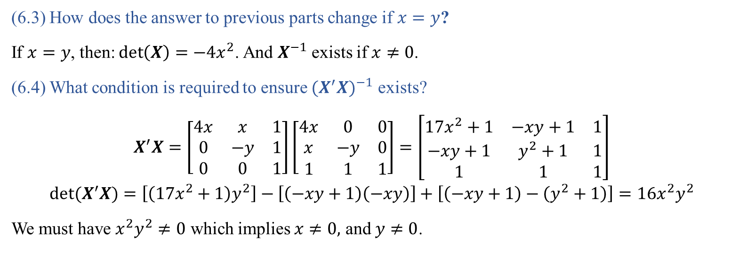
Question 6 (Cont’d)
(6.3) How does the answer to previous parts change if $x=y$?
If $x=y$, then:$\det\left(X\right)=−4x^{2}$. And $X^{−1}$ exists if $x≠0$.
(6.4) What condition is required to ensure ${(X^{′}X)}^{−1}$ exists?
$$X^{′}X=\left[\begin{matrix}4x & x & 1 \\ 0 & −y & 1 \\ 0 & 0 & 1\end{matrix}\right]\left[\begin{matrix}4x & 0 & 0 \\ x & −y & 0 \\ 1 & 1 & 1\end{matrix}\right]=\left[\begin{matrix}17x^{2}+1 & −xy+1 & 1 \\ −xy+1 & y^{2}+1 & 1 \\ 1 & 1 & 1\end{matrix}\right]$$
$${det(X}^{′}X)=\left[\left(17x^{2}+1\right)y^{2}\right]−\left[\left(−xy+1\right)\left(−xy\right)\right]+\left[\left(−xy+1\right)−\left(y^{2}+1\right)\right]=16x^{2}y^{2}$$
We must have $x^{2}y^{2}≠0$ which implies $x≠0,$ and $y≠0$.

Slide 16
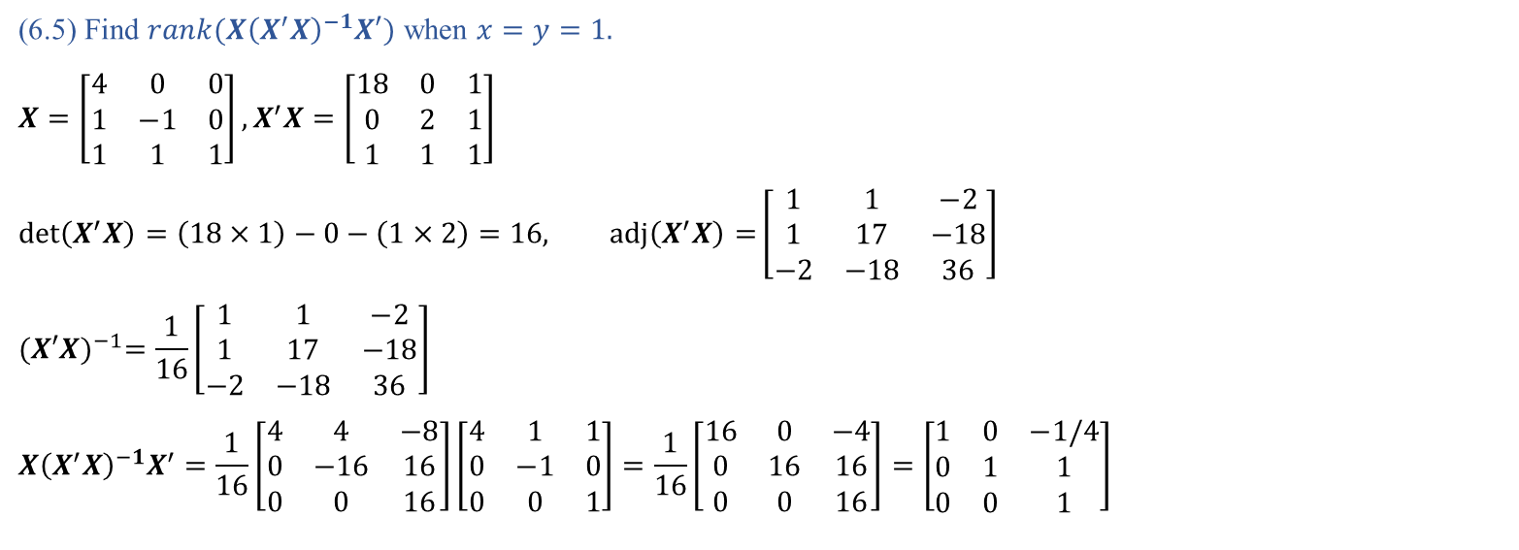
Question 6 (Cont’d)
(6.5) Find $rank(X{\left(X^{′}X\right)}^{−1}X′)$ when $x=y=1.$
$$X=\left[\begin{matrix}4 & 0 & 0 \\ 1 & −1 & 0 \\ 1 & 1 & 1\end{matrix}\right],X^{′}X=\left[\begin{matrix}18 & 0 & 1 \\ 0 & 2 & 1 \\ 1 & 1 & 1\end{matrix}\right]$$
$$\det\left(X^{′}X\right)=\left(18×1\right)−0−\left(1×2\right)=16, \operatorname{adj}\left(X^{′}X\right)=\left[\begin{matrix}1 & 1 & −2 \\ 1 & 17 & −18 \\ −2 & −18 & 36\end{matrix}\right]$$
$${(X′X)}^{−1}=\frac{1}{16}\left[\begin{matrix}1 & 1 & −2 \\ 1 & 17 & −18 \\ −2 & −18 & 36\end{matrix}\right]$$
$$X{\left(X^{′}X\right)}^{−1}X^{′}=\frac{1}{16}\left[\begin{matrix}4 & 4 & −8 \\ 0 & −16 & 16 \\ 0 & 0 & 16\end{matrix}\right]\left[\begin{matrix}4 & 1 & 1 \\ 0 & −1 & 0 \\ 0 & 0 & 1\end{matrix}\right]=\frac{1}{16}\left[\begin{matrix}16 & 0 & −4 \\ 0 & 16 & 16 \\ 0 & 0 & 16\end{matrix}\right]=\left[\begin{matrix}1 & 0 & −1/4 \\ 0 & 1 & 1 \\ 0 & 0 & 1\end{matrix}\right]$$

Slide 17

Question 6 (Cont’d)
(6.6) Find $tr(X{\left(X^{′}X\right)}^{−1}X′)$ and $det(X{\left(X^{′}X\right)}^{−1}X′)$ when $x=y=1$.
$tr\left(X{\left(X^{′}X\right)}^{−1}X^{′}\right)=3$.
$$det\left(X{\left(X^{′}X\right)}^{−1}X^{′}\right)=\left(1×1\right)−0−0=1$$

Slide 18
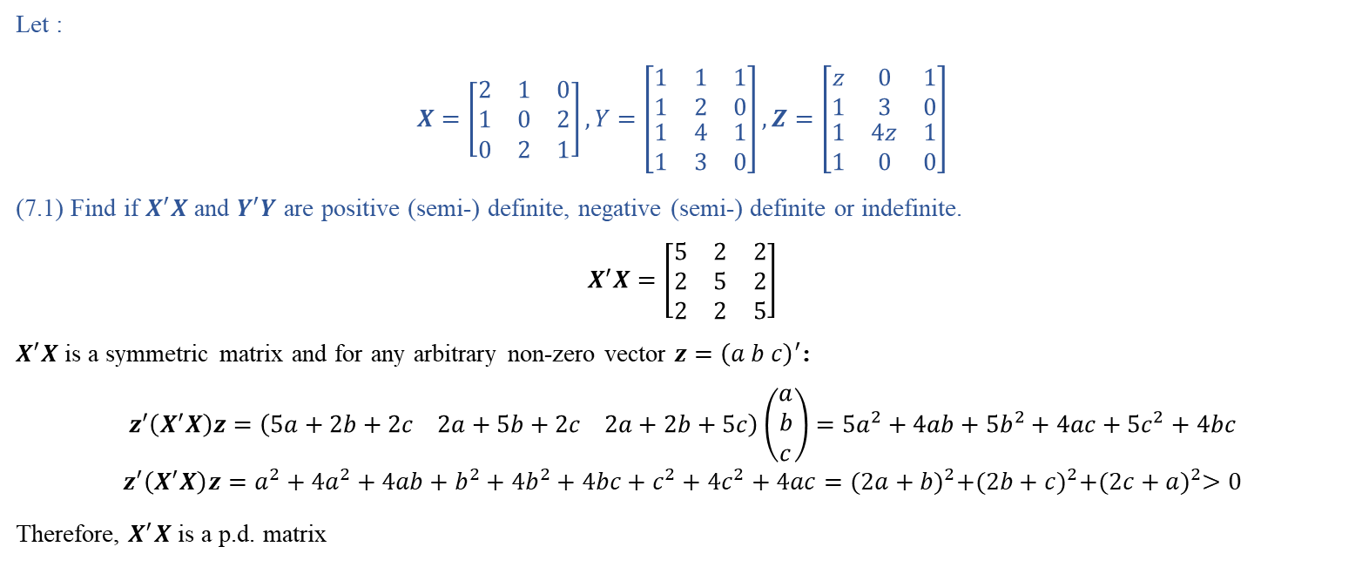
Question 7
Let :
$$X=\left[\begin{matrix}2 & 1 & 0 \\ 1 & 0 & 2 \\ 0 & 2 & 1\end{matrix}\right],Y=\left[\begin{matrix}1 & 1 & 1 \\ 1 & 2 & 0 \\ \begin{matrix}1 \\ 1\end{matrix} & \begin{matrix}4 \\ 3\end{matrix} & \begin{matrix}1 \\ 0\end{matrix}\end{matrix}\right],Z=\left[\begin{matrix}z & 0 & 1 \\ 1 & 3 & 0 \\ \begin{matrix}1 \\ 1\end{matrix} & \begin{matrix}4z \\ 0\end{matrix} & \begin{matrix}1 \\ 0\end{matrix}\end{matrix}\right]$$
(7.1) Find if $X^{′}X$ and $Y^{′}Y$ are positive (semi-) definite, negative (semi-) definite or indefinite.
$$X^{′}X=\left[\begin{matrix}5 & 2 & 2 \\ 2 & 5 & 2 \\ 2 & 2 & 5\end{matrix}\right]$$
$X^{′}X$is a symmetric matrix and for any arbitrary non-zero vector $z={\left(a b c\right)}^{′}$:
$$z^{′}\left(X^{′}X\right)z=\left(5a+2b+2c 2a+5b+2c 2a+2b+5c\right)\left(\begin{matrix}a \\ b \\ c\end{matrix}\right)=5a^{2}+4ab+5b^{2}+4ac+5c^{2}+4bc$$
$$z^{′}\left(X^{′}X\right)z=a^{2}+4a^{2}+4ab+b^{2}+4b^{2}+4bc+c^{2}+4c^{2}+4ac={(2a+b)}^{2}+{(2b+c)}^{2}+{(2c+a)}^{2}>0$$
Therefore, $X^{′}X$ is a p.d. matrix

Slide 19
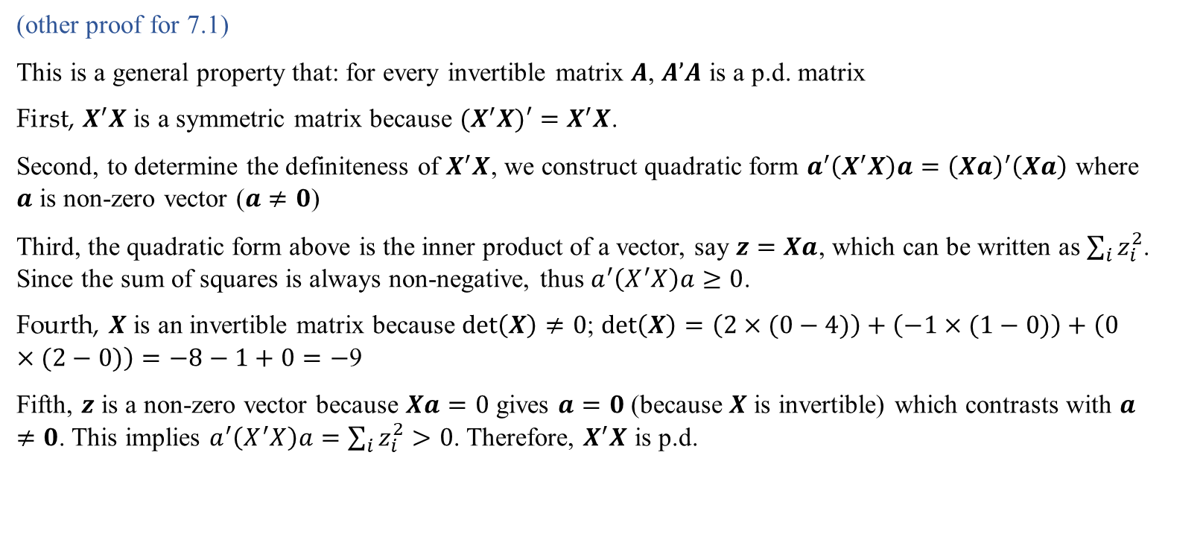
Question 7 (Cont’d)
(other proof for 7.1)
This is a general property that: for every invertible matrix $A$, $A’A$ is a p.d. matrix
First, $X^{′}X$ is a symmetric matrix because ${(X}^{′}X)′=X^{′}X$.
Second, to determine the definiteness of $X^{′}X$, we construct quadratic form $a^{′}\left(X^{′}X\right)a={\left(Xa\right)}^{′}\left(Xa\right)$ where $a$ is non-zero vector ($a≠0$)
Third, the quadratic form above is the inner product of a vector, say $z=Xa$, which can be written as $\sum_{i}{z_{i}^{2}}$. Since the sum of squares is always non-negative, thus $a^{′}\left(X^{′}X\right)a≥0$.
Fourth, $X$ is an invertible matrix because $\det\left(X\right)≠0$; $\det\left(X\right)=\left(2×(0−4)\right)+\left(−1×(1−0)\right)+\left(0×(2−0)\right)=−8−1+0=−$9
Fifth, $z$ is a non-zero vector because $Xa=0$ gives $a=0$ (because $X$ is invertible) which contrasts with $a≠0$. This implies $a^{′}\left(X^{′}X\right)a=\sum_{i}{z_{i}^{2}}>0$. Therefore, $X^{′}X$ is p.d.

Slide 20
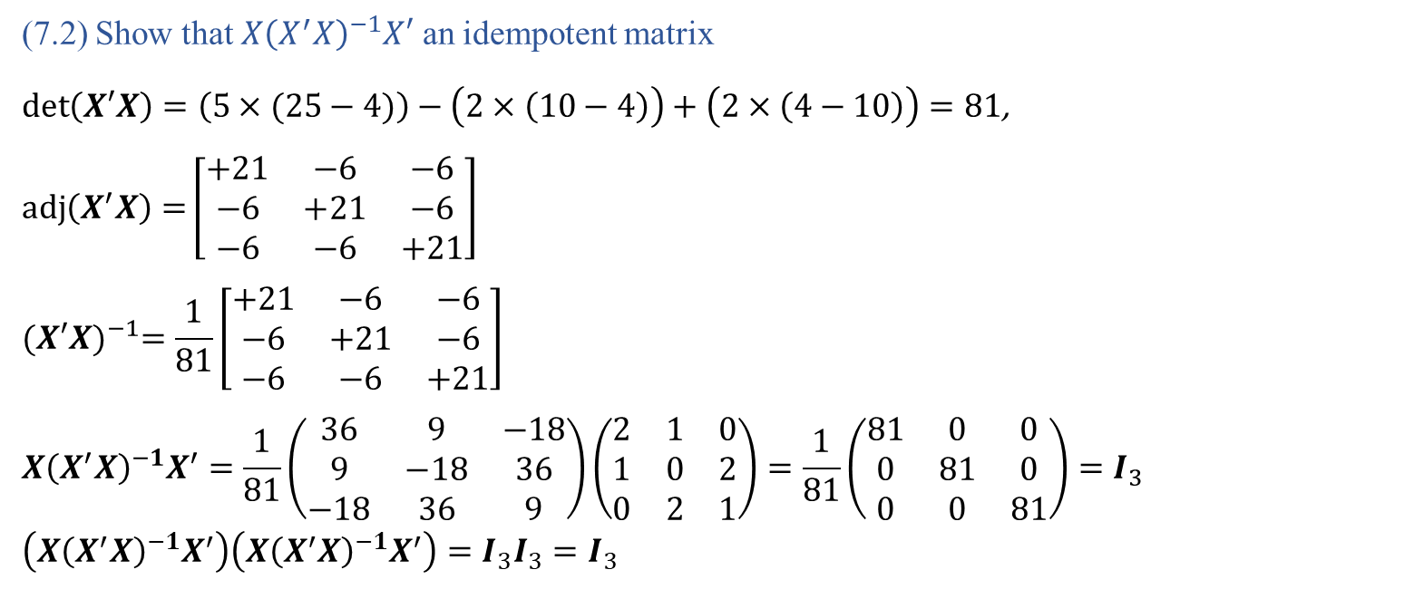
Question 7 (Cont’d)
(7.2) Show that $X{\left(X^{′}X\right)}^{−1}X′$ an idempotent matrix
$\det\left(X′X\right)=\left(5×(25−4)\right)−\left(2×\left(10−4\right)\right)+\left(2×\left(4−10\right)\right)=81$, $\operatorname{adj}\left(X^{′}X\right)=\left[\begin{matrix}+21 & −6 & −6 \\ −6 & +21 & −6 \\ −6 & −6 & +21\end{matrix}\right]$
$${(X′X)}^{−1}=\frac{1}{81}\left[\begin{matrix}+21 & −6 & −6 \\ −6 & +21 & −6 \\ −6 & −6 & +21\end{matrix}\right]$$
$$X{\left(X^{′}X\right)}^{−1}X^{′}=\frac{1}{81}\left(\begin{matrix}36 & 9 & −18 \\ 9 & −18 & 36 \\ −18 & 36 & 9\end{matrix}\right)\left(\begin{matrix}2 & 1 & 0 \\ 1 & 0 & 2 \\ 0 & 2 & 1\end{matrix}\right)=\frac{1}{81}\left(\begin{matrix}81 & 0 & 0 \\ 0 & 81 & 0 \\ 0 & 0 & 81\end{matrix}\right)=I_{3}$$
$$\left(X{\left(X^{′}X\right)}^{−1}X^{′}\right)\left(X{\left(X^{′}X\right)}^{−1}X^{′}\right)=I_{3}I_{3}=I_{3}$$

