Slide 1

Data Science & Machine Learning in Finance: Solution to Exercises 1.10
Hadi Movaghari
2022-2023

Slide 2
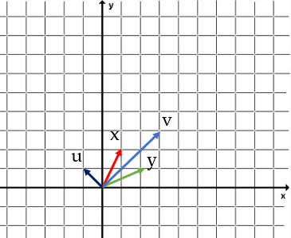

Question 1
Let $x = (1, 2)’$and $y = (2 1)’$:
(1.1) Find v = x + y
v$=\left[\begin{matrix}1 \\ 2\end{matrix}\right]$ + $\left[\begin{matrix}2 \\ 1\end{matrix}\right]$= $\left[\begin{matrix}3 \\ 3\end{matrix}\right]$
(1.2) Find u = x - y
$u=\left[\begin{matrix}1 \\ 2\end{matrix}\right]$ -$\left[\begin{matrix}2 \\ 1\end{matrix}\right]$= $\left[\begin{matrix}−1 \\ 1\end{matrix}\right]$
(1.3) Draw a diagram of x, y, u and v
Data Science & Machine Learning in Finance: Solution to Exercises 1.10
University of Glasgow
2022-2023

Slide 3
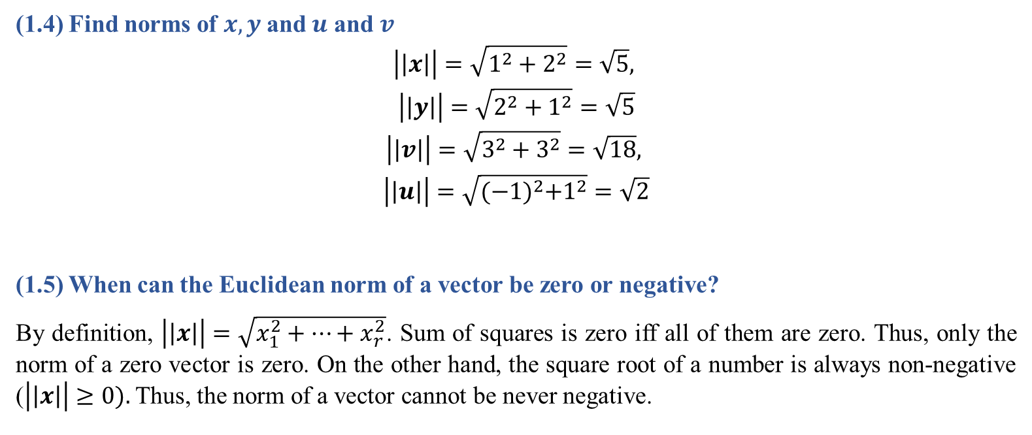
Question 1 (Cont’d)
(1.4) Find norms of $x, y$and $u$ and $v$
$$\left|\left|x\right|\right|=\sqrt{1^{2}+2^{2}}=\sqrt{5},$$
$$\left|\left|y\right|\right|=\sqrt{2^{2}+1^{2}}=\sqrt{5}$$
$$\left|\left|v\right|\right|=\sqrt{3^{2}+3^{2}}=\sqrt{18},$$
$$\left|\left|u\right|\right|=\sqrt{{(−1)}^{2}+1^{2}}=\sqrt{2}$$
(1.5) When can the Euclidean norm of a vector be zero or negative?
By definition, $\left|\left|x\right|\right|=\sqrt{x_{1}^{2}+…+x_{r}^{2}}$. Sum of squares is zero iff all of them are zero. Thus, only the norm of a zero vector is zero. On the other hand, the square root of a number is always non-negative ($\left|\left|x\right|\right|≥0).$ Thus, the norm of a vector cannot be never negative.
Data Science & Machine Learning in Finance: Solution to Exercises 1.10
University of Glasgow
2022-2023

Slide 4
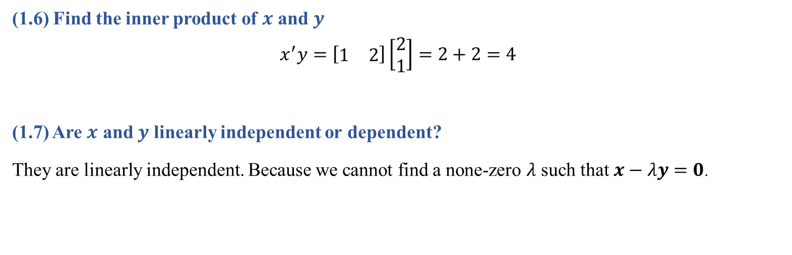
Question 1 (Cont’d)
(1.6) Find the inner product of $x$ and $y$
$$x^{′}y=\left[\begin{matrix}1 & 2\end{matrix}\right]\left[\begin{matrix}2 \\ 1\end{matrix}\right]=2+2=4$$
(1.7) Are $x$ and $y$ linearly independent or dependent?
They are linearly independent. Because we cannot find a none-zero $λ$ such that $x−λy=0$.
Data Science & Machine Learning in Finance: Solution to Exercises 1.10
University of Glasgow
2022-2023

Slide 5
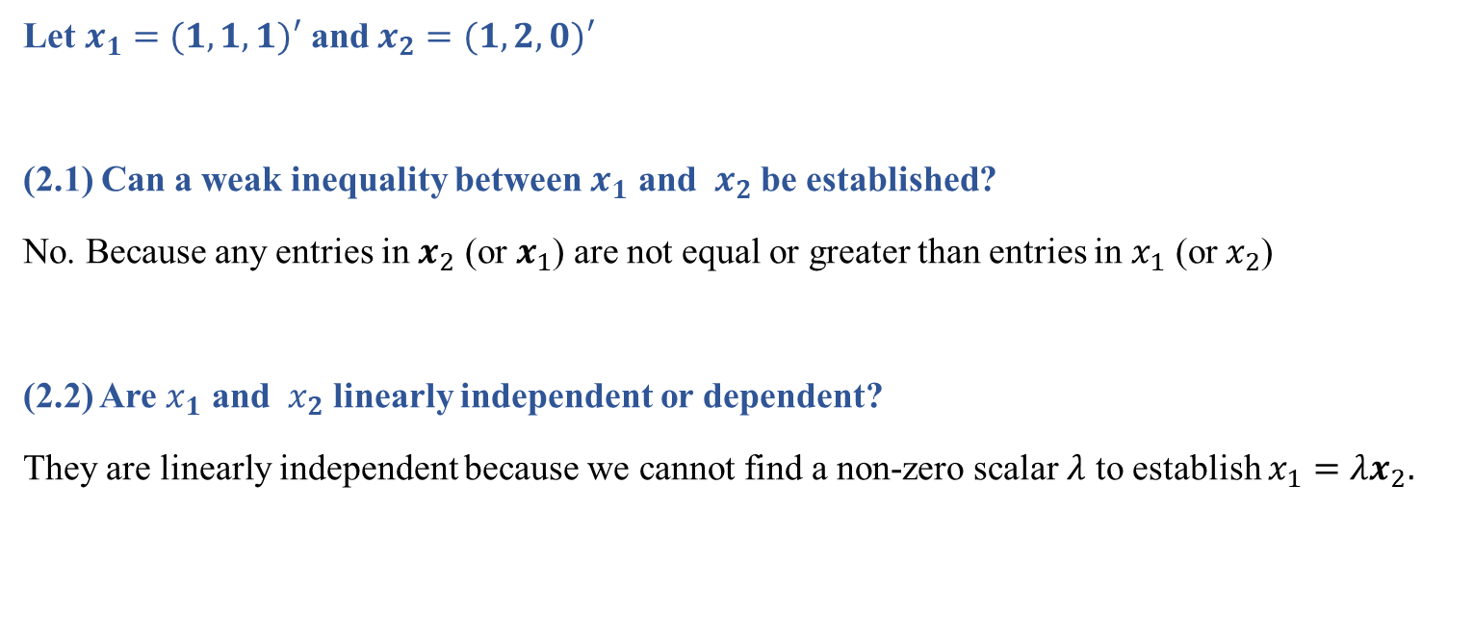
Question 2
Let $x_{1}=(1,1,1)′$ and $x_{2}=(1,2,0)′$
(2.1) Can a weak inequality between $x_{1}$ and $x_{2}$ be established?
No. Because any entries in $x_{2}$ (or $x_{1}$) are not equal or greater than entries in $x_{1}$ (or $x_{2}$)
(2.2) Are $x_{1}$ and $x_{2}$ linearly independent or dependent?
They are linearly independent because we cannot find a non-zero scalar $λ$ to establish $x_{1}=λx_{2}.$
Data Science & Machine Learning in Finance: Solution to Exercises 1.10
University of Glasgow
2022-2023

Slide 6
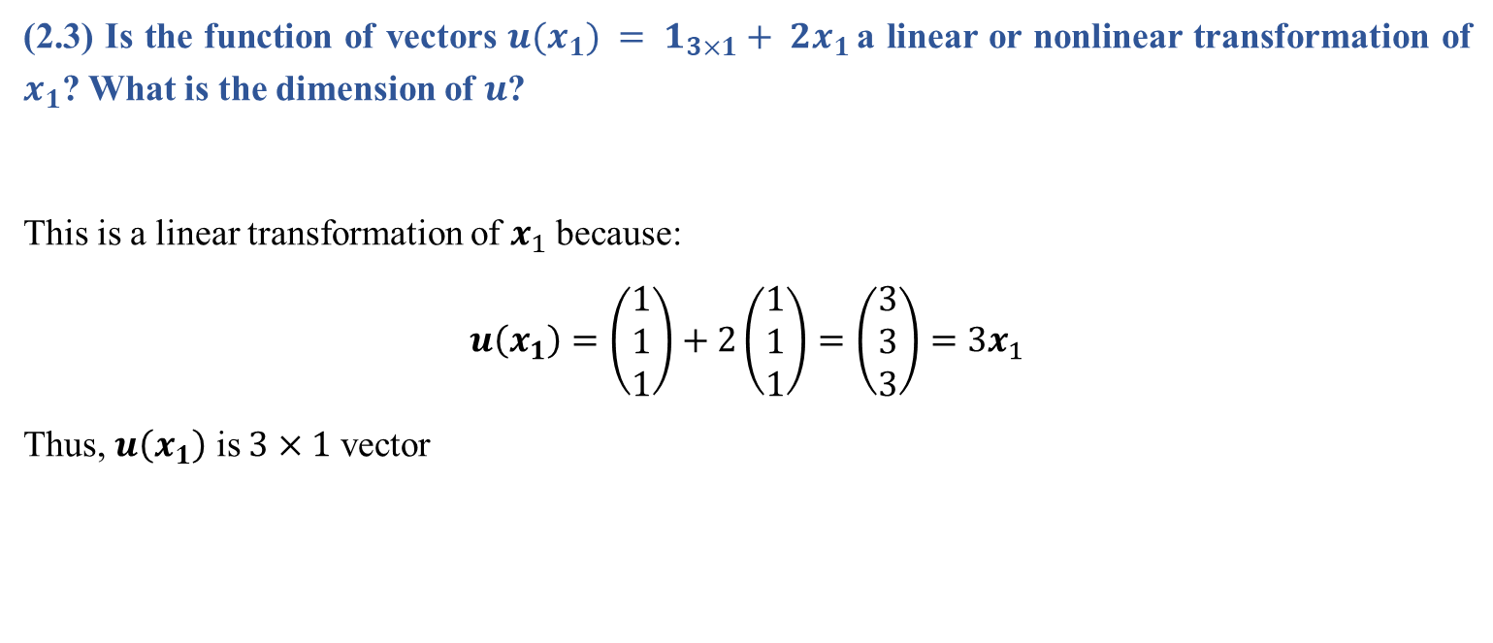
Question 2 (Cont’d)
(2.3) Is the function of vectors $u(x_{1}) = 1_{3×1}+ 2x_{1}$a linear or nonlinear transformation of $x_{1}$? What is the dimension of $u$?
This is a linear transformation of $x_{1}$ because:
$$u\left(x_{1}\right)=\left(\begin{matrix}1 \\ 1 \\ 1\end{matrix}\right)+2\left(\begin{matrix}1 \\ 1 \\ 1\end{matrix}\right)=\left(\begin{matrix}3 \\ 3 \\ 3\end{matrix}\right)=3x_{1}$$
Thus, $u\left(x_{1}\right)$ is $3×1$ vector
Data Science & Machine Learning in Finance: Solution to Exercises 1.10
University of Glasgow
2022-2023

Slide 7
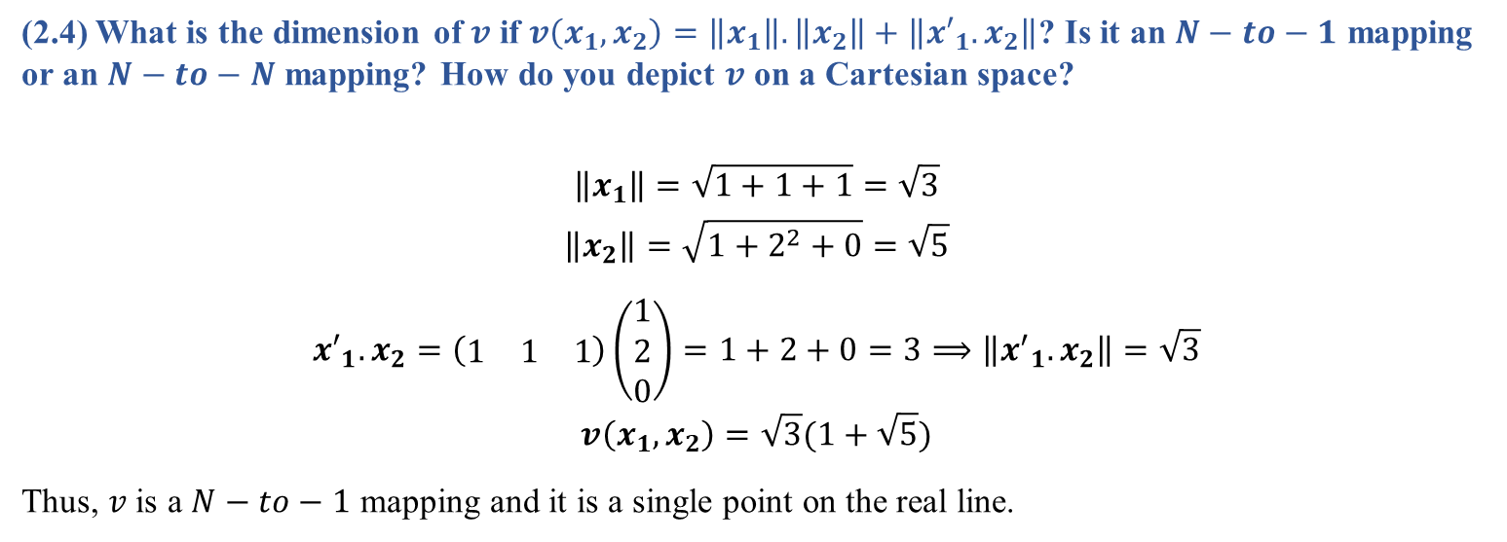
Question 2 (Cont’d)
(2.4) What is the dimension of $v$ if $v\left(x_{1},x_{2}\right)=\left\|x_{1}\right\|.\left\|x_{2}\right\|+\left\|{x′}_{1}.x_{2}\right\|$? Is it an $N−to−1$ mapping or an $N−to−N$ mapping? How do you depict $v$ on a Cartesian space?
$$\left\|x_{1}\right\|=\sqrt{1+1+1}=\sqrt{3}$$
$$\left\|x_{2}\right\|=\sqrt{1+2^{2}+0}=\sqrt{5}$$
$${x′}_{1}.x_{2}=\left(\begin{matrix}1 & 1 & 1\end{matrix}\right)\left(\begin{matrix}1 \\ 2 \\ 0\end{matrix}\right)=1+2+0=3⟹\left\|{x^{′}}_{1}.x_{2}\right\|=\sqrt{3}$$
$$v\left(x_{1},x_{2}\right)=\sqrt{3}(1+\sqrt{5})$$
Thus, $v$ is a $N−to−1$ mapping and it is a single point on the real line.
Data Science & Machine Learning in Finance: Solution to Exercises 1.10
University of Glasgow
2022-2023

Slide 8
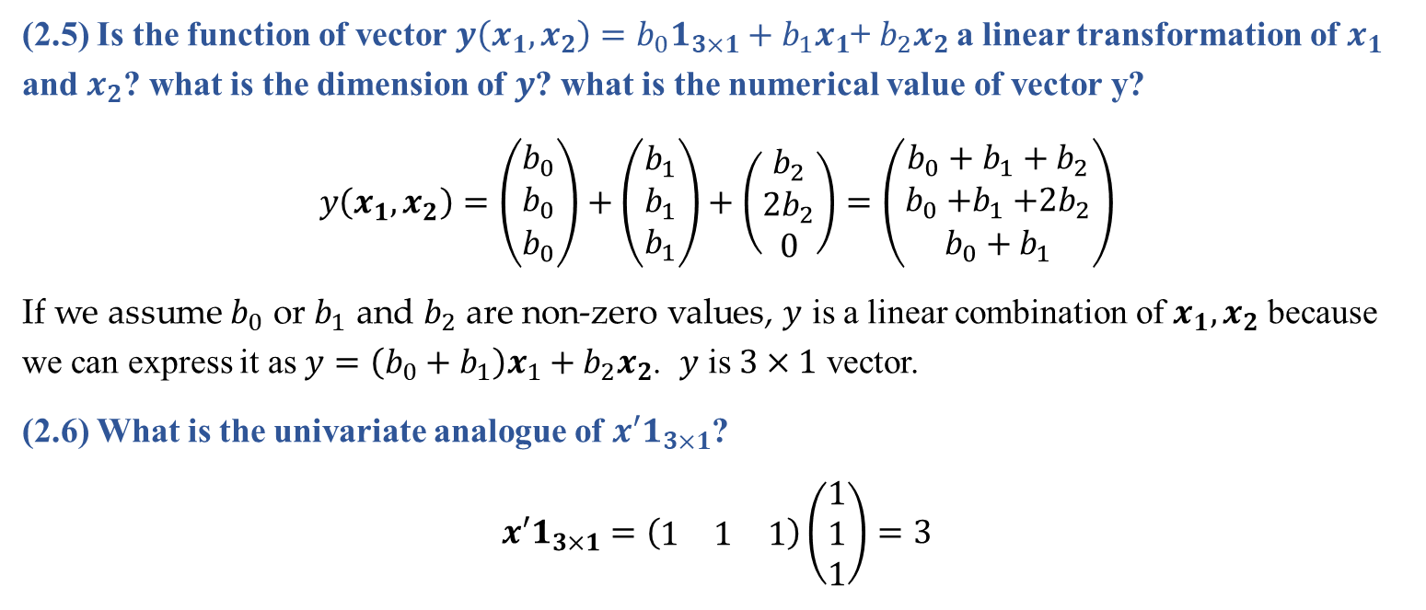
Question 2 (Cont’d)
(2.5) Is the function of vector $y\left(x_{1},x_{2}\right)=b_{0}1_{3×1}+b_{1}x_{1}$+ $b_{2}x_{2}$a linear transformation of $x_{1}$ and $x_{2}$? what is the dimension of $y$? what is the numerical value of vector y?
$$y\left(x_{1},x_{2}\right)=\left(\begin{matrix}b_{0} \\ b_{0} \\ b_{0}\end{matrix}\right)+\left(\begin{matrix}b_{1} \\ b_{1} \\ b_{1}\end{matrix}\right)+\left(\begin{matrix}b_{2} \\ {2b}_{2} \\ 0\end{matrix}\right)=\left(\begin{matrix}{b_{0}+b}_{1}+b_{2} \\ b_{0}{+b}_{1}+2b_{2} \\ b_{0}+b_{1}\end{matrix}\right)$$
If we assume $b_{0}$ or $b_{1}$ and $b_{2}$ are non-zero values, $y$ is a linear combination of $x_{1},x_{2}$ because we can express it as $y=\left(b_{0}+b_{1}\right)x_{1}+b_{2}x_{2}$. $y$ is $3×1$ vector.
(2.6) What is the univariate analogue of ${x′1}_{3×1}$?
$${x′1}_{3×1}=\left(\begin{matrix}1 & 1 & 1\end{matrix}\right)\left(\begin{matrix}1 \\ 1 \\ 1\end{matrix}\right)=3$$
Data Science & Machine Learning in Finance: Solution to Exercises 1.10
University of Glasgow
2022-2023

Slide 9
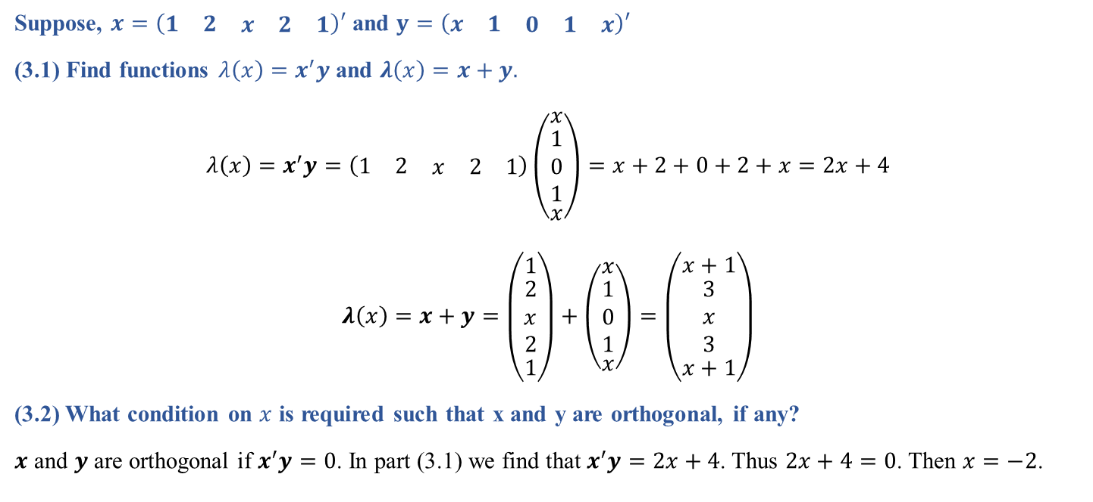
Question 3
Suppose, $x=\left(\begin{matrix}1 & 2 & \begin{matrix}x & 2 & 1\end{matrix}\end{matrix}\right)′$ and $y=\left(\begin{matrix}x & 1 & \begin{matrix}0 & 1 & x\end{matrix}\end{matrix}\right)′$
(3.1) Find functions $λ\left(x\right)=x^{′}y$ and $λ\left(x\right)=x+y.$
$$λ\left(x\right)=x^{′}y=\left(\begin{matrix}1 & 2 & \begin{matrix}x & 2 & 1\end{matrix}\end{matrix}\right)\left(\begin{matrix}x \\ \begin{matrix}1 \\ 0 \\ 1\end{matrix} \\ x\end{matrix}\right)=x+2+0+2+x=2x+4$$
$$λ\left(x\right)=x+y=\left(\begin{matrix}1 \\ \begin{matrix}2 \\ x \\ 2\end{matrix} \\ 1\end{matrix}\right)+\left(\begin{matrix}x \\ \begin{matrix}1 \\ 0 \\ 1\end{matrix} \\ x\end{matrix}\right)=\left(\begin{matrix}x+1 \\ \begin{matrix}3 \\ x \\ 3\end{matrix} \\ x+1\end{matrix}\right)$$
(3.2) What condition on $x$ is required such that x and y are orthogonal, if any?
$x$ and $y$ are orthogonal if $x^{′}y=0$. In part (3.1) we find that $x^{′}y=2x+4$. Thus $2x+4=0$. Then $x=−2$.
Data Science & Machine Learning in Finance: Solution to Exercises 1.10
University of Glasgow
2022-2023

Slide 10

Question 3 (Cont’d)
(3.3) Find $x$ such that $\left\|y\right\|=3$.
$$\left\|y\right\|=\sqrt{x^{2}+1+0+1+x^{2}}=\sqrt{2x^{2}+2}=3$$
$$2x^{2}+2=9⇒x^{2}=\frac{7}{2}⇒\left|x\right|=\sqrt{\frac{7}{2}}$$
$$x=±\sqrt{\frac{7}{2}}$$
Data Science & Machine Learning in Finance: Solution to Exercises 1.10
University of Glasgow
2022-2023

Slide 11

Question 3 (Cont’d)
(3.4) Find $\left\|λ(x)\right\|.$ Under what values for $x$, $\left\|λ(x)\right\|>\sqrt{3}x$
$$\left\|λ(x)\right\|=\sqrt{{(x+1)}^{2}+9+x^{2}+9+{(x+1)}^{2}}$$
$$⇒ \sqrt{3x^{2}+4x+20}>\sqrt{3}x$$
$$⇒3x^{2}+4x+20>3x^{2}$$
$$⇒4x≻−20$$
$$⇒x≻−5$$
Data Science & Machine Learning in Finance: Solution to Exercises 1.10
University of Glasgow
2022-2023

Slide 12

Question 4
Suppose $x=\left(\begin{matrix}1 & x & \begin{matrix}y & 2\end{matrix}\end{matrix}\right)′$ and $y=\left(\begin{matrix}x & 1 & \begin{matrix}1 & 1\end{matrix}\end{matrix}\right)′$
(4.1) What condition on $x$ and $y$ does imply $x⊥y$?
$$x^{′}y=\left(\begin{matrix}1 & x & \begin{matrix}y & 2\end{matrix}\end{matrix}\right)\left(\begin{matrix}x \\ 1 \\ \begin{matrix}1 \\ 1\end{matrix}\end{matrix}\right)=x+x+y+2=2x+y+2$$
For orthogonality we set$2x+y+2=0$. Then:
$2x+y=−2$
Data Science & Machine Learning in Finance: Solution to Exercises 1.10
University of Glasgow
2022-2023

Slide 13

Question 4
(4.2) Find the following norms: ${\left\|x\right\|}_{2}^{−1}$ and ${\left\|y\right\|}_{2}^{−1}y$.
We have: $\left\|x\right\|=\sqrt{1+x^{2}+y^{2}+4}=\sqrt{x^{2}+y^{2}+5}$ and $\left\|y\right\|=\sqrt{x^{2}+1+1+1}=\sqrt{x^{2}+3}$
Thus:
$${\left\|x\right\|}^{−1}=\frac{1}{\sqrt{x^{2}+y^{2}+5}}$$
$${\left\|y\right\|}_{2}^{−1}y=\frac{1}{\sqrt{x^{2}+3}}\left(\begin{matrix}x \\ 1 \\ \begin{matrix}1 \\ 1\end{matrix}\end{matrix}\right)$$
Data Science & Machine Learning in Finance: Solution to Exercises 1.10
University of Glasgow
2022-2023

